Slide 1
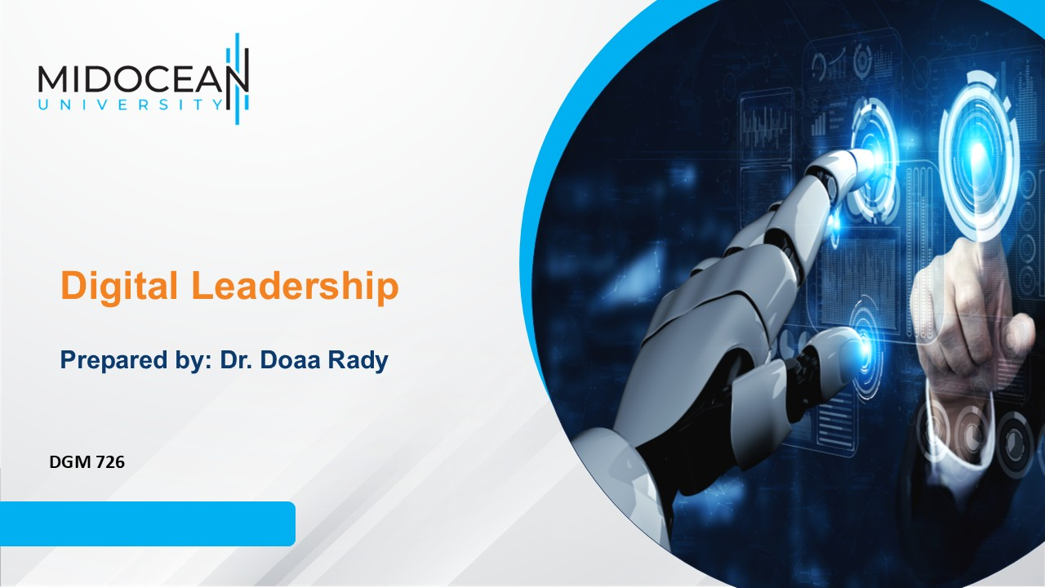
Lecture 9
Leadership Ethics and Innovation

Slide 2

Lec.9
Last Lecture, we leaned about
  Leading Digital Organizations in a VUCA World
  Digital Leadership Model
  Effective Communication in virtual organizations
    Aspects of successful communication
    Employee engagement as internal communication strategy
  Digital Skills for Improving Organizational Performance
  Digital Literacy Skills

Slide 3
Lecture outline
Lec.9
Today’s Lecture we will Know about
  Digital Media and Social Media
    Digital Media Ethics
  Leaders and Social Media
    The six dimensions of social-media-literate leadership
      The leader as producer
      The leader as distributor
      The leader as recipient
      The leader as adviser and orchestrator
      The leader as architect
      The leader as analyst
  Ethical leadership
    Components of ethical leadership
    Cross-Cultural Versus Diversity
    Innovation and Leadership in the Media Industry

Slide 4
Learning Outcomes
Understand Leading Digital Media and Social Media with the consideration of Digital Media Ethics
Know the relation between Leaders and Social Media through the six dimensions of social-media-literate leadership
Understand Ethical leadership and its components and the difference between Cross-Cultural & Diversity
Understand how innovation and Leadership in the Media Industry are important for having unique products
Lec.9

Slide 5
Introduction
People are the most important resource for a leader to manage. And the leader must have it very clear to achieve success within the media industry.
The distinguishing feature of a leader’s job is the ability to motivate others, his/her creativity to encourage others, the innovation he/she develops, the talent to keep people in the organization and the future vision he/she has and conveys to the team.
A leader should have to be able to develop a series of actions to fulfill the goal driving successfully the media and entertainment company.
Thus, creativity and innovation must become a key issue.
Lec.9

Slide 6

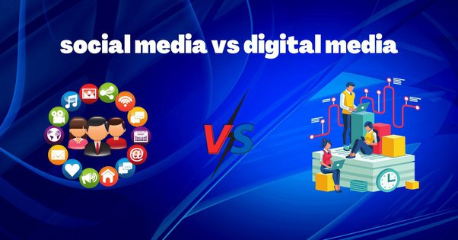
Lec.9
Digital Media and Social Media

Slide 7
Digital Media and Social Media
Lec.9
Digital media are any media that are encoded in a machine-readable format.
Digital media can be created, viewed, distributed, modified and preserved on digital electronics devices. Computer programs and software; digital imagery, digital video; video games; web pages and websites, including social media; data and databases; digital audio, such as mp3s; and e-books are examples of digital media.
Digital media are frequently contrasted with print media, such as printed books, newspapers and magazines, and other traditional or analog media, such as pictures, film or audio tape.

Slide 8
Digital Media and Social Media
Lec.9
Combined with the Internet and personal computing, digital media has caused disruption in publishing, journalism, entertainment, education, commerce and politics.
Digital media has also posed new challenges to copyright and intellectual property laws, fostering an open content movement in which content creators voluntarily give up some or all of their legal rights to their work.
The ubiquity of digital media and its effects on society suggest that we are at the start of a new era in industrial history, called the Information Age, perhaps leading to a paperless society in which all media are produced and consumed on computers.

Slide 9
Digital Media and Social Media
Lec.9
However, challenges to a digital transition remain, including outdated copyright laws, censorship, the digital divide, in which older media becomes inaccessible to new or upgraded information systems.
Digital media has a significant, wide-ranging and complex impact on society and culture.
The impact of digital media on other media industries is similarly sweeping and complex.
In journalism, digital media and citizen journalism have led to the loss of thousands of jobs in print media and the bankruptcy of many major newspapers. But the rise of digital journalism has also created thousands of new jobs and specializations.

Slide 10
Digital Media and Social Media
Lec.9
Digital media has also allowed individuals to be much more active in content creation. Anyone with access to computers and the Internet can participate in social media and contribute their own writing, art, videos, photography and commentary to the Internet, as well as conduct business online. This has come to be known as citizen journalism. This spike in user created content is due to the development of the internet as well as the way in which users interact with media today.
User-generated content raises issues of privacy, credibility, civility and compensation for cultural, intellectual and artistic contributions. The spread of digital media, and the wide range of literacy and communications skills necessary to use it effectively, have deepened the digital divide between those who have access to digital media and those who don't.

Slide 11
Digital Media and Social Media
Lec.9
Digital Media Ethics
Changes occur at such a rapid rate; meticulous attention must be paid to the potential impacts of digital media that may threaten traditional ethical standards. In response to such rapid changes, academics work to keep pace with the transformation of our society into a digitally mediated world controlled by technological tools.
Digital Media Ethics, focuses on the implications of digital media advancements in our world.
Digital Media Ethics is best suited for university undergraduate students studying communication, media, and information technology.

Slide 12
Digital Media and Social Media
Lec.9
Digital Media Ethics develops a deep understanding of the most current struggles that communication media ethicists face today.
Though these challenges can be viewed as opportunities for improvement in our individual and societal ethical standards .
The introduction of new digital technology poses to traditional ethics: One prominent issue that digital media ethics face is that the media tend to sensationalize the issues that have emerged with these new introductions. This process has developed a societal perception of a false dichotomy between “good technology vs. bad technology.”
This polarization is misleading and detrimental of creating and implementing new ethical standards.

Slide 13
Digital Media and Social Media
Lec.9
Understanding our relationship with digital media, and our perceptions must remain open and flexible, these are two of most influential elements.
There are three main distinct characteristics of new digital media which are: convergence, “greased” media, and global implications. Each characteristic illustrates how digital media have allowed for vast changes in our communication capabilities in terms of accessibility, speed, and scope.

Slide 14
Digital Media and Social Media
Lec.9
It is now possible to share media on a variety of different systems for many different uses. For example, once a music recording is digitally inscribed, it is possible to listen to it on an iPod, utilize it in the creation of a video for YouTube, or make it a new ringtone for a cell phone.
The “greasing” of media is a metaphorical phrase that alludes to the fact that information can be sent and shared instantaneously. The global scope of communication is an amazing element of digital media, as it allows us to connect with people beyond geographical boundaries in real time.
Facing these issues has sparked debate with regards to how these characteristics impact our cultural and societal standards.

Slide 15
Digital Media and Social Media
Lec.9
Privacy is one of the main concerns that has emerged with these new changes, as many aspects of our lives leak into cyberspace. New tools such as cell phones and digital cameras can invade one’s privacy, unbeknownst to the victim.
Although some people choose to share images with others online, it has also become apparent that others can capture images without consent, and share them online without the knowledge of the victim, risking their reputation, credibility, and relationships.
The issue of privacy also interacts with cultural differences. Some cultures have different standards and expectations of communicative practices and privacy than others.

Slide 16
Digital Media and Social Media
Lec.9
The cultural imperialism is a common problem that has emerged, especially on the Internet, as many people often choose to impose their own practices and expectations on those who do not share a similar standard.
At the same time, skilled users of new technologies tend to be of a younger generation who see the use of such technology as second nature, while older generations have much different experiences.
Thus, the expectations of older generations about new digital media greatly differ from younger generations.

Slide 17
Digital Media and Social Media
Lec.9
These differences result in difficult implications when looking at issues of privacy and self-disclosure on the Internet; while younger people feel more comfortable with divulging personal elements of their lives, older people feel that such behavior is wrong and unethical.
However, it is completely possible for both generations to be ethically developed, while each side exhibits different standards due to circumstances. Given all of these difficulties, we should understand the importance of developing an understanding for different cultural practices and generational differences to avoid misunderstandings during communication with people from other backgrounds.
Although it can be frustrating, it is important to be patient with the process and adapt a balanced perspective on the situation.

Slide 18
Digital Media and Social Media
Lec.9
It was thought that through being able to communicate worldwide, we could shed our consciousness of physical and cultural differences because they would become invisible.
However, this process known as “disembodiment” has contributed to a rise in communicative ignorance and ethnocentrism in intercultural engagements mediated by digital communication technology.
when involved in a face-to-face interaction it is possible to be conscious of the cultural differences among people, and therefore be sensitive to others’ backgrounds.
Furthermore, because we are able to remove ourselves from communicative situations, hurtful speech can be committed with little consequences. Essentially, the process of disembodiment has given rise to ignorant behavior because people do not always have to take on the responsibilities of their actions.

Slide 19
Digital Media and Social Media
Lec.9
Leadership occurs whenever we are dealing with a process of communication between two or more people - transmitter and receiver - between which there is a circulation of meanings.
The significations movement between these two poles affects the counterparts in some way by these significations, for long or short term. Some influences are deliberately pursued by the transmitter in the short term and the receiver cannot be aware of this influence. We talk here about advertising, political and media influences.
During this period the term leadership is used in place of the commander. Thus, the manager must lead not only as a commander, but he has to influence subordinates and to consent to be influenced by them so as to create a consensus that can be translated into actions.

Slide 20
Digital Media and Social Media
Lec.9
Also, the use of new media increases transparency of management decisions.
The new media increases top managers leadership. Top manager gains through social media greater visibility which can be tangible what he thinks, how he expresses himself, that attitude he shows, that opinion he has, etc.
In contrast at the level of middle management, there is no such a problem: his message is addressed to a small group, which interacts and communicates directly.
Social media, through free access of persons in the group, flattens hierarchical structures and creates a personalized relationship between management and employees.

Slide 21
Digital Media and Social Media
Lec.9
Under these conditions, the type recommended is that transformational leadership.
Leadership that uses the new media is a collective leadership. However, it should not replace control as management function.
Leadership becomes fragile by opening in new media and exposure to critical opinions.
Feedback from bottom to top can be critical and opinions are interrelated and influence each other and can cause currents of opinion for or against the management style practiced in the firm.

Slide 22
Digital Media and Social Media
Lec.9
The emergence of informal leaders who influence individual messages and lead to the structuring of group views; also, the use of social networking and the attraction of a large number of friends can lead to the discovery of the structure leading to the person concerned.
Employees are also beneficiaries of the company. Expressing their opinions in social media influences company general opinion of the beneficiaries of the company. These employees send out a high degree of credibility they are meant witness of corporate image to give a positive image of the organization, managers must increase the level of accountability and motivation of their employees.

Slide 23

Digital Media and Social Media
Lec.9
The leaders blog is less visible. The possible explanation is that the companies have managers and leadership and are not concerned with the transmission of the vision and mission of the organization they lead.
The image transmitted through social media organization should be related to existing organizational culture type. A negative image transmitted from the organization can harm fragile company.
This may however have a boomerang effect on employees: if their organization is in decline, their own situation may be endangered, employees are the ones who bear direct consequences.
The boomerang effect
is a situation where people tend to pick the opposite of what something or someone is saying or doing because of how it is presented to them.

Slide 24
Digital Media and Social Media
Lec.9
The image spread outside organization involves the opinions of the employees related with the company internal communication.
The public relations departments send a positive global image of the organization, while social media is transmitted through personalized messages, individual testimonies of leaders and employees who are found in proximity relationship with the hierarchy.
A positive feedback received from group/person on a social network increases self-esteem and confidence of the employees.

Slide 25
Digital Media and Social Media
Lec.9
An example of a negative reaction to the message group was a formal New Year greeting sent by a multinational CEO:
  only 50% of employees surveyed have opened that email and
  only 5% read the message until the end.
The explanations: the message was formal without being adapted to the group (survey conducted at the Master of Corporate Communications.

Slide 26
Digital Media and Social Media
Lec.9
As defined by Welch and Jackson (2007) internal corporate communication is defined as “communication between an organization's strategic managers and its internal stakeholders, designed to promote commitment to the organization, a sense of belonging to it, awareness of its changing environment and understanding of its evolving aims”. Going back to the alternative definitions for internal communication we believe this sounds a lot like employee communication.
The model suggests communication from the top management to employees as predominantly one-way, but two-way communication is important for successful internal communication.
Internal Corporate Communication Model

Slide 27
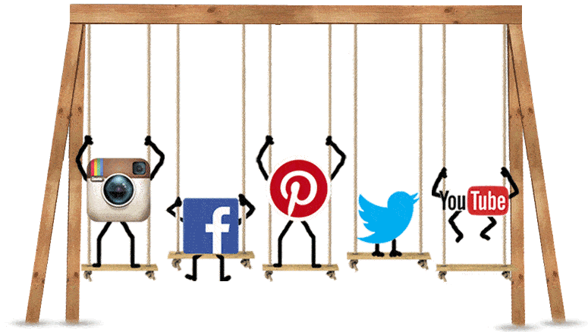

Lec.9
Leaders and Social Media

Slide 28
Lec.9
Leaders and Social Media
The six dimensions of social-media-literate leadership
1. The leader as producer: Creating compelling content
With video cameras achieving near ubiquity and film clips uploading in the blink of an eye to YouTube or other platforms, the tools for producing and sharing rich media are in everyone's hands.
Leaders incorporate video streams into their blogs.
As video communication rises in importance, effective leadership will increasingly require the kind of creative skills we know from the world of "auteur" filmmaking—an authentic voice, imagination, and the ability to craft compelling stories and to turn them into media products that make people take note and "lean forward." To engage in real time on a personal level, executives will also need the technical skills to master the basics of digital-multimedia production, including how to shoot and, if necessary, edit videos.

Slide 29
Lec.9
Leaders and Social Media
The six dimensions of social-media-literate leadership
2. The leader as distributor: Leveraging dissemination dynamics
While traditional distribution pathways won't disappear, social media revolutionizes the standard information process by reversing it. Social communication makes distribution the starting point and then invites company audiences to cocreate and contextualize content to create new meaning. Messages are rebroadcast and repurposed at will by recipients who repost videos, retweet and comment on blogs, and use fragments of other people's content to create their own mash-ups.
As the (vertical) broadcast media and the (horizontal) participatory media converge, leaders need to master the interplay of two fundamentally different paradigms: those of the traditional channels, which follow the logic of control, and of the new channels, where it is essential to let the system's dynamics work without too much direct intervention.

Slide 30
Lec.9
Leaders and Social Media
The six dimensions of social-media-literate leadership
3. The leader as recipient: Managing communication overflow
Social media has created an ocean of information. We are drowning in a never-ending flood of e-mails, tweets, Facebook updates, RSS feeds, and more that's often hard to navigate.
In traditional corporate communications, consumption is a mostly passive act: you are pretty much left alone to make sense of messages and to assess their authenticity and credibility. In the social-media realm, information gets shared and commented on within seconds, and executives must decide when (and when not) to reply, what messages should be linked to their blogs, when to copy material and mash it up with their own, and what to share with their various communities. The creation of meaning becomes a collaborative process in which leaders have to play a thoughtful part, as this is the very place where acceptance of or resistance to messages will be built.

Slide 31
Lec.9
Leaders and Social Media
The six dimensions of social-media-literate leadership
4. The leader as adviser and orchestrator: Driving strategic social-media utilization
In most companies, social-media literacy is in its infancy. Excitement often runs high for the technology's potential to span functional and divisional silos. But without guidance and coordination, and without the capabilities we discuss here, social-media enthusiasm can backfire and cause severe damage.
To harvest the potential of social media, leaders must play a proactive role in raising the media literacy of their immediate reports and stakeholders. Within this 360-degree span, executives should become trusted advisers, enabling and supporting their environment in the use of social tools, while ensuring that a culture of learning and reflection takes hold. As a new and media-savvy generation enters the workplace, smart leaders can accelerate organizational change by harnessing these digital natives' expertise through "reverse mentoring" systems

Slide 32
Lec.9
Leaders and Social Media
The six dimensions of social-media-literate leadership
5. The leader as architect: Creating an enabling organizational infrastructure
Leaders who have steeped themselves in new media will testify that it requires them to navigate between potentially conflicting goals: they must strive to establish an organizational and technical infrastructure that encourages free exchange but also enforce controls that mitigate the risks of irresponsible use. This is a tough organizational-design challenge.
Most companies have a defined formal organization, with explicit vertical systems of accountability. But below the surface of org charts and process manuals we find an implicit, less manageable "informal organization," which has always been important and now gets amplified through social media. The leader's task is to merge vertical accountability with networked horizontal collaboration in a way that is not mutually destructive.

Slide 33
Lec.9
Leaders and Social Media
The six dimensions of social-media-literate leadership
6. The leader as analyst: Staying ahead of the curve
The next generation of connectivity—the Internet of Things—will link together appliances, cars, and all kinds of objects.
As a result, there is about 50 billion connected devices. This transformation opens new opportunities, spawn new business models, and herald yet another major inflection point that leaders must manage.
It's imperative to keep abreast of such emerging trends and innovations—not just their competitive and marketplace implications, but also what they mean for communications technologies, which are fundamental for creating an agile, responsive organization. Executives who monitor weak signals and experiment with new technologies and devices will be able to act more quickly and capture the advantages of early adoption.

Slide 34
Lec.9
Leaders and Social Media
Do-good and avoid-harm ethics issues in social media
Do-good ethics
Social media use should contribute to the following:
  - Empowerment
  - Transparency
  - Employee engagement
  - Sharing of knowledge
  - Driving positive change
  - Prosocial behavior
Avoid-harm ethics
Social media use should not contribute to the following:
  - Loss of integrity
  - Harassment
  - Discrimination
  - Trolling
  - Fake news
  - Destructive politics

Slide 35
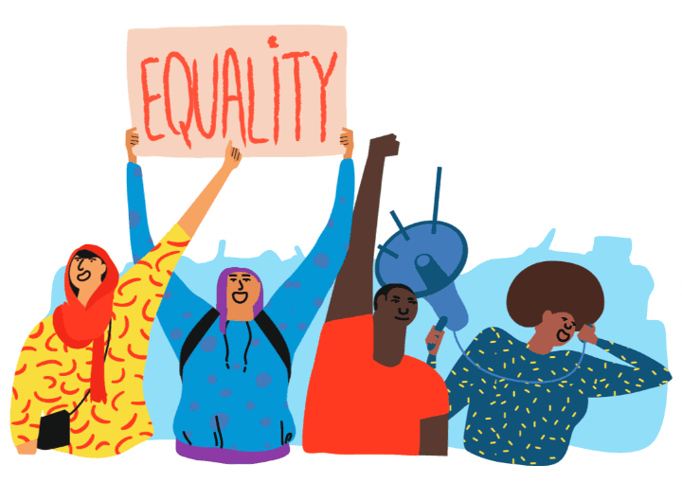
Lec.9
Ethical Leadership

Slide 36
Lec.9
Ethical Leadership
What is ethical leadership?
Ethical leadership involves both acting and leading ethically over time all the time.
When and by whom should ethical leadership be practiced?
Ethical leadership should be practiced all the time by anyone in a formal or informal leadership position.

Slide 37
Lec.9
Ethical Leadership
Why practice ethical leadership?
Ethical leadership models ethical behavior to the organization and the community.
Ethical leadership builds trust.
Ethical leadership brings credibility and respect, both for you and for the organization.
Ethical leadership can lead to collaboration.
Ethical leadership creates a good climate within the organization.
If you have opposition, or are strongly supporting a position, ethical leadership allows you to occupy the moral high ground.
Ethical leadership is simply the right way to go.
Ethical leadership affords self-respect.

Slide 38
Lec.9
Ethical Leadership
How do you practice ethical leadership?
General guidelines:
Ethical leadership requires a clear and coherent ethical framework on which the leader can draw in making decisions and taking action.
Your ethical framework should agree with the ethical framework, vision, and mission of the organization or initiative.
Ethics should be a topic of discussion.
Ethics should be out in the open.
Ethical thought must be connected to action.
Ethical leadership is a shared process.

Slide 39
Lec.9
Ethical Leadership
Specific components of ethical leadership:
Put the good of the organization and the general good before your own interests and ego.
Encourage the discussion of ethics in general and of the ethical choices involved in specific situations and decisions as an ongoing feature of the organizational culture.
Institutionalize ways for people to question your authority.
Don’t take yourself too seriously.
Consider the consequences to others of your decisions, and look for ways to minimize harm.
Treat everyone with fairness, honesty, and respect all the time.
Treat other organizations in the same way you treat other people – with fairness, honesty, and respect.

Slide 40
Lec.9
Ethical Leadership
Specific components of ethical leadership:
Collaborate inside and outside the organization.
Communicate.
Work to become increasingly culturally and interpersonally competent.
Take cultural sensitivity and cultural competence seriously.
Work to be inclusive.
Take your leadership responsibility seriously, and be accountable for fulfilling it.
Constantly strive to increase your competence.
Don’t outstay your usefulness.
Never stop reexamining your ethics and your leadership

Slide 41
Lec.9
Ethical Leadership
Cross-Cultural Versus Diversity
While culturally based conceptions of leadership are important to diversity and leadership, we need to differentiate between cross-cultural and diversity.
Cross-cultural studies compare differences between societies and countries while diversity often compares differences within countries. The latter includes issues of power, privilege, and equity important to diverse groups within a country or culture. Often, those subgroups with less privilege, which are in the minority, who share struggles from oppression have a sense of commonality and affinity among its members. These differences could be based on race, ethnicity, gender, and so forth.

Slide 42

Lec.9
Innovation and Leadership
in the Media Industry

Slide 43
Lec.9
Innovation and Leadership in the Media Industry
Innovation equals survival
It’s well documented that in this age of widespread disruption, companies must innovate continuously, creating new markets, experiences, products, services, content or processes.
So, how can leaders encourage innovation?
It’s more than recruiting the brightest minds. While having the best talent is clearly an asset, people need the right culture to flourish.

Slide 44
Lec.9
Innovation and Leadership in the Media Industry
Why media need innovation?
The answer is in its own nature. The characteristics of the media products make it moves continuously, unlike other industries where products are more stable and lasting. Yesterday’s news is not the same of today and although journalists have a working routine to prepare them, wrapping and present the content every day, it is hard because they have to think on how to delight the consumer.
The tastes and preferences change continuously, in the same way that technologies does so as to get better quality informative and entertaining products.

Slide 45
Lec.9
Innovation and Leadership in the Media Industry
What is a culture of equality?
Empowering Environment
  One that trusts employees, respects individuals and offers the freedom to be creative and to train and work flexibly.
Bold Leadership
  A diverse leadership team that sets, shares and measures equality targets openly.
Comprehensive Action
  Policies and practices that are family-friendly, support all genders and are bias-free in attracting and retaining people.

Slide 46
Lec.9
Innovation and Leadership in the Media Industry
What is an innovation mindset?
The six elements of an innovation mindset:
Purpose
  Alignment around and support for the purpose of the organization.
Resources
  Having the tools, time and incentives necessary to innovate.
Collaboration
  Working with other departments or in fluid, cross-function teams.
Autonomy
  Being shown a clear mandate for change—and being trusted to follow through.
  Inspiration
  Tapping into inspiration from beyond the organization.
  Experimentation
  Experimenting with new ideas quickly without fear of failure.

Slide 47
Lec.9
Innovation and Leadership in the Media Industry
A Model explains how Digital leadership influences exploratory innovation

Slide 48
Lec.9
Innovation and Leadership in the Media Industry
Digital leadership influences exploratory innovation via three routes:
First, digital leaders steer organizational management changes to build a digital organizational culture, which is driven by internal conditions to mobilize members’ participation and creativity, forming a positive interaction between people and innovation and then promoting exploratory innovation behaviors.
Second, digital leaders conduct business management remodeling to establish the digital entrepreneurial orientation, which is driven by changing market demands, leading companies to enhance exploratory innovation activities earlier and faster.
Third, digital leaders transform both organizational management and business management. Digitalization of products and digitalization of actors are given equal importance. Exploratory innovation behaviors are reinforced by the combined force of digital entrepreneurial orientation and digital organizational culture.

Slide 49
Lec.9
Innovation and Leadership in the Media Industry
Uniqueness of media companies
Media companies are social organizations, usually with complex structures, and regulate a series of activities that must be organized and implemented to develop it. They are also important because they exist, because the role they play is to inform, entertain, while others are focused to the social role in order to contribute to development and the correct working of democracy, owing to its controller role. And also, some of them work with a mixture of them.
The management of media companies requires making-decisions that incorporate efficiently the content and the audience, where it is understood as all people participating in a communication channel.

Slide 50
Lec.9
Innovation and Leadership in the Media Industry
Therefore, the important aspect in media products is the capacity to satisfy the needs and wishes of the potential clients by means of providing informative, persuasive or entertaining content and not during the material process which tend to be similar. Furthermore, one of the main characteristics that the assets share, such as content, is the multiplication of utilities that can produce. In that sense, they are considered as dual assets, as I previously mentioned, because they are aimed to audience and advertisers who hope to get the attention of that audience.
So, most of the society perceives the communication media as a bridge between both; customers see a supermarket where supply and demand are together, and a place where these two customers can satisfy their needs.

Slide 51
Innovation and Leadership in the Media Industry
Lec.9
Organizational creativity and innovation theory suggests that if we stimulate the way of thinking in a creative way, the conflicts will minimize, barriers between employees and managers will be broken, and it will considerably increase the creative capital within the organization.
The objective is to generate sustainable competitive advantages and mark the difference with the competitors.

Slide 52
Conclusion
Lec.9
We learned about
  Digital Media and Social Media
    Digital Media Ethics
  Leaders and Social Media
    The six dimensions of social-media-literate leadership
      The leader as producer
      The leader as distributor
      The leader as recipient
      The leader as adviser and orchestrator
      The leader as architect
      The leader as analyst
  Ethical leadership
    Components of ethical leadership
    Cross-Cultural Versus Diversity
    Innovation and Leadership in the Media Industry

Slide 53


References
Lec.9
Rabinowitz, P. (n.d.). Leadership and Management chapter 13:16. Community Tool Box. Retrieved January 4, 2023, from https://ctb.ku.edu/en/table-of-contents
Bli-Group-Wp. (2011). Leadership Course material. Amideast Egypt. Business Intelligence, Training & Consulting, http://bli-group.com/
Deiser, R., & Newton, S. (2013, February 1). Six social-media skills every leader needs. McKinsey & Company. Retrieved March 27, 2023, from https://www.mckinsey.com/industries/technology-media-and-telecommunications/our-insights/six-social-media-skills-every-leader-needs
Westman, D., & Lindfors, P. (2012, October 23). Leaders and social media: Improving HRM through better internal communication. DIVA. Retrieved March 27, 2023, from https://www.semanticscholar.org/paper/Leaders-and-Social-Media-%3A-Improving-HRM-through-Westman-Lindfors/416441e40428f602f40026460777082c41d0663a
Hwang. (2014). Digital Media. Studocu.com. Retrieved March 27, 2023, from https://www.studocu.com/en-us/document/elmwood-park-high-school/english/digital-media/29579962
Eid, M. (2012, October-December). Digital Media Ethics. International Journal of Mobile and Blended Learning. Retrieved March 27, 2023, from https://www.academia.edu/15288650/Digital_Media_Ethics
Paus, V. (2016, December 9). New Media and Leadership: Social Media and open organizational communication. Manager Journal. Retrieved March 27, 2023, from https://www.academia.edu/30358336/New_Media_and_Leadership_Social_Media_and_Open_Organizational_Communication
Kvalnes, Ø. (2020). Leadership and Ethics in Social Media. In Digital Dilemmas. exploring Social Media Ethics in organizations (p. 7). essay, Springer International Publishing. Retrieved March 27, 2023, from https://link.springer.com/book/10.1007/978-3-030-45927-7.
Lau Chin, J., & E Trimble, J. (2015, January). diversity and leadership. Research Gate. Retrieved March 28, 2023, from https://www.researchgate.net/publication/341207394_Diversity_and_Leadership
Wang T, Lin X and Sheng F (2022) Digital leadership and exploratory innovation: From the dual perspectives of strategic orientation and organizational culture. doi: 10.3389/fpsyg.2022.902693 Retrieved March 28, 2023, from https://www.frontiersin.org/articles/10.3389/fpsyg.2022.902693/full
Netherlands, A. the. (2021, April 19). Workplace innovation with culture of equality: Accenture. Insights. Retrieved March 28, 2023, from https://www.accenture.com/nl-en/blogs/insights/why-a-culture-of-equality-will-boost-workplace-innovation
Benavides, C.L. (2012). Innovation and Leadership in the Media Industry. Retrieved March 28, 2023, from https://www.semanticscholar.org/paper/Innovation-and-Leadership-in-the-Media-Industry-Benavides/5d9a831cfa39e4e6c04594df4928d295de00d739

Slide 54



Thank You

