Slide 1


Human Resources Management
Robert L. Mathis ⏐ John H. Jackson
Prepared by Dr. Samah Abdelfatah
MGM 243
Lecture 08

Slide 2



Part 3: Developing HRM
Performance Management and Appraisal
Chapter
11
Lecture 08
MGM 243
Prepared by
Dr. Samah Abdelfatah

Slide 3

Chapter
Learning Outcomes
11
After you have read this chapter, you should be able to:
Identify the components of performance management systems.
Distinguish between performance management and performance appraisal.
Explain the differences between administrative and developmental uses of performance appraisal.
Discuss the importance of training managers and employees about performance appraisal and give examples of rater errors.
Identify several concerns about appraisal feedback and ways to make it more effective

Slide 4



Chapter
Identifying and Measuring Employee Performance
11
Performance Appraisal
  Process of determining how well employees do their job relative to a standard and communicating that information to the employee
Performance Management System
Processes used to identify, encourage, measure, evaluate, improve, and reward employee performance.
Continuous process aligning employee performance with strategy.
New concepts in PMS:
Measuring Standards
Goal achievement
Objectives and Key results (OKRs)
Key Performance Indicators (KPIs)
Formal assessment vs. standards
Data-driven insights & regular feedback
Employee engagement
Evaluates outcomes (What) & behaviors (How)
Integrates technology & AI monitoring
Collaboration & teamwork
Focus on improvement & growth
Complemented by continuous feedback
Innovation & adaptability
Customer satisfaction
Real-time performance conversations
Learning agility

Slide 5
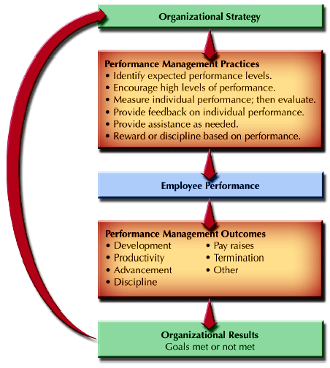
Linkage Between Strategy, Outcomes, and Organizational Results
Chapter
11
FIGURE 11-1

Slide 6

Chapter
Performance-Focused Organizational Cultures
11
Some corporate cultures are based on entitlement, meaning that adequate performance and stability dominate the organization. As a result, performance appraisal activities are seen as having little tie to performance and as being primarily a “bureaucratic exercise.”
At the other end of the spectrum is a performance-driven organizational culture that is focused on results. Performance appraisals link results to employee compensation and development.

Slide 7
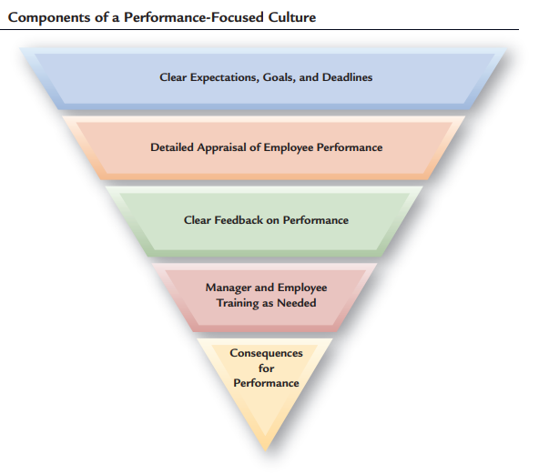
Components of a Performance-Focused Culture
Chapter
11
FIGURE 11-2

Slide 8
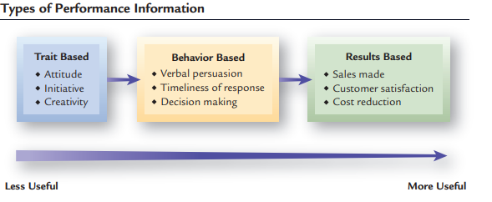
Types of Performance Information
Chapter
11
Trait-based
Information
Job
Performance?
Behavior-based
Information
Results-based
Information
FIGURE 11-3

Slide 9







Performance Standards
Effective Characteristics (SMART)
Defining Standards
S
M
Specific
Measurable
Benchmarks
Goals
A
R
Achievable
Relevant
Targets
T
Key Performance Indicators (KPIs)
Time-bound
Objectives & Key Results (OKRs)
Clearly understood & Fair
Modern Adaptability
Standards should be adaptable to hybrid and remote work environments.

Slide 10
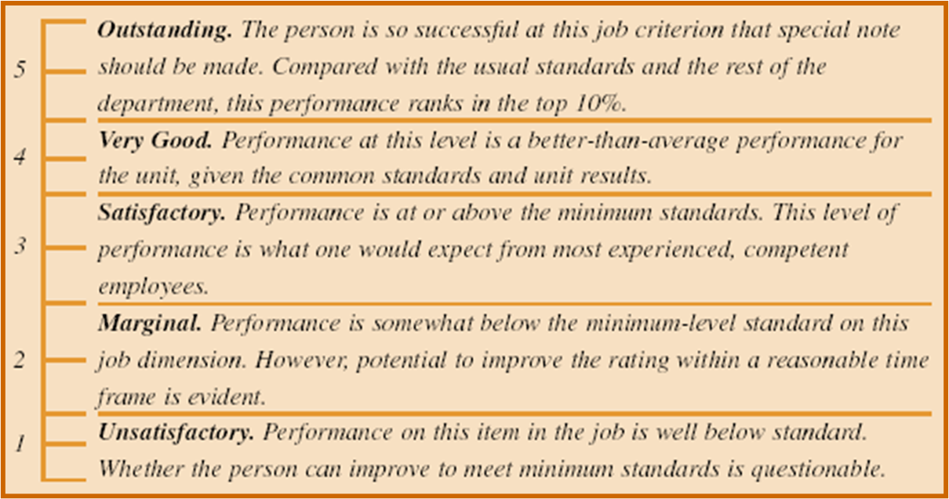
Example of Terms Defining Standards
FIGURE 11-4

Slide 11










Uses of Performance Appraisal
Administrative Uses
Developmental Uses
Pay and reward decisions
Identifying training & development needs
Promotions, transfers, succession planning
Career development planning
Workforce planning & Talent identification
Coaching, mentoring & Reskilling
Disciplinary and corrective actions
Enhancing engagement & well-being

Slide 12
Chapter
Decisions About the Performance Appraisal Process
11
Appraisal Responsibilities The appraisal process can benefit both the organization and the employees, if done properly.
Informal vs. Systematic Appraisal Processes
  Informal Appraisal
    Day-to-day contacts, largely undocumented
  Systematic Appraisal
    Formal contact at regular time intervals, usually documented

Slide 13
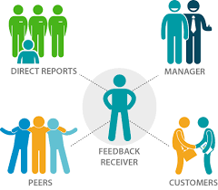
Chapter
Who Conducts Appraisals ?
11
Supervisors who rate their subordinates
Employees who rate their supervisors
Team members who rate each other
External sources
Employees’ self-appraisal
Multisource (360° feedback) appraisal
Technology Facilitates real-time feedback from multiple stakeholders.
AI-enabled systems may support documentation but should not replace managerial judgment.

Slide 14
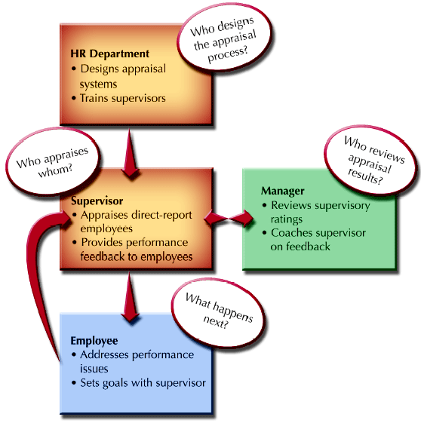
Traditional Performance Appraisal: Logic and Process
Figure 11–5

Slide 15






Emerging Evaluation Approaches
Organizations are shifting from annual reviews to ongoing performance conversations and data-driven insights.
Continuous Management
Real-Time Feedback
Check-in Conversations
Ongoing process replacing annual cycles.
Rapid insights and recognition.
Regular, informal dialogue on progress.
Project-Based Evaluation
Skills-Based Assessment
Data-Driven Analytics
Assessment tied to specific deliverables.
Focus on capabilities and competencies.
Leveraging data for objective evaluation.

Slide 16


Employee Rating of Managers
Advantages
  Helps in identifying competent managers
  Serves to make managers more responsive to employees
  Can contribute to the career development of managers
Disadvantages
  Negative reactions by managers to employee ratings
  Subordinates’ fear of reprisals may inhibit them from giving realistic (negative) ratings
  Ratings are useful only for self-improvement purposes

Slide 17
Team/Peer Ratings
Advantages
  Helps improve the performance of lower-rated individuals
  Peers have opportunity to observe other peers.
  Peer appraisals focus on individual contributions to teamwork and team performance.
Disadvantages
  Can negatively affect working relationships.
  Can create difficulties for managers in determining individual performance.
  Organizational use of individual performance appraisals can hinder the development of teamwork

Slide 18
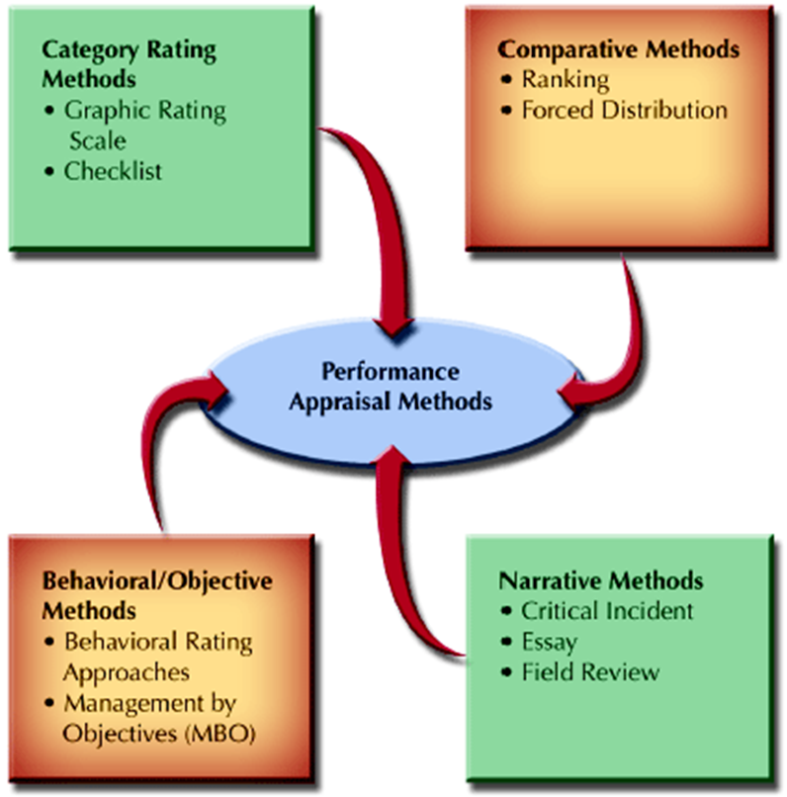
Performance Appraisal Methods
Figure 11–6

Slide 19
Chapter
1. Category Rating Methods
11
1. Graphic Rating Scale
A scale that allows the rater to indicate an employee’s performance on a continuum.
    Job criteria scales
    Behavioral scales
Drawbacks
  Restrictions on the range of possible rater responses
  Differences in the interpretations of the meanings of scale items and scale ranges by raters
  Poorly designed scales that encourage rater errors
  Rating form deficiencies that limit the effectiveness of the appraisal

Slide 20
1. Category Rating Methods (Cont’d)
2. Checklists
  A performance appraisal tool that uses a list of statements or work behaviors that are checked by raters.
    Can be quantified by applying weights to individual checklist items.
    Drawbacks:
    Interpretation of item meanings by raters
    Weighting creates problems in appraisal interpretation
    Assignment of weights to items by persons other than the raters

Slide 21
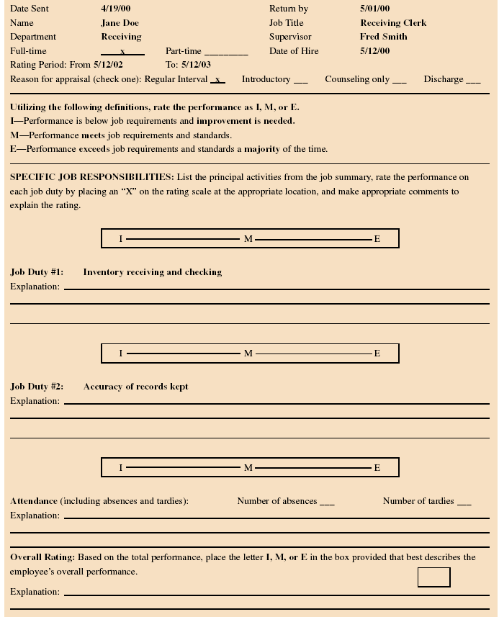
Sample Performance Appraisal Form
FIGURE 11-7a

Slide 22
Sample Performance Appraisal Form (Cont)
FIGURE 11-7b

Slide 23
2. Comparative Methods
1. Ranking
  Listing of all employees from highest to lowest in performance.
  Drawbacks:
    Does not show size of differences in performance between employees
    Implies that lowest-ranked employees are unsatisfactory performers.
    Becomes an unwieldy process if the group to be ranked is large.

Slide 24
2. Comparative Methods (Cont)
2. Forced Distribution
  Performance appraisal method in which ratings of employees are distributed along a bell-shaped curve.
Drawbacks:
  Assumes a normal distribution of performance.
  Resistance by managers to placing individuals in the lowest or highest groups.
  Providing explanation for placement in a higher or lower grouping can be difficult.
  Is not readily applicable to small groups of employees.

Slide 25
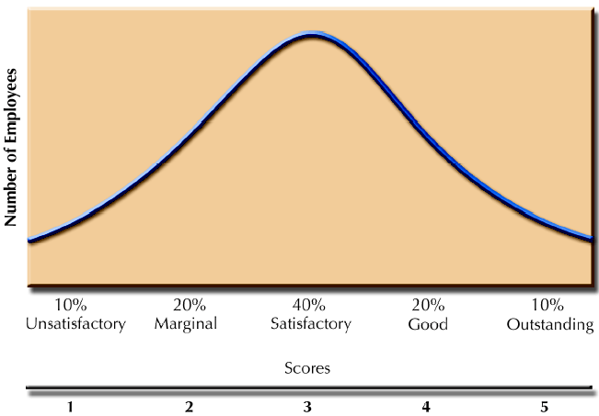
Forced Distribution on a Bell-shaped Curve
Figure 11–8

Slide 26
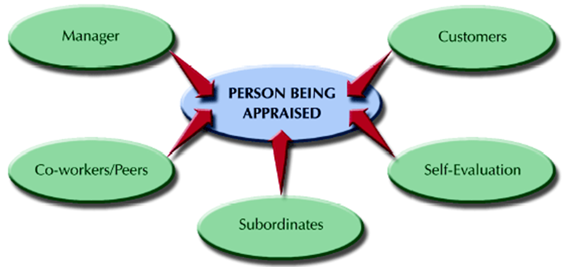
3. Narrative Methods
Figure 11–9

Slide 27
3. Narrative Methods Cont.
1. Critical Incident
  Manager keeps a written record of highly favorable and unfavorable employee actions.
Drawbacks
  Variations in how managers define a “critical incident”
  Time involved in documenting employee actions
  Most employee actions are not observed and may become different if observed
  Employee concerns about manager’s “black books”

Slide 28
3. Narrative Methods (Cont.)
2. Essay Method: Manager writes a short essay describing an employee’s performance.
Drawbacks
  Depends on the managers’ writing skills and their ability to express themselves.
3. Field Review :Outside reviewer interviews the manager about the performance of each employee and develops a rating for the employees from the interview notes.
  Drawbacks
  The external reviewer may lack sufficient knowledge of the employees' daily work.
  The evaluation may rely heavily on the manager's information, which may be biased.
  This method can be costly and time-consuming.

Slide 29
4. Behavioral/Objective Methods
1. Behavioral Rating Approach
  Assesses employees’ behaviors instead of other characteristics
  Consists of a series of scales created by:
    Identifying important job dimensions
    Creating statements describing a range of desired and undesirable behaviors (anchors)
Types of behavioral scales
    Behaviorally Anchored Rating Scales (BARS)
    Behavioral Observation Scales (BOS)
    Behavioral Expectation Scales (BES)

Slide 30
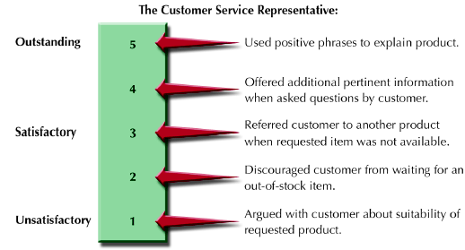
Customer Service Skills (BOS)
Figure 11–10

Slide 31
4. Behavioral/Objective Methods (Cont.)
2. Management by Objectives
  Specifying the performance goals that an individual and his or her manager agree to try to attain within an appropriate length of time.
Key MBO Ideas
  Employee involvement creates higher levels of commitment and performance.
  Encourages employees to work effectively toward achieving desired results.
  Performance measures should be measurable and should define results.

Slide 32
The MBO Process
Job Review and Agreement
Development of Performance Standards
Guided Objective Setting
Continuing Performance Discussions
FIGURE 11-11

Slide 33











Common Rater Errors
Traditional Errors
Contemporary Concerns
Reducing Errors
Halo Effect
Unconscious Bias
Rater training
Horn Effect
Gender & Diversity Bias
Calibration meetings
Leniency Error
Remote Worker Bias
Structured criteria
Strictness Error
Algorithmic Bias (AI)
Multiple-source feedback
Central Tendency
Periodic review
Similar-to-Me Bias
Recency Effect

Slide 34









Feedback as a System
Data Collection
Performance Analytics
Continuous Feedback
Coaching & Development
Improvement
Recognition
FIGURE 11-12
Timely
Specific
Constructive
Future-oriented
Platforms facilitate ongoing feedback and development conversations.

Slide 35








Appraisal Interview Hints
Prepare objective evidence
Focus on behaviors & outcomes
Encourage two-way dialogue
Discuss achievements & needs
Virtual Discussions
Create development action plan
Set future goals collaboratively
Virtual appraisals require active listening, engagement, and clear communication.
Maintain confidentiality

Slide 36













Performance Appraisals and the Law
Job Analysis Based
Valid & Reliable
Standardized Procedures
Consistent Documentation
Data Privacy Regulations
Ethical Use of AI
Algorithmic Transparency
Rater Training
Transparent Review
Documented Decisions
EEO Compliance
No Discrimination

Slide 37
Performance Management System
Effective PMS systems are:
  Consistent with the strategic mission of the organization
  Beneficial as development tool
  Useful as an administrative tool
  Legal and job-related
  Viewed as generally fair by employees
  Effective in documenting employee performance

Slide 38
SUMMARY
Performance Management System
Performance Appraisal
Linkage Between Strategy, Outcomes, And Organizational Results
Performance-focused Organizational Cultures
Types Of Performance Information
Uses Of Performance Appraisal
Decisions About The Performance Appraisal Process
Who Conducts Appraisals
Performance Appraisal Methods
Common Rater Errors
Performance Appraisals And The Law
Effective PMS systems are

Slide 39
References
Armstrong, M., & Taylor, S. (2023). Armstrong's handbook of human resource management practice (16th ed.). Kogan Page.
Boxall, P., Purcell, J., & Wright, P. (2024). The Oxford handbook of human resource management (2nd ed.). Oxford University Press.
Dessler, G. (2023). Human resource management (17th ed.). Pearson.
Aguinis, H. (2024). Performance management (6th ed.). Chicago Business Press.
DeNisi, A., & Murphy, K. R. (2017). Performance appraisal and performance management: 100 years of progress? Journal of Applied Psychology, 102(3), 421–433.
Mathis, R. L., Jackson, J. H., Valentine, S., & Meglich, P. (2023). *Human resource management* (16th ed.). Cengage Learning.
Minbaeva, D. (2021). Disrupted HR? Human resource management in the digital age. Human Resource Management Review, 31(1), 100820.
SHRM. (2024). Managing employee performance in the age of AI. Society for Human Resource Management.
World Economic Forum. (2025). Future of jobs report 2025.
CIPD. (2024). Performance management: An introduction. Chartered Institute of Personnel and Development.
Cappelli, P., & Tavis, A. (2018). HR goes agile. Harvard Business Review, 96(2), 46–52.
Buckingham, M., & Goodall, A. (2019). Reinventing performance management. Harvard Business Review, 97(2), 40–50.

Slide 40


Thank You

