Slide 1


Prepared by Dr. Wesam Ahmed
IT393‎
Business Intelligence
Lecture 5

Slide 2



Practical guide to using Excel for Data Analytics and visualization
Lecture 5
IT393‎
Business Intelligence
Prepared by
Dr. Wesam Ahmed

Slide 3

01
Learning Objectives:
1.1 Using Excel for data analytics
1.2 Understand the importance of data/ information visualization
1.3 Learn different types of visualization techniques
1.4 Using Excel for data visualization

Slide 4
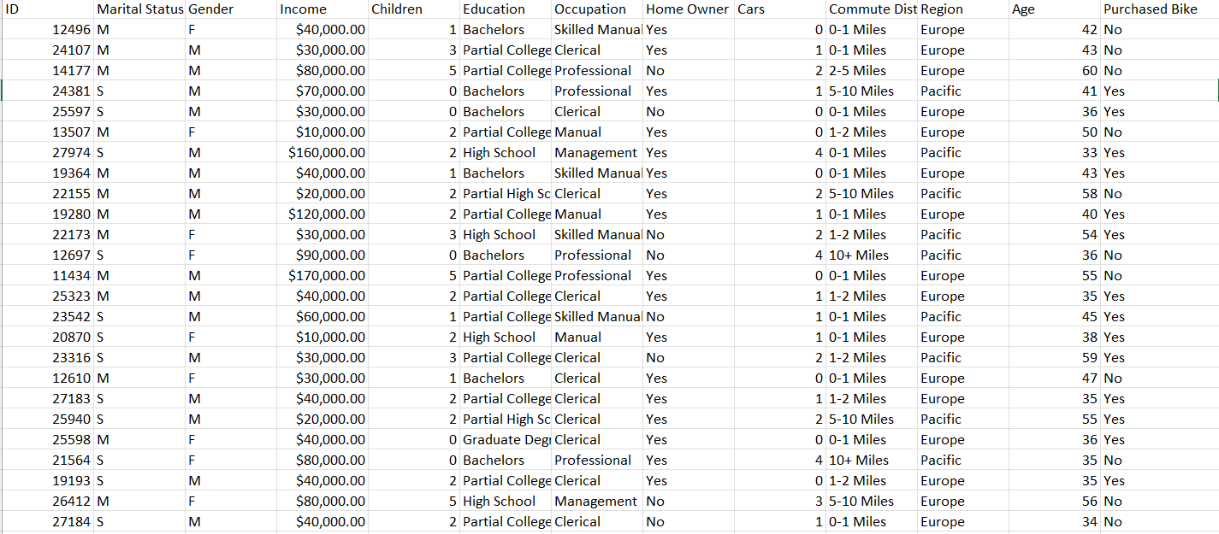
02
Using Excel for data analytics:
FIGURE 2.2 A Simple Taxonomy of Data.
Figure 5.1 Bike data

Slide 5
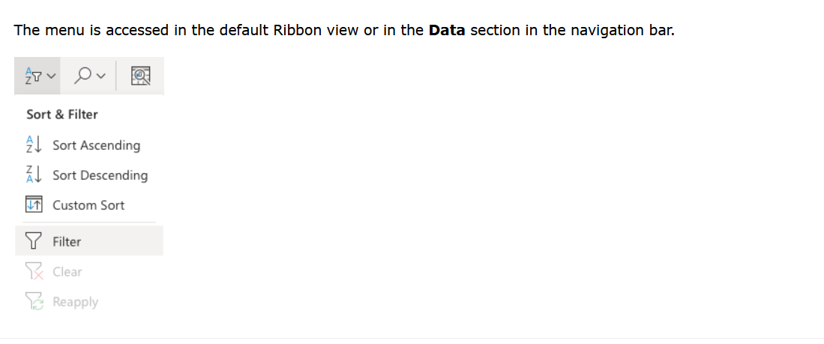
03
Using Excel for data analytics:
Filters can be applied to sort and hide data. It makes data analysis easier.

Slide 6
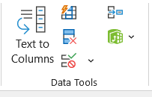
04
Using Excel for data analytics:
Understand the Importance of Business Intelligence
Remove duplicates
Duplicate entries can distort analysis and insights, so removing them ensures data accuracy.
Select the worksheet or range of cells from which you want to remove duplicates.
Go to the Data tab on the Ribbon.
Click on Remove Duplicates in the Data Tools group.
In the Remove Duplicates dialog box, specify which column to check for duplicates.
Click OK. Excel will display a message showing the number of duplicate values removed.

Slide 7
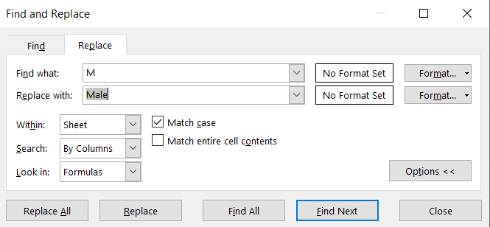
05
Using Excel for data analytics:
Understand the Importance of Business Intelligence
Press Ctrl+H or go to Home > Find & Select > Replace

Slide 8
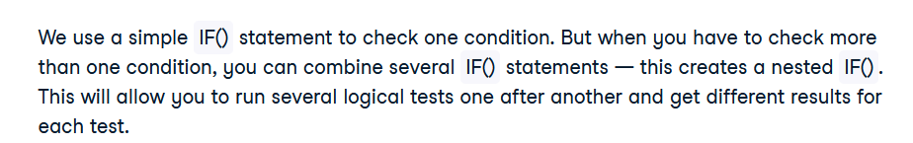
06
Using Excel for data analytics:
Understand the Importance of Business Intelligence
=IF(condition1, value_if_true, IF(condition2, value_if_true, value_if_false))

Slide 9
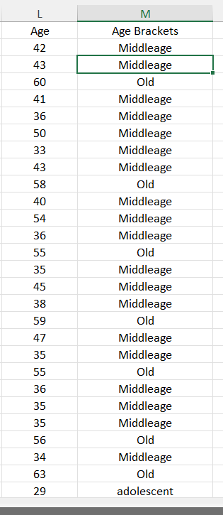

07
Using Excel for data analytics:
Understand the Importance of Business Intelligence

Slide 10
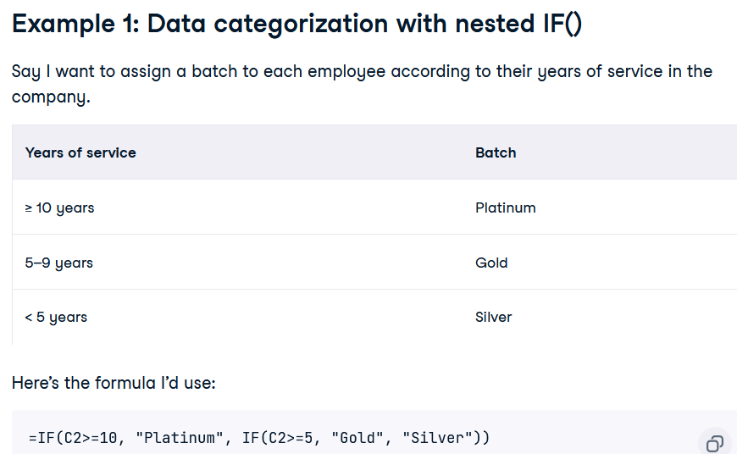
08
Using Excel for data analytics:

Slide 11
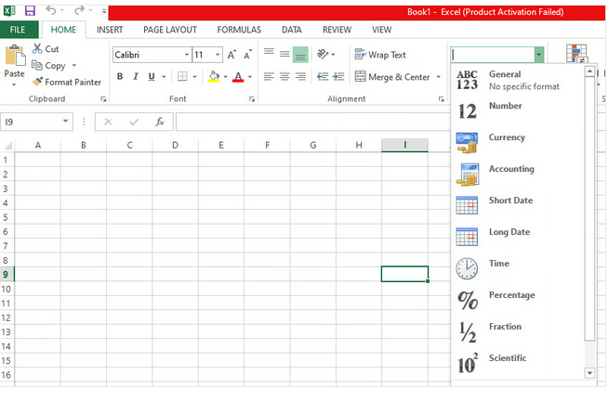
09
Using Excel for data analytics:
FIGURE 2.2 A Simple Taxonomy of Data.
You can go to the Number group from the Home tab and see the data types.

Slide 12
10
Using Excel for data analytics:
FIGURE 2.2 A Simple Taxonomy of Data.
PivotTables in Excel offer several benefits that enable you to summarize and analyze large amounts of data to help quickly identify trends and patterns. They are a popular user-friendly tool enabling technical/non-technical people alike to dive deeper into their data.
At the most basic level, PivotTables enable you to create a data matrix in a row and column formats. You can apply filtering, sorting, aggregation, and summarization of your data in various ways.

Slide 13
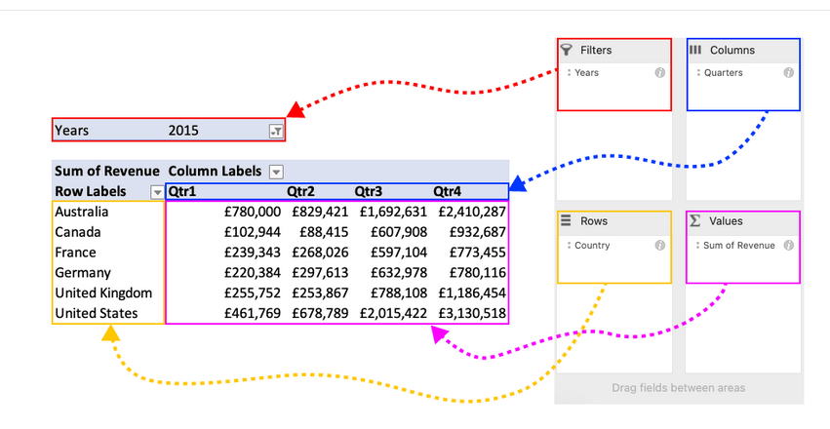
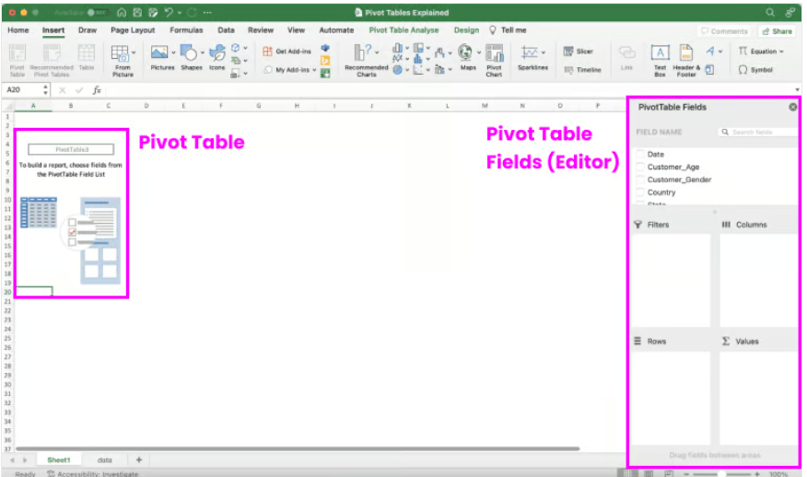
11
Using Excel for data analytics:
FIGURE 2.2 A Simple Taxonomy of Data.

Slide 14

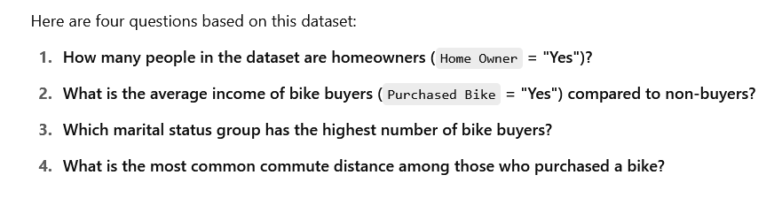
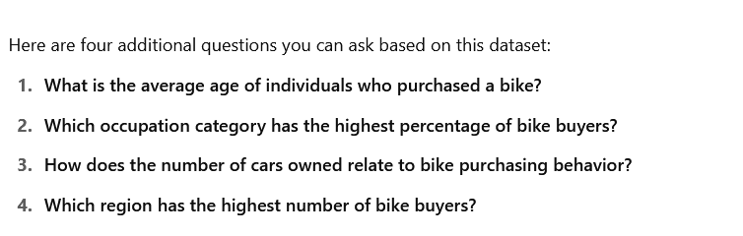
12
Using Excel for data analytics:
Using LLM for Asking Business Questions

Slide 15
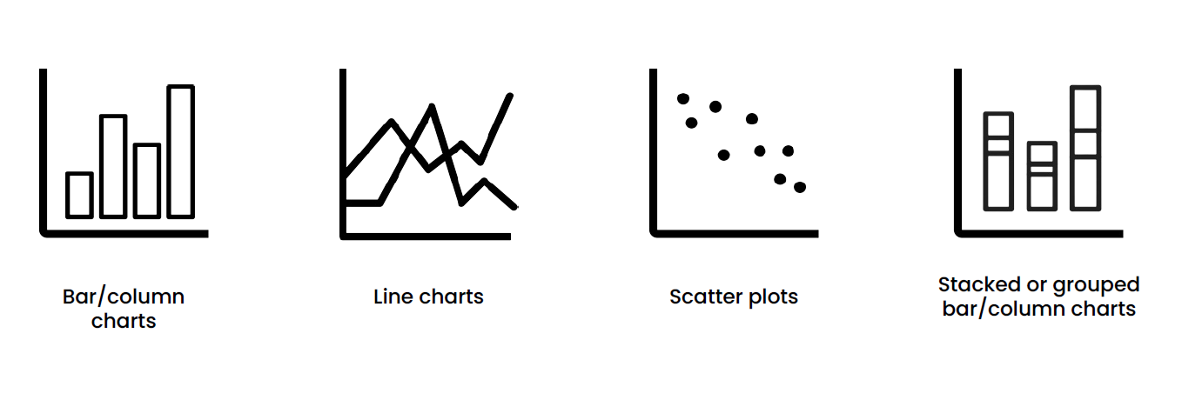
13
Data Visualization:
Assessing stakeholder satisfaction
Data visualization (or more appropriately, information visualization) has been defined as “the use of visual representations to explore, make sense of, and communicate data” (Few, 2007).

Slide 16
14
Data Visualization:
Assessing stakeholder satisfaction
Although the name that is commonly used is data visualization, usually what is meant by this is information visualization. Because information is the aggregation, summarization, and contextualization of data (raw facts), what is portrayed in visualizations is the information and not the data.
Data visualization available in both BI applications have included charts and graphs, as well as the other types of visual elements used to create scorecards and dashboards.
Different Types of Charts and Graphs: Often end users of business analytics systems are not sure what type of chart or graph to use for a specific purpose. Some charts or graphs are better at answering certain types of questions. Some look better than others. Some are simple; some are rather complex and crowded.

Slide 17
15
Data Visualization:
Understand the Importance of Business Intelligence
Basic Charts and Graphs:
Line charts are perhaps the most frequently used graphical visuals for time series data.
Line charts (or a line graphs) show the relationship between two variables. They are most often used to track changes or trends over time (having one of the variables set to time on the x-axis).
Line charts sequentially connect individual data points to help infer changing trends over a period of time.
Line charts are often used to show time-dependent changes in the values of some measure, such as changes on a specific stock price over a 5-year period or changes on the number of daily customer service calls over a month.

Slide 18
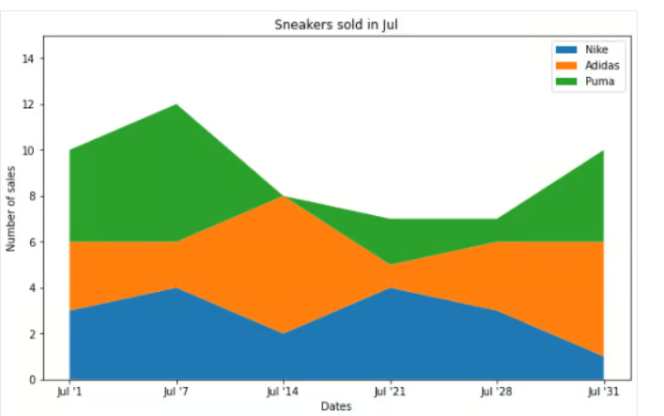
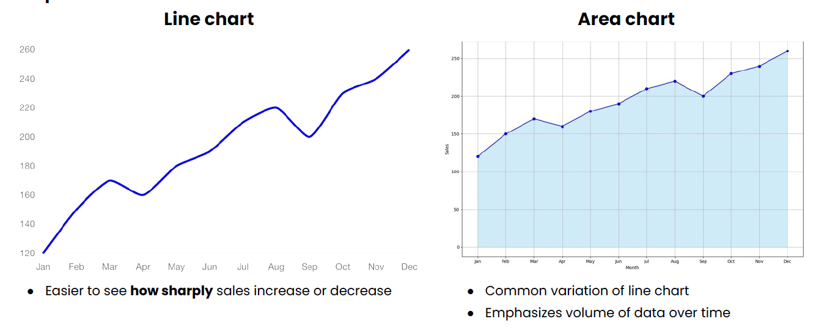
16
Data Visualization:
Understand the Importance of Business Intelligence
Purpose: To show trends in a numerical feature over time

Slide 19
17
Data Visualization:
Understand the Importance of Business Intelligence
Bar charts are among the most basic visuals used for data representation. Bar charts are effective when you have nominal data or numerical data that splits nicely into different categories so you can quickly see comparative results and trends within your data.
Bar charts are often used to compare data across multiple categories such as percent of advertising spending by departments or by product categories. Bar charts can be vertically or horizontally oriented. They can also be stacked on top of each other to show multiple dimensions in a single chart.

Slide 20
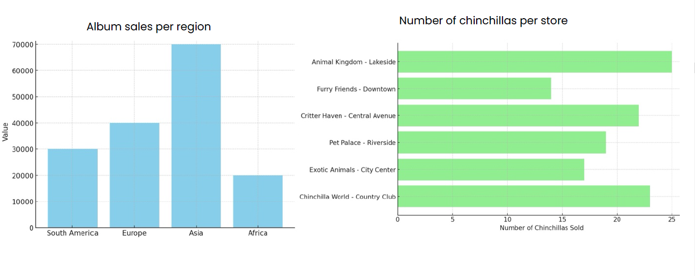
18
Data Visualization:
Understand the Importance of Business Intelligence
Purpose: To compare a numerical feature across a categorical feature

Slide 21
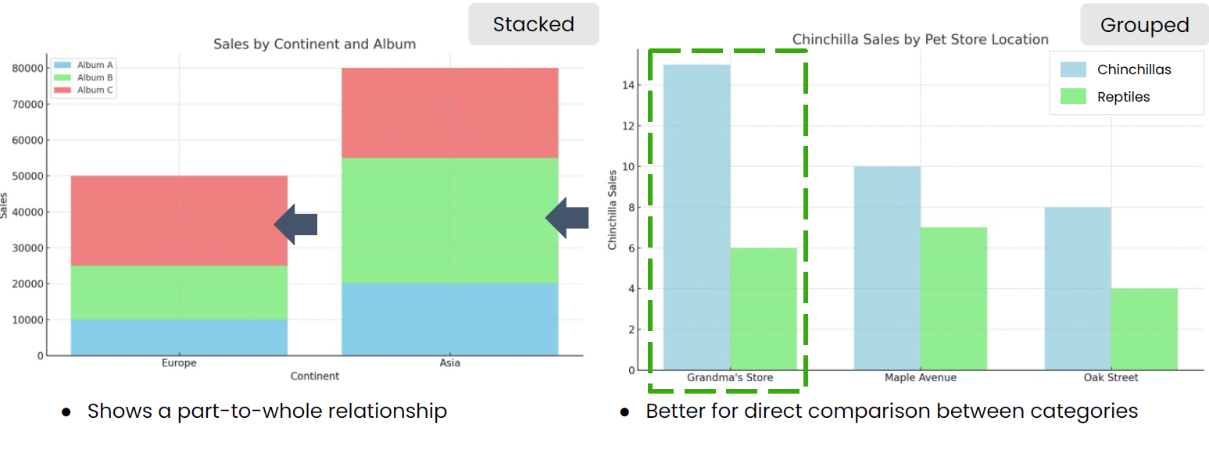
19
Data Visualization:
Understand the Importance of Business Intelligence
Purpose: Compare a numerical feature across multiple categorical features

Slide 22
20
Data Visualization:
Understand the Importance of Business Intelligence
Scatter plots are often used to explore the relationship between two or three variables (in 2-D or 2-D visuals). Because they are visual exploration tools, having more than three variables, translating them into more than three dimensions is not easily achievable.
Scatter plots are an effective way to explore the existence of trends, concentrations, and outliers. For instance, in a two-variable (two-axis) graph,a scatter plot can be used to illustrate the corelationship between age and weight of heart disease patients or it can illustrate the relationship between the number of customer care representatives and the number of open customer service claims. Often, atrend line is superimposed on a two-dimensional scatter plot to illustrate the nature of the relationship.

Slide 23
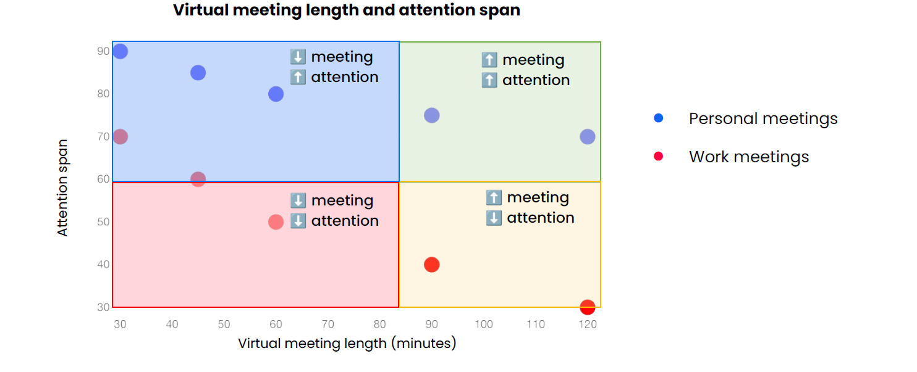
21
Data Visualization:
Understand the Importance of Business Intelligence
Purpose: To compare two numerical features

Slide 24
22
Data Visualization:
Understand the Importance of Business Intelligence
Pie charts are visually appealing, as the name implies, pie-looking charts. Because they are so visually attractive, they are often incorrectly used.
Pie charts should only be used to illustrate relative proportions of a specific measure. For instance, they can be used to show the relative percentage of an advertising budget spent on different product lines, or they can show relative proportions of majors declared by college students in their sophomore year. If the number of categories to show is more than just a few (say more than four), one should seriously consider using a bar chart instead of a pie chart.

Slide 25
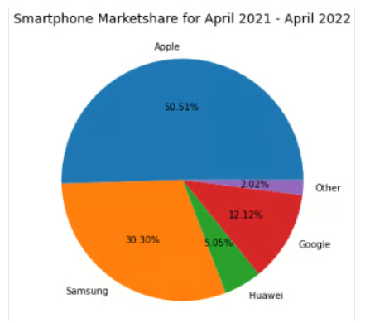
23
Data Visualization:
Understand the Importance of Business Intelligence
For example, a good use case for a pie chart would be to represent the market share for smartphones.

Slide 26
24
Data Visualization:
Understand the Importance of Business Intelligence
Histogram looks just like a bar chart. Histograms are used to show the frequency distribution of a variable or several variables.
In a histogram, the x-axis is often used to show the categories or ranges, and the y-axis is used to show the measures/values/frequencies. Histograms show the distributional shape of the data.
That way, one can visually examine if the data is normally or exponentially distributed. For instance, one can use a histogram to illustrate the exam performance of a class, where distribution of the grades as well as comparative analysis of individual results can be shown, or one can use a histogram to show age distribution of the customer base.

Slide 27
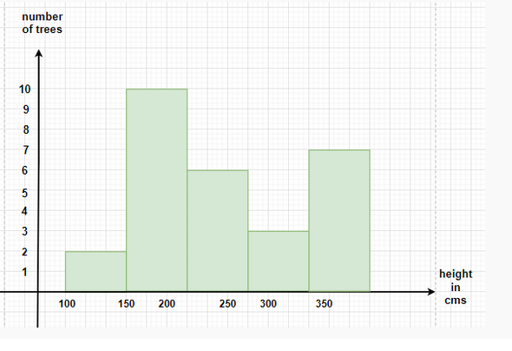
25
Data Visualization:
Understand the Importance of Business Intelligence
The histogram is similar to a bar graph, but histogram groups numbers into different ranges.

Slide 28
26
Data Visualization:
Understand the Importance of Business Intelligence
Geographic Map : when the data set includes any kind of location data (e.g., physical addresses, postal codes, state names or abbreviations, country names, latitude/longitude, or some type of custom geographic encoding), it is better and more informative to see the data on a map.
For instance, one can use maps to show distribution of customer service requests by product type by geographic locations.
Often a large variety of information (e.g., age distribution, income distribution, education, economic growth, or population changes) can be portrayed in a geographic map to help decide where to open a new restaurant or a new service station.

Slide 29
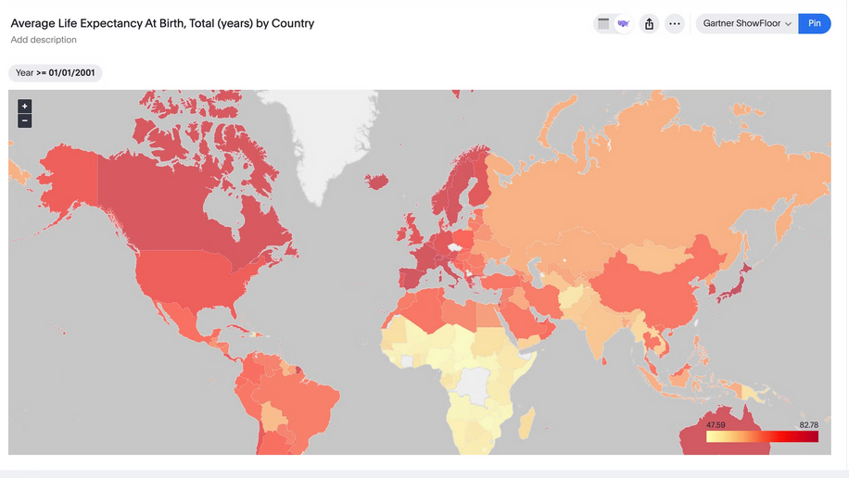
27
Data Visualization:
Understand the Importance of Business Intelligence
They show spatial information, such as the distribution of values across different regions, countries, or states.

Slide 30
28
Data Visualization:
Understand the Importance of Business Intelligence
Tree maps display hierarchical (tree-structured) data as a set of nested rectangles. Each branch of the tree is given a rectangle, which is then tiled with smaller rectangles representing subbranches. A leaf node’s rectangle has an area proportional to a specified dimension on the data. Often the leaf nodes are colored to show a separate dimension of the data. When the color and size dimensions are correlated in some way with the tree structure, one can often easily see patterns that would be difficult to spot in other ways, such as if a certain color is particularly relevant. A second advantage of tree maps is that, by construction, they make efficient use of space. As a result, they can legibly display thousands of items on the screen simultaneously.

Slide 31
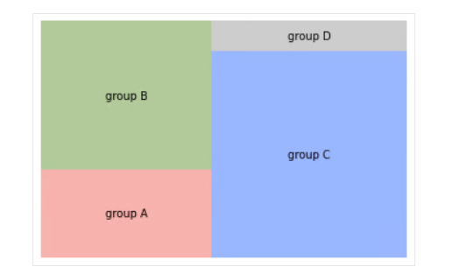
29
Data Visualization:
Understand the Importance of Business Intelligence
Each rectangle is a category within a given variable, whereas the area of the rectangle is proportional to the size of that category.

Slide 32
30
Data Visualization and Best Practices:
Understand the Importance of Business Intelligence
Tips for Creating Effective Data Visualizations:
Data visualizations should have a clear purpose and audience.
Choose the right type of viz or chart for your data.
Use text and labels to clarify, not clutter.
Use color to highlight important information or to differentiate or compare.
Avoid misleading visualizations.
Keep your visualizations simple. Less is more.

Slide 33
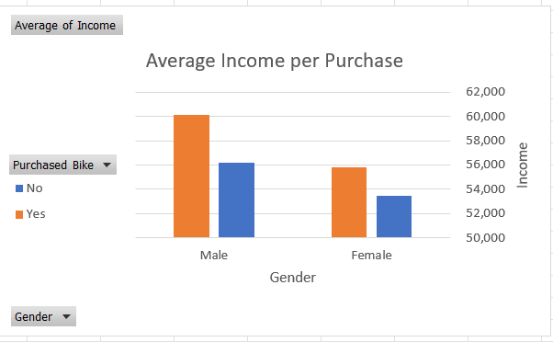
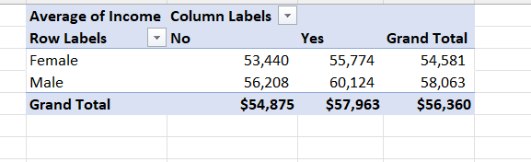
31
Data Visualization :
Business Question:
What is the average income for each gender among people who purchased a bike?
Understand the Importance of Business Intelligence

Slide 34
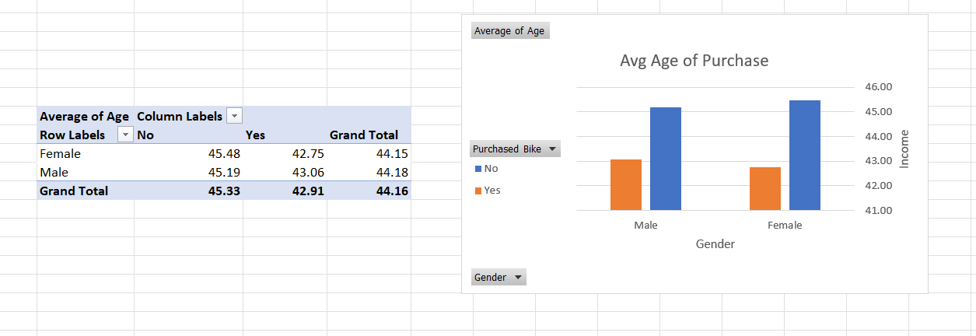
32
Data Visualization :
Business Question:
What is the average age of individuals who purchased a bike?
Understand the Importance of Business Intelligence

Slide 35
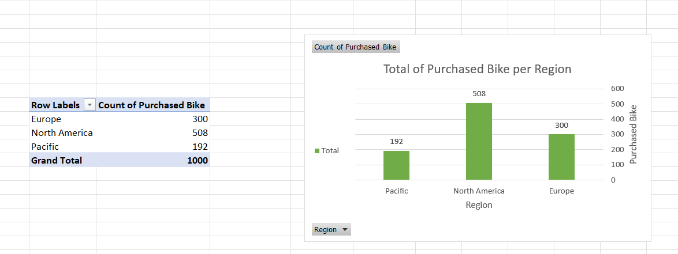
33
Data Visualization :
Business Question:
Which region has the highest number of bike buyers?
Understand the Importance of Business Intelligence

Slide 36
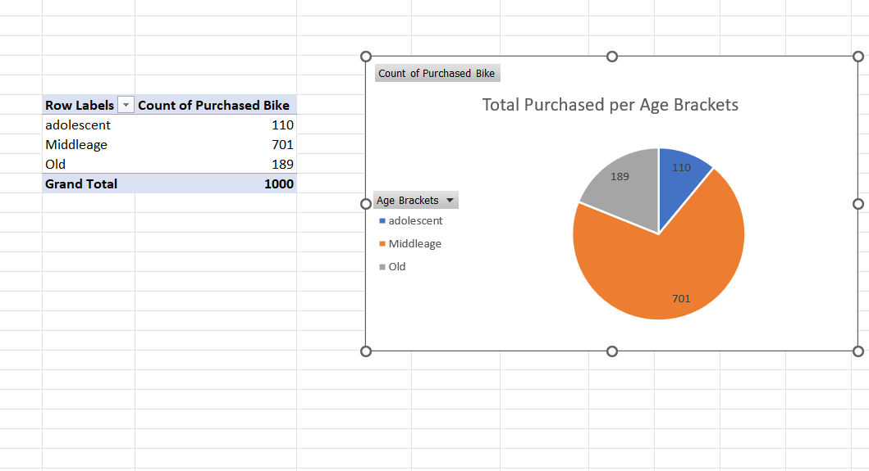
34
Data Visualization :
Business Question:
What is the total purchased Bike for each age brackets?
Understand the Importance of Business Intelligence

Slide 37
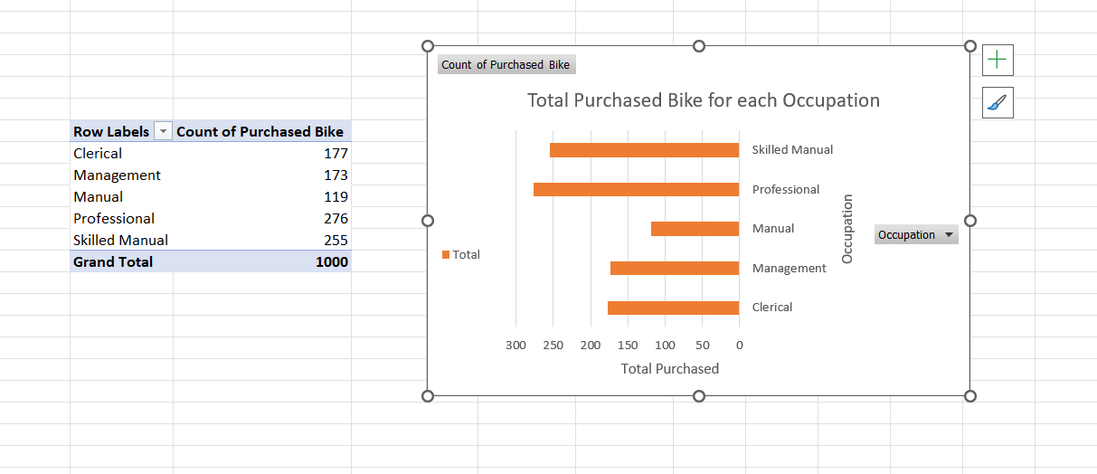
35
Data Visualization :
Business Question:
Which occupation category has the highest percentage of bike buyers?
Understand the Importance of Business Intelligence

Slide 38
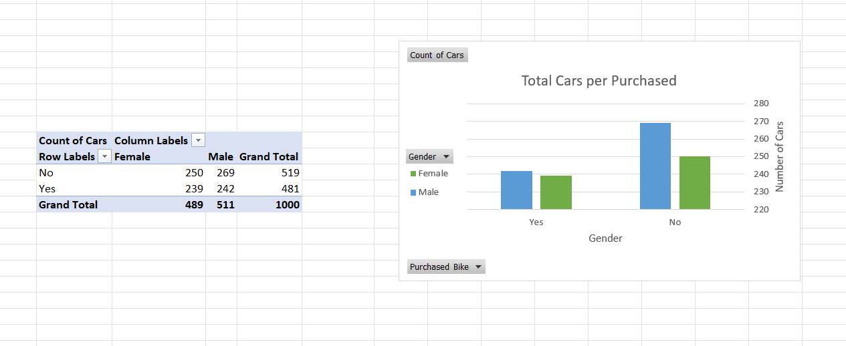
36
Data Visualization :
Business Question:
How does the number of cars owned relate to bike purchasing behavior?
Understand the Importance of Business Intelligence

Slide 39
37
Summary
Using Excel for data analytics.
data visualization and best practices.
How to use Excel for data visualization.

Slide 40


Thank You

