Slide 1


Creative and Scientific Thinking
Prepared by Prof. Shereen Taie
CRE252
Information Technology Department
Lecture 5

Slide 2




Creative and Scientific
Thinking
Lecture 5
CRE252
Information Technology Department
Prepared by
Prof. Shereen Taie
www.midocean.ae

Slide 3
Learning Objectives:
Scientific thinkers and intellectual standards
Sources of Knowledge
Elements of Science
Measurements
The Scientific Method
The Many Roles of Theory
Chapter
02
www.midocean.ae

Slide 4
Scientific thinkers and intellectual standards
Chapter
02
www.midocean.ae

Slide 5
Scientific thinkers and intellectual standards:
There are seven Intellectual Standards we use to assess thinking:
1. Clarity
2. Accuracy
3. Precision
4. Relevance
5. Depth
6. Logic
7. Fairness
Chapter
02
www.midocean.ae

Slide 6
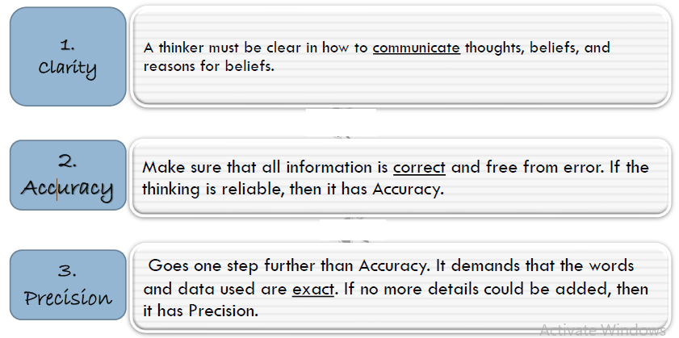
Chapter
02
www.midocean.ae

Slide 7
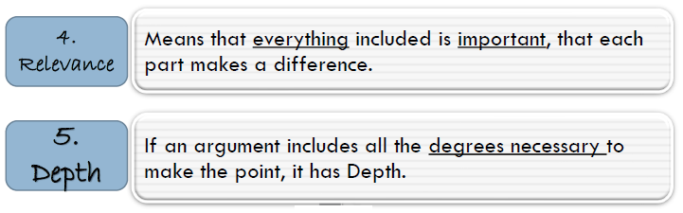
Chapter
02
www.midocean.ae

Slide 8
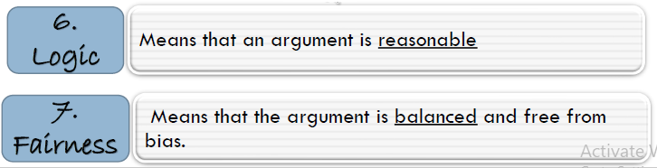
Chapter
02
www.midocean.ae

Slide 9

Chapter
02
Sources of Knowledge
www.midocean.ae

Slide 10
Sources of Knowledge:
Gather information: Sources of Knowledge
Primary Sources
Secondary Sources
Chapter
02
www.midocean.ae

Slide 11
                Primary Sources
Chapter
02
www.midocean.ae

Slide 12
Sources of Knowledge: Primary Source
A primary source provides director firsthand evidence about an event, object, person, or work.
Primary sources provide the original materials on which other research is based and enable students and other researchers to get as close as possible to what actually happened during a particular event or time period.
Chapter
02
www.midocean.ae

Slide 13
Sources of Knowledge: Primary Source
Primary sources can be written or non-written(sound, pictures, artifacts, etc.).In scientific research, primary sources present original thinking, report on discoveries, or share new information.
Examples of primary sources:
Interviews, surveys, observation as well as fieldwork.
Chapter
02
www.midocean.ae

Slide 14
                Secondary Source
Chapter
02
www.midocean.ae

Slide 15
Sources of Knowledge: Secondary Source
Secondary sources describe, discuss, interpret, comment upon, analyze, evaluate, summarize, and process primary sources.
A secondary source is generally one or more steps removed from the event or time period and are written or produced after the fact with the benefit of hindsight.
Chapter
02
www.midocean.ae

Slide 16
Sources of Knowledge: Secondary Source
Secondary sources often lack the freshness and immediacy of the original material.
Examples of secondary sources:
Reference books, including dictionaries, encyclopedias, and atlases
Articles from magazines, journals, and newspapers after the event
Literature reviews and review articles (e.g., movie reviews, book reviews)
Books
Textbooks
Chapter
02
www.midocean.ae

Slide 17
Elements of Science:
They are:
Concepts ,
Variables ,
Hypotheses ,
and theories.
The way in which these elements are combined constitutes the scientific method.

Slide 18
Chapter
02
Scientific method
www.midocean.ae

Slide 19
Definition:
A concept is a verbal abstraction (a name) drawn from observation of a number of specific cases.
Reality testing is built right into the process of naming things, one of the most elementary transactions of existence.
Chapter
02
www.midocean.ae

Slide 20
Definition:
concepts—names for things, feelings, and ideas generated or acquired by people in the course of relating to each other and to their environment.
Chapter
02
www.midocean.ae

Slide 21
Science is a way of checking on the formulation of concepts and of testing the possible linkages between them through references to observable phenomena.
The next step is to see how scientists turn concepts into something that can be observed. When concepts are defined as variables, they can be used to form a special kind of sentence, the hypothesis.
Chapter
02
www.midocean.ae

Slide 22
Chapter
02
What is a Variable
www.midocean.ae

Slide 23
What is a Variable:
As the name suggests, variables are things that vary.
A variable is a special kind of concept that contains within it a notion of degree or differentiation.
Chapter
02
www.midocean.ae

Slide 24
Examples
Chapter
02
www.midocean.ae

Slide 25
Heat is one variable in making water boil.
Age has been established as an important variable in voting.
There are many other more significant variables : race, gender,
region of residence, and so on.
Chapter
02
www.midocean.ae

Slide 26
Chapter
02
Types of variables
www.midocean.ae

Slide 27
Independent variable is the part of the experiment that is manipulated or changed by the scientist or person performing the experiment.
Independent variable:
Chapter
02
www.midocean.ae

Slide 28
Dependent variable is the part of the experiment that is affected by the independent variable.
Dependent variable:
Chapter
02
www.midocean.ae

Slide 29
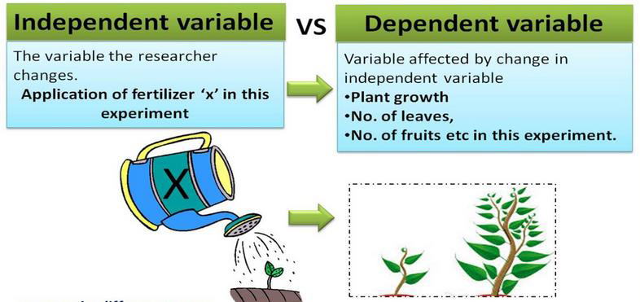
Chapter
02
www.midocean.ae

Slide 30
Chapter
02
Examples of variables
www.midocean.ae

Slide 31
Question | Variable
How much water flows through a valve at different openings? | Water valve opening (closed, half open, fully open) • Amount of water flowing, measured in liters per minute • Water pressure, or how much the water is "pushing“
Chapter
02
www.midocean.ae

Slide 32
Question | Variable
Does heating water allow it to dissolve more sugar? | Temperature of the water measured in degrees Celsius • Amount of sugar that dissolves completely, measured in grams • Type of sugar
Chapter
02
www.midocean.ae

Slide 33
Question | Variable
Does fertilizer make a plant grow bigger? | Amount of fertilizer, measured in grams • Growth of the plant, measured by its height • Growth of the plant, measured by the number of leaves • See Measuring Plant Growth for more ways to measure plant growth • Same type of fertilizer • Same pot size for each plant • Same plant type in each pot • Same type and amount of soil in each pot
Chapter
02
www.midocean.ae

Slide 34
Question | Variable
Does an electric motor turn faster if you increase the voltage? | Voltage of the electricity, measured in volts • Speed of rotation, measured in revolutions per minute (RPMs) • motor for every test
Chapter
02
www.midocean.ae

Slide 35
Only 1 variable is being tested.
All other variables of the experiment are constants.
There are adequate numbers of trials performed.
Components of a well-designed scientific experiment:
Chapter
02
www.midocean.ae

Slide 36
There is an adequate sample size (number of individuals per group per trial).
There is sufficient experimental time allowed.
Components of a well-designed scientific experiment:
Chapter
02
www.midocean.ae

Slide 37
Example for an experiment
Chapter
02
www.midocean.ae

Slide 38
To test my hypothesis, I do a controlled experiment. In this experiment, I set up two identical pots. Both contain ten bean seeds planted in the same type of soil, and both are placed in the same window. In fact, there is only one thing that I do differently to the two pots:
          One pot of seeds gets watered every afternoon.
          The other pot of seeds doesn't get any water at all.
Chapter
02
www.midocean.ae

Slide 39
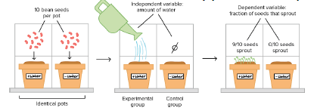
nine out of ten seeds in the watered pot have sprouted,
none of the seeds in the dry pot have sprouted.
It looks like the "seeds need water" hypothesis is probably correct!
After a week:
Chapter
02
www.midocean.ae

Slide 40



Thank You

