Slide 1


DIGITAL MEDIA ETHICS
DGM 723
Prepared by:
Dr. Sherihan Mohamed
Lecture 2

Slide 2



DMG 723
DIGITAL MEDIA ETHICS
Chapter 1
Central Issues in the Ethics of Digital Media
Prepared by:
Dr. Sherihan Mohamed

Slide 3

Lecture 1
Remember:
** Introduction.
** (Ethical) life in the (post-)digital age:
1. Digital media, analog media: convergence and Ubiquity.
2. Digital media and “greased information”.
3. Digital media as communication media: fluidity, ubiquity, global scope, and selfhood/identity.

Slide 4
Lecture 2
Outlines:
** Digital Media Ethics: How to proceed?
** Is Digital Media Ethics Possible? Grounds for hope
** How to do ethics in the new mediascape:
Dialogical approaches, difference, and Pluralism.
** Further considerations: Ethical judgments.

Slide 5

Digital media ethics:
How to proceed?
Lecture 2
Central Issues in the Ethics of Digital Media

Slide 6
Digital media ethics: How to proceed?
Lecture 2
In truth developing an ethics for digital media is both possible and essential. With the rapid expansion of digital technologies, creating ethical guidelines ensures responsible use, protects users, and promotes trust. These ethics can address various aspects
First of all, digital media often present us with strikingly new sorts of interactions with one another.

Slide 7

It remains uncertain whether existing ethical guidelines and approaches -already well- established for traditional media are applicable to digital media, and if they are, then how they should be adapted.

Slide 8
Digital media ethics: How to proceed?
Lecture 2
However, as highlighted by the term "post-digital," digital media fundamentally retain their analogue nature in many respects – for example, the music we hear is still analogue.
Consequently, the life worlds shaped by digital media are still intertwined with the analogue experiences of previous generations and cultures.

Slide 9

Additionally, as global media, digital media compel us to address culturally diverse perspectives, not only on basic ethical norms and practices BUT, more fundamentally, on the very way ethics should be approached.

Slide 10

Digital media ethics: How to proceed?
Lecture 2
In particular, non-Western views challenge traditional Western notions of the primary importance of the individual, and thereby Western understandings of ethical responsibility as primarily individual responsibility.

Slide 11
This means, more specifically, that multiple actors and agents must work together to make specific acts (both beneficent and harmful) possible.
Hence, in parallel with the distribution of information via networks, our ethical responsibility may be more accurately understood in terms of A Distributed Responsibility.

Slide 12

Digital media ethics: How to proceed?
Lecture 2
This understanding of distributed responsibility is, in fact, not an entirely new idea; rather, it is one shared with both pre-modern Western philosophies and religions and multiple philosophies and religions around the globe.

Slide 13
Certainly, this is a Very Good Thing: it suggests important ethical norms and practices that can be shared among the multiple cultures and peoples now brought into digital communication with one another. But it represents a major challenge, especially, to Western thinkers used to understanding ethical responsibility in primarily Individualistic Terms.

Slide 14
Is Digital Media Ethics Possible? Grounds for hope
Lecture 2

Slide 15
When we initially encounter the complexities of digital media ethics, the challenges may appear daunting and perhaps even insurmountable. However, our combined experience with past technological advancements, along with recent insights in information and computing ethics (ICE), demonstrates that despite the significant hurdles in crafting ethical frameworks for emerging technologies, we can indeed achieve this.

Slide 16

Is Digital Media Ethics Possible? Grounds for hope
Lecture 2
Indeed, this experience provides us with a number of examples of ethical resolutions that “work” both globally (as they involve discerning shared norms and understandings) and locally (as they further involve developing ways of interpreting and applying shared norms in specific cultural contexts).

Slide 17
Efforts to establish ethical controls over digital media have been ongoing for several years.
Within the last decades, numerous regional discussions have taken place in Europe, Latin America, Africa, and Asia in order to create a universal code of ethics for the information society.

Slide 18

Is Digital Media Ethics Possible? Grounds for hope
Lecture 2
One of the core issues in developing a universal code for media ethics is the difficulty of finding a common ground between ethical principles from one culture to another. Also, such codes may be interpreted differently according to various moral and legal standards.

Slide 19

As a primary example: The European Union has drawn up and now implemented more rigorous privacy protections than were defined under previous data regulations.

Slide 20

Is Digital Media Ethics Possible? Grounds for hope
Lecture 2
In 2015, the European Data Protection Supervisor (EDPS) established an Ethics Advisory Group, assigned to develop a “new digital ethics” to help guide the specific implementations of the GDPR, including sustaining the rigorous EU privacy protections vis the emerging Internet of Things and growing uses of Artificial Intelligence (AI).

Slide 21
This new digital ethics, however, turns squarely on two ethical frameworks, deontology and virtue ethics.
For example, the EDPS Ethics Advisory Group (EAG) foregrounds the central importance of autonomy and freedom, including as these are grounded in the philosophical work of Immanuel Kant.

Slide 22

Is Digital Media Ethics Possible? Grounds for hope
Lecture 2
Similarly, both the EAG report and the more philosophical account of the key ethical pillars of a Good AI Society foreground the central aims of virtue ethics – namely, flourishing, well-being, and good lives.

Slide 23

Simultaneously, these ethical frameworks are applied in a pluralistic manner. The EAG emphasizes that fundamental norms and values—such as autonomy, dignity, and equality, are integral to “The European project“.

Slide 24
Is Digital Media Ethics Possible? Grounds for hope
Lecture 2
These examples suggest that digital media ethics – as likewise requiring us to address the ethical dimensions evoked by developing new technologies, _ including how these implicate diverse cultural norms and traditions– is nonetheless a doable project. Moreover, extensive evidence argues that with few exceptions, as enculturated human beings, we are already deeply ethical.

Slide 25
How to do ethics in
the new mediascape
Lecture 2

Slide 26

How to do ethics in the new mediascape
Lecture 2
Frameworks for Ethical Decision Making:
When making an ethical decision, there are a range of steps that we go through, perhaps spontaneously and involuntarily, yet these steps are necessary to make the Right Ethical Decision.

Slide 27
* Identify the Ethical Issues
Could this decision or situation be damaging to someone or to some group, or unevenly beneficial to people? Does this decision involve a choice between a good and bad alternative, or perhaps between two “goods” or between two “bads”? Is this issue about more than solely what is legal or what is most efficient? If so, how?

Slide 28
How to do ethics in the new mediascape
Lecture 2
* Get the Facts
What are the relevant facts of the case? What facts are not known? Can I learn more about the situation? Do I know enough to make a decision?
What individuals and groups have an important stake in the outcome? Are the concerns of some of those individuals or groups more important? Why?
What are the options for acting? Have all the relevant persons and groups been consulted? Have I identified creative options?

Slide 29
* Evaluate Alternative Actions
Evaluate the options by asking the following questions:
Which option best respects the rights of all who have a stake?
Which option treats people fairly, giving them each what they are due?
Which option will produce the most good and do the least harm for as many stakeholders as possible?

Slide 30

How to do ethics in the new mediascape
Lecture 2
Which option best serves the community as a whole, not just some members?
Which option leads me to act as the sort of person I want to be?
Which option appropriately takes into account the relationships, concerns, and feelings of all stakeholders?

Slide 31
* Choose an Option for Action and Test It
After an evaluation, which option best addresses the situation?
If I told someone I respect (or a public audience) which option I have chosen, what would they say?
How can my decision be implemented with the greatest care and attention to the concerns of all stakeholders?

Slide 32

How to do ethics in the new mediascape
Lecture 2
In this context and in general, there are three philosophical methodologies used to interpret ethical decisions, namely:
* Ethical Monism
* Ethical relativism
* Ethical pluralism

Slide 33

Ethical Monism:
This framework posits that there is a single, universal set of ethical principles that apply to all situations. It suggests that One Moral Standard can be used to judge all actions as right or wrong, regardless of context. Ethical monists believe in an objective moral truth.

Slide 34

How to do ethics in the new mediascape
Lecture 2
Ethical Relativism:
This framework asserts that moral principles are not absolute but are relative to the cultural, social, or individual context. Ethical relativists believe that what is considered morally right or wrong can vary from one culture or society to another, and that no one moral perspective is superior to another.

Slide 35
Ethical Pluralism:
Ethical pluralism acknowledges the existence of multiple, sometimes conflicting, ethical principles. It accepts that there can be various moral values and principles that are equally valid and important. Ethical pluralists recognize the complexity of moral life and the need for a flexible approach to moral decision-making.
Ethical Pluralism stands as a Middle Ground between absolutism and relativism

Slide 36
Further considerations:
Ethical judgments
Lecture 2

Slide 37

Further considerations: Ethical judgments
Lecture 2
Another difficulty with the “moral panics” approach to ethical issues in the new mediascape is that it suggests that “ethics” works like this:

Slide 38
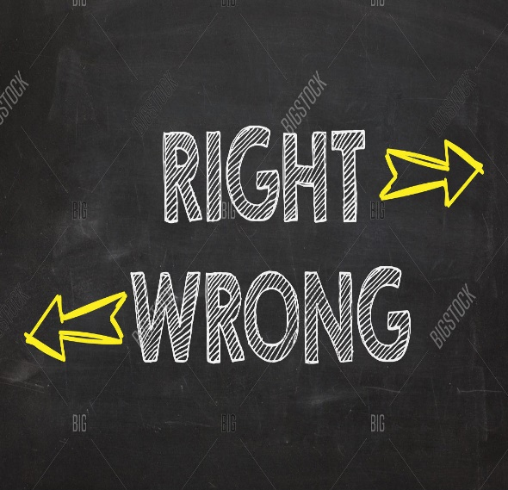
1. There are clear, universally valid norms of right and wrong that we can take as our ethical starting points – as premises in an ethical argument.

Slide 39

Further considerations: Ethical judgments
Lecture 2
2. All that “ethics” really involves is applying these initial premises to the particulars of the current case in front of us – in a straightforward deduction that concludes the right thing to do, as based on our first premises.

Slide 40

3. Once we have our ethical answers in this way, we can be confident that our answers are right; those who disagree with us must be wrong.

Slide 41

Further considerations: Ethical judgments
Lecture 2
This approach to ethics is not necessarily mistaken; on the contrary, it seems that much of the time, Most of us in fact do not perceive an ethical problem or difficulty in the situation we’re facing – Because our ethical frameworks already provide us with reasonably clear and straightforward answers along just these lines.

Slide 42
At the same time, however, this initial understanding of ethics obscures a number of important dimensions of ethical reflection.
There is no general rule for discerning which values, principles, norms, approaches apply before we can proceed to any inferences/conclusions about what to do.

Slide 43
Further considerations: Ethical judgments
Lecture 2
That is, we will find it difficult conceptually to move toward pluralism and other forms of middle grounds, Because our thinking insists that we can only have either unity (shared norms) or difference (in interpretation/application), but not both.

Slide 44
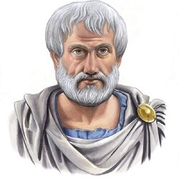
Aristotle referred to this kind of judgment as “practical judgment”.
For Aristotle, the development of this sort of practical judgment is an ongoing project that continues throughout one’s entire life.

Slide 45
Further considerations: Ethical judgments
Lecture 2
Analogously, our first efforts to grapple with difficult ethical issues that require practical judgment do not always go well:
We are caught in the ethical “bootstrapping” problem of needing precisely the ability to judge that will be robust enough to help only after it has been developed and honed through many years of (sometimes hard) experience.

Slide 46


Digital Media Ethics (Digital Media and Society Series), 3rd Edition, by Charles Ess
Intro
Recommended Reference

Slide 47
Lecture 2
Outlines:
** Digital Media Ethics: How to proceed?
** Is Digital Media Ethics Possible? Grounds for hope
** How to do ethics in the new mediascape:
Dialogical approaches, difference, and Pluralism.
** Further considerations: Ethical judgments.

Slide 48



Thank You

Slide 49
DIGITAL MEDIA ETHICS
Lecture 2
DMG 723
Prepared by:
Dr. Sherihan Mohamed

