Slide 1


Machine Learning
for Finance
Prepared by Dr. Diaa Salama
FNT633
KNN
Lecture 2

Slide 2




Machine Learning
for Finance
Lecture 2
FNT633
Intro
Prepared by
Dr. Diaa Salama
www.midocean.ae

Slide 3
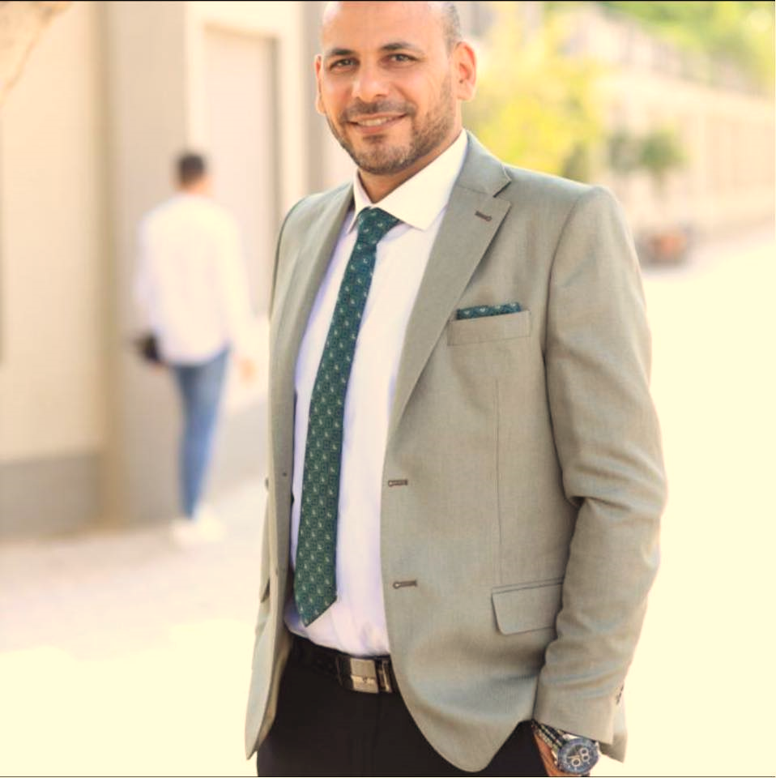
www.midocean.ae
Associate Professor, Data Science Department, Faculty of Computers Science , Misr International University, On Leave from Faculty of Computers & Artificial Intelligence, Banha University, Banha, Egypt.
Member, National Committee of Communications and Information Technology, Academy of Scientific Research & Technology, CAIRO, Egypt.
Member, International Telecommunication Union (ITU), United Nations (UN)
Member, International Federation for Information Processing - IFIP
Winner of the Arab Republic of Egypt Encouragement Award for Advanced Science and Technology in the Field of Engineering Sciences 2021
Winner of the Benha University Encouragement Award for Advanced Science and Technology in the Field of Engineering Sciences 2019
Winner of the DELL EMC AWARD for the academic year 2015/2016, 2016/2017, and 2017/2018
Dr.Diaa Salama Ph.D
One of the top 2% Scientists worldwide 2023 by Stanford university ranking.
Email: diaasalama@midocean.edu.km

Slide 4
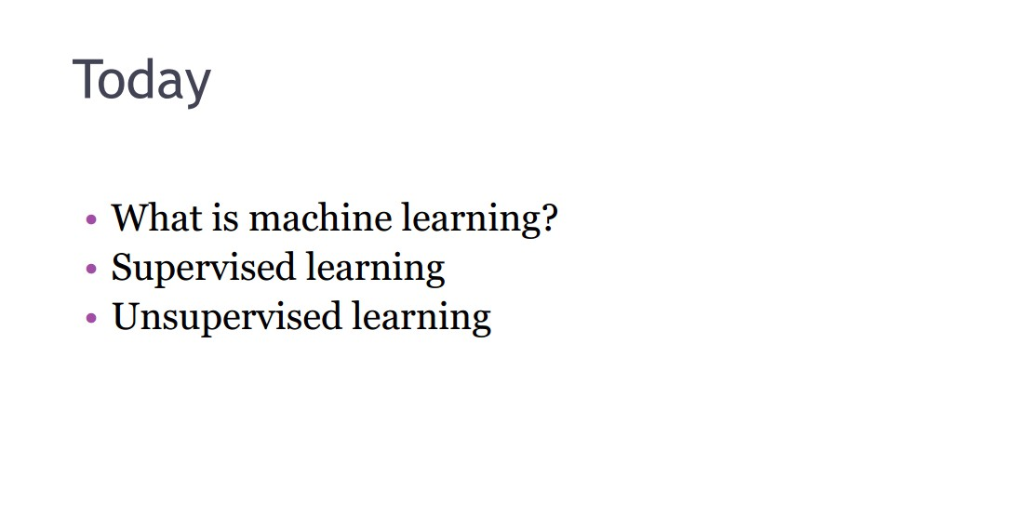
Week
Machine Learning
03
www.midocean.ae

Slide 5
Week
03
Today
What is machine learning?
Machine Learning applications and tasks
Supervised learning KNN
www.midocean.ae

Slide 6
Week
03
KNN
Used for
    Classification
    Regression
www.midocean.ae

Slide 7
Week
03
What is machine learning?
www.midocean.ae

Slide 8
Week
03
Machine learning!
Give the machine the ability how to solve some problems (e.g. statistical phenomenon) based on incomplete information
Here, learning is not only a question of remembering but also of generalization to unseen cases
Learn by example
www.midocean.ae

Slide 9
Week
03
Machine learning types
Suppose you are building a Face recognition program
Supervised learning (Classification):
    You have a dataset of faces image and other images.
    The dataset is labeled (classified) into Faces images, and other images.
    Program task know is to classify new images based on the available dataset.
Unsupervised learning (Clustering):
    You don’t have a dataset, and program role know is to cluster similar images for a new given dataset into different group, e.g. it can distinguish that faces are very different from landscapes, which are very different from
www.midocean.ae

Slide 10
Week
03
Supervised Learning
www.midocean.ae

Slide 11
Week
03
Supervised Classification
Referred to as classification or pattern recognition.
The goal is to find a functional mapping between the input data (patterns or examples) X, to a class label Y.
    i.e. Y=f(X)
A pattern is described by a set of features.
    E.g. color of eyes, or distance between the eyes.
Pattern recognition task can be viewed as a two dimensional matrix, whose axes are the examples and the features.
www.midocean.ae

Slide 12
Week
03
Pattern classification tasks
Data collection and representation.
Feature selection and/or feature reduction.
Classification.
www.midocean.ae

Slide 13
Week
03
Classification algorithms
Techniques for Low dimensional data sets
    K-Nearest Neighbor Classification
    Linear Discriminant Analysis
    Decision Trees
    Neural Networks
Techniques for High dimensional data sets
    Support Vector Machines
    Boosting
www.midocean.ae

Slide 14
Week
03
Machine Learning Tasks …
www.midocean.ae

Slide 15
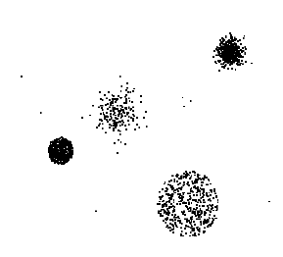
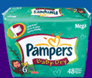
Week
03
Machine Learning Tasks …
Data
Clustering
Predictive Modeling
Association
Rules
Anomaly
Detection
Milk
15
www.midocean.ae

Slide 16
Week
03
The business understanding (Define objectives)
Define the project goals by asking and refining "sharp" questions that are relevant, specific, and unambiguous. Data science is a process that uses names and numbers to answer such questions. You typically use data science or machine learning to answer five types of questions:
      How much or how many? (regression)
      Which category? (classification)
      Which group? (clustering)
      Is this weird? (anomaly detection)
      Which option should be taken? (recommendation)
Determine which of these questions you're asking and how answering it achieves your business goals.
www.midocean.ae

Slide 17
Week
03
Predictive Model
Find a model for class attribute as a function of the values of other attributes
Model for predicting credit worthiness
Class
www.midocean.ae

Slide 18
Week
03
Classification Example
Find a model for class attribute as a function of the values of other attributes
categorical
categorical
quantitative
class
Test
Set
Learn
Classifier
Training
Set
Model
www.midocean.ae

Slide 19

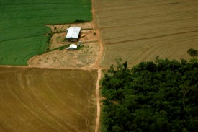
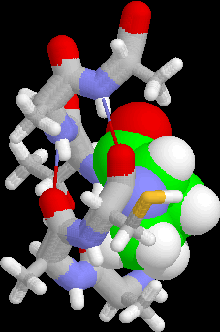
Week
03
Examples of Classification Task
Classifying credit card transactions
as legitimate or fraudulent
Classifying land covers (water bodies, urban areas, forests, etc.) using satellite data
Categorizing news stories as finance,
weather, entertainment, sports, etc
Identifying intruders in the cyberspace
Predicting tumor cells as benign or malignant
Classifying secondary structures of protein
as alpha-helix, beta-sheet, or random coil
www.midocean.ae

Slide 20
Week
03
Classification: Application 1
Fraud Detection
  Goal: Predict fraudulent cases in credit card transactions.
  Approach:
  Use credit card transactions and the information on its account-holder as attributes.
      When does a customer buy, what does he buy, how often he pays on time, etc
  Label past transactions as fraud or fair transactions. This forms the class attribute.
  Learn a model for the class of the transactions.
  Use this model to detect fraud by observing credit card transactions on an account.
www.midocean.ae

Slide 21
Week
03
Classification: Application 2
Churn prediction for telephone customers
  Goal: To predict whether a customer is likely to be lost to a competitor.
  Approach:
  Use detailed record of transactions with each of the past and present customers, to find attributes.
      How often the customer calls, where he calls, what time-of-the day he calls most, his financial status, marital status, etc.
  Label the customers as loyal or disloyal.
  Find a model for loyalty.
www.midocean.ae

Slide 22
Week
03
Classification: Application 3
Sky Survey Cataloging
  Goal: To predict class (star or galaxy) of sky objects, especially visually faint ones, based on the telescopic survey images (from Palomar Observatory).
      3000 images with 23,040 x 23,040 pixels per image.
  Approach:
  Segment the image.
  Measure image attributes (features) - 40 of them per object.
  Model the class based on these features.
  Success Story: Could find 16 new high red-shift quasars, some of the farthest objects that are difficult to find!
www.midocean.ae

Slide 23
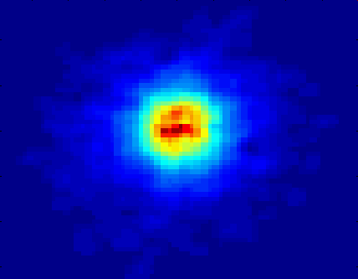
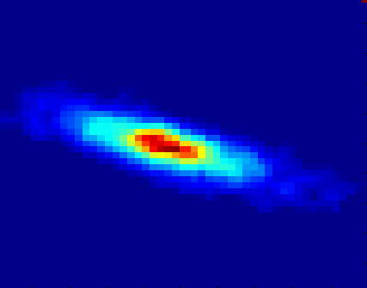
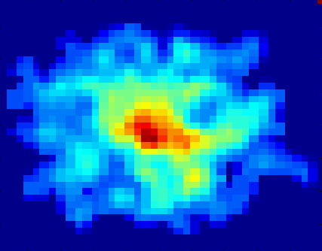
Week
03
Classifying Galaxies
Courtesy: http://aps.umn.edu
Early
Class:
Stages of Formation
Attributes:
Image features,
Characteristics of light waves received, etc.
Intermediate
Late
Data Size:
72 million stars, 20 million galaxies
Object Catalog: 9 GB
Image Database: 150 GB
23
www.midocean.ae

Slide 24
Week
03
Regression
Predict a value of a given continuous valued variable based on the values of other variables, assuming a linear or nonlinear model of dependency.
Extensively studied in statistics, neural network fields.
Examples:
    Predicting sales amounts of new product based on advertising expenditure.
    Predicting wind velocities as a function of temperature, humidity, air pressure, etc.
    Time series prediction of stock market indices.
www.midocean.ae

Slide 25
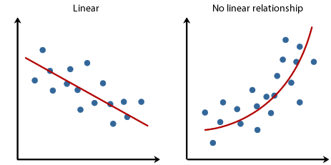
Week
03
Regression
www.midocean.ae

Slide 26
Week
03
Clustering
Finding groups of objects such that the objects in a group will be similar (or related) to one another and different from (or unrelated to) the objects in other groups
Inter-cluster distances are maximized
Intra-cluster distances are minimized
www.midocean.ae

Slide 27
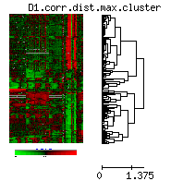
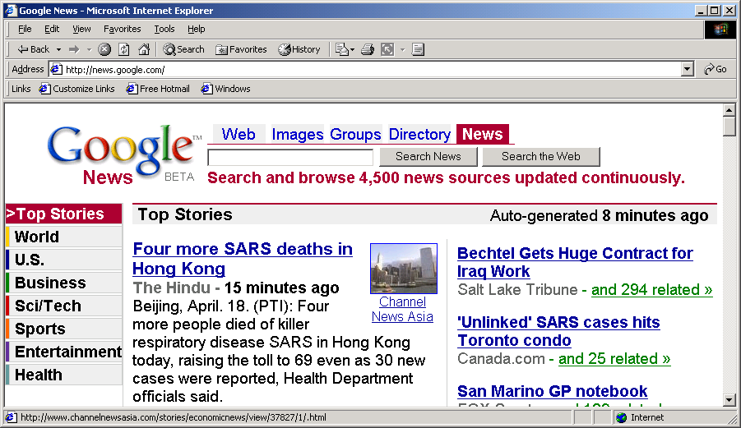
Week
03
Applications of Cluster Analysis
Understanding
    Custom profiling for targeted marketing
    Group related documents for browsing
    Group genes and proteins that have similar functionality
    Group stocks with similar price fluctuations
Summarization
    Reduce the size of large data sets
Use of K-means to partition Sea Surface Temperature (SST) and Net Primary Production (NPP) into clusters that reflect the Northern and Southern Hemispheres.
www.midocean.ae

Slide 28
Week
03
Clustering: Application 1
Market Segmentation:
  Goal: subdivide a market into distinct subsets of customers where any subset may conceivably be selected as a market target to be reached with a distinct marketing mix.
  Approach:
    Collect different attributes of customers based on their geographical and lifestyle related information.
    Find clusters of similar customers.
    Measure the clustering quality by observing buying patterns of customers in same cluster vs. those from different clusters.
www.midocean.ae

Slide 29
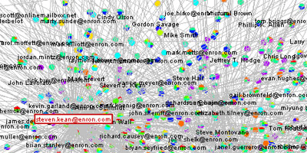
Week
03
Clustering: Application 2
Document Clustering:
  Goal: To find groups of documents that are similar to each other based on the important terms appearing in them.
  Approach: To identify frequently occurring terms in each document. Form a similarity measure based on the frequencies of different terms. Use it to cluster.
Enron email dataset
www.midocean.ae

Slide 30
Week
03
Association Rule Discovery: Definition
Given a set of records each of which contain some number of items from a given collection
    Produce dependency rules which will predict occurrence of an item based on occurrences of other items.
Rules Discovered:
{Milk} --> {Coke}
{Diaper, Milk} --> {Beer}
www.midocean.ae

Slide 31
Week
03
Association Analysis: Applications
Market-basket analysis
  Rules are used for sales promotion, shelf management, and inventory management
Telecommunication alarm diagnosis
  Rules are used to find combination of alarms that occur together frequently in the same time period
Medical Informatics
  Rules are used to find combination of patient symptoms and test results associated with certain diseases
www.midocean.ae

Slide 32
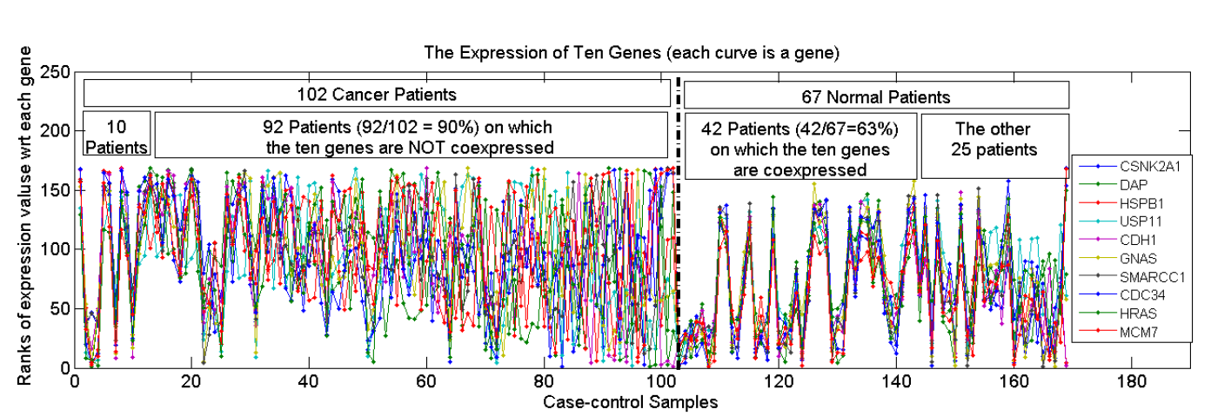
Week
03
Association Analysis: Applications
An Example Subspace Differential Coexpression Pattern from lung cancer dataset
An Example Subspace Differential Coexpression Pattern from lung cancer dataset
Enriched with the TNF/NFB signaling pathway
which is well-known to be related to lung cancer
P-value: 1.4*10⁻⁵ (6/10 overlap with the pathway)
  Three lung cancer datasets [Bhattacharjee et al. 2001], [Stearman et al. 2005], [Su et al. 2007]
[Fang et al PSB 2010]
www.midocean.ae

Slide 33
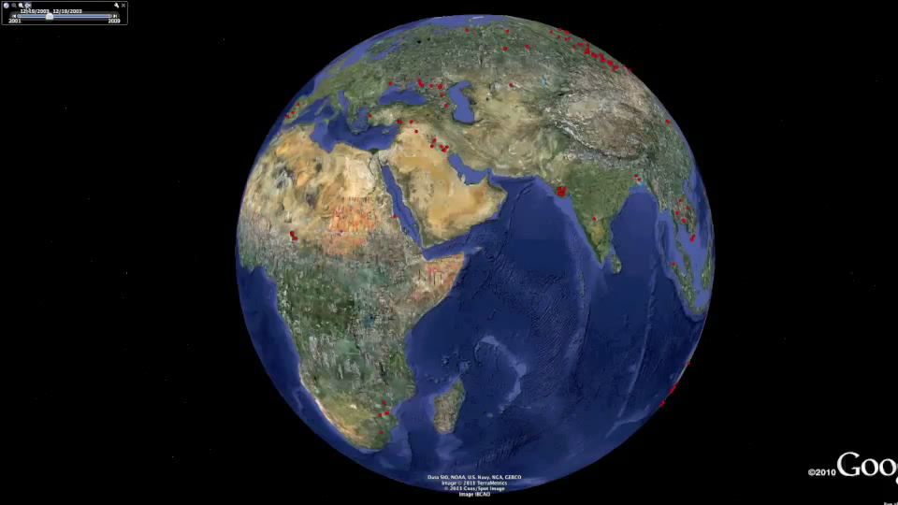
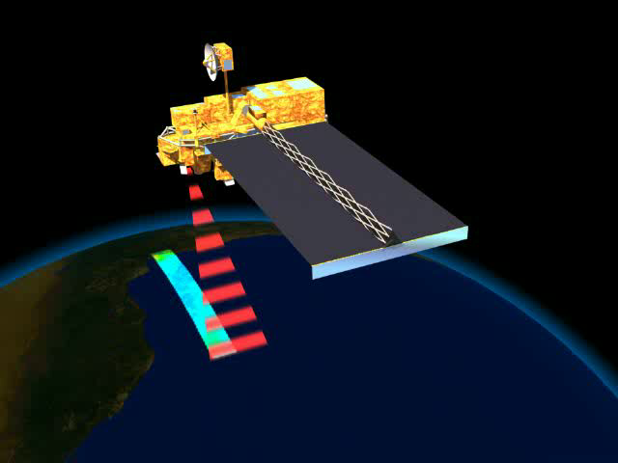
Week
03
Deviation/Anomaly/Change Detection
Detect significant deviations from normal behavior
Applications:
    Credit Card Fraud Detection
    Network Intrusion
    Detection
    Identify anomalous behavior from sensor networks for monitoring and surveillance.
    Detecting changes in the global forest cover.
www.midocean.ae

Slide 34
Week
03
K-Nearest Neighbor Classification
K-NN
www.midocean.ae

Slide 35
Week
03
KNN
Used for
    Classification
    Regression
www.midocean.ae

Slide 36
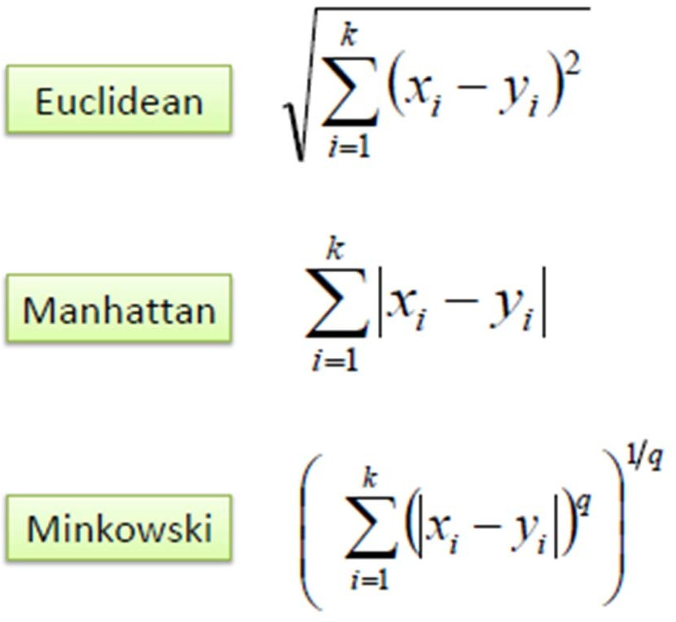
Week
03
K-Nearest Neighbor Classification
K nearest neighbors measured by a distance function.
These functions are valid only with continuous variables.
www.midocean.ae

Slide 37
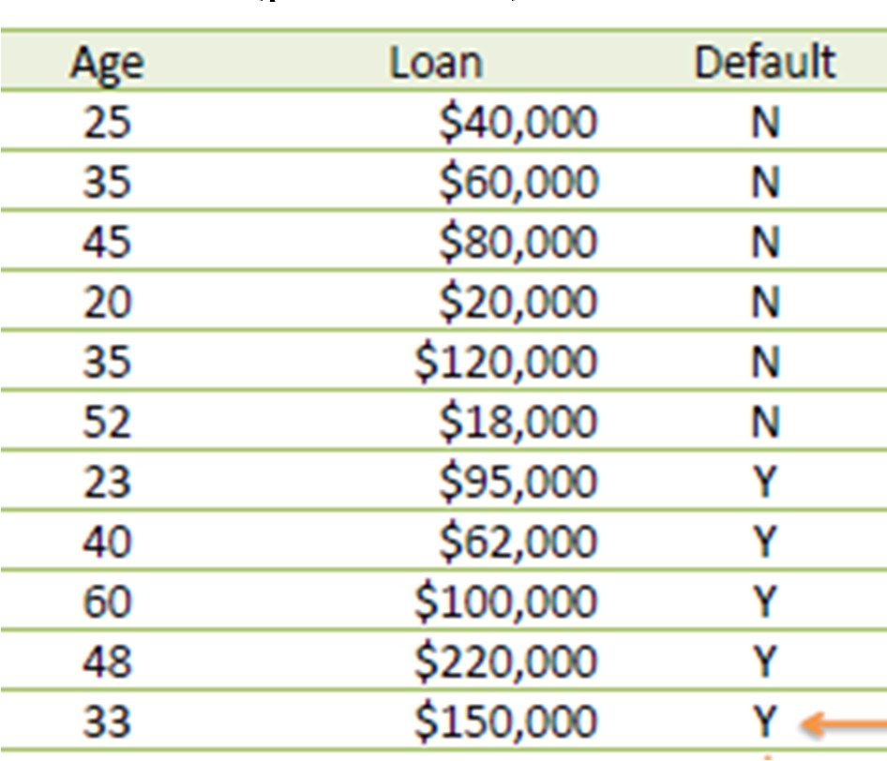
Week
03
KNN Example
Consider the following data concerning credit default. Age and Loan are two numerical variables (predictors) and Default is the target.
Know we want to classify unknown case ((Age=48 and Loan=$142,000) using Euclidean distance.) !!!!
www.midocean.ae

Slide 38
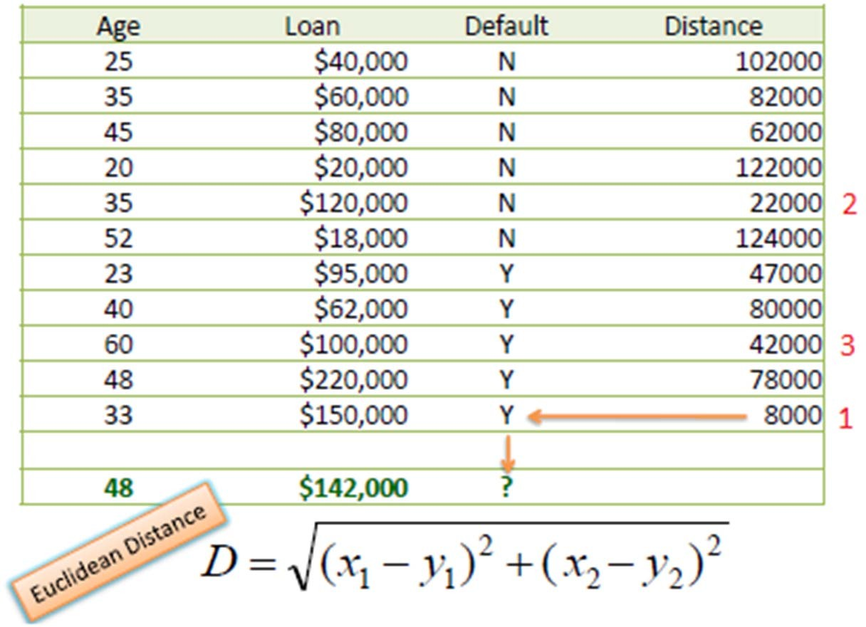
Week
03
KNN Example
Using Euclidean distance: E.g. distance between (48, $142k) and (33, 150k)
▫ Sqrt[(48-33)^2 + (142000-150000)^2] = 8000.01
So for all the dataset
www.midocean.ae

Slide 39
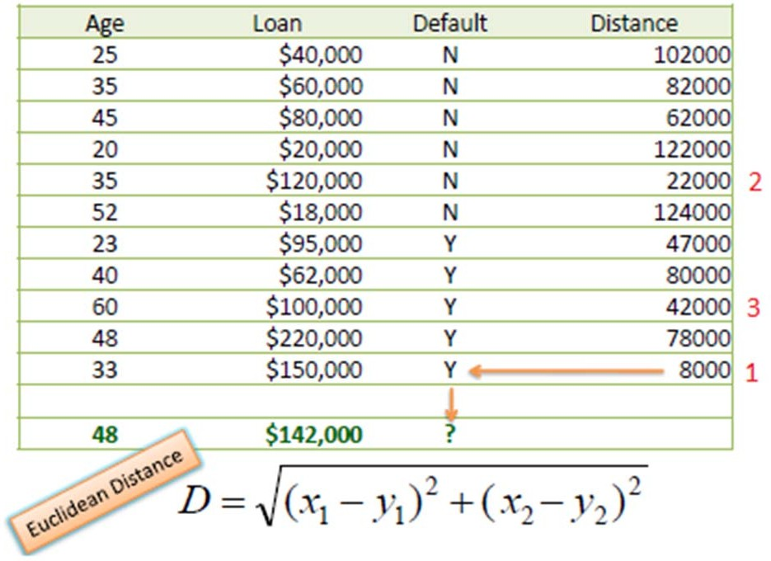
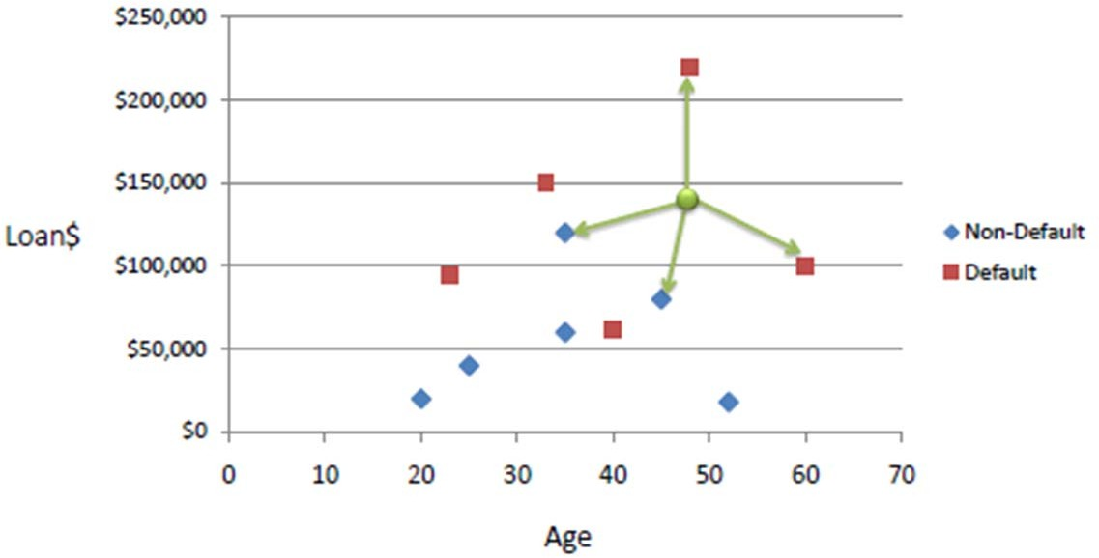
Week
02
KNN Example cont.
Know we choose the number of neighbors K
    If K=1 then this case is Y
    If K=3 then we have 2 Y and 1 N which give us Y
www.midocean.ae

Slide 40
Week
03
1- Classification using KNN:
Steps:
    Find distance.
    Find Rank.
    Find the output according to the value of k.
Euclidean Distance:
𝑑 = 𝑦₂ − 𝑦₁
2 ₊
𝑥₂ − 𝑥₁
2
www.midocean.ae

Slide 41
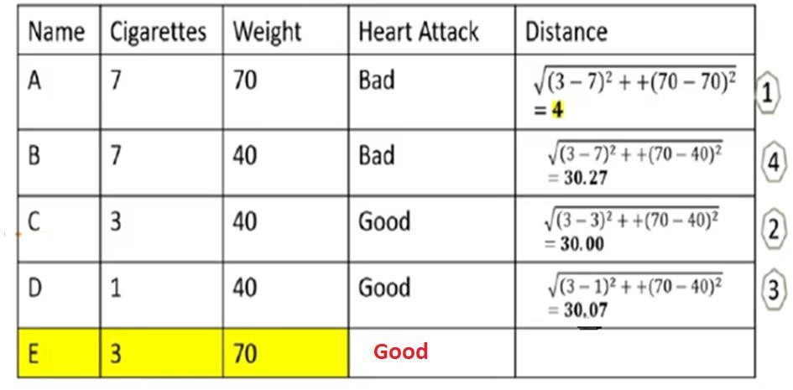
Week
03
Example
Consider k = 3
www.midocean.ae

Slide 42
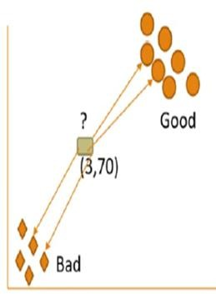
Week
03
Example
Consider k = 4
www.midocean.ae

Slide 43
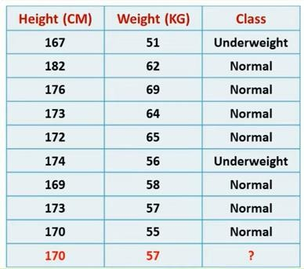
Week
03
Example2 :
www.midocean.ae

Slide 44
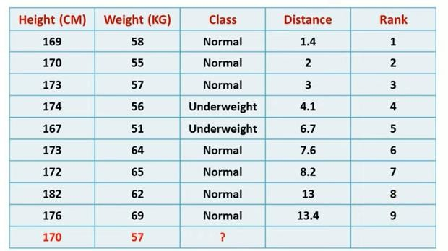
Week
03
Solution cont.:
www.midocean.ae

Slide 45
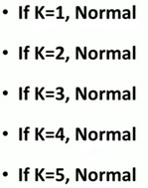
Week
03
Solution cont.:
www.midocean.ae

Slide 46
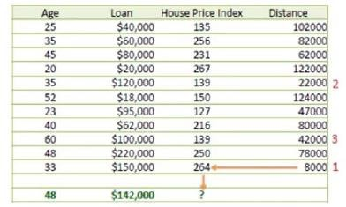
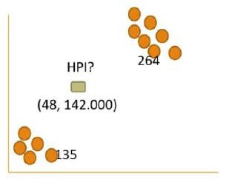
Week
03
2- Regression Using KNN:
www.midocean.ae

Slide 47
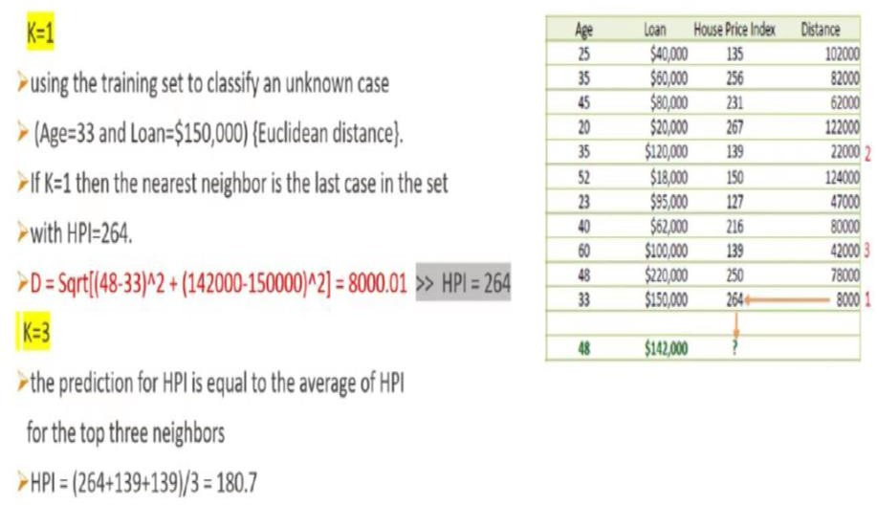
Week
03
2- Regression Using KNN:
www.midocean.ae

Slide 48
Week
03
Example: Assume k = 3
x1 | x2 | weight
7 | 7 | 6
7 | 4 | 3
3 | 4 | 2
1 | 3 | 1
2 | 1 | ?
www.midocean.ae

Slide 49
Week
03
2. Data preparation
The data is explored, putted into a suitable place and prepared to
use in our machine learning training. In this step, we understand
the nature of data that we must work with. We need to understand the characteristics, format, and quality of data.
A better understanding of data leads to an effective outcome. In this, we find Correlations, general trends, and outliers.
Data wrangling is the process of cleaning and converting raw data into a useable format.
In real-world applications, collected data may have various issues
www.midocean.ae

Slide 50
Week
03
Solution: K = 3
Weight = ³⁺²⁺¹ = 2
3
x1 | x2 | weight | Distance | Rank
7 | 7 | 6 | 7.81 | 4
7 | 4 | 3 | 5.83 | 3
3 | 4 | 2 | 3.16 | 2
1 | 3 | 1 | 2.23 | 1
2 | 1 | 2
www.midocean.ae

Slide 51
Week
03
KNN disadvantages
Computationally expensive
Requires a large memory to store the training data.
www.midocean.ae

Slide 52



Thank You

