Slide 1


Information Security Operations Center
(Info SOC)
Lecture 9
Analyze network intrusion data to identify compromised hosts and vulnerabilities
Prepared by
Dr. Ibrahim Gomaa

Slide 2

Lecture
Contents
9
Topic Title | Topic Objective
A Common Data Platform | Explain how data is prepared for use in a Network Security Monitoring (NSM) system.
Investigating Network Data | Use Security Onion tools to investigate network security events.
Enhancing the Work of the CyberSecurity Analyst | Describe network monitoring tools that enhance workflow management.
Information Security Operations Center
Lecture 9
Dr. Ibrahim Gomaa

Slide 3
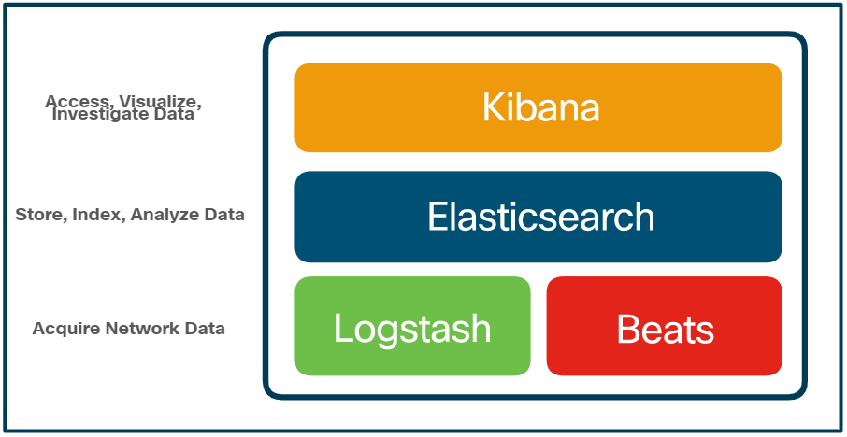
Lecture
A Common Data Platform
9
ELK
Security Onion includes Elastic Stack that consists of Elasticsearch, Logstash, and Kibana (ELK).
  Core Components of ELK:
  Elasticsearch: An open-core platform for searching and analyzing an organization’s data in near real time.
  Logstash: Enables collection and normalization of network data into data indexes that can be efficiently searched by Elasticsearch.
  Kibana: Provides a graphical interface to data that is compiled by Elasticsearch.
  Beats: Series of software plugins that send different types of data to the Elasticsearch data stores.
Information Security Operations Center
Lecture 9
Dr. Ibrahim Gomaa

Slide 4
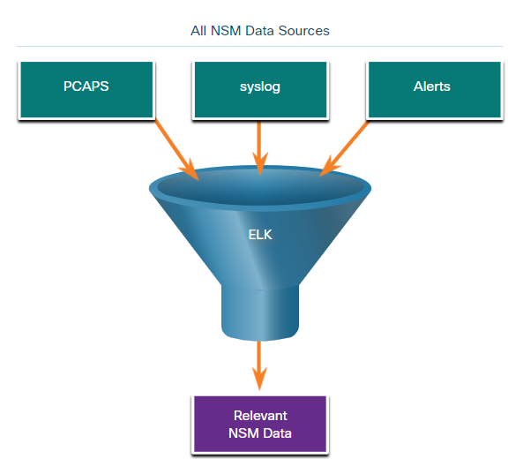
Lecture
A Common Data Platform
9
Data Reduction
To reduce data, it is essential to identify the network data that should be gathered and stored to reduce the burden on systems.
By limiting the volume of data, tools like Elasticsearch will be far more useful.
Information Security Operations Center
Lecture 9
Dr. Ibrahim Gomaa

Slide 5
Lecture
A Common Data Platform
9
Data Normalization
Data normalization is the process of combining data from a number of sources into a common format.
A common schema will specify the names and formats for the required data fields.
For example, IPv6 addresses, MAC addresses, and date and time can be represented in varying formats:
IPv6 Address Formats | Mac Formats | Date Formats
2001:db8:acad:1111:2222::33 | A7:03:DB:7C:91:AA | Monday, July 24, 2017 7:39:35pm
2001:DB8:ACAD:1111:2222::33 | A7-03-DB-7C-91-AA | Mon, 24 Jul 2017 19:39:35 +0000
2001:DB8:ACAD:1111:2222:0:0:33 | A70.3DB.7C9.1AA | 2017-07-24T19:39:35+00:00
Data normalization is also required to simplify searching for correlated events.
Information Security Operations Center
Lecture 9
Dr. Ibrahim Gomaa

Slide 6
Lecture
A Common Data Platform
9
Data Archiving
Retaining Network Security Monitoring (NSM) data indefinitely is not feasible due to storage and access issues.
The retention period for certain types of network security information may be specified by compliance frameworks.
Sguil alert data is retained for 30 days by default. This value is set in the securityonion.conf file.
Security Onion data can always be archived to external storage by a data archive system, depending on the needs and capabilities of the organization.
Note: The storage locations for the different types of Security Onion data will vary based on the Security Onion implementation.
Information Security Operations Center
Lecture 9
Dr. Ibrahim Gomaa

Slide 7
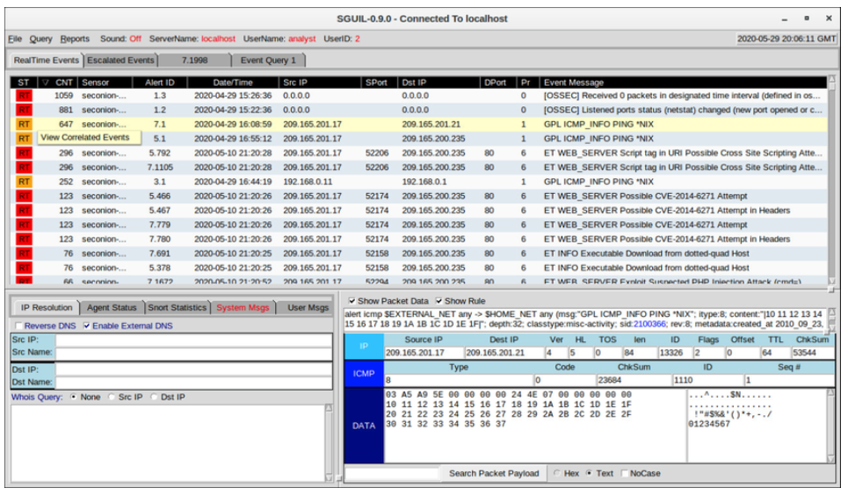
Lecture
Investigating Network Data
9
Working in Sguil
In Security Onion, the first place that a cybersecurity analyst will go to verify alerts is Sguil.
Sguil automatically correlates similar alerts into a single line and provides a way to view correlated events represented by that line.
To understand what is happening in the network, it may be useful to sort the CNT column to display the alerts with the highest frequency.
Sguil Alerts Sorted on CNT
Information Security Operations Center
Lecture 9
Dr. Ibrahim Gomaa

Slide 8
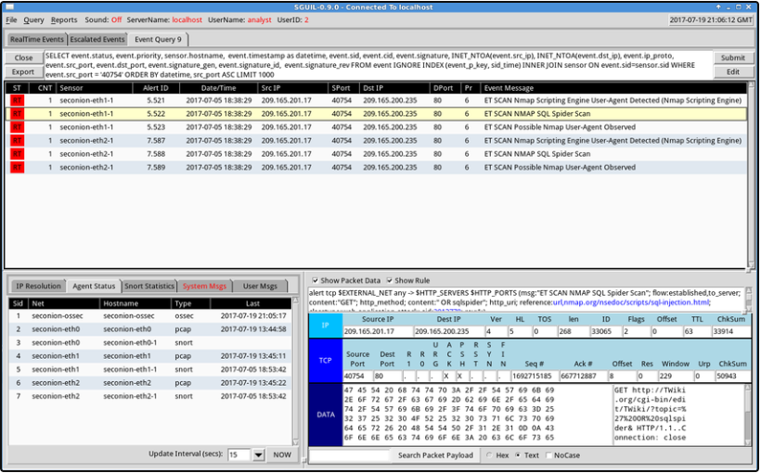
Lecture
Investigating Network Data
9
Sguil Queries
Queries can be constructed in Sguil using the Query Builder. It simplifies constructing queries to a certain degree.
Cybersecurity analyst must know the field names and some issues with field values to effectively build queries in Sguil.
For example, Sguil stores IP addresses in an integer representation.
Information Security Operations Center
Lecture 9
Dr. Ibrahim Gomaa

Slide 9
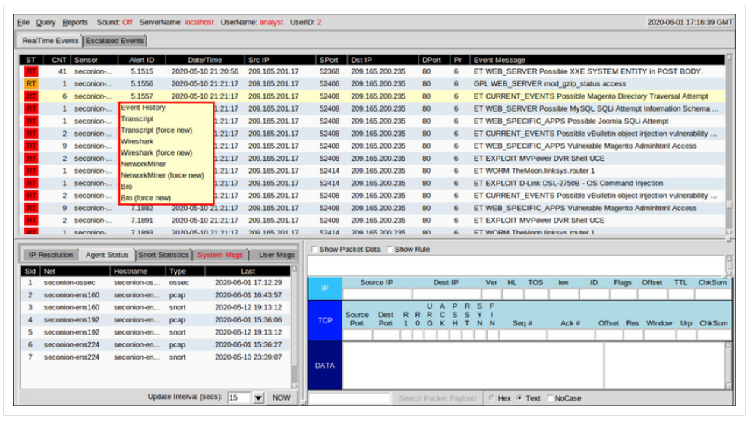
Lecture
Investigating Network Data
9
Pivoting from Sguil
Sguil provides the ability for the cybersecurity analyst to pivot to other information sources and tools.
Log files are available in Elasticsearch.
Relevant packet captures can be displayed in Wireshark.
Information Security Operations Center
Lecture 9
Dr. Ibrahim Gomaa

Slide 10
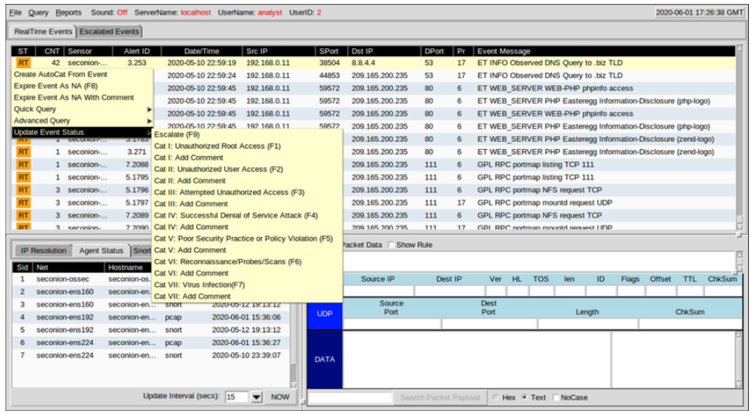
Lecture
Investigating Network Data
9
Event Handling in Sguil
  Sguil is a console that enables a cybersecurity analyst to investigate, verify, and classify security alerts.
  Three tasks can be completed in Squil to manage alerts:
      Alerts that have been found to be false positives can be expired.
      An event can be escalated by pressing the F9 key.
      An event can be categorized.
Sguil includes seven pre-built categories that can be assigned by using a menu or by pressing the corresponding function key.
Information Security Operations Center
Lecture 9
Dr. Ibrahim Gomaa

Slide 11
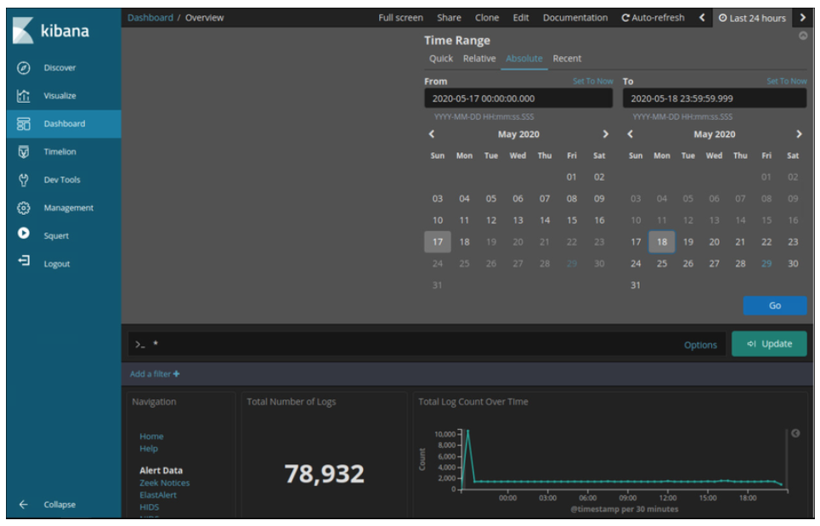
Lecture
Investigating Network Data
9
Working in ELK
  Logstash and Beats are used for data ingestion in the Elastic Stack.
  Kibana, which is the visual interface into the logs, is configured to show the last 24 hours by default.
  Logs are ingested into Elasticsearch into separate indices or databases based on a configured range of time.
  The best way to monitor the data in Elasticsearch is to build customized visual dashboards.
Information Security Operations Center
Lecture 9
Dr. Ibrahim Gomaa

Slide 12
Lecture
Investigating Network Data
9
Queries in ELK
  Elasticsearch is built on Apache Lucene, an open-source search engine software library featuring full text indexing and searching capabilities.
  Using Lucene software libraries, Elasticsearch has its own query language based on JSON called Query Domain Specific Language (QDSL).
  Along with JSON, Elasticsearch queries make use of elements such as Boolean operators, Fields, Ranges, Wildcards, Regex, Fuzzy Search, and Text Search.
  Elasticsearch was designed to interface with users using web-based clients that follow the HTTP REST framework.
  Methods used for executing the queries are URI, cURL, JSON and Dev Tools.
Information Security Operations Center
Lecture 9
Dr. Ibrahim Gomaa

Slide 13
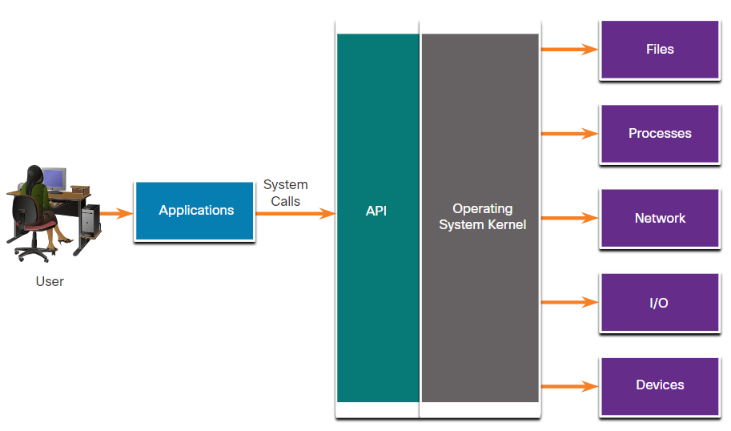
Lecture
Investigating Network Data
9
Investigating Process or API Calls
  Applications interact with an Operating System (OS) through system calls to the OS Application Programming Interface (API).
  If malware can fool an OS kernel into allowing it to make system calls, many exploits are possible.
  OSSEC rules detect changes in host-based parameters.
  OSSEC rules will trigger an alert in Sguil.
  Pivoting to Kibana on the host IP address allows you to choose the type of alert based on the program that created it.
Information Security Operations Center
Lecture 9
Dr. Ibrahim Gomaa

Slide 14
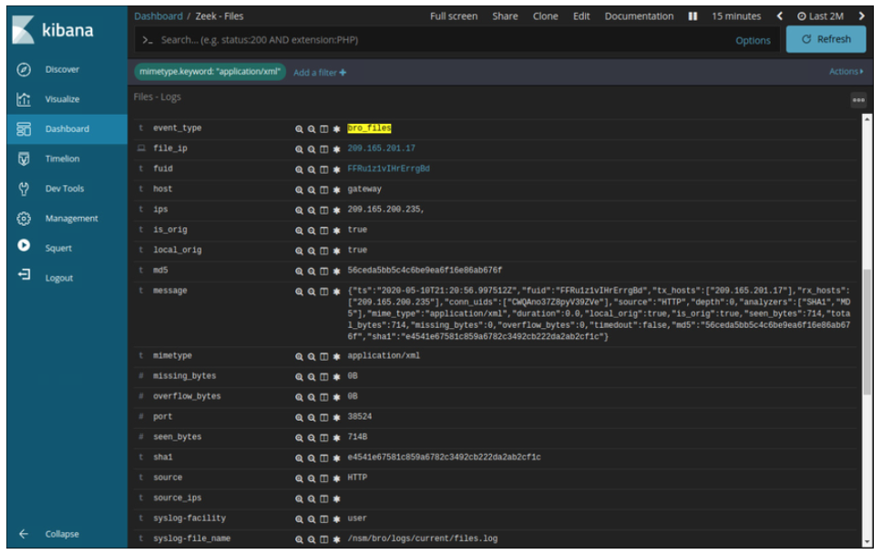
Lecture
Investigating Network Data
9
Investigating File Details
  In Sguil, if the cybersecurity analyst is suspicious of a file, the hash value can be submitted to an online site to determine if the file is a known malware.
  In Kibana, Zeek Hunting can be used to display information regarding the files that have entered the network.
  Note that in Kibana, the event type is shown as bro_files, even though the new name for Bro is Zeek.
Information Security Operations Center
Lecture 9
Dr. Ibrahim Gomaa

Slide 15
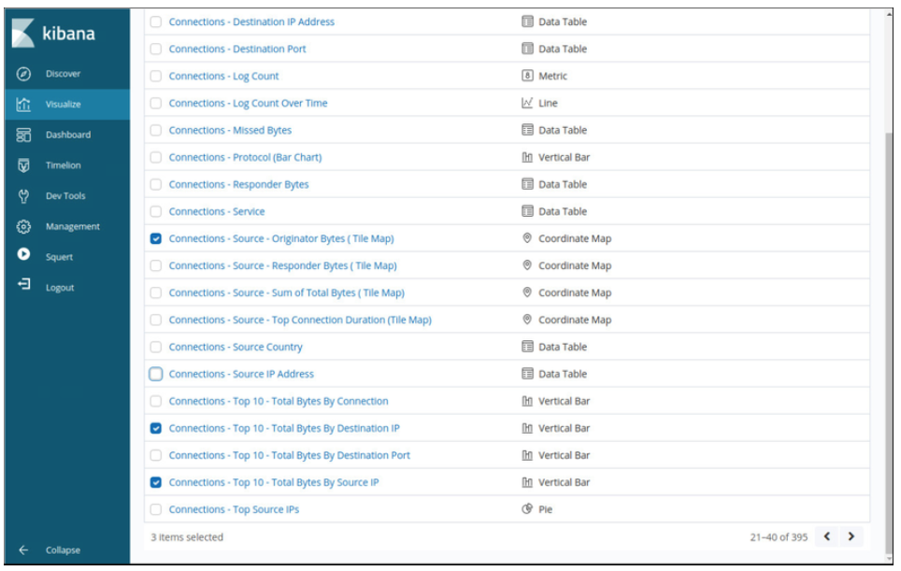
Lecture
Enhancing the Work of the Cybersecurity Analyst
9
Dashboards and Visualizations
Dashboards provide a combination of data and visualizations which allows cybersecurity analysts to focus on specific details and information.
Dashboards are usually interactive.
Kibana includes the capability of designing custom dashboards.
In addition, tools such as Squert in Security Onion provide a visual interface to NSM data.
Information Security Operations Center
Lecture 9
Dr. Ibrahim Gomaa

Slide 16
Lecture
Enhancing the Work of the Cybersecurity Analyst
9
Workflow Management
Workflows are the sequence of processes and procedures through which work tasks are completed.
  Managing the SOC workflows:
      Enhances the efficiency of the cyberoperations team
      Increases the accountability of the staff
      Ensures that all potential alerts are treated properly
Sguil provides a basic workflow management but not a good choice for large operations. There are third party systems available that can be customized.
Automated queries add efficiency to the cyberoperations workflow. These queries automatically search for complex security incidents that may evade other tools.
Information Security Operations Center
Lecture 9
Dr. Ibrahim Gomaa

Slide 17
Lecture
Enhancing the Work of the Cybersecurity Analyst
9
Activity: Isolate Compromised Host Using 5-Tuple
In this activity, you will complete the following objective:
Use Security Onion tools to investigate an exploit.
Information Security Operations Center
Lecture 9
Dr. Ibrahim Gomaa

Slide 18
Lecture
9
Thanks
Information Security Operations Center
Lecture 9
Dr. Ibrahim Gomaa

