Slide 1


Supply Chain Management
Prepared by Dr. Tarek Mohamed
MGM 660
Lecture 4

Slide 2


Designing distribution networks in the Supply Chain
Lecture 4
MGM 660
Prepared by
Dr. Tarek Mohamed

Slide 3

Course Agenda
Chapter
01
1- Identify the key factors to be considered when designing
a distribution network.
2- Discuss the strengths and weaknesses of various
distribution options.
3- Understand how e-business have affected the design of
distribution networks in different industries.
4- Understand the role of AI in designing distribution networks
in the Supply Chain

Slide 4
The Role of Distribution in the Supply Chain
Distribution – the steps taken to move and store a product from the supplier stage to the customer stage in a supply chain
Distribution- is a key driver of the overall profitability of a firm because it affects both the supply chain cost and the customer value directly
Choice of distribution network can achieve supply chain objectives from low cost to high responsiveness
In the apparel retail industry, for example, distribution affects about 35 percent of the revenue (including its influence on markdowns and lost sales).

Slide 5
The Role of Distribution in the Supply Chain
Until 2007, Dell distributed its PCs directly to end consumers, whereas companies such as HP distributed through resellers.
Dell customers waited several days to get a PC, whereas customers could walk away with an HP computer from a reseller.
Starting in June 2007, Dell also started selling its PCs through retailers such as Walmart.
IKEA Role of Distribution: Uses centralized warehouses and regional distribution centers. Employs flat-pack packaging to reduce transportation and storage costs. Supply Chain Benefit: Lower logistics costs and efficient inventory management.

Slide 6
The Role of Distribution in the Supply Chain
Amazon
Role of Distribution:
Uses a vast network of fulfillment centers and distribution hubs.
Ensures fast delivery, including same-day and next-day shipping.
Optimizes inventory placement close to customers.
Supply Chain Benefit:
Reduced delivery times and improved customer satisfaction.
Walmart
Role of Distribution:
Operates large regional distribution centers that supply retail stores.
Uses advanced logistics systems to replenish inventory efficiently.
Supply Chain Benefit:
Lower transportation costs and high product availability.

Slide 7
The Role of Distribution in the Supply Chain
Coca-Cola
Role of Distribution:
Uses bottling plants, warehouses, wholesalers, and retailers to distribute products worldwide.
Ensures beverages are available in supermarkets, restaurants, and convenience stores.
Supply Chain Benefit:
Wide market coverage and consistent product availability.
Apple
Role of Distribution:
Distributes products through online stores, retail stores, and authorized resellers.
Uses centralized warehouses and logistics partners for global distribution.
Supply Chain Benefit:
Efficient global product launches and inventory management

Slide 8
The Role of Distribution in the Supply Chain
FedEx
Role of Distribution:
Provides transportation and distribution services for businesses worldwide.
Uses hub-and-spoke distribution networks.
Supply Chain Benefit:
Fast and reliable delivery of goods.
DHL
Role of Distribution:
Manages warehousing, transportation, and international distribution.
Connects manufacturers with global markets.
Supply Chain Benefit:
Efficient cross-border movement of products.

Slide 9
Designing distribution networks in the Supply Chain
Designing Distribution Networks in the Supply Chain
Distribution network design is the process of determining how products move from manufacturers to customers in the most efficient and cost-effective way.
It involves deciding the number, location, and roles of facilities such as factories, warehouses, distribution centers, and retail outlets.
Objectives of Distribution Network Design
Minimize total supply chain costs.
Improve customer service levels.
Reduce delivery times.
Increase product availability.
Optimize inventory levels.

Slide 10
Factors influencing distribution network Design
Distribution network performance evaluated along two dimensions
  Customer needs that are met
  Cost of meeting customer needs
Evaluate the impact on customer service and cost for different distribution network options
Profitability of the delivery network is determined by revenue from meeting customer needs and network costs
Inbound transportation costs are costs incurred in bringing material into a facility
Outbound transportation costs are costs incurred in sending material out of a facility

Slide 11
Factors influencing distribution network design
Elements of customer service influenced by network structure:
Response time
Product variety
Product availability
Customer experience
Order visibility
Returnability

Slide 12
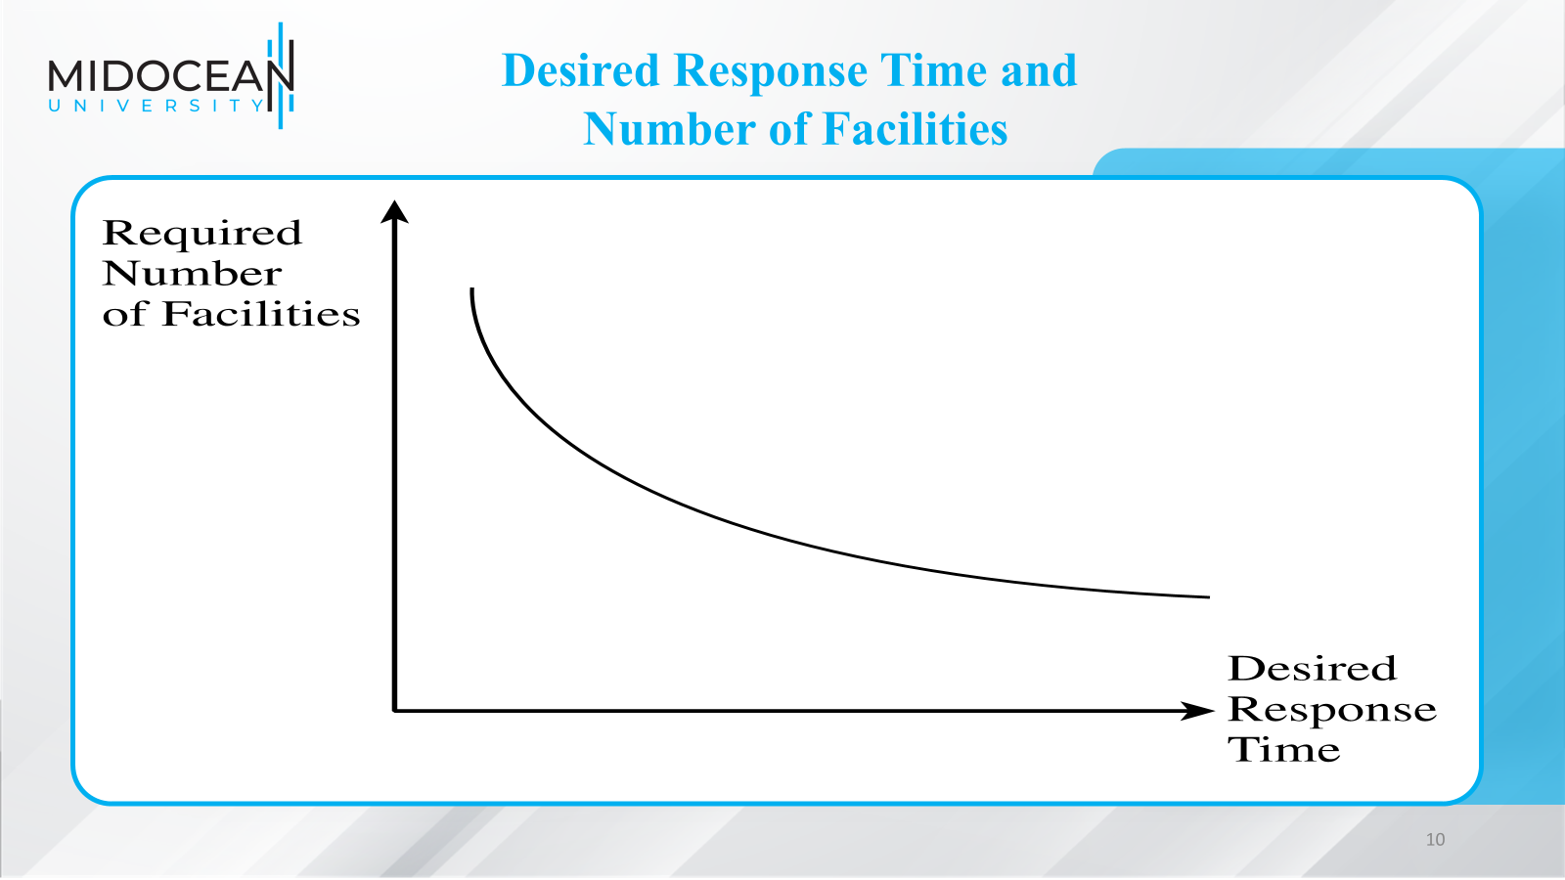

Slide 13
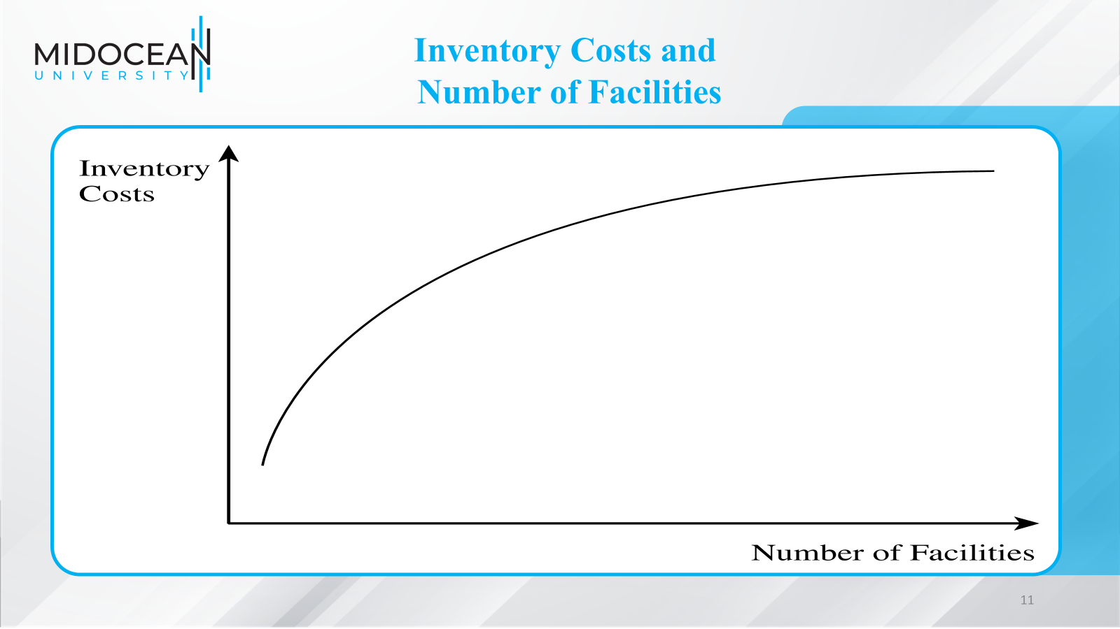

Slide 14
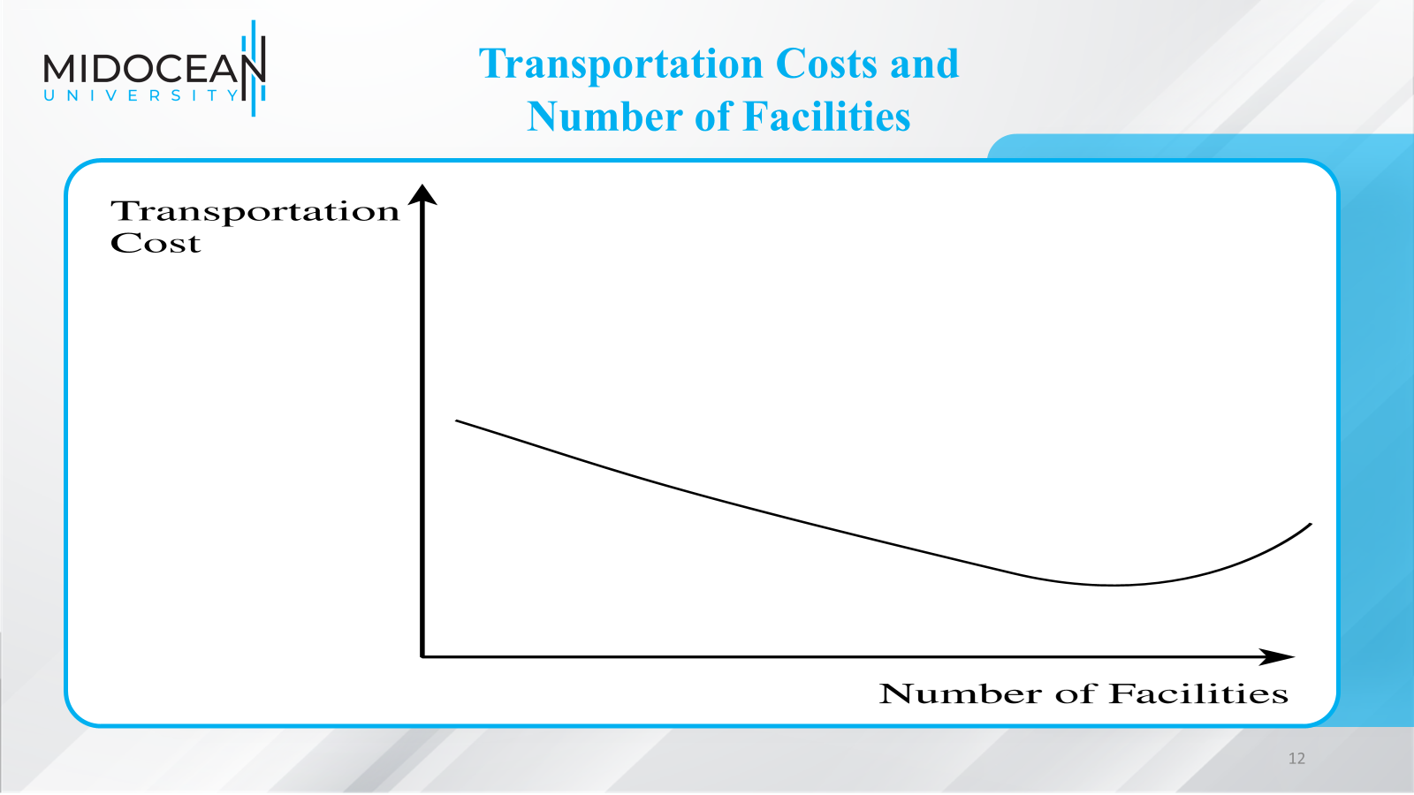

Slide 15
Factors Influencing
Distribution Network Design
Supply chain costs affected by network structure:
Inventories
Transportation
Facilities and handling
Information
The choice of the distribution network can be used to achieve supply chain objectives such as low cost and high responsiveness
Total logistics costs for a supply chain network are a sum of inventory, transportation, and facility costs

Slide 16
Design Options for a Distribution Network
Distribution network choices from the manufacturer to the end consumer
Two key decisions
Will product be delivered to the customer location or picked up from a prearranged site?
Will product flow through an intermediary (or intermediate location)?

Slide 17
Design Options for a Distribution Network
One of six designs may be used
Manufacturer storage with direct shipping
Manufacturer storage with direct shipping and in-transit merge
Distributor storage with carrier delivery
Distributor storage with last-mile delivery
Manufacturer/distributor storage with customer pickup
Retail storage with customer pickup

Slide 18
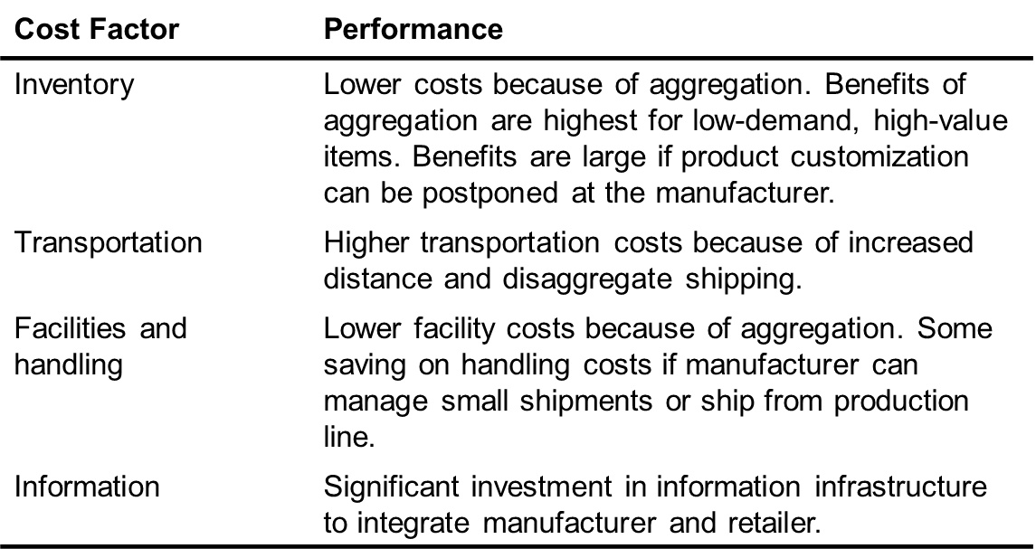
Manufacturer Storage with Direct Shipping Network

Slide 19
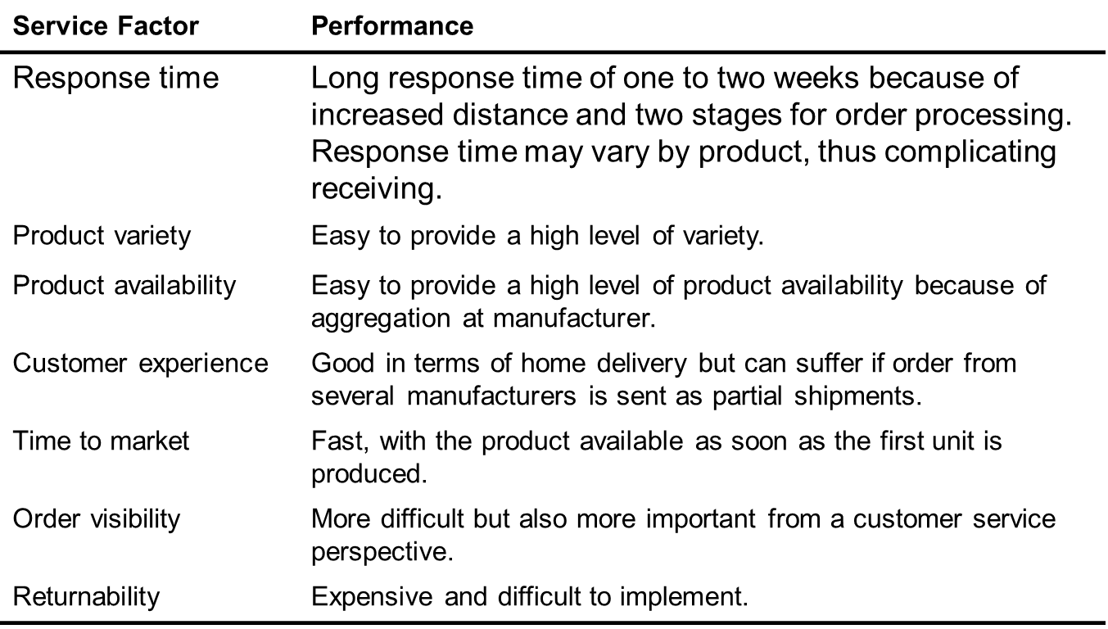
Manufacturer Storage with Direct Shipping Network

Slide 20
In-Transit Merge
Cost Factor | Performance
Inventory | Similar to drop-shipping.
Transportation | Somewhat lower transportation costs than drop-shipping.
Facilities and handling | Handling costs higher than drop-shipping at carrier; receiving costs lower at customer.
Information | Investment is somewhat higher than for drop-shipping.

Slide 21
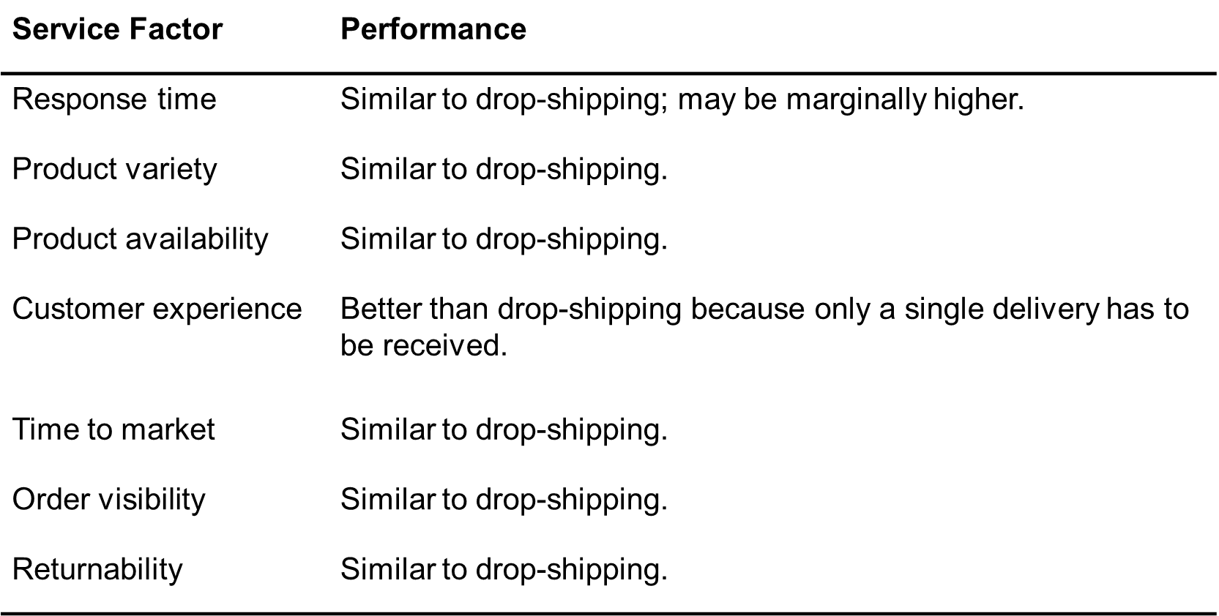
In-Transit Merge

Slide 22
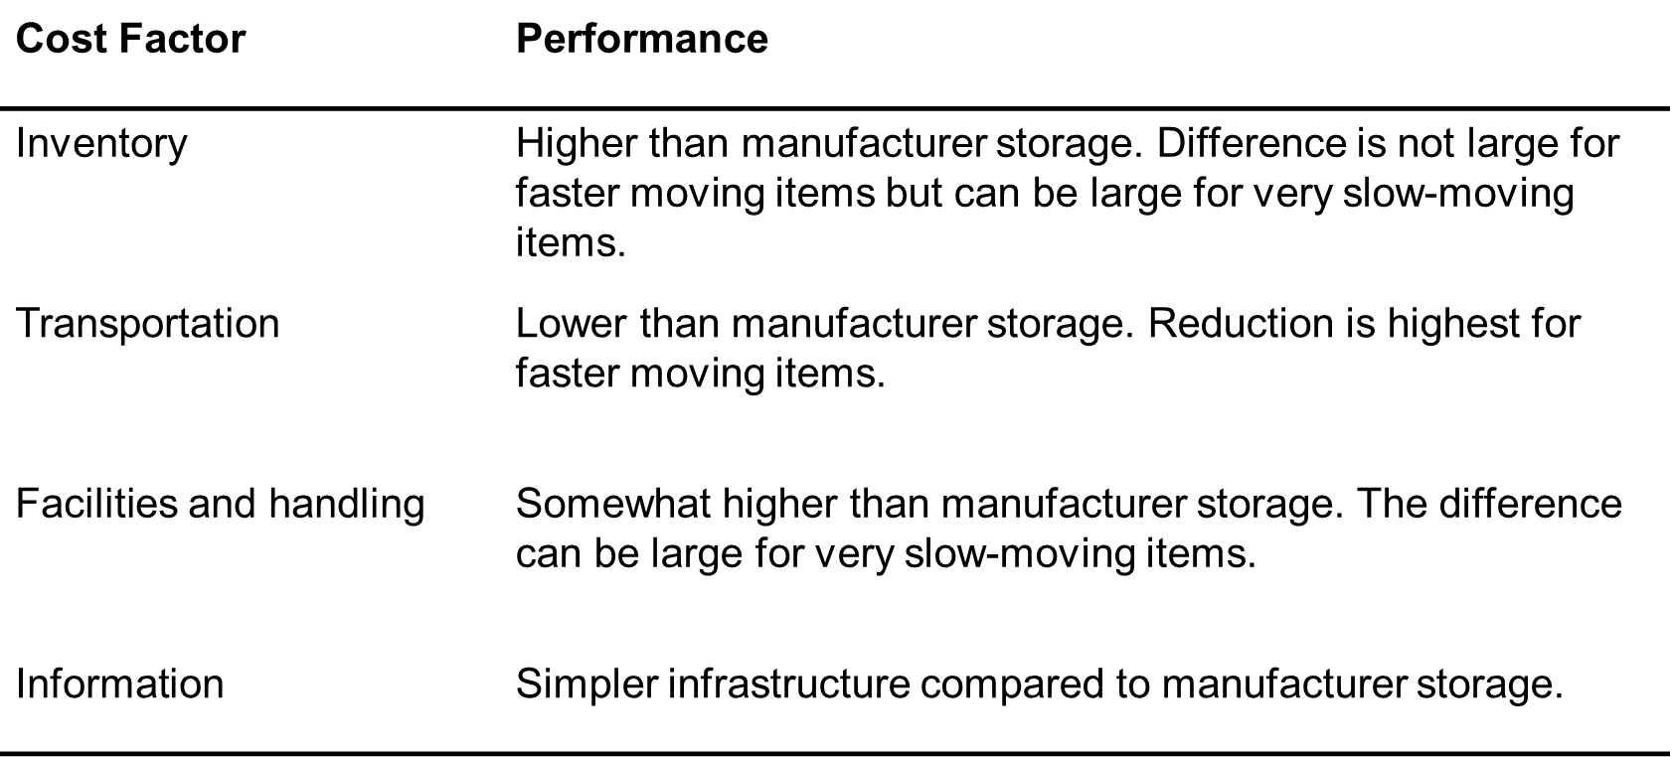
Distributor Storage with Carrier Delivery

Slide 23
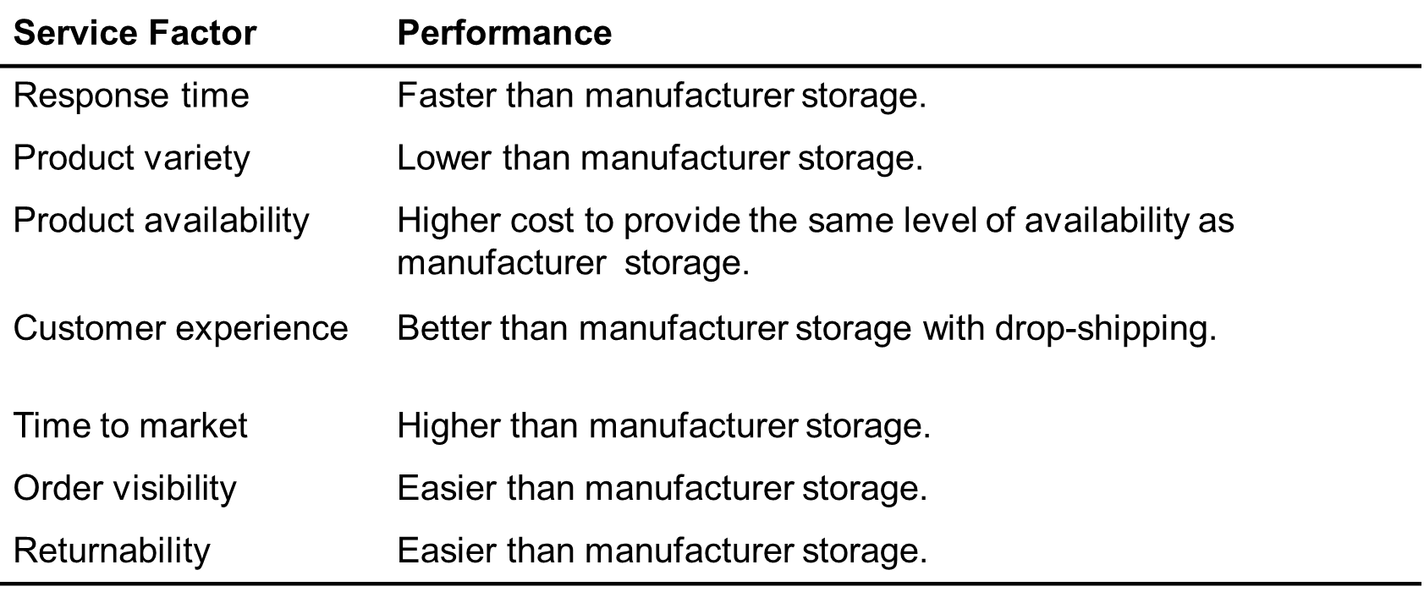
Distributor Storage with Carrier Delivery

Slide 24
Distributor Storage with Last Mile Delivery
Cost Factor | Performance
Inventory | Higher than distributor storage with package carrier delivery.
Transportation | Very high cost given minimal scale economies. Higher than any other distribution option.
Facilities and handling | Facility costs higher than manufacturer storage or distributor storage with package carrier delivery, but lower than a chain of retail stores.
Information | Similar to distributor storage with package carrier delivery.

Slide 25
Distributor Storage with Last Mile Delivery
Service Factor | Performance
Response time | Very quick. Same day to next-day delivery.
Product variety | Somewhat less than distributor storage with package carrier delivery but larger than retail stores.
Product availability | More expensive to provide availability than any other option except retail stores.
Customer experience | Very good, particularly for bulky items. Slightly higher than distributor storage with package carrier delivery.
Time to market | Less of an issue and easier to implement than manufacturer storage or distributor storage with package carrier delivery.
Order visibility | Easier to implement than other previous options.
Returnability | Harder and more expensive than a retail network.

Slide 26
Manufacturer or Distributor Storage with Customer Pickup
Manufacturer or Distributor Storage with Customer Pickup
Cost Factor | Performance
Inventory | Can match any other option, depending on the location of inventory.
Transportation | Lower than the use of package carriers, especially if using an existing delivery network.
Facilities and handling | Facility costs can be high if new facilities have to be built. Costs are lower if existing facilities are used. The increase in handling cost at the pickup site can be significant.
Information | Significant investment in infrastructure required.

Slide 27
Manufacturer or Distributor Storage with Customer Pickup
Service Factor | Performance
Response time | Similar to package carrier delivery with manufacturer or distributor storage. Same-day delivery possible for items stored locally at pickup site.
Product variety | Similar to other manufacturer or distributor storage options.
Product availability | Similar to other manufacturer or distributor storage options.
Customer experience | Lower than other options because of the lack of home delivery. Experience is sensitive to capability of pickup location.
Time to market | Similar to manufacturer storage options.
Order visibility | Difficult but essential.
Returnability | Somewhat easier given that pickup location can handle returns.

Slide 28
Retail Storage with Customer Pickup
Cost Factor | Performance
Inventory | Higher than all other options.
Transportation | Lower than all other options.
Facilities and handling | Higher than other options. The increase in handling cost at the pickup site can be significant for online and phone orders.
Information | Some investment in infrastructure required for online and phone orders.

Slide 29
Retail Storage with Customer Pickup
Service Factor | Performance
Response time | Same-day (immediate) pickup possible for items stored locally at pickup site.
Product variety | Lower than all other options.
Product availability | More expensive to provide than all other options.
Customer experience | Related to whether shopping is viewed as a positive or negative experience by customer.
Time to market | Highest among distribution options.
Order visibility | Trivial for in-store orders. Difficult, but essential, for online and phone orders.
Returnability | Easier than other options because retail store can provide a substitute.

Slide 30
Impact of Online Sales on Customer Service
Response time to customers
  Physical products take longer to fulfill than retail store
  No delay for information goods
Product variety
  Easier to offer larger selection
Product availability
  Aggregating inventory and better information on customer preferences improves product availability

Slide 31
Impact of Online Sales on Customer Service
Customer experience
  Improved access, customization, and convenience
Faster time to market
Order Visibility
Returnability
  Harder with online orders
  Proportion of returns likely to be much higher

Slide 32
Impact of Online Sales on Customer Service
Direct Sales to Customers
  Social networking channels allow firms to directly pitch products and promotion
Flexible Pricing, Product Portfolio, and Promotions
  Manage revenues from product portfolio more effectively than traditional channels
  Promotion information can be conveyed to customers quickly and inexpensively
Efficient Funds Transfer

Slide 33
Impact of Online Sales on Cost
Inventory
  Lower inventory levels if customers will wait
  Postpone variety until after the customer order is received
Facilities
  Costs related to the number and location of facilities in a network
  Costs associated with the operations in these facilities
Transportation
  Lower cost of “transporting” information goods in digital form
  For nondigital, aggregating inventories increases outbound transportation
Information
  Share demand, planning, and forecasting information throughout its supply chain
  Additional costs to build and maintain the information infrastructure

Slide 34
Using Online Sales to Sell Computer Hardware: Dell
Impact of online sales on customer service
Delay in fulfilling customer request
Impact of online sales on cost
Reduced inventory costs
Lower facility costs
Higher total transportation costs
Incremental increase in information costs

Slide 35
Using Online Sales to Sell Computer Hardware: Dell
A tailored supply chain network to sell computer hardware for Dell includes :
A hybrid model can be very effective
More significant as hardware becomes more of a commodity
Take advantage of the strengths of both online sales and traditional retail and distribution channels

Slide 36
Using Online Sales to Sell Books: Amazon
Impact of online sales on customer service
  Internet has not shortened supply chains
  Increased selection, convenience
Impact of online sales on cost
  Reduced inventory costs
  Lower facility costs
  Higher total transportation costs
  Increase in information costs
A supply chain network for books
  Traditional bookstores pressured from both ends
  Amazon more efficient

Slide 37
Using the Internet to Sell Groceries: Peapod
Impact of online sales on customer service
  Sell convenience and the time savings
  Offers less variety
  Creating a personalized shopping experience and customized advertising and promotions
Impact of online sales on cost
  Reduced inventory costs
  Higher facility costs due to picking operation
  Significantly higher total transportation costs
  Increase in information costs

Slide 38
The Role of AI in Designing Distribution Networks
in the Supply Chain
Artificial Intelligence (AI) helps companies design and optimize distribution networks by analyzing large amounts of data, predicting demand, and recommending the most efficient locations, inventory levels, and transportation routes.
Key Roles of AI in Distribution Network Design
Demand Forecasting
AI analyzes historical sales, market trends, weather patterns, and customer behavior to predict future demand.
Benefits:
More accurate forecasts
Reduced stockouts and excess inventory
Better warehouse location decisions

Slide 39
The Role of AI in Designing Distribution Networks
in the Supply Chain
Warehouse and Distribution Center Location Optimization
AI evaluates factors such as customer locations, transportation costs, labor availability, and delivery times to determine the best locations for warehouses and distribution centers.
Benefits:
Lower logistics costs
Faster deliveries
Improved customer service
Route Optimization
AI identifies the most efficient transportation routes by considering traffic, fuel costs, weather conditions, and delivery schedules.
Benefits:
Reduced transportation costs
Shorter delivery times
Lower fuel consumption

Slide 40
The Role of AI in Designing Distribution Networks
in the Supply Chain
Inventory Optimization
AI determines how much inventory should be stored at each warehouse or distribution center.
Benefits:
Lower inventory holding costs
Higher product availability
Improved supply chain efficiency
Risk Management
AI can identify potential disruptions such as supplier delays, natural disasters, or transportation bottlenecks.
Benefits:
Better contingency planning
Increased supply chain resilience
Reduced operational risks

Slide 41
Real-World Examples
Amazon
Uses AI to forecast demand and position inventory in fulfillment centers close to customers.
Optimizes warehouse operations and delivery routes.
Walmart
Uses AI for demand forecasting and inventory optimization across its distribution network.
Improves product availability while reducing costs.
DHL
Uses AI-powered analytics to optimize transportation routes and warehouse operations.
Enhances delivery speed and operational efficiency.
UPS
Uses AI-based route optimization systems to reduce travel distance and fuel consumption.
Improves delivery performance and sustainability.

Slide 42
Distribution Networks in Practice
The ownership structure of the distribution network can have as big as an impact as the type of distribution network
It is important to have adaptable distribution networks
Product price, commoditization, and criticality affect the type of distribution system preferred by customers
Integrate the Internet with the existing physical network
Consider whether an exclusive distribution strategy is advantageous

Slide 43
Summary of Learning Objectives
Chapter
01
1- Identify the key factors to be considered when designing
a distribution network.
2- Discuss the strengths and weaknesses of various
distribution options.
3- Understand how e-business have affected the design of
distribution networks in different industries.
4- Understand the role of AI in designing distribution networks
in the Supply Chain

Slide 44
Essential Reference
Chopra, S., & Meindl, P. (2016). Global Edition. Pearson Education Limited Chapter 4.
Lysons, K., & Farrington, B. (2020). Procurement and supply chain management. Pearson UK.
Morris, P. W., & Pinto, J. K. (Eds.). (2007). The Wiley guide to project technology, supply chain, and procurement management (Vol. 4). John Wiley & Sons.
Schwalbe, K. (2015). Information technology project management. Cengage Learning.
Supply Chain Council

Slide 45

Thank You

