Slide 1


Job seeking process 1
Chapter 5
Business Champions
School
CMM201
Communication skills

Slide 2
Section two
Applying Résumés
Lecture
Section one
Exploring
Researching

Slide 3
THINK WITH ME
Are we always sure of what we want, or we live in UNCERTAINTY?
This uncertainty makes selecting a major in college a daunting task for many students.
The uncertainty remains as you face the plethora of career choices.
This uncertainty makes you feel lost about owing your business or working for a company

Slide 4
THINK WITH ME
Are we always sure of what we want, or we live in UNCERTAINTY?
This uncertainty makes you confused about what company should you work with
This uncertainty makes you worry about leaving the country or staying home
This uncertainty makes you wonder whether you want to work for business or charity! If so, would you prefer to work with children, women, the elderly, diabetics, burn victims, or cancer patients?

Slide 5
Influencer
Business owner
Family business
Charity seeker
The choices are many.

Slide 6
The Job-Seeking Process
What is the job-seeking process?
Seeking a job is a multifaceted process that is part research, part performance, and part roller-coaster ride.
The job-seeking process involves six stages
Exploring,
Interviewing,
Researching,
Following up,
Applying,
Negotiating,

Slide 7
Section one

Slide 8
Exploring

Slide 9
Stage One: Exploring
The exploring stage begins with you, the job seeker. During this stage, you will need to explore both yourself and potential careers.
Self-Exploration
Career-Exploration

Slide 10
Stage One: Exploring
Self-Exploration
It means to know yourself!
Take time to explore your goals and priorities.
Here are just a few questions you should consider:
What are you best at?
What do you enjoy doing the most?
What motivates you?
What salary range do you need to live the lifestyle you desire?
Is a family-friendly career a priority for you?
Would you prefer to work in a large or small organization?

Slide 11
Stage One: Exploring
Self-Exploration
It means to know yourself!
A list of what you do not like in your life& yourself
A list of what you want to be or have
An action plan

Slide 12
Stage One: Exploring
Career-Exploration
Career exploration requires you to:
Research opportunities in your major that correspond with your goals and priorities.
Do some investigating.
Interview several people in that line of work and find out what the job involves.
Ask questions that will help you determine if this career lines up with your goals and priorities.
Try shadowing someone in the field for a week or two.
Seek an internship that will allow you to develop a clearer understanding of this career choice.

Slide 13
Researching

Slide 14
Stage Two: Researching
The researching stage of the job-seeking process comprises two components:
Researching openings
Researching potential employers

Slide 15
Stage Two: Researching
Researching openings
Did you face disappointment when your dream job requires 5 years of experience that you do not have?
So become aware of the steps or experiences you will need to get to your dream job, and begin working your way up the ladder.

Slide 16
Stage Two: Researching
Researching openings
Mistakes you might make when researching for a job
Not Utilizing Career Guidance Resources
Most colleges have career guidance offices with beneficial resources for the students. It is advisable that you seek help from such offices because they have dedicated professionals who are ready to guide you through your career challenges.

Slide 17
Stage Two: Researching
Researching openings
Mistakes you might make when researching for a job
Not searching in the right places
Most graduates research for jobs in the yellow websites (non-real websites) because they have a lack experiences in searching right and well.
So, Begin by asking help from:
Career planning centers or career services, career placements, career development, or career consulting.
Job fairs

Slide 18
Stage Two: Researching
Researching openings
Mistakes you might make when researching for a job
So, Begin by asking help from:
The classified/help-wanted ads in the newspaper
The Internet has become an excellent tool for locating employment opportunities.
Multiple websites are dedicated to matching employees to jobs.
Word of mouth. Tell everyone you know that you are job searching, making certain to be specific about the kind of job you are looking for.
Professional associations. Almost every industry has a professional association that sponsors meetings and conferences. Joining the local, regional, or even national chapter of a professional association will greatly enhance your ability to network with other professionals who may be looking to hire.

Slide 19
Stage Two: Researching
Researching openings
Mistakes you might make when researching for a job
Not understanding the market value
Every graduate should research and assess their market value in order to fit in the marketplace. It is advisable that you understand the data before attending any single interview. You can consider learning new skill sets that will put your market value at a higher rate.

Slide 20
Stage Two: Researching
Researching openings
Mistakes you might make when researching for a job
Not preparing for Job interview
Many graduates make the mistake of not preparing well enough for their job interviews. It is critical to ensure that you are well-prepared and that you have researched everything you need to know about the employer.

Slide 21
Stage Two: Researching
Researching potential employers
At this point, it should be clear that job searching is time-consuming. Therefore, you do not want to waste valuable time and energy on positions and organizations that do not fit your desires, goals, and priorities.
Think about this stage of the job-seeking process as job researching, not job searching. You are not simply searching for vacant positions. You are researching positions and companies to find the right fit between your skills and desires and their needs and opportunities.

Slide 22
Stage Two: Researching
Researching potential employers
Before applying, take a few moments to research the position and the company. This research not only will help you determine if you truly wish to apply for this position with this organization but also will help you down the line when you customize your résumé and prepare for your interview.
Remember, excelling as a communicator means you must be audience centered. You can’t be audience centered if you do not know your audience. Where do you find information on potential employers?

Slide 23
Stage Two: Researching
Researching potential employers
Begin by researching their websites, but remember that the purpose of company websites is to make the organization look appealing, so you do not want to end your research there.
Interview anyone who works for the organization in question or has a similar type of position with a different organization for insights.
Other sources of information that may be helpful include the Chamber of Commerce, Better Business Bureau reports, the College Placement Annual, Public libraries and career centers have valuable information about employers, including companies’ annual reports to shareholders, reports kept by local chambers of commerce, trade journals, and business indexes.

Slide 24
Section Two

Slide 25
Applying Résumés

Slide 26
Stage Three: Applying Résumés
Once you have researched a place you would like to consider for employment, it is time to turn your attention to résumés and cover letters.
Characteristics of good Résumé
Highlighting your skill set.
Shows how you fit this position and this organization and highlights the skills you possess relevant to the skills required by the position for which you are applying.
Select a format that will highlight your strengths and downplay your weaknesses.
Customize your résumé to each position and organization.
Should be no more than two pages and must be visually appealing.

Slide 27
Stage Three: Applying Résumés
Types Résumé
Chronological
This is the most common form and probably the easiest to prepare.
The chronological résumé emphasizes employment and/or experience history, listing elements in reverse chronological order (i.e., your most recent experience first).
This format is especially useful to new graduates or those with limited work experience.

Slide 28
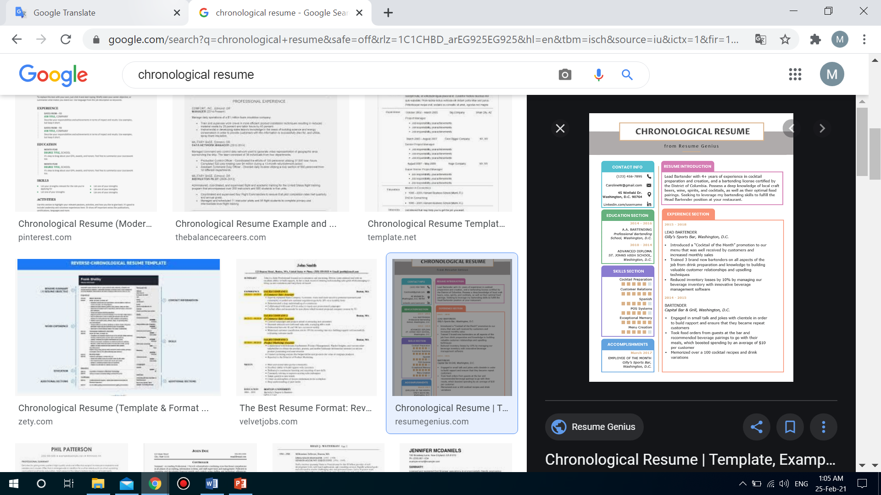
Stage Three: Applying Résumés
Chronological

Slide 29
Stage Three: Applying Résumés
Types Résumé
Functional (skill-based)
This functional résumé emphasizes skills and attributes that can be applied to a variety of employment situations.
Your skills are broken down into categories that quickly communicate to employers what you can do for them.
This format is useful for candidates without direct employment-related experience or for those who wish to work in fields unrelated to their academic major.

Slide 30
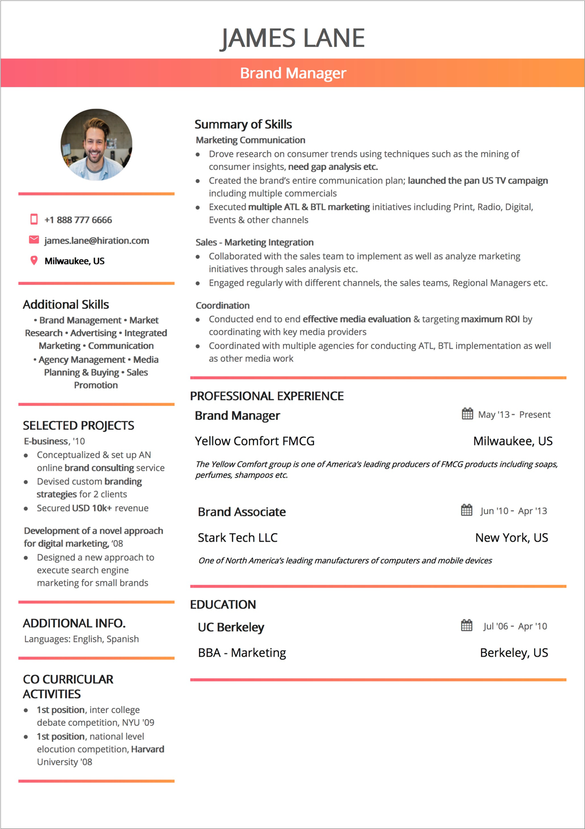
Stage Three: Applying Résumés
Functional (skill-based)

Slide 31
Stage Three: Applying Résumés
Types Résumé
Combination
For many candidates, a combination of elements from the chronological and functional résumé formats works best.

Slide 32
Stage Three: Applying Résumés
Sections of Résumé
Contact information
Begin your generic résumé by listing your contact information.
You should include your name, address, phone number, and e-mail address.
You should make certain the address you provide will be valid throughout your job search. Believe it or not, many prospective job seekers are taken out of the running due to problems with their contact information.

Slide 33
Stage Three: Applying Résumés
Sections of Résumé
Contact information
An e-mail address such as “partygirl2010” is going to land your résumé in the trash. Addresses like these are unprofessional as well.
Choose an e-mail address related to your name, and be certain to check your e-mail account regularly.
It’s also important to make sure there is nothing in cyberspace that you would not want your future employer to see. What comes up when you “Google” your name? What information can be found on your Facebook and Instagram accounts? If you think prospective employers don’t bother to check these sites, you’re wrong. Not only do employers use Google and Yahoo to run background checks on potential employees; they also check Facebook, Twitter, and other forms of social media.

Slide 34
Stage Three: Applying Résumés
Sections of Résumé
Objective and summary
An objective is a one- or two-sentence declarative statement about your career goals.
The benefit of including an objective is debatable. Some people argue it can be beneficial and has been a résumé standard for years.
Others argue that since the objective is clear (to obtain the position), there is no need to waste space stating the obvious. Many résumés have moved away from the objective to a summary of skills and traits.

Slide 35
Stage Three: Applying Résumés
Sections of Résumé
Objective and summary
Example 1:
Highly motivated individual and a certified digital marketer with strong SEO and SEM skills, attention to detail, and a solid online marketing background looking to obtain a position of SEO Specialist with XYZ company.
Example 2:
An MBA with specialization in online marketing, working knowledge of Google Analytics and Adwords, and 4 years experience in developing and managing marketing campaigns seek the role of Online Marketing Manager with ABC Inc. to provide thought leadership and implement best practices for digital marketing.

Slide 36
Stage Three: Applying Résumés
Sections of Résumé
Education
If you’re a recent college graduate, your education is, in all likelihood, the most important thing you want future employers to consider, So your education section should be displayed prominently.
Include the name of any college or university from which you have graduated or that you are currently attending.
Don’t list high school education or high school accomplishments.
List the name of your degree and your major (e.g., bachelor of science in biology).

Slide 37
Stage Three: Applying Résumés
Sections of Résumé
Education
You may also wish to state a minor if you have one. Include the date of graduation.
You may also wish to list some relevant courses. For the purposes of the generic résumé, list all the courses you think may be relevant during your job-seeking process.
If your GPA is a 3.0 or higher, include it.
You can narrow the list during the customizing step.

Slide 38
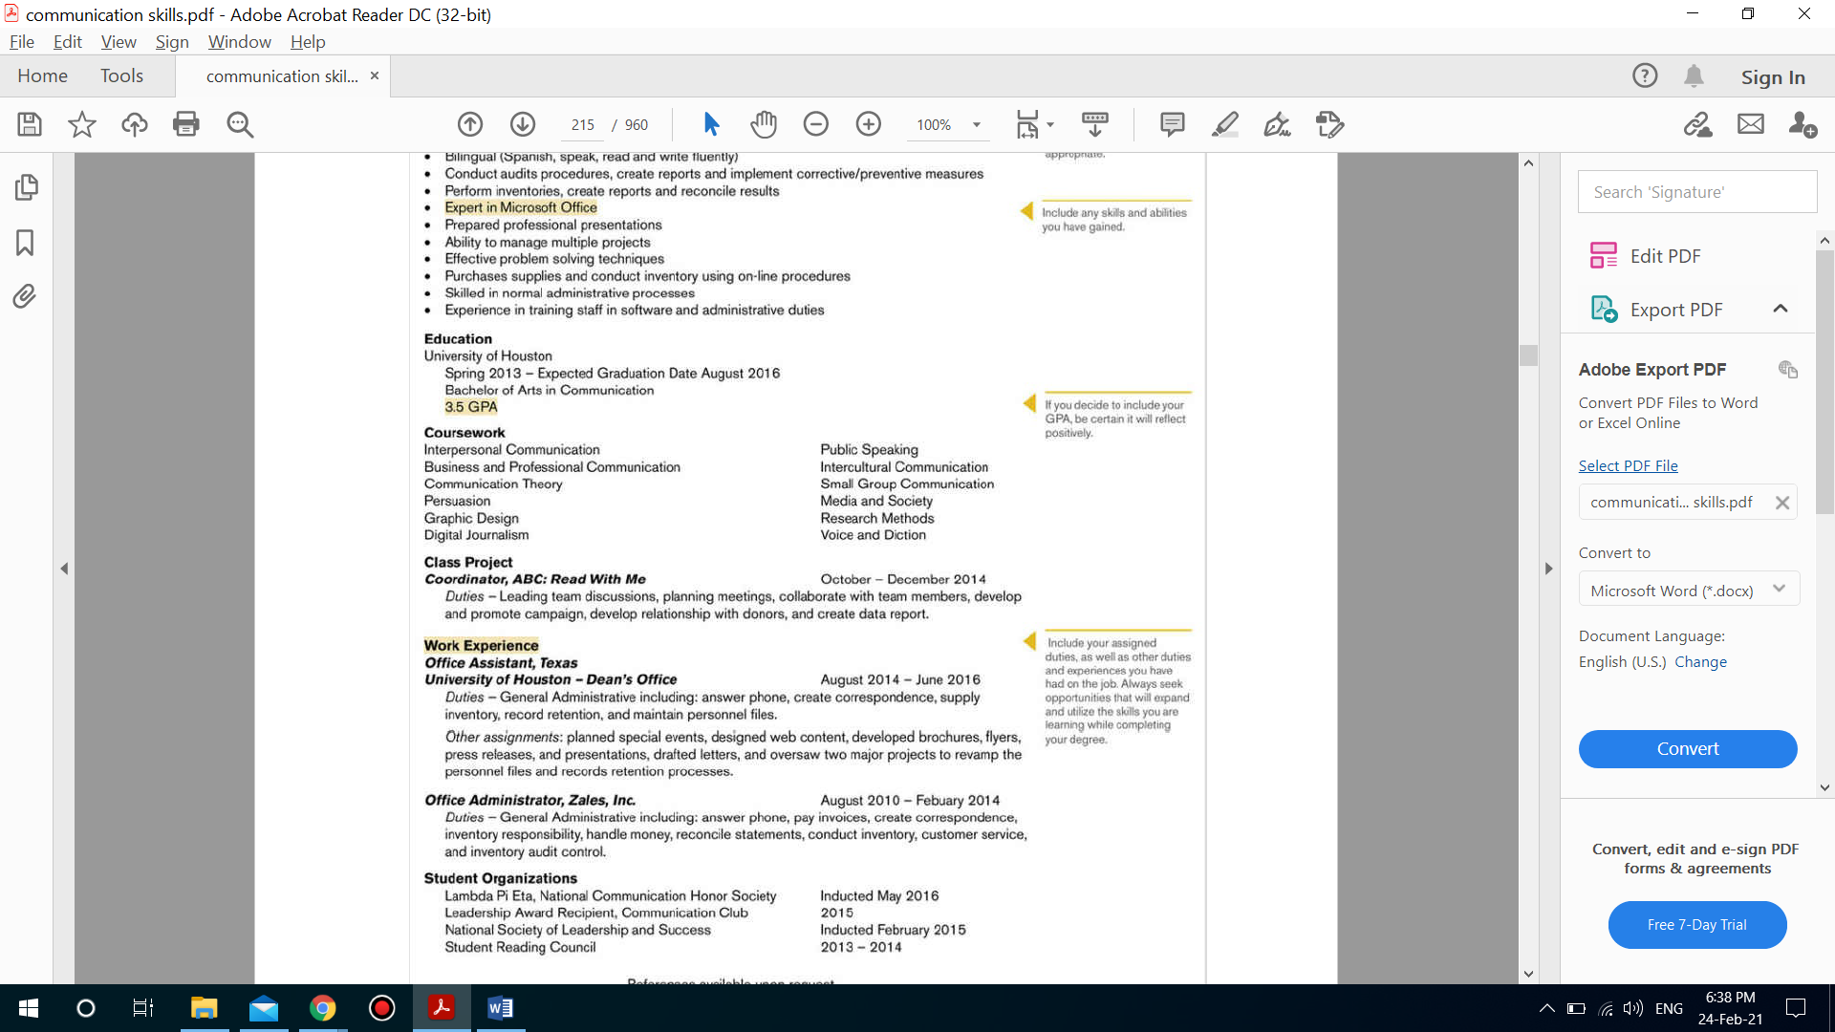
Stage Three: Applying Résumés
Sections of Résumé
Education

Slide 39
Stage Three: Applying Résumés
Sections of Résumé
Experience
A section on experience is a standard part of the résumé.
As you advance in your career, you will most likely label this section as employment experience, which will take precedence over your education.
Yet, for most college graduates, including relevant experience, not just employment experience, is more beneficial. Using the general title “Relevant Experience” allows you to incorporate a broader range of information.

Slide 40
Stage Three: Applying Résumés
Sections of Résumé
Experience
In this section, you can list the following:
Relevant employment history
Relevant class projects
Internships
Relevant work
Volunteering
Example 1:
you may be applying for a job that requires leadership and grant-writing experience. During college, you worked as a waitress, but you were also the president of two student organizations, and as part of an English course, you wrote a grant for the local food bank, which was funded.

Slide 41
Stage Three: Applying Résumés
Sections of Résumé
Skills
Hard skills,
are those of your skills that you’ve acquired through deliberate effort. They can be learned, taught, and measured. Examples of hard skills include English, Spanish, HTML, copywriting, data analysis, SEO, SEM, and others.
Soft skills,
on the other hand, are closely tied to one’s personality traits. They arise from your previous experiences and the environment you grew up in. These could be your leadership, communication, or other interpersonal skills. Examples of soft skills include: problem-solving, negotiating, multitasking, time management, presenting, and others.

Slide 42
Stage Three: Applying Résumés
Sections of Résumé
Skills, that should NOT include
Skills you DON’T have.
Skills that have nothing to do with the job.
Skills everybody should have.

Slide 43
Stage Three: Applying Résumés
Sections of Résumé
Employment Experience
If you’ve been lucky enough to work at a job that’s relevant to the position you’re seeking, prominently display that experience and your job duties. For most college graduates, however, this will not be the case.
Let’s look at a few possible scenarios. In the first scenario, your work history is by and large unrelated to the career you are pursuing.
in this situation, list the class projects, your internship, and your work with the Sociology Club under “Relevant Experience,” as previously discussed. Give some details about each experience
Then you can simply list your places of employment, job titles, and employment dates later in the résumé in a section titled “Employment Experience,” “Employment History,” or “Work History.”

Slide 44
Stage Three: Applying Résumés
Sections of Résumé
Employment Experience
If your work history is not directly related to the position you are pursuing, list the place of employment, job title, employment dates, and some skills you acquired at this job. Even if the job is not directly related to your career, you likely gained or honed some skill(s) that will make you a more appealing applicant.
Example 1:
if you worked as a waiter, you have developed your customer service skills, worked both independently and as part of a team, handled difficult situations with professionalism, and demonstrated the ability to multitask.

Slide 45
Stage Three: Applying Résumés
Sections of Résumé
Awards
Include an awards and honors section only if you have multiple listings and they are relevant to the position.
If you have Academic awards and honors.
Hobbies
As for hobbies, do not put a hobbies and interests section in your résumé. If you do have a hobby or interest directly relevant to the position, work it into your résumé as a skill or experience. Otherwise, leave it out.

Slide 46
Stage Three: Applying Résumés
Sections of Résumé
References
References should not be listed on your résumé. You can make a note about references at the bottom of the page (e.g., “References available on request”)

Slide 47
Stage Three: Applying Résumés
Customizing Résumé
When customizing your résumé, the goal is to include information about yourself that addresses every qualification noted in the job posting without exceeding the one- two page limit.
Review your audience
The research you have done on the organization will give you some insight into the organization’s mission and values. In addition, the job posting will tell you exactly what they are looking for in terms of this position.

Slide 48
Stage Three: Applying Résumés
How to Customize your Résumé
Begin with the generic résumé you have already developed.
Identifying the information that is most relevant to this position.
During the first round of cuts, delete all the information that is not relevant to the position.
If the remaining information does not fit on two pages, go back and eliminate the information that is least relevant to the position.

Slide 49
Stage Three: Applying Résumés
Creating visual Appeal
Although résumés can come in a variety of different forms, all résumés should be visually appealing and utilize a parallel structure.
In terms of visual appeal, you need to include:
A balance between text and white space. Too much white space indicates a lack of qualifications. On the flip side, too much information jammed on a page does not make you look more qualified. Instead, it makes your résumé difficult to read, which makes you less appealing.
Remember, a résumé is a snapshot. You can’t include every detail of your life, so make sure to include the information that is most relevant to this position at this organization.

Slide 50
Stage Three: Applying Résumés
Creating visual Appeal
In terms of visual appeal, you need to include:
The font you select for the text of the résumé should be 12 point—no less than 11 point if you need more space—for easy reading.
When selecting a font, you want to stick with standard fonts such as Arial, Helvetica, and Times New Roman to ensure easy electronic transfer.
As for parallel structure, decide on a heading system, and keep it consistent throughout the résumé. If your first major heading is bold, 14 point, and all capitals, then all major headings should be bold, 14 point, and all capitals.

Slide 51
Stage Three: Applying Résumés
Creating visual Appeal
In terms of visual appeal, you need to include:
The use of a parallel structure can also be applied to your word choices. For example, when listing your duties/work experience, use active verbs. In addition, you may utilize a list of bulleted duties/skills.
Whichever format you select, remember to use that format throughout that section of the résumé.
It’s also critical to edit résumés, applications, and cover letters carefully.
Make it a habit to check, double-check, and triple-check.
Spelling errors seem to jump off the page at potential employers. If you want to be considered for an interview, your résumé can contain no spelling errors.

Slide 52
Stage Three: Applying Résumés
Creating visual Appeal
Example 1:
When discussing a former job or experience, use past tense; when discussing a current job or experience, use present tense. Once your résumé and cover letter are complete, you should laser print them onto 8½- by 11-inch bond paper, also known as résumé paper.

Slide 53
Stage Three: Applying Résumés
Developing Electronic and Scannable Résumés and Online
Applications Back in the day, résumés and cover letters were either mailed or hand-delivered to organizations. Today, organizations are requesting that résumés be submitted electronically or that the information traditionally found in a résumé be submitted via an online application.
When it comes to submitting electronic or scannable résumés, you must take into your consecration the following:
Electronic résumés should be prepared in common programs, such as Microsoft Word.
Scannable résumés should be simplistic; so avoid any decorative fonts or graphics.
For electronic applications, you’ll most likely be cutting information from your résumé and pasting it into the application. the information presented should still be concise and relevant.

Slide 54
Stage Three: Applying Résumés
Developing Cover Letter
The goal of the cover letter is to get prospective employers to look at your résumé,
The goal of a résumé is to get the prospective employer to ask you on an interview,
and the goal of the interview is to get you the job.
Why cover letters are important?
Cover letters accompany your résumé and serve to introduce you as a potential employee, highlight your résumé, and demonstrate your writing skills.

Slide 55
Stage Three: Applying Résumés
Steps to write Cover Letter
Begin the cover letter by stating
Your name
Your phone number
Your email address
The date
The name of the hiring manager and their professional title
The name and address of the company to which you’re applying
The specific position you are interested in (state the exact position title).

Slide 56
Stage Three: Applying Résumés
Steps to write Cover Letter
In the next paragraph or two, highlight why you are qualified for this position, making specific reference to the required skills and qualifications noted in the job posting.
End the letter by expressing your desire to discuss your qualifications further during an interview.
Like the résumé, your cover letter should be concise, no more than one page. Use the same paper and font for both your résumé and your cover letter.

Slide 57
Stage Three: Applying Résumés
Examples of Cover Letter
Dear Ms. Smith,
I am interested in the author's assistant position at Acme Company, as advertised on LinkedIn. I am currently employed as legislative director for Assemblywoman Nora Kiel, Chairperson of the NYS Assembly. I believe that the skills and experiences I have gained at this position make me an ideal candidate for the job of author’s assistant.
As legislative director, I have developed strong writing and editing skills. For example, one of my main duties is to prepare Assemblywoman Nora Kiel’s personal legislation, which deals with issues related to her position as Senior Member of the NYS Assembly Standing Committee.
This duty requires meticulous writing and editing skills, and an ability to convey complex legal ideas clearly. I have prepared dozens of pieces of legislation and received praise for the clarity of my writing.
I have also gained extensive experience in legal and policy research – fields that you state the author’s assistant must be familiar with.

Slide 58
Stage Three: Applying Résumés
Examples of Cover Letter
My experience in the NYS Assembly has afforded me the opportunity to become familiar with the consolidated and unconsolidated laws of the State of New York. In particular, through my work with Assemblywoman Nora Kiel, I have become heavily involved in the current welfare and Medicaid reform movement. I am always eager to learn more about state legislation, reading up on these topics on my own time to become more knowledgeable. I would love to bring this passion for policy and law to your company.
I am confident that my experience in the Legislature and my research and writing skills qualify me for consideration. If you would like, I can provide you with current samples of my work. I have also enclosed my resume. I look forward to meeting with you and discussing my qualifications in more detail.
Sincerely,
Joseph Q. Applicant (signature hard copy letter)
Joseph Q. Applicant

Slide 59
THANK YOU

