Slide 1



Data Analysis
Lecture 10
HCIA-Security
Prepared by
Dr. Abdelrhman Ahmed

Slide 2
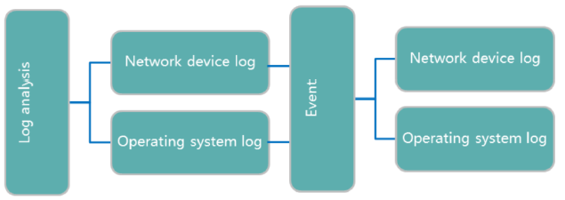
Chapter
10
Log Analysis
• The primary method to locate attackers is to extract and analyze the "traces" of perpetrators in computer systems.
• Important network events are recorded in logs. Analyzing logs plays a vital role in cracking down on network crimes.

Slide 3
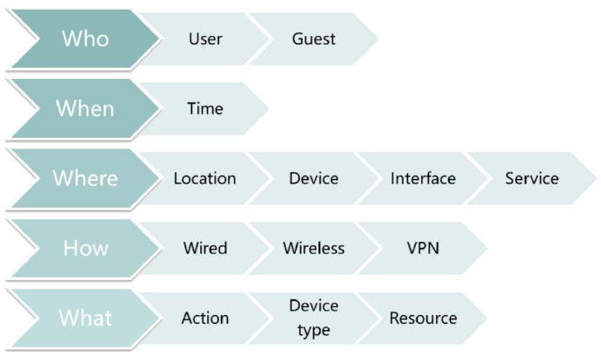
Chapter
10
Key Log Analysis Points

Slide 4
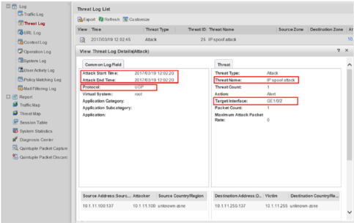
Chapter
10
Analysis of Network Device Logs
This example uses the firewall to describe how to analyze attacks based on logs.
Click Threat Log in the navigation sidebar. As shown in the figure, information about an IP spoofing attack, including the attack time, protocol used, and target interface, is displayed.

Slide 5
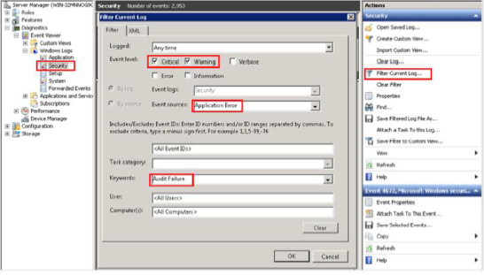
Chapter
10
Analysis of Operating System Logs
Logs record all events of the operating system. It is vital to quickly identify key information from a large amount data. In the Windows operating system, you can filter key events as required.

Slide 6
Chapter
10
Analysis of Login and Logout Events
• Application scenarios:
□ Identifying users who have logged in to the operating system.
□ Analyzing how the operating system is used.
• Event ID:
□ 4624-Login success (security log)
□ 4625 - Login failure (security log)
□ 4634- Logout success (security log)
□ 4672 - Login as an administrator (security log)

Slide 7
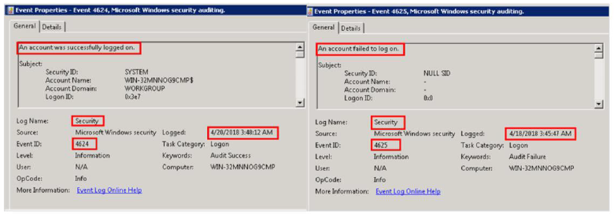
Chapter
10
Login Success & Failure Events
• The following figure displays the security log information regarding login success and login failure.

Slide 8
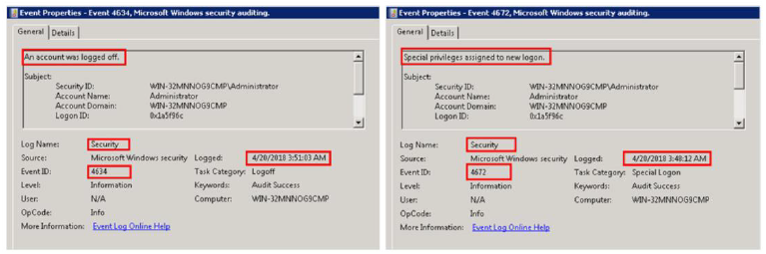
Chapter
10
Logout & Privileged Login Events
• The following figure displays the security log information regarding logout and privileged login.

Slide 9
Chapter
10
Analysis of System Time Change Events
• Application scenario:
□ Collecting evidence proving that a user has changed the system time.
• Event ID:
□ 1 - Kernel-General (system log)
□ 4616 - Change system time (security log)

Slide 10
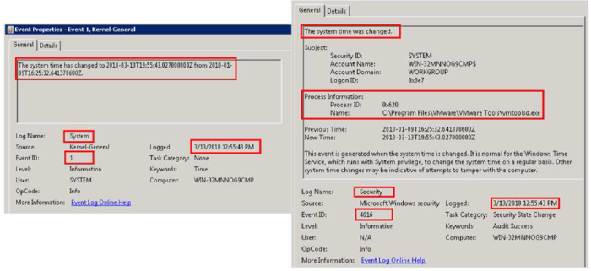
Chapter
10
Logs About System Time Change Events
• The following figures show the system log and security log for system time change events.

Slide 11
Chapter
10
Analysis of External Device Use Events
• Application scenario:
□ Analyzing the time when hardware devices are installed in the system.
• Event ID:
□ 20001/20003- Plug-and-play drive installation (system log)

Slide 12
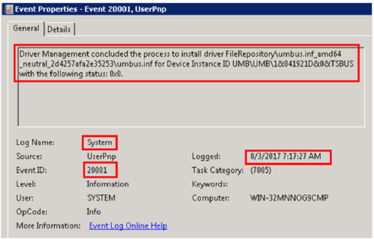
Chapter
10
Logs About External Device Use Events
• The following figure shows the system log's record of the external drive installation event.

Slide 13
Chapter
10
Log Analysis Tools
• Log Parser is a high-performance and easy-to-use log analysis tool developed by Microsoft. It can analyze text log files, Extensible Markup Language (XML) files, comma separated values (CSV) files, event logs, registries, file systems, and Active Directory of the operating system.
• To use Log Parser, you must be skilled in SQL language.
• Log Parser Lizard is a GUI and saves users from remembering complicated commands. Users can obtain the analysis results by setting the basic SQL statements.

Slide 14
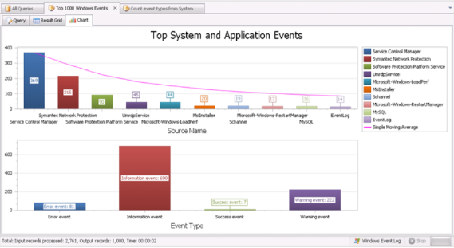
Chapter
10
Use of Log Parser Lizard (1)
• The following figure shows the Top 1000 Windows Events results filtered by Log Parser Lizard.

Slide 15
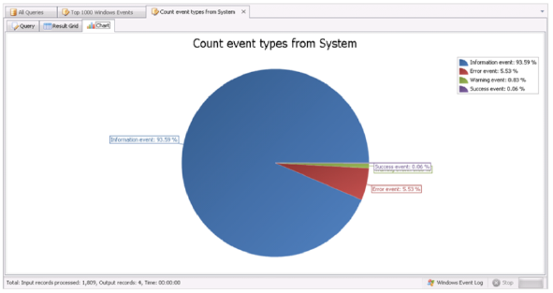
Chapter
10
Use of Log Parser Lizard (2)
• The following figure shows the Count event types from System results filtered by Log Parser Lizard.

Slide 16



Thank You

