Slide 1


Foundations of Project
Management
PMG 101
Estimating Time and Cost
Lecture 10

Slide 2

Learning Outcomes
Factors Influencing the Quality of Estimates.
Estimating Guidelines for Times, Costs, and Resources.
Top-Down versus Bottom-Up Estimating.
Methods for Estimating Project Times and Costs .

Slide 3
Why Estimating Time and Cost Is Important?
• Estimates are needed to support good decisions.
• Estimates are needed to schedule work.
• Estimates are needed to determine how long the project should take and its cost.
• Estimates are needed to determine whether the project is worth doing.
• Estimates are needed to develop cash flow needs.
• Estimates are needed to determine how well the project is progressing.
• Estimates are needed to develop time-phased budgets and establish the project baseline.

Slide 4
Understand estimating project times and costs are the foundation for project planning and control
Estimating is the process of forecasting or approximating the time and cost of completing project deliverables.
Estimating processes are frequently classified as:
Top-down : Top-down estimates are usually done by senior management. Management will often derive estimates from analogy, group consensus, or mathematical relationships.
Bottom-up: Bottom-up estimates are typically performed by the people who are doing the work. Their estimates are based on estimates of elements found in the work breakdown structure.

Slide 5
Understand estimating project times and costs are the foundation for project planning and control
All project stakeholders prefer accurate cost and time estimates, but they also understand the inherent uncertainty in all projects. Inaccurate estimates lead to false expectations and consumer dissatisfaction. Accuracy is improved with greater effort but is it worth the time and cost?—estimating costs money! Project estimating becomes a trade-off, balancing the benefits of better accuracy against the costs for securing increased accuracy
Cost, time, and budget estimates are the lifeline for control; they serve as the standard for comparison of actual and plan throughout the life of the project. Project status reports depend on reliable estimates as the major input for measuring variances and taking corrective action. Ideally, the project manager, and in most cases the project owner, would prefer to have a database of detailed schedule and cost estimates for every work package in the project. Regrettably, such detailed data gathering is not always possible or practical and other methods are used to develop project estimates.

Slide 6
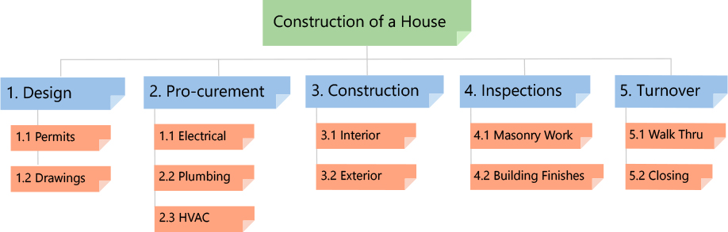
What Is a Work Package in Project Management?
A work package is a group of related tasks within a project. Because they look like projects themselves, they are often thought of as sub-projects within a larger project. Work packages are the smallest unit of work that a project can be broken down into when creating your Work Breakdown Structure (WBS). Tasks are typically grouped into work packages based on geographical area, engineering discipline, technology, or the time needed to accomplish them.

Slide 7


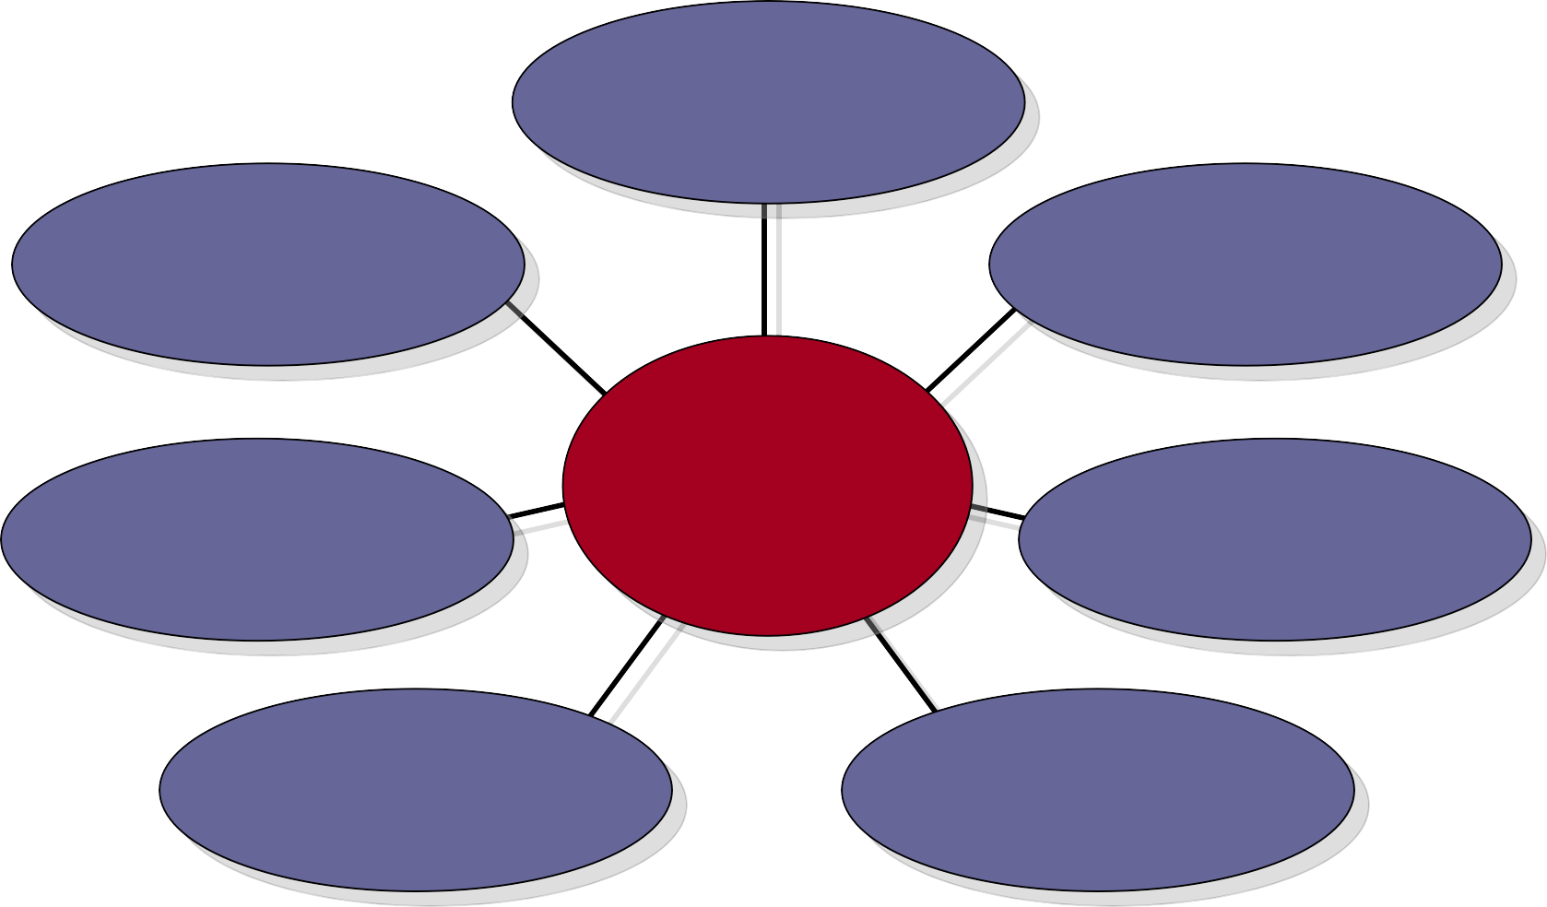
Factors Influencing the Quality of Estimates
Planning Horizon
Other (Nonproject) Factors
Project Duration
Quality of Estimates
Organization Culture
People
Padding Estimates
Project Structure and Organization

Slide 8
Factors Influencing the Quality of Estimates
A typical statement in the field is the desire to “have a 95 percent probability of meeting time and cost estimates.” Experience is a good starting point for developing time and cost estimates. But experience estimates must almost always be refined by other considerations to reach the 95 percent probability level. Factors related to the uniqueness of the project will have a strong influence on the accuracy of estimates. Project, people, and external factors all need to be considered to improve quality of estimates for project times and costs.
1. Planning Horizon
The quality of the estimate depends on the planning horizon; estimates of current events are close to 100 percent accurate but are reduced for more distant events.
For example, cost estimates for a party you are organizing this weekend should be much more accurate than the estimates for a party that will take place in six months. The accuracy of time and cost estimates should improve as you move from the conceptual phase to the point where individual work packages are defined. Long-duration projects increase the uncertainty in estimates.

Slide 9
Factors Influencing the Quality of Estimates
2. Project Duration
Time to implement new technology has a habit of expanding in an increasing, nonlinear fashion. Sometimes poorly written scope specifications for new technology result in errors in estimating times and costs
3. People
The people factor can influence the quality of time and cost estimates. For example, accuracy of estimates depends on the skills of the people making the estimates. How familiar are they with the task they are estimating?
4. Project Structure and Organization
Which project structure is chosen to manage the project will influence time and cost estimates. One of the major advantages of a dedicated project team is the speed gained from concentrated focus and localized project decisions. This speed comes at an additional cost of tying up personnel full time. Conversely, projects operating in a matrix environment may reduce costs by more efficiently sharing personnel across projects but may take longer to complete since attention is divided and coordination demands are higher.

Slide 10
Factors Influencing the Quality of Estimates
5. Padding Estimates
In some cases, people are inclined to pad estimates. For example, if you are asked how long it takes you to drive to the airport, you might give an average time of 30 minutes, assuming a 50/50 chance of getting there in 30 minutes. If you are asked the fastest you could possibly get there, you might reduce the driving time to 20 minutes. Finally, if you are asked how long the drive would take if you absolutely had to be there to meet with the president, it is likely you would increase the estimate to say 50 minutes to ensure not being late.
In work situations where you are asked for time and cost estimates, most of us are inclined to add a little padding to increase the probability and reduce the risk of being late. If everyone at all levels of the project adds a little padding to reduce risk, the project duration and cost are seriously overstated. This phenomenon causes some managers or owners to call for a 10–15 percent cut in time and/or cost for the project. Of course, the next time the game is played, the person estimating cost and/or time will pad the estimate to 20 percent or more. Clearly such games defeat chances for realistic estimates, which is what is needed to be competitive

Slide 11
Factors Influencing the Quality of Estimates
6. Organization Culture
Organization culture can significantly influence project estimates. In some organizations padding estimates is tolerated and even privately encouraged. Other organizations place a premium on accuracy and strongly discourage estimating gamesmanship. Organizations vary in the importance they attach to estimates. The prevailing belief in some organizations is that detailed estimating takes too much time and is not worth the effort or that it’s impossible to predict the future. Other organizations subscribe to the belief that accurate estimates are the bedrock of effective project management. Organization culture shapes every dimension of project management; estimating is not immune to this influence.
7. Other Factors
Finally, non project factors can impact time and cost estimates. For example, equipment down-time can alter time estimates. National holidays, vacations, and legal limits can influence project estimates. Project priority can influence resource assignment and impact time and cost.

Slide 12
Estimating Guidelines for Times, Costs, and Resources
Managers recognize time, cost, and resource estimates must be accurate if project planning, scheduling, and controlling are to be effective. However, there is substantial evidence suggesting poor estimates are a major contributor to projects that have failed. Therefore, every effort should be made to see that initial estimates are as accurate as possible since the choice of no estimates leaves a great deal to luck and is not palatable to serious project managers. Even though a project has never been done before, a manager can follow seven guidelines to develop useful work package estimates.
  Responsibility.
At the work package level, estimates should be made by the person(s) most familiar with the task. Draw on their expertise! Except for super technical tasks, those responsible for getting the job done on schedule and within budget are usually first-line supervisors or technicians who are experienced and familiar with the type of work involved. These people will not have some preconceived, imposed duration for a deliverable in mind. They will give an estimate based on experience and best judgment. If those involved are not consulted, it will be difficult to hold them responsible for failure to achieve the estimated time. Finally, drawing on the expertise of team members who will be responsible helps to build communication channels early.

Slide 13
Estimating Guidelines for Times, Costs, and Resources
2. Use several people to estimate.
It is well known that a cost or time estimate usually has a better chance of being reasonable and realistic when several people with relevant experience and/or knowledge of the task are used (sometimes called “crowdsourcing” التعهيد الجماعي). True, people bring different biases based on their experience. But discussion of the individual differences in their estimate leads to consensus and tends to eliminate extreme estimate errors.

Slide 14
Estimating Guidelines for Times, Costs, and Resources
3. Normal conditions.
When task time, cost, and resource estimates are determined, they are based on certain assumptions. Estimates should be based on normal conditions, efficient methods, and a normal level of resources. Normal conditions are sometimes difficult to discern, but it is necessary to have a consensus in the organization as to what normal conditions mean in this project. If the normal workday is eight hours, the time estimate should be based on an eight-hour day. Similarly, if the normal workday is two shifts, the time estimate should be based on a two-shift workday. Any time estimate should reflect efficient methods for the resources normally available. The time estimate should represent the normal level of resources— people or equipment. For example, if three programmers are available for coding or two road graders are available for road construction, time and cost estimates should be based on these normal levels of resources unless it is anticipated the project will change what is currently viewed as “normal.”

Slide 15
Estimating Guidelines for Times, Costs, and Resources
4.Time units.
Specific time units to use should be selected early in the development phase of the project network. All task time estimates need consistent time units. Estimates of time must consider whether normal time is represented by calendar days, workdays, workweeks, person days, single shift, hours, minutes, etc. In practice the use of workdays is the dominant choice for expressing task duration. However, in projects such as a heart transplant operation, minutes probably would be more appropriate as a time unit. One such project that used minutes as the time unit was the movement of patients from an old hospital to an elegant new one across town. Since there were several life-endangering moves, minutes were used to ensure patient safety so proper emergency life-support systems would be available if needed. The point is, network analysis requires a standard unit of time. When computer programs allow more than one option, some notation should be made of any
variance from the standard unit of time. If the standard unit of time is a five-day workweek and the estimated activity duration is in calendar days, it must be converted to the normal workweek.

Slide 16
Estimating Guidelines for Times, Costs, and Resources
5.Independence.
Estimators should treat each task as independent of other tasks that might be integrated by the WBS. Use of first-line managers usually results in considering tasks independently; this is good. Top managers are prone to aggregate many tasks into one time estimate and then deductively make the individual task time estimates add to the total. If tasks are in a chain and performed by the same group or department, it is best not to ask for all the time estimates in the sequence at once to avoid the tendency for a planner or a supervisor to look at the whole path and try to adjust individual task times in the sequence to meet an arbitrary imposed schedule or some rough “guesstimate” of the total time for the whole path or segment of the project. This tendency does not reflect the uncertainties of individual activities and generally results in optimistic task time estimates. In summary, each task time estimate should be considered independently of other activities

Slide 17
Estimating Guidelines for Times, Costs, and Resources
6. Contingencies.
Work package estimates should not include allowances for contingencies. The estimate should assume normal or average conditions even though every work package will not materialize as planned. For this reason, top management needs to create an extra fund for contingencies that can be used to cover unforeseen events.
7. Adding risk assessment
Adding risk assessment to the estimate helps to avoid surprises to stakeholders. It is obvious some tasks carry more time and cost risks than others. For example, a new technology usually carries more time and cost risks than a proven process. Simply identifying the degree of risk lets stakeholders consider alternative methods and alter process decisions. A simple breakdown by optimistic, most likely, and pessimistic for task time could provide valuable information regarding time and cost.

Slide 18
Top-Down versus Bottom-Up Estimating
Since estimating efforts cost money, the time and detail devoted to estimating are important decisions. Yet, when estimating is considered, you as a project manager may hear statements such as these:
Rough order of magnitude is good enough. Spending time on detailed estimating wastes money.
Time is everything; our survival depends on getting there first! Time and cost accuracy is not an issue.
The project is internal. We don’t need to worry about cost.
The project is so small, we don’t need to bother with estimates. Just do it.

Slide 19
Top-Down versus Bottom-Up Estimating
However, there are sound reasons for using top-down or bottom-up estimates. Table 5.1 depicts conditions that suggest when one approach is preferred over another. Top-down estimates usually are derived from someone who uses experience and/ or information to determine the project duration and total cost. However, these estimates are sometimes made by top managers who have very little knowledge of the component activities used to complete the project. For example, a mayor of a major city making a speech noted that a new law building would be constructed at a cost of $23 million and would be ready for occupancy in two and one-half years. Although the mayor probably asked for an estimate from someone, the estimate could have come from a luncheon meeting with a local contractor who wrote an estimate (guesstimate) on a napkin. This is an extreme example, but in a relative sense this scenario is frequently played out in practice. The question actually is, do these estimates represent low cost, efficient methods? Seldom. The fact that the estimate came from the top can influence people responsible to “do what it takes to make the estimate.”

Slide 20
Top-Down versus Bottom-Up Estimating

Slide 21
Top-Down versus Bottom-Up Estimating
If possible and practical, you want to push the estimating process down to the work package level for bottom-up estimates that establish low-cost, efficient methods. This process can take place after the project has been defined in detail. Good sense suggests project estimates should come from the people most knowledgeable about the estimate needed. The use of several people with relevant experience with the task can improve the time and cost estimate. The bottom-up approach at the work package level can serve as a check on cost elements in the WBS by rolling up the work packages and associated cost accounts to major deliverables. Similarly, resource requirements can be checked. Later, the time, resource, and cost estimates from the work packages can be consolidated into time-phased networks, resource schedules, and budgets that are used for control.

Slide 22
Top-Down versus Bottom-Up Estimating
The bottom-up approach also provides the customer with an opportunity to compare the low-cost, efficient method approach with any imposed restrictions. For example, if the project completion duration is imposed at two years and your bottom-up analysis tells you the project will take two and one-half years, the client can now consider the trade-off of the low-cost method versus compressing the project to two years—or in rare cases canceling the project.
Similar trade-offs can be compared for different levels of resources or increases in technical performance. The assumption is any movement away from the low-cost, efficient method will increase costs—e.g., overtime. The preferred approach in defining the project is to make rough top-down estimates, develop the WBS/OBS, make bottom-up estimates, develop schedules and budgets, and reconcile differences between top- down and bottom-up estimates. Hopefully, these steps will be done before final negotiation with either an internal or external customer. In conclusion, the ideal approach is for the project manager to allow enough time for both the top-down and bottom-up estimates to be worked out so a complete plan based on reliable estimates can be offered to the customer. In this way false expectations are minimized for all stakeholders and negotiation is reduced.

Slide 23
Methods for Estimating Project Times and Costs
Top-Down Approaches for Estimating Project Times and Costs
At the strategic level top-down estimating methods are used to evaluate the project proposal. Sometimes much of the information needed to derive accurate time and cost estimates is not available in the initial phase of the project—for example, design is not finalized. In these situations top-down estimates are used until the tasks in the WBS are clearly defined.
1. Consensus Methods
This method simply uses the pooled experience of senior and/or middle managers to estimate the total project duration and cost. This typically involves a meeting where experts discuss, argue, and ultimately reach a decision as to their best guess estimate. Firms seeking greater rigor will use the Delphi Method to make these macro estimates.
The Delphi method is a process used to arrive at a group opinion or decision by surveying a panel of experts. Experts respond to several rounds of questionnaires, and the responses are aggregated and shared with the group after each round.

Slide 24
2. Ratio Methods
Top-down methods (sometimes called parametric) usually use ratios to estimate project times or costs. Top-down approaches are often used in the concept or “need” phase of a project to get an initial duration and cost estimate for the project. For example, contractors frequently use number of square feet to estimate the cost and time to build a house; that is, a house of 2,700 square feet might cost $160 per square foot (2,700 feet 3 $160 per foot equals $432,000). Likewise, knowing the square feet and dollars per square foot, experience suggests it should take approximately 100 days to complete. Two other common examples of top-down cost estimates are the cost for a new plant estimated by capacity size, or a software product estimated by features and complexity.

Slide 25
3. Apportion Methods طريقة التقسيم
This method is an extension to the ratio method. Apportionment is used when projects closely follow past projects in features and costs. Given good historical data, estimates can be made quickly with little effort and reasonable accuracy. This method is very common in projects that are relatively standard but have some small variation or customization.
Anyone who has borrowed money from a bank to build a house has been exposed to this process. Given an estimated total cost for the house, banks and the FHA (Federal Housing Authority) authorize pay to the contractor by completion of specific segments of the house. For example, foundation might represent 3 percent of the total loan, framing 25 percent, electric, plumbing and heating 15 percent, etc. Payments are made as these items are completed. An analogous process is used by some companies that apportion costs to deliverables in the WBS—given average cost percentages from past projects. Figure 5.1 presents an example similar to one found in practice. Assuming the total project cost is estimated, using a top-down estimate, to be $500,000, the costs are apportioned as a percentage of the total cost. For example, the costs apportioned to the “Document” deliverable are 5 percent of the total, or $25,000. The sub deliverables “Doc-1 and Doc-2” are allocated 2 and 3 percent of the total—$10,000 and $15,000, respectively.

Slide 27
Bottom-Up Approaches for Estimating Project Times and Costs
1. Template Methods
If the project is similar to past projects, the costs from past projects can be used as a starting point for the new project. Differences in the new project can be noted and past times and costs adjusted to reflect these differences. For example, a ship repair drydock firm has a set of standard repair projects (i.e., templates for over- haul قوالب للإصلاح الشامل , electrical, mechanical) that are used as starting points for estimating the cost and duration of any new project. Differences from the appropriate standardized project are noted (for times, costs, and resources) and changes are made. This approach enables the firm to develop a potential schedule, estimate costs, and develop a budget in a very short time span. Development of such templates in a database can quickly reduce estimate errors.

Slide 28
2. Parametric Procedures Applied to Specific Tasks
Just as parametric techniques such as cost per square foot can be the source of top-down estimates, the same technique can be applied to specific tasks. For ex- ample, as part of an MS Office conversion project, 36 different computer workstations needed to be converted. Based on past conversion projects, the project manager determined that on average one person could convert three workstations per day. Therefore the task of converting the 36 workstations would take three technicians four days [(36/3)/3]. Similarly, to estimate the wallpapering allowance on a house remodel, the contractor figured a cost of $5 per square yard of wallpaper and $2 per yard to install it, for a total cost of $7. By measuring the length and height of all the walls she was able to calculate the total area in square yards and multiply it by $7.

Slide 29

Apportionment
Bottom-up estimates
Delphi Method
Learning curves
Padding estimates
Phase estimating
Range estimating
Ratio methods
Template method
Top-down estimates

Slide 30



Thank You

