Slide 1


Project Management Technologies
Prepared by Dr. Majid Ghaleb
PMG 312
Lecture 1

Slide 2



Project Management Technologies
Lecture 1
PMG 312
Prepared by
Dr. Prepared by Dr. Majid Ghaleb
www.midocean.ae

Slide 3
AGENDA
Introduction
What is the project?
Methodology
www.midocean.ae

Slide 4
Introduction
Project management in a nutshell
Methodology
Project life cycle
Project requirements definition
Understanding the project business case
Project ranking matrix
How to evaluate and prioritize IT project proposals
Quality management
Sponsor and supplier agreements
Microsoft Project 2010
Challenging
www.midocean.ae

Slide 5
Chapter objectives
Looks at the big picture of project management and how to get projects started by using a methodology.
A good starting point for having a methodology is to look at the PMBOK Guide (PMI 2008).
Many organizations use this model methodology as a starting point and modify it to meet their unique needs.
Included in the methodology is to define the project’s requirements and evaluating its business case.
Addresses useful brainstorming techniques such as brown papers (as-is and to-be model), process charting, decision logic table (DLT) (displays an entire situation visually), RACI (responsible–accountable–consult– inform) charting, and how to evaluate and prioritize projects.
www.midocean.ae

Slide 6
Introduction
The book try to find realistic ways to eliminate the negative effects of developing systems using tools and techniques and to look at key ways that are needed to have successful projects that help improve organizations (Smith 1983).
www.midocean.ae

Slide 7

Introduction
The writing style here uses mostly nontechnical language, which includes a heavy usage of graphics and tables for easy reading and as much as possible adheres to the “KISS” principle.
www.midocean.ae

Slide 8
Introduction
The "keep it simple stupid" (KISS) principle is a design rule that states that systems perform best when they have simple designs rather than complex ones. KISS is not meant to imply stupidity.
On the contrary, it is usually associated with intelligent systems that may be misconstrued as stupid because of their simplistic design.
The KISS Principle hinders and/or prevents creeping featurism, system failover and other IT issues.
www.midocean.ae

Slide 9

Introduction
KISS is an old information-processing acronym that stands for “keep it simple stupid” and more recently has been modified or updated to mean “keep it short and simple.” It is usually referred to the building of new software applications.
www.midocean.ae

Slide 10

Introduction
The following is an expanded and updated definition of the elements that make up the KISS principle (Smith 1983):
If you are fortunate to have a simple solution to a problem—keep it that way.
www.midocean.ae

Slide 11
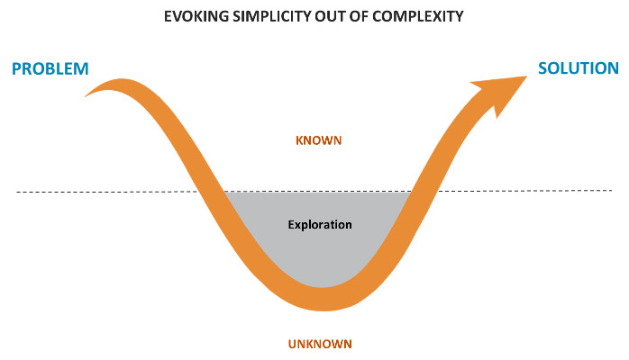
Introduction
Sometimes, it is human nature to take a simple solution to a problem and complicate it.
www.midocean.ae

Slide 12


Introduction
www.midocean.ae

Slide 13

Introduction
www.midocean.ae

Slide 14

Introduction
Quite often, today’s complicated solutions create tomorrow’s problems.
www.midocean.ae

Slide 15
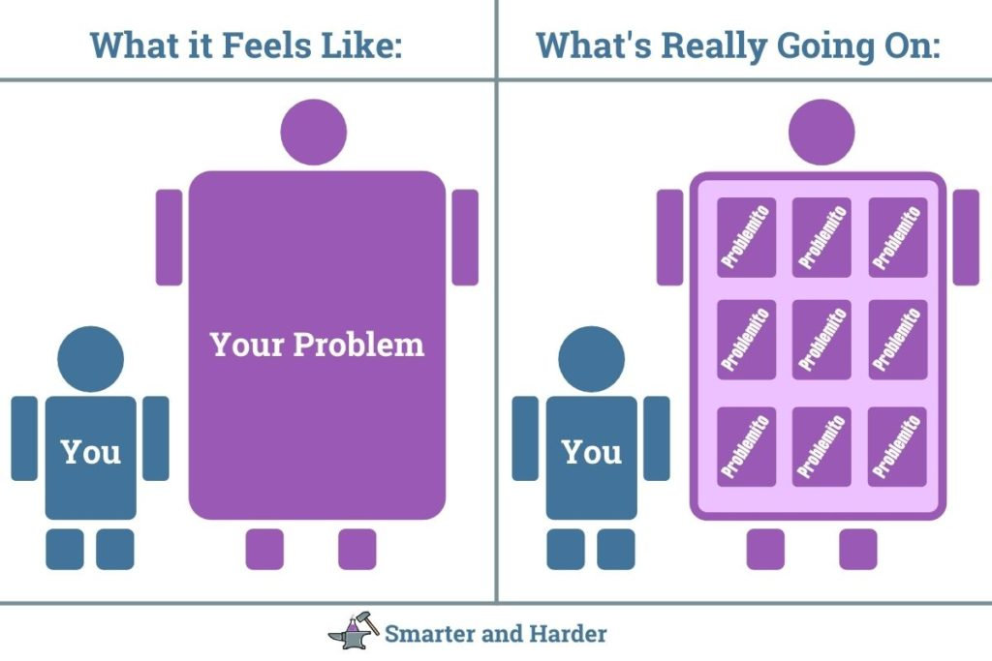
Introduction
If the only solution to a problem is a complicated one, then the solution should be divided into simple and workable parts that interface with each other.
www.midocean.ae

Slide 16


Introduction
The complicated solution should be like putting the pieces of a puzzle together.
www.midocean.ae

Slide 17
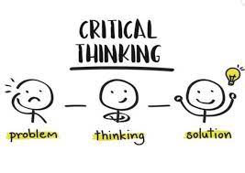
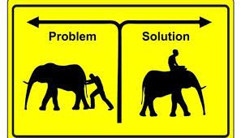
Introduction
Once you have defined your solution, there will be many levels of approaches in planning, designing, and implementing that alternative.
www.midocean.ae

Slide 18

Introduction
The difficult part is to choose the overall approach.
In today’s highly sophisticated industrial environment, it is often best to partner with other organizations that can perform special segment better than doing it all in-house.
www.midocean.ae

Slide 19

Introduction
The term for this strategy is “outsourcing” and it is increasingly employed in projects
www.midocean.ae

Slide 20
Introduction
What are the odds of having a successful product that is delivered within the budget and schedule? ما هي احتمالات الحصول على منتج ناجح يتم تسليمه ضمن الميزانية والجدول الزمني؟
www.midocean.ae

Slide 21



Introduction
Various surveys indicate that:
25% of all projects are completed on time
50% have late completion dates and/or go over budget
25% are canceled.
www.midocean.ae

Slide 22

Introduction
This means that approximately 75% of all projects undertaken will probably come in late or be canceled!
www.midocean.ae

Slide 23
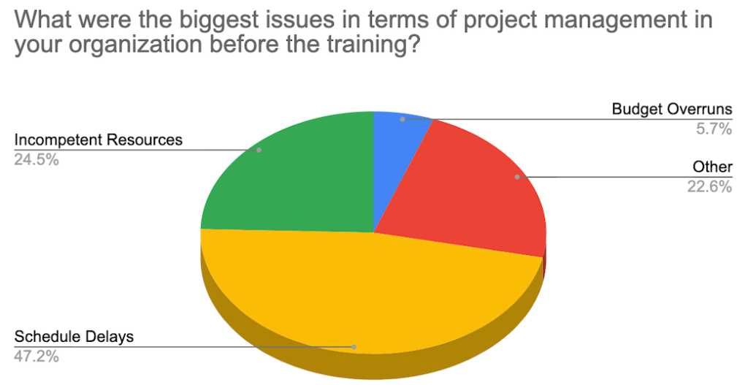

Introduction
Also, the projects that are completed (on time or late) usually end up having fewer features and functions than originally specified to save development time and/or costs.
www.midocean.ae

Slide 24
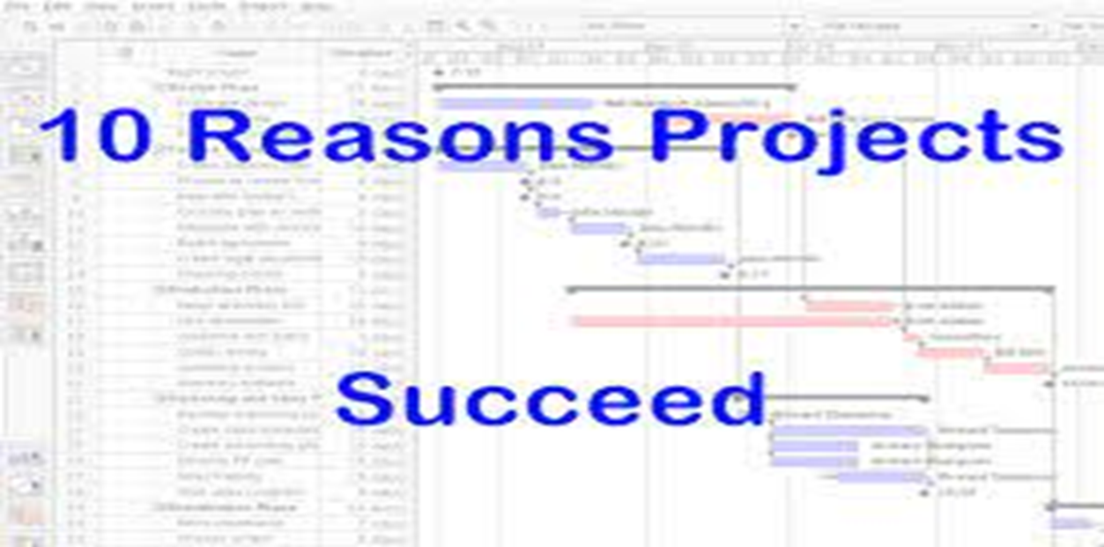
Introduction
www.midocean.ae

Slide 25
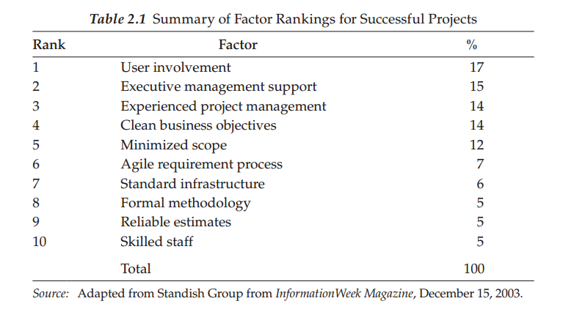
Introduction
The top 10 reasons why projects are successful and the first five make up 72% of the total.
www.midocean.ae

Slide 26
What is Project Management?
Project Management is the process of defining, Planning ,organizing, leading and controlling the development of an Information System Project.
The goal of Project Management is to deliver an Information System that is acceptable to Users and is developed on time and within budget
www.midocean.ae

Slide 27
What is Project Management?
Based on a business need or opportunity
Often explored and initiated by the Project Sponsor(s), who writes or approves the Project Charter
Has the following features:
  A defined beginning and end
  Unique goals and outcomes
  Typically requires team members with varied skills
Contrasts with Operational Work, which is repetitive ‘business as usual’
www.midocean.ae

Slide 28

Project Management Phases
INITIATING/Defined THE PROJECT
PLANNING THE PROJECT
EXECUTING THE PROJECT
CLOSING DOWN THE PROJECT
www.midocean.ae

Slide 29
1. PROJECT INITIATION/ Defined
The first phase of Project Management
Process in which activities are performed to asses the Size, Scope, and Complexity of the Project and to establish procedures to support later Project activities.
www.midocean.ae

Slide 30
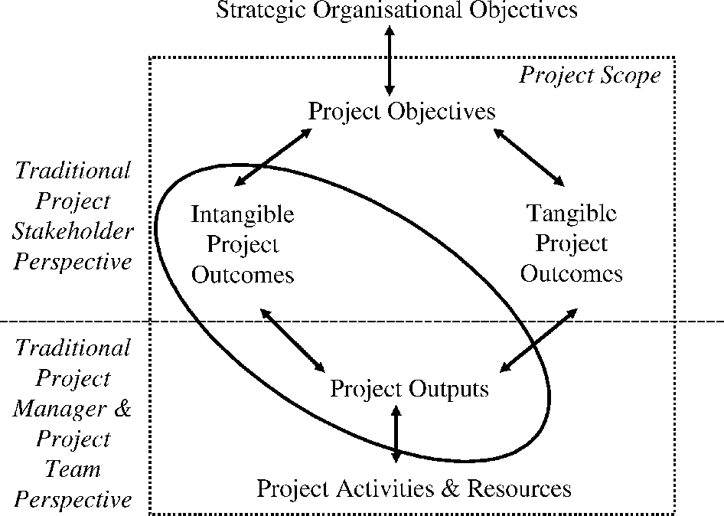
1. PROJECT INITIATION/ Defined
www.midocean.ae

Slide 31
2. PROJECT PLANNING
The Project Planning provides an overall framework for managing Project Costs and schedules.
Project Planning takes place at the beginning and at the end of each Project Phase.
Project Planning involves defining clear, discrete “Activities” or “Tasks” and the work needed to complete each Activity.
IF YOU FAIL TO PLAN, YOU PLAN TO FAIL!
www.midocean.ae

Slide 32
3. EXECUTING THE PROJECT
The third Phase in Project Management Process in which the Plans created in the prior Project Phases are put to action.
If you develop a high quality Project Plan, it is much more likely that the Project will be successfully executed
www.midocean.ae

Slide 33
4. CLOSING DOWN THE PROJECT
The final Phase of Project Management process which focuses on bringing a Project to an end.
Closedown is a very important activity since a Project is not complete until it is closed and it is at closedown that projects are deemed a success or failure.
www.midocean.ae

Slide 34
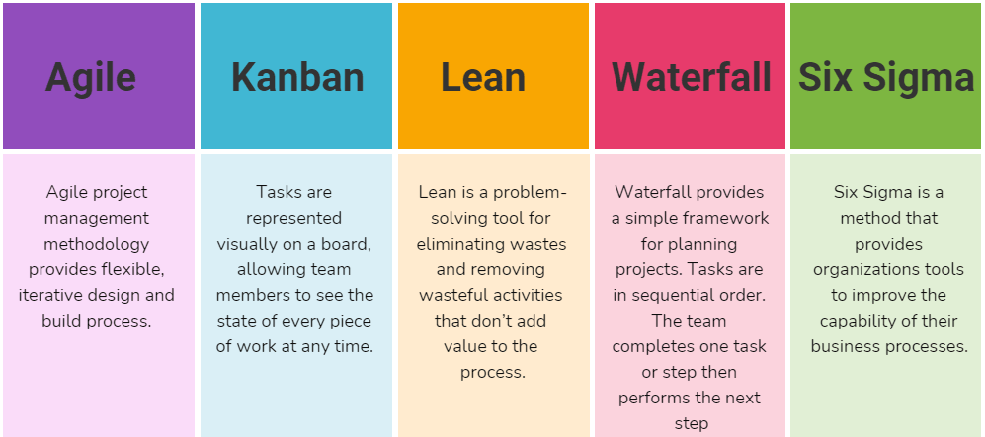
Methodology
Every project should follow some form of standardized approach.
www.midocean.ae

Slide 35
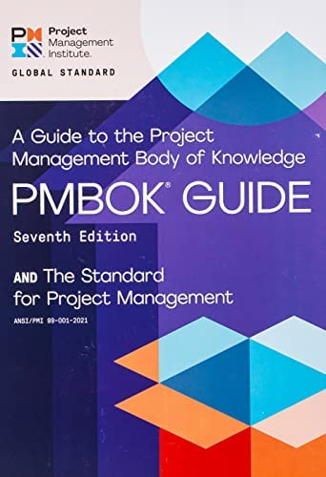
Methodology
There are many options to look at for guidance in this. Some notable examples of project management definition are found in the Project Management Body of Knowledge (PMBOK) from the PMI, PRINCE2 (UK), or the more contemporary
www.midocean.ae

Slide 36
Methodology
Agile methodology (prototyping or taking development shortcuts to release more quickly).
Each of these approaches attempts to model a project life cycle and through this guidance helps produce a more successful outcome.
www.midocean.ae

Slide 37
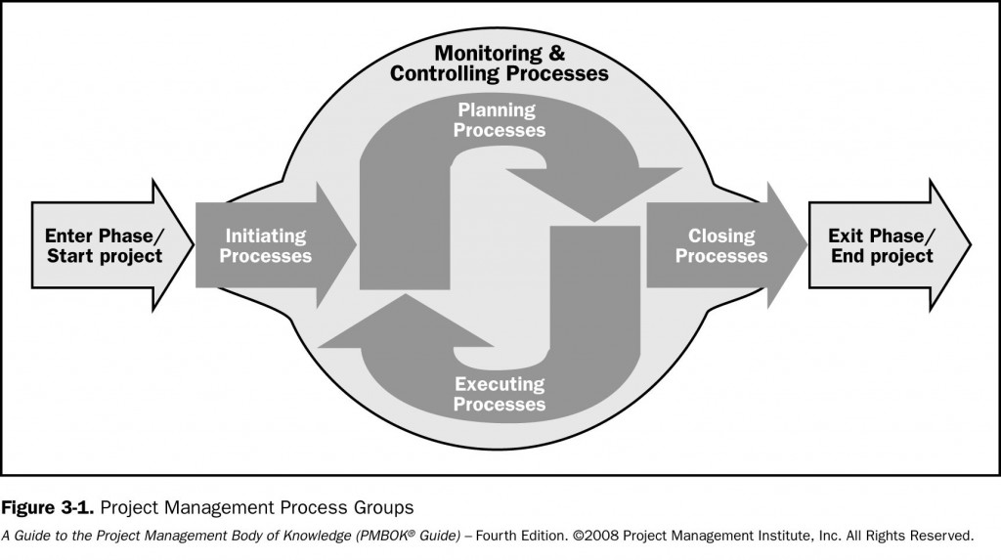
Methodology
These groups are briefly defined as follows:
www.midocean.ae

Slide 38
Methodology
These groups are briefly defined as follows:
Initiating—Tasks and activities that conceptualize and/or authorize the project or phase.
Planning—Activities and related tasks that define and refine objectives within the project.
Executing—Activities and related tasks that coordinate resources to carry out the plan.
Monitoring and controlling—Monitoring and measuring progress regularly to identify variances within the plan, so corrective actions can be taken if needed.
Closing—Finalize all activities/tasks and above processes to close the project.
www.midocean.ae

Slide 39
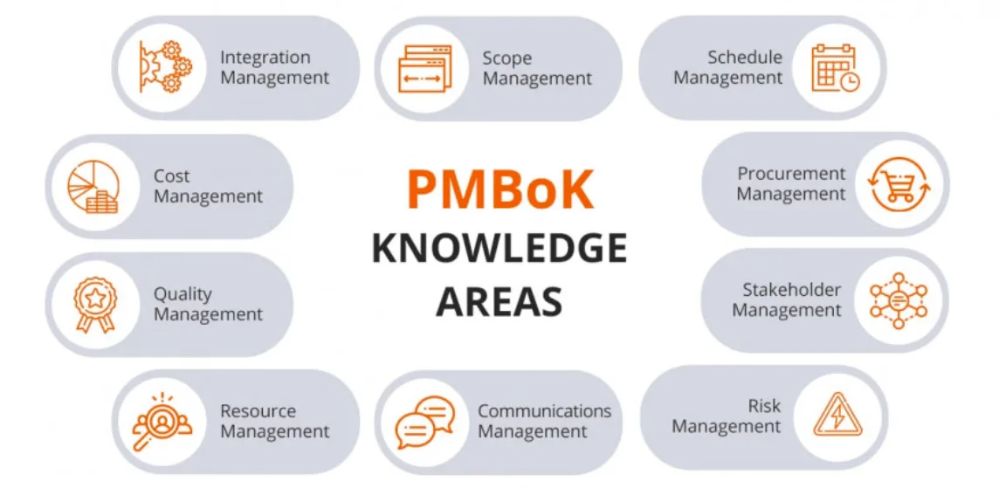
The nine organizational knowledge management areas covered in PMBOK
www.midocean.ae

Slide 40
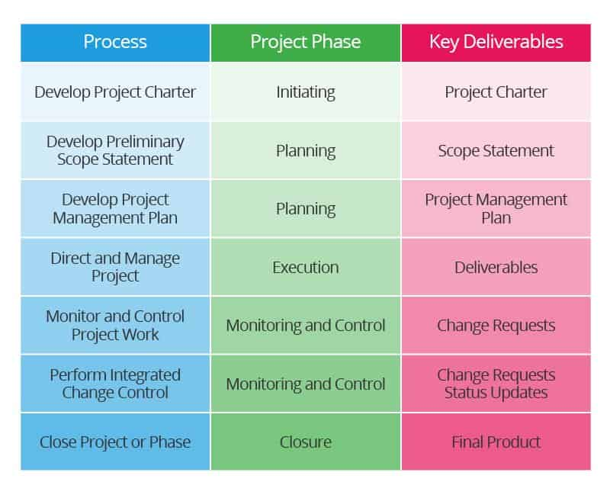
The nine organizational knowledge management areas covered in PMBOK
1. Project integration—These are processes (i.e., coordination of procedures and phases) in place to develop, manage, and monitor your project, which includes change control.
www.midocean.ae

Slide 41
The nine organizational knowledge management areas covered in PMBOK
2. Scope—These are processes (work included and excluded) in place to define the project work.
www.midocean.ae

Slide 42
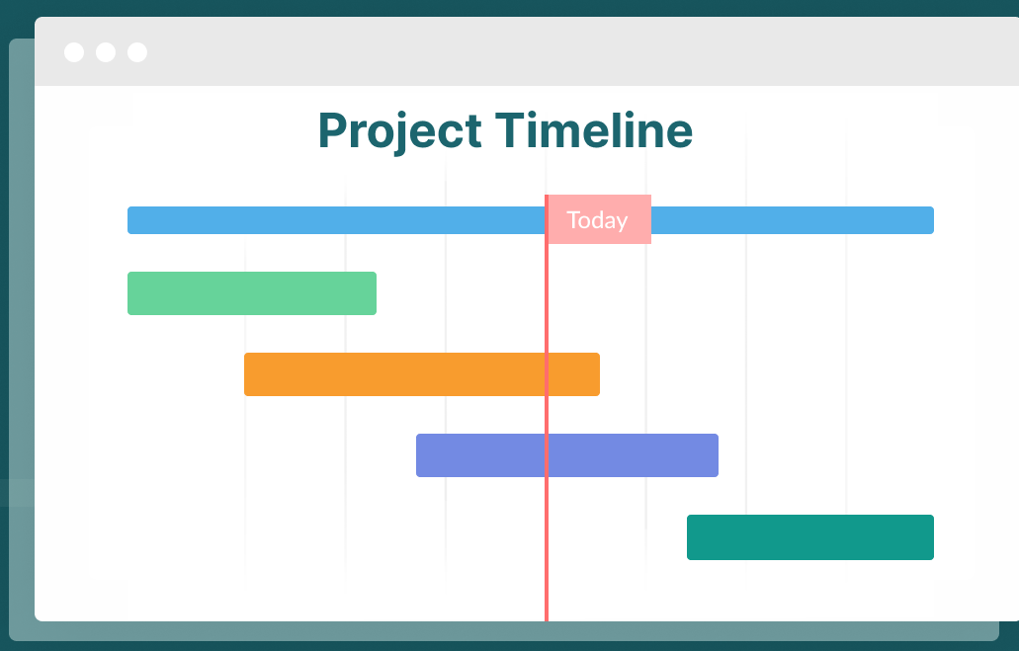
The nine organizational knowledge management areas covered in PMBOK
3. Time—These are processes (i.e., estimating and scheduling) in place to make to support schedule development and status tracking.
www.midocean.ae

Slide 43
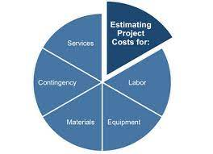
The nine organizational knowledge management areas covered in PMBOK
4. Cost—These are processes (i.e., costing and cost control) in place to support budget planning and status tracking.
www.midocean.ae

Slide 44
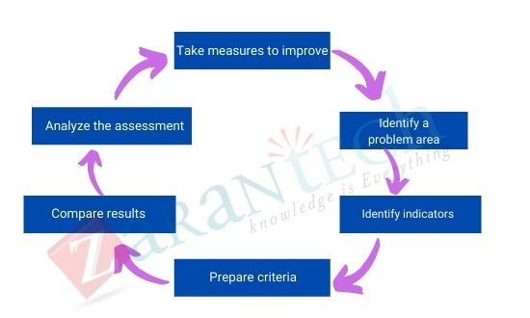
The nine organizational knowledge management areas covered in PMBOK
5. Quality—
www.midocean.ae

Slide 45
The nine organizational knowledge management areas covered in PMBOK
5. Quality—These are processes in place to support meeting quality goals.
There are three types of quality assurance (QA) project reviews: deliverable, compliance, and health.
www.midocean.ae

Slide 46
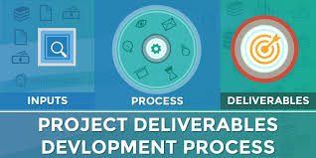
The nine organizational knowledge management areas covered in PMBOK
There are three types of quality assurance (QA) project
Deliverable is any tangible outcome or item produced to complete a project; this can range from a client’s approval of a project plan to completion sign-off.
www.midocean.ae

Slide 47
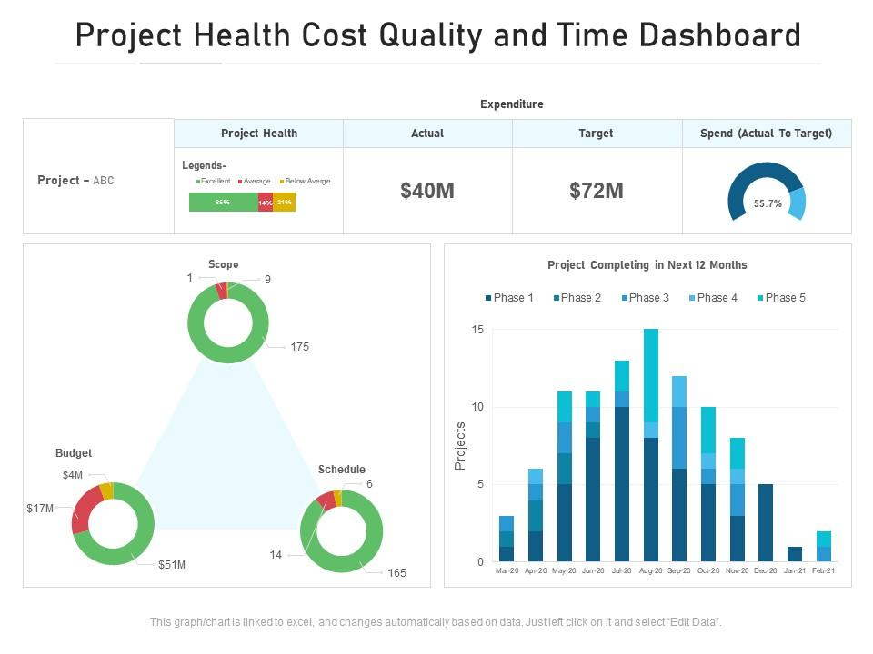
The nine organizational knowledge management areas covered in PMBOK
There are three types of quality assurance (QA) project
Health tells how well a project is doing; if it has run off the rails, the team can use the review to decide which actions to take to get the project back on track.
www.midocean.ae

Slide 48
The nine organizational knowledge management areas covered in PMBOK
www.midocean.ae

Slide 49
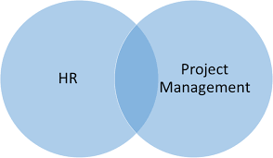
The nine organizational knowledge management areas covered in PMBOK
6. Human resources—These are processes (i.e., acquiring, developing and managing) in place to make sure you have the right project team and support people (i.e., sponsors, stakeholders, and end users).
www.midocean.ae

Slide 50
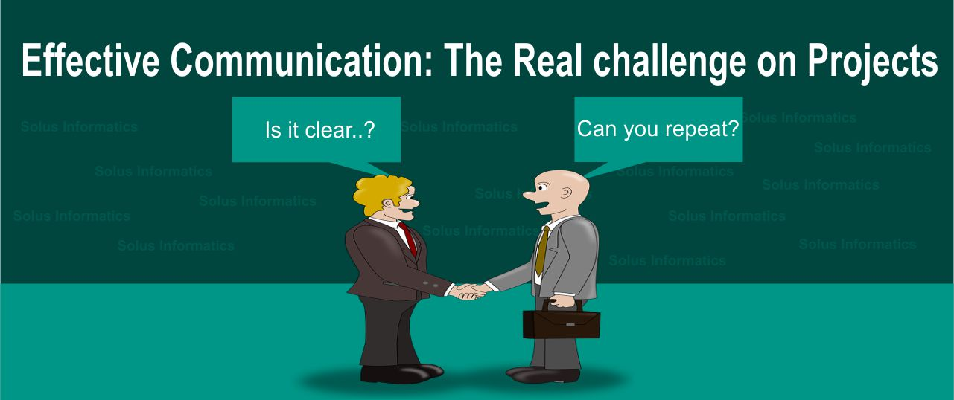
The nine organizational knowledge management areas covered in PMBOK
7. Communication—These are processes (i.e., planning and managing team, user expectations, and performance) in place to support meeting your information needs.
www.midocean.ae

Slide 51
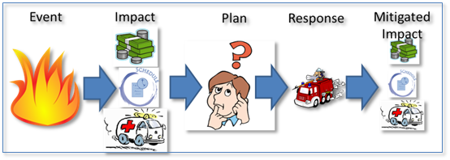
The nine organizational knowledge management areas covered in PMBOK
8. Risk—These are processes in place (i.e., identifying, performing qualitative analysis, and planning responses) to support preventing a potential event or future situation that may adversely affect the project.
www.midocean.ae

Slide 52
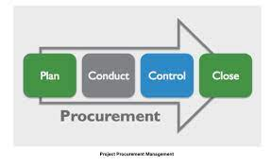
The nine organizational knowledge management areas covered in PMBOK
9. Procurement—These are processes (i.e., planning the solicitation and obtaining) in place to support the procuring of goods and services, which includes good contract management.
www.midocean.ae

Slide 53
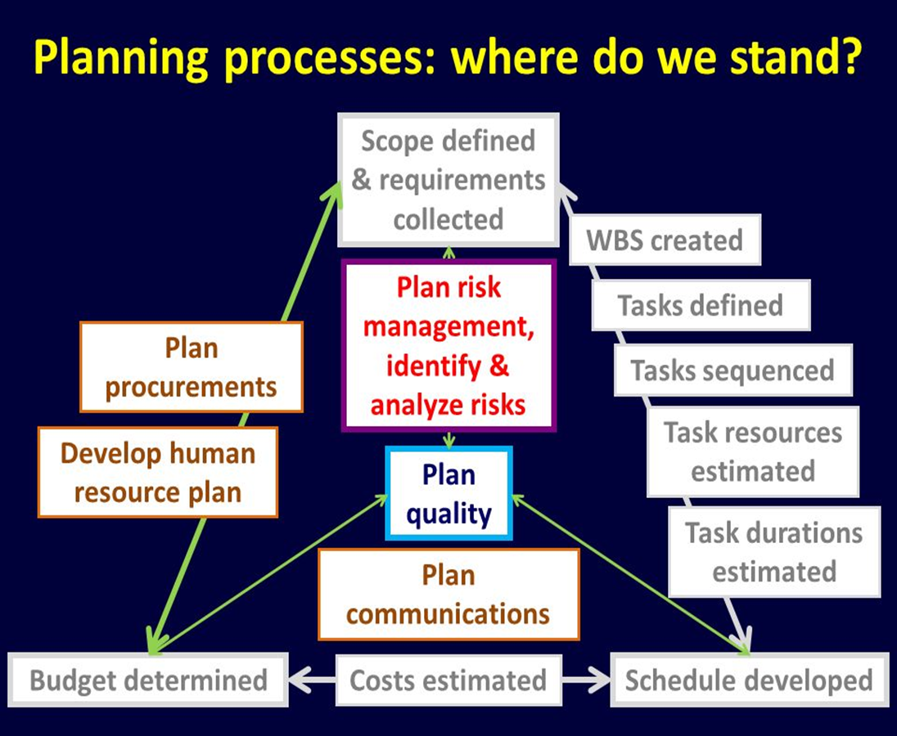
The nine organizational knowledge management areas covered in PMBOK
www.midocean.ae

Slide 54
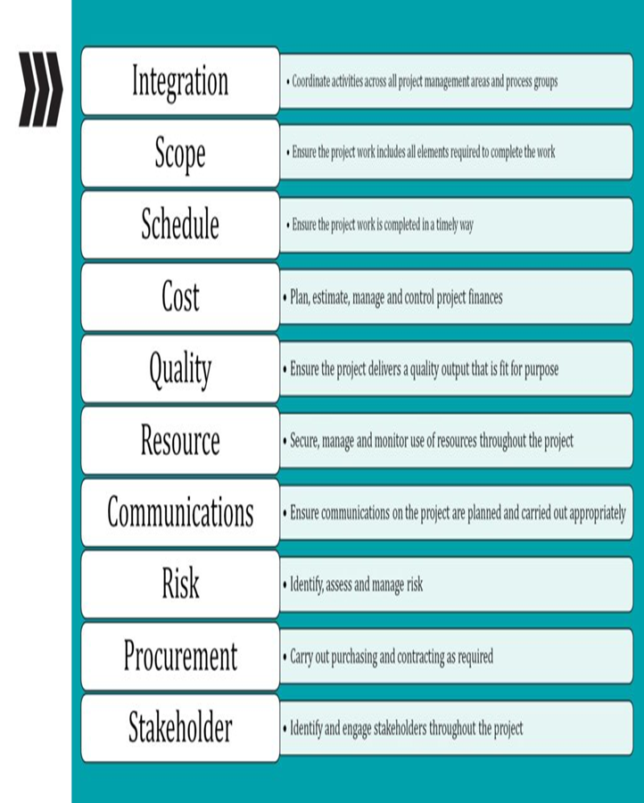
The nine organizational knowledge management areas covered in PMBOK
www.midocean.ae

Slide 55
Conclusion
A good methodology encompasses standard policies, processes, and procedures that incorporate a suite of tools and techniques to help guide the process through its life cycle in an efficient, consistent, and repeatable manner.
Even though a methodology is described as a standard approach, it should be viewed as a living organism that constantly needs to be reviewed and updated for improvements based on experience.
www.midocean.ae

Slide 56
The nine organizational knowledge management areas covered in PMBOK
A large part of improving a methodology is keeping a documented history of lessons learned from project outcomes.
Unfortunately, most companies do not do this or they record it and just let it collect dust.
Using lessons learned is a way of benchmarking and collecting best practices to help you improve your methodology by updating your policies, processes, and procedures along with your associated tools and techniques.
www.midocean.ae

Slide 57
The practical aspects of this process from the
author’s experiences.
www.midocean.ae

Slide 58
The practical aspects of this process from the
author’s experiences.
www.midocean.ae

Slide 59
The practical aspects of this process from the
author’s experiences.
www.midocean.ae

Slide 60
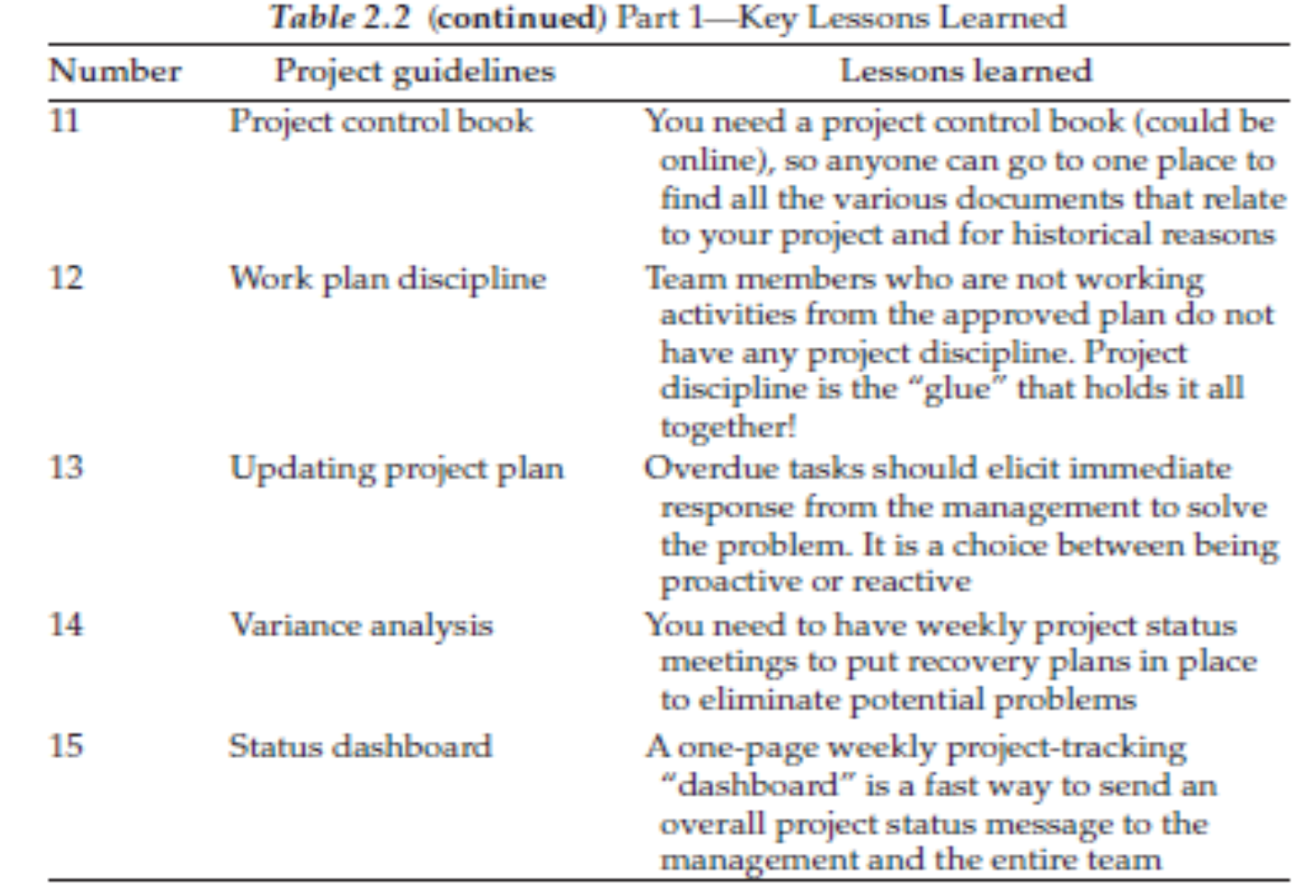
The practical aspects of this process from the
author’s experiences.
www.midocean.ae

Slide 61




Thank You

