Slide 1

DIGITAL MEDIA ETHICS
Prepared by Dr. Sherihan Mohamed
DGM723
DIGITAL MEDIA ETHICS

Slide 2
DIGITAL MEDIA ETHICS
Final Revision

Slide 3
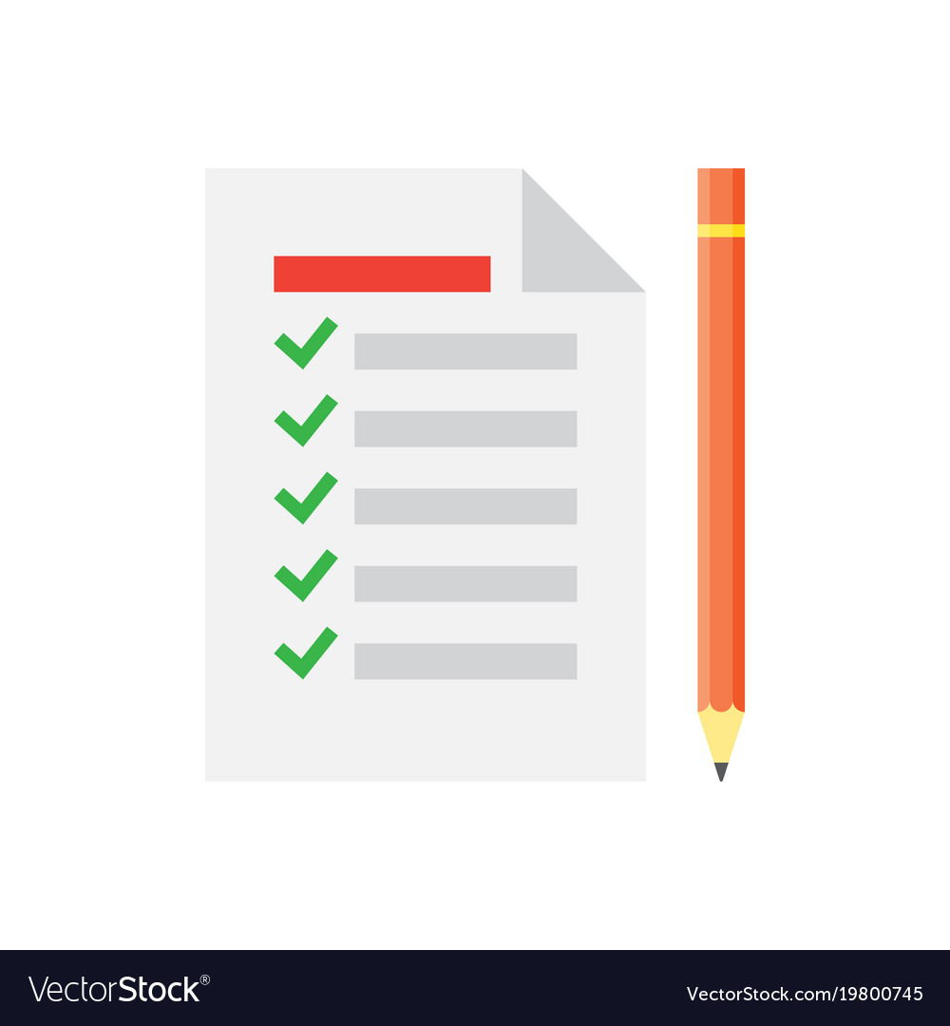

Chapter
01
Lecture1
** Introduction.
** (Ethical) life in the (post-)digital age:
1. Digital media, analoug media: convergence and Ubiquity.
2. Digital media and “greased information”.
3. Digital media as communication media: fluidity, ubiquity, global scope, and selfhood/identity.

Slide 4

Chapter
02
Lecture 2
** Digital media ethics: How to proceed?
** Is digital media ethics possible? Grounds for hope
** How to do ethics in the new mediascape:
Dialogical approaches, difference, and
Pluralism.
** Further considerations: Ethical judgments

Slide 5

Chapter
02
Lecture 3
** Information and privacy in the global digital Age.
** “Privacy” and private life: Changing attitudes in the age of social media and mobile devices
** “Privacy” and private life: Cultural and philosophical considerations
** “Privacy” and private life: Cultural differences and ethical pluralism

Slide 6

Chapter
03
Lecture 4
** Introduction
1- What do you know about copying and distributing? 2- How Copyrighting Works.
** The ethics of copying: Is it theft or Open Source?
1- Intellectual property: (Western) approaches.
2- Intellectual property and culture.

Slide 7

Chapter
03
Lecture 5
** What do we mean with copyleft?
- Copyleft and open sources.
- What is the Public copyright?
** The Copyleft Applications:
- Creative commons.
- Public domain.

Slide 8

Chapter
04
Lecture 6
** Friendship online? Initial considerations
- Privacy Paradox and social media
- Ethics and social media.
- Ethical challenges with social media use.
** Slow/Fair Technology:
- Fairphone as a type of slow/fair Technology.

Slide 9

Chapter
04
Lecture 7
** Democracy, Freedom and Truth at a Time of Digital Disruption:
- Freedom of information and freedom of expression: a conceptual and legal framework.
** “Information, the key to democracy”:
- Media at the intersection of democratic culture and technological progress.
- Information and the need for truth.

Slide 10

Chapter
04
Lecture 8
** Fake news on Social Media: the Impact on Society:
- What is Fake News?
- Fake News Spread, and Social Media
- Contributors of fake news.
** Five types of misinformation:
1- Satire. 2- False context. 3- Imposter content.
4- Fabricated content. 5- Manipulated content.
- Examples of Fake news from Arabic Websites

Slide 11

Chapter
05
Lecture 9
** Digital media ethics: an overview
- A revolution in ethics.
- Tensions on two levels.
- What would an integrated ethics look like?
** Difficult questions for digital media ethics
- Who is a journalist?
- What is journalism?
** Ethical guidelines for online journalism

Slide 12

Chapter
05
Lecture 10
** A Synopsis of digital media ethics
- Computing code of ethics
- Global media ethics
** Basic ethical frameworks
- Deontology - Virtue Ethics
- Moral Absolutism - Moral Relativism
- Moral Pluralism - Consequentialism
- Utilitarianism

Slide 13
DIGITAL MEDIA ETHICS
Prepared by Dr. Sherihan Mohamed
DGM723
DIGITAL MEDIA ETHICS

