Slide 1


Overview of the Clinical Governance ( Part 2 )
Prepared by Dr. Abdulaziz Alsaedi
MHA611
Healthcare Systems
Lecture 10

Slide 2

Outlines:
Concepts on risk management.
Types of risks.
What is the clinical risk management.
Risk management framework.
Education and training pillar.
Patient and public pillar.
Using of information pillar.
Staffing and staff management pillar.

Slide 3

Chapter
10
Pillar 3: Risk Management

Slide 4
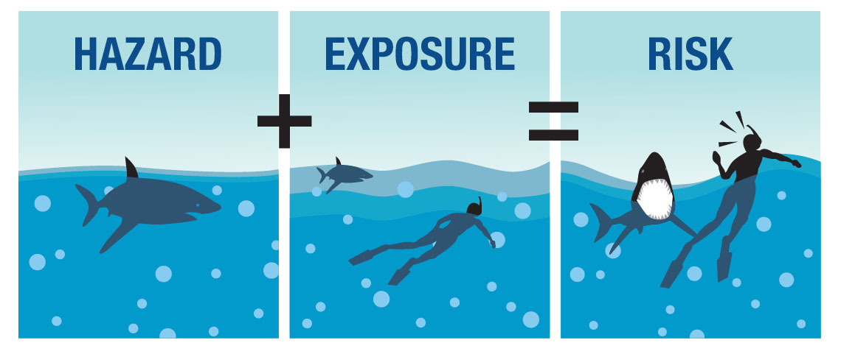
Chapter
10
Pillar 3: Risk Management:

Slide 5
Chapter
10
Pillar 3: Risk Management:
A Risk can be defined as anything that threatens a practice team’s ability to achieve its clinical objectives or anything that increases the probability of patient harm.
A Risk is characterized by reference to potential events and expressed in terms of the “Likelihood” and the associated “Consequences” or a combination of these.
Reference: Clinical Risk Management in general practice,

Slide 6
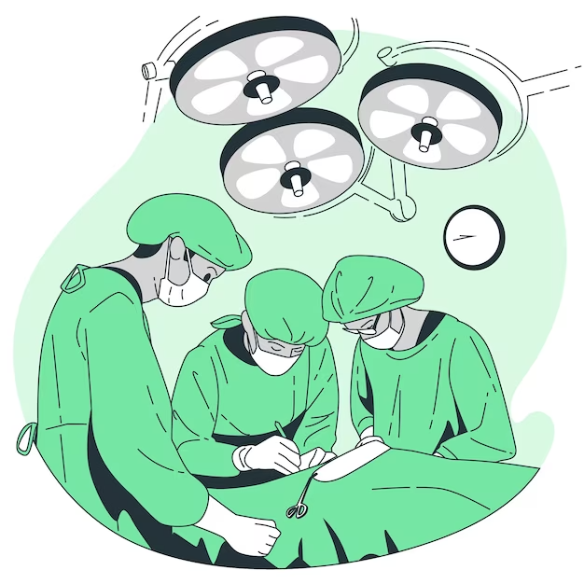
Chapter
10
Examples of Risks in Healthcare

Slide 7
Chapter
10
Types of Risks:
Operational
Human Capital
Clinical & Patient Safety
Legal & Regulatory
Strategic
Technological
Financial
Environmental
Reference: Clinical Risk Management in general practice,

Slide 8
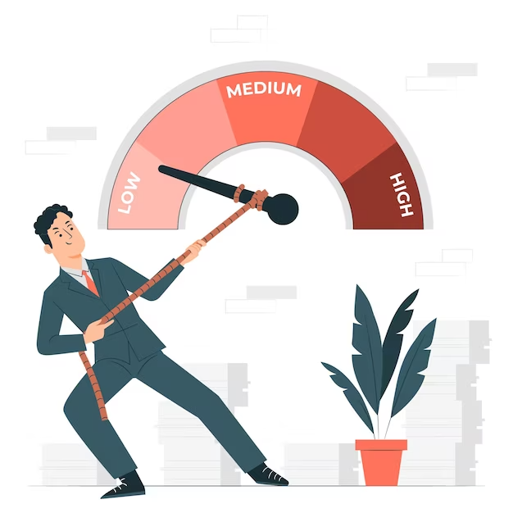
Chapter
10
What is Clinical Risk Management:
Risk management in healthcare is a complex set of clinical and administrative systems, processes, procedures, and reporting structures designed to detect, monitor, assess, mitigate, and prevent risks to patients.

Slide 9
Chapter
10
Why Clinical Risk Management:
Clinical risk management specifically is concerned with improving the quality and safety of healthcare services by identifying the circumstances and opportunities that put patients at risk of harm and acting to prevent or control those risks.
World Health Organization
منظمة الصحة العالمية
Clinical Risk Management involves having robust systems in place to understand, monitor, and minimize the risks to patients and staff and learn from mistakes. When things go wrong in the delivery of care, doctors and other clinical staff should feel safe admitting it and be able to learn and share what they have learnt.

Slide 10
Chapter
10
Risk Management includes:
Complying with protocols.
Learning from mistakes and near-misses.
Reporting any significant adverse events.
Assessing the risks identified for their frequency and severity.
Promoting a blame-free culture.
Reference: https://alison.com/topic/learn/133628/the-pillars-of-clinical-governance

Slide 11
Chapter
10
What can be done to manage risk?
Assess how patients may be harmed even before this happens:
An understanding of the adverse incidents that have occurred in the past and identifying common problems can help identify future risks. Clinical risk identification and analysis should take place in every ward to prevent patient safety incidents.
Reference: A CLINICAL GOVERNANCE HANDBOOK FOR DISTRICT CLINICAL SPECIALIST TEAMS

Slide 12
Chapter
10
What can be done to manage risk?
2. Prevent or manage risks:
Make staff aware of risks in the environment. Put in place robust systems to prevent common errors and ensure that safety protocols are in place to protect patients undergoing high-risk procedures.
Reference: A CLINICAL GOVERNANCE HANDBOOK FOR DISTRICT CLINICAL SPECIALIST TEAMS

Slide 13
Chapter
10
What can be done to manage risk?
3. Report and analyze adverse events:
Facilities need to actively encourage reporting of adverse events so that adverse events are identified promptly and managed to minimize harm and suffering.
There should be a procedure in place for acknowledging, investigating and dealing with patient complaints. Complaints should be screened to ensure adverse events are identified and appropriately managed.
Reference: A CLINICAL GOVERNANCE HANDBOOK FOR DISTRICT CLINICAL SPECIALIST TEAMS

Slide 14
Chapter
10
What can be done to manage risk?
4. Learn from such incidents:
Morbidity and mortality meetings are a key vehicle for learning from adverse events. It is critical to move away from just blaming individuals to trying to understand the role of system factors in patient safety.
5. Implement solutions to minimize the likelihood of them re-occurring.
Reference: A CLINICAL GOVERNANCE HANDBOOK FOR DISTRICT CLINICAL SPECIALIST TEAMS

Slide 15
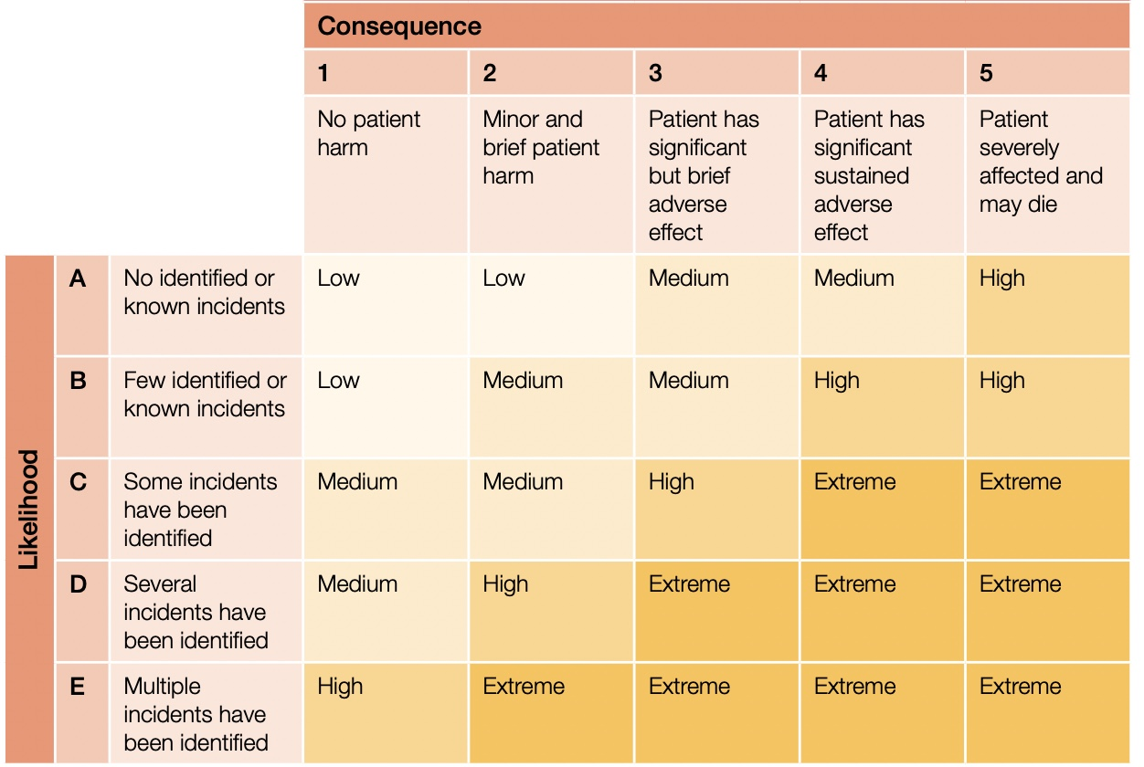
Chapter
10
Risk Matrix

Slide 16
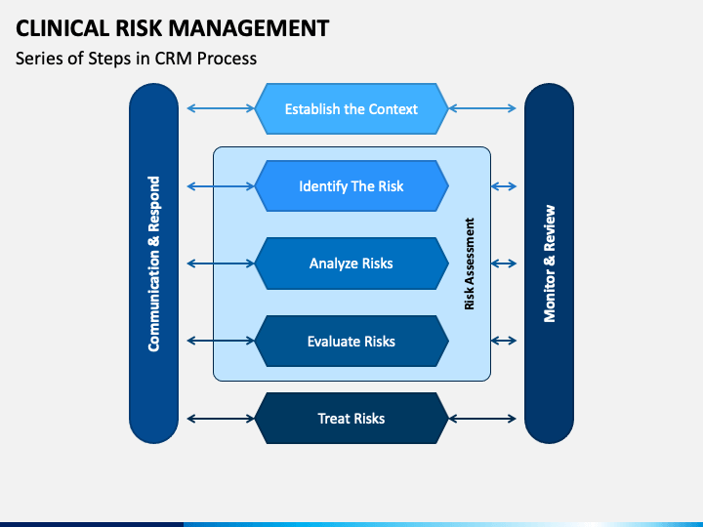
Chapter
10
Risk Management Framework

Slide 17
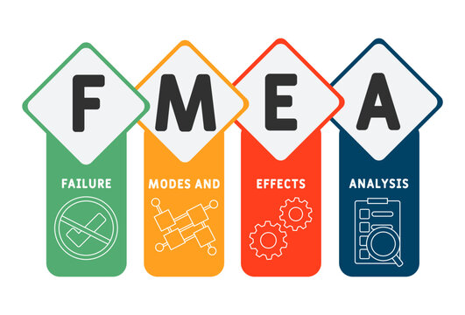
Chapter
10
Clinical Risk Management Techniques:
The Clinical Risk Management function exists to anticipate adverse events and to mitigate the possible consequences when they occur.
There are numerous risk prediction techniques that have been developed in the industry, such as FMEA.
Reference: Textbook of Patient Safety and Clinical Risk Management

Slide 18
Chapter
10
The application of FMEA is divided into Seven Steps:
1. Select a process to be evaluated with FMEA, bearing in mind that this technique works best for the analysis of linear processes that do not have many sub-processes. In the case of many sub-processes, it is advisable to apply the technique to each individual sub-process.
2. Organize a multidisciplinary group with all the actors who have been involved in the process being analyzed, some of whom may be included only for the part of the analysis that concerns them.
Reference: Textbook of Patient Safety and Clinical Risk Management

Slide 19
Chapter
10
The application of FMEA is divided into Seven Steps:
3. Set a meeting to analyze the process starting with the description of steps in the process, trying to describe each phase in a detailed manner and without any bias
4. For each step of the process, list all the possible failure modes (FM), that is all that could go wrong, including rare and minor problems. Then proceed to identify the possible contributory factors and consequences of each failure mode.
5. For each failure mode identified, have the group assign a numerical value on a scale from 1 to 10 for the frequency and the severity of the FM.
Reference: Textbook of Patient Safety and Clinical Risk Management

Slide 20
Chapter
10
The application of FMEA is divided into Seven Steps:
6. Calculate the Risk Priority Index (RPI) for each FM, taking the product of the frequency score (F), the severity score (S), and the probability of identifying the failure by the operators (I). The possible calculation results range from an RPI equal to 1 to an RPI equal to 1000.
7. Define improvement plans, starting from the FM that have accumulated a higher RPI score and therefore require priority interventions.
Reference: Textbook of Patient Safety and Clinical Risk Management

Slide 21
Chapter
10
Pillar 4: Education and Training

Slide 22

Chapter
10
Why focus on Education and Training:
Quality is defined as:
“ Doing the right things right the first time”

Slide 23
Chapter
10
Education and Training:
Education and Training entail providing appropriate support available to enable staff to be competent in doing their jobs and to develop their skills so that they are up-to-date.
Professional development needs to continue through lifelong learning.
A healthcare provision is a career of continual learning.
This ensures that practitioners remain up-to-date with the latest skills, knowledge and research – linking into Clinical Effectiveness and Research.
Reference: https://alison.com/topic/learn/133628/the-pillars-of-clinical-governance

Slide 24
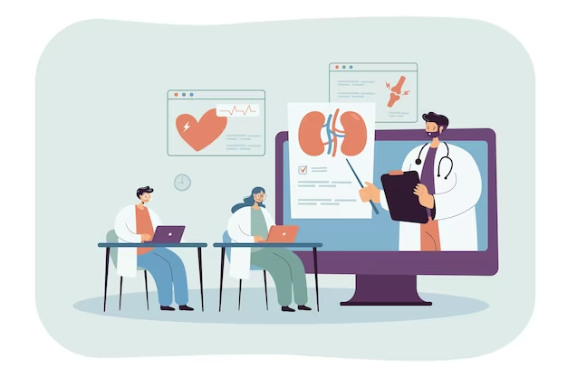
Chapter
10
Why focus on Education and Training

Slide 25
Chapter
10
Why focus on Education and Training:
Medical knowledge is rapidly changing and there have been vast advances in the field of obstetrics and gynecology, some of them involving a paradigm shift in practice.
This necessitates the staff to be continuously updated and equipped with the latest knowledge to deliver safe and appropriate patient care.
Continuous Professional Development (CPD) should be the responsibility of the individual practitioners, a culture that should be promoted.
Reference: Article: Clinical Governance, Chandaraharan & Arulkumaran, 2007

Slide 26
Chapter
10
Why focus on Education and Training:
In practice, this involves:
Attending courses and conferences (commonly referred to as CPD)
Taking relevant exams.
Regular assessment is designed to ensure that training is appropriate.
Appraisal by peers (to assess competency and areas for improvement/ further training)
Completing further training, e.g.: certificates, diplomas, or degrees.
Reference: Article: Clinical Governance, Chandaraharan & Arulkumaran, 2007

Slide 27

Chapter
10
Why focus on Education and Training:
How do you see your hospital?

Slide 28

Chapter
10
Why focus on Education and Training:
Who is responsible?

Slide 29
Chapter
10
Pillar 5: Patient and Public Involvement

Slide 30
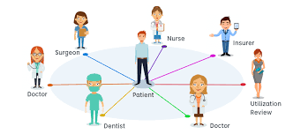
Chapter
10
Patient and Public Involvement (PPI)
What do we mean by PPI?

Slide 31
Chapter
10
Patient and Public Involvement (PPI):
What do we mean by PPI?
Patient and Public Involvement (PPI) is about ensuring that the services provided suit patients, that patient and public feedback is used to improve services into day-to-day practice to ensure an increased level of quality and suitability, and that patients and the public are involved in the development of services and the monitoring of treatment outcomes.
Reference: https://www.dentalnotebook.com/7-pillars-clinical-governance/

Slide 32
Chapter
10
Patient and Public Involvement (PPI):
This is being implemented through a number of initiatives and organizations, including:
Local patient feedback questionnaires.
The involvement of the Patient Advice and Liaison Service (PALS) in handling issues with patients.
Patients Satisfaction surveys.
Foundation Trust Board of Governors who are elected by members of the local community and have a say on who runs a hospital and how it should be run, including the services it can provide.
Sources: https://alison.com/topic/learn/133628/the-pillars-of-clinical-governance

Slide 33
Chapter
10
Patient and Public Involvement (PPI):
Through this, we are able to assess the quality of services from a patient’s point of view and address any issues.
Methods through which this is implemented include:
Patient feedback questions e.g. Friends and Family questionnaires
Patient representatives on practice and hospital boards
Patient Forums to discuss healthcare matters
Reference: https://www.dentalnotebook.com/7-pillars-clinical-governance/

Slide 34
Chapter
10
Why Patient and Public Involvement (PPI):
Joran Trilogy:
Quality Planning
Quality Improvement
Quality Control

Slide 35
Chapter
10
Patient and Public Involvement (PPI):
Joran Trilogy:
Reference: https://www.dentalnotebook.com/7-pillars-clinical-governance/

Slide 36

Chapter
10
Patient and Public Involvement (PPI):
Perceptive Quality:
Is the degree of excellence which is perceived by the recipient or the observer of care rather than by the provider of care.
Is generally based more on the degree of caring expressed by physicians, nurses, and other staff than on the physical environment and technical competence.

Slide 37
Chapter
10
Pillar 6: Using Information and IT
Reference: https://www.dentalnotebook.com/7-pillars-clinical-governance/

Slide 38

Chapter
10
Using Information and IT:
Why is it important?

Slide 39
Chapter
10
Using Information and IT:
This aspect of Clinical Governance is about ensuring that:
Patient data is available.
Patient data is accurate
Patient data is up-to-date.
Patient data is confidential.
Patient data is complete.
Sources: https://alison.com/topic/learn/133628/the-pillars-of-clinical-governance

Slide 40
Chapter
10
Using Information and IT:
It aims to ensure data protection and confidentiality for patients as well as appropriate storage and management of patient data e.g. including use for audits.
Reference: https://www.dentalnotebook.com/7-pillars-clinical-governance/

Slide 41
Chapter
10
Using Information and IT:
In practice:
This includes efficient and appropriate management of patient records.
It is important to ensure that the patient’s notes are available at his/her appointment.
Request forms should have a patient’s details legibly written.
The use of printed labels should be encouraged. It is essential to ensure that labels are affixed on all copies of the request form.
General practitioners should be kept informed of the progress of a patient’s condition or treatment with his/her consent.
Reference: https://www.dentalnotebook.com/7-pillars-clinical-governance/

Slide 42
Chapter
10
Pillar 7: Staffing and Staff Management
Reference: https://www.dentalnotebook.com/7-pillars-clinical-governance/

Slide 43
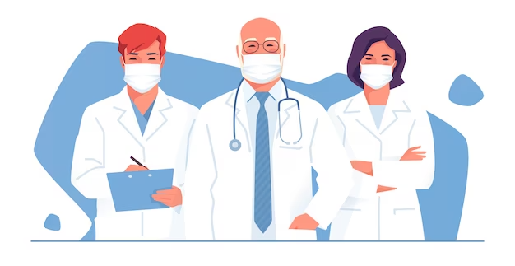
Chapter
10
Staffing and staff management
How can staff participate in improving the quality and patient safety?

Slide 44
Chapter
10
Staffing and staff management:
This is related to the need for:
Appropriate recruitment and management of staff.
Ensuring that underperformance is identified and addressed.
Encouraging staff retention by motivating and developing staff.
Providing good working conditions.
Sources: https://alison.com/topic/learn/133628/the-pillars-of-clinical-governance

Slide 45
Chapter
10
Staffing and staff management:
From the above explanations, you may have noted that some of the pillars are more directly related to the day-to-day responsibilities of a junior doctor:
Clinical Effectiveness.
Audit.
Risk Management.
Education and Training.

Slide 46
Chapter
10
Staffing and staff management:
This ensures correct staff are employed for the correct jobs. Any staffing issues, e.g. performance, are addressed as well as encouraging staff to actively participate in the environment.
Additionally, it requires the employer to provide an open attitude with good working conditions and appropriate management of staff members.
Reference: https://www.dentalnotebook.com/7-pillars-clinical-governance/

Slide 47
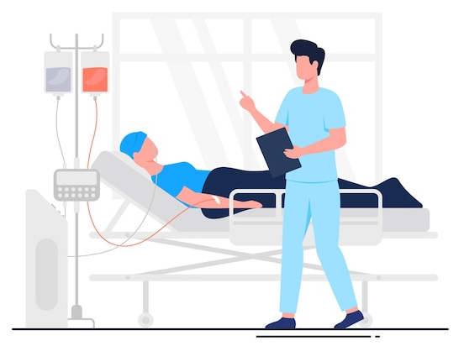

Conclusion:
Clinical Governance is a set of activities/ processes/ systems/ components that work integrally to build
an ENVIRONMENT
that ensures and sustains
PATIENT SAFETY.
Dr. Abdulaziz Alsaedi

Slide 48
Chapter
Summary
10
Risk management in healthcare is designed to detect, monitor, assess, mitigate, and prevent risks to patients.
A healthcare provision is a career of continual learning.
Patient and Public Involvement (PPI) is about ensuring that the services provided suit patients and that patients and the public are involved in the development of services and the monitoring of treatment outcomes.
Staffing and staff management related to appropriate recruitment and management of staff.
Clinical governance leads directly and indirectly to patient safety.

Slide 49



Thank You

