Slide 1


Data Analytics
Prepared by Dr. Mohamed Sleem
FNT 631
Data Analytics
Lecture 0

Slide 2



Data Analytics
FNT 631
Data Analytics
Lecture 0
Prepared by
Dr. Mohamed Sleem

Slide 3

Chapter
Introduction to Data Analysis
01
Understand the importance of data analysis in decision-making processes.
Learn basic data analysis techniques and tools.
Gain insights into the various steps involved in data analysis.

Slide 4
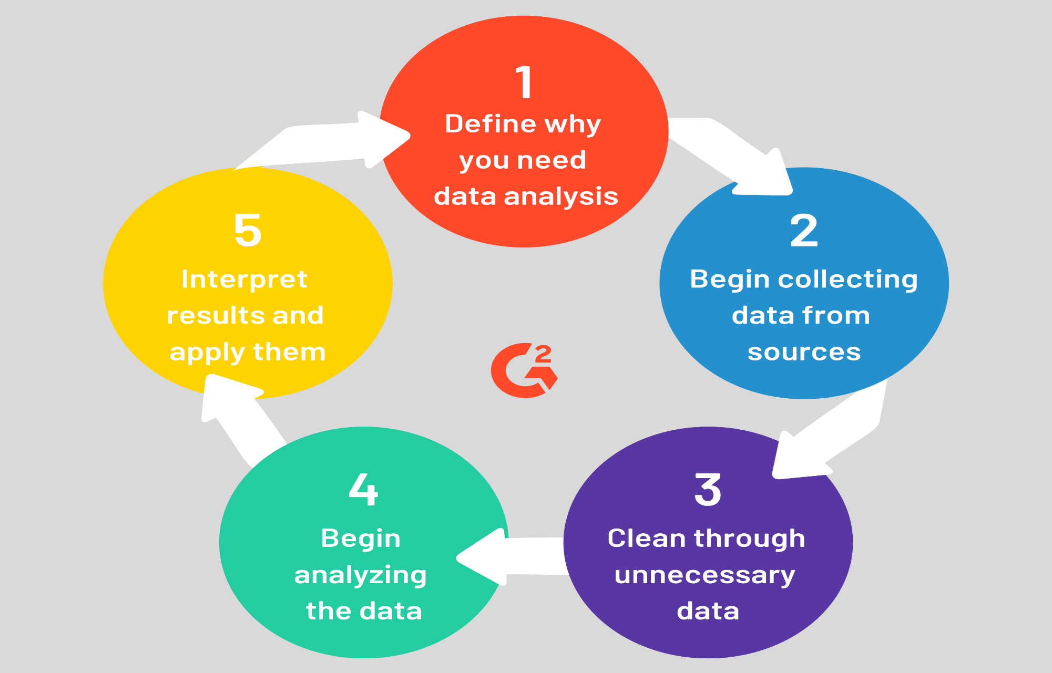

Slide 5
Chapter
Data Visualization
02
Understand the principles of effective data visualization.
Learn various types of visualization techniques such as charts, graphs, and maps.
Explore tools and software for creating visualizations.
Enhance communication and presentation of data analysis results.

Slide 6
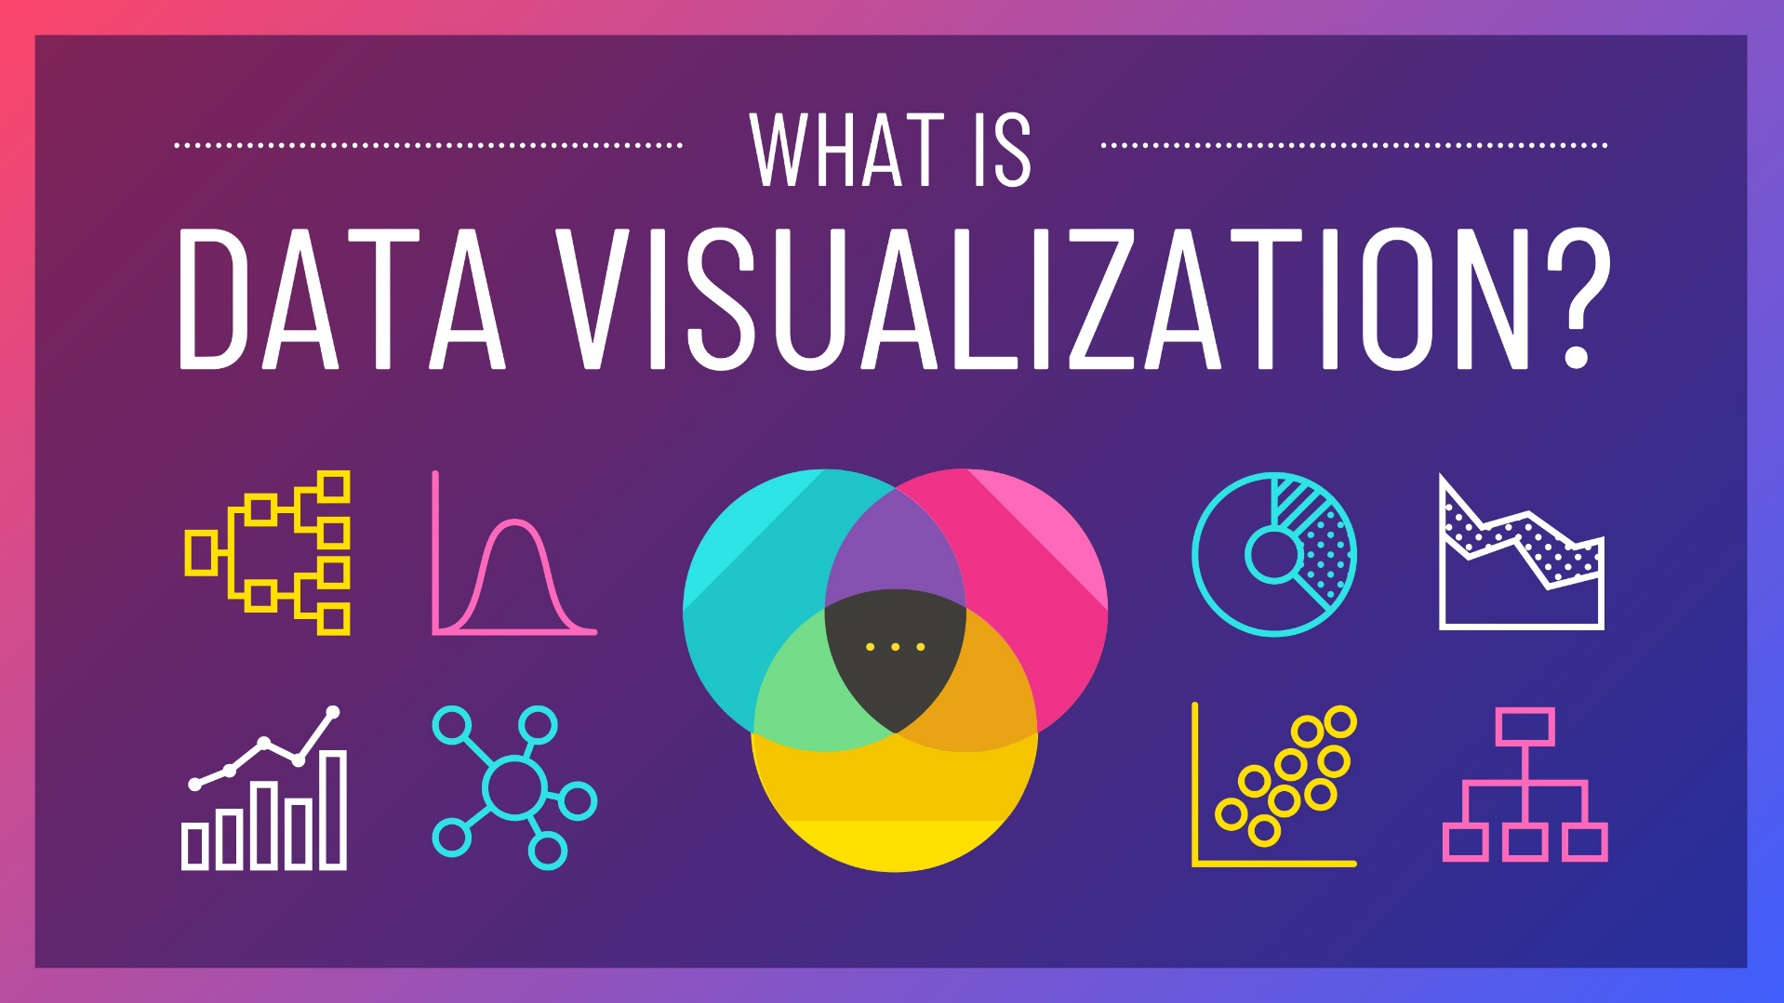
Chapter
01

Slide 7
Chapter
Descriptive Statistics and Data Analysis
03
Understand the concept of descriptive statistics and its importance in data analysis.
Learn how to calculate and interpret various descriptive statistics measures.
Apply descriptive statistics techniques to analyze datasets.

Slide 8
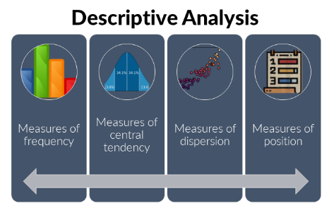
Chapter
03

Slide 9
Chapter
Probability Concepts and Distributions
04
Understand basic probability concepts such as events, outcomes, and probability rules.
Learn about different probability distributions and their properties.
Apply probability concepts to analyze real-world scenarios.

Slide 10
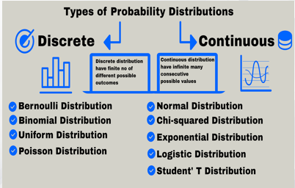
Chapter
04

Slide 11
Chapter
Sampling and Estimation
05
1.Understand sampling techniques and their importance in data analysis.
2.Learn methods for estimating population parameters from sample data.
3.Apply sampling and estimation techniques to solve practical problems.

Slide 12
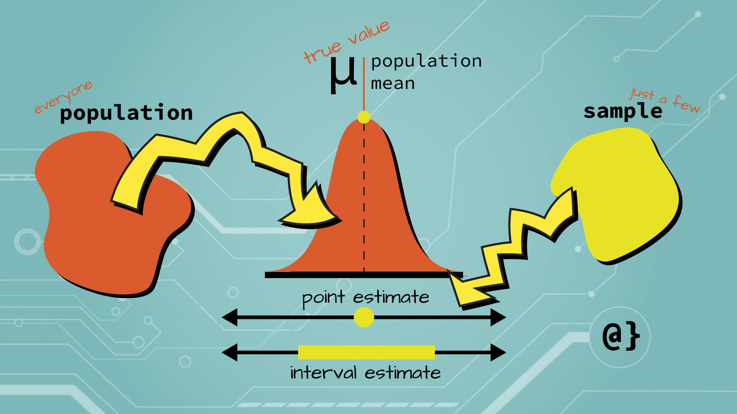
Chapter
05

Slide 13
Chapter
Regression Analysis
06
Understanding the principles of regression analysis.
Learning different types of regression models.
Applying regression analysis to explore relationships and make predictions.

Slide 14
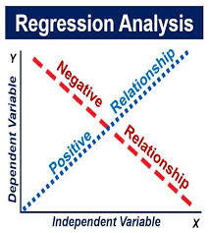
Chapter
06

Slide 15

Chapter
08

Slide 16
Chapter
Forecasting
07
Understand the concept of forecasting and its significance in business and decision-making.
Learn various forecasting techniques such as time series analysis, regression-based forecasting, and qualitative methods.
Apply forecasting methods to predict future trends and outcomes.

Slide 17

Chapter
08

Slide 18
Chapter
Building and Using Decision Models
08
Understand the concept of decision modeling and its applications.
Learn different types of decision models such as decision trees, Markov chains, and optimization models.
Apply decision models to solve business problems and make informed decisions.

Slide 19

Chapter
09

Slide 20
Chapter
Data Analysis via Data Mining
09
Understand the concept of data mining and its role in extracting useful information from data.
Learn various data mining techniques such as classification, clustering, association rule mining, and anomaly detection.
Apply data mining methods to analyze and interpret complex datasets.

Slide 21
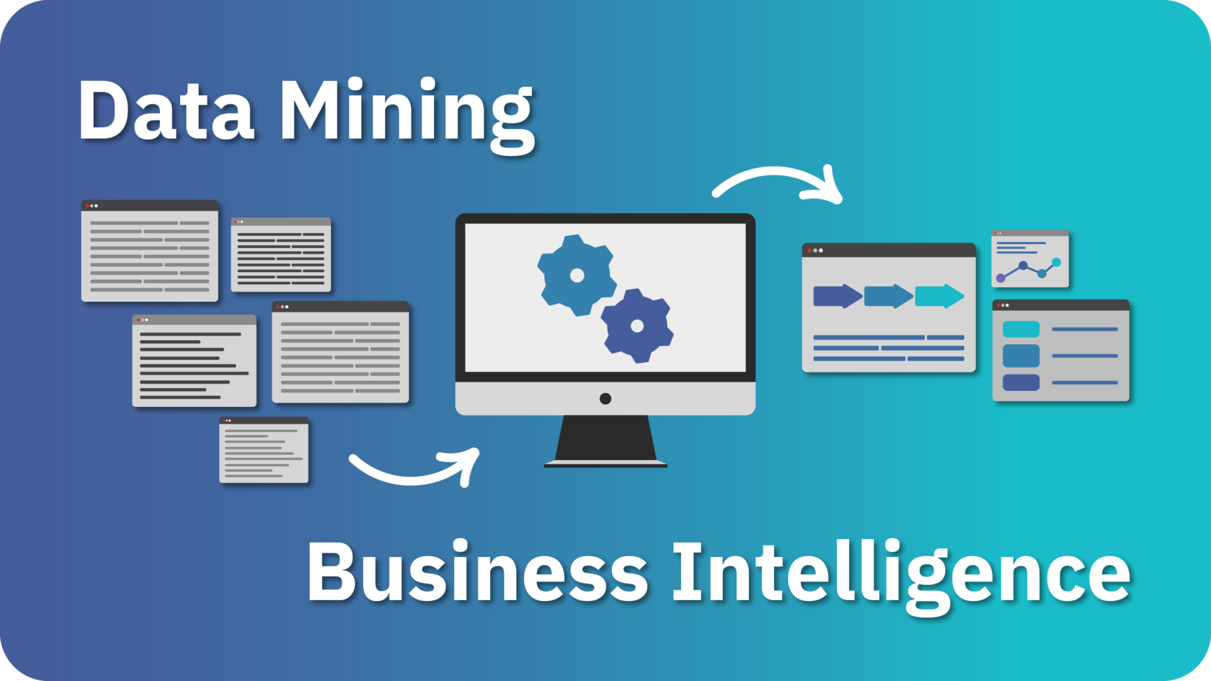
Chapter
10

Slide 22
Chapter
Data Mining
10
- Understand the goals and challenges of data mining.
- Learn about different data mining techniques and algorithms.
- Apply data mining methods to solve real-world problems and extract valuable insights from data.

Slide 23



Thank You

