Slide 1


System Administration (2)
IT401
Prepared by
Dr. Ahmed El-Douh
Lecture 6

Slide 2



System Administration 2
Lecture 6
IT401
Controlling Daemons and Securing OpenSSH
Prepared by
Dr. Ahmed El-Douh

Slide 3
Objectives
Upon completion of this lecture, you will be able to:
  Manage and control system services and daemons using command-line tools.
  Configure and secure the OpenSSH service for remote access.
  Troubleshoot, enable, disable, and protect services to ensure secure system operation

Slide 4
Chapter
Outlines
05
Controlling Services and Daemons
Configuring and Securing OpenSSH Service

Slide 5


Controlling Services and Daemons

Slide 6
Identifying Automatically Started System Processes
Objective
List System Daemons and Network Services.
Identify services managed by systemd and Socket Units.
Introduction to systemd
The primary System and Service Manager in modern Linux.
Manages system startup and server processes.
Activates system resources at boot time and during runtime.
Key Concepts
Daemons: Background processes that perform automatic tasks.
  Start automatically at boot (Names often end in 'd').
Sockets: Primary communication channels used by Daemons to listen for connections.
Socket Units: A systemd mechanism to manage Sockets separately from Daemons.
  Improves system startup speed by only starting the daemon when a connection is received.

Slide 7
A Bit of History: From init to systemd
The Traditional Init System:
  For many years, Process ID 1 was the init process.
  Used System V and LSB init scripts to start frequently used daemons at boot.
  These scripts are shell scripts that varied across distributions.
  Less frequent daemons started on-demand using tools like initd or xinetd.
  Traditional init systems had several limitations.
The systemd Era:
  In modern Linux e.g. RHEL 7, Process ID 1 is systemd, the new init system.
  systemd provides key new features:
    Parallelization capabilities which increase the boot speed of a system.
    On-demand starting of daemons without requiring a separate service.
    Automatic service dependency management to prevent long timeouts.
    Tracking related processes using Linux control groups.

Slide 8
Systemctl and systemd Units
Managing systemd
  The systemctl command is used to manage systemd objects.
  These objects are called Units.
  Use systemctl -t help to see a list of available unit types.
Common systemd Unit Types
  Service Units (.service extension):
    Represent system services like a web server.
    Used to start frequently accessed daemons.
  Socket Units (.socket extension):
    Represent Inter-Process Communication IPC sockets.
    Used to delay service start at boot time.
    Starts services on demand, similar to xinetd.
  Path Units (.path extension):
    Delay service activation until a specific file system change occurs.
    Common for services using spool directories, such as a printing system.

Slide 9
Systemctl and systemd Units
Viewing Service Status
Use the command: systemctl status name.type.
If you omit the unit type, systemctl will assume it is a service unit.
The command output provides the complete status and log information.
Key Status Fields
  Loaded: Shows if the unit file is loaded and enabled/disabled.
  Active: Shows the current state of the service.
    Example: active (running) indicates the service is running.
  Main PID: The Process ID of the service's main process.
  CGroup: The control group path for all related processes.
  Log Output: Recent log entries generated by the service.
Example Command
  systemctl status sshd.service

Slide 10
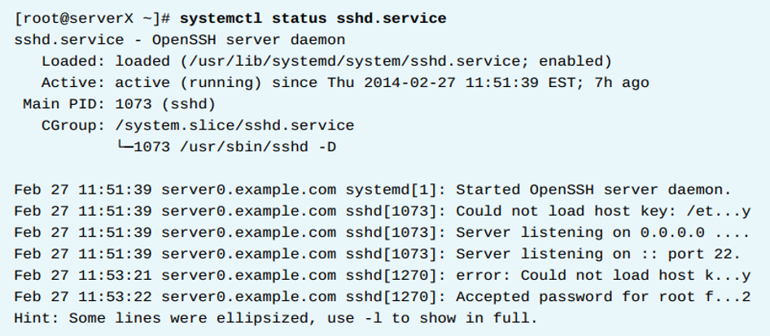
Systemctl and systemd Units

Slide 11
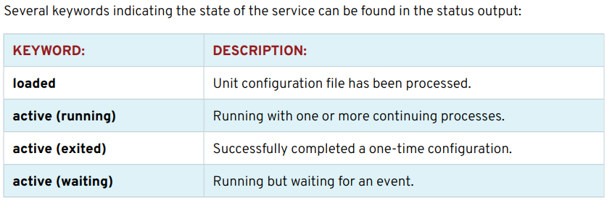
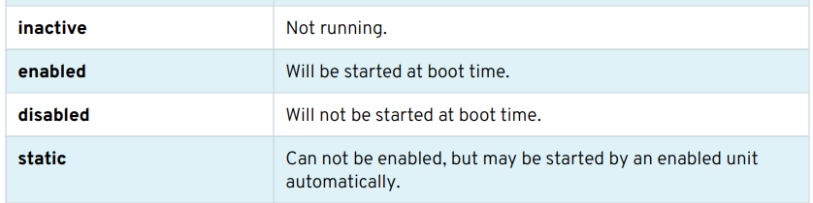
Systemctl and systemd Units

Slide 12
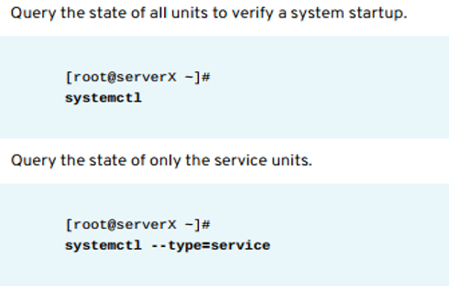
Listing Unit Files with systemctl
The systemctl command automatically paginates the output using the less utility.
Command Examples:
Query the state of all units:
  Command: systemctl
  Purpose: Verify the overall system startup and status.
Query the state of only the service units:
  Command: systemctl --type=service
  Purpose: Filter the output to show only Service Units
  e.g. .service files.

Slide 13
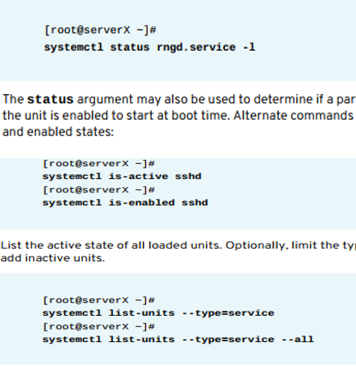
Listing Unit Files with systemctl
3. Detailed Status Investigation
Investigate failed or maintenance units:
  Command: systemctl status rngd.service -l
  The -l option shows the full log output.
4. Checking Specific States
The Status argument shows the active and enabled states.
Alternate Commands for Specific States:
  Check Active State: systemctl is-active sshd
  Check Enabled State: systemctl is-enabled sshd
5. Listing and Filtering Units
List the active state of all loaded units:
  Command: systemctl list-units --type=service
  the --all option to show inactive units as well.
  Command: systemctl list-units --type=service --all

Slide 14
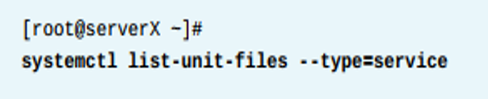

Listing Unit Files with systemctl
6. View enabled and disabled settings for all units:
  Command: systemctl list-unit-files --type=service
  This output shows the enabled or disabled status for each unit.
7. View only failed services:
  Command: systemctl --failed --type=service
  The --failed option filters the unit list to show only units that are in a failed state.

Slide 15
Controlling System Services

Slide 16
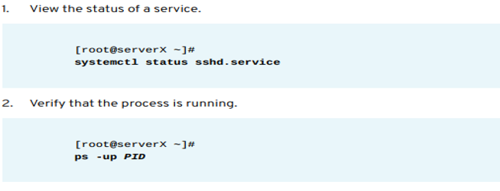
Controlling System Services
Service Management Actions
  Restarting: Necessary after configuration file changes or updates.
  Stopping: Used before removing software or when a service is no longer needed.
  Manual Starting: An administrator may start a service on-demand if it is infrequently used.
Example Steps:

Slide 17
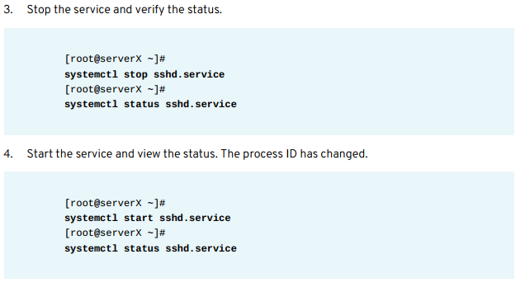
Controlling System Services

Slide 18
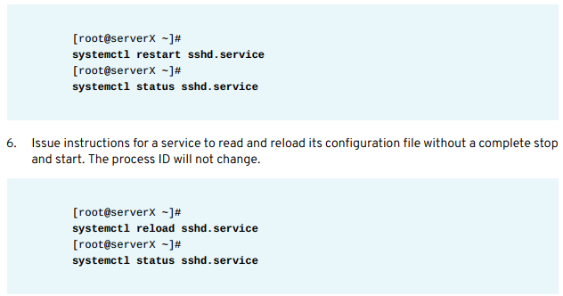
Controlling System Services

Slide 19
Unit Dependencies

Slide 20
Unit Dependencies
Dependency Activation
  Services may be started as dependencies of other units.
  Socket Units can automatically start a service when a network request is made.
  Path Units can start a service when a specific file system condition is met.
  Example: A file in the print spool directory triggers the cups.service.

Slide 21
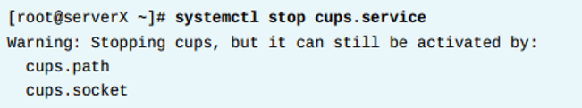
Unit Dependencies
Stopping Dependent Services
  To completely stop a service, all its dependent units must be stopped.
  Disabling a service will automatically disable its dependencies.
Listing Dependencies (systemctl list-dependencies)
  Command: systemctl list-dependencies UNIT
  Shows a tree of other units that must be started.
Reverse Dependency:
  Use the --reverse option to show which units depend on the specified unit.

Slide 22
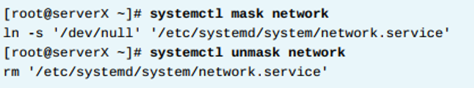
Masking Services
Purpose of Masking
  Used to prevent an administrator from accidentally starting a conflicting service.
  Relevant when multiple methods exist to manage a resource e.g., networks, firewalls.
How Masking Works
Masking creates a symbolic link in the configuration directories.
This link points the service file to /dev/null.
If anyone tries to start the masked service, nothing will happen.
Masking Prevent start:
  Command: systemctl mask network
Unmasking Allow start:
  Command: systemctl unmask network

Slide 23



Enabling Services at Boot
Key Concept
Starting/Stopping a service manually does not guarantee its state after a reboot.
Services are started at boot time via symbolic links managed by systemctl.
Service Management Actions:
1. View the status of a service:
  Command: systemctl status sshd.service
2. Disable the service at boot:
  Command: systemctl disable sshd.service
  Note: Disabling a service does not stop it immediately.
3. Enable the service at boot:
  Command: systemctl enable sshd.service
  Verification: systemctl is-enabled sshd.service

Slide 24
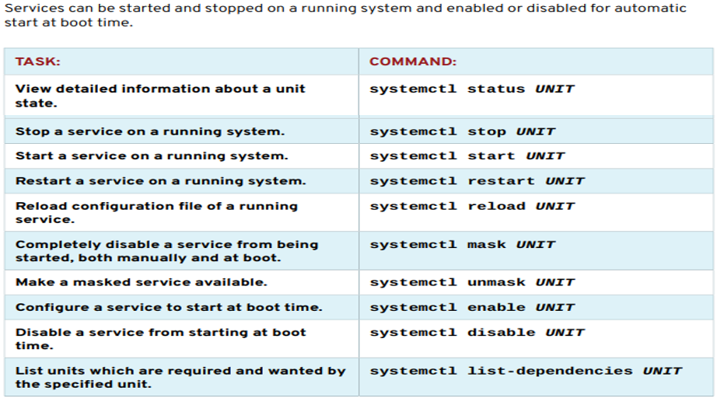
SUMMARY OF systemctl COMMANDS

Slide 25
Configuring and Securing OpenSSH Service

Slide 26
Configuring and Securing OpenSSH Service
Goal
To configure secure command-line access on remote systems using OpenSSH.
Objectives
Log in to a remote system using ssh to run commands from a shell prompt.
Set up ssh for secure password-free logins using a private authentication key file.
Customize sshd configuration to restrict direct logins as root or to disable password-based authentication.
Sections
Accessing the Remote Command Line with SSH.
Configuring SSH Key-based Authentication.
Customizing SSH Service Configuration.

Slide 27
Accessing the Remote Command Line with SSH

Slide 28
Accessing the Remote Command Line with SSH
What is OpenSSH Secure Shell )SSH(?
OpenSSH is the software implementation of the Secure Shell protocol.
SSH is used to securely run a shell on a remote system.
The ssh command is the primary tool used to remotely log into a system.
SSH can also be used to run an individual command on a remote system.

Slide 29
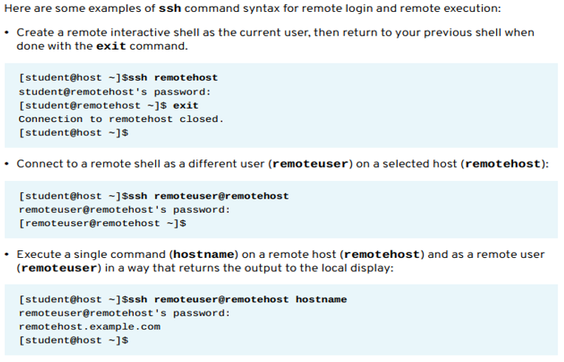
Accessing the Remote Command Line with SSH
Secure Shell SSH Examples:

Slide 30
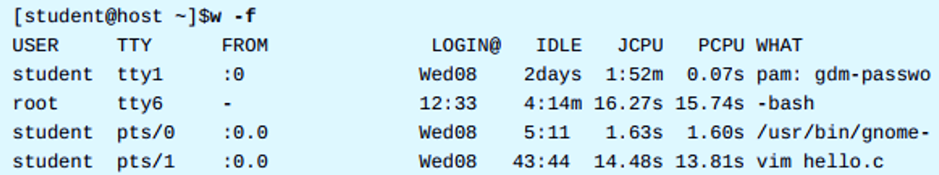
Accessing the Remote Command Line with SSH
Listing Logged-In Users (w command)
Purpose of the 'w' command
  The w command displays a list of all users currently logged into the computer.
  It is useful for showing which users logged in using ssh from remote locations and what they are currently doing.
Command Syntax and Output:
Command: w -f
  The -f option shows the FROM column, which indicates the remote host or location of the user's connection.
Output Information:
  USER: The username.
  TTY: The terminal type (e.g., tty1 for local, pts/0 for remote/pseudo-terminal).
  FROM: The remote location or IP address (especially for SSH logins).
  WHAT: The current command being run by the user.

Slide 31
SSH HOST KEYS
Security Mechanism:
SSH secures communication via public-key encryption.
The server sends its public key to the client before the login process.
Purpose: Sets up secure encryption and authenticates the server to the client.
The known_hosts File:
The first time a user connects, the ssh command stores the server’s public key in the user's $\sim/.ssh/known_hosts file.
Subsequent Connections: The client compares the stored key with the key sent by the server.
Key Mismatch: If keys do not match, the client breaks the connection, assuming the server is compromised or the traffic is being hijacked.
Key Change Management:
If the server's public key changes (e.g., due to loss or replacement), users must remove the old entry from their $\sim/.ssh/known_hosts file to log in successfully.

Slide 32
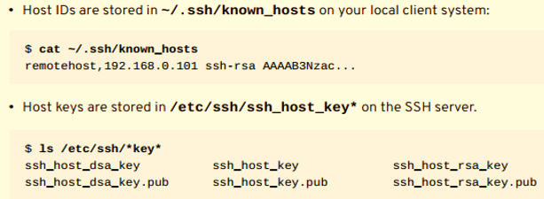
SSH Key Locations
1. Client System Key Storage
  Host IDs (Public Keys of remote hosts) are stored on the local client system.
  File Location: $\sim/.ssh/known_hosts
  Content Example: Shows the remote host name/IP and its public key hash.
2. SSH Server Key Storage
  Host keys (The server's actual Public and Private keys) are stored on the SSH server.
  Directory Location: /etc/ssh/
  Key Files: These include the private key and the corresponding .pub (public) key for different encryption types (e.g., ssh_host_rsa_key, ssh_host_dsa_key).

Slide 33
CONFIGURING SSH KEY-BASED AUTHENTICATION

Slide 34
SSH Key-Based Authentication
Authentication Scheme:
  Key Generation: SSH uses a private-public key scheme where two keys are generated (a private key and a public key).
  Private Key: Used as the authentication credential and must be kept secret and secure (like a password).
  Public Key: Copied to the remote systems the user wants to log into and is used to verify the private key. It does not need to be secret.
Benefit: Allows access to systems without typing a password every time, while remaining secure.

Slide 35
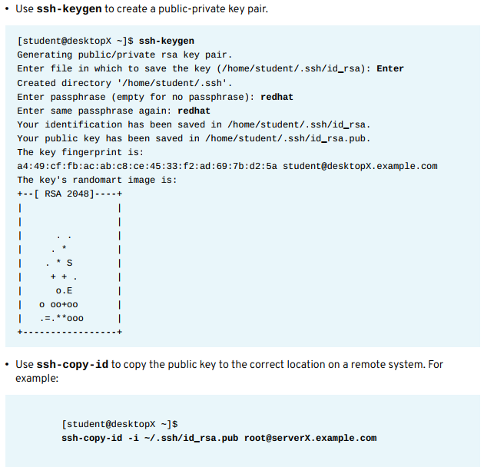
SSH Key-Based Authentication

Slide 36
Customizing SSH Service Configuration

Slide 37
Customizing SSH Service Configuration
The OpenSSH Server Configuration File:
  The OpenSSH server configuration typically does not require modification, but additional security measures are available.
  Various aspects of the OpenSSH server can be modified in the configuration file: /etc/ssh/sshd_config.

Slide 38
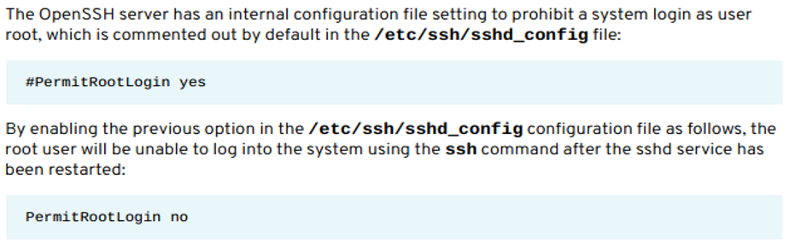
Prohibiting Root SSH Login
Security Rationale:
It is advisable to prohibit direct root login with ssh from a security standpoint.
Reasons:
  The root username exists by default, requiring an attacker only to guess the password.
  The root user has unrestricted privileges (highest risk if compromised).
Configuration Steps:

Slide 39
Applying SSH Changes
1. Restart Requirement:
The sshd service must be restarted after any changes to the /etc/ssh/sshd\_config file to put the changes into effect.
Restart Command (Implicit): systemctl restart sshd (though the slide shows only systemctl sshd).
2. Alternative Root Login Setting:
To allow the root user to log in only with key-based authentication (for security), use the following configuration:
  PermitRootLogin without-password
Note: This setting prevents root login via passwords but still allows secure key-based access

Slide 40

Prohibiting Password Authentication
Advantages of Key-based Login
Security: SSH keys are longer than typical passwords, which enhances security.
Convenience: Less effort is needed to initiate remote shell access after the initial setup.
Configuration Steps
Default Setting: Password authentication is on by default: PasswordAuthentication yes.
Secure Setting: To prevent password authentication and rely only on key-based logins, set the option to: PasswordAuthentication no.
Activation: Whenever the /etc/ssh/sshd\_config file is changed, the sshd service must be restarted to apply the changes.

Slide 41



Thank You

