Slide 1


Project Business
Analysis
Prepared by Eng. Ahmed Hussein, MBA, PfMP©, PMP©, CMP APMG
PMG 461
Bachelor of Project Management
Lecture 7

Slide 2



Business Modeling
Lecture 7
PMG 461
Project Business Analysis
Prepared by
Eng. Ahmed Hussein, MBA, PfMP©, PMP©, CMP APMG
www.midocean.ae

Slide 3
In Previous Lectures
Business Analysts elicit requirements from stakeholders using various qualitative and quantitative techniques.
Business analyst captures Different stakeholders views in Business Activity Models
Business analysts contribute to identifying and engaging stakeholders.
Requirements are engineered through elicitation, analysis, documentation, validation, and requirements management.
It is important to plan for business analysis plan and work plan before starting the analysis
www.midocean.ae

Slide 4

Lecture
What we will cover
07
Business Models Overview
Scope Models
Process Models
Rule Models
Data Models
www.midocean.ae

Slide 5

Lecture
Business Models Overview
07
www.midocean.ae

Slide 6
Definition of a Model
A model is a visual representation of information that operates under a set of rules to efficiently arrange and convey a lot of information in a concise manner.
Business analysis model is a structured representation of information.
Models can be in the form of diagrams, tables, or structured text.
Created with a variety of tools from formal modeling software to whiteboards or artistic software.
There are many business analysis models serving different purposes.
www.midocean.ae

Slide 7
Purpose of Models
Provide context to better understand information
Facilitate analysis of information through visualization and summarization.
Help convey information clearly.
Help find gaps or missing information.
To identify irrelevant information.
www.midocean.ae

Slide 8
Cateogories of Models
Scope Models
Models that structure and organize the features, functions, and boundaries
Examples:
Goal and Business objectives model
Ecosystem map
Context diagrams
Feature Model
Organization Charts
Use Case Diagram
Fishbone Diagram
SWOT Diagram
Process Models
Models that describe business processes and ways in which stakeholders interact with those processes.
Examples:
Process Flow
Use Case
User Story
Rule Models
Models of concepts and behaviors that define or constrain aspects of a business in order to enforce established business policies
Examples:
Business rules catalog
Decision Tree
Decision Table.
Data Models
Models that document the data used in a process or system and its lifecycle
Examples:
Entity relationship diagram
Data flow diagram
Data dictionary
State table
State diagram
Interface Models
Models that assist in understanding specific systems and their relationships within a solution
Examples:
Report table
System interface table
User Interface flow
Wireframes
Display-Action-Response
www.midocean.ae

Slide 9
Business Modeling is performed within Requirements
Analysis and Documentation.
Business Models are validated in Requirements Validation.
Requirement Elicitation
Requirements Analysis
Requirements validation
Requirements Documentation
Requirements Management
www.midocean.ae

Slide 10
Selection of Models
There may be multiple valid model choices.
We can use more than one type of Model.
Models should be prioritized based on applicability.
Several factors to consider when choosing which model to use.
Methodology
Characteristics
Timing
Categories of Models
Level of Abstraction
Traditional or Agile
nature, scope, and compelxity of project
early phases or late phases of requirements management
level of details needed
better to cover more than one category or even all in some projects.
www.midocean.ae

Slide 11
Examples
Agile project → user stories rather than use cases
Analytics project → data models, data dictionary, and data tables
System migration project → ecosystem map or context diagram, data dictionary, and business rules catalog.
Early in a project (High-level Analysis) → ecosystem map, context diagram, and data dictionary
Later in a project (Detailed level Analysis) → state models, decision models, and user interface models
www.midocean.ae

Slide 12
Lecture
Scope Models
07
www.midocean.ae

Slide 13
Ecosystem Map
A diagram that shows all relevant systems, relationships between them, and any data objects passed between them.
Made up of boxes representing the systems and lines depicting the relationships, labels identify data objects.
Shows all in scope systems that passes or consumes data.
Used to understand all systems that are affected by the in-scope systems and shows interface requirements.
Systems
Data objects
www.midocean.ae

Slide 14
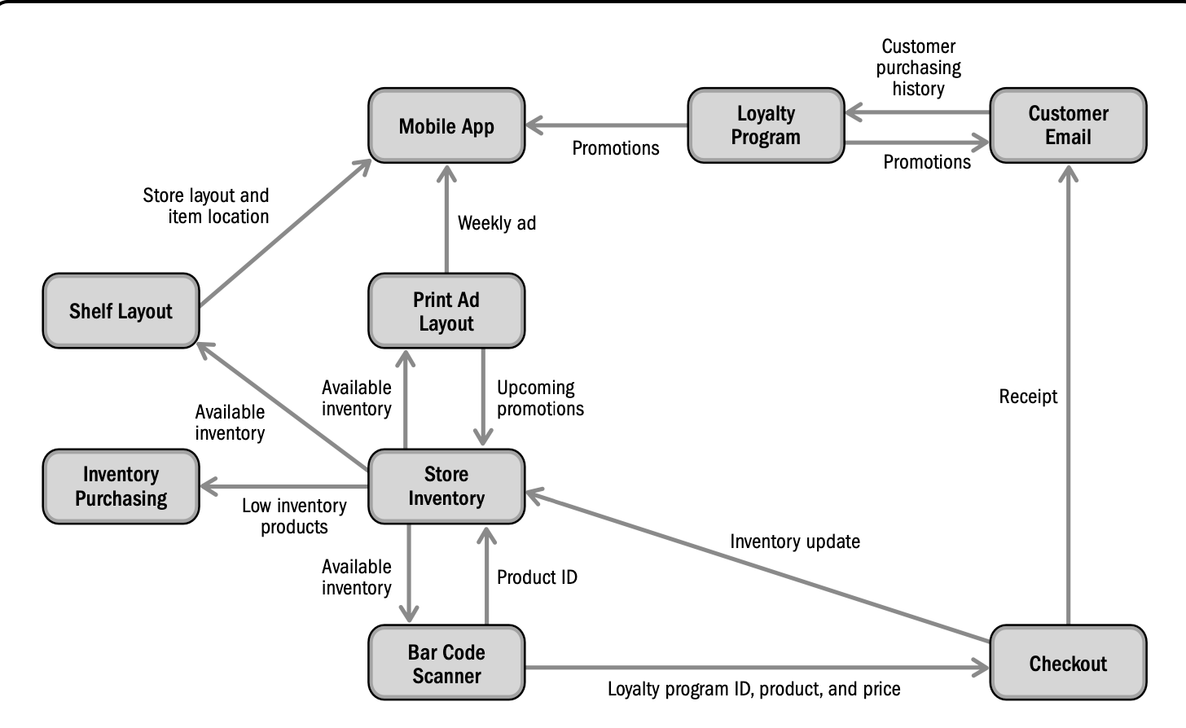
Ecosystem Map Sample
www.midocean.ae

Slide 15

Context Diagrams
Shows all direct and human interfaces to systems within a solution.
System is represented as a circle in the middle, interfaces as boxes. Human actors as people shapes or boxes, lines to show actual interface and data passed.
Called LEVEL 0 of a data flow diagram which digs deeper in details.
Used early in a project to specify the scope and interfaces.
Shows external touch points between the system and the other systems or people,
Helpful in determining where an interface is needed.
Easy to build and understand the as-is and to-be systems.
System
Interfaces
People
Interface
www.midocean.ae

Slide 16
Context Diagram Sample
Online Ordering Application
Supplier
Delivery
Order
Customer Order
Online Ordering App
Customer
Store
Order
Receipt
Reports
Sales Manager
www.midocean.ae

Slide 17
Use Case Diagram
Shows all of the in-scope use cases for a system.
Use case is represented by an oval, actors as stick figures, lines for actor-system interaction, and human interfaces to systems within a solution.
Used to summarize the scope of a solution, highlighting main features.
Shows stakeholders who directly interact with the system, and interfaces needed.
Indicates out of scope to manage stakeholder expectations.
Helpful in planning and tracking progress in building a solution as it summarizes scope of features.
it does not show requirements, but helps to organize requirements in a requirements document.
Use Case
Actors
Actor-System Interaction
www.midocean.ae

Slide 18
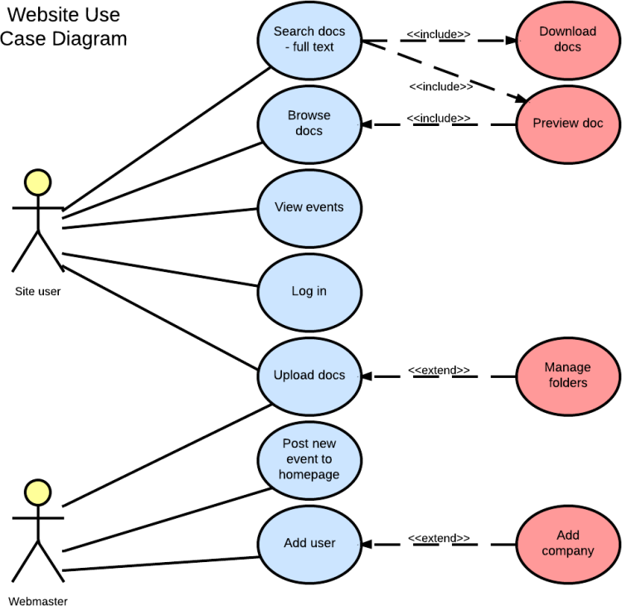
Use Case Diagram Sample
www.midocean.ae

Slide 19
Lecture
Process Models
07
www.midocean.ae

Slide 20
Process Flow Diagram
Also called, process maps, process flow charts, process diagrams, or swimlane diagrams
Describes steps that people or system make.
Steps are represented as boxes, decision logic as diamond, arrows represent order of flow, swimlanes groups steps performed by a person or group.
Used to model both As-Is and To-Be processes.
Valuable in most types of projects whenever there are people performing tasks.
Helps in facilitating conversations with stakeholders during elicitation
Used to identify missing features or requirements
Shows flow of work to provide context and order.
Steps
Decision
Order of Flow
www.midocean.ae

Slide 21
Process Flow Diagram Sample
Develop project charter
Review Business Case
Meet with Sponsor
Develop Project Charter
Start
Project Manager
Approve Charter
Swimlanes
Project Sponsor
No
Yes
File Charter Document
Project Officer
End
www.midocean.ae

Slide 22
Use Cases
Describe a set of scenarios, and is a set of activities, actions, and reactions that take the primary actor from initiation to completion of the goal.
Are text based, usually presented in a tabular format.
Represent functional requirements of a system and cannot be used for non-functional requirements (as how fast the product should work).
Used in complex interactions, and in elicitation sessions to discover and describe interactions
Helpful in creating tests.
Common Fields
Name
Description
Actors
Benefit
Trigger
Flow or steps
www.midocean.ae

Slide 23
Use Cases Sample
ID | Name | Description | Actors | Benefits | Trigger | Flow
A01 | Find Recipe Items | A daily email with the featured recipe is sent to customers who have opted-in to the program. The customer opens the Recipe Box application directly on their iOS or Android device. The customer can choose a past recipe or use the current one. With a recipe chosen, the customer chooses a store or uses a store already indicated a "My Store." A map of the store is displayed with an overlay showing the locations of the items for the recipe. | User | Customer visits store to make purchases related to the recipe which are high-margin cooking items. | Customer clicks on link in email on mobile device or directly opens application | 1. System shows short description of the daily recipe 2. Customer selects current recipe or chooses a past recipe 3. Customer chooses to use their local store ("My Store") 4. System displays map of the store with the recipe items overlaid as icons 5. Customers can select icons to see item aisle and shelf location
www.midocean.ae

Slide 24
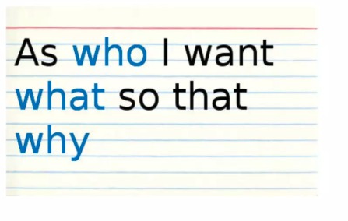
User Stories
A statement written from the point of view of the user, and describes the functionality needed in a solution.
Typically used in Agile methodology.
Follows the format of:
As a <Actor>, I want to be able to <function>, so that I can <business reason>.
Acceptance criteria for each user story is included.
Big user stories (called Epics) are broken down into user stories.
Focus on user, easy for stakeholders to engage with.
Epics and user stories form functional grouping of requirements.
User stories are prioritized and can be traced to releases.
www.midocean.ae

Slide 25
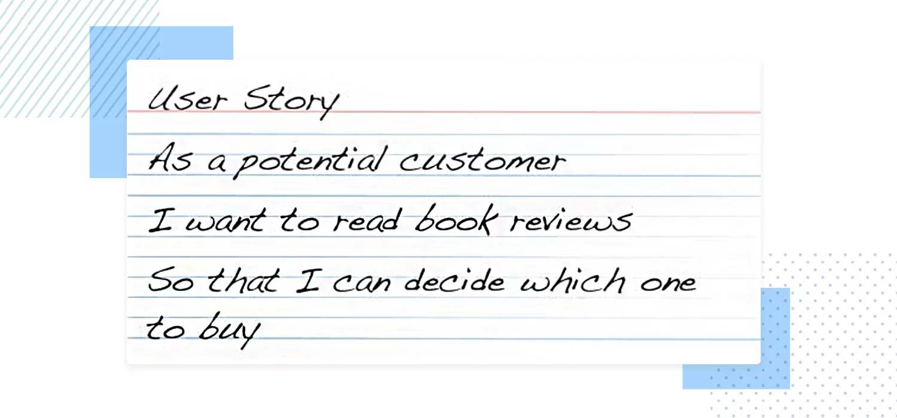
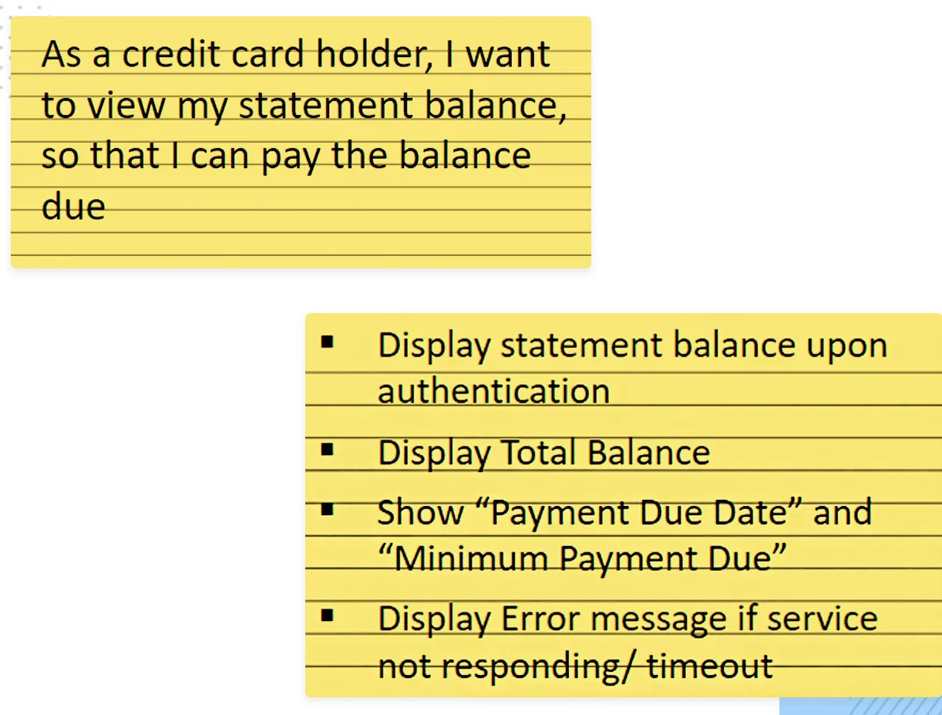
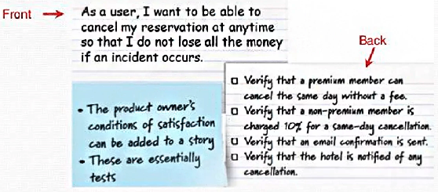
User Stories Sample
www.midocean.ae

Slide 26
Lecture
Rule Models
07
www.midocean.ae

Slide 27
Business Rules Catalogue
A table of business rules and related attributes.
Business rules are not processes, but apply across processes, and describe rules, policies, and constraints.
Rules need to be correct, verifiable, and consistent.
ID | Title | Description | Type | Reference
BR01 | Recipe email opt-in | Recipe emails will only be sent to customers who have opted-in and have a valid e-mail address | Constraint | See corporate email policy
www.midocean.ae

Slide 28
Decision Trees
Represent a series of decisions and their outcomes in a tree of decision points where each branch represent the outcomes of a decision.
Decision points are represented as diamond, outcomes are shown in boxes.
Decision trees work best with binary choices (yes or no).
Inventory Available
Place Order
Yes
Yes
Store within range
No
Select Recipe
Notify user
Notify user
No
www.midocean.ae

Slide 29
Decision Tables
Represent a series of decisions and their outcomes.
Use a tabular format where upper row represents decision points and the other rows represent outcomes.
Used to model complex decision logic
Help to identify ways to reduce complex logic and ensure all possible combinations are considered.
Decision Table | Rule 1 | Rule 2 | Rule 3 | Rule 4
Condition: Stores within preference Range | N | Y | Y | Y
Condition: Inventory available | - | Y | N | N
Outcome: Notify User | X | - | - | -
Outcome: Notify User of Lack of Inventory | - | X | - | -
www.midocean.ae

Slide 30
Lecture
Data Models
07
www.midocean.ae

Slide 31
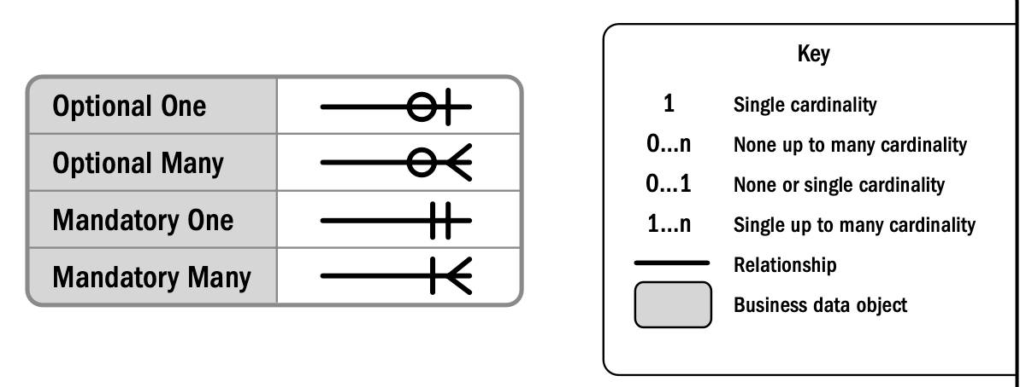
Entity Relationship Diagrams
Entity Relationship diagrams (ERD), also called business data Diagrams, shows business data objects or pieces of information in a project and the relationship between them.
Business data objects represent people, places, things and concepts.
Business data objects are shown as boxed, relationships as line, and cardinality as labels on lines.
Used in projects that has data management components.
Attributes are specified in a data dictionary.
Business Data object
Relationship
www.midocean.ae

Slide 32
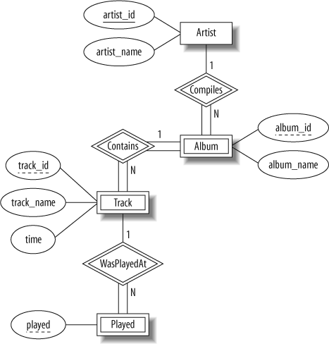
Entity Relationship Diagram Sample
www.midocean.ae

Slide 33
Data Flow Diagrams
Illustrates relationships between systems, actors, and the data that is exchanged over one or more processes.
Can be used after Entity Relationship Diagrams, process flows, and ecosystem maps.
Data stores (parallel lines) show where information is conceptually stored, process steps (circles) indicate functions using the data, and entities (boxes) create or consume data.
Used to describe movement of data between actors, systems.
Identify data inputs and outputs of processes.
DFD do not specify timing or sequence.
Data Store
Process Steps
Entities
www.midocean.ae

Slide 34
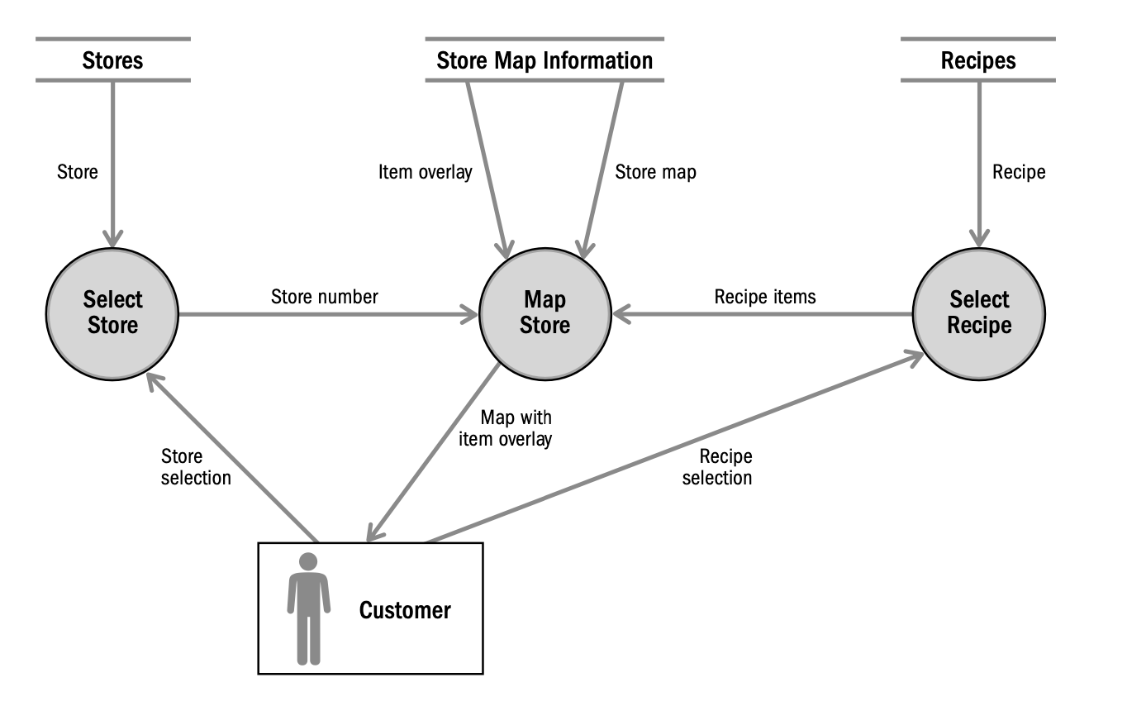
Data Flow Diagram Sample
www.midocean.ae

Slide 35
Data Dictionary
A tabular format that shows data fields and attributes of these fields.
ID | Business Data object | Field Name | Description | Unique Value | Data Type | Length | Valid values
R01 | Recipe | Recipe Text | Recipe in formatted layout | Yes | Alphanumeric | <200 characters | Structured Text
www.midocean.ae

Slide 36
Lecture
Key Points
07
Models are a visual representation of information and efficiently arrange and convey a lot of information in a concise manner.
Typically in a project, more than model is used, depending on need, methodology, characteristics, timing, and level of detail.
Models are categorized as scope, process, data, rules, and interface models.
Models are done in requirements analysis and documentation, and validated in requirements validation.
Business analysts should know various types of models and be able to apply them
www.midocean.ae

Slide 37

For Discussion Panel:
Questions:
Which tools have you used and in which types of projects?
How do these tools helped you in defining and analyzing requirements?
Lecture
07
For Discussion Panel and Next Lecture
www.midocean.ae

Slide 38



Thank You

