Slide 1

CCNA (200-301) Cisco Certified Network Associate
Prepared by Eng. Taghreed Elsayed
Lecture 5
Dynamic Routing

Slide 2
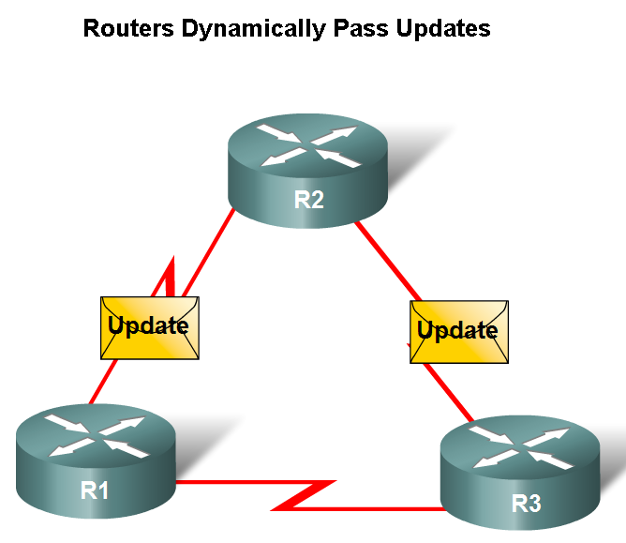

Chapter
03
Dynamic Routing
Dynamic Routing Protocols
Function(s) of Dynamic Routing Protocols:
  -Dynamically share information between routers.
  -Automatically update routing table when topology changes.
  -Determine best path to a destination.

Slide 3
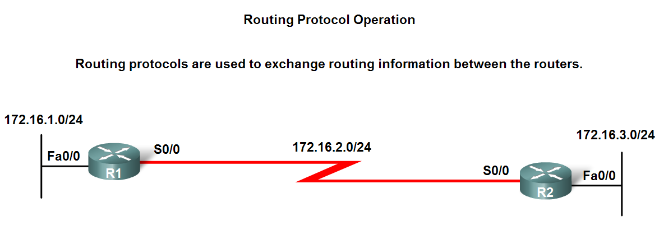
Chapter
03
Dynamic Routing
Dynamic Routing Protocols
The purpose of a dynamic routing protocol is to:
  -Discover remote networks
  -Maintaining up-to-date routing information
  -Choosing the best path to destination networks
  -Ability to find a new best path if the current path is no longer available

Slide 4
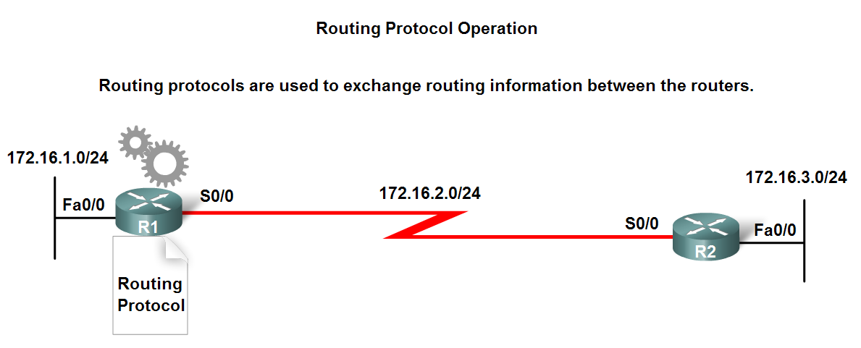
Chapter
03
Dynamic Routing
Dynamic Routing Protocols
Components of a routing protocol
  Algorithm
    In the case of a routing protocol algorithms are used for facilitating routing information and best path determination
  Routing protocol messages
    These are messages for discovering neighbors and exchange of routing information

Slide 5
Chapter
03
Dynamic Routing
Dynamic Routing Protocols
Advantages of static routing
  -It can backup multiple interfaces/networks on a router
  -Easy to configure
  -No extra resources are needed
  -More secure
Disadvantages of static routing
  -Network changes require manual reconfiguration
  -Does not scale well in large topologies

Slide 6
Chapter
03
Dynamic Routing
Classifying Routing Protocols
Dynamic routing protocols are grouped according to characteristics. Examples include:
  -RIP
  -IGRP
  -EIGRP
  -OSPF
  -IS-IS
  -BGP
Autonomous System is a group of routers under the control of a single authority.

Slide 7
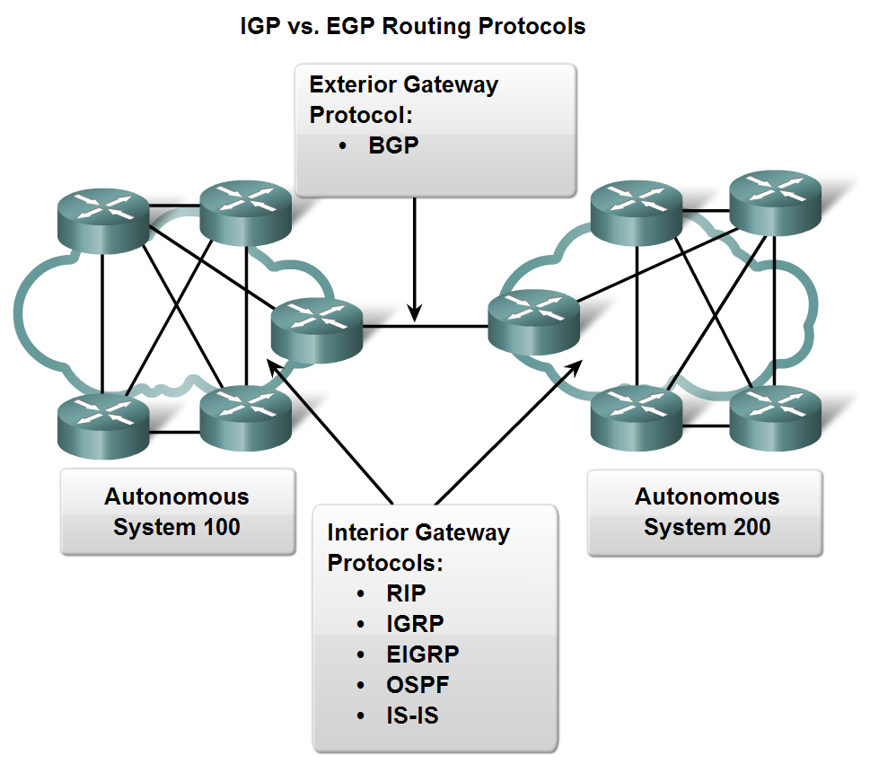
Chapter
03
Dynamic Routing
Classifying Routing Protocols
Types of routing protocols:
  -Interior Gateway Protocols (IGP)
  -Exterior Gateway Protocols (EGP)

Slide 8
Chapter
03
Dynamic Routing
Classifying Routing Protocols
Interior Gateway Routing Protocols (IGP)
  -Used for routing inside an autonomous system & used to route within the individual networks themselves.
  -Examples: RIP, EIGRP, OSPF
Exterior Routing Protocols (EGP)
  -Used for routing between autonomous systems
  -Example: BGPv4

Slide 9
Chapter
03
Dynamic Routing
Classifying Routing Protocols
  Link state
  complete view of network
  topology is created.
  updates are not
  periodic.
IGP: Comparison of Distance Vector & Link State Routing Protocols
  Distance vector
  routes are advertised as vectors
  of distance & direction.
  incomplete view of network
  topology.
  Generally, periodic
  updates.
  Link state
  complete view of network
  topology is created.
  updates are not
  periodic

Slide 10
Chapter
03
Dynamic Routing
Points of difference between IGP protocols:
IGP Category:
1.Distance vector (RIP V 1, RIP V2 , IGRP)
2. Link State (OSPF , IS-IS)
3.Hybrid Balanced (EIGRP)

Slide 11
Chapter
03
Dynamic Routing
  2. Updated Types :
  Routing protocols send updates in two ways
Full update :send full routing table in regular intervals regardless of changes
Consuming B.W and making delay in update exchange (distance vector)
Partial Update :Send a part of routing table changed when the changes are occurred
This maintains B.W and reduces delay (link state & Hybrid Balanced)

Slide 12
Chapter
03
Dynamic Routing
  3. Convergence Time
  is the time required by routing protocols to send updates in routing table to the other routers.
  Routing protocols used full updates have a slow time while Routing protocols used partial updates have faster time

Slide 13
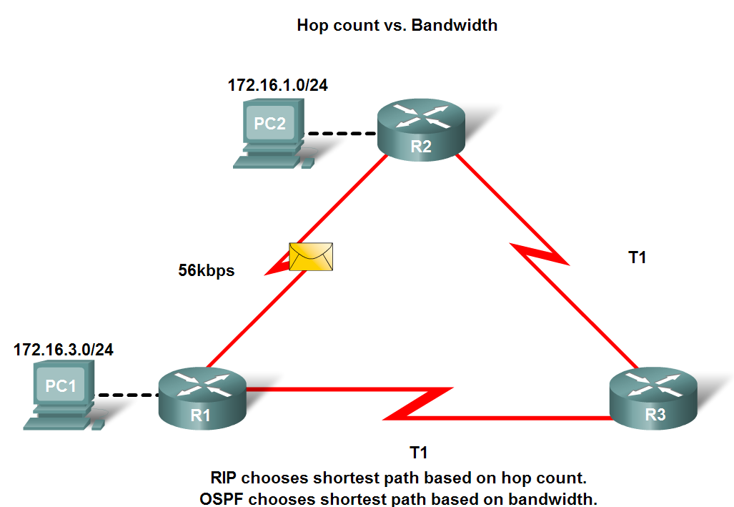
Chapter
03
Dynamic Routing
4.Metric
  A value used by a routing protocol to determine which routes are better than others.
Metrics used in IP routing protocols
  -Bandwidth
  -Cost
  -Delay
  -Hop count
  -Load
  -Reliability
  Best Route = Lowest Metric

Slide 14
Chapter
03
Dynamic Routing
5.Industry Standard or Vendor Specific
  IGRP & EIGRP are vendor specific (worked only in cisco devices)
  (RIP V1, RIP V2 , OSPF ) are industry standard protocols
  6.Classless or Classful Protocols
  Classful Protocols :Send updates without subnet mask
  Classless Protocols Send updates with subnet mask

Slide 15
Chapter
03
Dynamic Routing
7.Multicast or Broadcast update
Type | Destination IP | Routing Protocols
broadcast | 255.255.255.255 | RIP V1
broadcast | 255.255.255.255 | IGRP
Multicast | 224.0.0.10 | EIGRP
Multicast | 224.0.0.5 & 224.0.0.6 | OSPF
Multicast | 224.0.0.9 | RIP V2

