Slide 1


Agile Project
Management
Prepared by Eng. Ahmed Hussein, MBA, PfMP©, PMP©, CMP APMG
PMG 622
Master of Project Management
Lecture 1

Slide 2


History, principles, and values of agile approaches and the Agile Manifesto
Lecture 1
PMG 622
Agile Project Management
Prepared by
Eng. Ahmed Hussein, MBA, PfMP©, PMP©, CMP APMG

Slide 3
Lecture
Key Points from Previous Lecture
01
Organizations need to continuously adapt and change in response to changing business environment
Agile is an iterative and incremental approach to project management that adapts to uncertain, complex and changing needs
Being Agile is a mindset based on Values and principles
In Agile project management approach, the project is delivered in a series of “Iterations”
Agile approaches embrace change, Scope can vary within the project

Slide 4

Lecture
Learning Objectives
01
Understand the Evolution of Agile Project Management
Learn the four values and twelve principles of the Agile Manifesto
List the main agile project management frameworks
Determine factors to select which project management lifecycle to use

Slide 5

History of agile
project management
Lecture
01

Slide 6

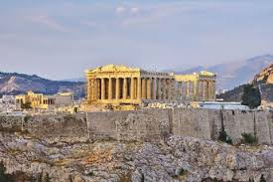

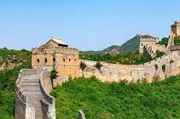
Lecture
History of Project Management
01
Large scale projects existed thousands of years ago and were usually managed by the Technical Engineer or Designer.

Slide 7
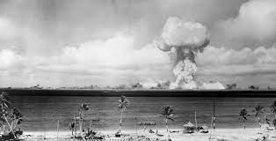
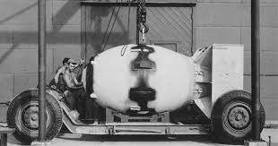
Most people consider Manhattan Project during WWII to be the first project to use “modern” project management

Slide 8
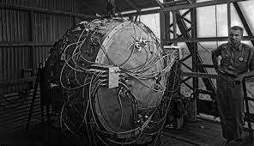
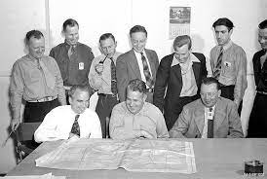
Lecture
History of Project Management
01
Manhattan Project:
  Four-years (1942-1946),
  A team of 130,000 personnel, and
  Spent $2.2 billion
The project had a Project Manager and a Technical Manager
The Project used modern Project Management techniques as the Critical Path Method

Slide 9
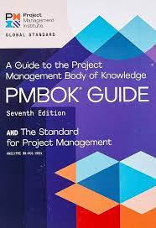
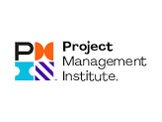
Lecture
History of Project Management
01
The Project Management Institute (PMI) is an international professional society for project managers was founded in 1969
The first PMBOK® Guide published in 1996 in the US
PRINCE was released in 1989 and PRINCE2 in 1995 in the UK.

Slide 10
Characteristics of Traditional Approaches
Define requirements in a clear, complete, and detailed manner
Develop a detailed and complete plan (from start to finish)
Follow the plan, monitor and manage changes
Characteristics:
  Plan-driven
  Process heavy
  Documentation heavy
Plan
Develop
Test
Final Outcome
Deploy
Classic/Traditional/Predictive/Waterfall Approach
Project Timeline

Slide 11
Lecture
History of Project Management
01
As business needs kept emerging and due to the rise of the knowledge work, projects became more complex with high degree of uncertainty.
Traditional project management methodologies were rigid and inflexible leading to projects being:
Over budget,
Behind schedule, or
Their outcomes became obsolete

Slide 12
Lecture
History of Project Management
01
In the 1970s and 1980s.there were efforts to bring flexibility into traditional project management as :
        Introducing phases and rolling wave planning,
        Development of software development methodologies such as Rapid Application Development (RAD) and Adaptive Software Development (ASD).
        These methodologies emphasized the importance of flexibility, adaptability, and customer
        collaboration.
In the late 1990s, software developers began to experiment with new, more agile approaches. These approaches were based on the principles of iterative development, incremental delivery, and continuous feedback.

Slide 13
Lecture
01
The Agile Manifesto

Slide 14
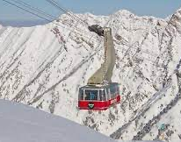
Lecture
The Agile Manifesto
01
In 2001, a group of software developers met at Snowbird, Utah to discuss their experiences with lightweight software development methodologies.
The outcome of this meeting was the Agile Manifesto, a document that outlines the four core principles of agile project management.

Slide 15
Lecture
The Agile Manifesto
01
The Agile Manifesto unified the agile community and raised awareness of agile methodologies.
Agile project management became increasingly popular and is now used by teams of all sizes, in all industries, to deliver high-quality results quickly and efficiently.
Research & Development
Product Development
Business Process Management

Slide 16
Lecture
The Agile Manifesto
01
Agile project management continues to evolve, new practices and tools are being developed to help deliver value to customers more quickly and efficiently.
Agile project management trends include:
            DevOps: a set of practices that combines software development and IT operations to shorten the systems development life cycle and provide continuous delivery with high software quality.
      Scaled agile: frameworks, such as SAFe and Disciplined Agile, designed to help large organizations implement agile principles at scale.
      Agile for business: applying agile principles to business functions other than software development, such as marketing, sales, and product management.

Slide 17
Lecture
The Agile Manifesto – Four Values
01
“We are uncovering better ways of developing software by doing it and helping others do it. Through this work we have come to value:
Individuals and interactions over processes and tools
Working software over comprehensive documentation
Customer collaboration over contract negotiation
Responding to change over following a plan
That is, while there is value in the items on the right, we value the items on the left more.”

Slide 18
Lecture
The Agile Manifesto – Twelve Principles (1/3)
01
1
2
3
4
Our highest priority is to satisfy the customer through early and continuous delivery of valuable software.
Welcome changing requirements, even late in development. Agile processes harness change for the customer’s competitive advantage.
Deliver working software frequently, from a couple of weeks to a couple of months, with a preference to the shorter timescale.
Business people and developers must work together daily throughout the project.

Slide 19
Lecture
The Agile Manifesto – Twelve Principles (2/3)
01
6
7
8
The most efficient and effective method of conveying information to and within a development team is face-to-face conversation.
Working software is the primary measure of progress.
Agile processes promote sustainable development. The sponsors, developers, and users should be able to maintain constant pace indefinitely.
5
Build projects around motivated individuals. Give them the environment and the support they need, and trust them to get the job done.

Slide 20
Lecture
The Agile Manifesto – Twelve Principles (3/3)
01
11
12
The best architectures, requirements, and designs emerge from self-organizing teams.
At regular intervals, the team reflects on how to become more effective, then tunes and adjusts its behavior accordingly.
9
Continuous attention to technical excellence and good design enhances agility.
10
Simplicity--the art of maximizing the amount of work not done–is essential.

Slide 21
Lecture
Agile Project Management
01
iterative and incremental approach
Mindset Based on values and principles
Emphasizes collaboration, change, and flexibility
Agile project management is an iterative and incremental approach to project management that emphasizes collaboration, flexibility, change, and continuous improvement.
Agile project management is a Mindset based on Values and Principles.

Slide 22
Agile is a mindset, defined by values, guided by principals, and manifested through many different practices.
Mindset
4 Values
12 Principles
Practices

Slide 23
Agile vs. Traditional Approaches
Plan
Develop
Test
Final Outcome
Deploy
Classic/Traditional/Predictive/Waterfall Approach
Project Timeline
Agile/Incremental/Iterative Approach
Iteration 1
Iteration 2
Iteration 3
………….
Iteration N
Develop
Test
Develop
Test
Develop
Test
Develop
Test
Plan
Deploy
Plan
Deploy
Plan
Deploy
Plan
Deploy
Intermediate Outcome
Intermediate Outcome
Intermediate Outcome
Final Outcome

Slide 24
Lecture
There are many different Agile frameworks
01
Lean
Agile
Scrum
ScrumBan
Kanban
Crystal
AUP
DSDM
FDD
XP

Slide 25


Lecture
Main Agile Organizations and Certifications
01
Lean
Agile
PMI Agile Certified Practitioner(PMI-ACP®)
Professional Scrum Master (I,II,III)
Scaled Agile Framework (SAFe) Agilist
ICAgile Certified Professional (ICP)

Slide 26
How to select appropriate Project Management approach?
Lecture
01

Slide 27
Lecture
Uncertainty leads to increased project risks
01
Lean
Anticipated high rate of Change and Complexity
Uncertainty
Risk
What are the requirement?
How to fulfill those requirements?
Rework?
Need to change approach
Adapted from: Project Management Institute, Agile Practice Guide, Project Management Institute Inc., 2017, Page 13.

Slide 28
Stacey Complexity Model
High
Chaos
Risk
Complex
Requirements Uncertainty
Complicated
Simple
Low
Low
Technical Degree of Uncertainty
High
Adapted from: Project Management Institute, Agile Practice Guide, Project Management Institute Inc., 2017, Page 14.

Slide 29
Lecture
There are many different Agile frameworks
01
When teams deliver small increments, they better understand requirements in a more accurate manner than with a static written specification
Teams verify work after each small increment and can change what they do next
When requirements are explored iteratively and deliver more often incrementally, the teams adapt to changes more easily
Adapted from: Project Management Institute, Agile Practice Guide, Project Management Institute Inc., 2017, Page 13.

Slide 30
Iterative and Incremental Approaches reduce waste and rework because of feedback and learning
Very Short Feedback Loops
Frequent Adaptation of Process
Reprioritization
Regularly Updated Plans
Frequent Delivery
Source: Project Management Institute, Agile Practice Guide, Project Management Institute Inc., 2017, Page 15.

Slide 31
Agile
Iterative
Incremental

Slide 32
The four main Project Life Cycles
 | Predictive | Iterative | Incremental | Agile
Definition | A more traditional approach, with the bulk of planning occurring upfront, then executing in a single pass; a sequential process | An Approach that allows feedback for unfinished work to improve and modify that work | An approach that provides finished deliverables that the customer may be able to use immediately | An approach that is both iterative and incremental to refine work items and deliver frequently
Example | Building a house | Developing a new medication Product is released at the end only bit (product, technologies, methods might be adjusted along the way | Modifying100 processes in batches of 10 and implementing finished processes in each batch immediately | Developing a software application and adding features while testing different technologies
Definition Source: Project Management Institute, Agile Practice Guide, Project Management Institute Inc., 2017, Page 17.

Slide 33
The Continuum of Project Lifecycles
High
Continuum
Incremental
Agile
Frequency of Delivery
Predictive
Iterative
Low
Low
Degree of Change
High
Source: Project Management Institute, Agile Practice Guide, Project Management Institute Inc., 2017, Page 19.

Slide 34
Lecture
Selecting the project most suitable Life Cycle
01
  Each project must be rated based on:
          Anticipated Degree of Change
    Frequency of Delivery required
  And based on that the most suitable life cycle is selected
There is NO ONE SIZE FITS ALL

Slide 35
Lecture
Key Points
01
Agile project management started slowly since 1970s but gained momentum from 2001 onwards after publishing “The Agile Manifesto”
The Agile Manifesto has 4 values and 12 principles that focus on flexibility, faster delivery, and customer collaboration
There are many frameworks and methodologies following Agile Values and Principles (ex. Scrum, Kanban, XP)
Uncertainty in projects comes from lack of requirements clarity and/or solution clarity
We select the suitable approach to manage the project based on degree of change and frequency of change

Slide 36

Preparation for discussion panel:
Watch the Case study:
“Case Study Tesla | Scrum Academy explains agile at Tesla”
Note: search for more articles/videos on Agile in Tesla
Question for discussion:
How is Tesla implementing Agile mindset, values, and principles?
Lecture
01
For Discussion Panel

Slide 37
Before next lecture:
Download and Read:
”The Scrum Guide”
Lecture
01
For Next Lecture

Slide 38

Thank You

