Slide 1

CCNA - Introduction to Networks v7.0 (ITN)
Prepared by Dr. Abdelrhman Ahmed
Lecture 7
Module 13: ICMP

Slide 2
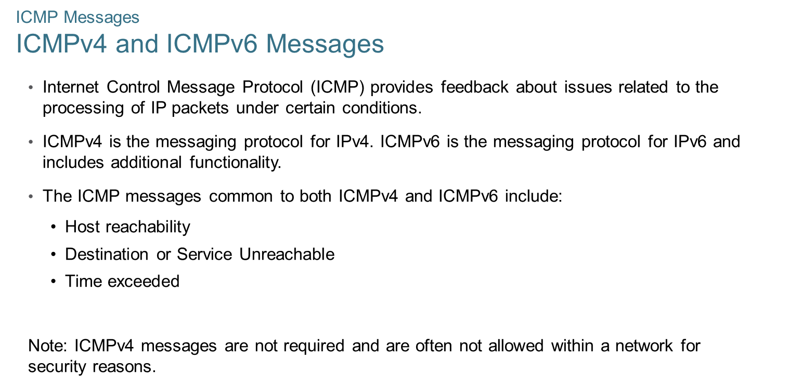

Chapter 7
ICMP Messages

Slide 3
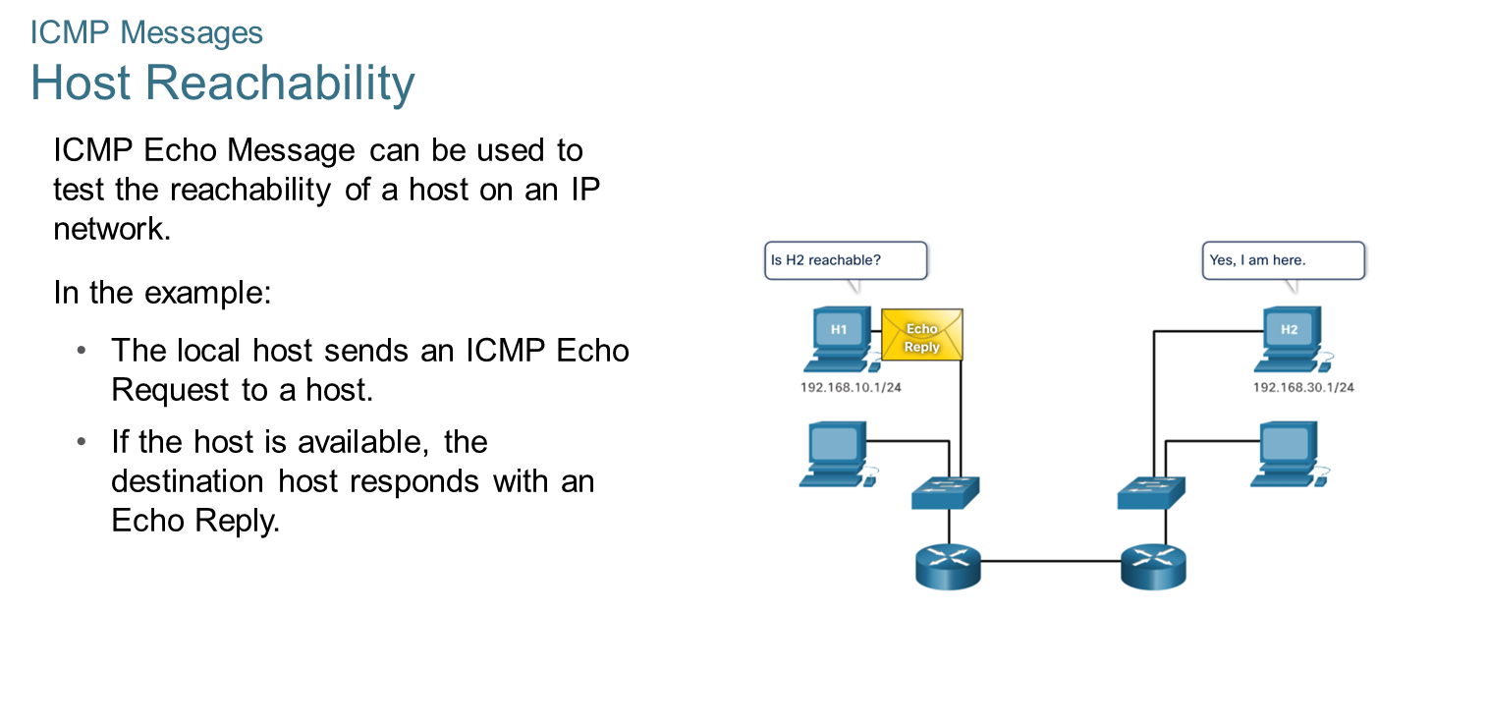
Chapter 7
ICMP Messages

Slide 4
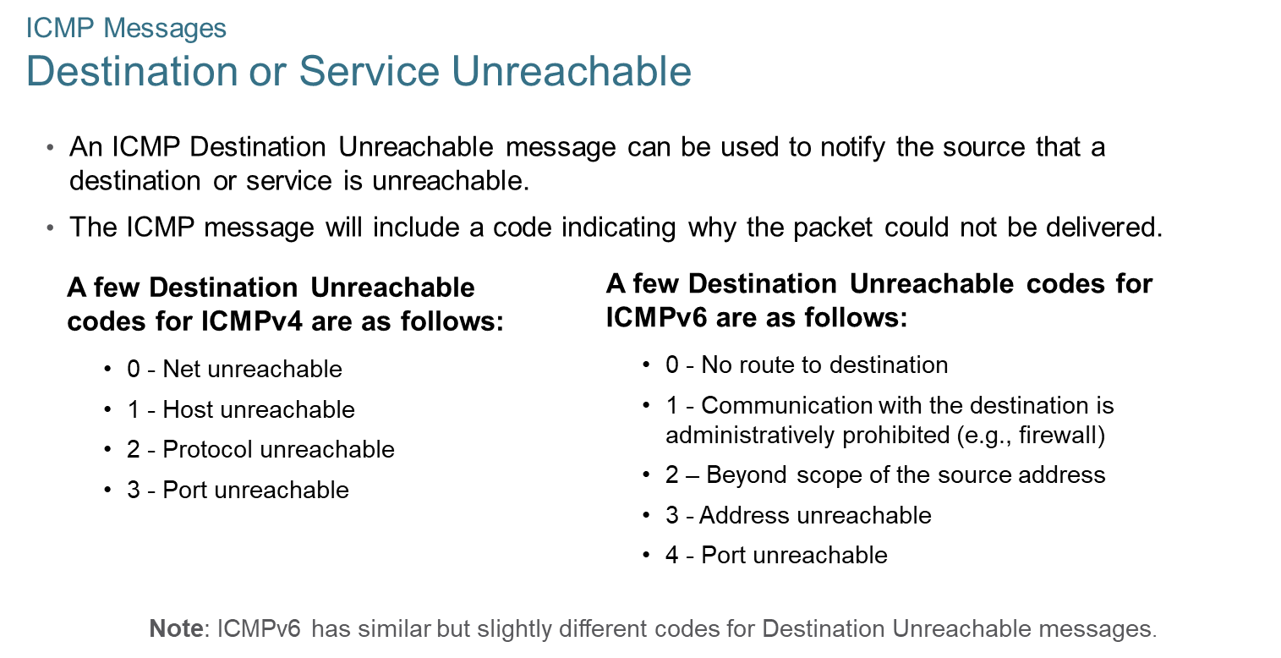
Chapter 7
ICMP Messages

Slide 5
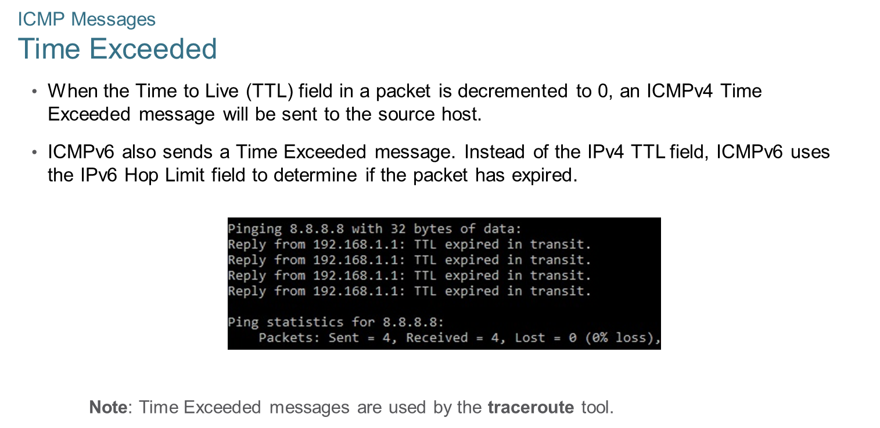
Chapter 7
ICMP Messages

Slide 6
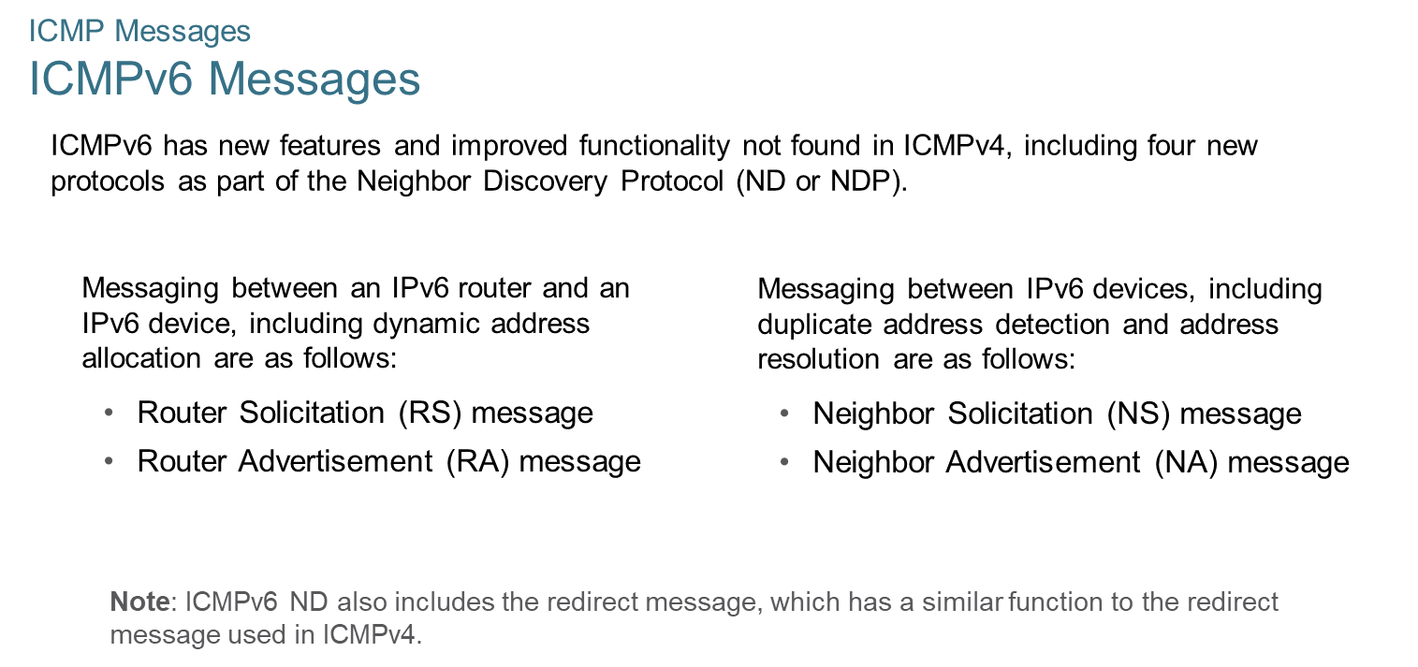
Chapter 7
ICMP Messages

Slide 7
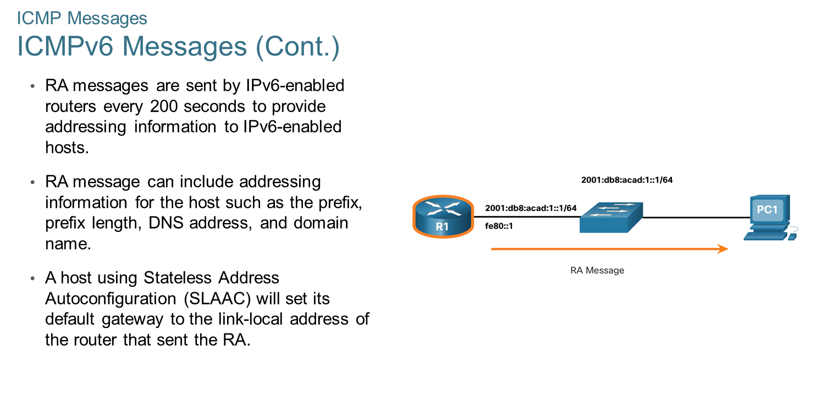
Chapter 7
ICMP Messages

Slide 8
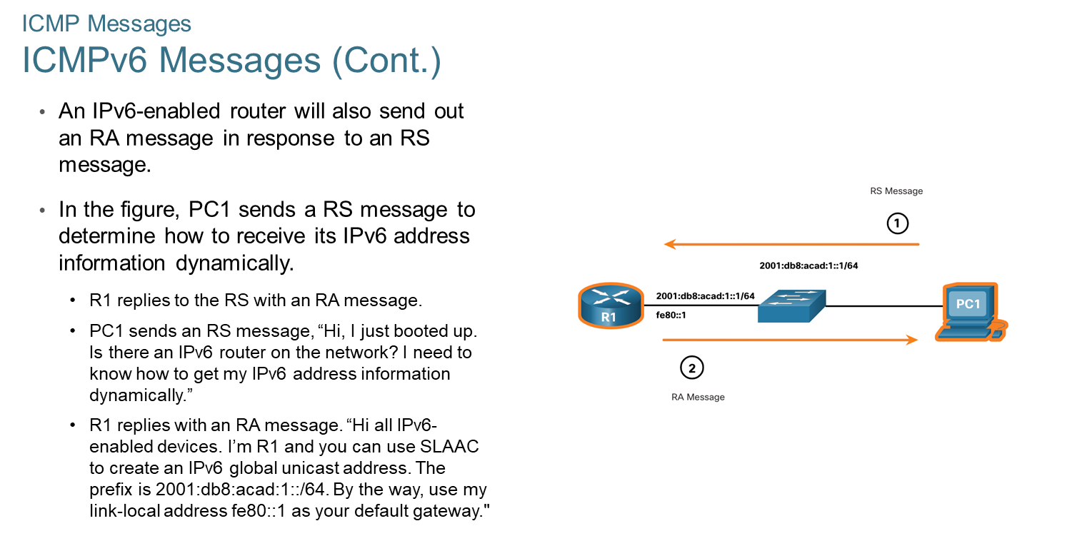
Chapter 7
ICMP Messages

Slide 9
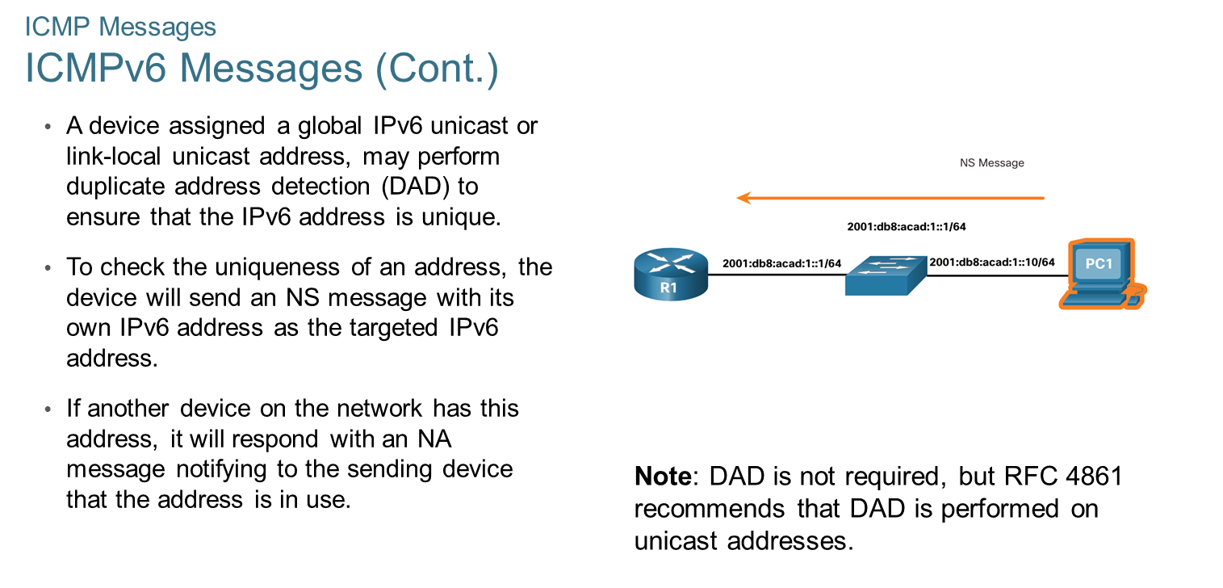
Chapter 7
ICMP Messages

Slide 10
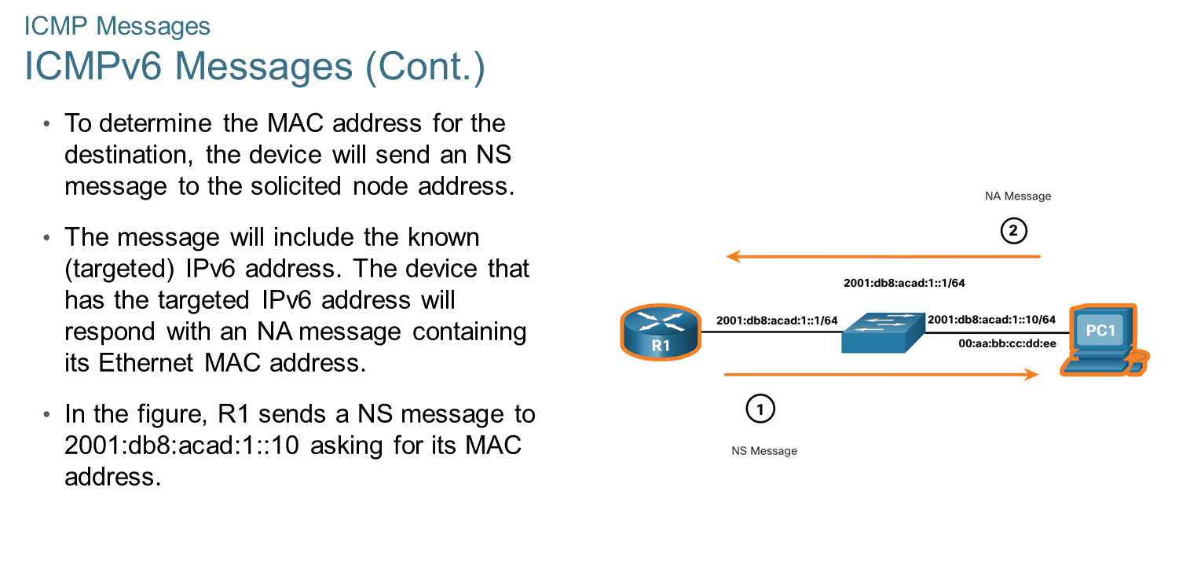
Chapter 7
ICMP Messages

Slide 11
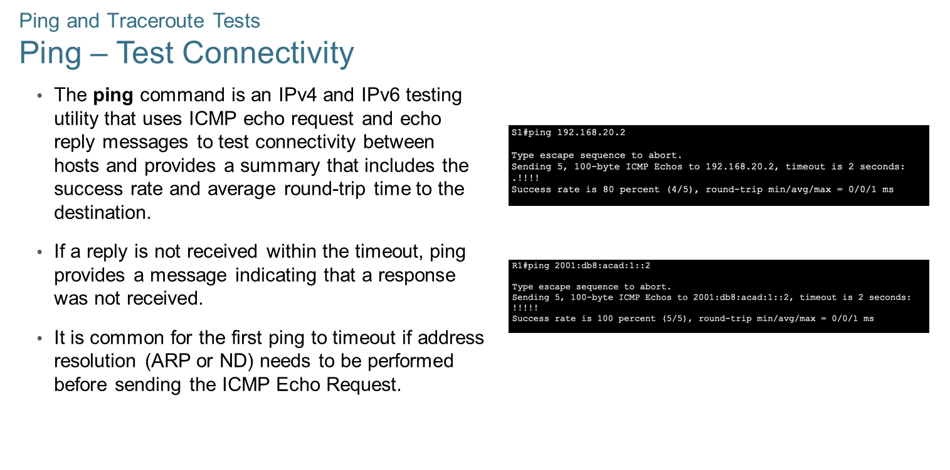
Chapter 7
Ping and Traceroute Tests

Slide 12
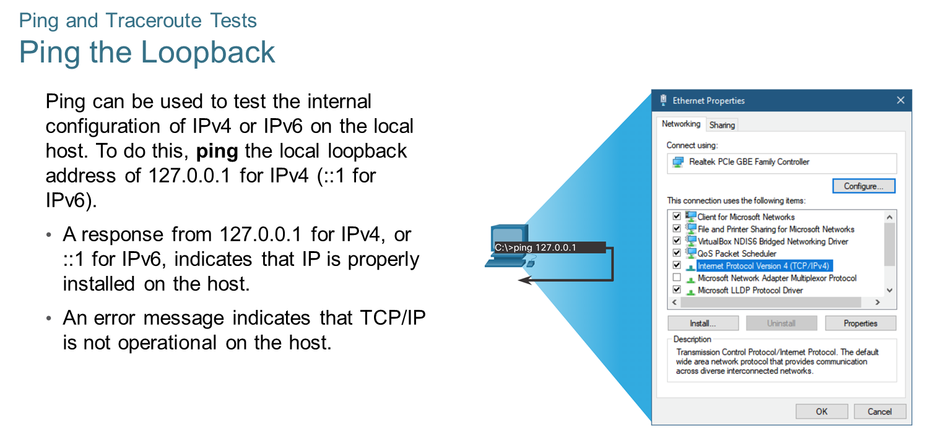
Chapter 7
Ping and Traceroute Tests

Slide 13
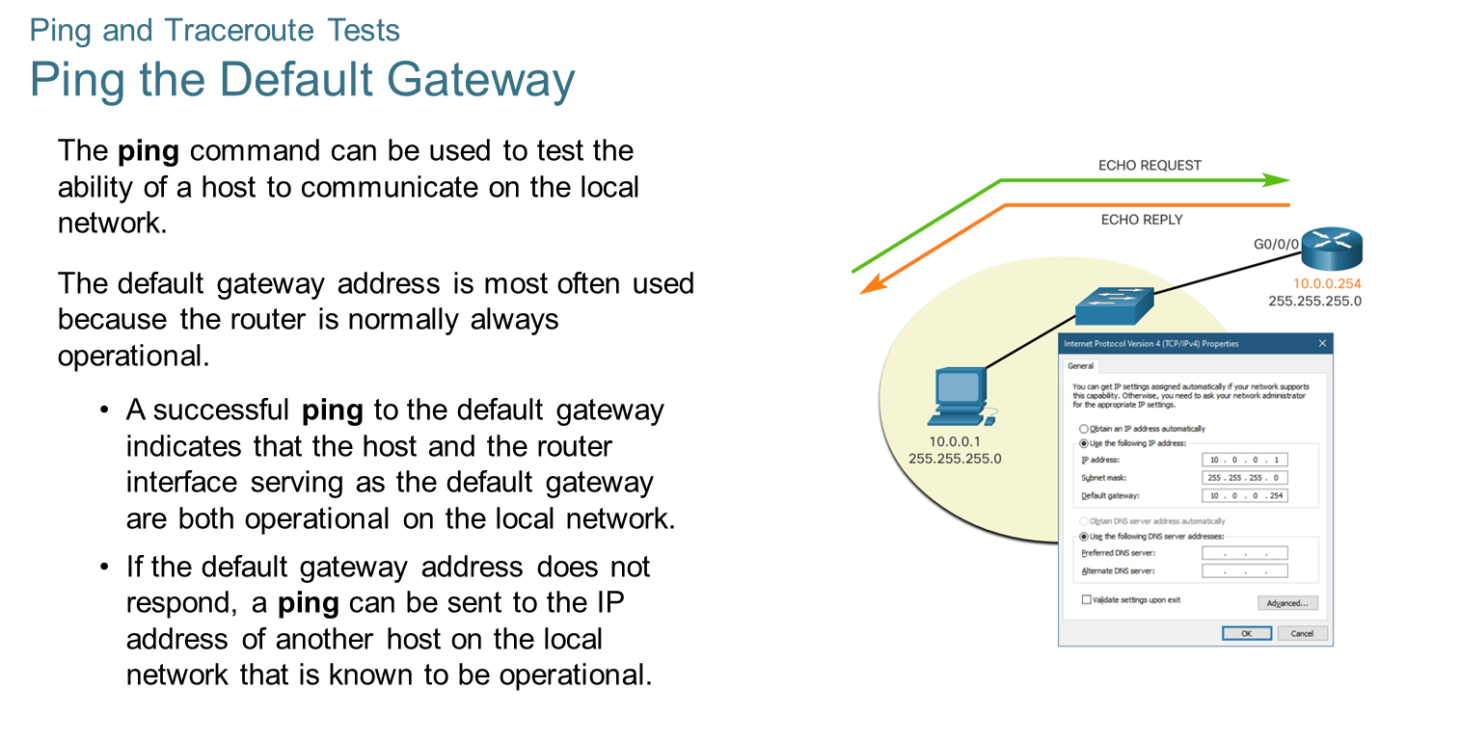
Chapter 7
Ping and Traceroute Tests

Slide 14
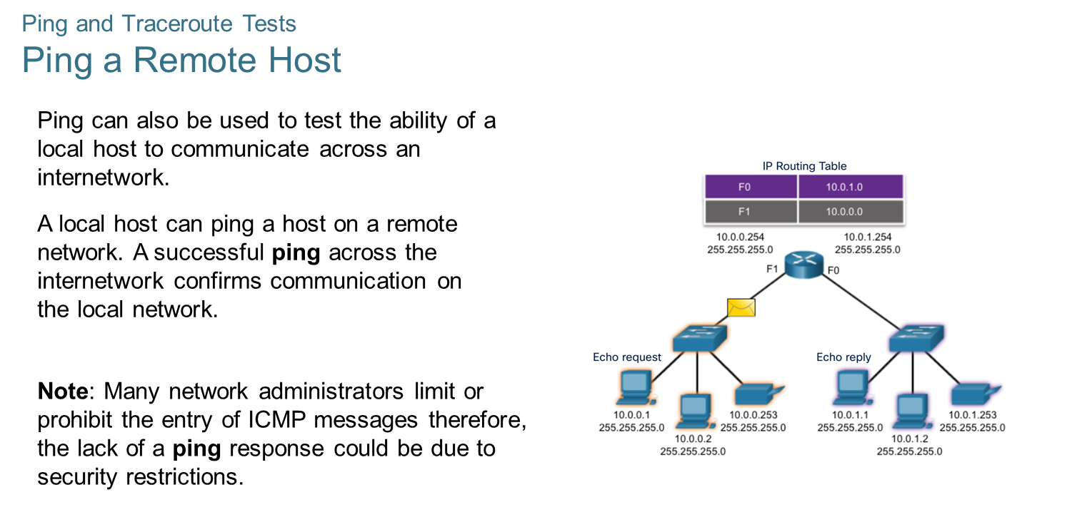
Chapter 7
Ping and Traceroute Tests

Slide 15
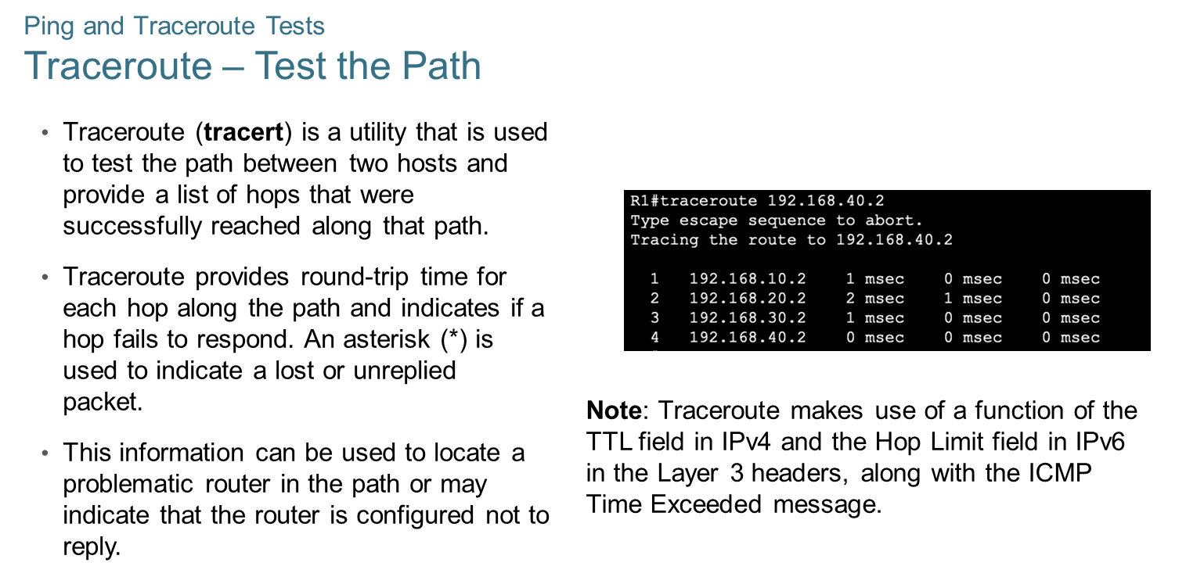
Chapter 7
Ping and Traceroute Tests

Slide 16

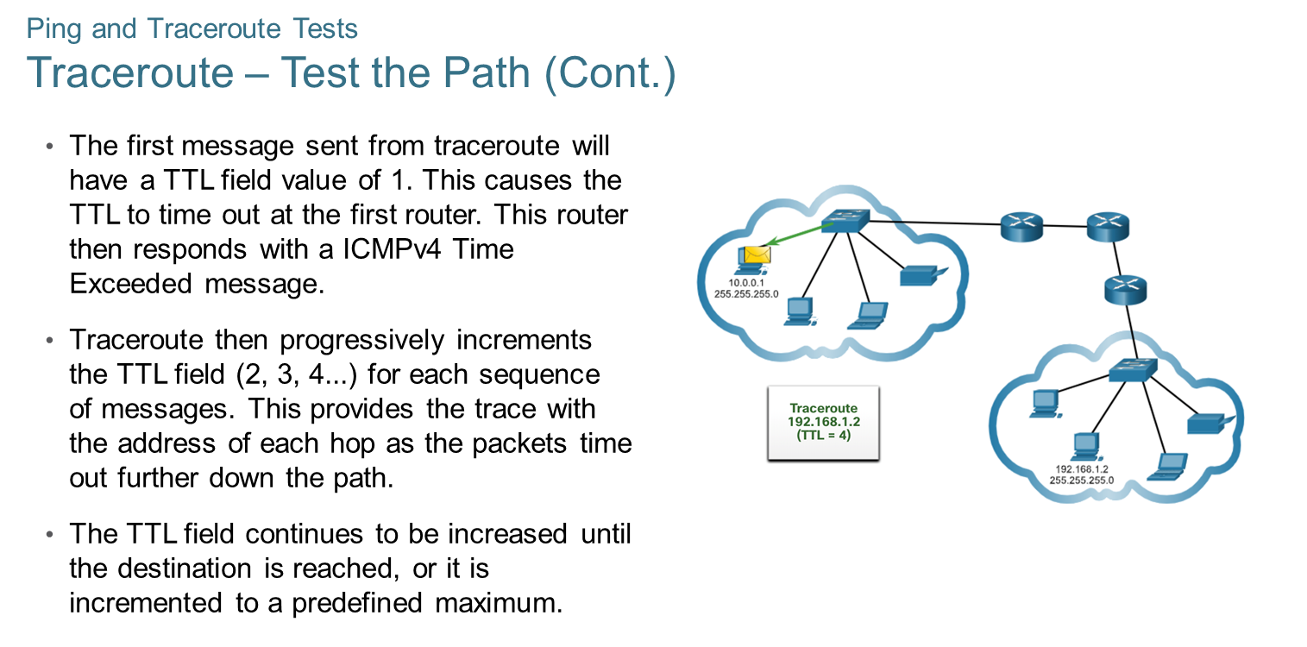
Chapter 7
Ping and Traceroute Tests

