Slide 1


Project Governance
Prepared by Dr. Fayez Jrad
PMG 424
Lecture 07

Slide 2



Project Governance
Lecture 07
PMG 424
Effective Project Governance
Prepared by
Dr. Fayez Jrad

Slide 3
Chapter
Learning Outcomes
07
Discussing the implications of ineffective project governance.
Explaining how effective project governance is necessary for project success.
Understanding the role of effective governance in project decision-making, risk management, and resource allocation.
Summarizing the solutions through which effective project governance enhance project outcomes.

Slide 4
Ineffective Project Governance
It is difficult to determine the extent to which a project’s governance can be said to be the cause of project failure.
Project governance failings are definitely detrimental to the health of a project.
Although the symptom of project failure may vary, problems with project governance will be a significant contributing factor.

Slide 5
Causes of Project Governance Problems
Many of the causes of project governance problems are interrelated and the list is by no means exhaustive.
In addition to organizational structures (heavily discussed in this course), the basic causes of project governance related problems can be categorized to:
Confusion regarding the objectives of project governance (decision-making);
Risk aversion (risk management);
Stakeholder issues (resource allocation).

Slide 6
The Governance Model
Understanding the Causes of Ineffective Project Governance Allows Identifying the Criteria That Any Solution Must Meet To Constitute An Effective and Efficient Project Governance Framework

Slide 7
Project Governance Objectives
Project governance is established to fulfil one primary objective – to enable efficient and effective project decision-making.
A project governance structure must also support project reporting, information dissemination and stakeholder management, since key stakeholders are closely involved in the decision-making process.

Slide 8
Confusion Regarding Project Governance Objectives
Problems arise when the side benefits of project governance become the main driver for the governance structure include:
Overemphasizing on stakeholder management results in committees growing in size to cater for the full range of project stakeholders, which decreases the effectiveness of decision-making.
Overemphasizing on reporting results in the project decision-making structure being integrated within the organization’s structure.

Slide 9
Problems of Overemphasized Project Reporting
Committees heavily reporting up through the line of command, which effectively negates the benefit of having a decision-making committee in the first place.
A project governance structure is formed precisely because the organization’s structure is not designed to meet the needs of project decision-making.
This blurring or integration of project structures and organization structures introduces several undesirable features:

Slide 10
Confusion Regarding Project Governance Objectives
Problems of overemphasized project reporting include:
It adds multiple layers to the decision-making structure, which slows the decision-making process.
Projects require timely decision-making; serial decision-making through the organizational hierarchy does not support this imperative.
The organizational hierarchy includes persons in the decision-making process who may not be best placed to make project decisions.
It blurs accountability since it becomes impossible to distinguish the different accountabilities of the different layers within the decision-making process.

Slide 11
Confusion Regarding Project Governance Objectives
Overemphasizing the decisions around contractual arrangements; the project governance structure should be dealing with the delivery of the complete project as defined by the business case rather than the specific contractual arrangements between customer and supplier.
This leads to detracting from the ability of decision-makers to concentrate on the issues that define the project rather than the issues surrounding the contract.

Slide 12
Risk Aversion
There are many opportunities for an individual in an organization to reduce or ‘smear’ individual risk.
Different organizations have different risk appetites, and the risk culture of the organization is reflected in the approach of its officers.
In large organizations, with their complex management structures, a risk-averse culture can become, to an extent, part of the fabric of the organization.
This consensus approach can lead to unhealthy behaviour in the project governance environment.

Slide 13
Problems with Consensus Approach Regarding Risk Aversion
A consensus approach to decision-making regarding risk aversion does not suit projects for four primary reasons:
This approach is slow.
The poor quality.
The assumption that people in the decision chain are equal.
The consensus-building approach blurs accountability.

Slide 14
This approach is slow
The consensus decision-making approach requires the decision to progress both up the chain of command and across the divisional structure of the organization.
This is done as an attempt to gain buy-in to the decision.
This process is very time-consuming.

Slide 15
The poor quality
The quality of the documentation that informs the decision can suffer since managers in the chain can seek to justify their involvement through ‘adding value’ by making unwarranted or unhelpful changes.
Each change sends the document in question back down the chain to start again.
This leads to the consensus decision-making being not only slows, but also affects the quality of the outcome.

Slide 16
The assumption that people in the decision chain are equal
This approach means that the persons who are best placed to make project decisions have equal weighting with those with marginal project involvement.
The outcome therefore is not necessarily ‘best for the project’ or the organization.

Slide 17
The consensus-building approach blurs accountability
When consensus decision-making is built into the project governance structure, the outcome is unclearly defined roles because accountability cannot be sliced so finely between so many persons.
No one thus can have a clear picture of their accountabilities or responsibilities, both of which are essential for clarity and speed of decision-making.

Slide 18
Project Stakeholders
Key stakeholder support for a project is an essential ingredient for its success.
Conversely, a lack of support by key stakeholders is likely to result in the project failing, remembering that those key stakeholders run business units whose cooperation is essential to project success.
Whatever decision-making body is established for the project should itself comprise the central project stakeholders.

Slide 19
Stakeholder Issues
Not all potential stakeholders can be engaged in project decision-making, since large committees cannot make effective decisions.
Only main stakeholders must be included in decision-making.
Projects run into problems when the decision-making does Not contain the correct stakeholders.
This can result in dissatisfied stakeholders and a lack of resources and clarity around decision-making responsibility.

Slide 20
Deciding on Main Stakeholders
It is important to decide on the main stakeholders who should participate in project decision-making, and other stakeholders whose needs must be addressed through other stakeholder management mechanisms.
The wrong decision potentially results in a failed project due to its inability to address the needs of those stakeholders who are not part of the decision-making.
If stakeholders do Not have a hand in decision-making, they are potentially less interested in supporting the project or providing resources for it.

Slide 21
Effective Project Governance
Effective project governance must address the previously discussed problems and, as far as possible, resolve them.
The extent to which the project governance framework can achieve this is one important measure of its effectiveness.
The following solutions explains the role of an effective project governance framework in addressing decision-making, risk management, and stakeholder (resource allocation) issues.

Slide 22
Summary of Effective Governance Solutions
Clear Objective
The project governance framework must be clear in its objectives.
It must fundamentally address project decision-making but must also address the structure that enables stakeholder management to be addressed.

Slide 23
Summary of Effective Governance Solutions
Efficient and Effective Project Decision-making
The project governance framework must enable efficient and effective project decision-making.
It must address issues such as multi-layered decision-making resulting from:
Organizational chain of command considerations.
The tendency towards consensus decision-making.

Slide 24
Summary of Effective Governance Solutions
Clarity of Accountability
The project governance must provide clarity of accountability and clear and correct assignment of accountability.
Clarity of Structure
The project governance must resolve the relationship between the organization’s structure and the temporary structure put in place to deliver the project.

Slide 25
Summary of Effective Governance Solutions
Focus on Project Delivery
The project governance must support the project, delivering a service rather than being just an asset, since an asset is only a platform for delivering a service.
Decide on Main Stakeholders In Project Decision-making
The project governance must ensure that the stakeholders who comprise the project’s decision-making forum are those necessary to meet the needs of the project without including so many that its effectiveness is reduced.

Slide 26
Summary of Effective Governance Solutions
Address the Needs of Less Important Stakeholders
It must ensure that those stakeholders not included within the decision-making forum have their needs adequately met by the project governance framework.
All These Considerations Must Take Place In a Project Governance Framework To Enable Effective and Efficient Decision-making, Risk Management, and Resource Allocation

Slide 27
Other Considerations of Effective Governance
Confusion Regarding the Objectives of Project Governance
Symptoms | Governance Solutions
Stakeholder management: Large and ineffective decision-making committees | Decide on main stakeholders to be included in the committee
Project reporting: Project governance structure embedded within organization structure. | Keep project decision-making process tight to necessary players to allow more relevant decisions and clearer accountability
Contract management: Decision-making has contract management focus. | Keep the focus on decision on project delivery and not on contractual terms.

Slide 28
Other Considerations of Effective Governance
Risk Aversion
Symptoms | Governance Solutions
Risk management: Consensus decision-making that involves many people across the organization, and analysis paralysis. | Keep the decisions related to risk management relevant through including only the persons who are best placed to make project decisions and eliminating the ones with marginal involvement.

Slide 29
Other Considerations of Effective Governance
Stakeholder Issues
Symptoms | Governance Solutions
Stakeholder management: Dissatisfied stakeholders | Link the project vision and objectives with the goals of all stakeholders to secure their support
Project responsibilities: Lack of clarity around decision-making responsibilities | Ensure clear project responsibilities through including only necessary stakeholders in project decision-making.

Slide 30
In the Total Model of Project Governance, A Paradigm Represents the Tool Used For Linking Project Management Capabilities With Requirements In Accordance With the Wider Corporate Governance Orientation

Slide 31
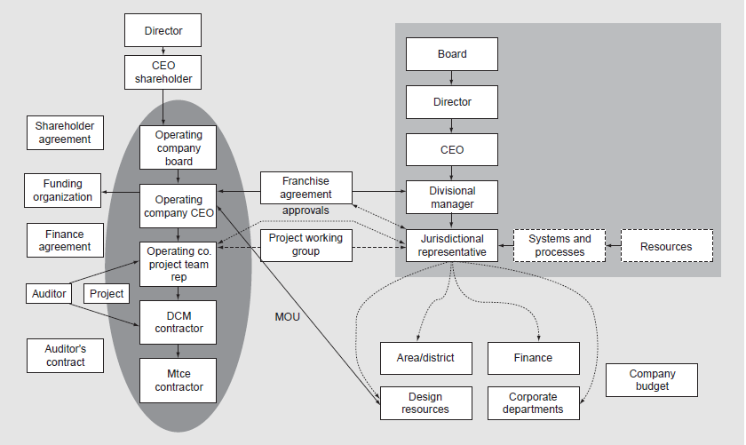

Slide 32
Conclusion
Poor project governance failings will definitely be detrimental to the health of a project.
Although the symptom of project failure may vary, problems with project governance will be a significant contributing factor.

Slide 33
Conclusion
Project governance is established to fulfil one primary objective – to enable efficient and effective project decision-making.
Overemphasizing project reporting and stakeholder management in the project governance structure causes many project disruptions.

Slide 34
Conclusion
An effective project governance provides solutions to address all issues related to decision-making, risk management, and stakeholder. These solutions include:
Ensuring Clear Objective
Making efficient and effective project decisions
Clarifying accountability
Clarifying structure
Focusing on project delivery
Deciding on most relevant stakeholders
Addressing the needs of less important stakeholders

Slide 35
Task 1
Identify two companies in your country (successful and unsuccessful) and compare between their project governance frameworks?

Slide 36
Task 2
Find an ineffective project governance framework, and analysis how it causes the issue related to decision-making, risk management, and resource allocation?

Slide 37

Reference

Slide 38



Thank You

