Slide 1



English Course
Ed Endings / Final S Pronunciation
Prepared by
Ahmed Soliman
www.midocean.ae

Slide 2

Pronunciation of ED Ending
We pronounce the final ed in three ways: /t/ - /d/ - /id/
Watch the video in the next slide to know the rule
www.midocean.ae

Slide 3

www.midocean.ae

Slide 4
The Rule
voiceless + ed /t/
voiced + ed /d/
t / d + ed /id/
s
www.midocean.ae

Slide 5
Voiceless Sounds (no vibration): /p/ - /k/ - /f/ - /s/ - /θ/ (th) - /ʃ/ (sh) - /t/ʃ/ (ch)
Voiced Sounds (vibration): /b/ - /g/ - /l/ - /m/ - /n/ - /r/ - /v/ - /z/ - /ð/ (th) - /ʒ/ - /dʒ/
www.midocean.ae

Slide 6
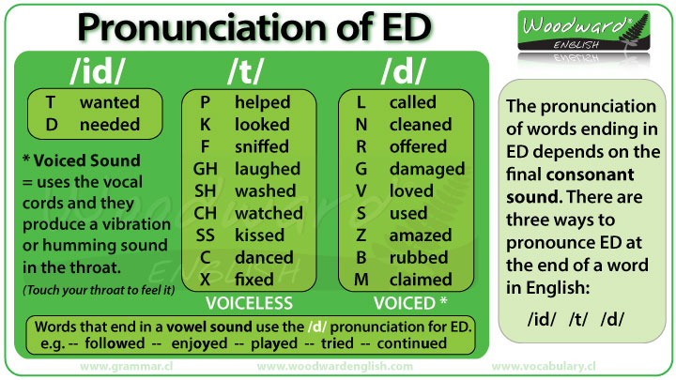
www.midocean.ae

Slide 7
Exercise: Classify the words according to their pronunciation
asked - wanted - moved - watched -helped - kissed - ended - played - missed- offered - claimed
/t/ | /d/ | /id/
asked missed watched helped kissed | moved played offered claimed | ended wanted
www.midocean.ae

Slide 8
Pronunciation of Final S
We pronounce the final S in three ways: /s/ - /z/ - /iz/
Watch the video in the next slide to know the rule
www.midocean.ae

Slide 9

www.midocean.ae

Slide 10
The Rule
voiceless + s /s/
/p/ - /t/ - /k/ - /f/
voiced + s /z/
/b/ - /d/ /g/ - /l/ - /m/ - /n/ - /r/ - /v/ - /w/
/ʃ/ (sh) - /t/ʃ/ (ch) - /dʒ/ - /s/ - /z/ + s /iz/
www.midocean.ae

Slide 11
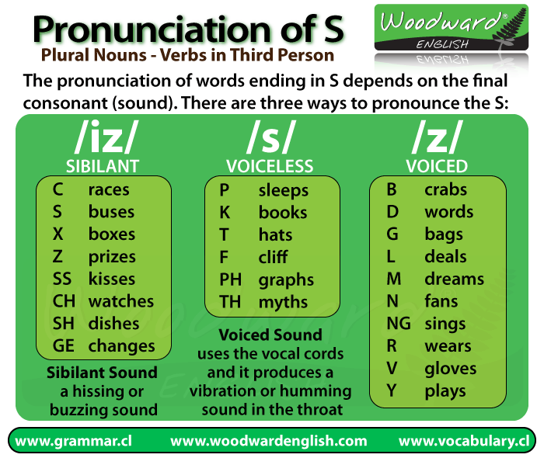
www.midocean.ae

Slide 12
Exercise: Classify the words according to their pronunciation
jars- bags- graphs- prizes-friends - books- labs- kisses- dishes- laps-
things- gloves- buses- fans- watches
/s/ | /z/ | /iz/
www.midocean.ae

Slide 13


Thank You

