Slide 1


Attitudes and Job Satisfaction
Organizational Behavior
and Projects
Lecture 8
PMG421
Conflict and Negotiation
Prepared by
Dr. Mohammed Mustafa
www.midocean.ae

Slide 2




Conflict in Organizations:
Basic Considerations
Causes of Conflict in Organizations
Resolving Conflict in Organizations
www.midocean.ae

Slide 3
Learning Objectives
Describe the three types of conflict and the three loci of conflict.
Outline the conflict process.
Contrast distributive and integrative bargaining.
Apply the five steps of the reducing conflict.
www.midocean.ae

Slide 4

Definitions of Conflict
Conflict:
A process that begins when one party perceives that another party has negatively affected, or is about to negatively affect, something that the first party cares about.
There has been no shortage of definitions for the word conflict, but common to most is the idea that conflict is a perception of differences of opposition.
www.midocean.ae

Slide 5
Definitions of Conflict – Cont.
We define conflict broadly as a process that begins when one party perceives that another party has negatively affected or is about to negatively affect some thing the first party cares about.
People experience a wide range of conflicts in organizations over an incompatibility of goals, differences in interpretations of facts, disagreements over behavioral expectations, and the like.
There is no consensus over the role of conflict in groups and organizations.
www.midocean.ae

Slide 6
Case of Tesla
Tesla, an American automotive and energy company, along with its founder and CEO, Elon Musk, has experienced conflict on several fronts.
From issues with Musk’s candid Twitter posts, lawsuits, and feuds with the Securities and Exchange Commission (SEC) to disagreements among Musk and musicians Azealia Banks and Claire Boucher (a.k.a. Grimes), Tesla, along with the board of directors and employees, has witnessed its fair share of conflict.
www.midocean.ae

Slide 7
Case of Tesla – Cont.
What is interesting, however, is where Tesla has not experienced conflict: within the board of directors.
Many have accused the board of being “asleep at the wheel,” not willing to cause conflict where some might be needed.
This might be due to loyalty to Musk and lack of time and resources (most board members are part time) and because all the corporate information they receive that affects their decision making is filtered through Musk.
www.midocean.ae

Slide 8
Case of Tesla – Cont.
This has even led some to suggest using artificial intelligence (AI) in corporate board decision making, which is not limited by lack of time and resources and is perhaps more impartial.
The case of Tesla illustrates that conflict can arise in a number of different organizational arenas and that even the absence of conflict altogether can be a signal that perhaps important issues are not being discussed or that controversial ideas are not being challenged.
www.midocean.ae

Slide 9
Case of Tesla – Cont.
This has even led some to suggest using artificial intelligence (AI) in corporate board decision making, which is not limited by lack of time and resources and is perhaps more impartial.
The case of Tesla illustrates that conflict can arise in a number of different organizational arenas and that even the absence of conflict altogether can be a signal that perhaps important issues are not being discussed or that controversial ideas are not being challenged.
www.midocean.ae

Slide 10
(Dys) functional Conflict
In the past, researchers tended to argue about whether conflict was uniformly good or bad.
Such simplistic views eventually gave way to approaches recognizing that not all conflicts are the same and that different types of conflict have different effects.
Contemporary perspectives classify conflict based on its effects as functional or dysfunctional.
www.midocean.ae

Slide 11
Functional Conflict
Functional conflict supports the goals of the group, improves its performance, and is thus a constructive form of conflict.
For example, a debate among members of a corporate board about the most efficient way to improve production can be functional if unique points of view are discussed and com pared openly.
www.midocean.ae

Slide 12
Functional Conflict – Cont.
This form of conflict can be an antidote for groupthink (see the chapter on groups).
It does not allow the group to passively rubber-stamp decisions that may be based on weak assumptions, inadequate consideration of relevant alternatives, or other weaknesses.
Conflict challenges the status quo, furthers the creation of new ideas, promotes reassessment of group goals and activities, and increases the probability that the group will respond to change.
www.midocean.ae

Slide 13
Dysfunctional Conflict
Conflict that hinders group performance is destructive or dysfunctional conflict.
A highly personal struggle for control in a team that distracts from the task at hand is dysfunctional.
Exhibit below; provides an overview depicting the effect of levels of conflict.
This form of conflict has clear detrimental effects on interpersonal dynamics, fosters negative emotions (e.g., anger, frustration, annoyance), and seeks to divide rather than unite toward a common goal
www.midocean.ae

Slide 14
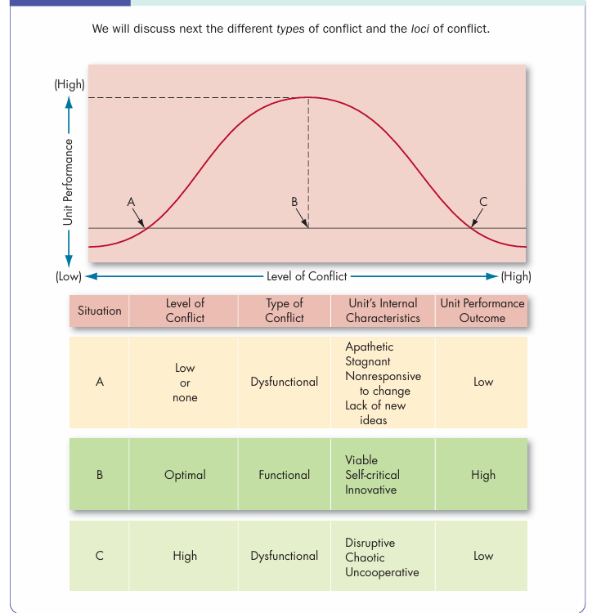
Conflict and Unit Performance

Slide 15
Types of Conflicts
One means of understanding conflict is to identify the type of disagreement, or what the conflict is about.
Is it a disagreement about goals?
Is it about people who just do not get along well with one another?
Or is it about the best way to get things done?
www.midocean.ae

Slide 16
Types of Conflicts – Cont.
Although each conflict is unique, researchers have classified conflicts into three categories: task, relationship, or process.
Relationship conflict focuses on interpersonal relationships.
Task conflict relates to the content and goals of the work.
Process conflict is about how the work gets done
www.midocean.ae

Slide 17
Types of Conflicts – Cont.
Relationship Conflict: Studies demonstrate that relationship conflicts, at least in work settings, are almost always dysfunctional.
Why? The friction and inter personal hostilities inherent in relationship conflicts increase interpersonal clashes and decrease mutual understanding.
They tend to derail team processes by reducing the extent to which people are open to working with one another collaboratively toward solutions while increasing the extent to which they avoid and compete with one another.
www.midocean.ae

Slide 18
Types of Conflicts – Cont.
As a result, relationship conflict strongly depletes trust, cohesion, satisfaction, job attitudes, and positive affect and can even lead to a reduction in organizational citizenship behaviors (OCBs) paired with an increase in deviant behavior.
However, relationship conflict itself is only weakly related to how well the team performs—so it appears its most nefarious affects are in how it affects people psychologically and how it reduces OCBs and increases deviance.
As such, of the three types, relationship conflict appears to be the most psychologically exhausting for workers.
www.midocean.ae

Slide 19
Types of Conflicts – Cont.
Task Conflict: While scholars agree that relationship conflict is dysfunctional, there is considerably less agreement about whether task and process conflict is functional.
Early research suggested that task conflict within groups correlated to higher group performance, but a review of ninety-five studies found that task conflict was essentially unrelated to group performance (although it did appear to be correlated to lower group performance in non-management positions, and higher group performance in decision-making teams).
www.midocean.ae

Slide 20
Types of Conflicts – Cont.
Despite these findings, research suggests that task conflict slightly reduces the extent to which people collaborate and moderately increases the degree to which they compete with one another.
This, in turn, has a strong negative effect on their trust and job attitudes; and like relationship conflict, leads to a reduction in OCBs paired with an increase in deviant behavior.
www.midocean.ae

Slide 21
Types of Conflicts – Cont.
Process Conflict: Process conflicts are often about delegation and roles.
Conflicts over delegation often revolve around the perception of some members as shirking, and conflicts over roles can leave some group members feeling marginalized.
Thus, process conflicts often become highly personalized and quickly devolve into relationship conflicts.
www.midocean.ae

Slide 22
Types of Conflicts – Cont.
It is also true, of course, that arguing about how to do something takes time away from actually doing it.
Although relatively less research has been conducted on process conflict, research suggests that it has a strong negative effect on team member trust and attitudes as well as a weak effect on team performance (like that of relationship conflict).
www.midocean.ae

Slide 23
Types of Conflicts – Cont.
Complicating Conflict It also appears to matter whether other types of conflict occur at the same time.
If task and relationship conflict occur together, task conflict is more likely to have a negative effect, whereas if task conflict occurs by itself, it is more likely to have a positive effect.
How often does this occur in practice? Research from one entrepreneurial venture suggests that although the two are initially co-occurring, over time, they tend to stabilize after some time.
www.midocean.ae

Slide 24
Types of Conflicts – Cont.
This suggests that one might expect relationship and task conflict to co-occur at the beginning of the relationship.
Even the mere perception of relationship conflict during task conflict is enough to cause people to hold on to their initial preferences regarding the task conflict.
Other scholars have argued that the perception of conflict is important.
If task conflict is perceived as being very low, people are not really engaged or addressing the important issues; if task conflict is too high, infighting will quickly degenerate into relationship conflict. Moderate levels of task conflict may thus be optimal.
www.midocean.ae

Slide 25
Types of Conflicts – Cont.
Furthermore, who perceives conflict also matters.
Incompatibilities between work styles or dominating personalities with little space for compromise can lead to “too many cooks in the kitchen,” resulting in relationship conflict and even abusive supervision.
Research suggests that conflict is more likely to have a positive effect on performance when a few members perceive strong task disagreement and most others on the team perceive weak task disagreement.
This is because those of the minority opinion are much more likely to present their disagreements in a careful, cooperative, open manner.
www.midocean.ae

Slide 26
Loci of Conflict
Another way to understand conflict is to consider its locus, or where the conflict occurs among people.
Here, there are three basic types.
Dyadic conflict; is conflict between two people.
Intragroup conflict; occurs within a group or team.
Intergroup conflict; is conflict between groups or teams.
www.midocean.ae

Slide 27
The Conflict Process
The conflict process has five stages:
potential opposition or incompatibility, cognition and personalization, intentions, behavior, and outcomes (see Figure below).
www.midocean.ae

Slide 28
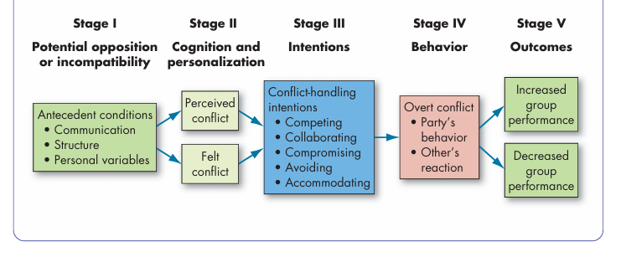
Figure: Explain the Conflict Process

Slide 29
Stage I: Potential Opposition or Incompatibility
Communication; is functional up to a point, after which it is possible to overcommunicate, increasing the potential for conflict.
Even the way communication is framed can have an effect: For example, framing task conflict as a debate increases receptivity to others’ opinions.
www.midocean.ae

Slide 30
Stage I: Potential Opposition or Incompatibility
Structure: The term structure in this context includes variables such as the size of the group, degree of specialization in tasks assigned to group members, role clarity, member–goal compatibility, leadership styles, reward systems, and degree of dependence between groups or group members.
The larger the group and the more specialized its activities, the greater the likelihood of intragroup conflict. Tenure and conflict are inversely related, meaning that the longer a person stays with an organization, the less likely intragroup conflict becomes.
www.midocean.ae

Slide 31
Stage I: Potential Opposition or Incompatibility
Our last category of potential sources of conflict is personal variables, which include personality, emotions, and values.
People high in the personality traits of disagreeableness, neuroticism, or self-monitoring are prone to spar with other people more often—and to react poorly when conflicts occur.
On the other hand, the politically skilled are less likely to initiate conflict as they are better able to manage others’ perceptions.
www.midocean.ae

Slide 32
Stage I: Potential Opposition or Incompatibility
Emotions can cause conflict even when they are not directed at others.
For example, an employee who shows up to work irate from the hectic morning commute may carry that anger into the workday, which can result in a tension-filled meeting.
Employees not sharing or experiencing the same emotions can also engender conflict.
For example, employees may experience more conflict when they are pessimistic about a task and their supervisors are more optimistic.
www.midocean.ae

Slide 33
Stage II: Cognition and Personalization
Perceived conflict: Awareness by one or more parties of the existence of or conditions that create opportunities for conflict.
Felt conflict: Emotional involvement in a conflict that creates anxiety, tenseness, frustration, or hostility
www.midocean.ae

Slide 34
Stage III: Intentions
Intentions intervene between people’s perceptions and emotions, and their overt behavior.
They are decisions to act in a particular way. Although we may decide to act in a certain way, our intentions do not always line up with what we actually do.
Furthermore, intentions are not always fixed.
During a conflict, intentions might change if a party is able to see the other’s point of view or to respond emotionally to the other’s behavior
www.midocean.ae

Slide 35
Stage III: Intentions
There are five conflict-handling intentions as;
(1) Competing: A desire to satisfy one’s interests, regardless of the impact on the other party to the conflict.
(2) Collaborating: A situation in which the parties involved in a conflict all desire to fully satisfy the concerns of all parties.
(3) Avoiding: The desire to withdraw from or suppress a conflict.
(4) Accommodating: The willingness of one party in a conflict to place the opponent’s interests above their own.
(5) Compromising: A situation in which each party to a conflict is willing to give up something to resolve the conflict.
www.midocean.ae

Slide 36
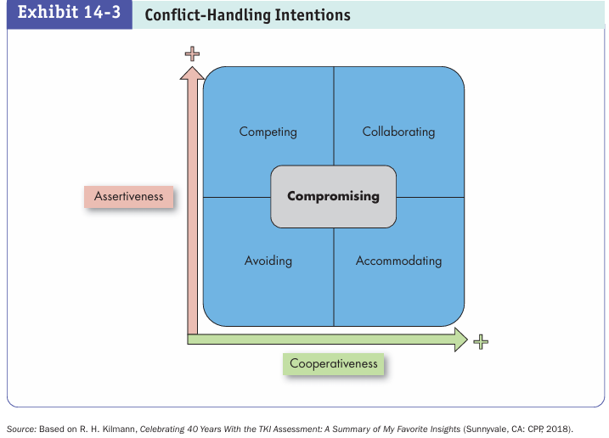

Slide 37
Stage IV: Behavior
The behavior stage includes statements, actions, and reactions made by conflicting parties, usually as overt attempts to implement their own intentions.
As a result of miscalculations or unskilled enactments, overt behaviors sometimes deviate from original intentions.
Intentions that are brought into a conflict are likely to be translated into behaviors.
Competing brings out active attempts to contend with team members and more individual effort to achieve ends without working together.
www.midocean.ae

Slide 38
Stage IV: Behavior – Cont.
Collaborating creates investigation of multiple solutions with other members of the team and trying to find a solution that satisfies all parties as much as possible.
Avoidance is seen in behavior as refusals to discuss issues and reductions in effort toward group goals.
People who accommodate put their relationships ahead of the issues in the conflict, deferring to others’ opinions and sometimes acting as a sub group with them.
When people compromise, they both expect to and do sacrifice parts of their interests, hoping that if everyone does the same, an agreement will emerge.
www.midocean.ae

Slide 39
Stage V: Outcomes
The action–reaction interplay between conflicting parties creates consequences.
As our model demonstrates, these outcomes may be functional if the conflict improves the group’s performance, or dysfunctional if it hinders performance.
Realistically, however, many researchers suggest that although workplace conflict can be beneficial, it is usually under special circumstances, and most of the time the dysfunctional outcomes outweigh the functional outcomes in severity.
This suggests that managers will likely spend most of their time reducing dysfunctional conflict rather than stimulating functional conflict.
www.midocean.ae

Slide 40
Stage V: Outcomes – Cont.
Functional Outcomes: How might conflict act as a force to increase group performance?
It is hard to visualize a situation in which agitated aggression could be functional.
But it is possible to see how low or moderate levels of conflict could improve group effectiveness and creativity.
Conflict is constructive when it improves the quality of decisions, stimulates creativity and innovation, encourages interest and curiosity among group members, provides the medium for problems to be aired and tensions released, and fosters self-evaluation and change.
www.midocean.ae

Slide 41
Stage V: Outcomes – Cont.
Indeed, over time, the right amount of task conflict (not relational conflict) can cause teams to improve their relations, the quality of social interaction, and meaningful communication.
Mild conflicts also may generate energizing emotions, so members of groups become more active, energized, and engaged in their work.
However, groups that are extremely polarized do not manage their underlying disagreements effectively and tend to accept suboptimal solutions, or they avoid making decisions altogether rather than work out the conflict.
www.midocean.ae

Slide 42
Stage V: Outcomes – Cont.
Dysfunctional Outcomes: The destructive consequences of conflict on the performance of a group or an organization are generally well known:
A substantial body of research documents how dysfunctional conflicts can reduce group effective ness.
Among the undesirable consequences are poor communication, reductions in group cohesiveness, and subordination of group goals to the primacy of infighting among members.
All forms of conflict—even the functional varieties— appear to reduce group member satisfaction and trust.
At the extreme, conflict can bring group functioning to a halt and threaten the group’s survival.
www.midocean.ae

Slide 43
Managing Conflict
Conflict management: The use of resolution and stimulation techniques to achieve the desired level of conflict.
At a broader level, executives try to manage conflict proactively by developing conflict management systems of policies and procedures, increase lower-level management’s involvement in conflict management, socialize dysfunctional conflict out of the organization’s culture, and improvise where needed to adapt to conflict management needs.
www.midocean.ae

Slide 44
Managing Conflict – Cont.
In anticipating and managing conflict, organizations can target three specific domains:
strategy (e.g., designing conflict management activities with an understanding of their effect on the organization system, garnering managerial support for and application of conflict management strategies),
function (e.g., encouraging the systemic adoption of conflict management practices, understanding employees’ needs, job design to reduce conflict),
and worker (e.g., improving employee perceptions of conflict, fostering ties and cohesion between people, adaptively addressing conflict as it emerges).
www.midocean.ae

Slide 45
Managing Conflict – Cont.
For example, if the conflict is expected to be perpetual and ongoing, a strategic conflict management strategy might not target resolving the conflict completely, but rather how people can adaptively address the conflict over time.
At a narrower level, leaders manage conflict in three primary ways: instigation (i.e., intentionally creating conflict when needed), engagement (i.e., escalating conflict, involving others, or strategically observing), and managing (i.e., handling or resolving conflict)
www.midocean.ae

Slide 46

www.midocean.ae

Slide 47



Thank You

