Slide 1




PMG 663
Supply Chain Risk Management: A Comprehensive Review
Lecture 1
Prepared by
Dr. Badur elgasim
www.midocean.ae

Slide 2
Chapter
01
Learning Objectives
Supply Chain Risk Management
Risk Management Dimensions
Risk levels
Risk management stages
Risk mitigation strategies
Modelling Process Steps
www.midocean.ae

Slide 3
Chapter
Introduction
01
Recently, managing risk has become a crucial challenge for supply chain managers owing to several factors, such as growing global competition, rising cost pressures, increasing customer expectations, and ever-increasing complexity . Due to the increasing complexity and interrelation of modern supply chains, the type and nature of uncertain developments and the impact of an action have become difficult, or even impossible, to predict . Risks and uncertainties frequently interrupt the operational efficiency of the supply chain and hence adversely impact a firm’s profits.SCRM is gaining interest of researchers and practitioners because of the occurrence of major supply chain disruptions. Global sourcing and lean operations are the main drivers of supply chain disruptions
www.midocean.ae

Slide 4
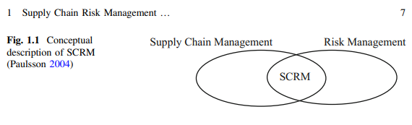
Chapter
Supply Chain Risk Management
01
Supply Chain Risk Management (SCRM) Although numerous discussions and studies have considered the definition of SCRM, there is still no consensus on the definitions of ‘supply chain risk’ and ‘SCRM’ . SCRM can be described as the intersection of supply chain management and risk management2
www.midocean.ae

Slide 5
Chapter
Supply Chain Management definition
01
The term “supply chain management” is relatively new in the literature, and used to describe connecting logistics with other functions. The term was also used to describe the connections between logistics and internal functions and external organizations .
A supply chain consists of all activities associated with the flow and transformation of goods from raw materials to end users. a supply chain is a network of facilities and distribution options that performs the function of procurement of materials, transformation of these materials into intermediate and finished products, and the distribution of these finished products to customers
www.midocean.ae

Slide 6
Chapter
01
Risk Management Dimensions
Ritchie and Brindley (2007) pointed out three dimensions of risk as follows:
1. Likelihood/probability of the occurrence of particular events/outcomes;
2. Consequences/severity of the occurrence of particular events;
3. Causal pathways leading to these events (detection).
www.midocean.ae

Slide 7
Chapter
01
estimated with accuracy and precision. A risk matrix defines the various levels of risk, considering both risk probability and risk impact. This is a simple mechanism to increase the visibility of risks and assist management decision making. A risk matrix can be used for both qualitative and quantitative risk analyses of a supply chain, where probabilities and impacts are considered as subjective values and objective values, respectively.
The two main elements, which are probability of occurrence and impact of risk, are critical to determining the necessity of an action to combat a risk in a supply chain
www.midocean.ae

Slide 8
Chapter
01
Risk levels
In general, there are three levels. The safest condition for a supply chain is when either the probability of occurrence or the impact of risk (or both) are very low. This level is referred to as the low level risk and usually does not require any effort with respect to risk management. In contrast, when both the probability of occurrence and the impact of risk are high, immediate action is required. The third level is defined such that the probability of occurrence or the impact of risk, or both, are moderate or high. This level, although requiring careful management, the risk is not as critical.
www.midocean.ae

Slide 9
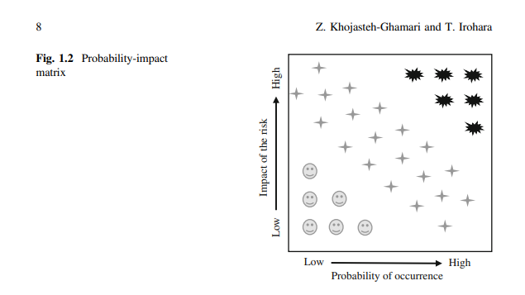
Chapter
01
the American culture has traditionally placed higher values on democratic than on authoritarian leadership, certain biases can be detected in the research on the effects of these leadership styles. A great deal of research is designed to prove that democracy is superior to autocracy, rather than to test that proportion.
www.midocean.ae

Slide 10
Chapter
01
Definition of Supply Chain Risk Management
SCRM has been defined in a number of ways.
SCRM described as the management of supply chain risk through coordination or collaboration among supply chain partners so as to ensure profitability and continuity.
The characteristic specific to SCRM, as opposed to traditional risk management, is that SCRM is characterized by cross-company orientation with the goal of identifying and reducing risk, not only at the company level, but with a focus on entire supply chains.
www.midocean.ae

Slide 11
Chapter
01
Definition of Supply Chain Risk Management
. SCRM defined as “the implementation of strategies to manage both everyday and exceptional risks along the supply chain based on continuous risk assessment with the objective of reducing vulnerability and ensuring continuity”.
The terms “risk” and “uncertainty” are frequently used interchangeably
www.midocean.ae

Slide 12
Chapter
01
Risk Placement
Supply chain risk has been categorized in different ways. However, we categorize it exclusively into three components:
1. Supply risk: any risk that may occur on the supply side with regard to the input material, e.g., disruptions and delays in supply, inventory, and schedules, or delays in inbound logistics.
2. Demand risk: any risk that may occur on the customer side, e.g., variations in demand.
3. Process risk: any risk that may occur during manufacturing and warehousing, e.g., machine breakdowns, human resource errors, operations failures, and financial problems. The last component exists between supply and demand risks.
www.midocean.ae

Slide 13
Chapter
01
Macro risks
In our categorization, macro risks, such as natural disasters, terrorist attacks, financial crises, and other such events that have enormous consequence, can be placed into any of the abovementioned categories depending on whether the macro risk affects the supply, demand, or process. Note that few papers considered macro risks, primarily because the probability of their occurrence is low compared to the supply, demand, and process risks, even though the impact of macro risks is enormous. For example, although the impact of the 2011 earthquake off the Pacific coast of Tohoku in Japan was high, the probability of a reoccurrence of that disaster is very low. Therefore, industries do not invest huge amount of money in order to protect the supply chain from such macro risks with a low probability of occurrence.
www.midocean.ae

Slide 14
Chapter
01
Decision Variables
selection is the optimal selection of material providers based on cost and quality. In contrast, facility location is the optimal placement of facilities to minimize transportation costs, while considering factors such as safety and distance from competitors’ facilities. The rest of the papers used other decision variables such as assembly line management, mitigation strategy selection, warehouse management, and stakeholder management. We found that the supplier selection problem is involved in considering supply risk
www.midocean.ae

Slide 15
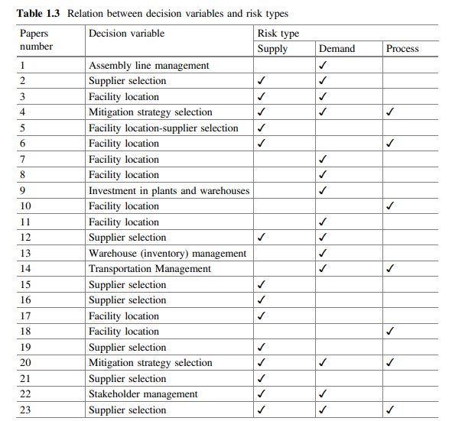
Chaterp
01
In our
www.midocean.ae

Slide 16
Chapter
01
Risk management stages
Risk management involves important stages of risk identification, risk analysis, risk evaluation, risk treatment and risk monitoring .Supply chain risk management (SCRM) is gaining an increasing interest both from the researchers and practitioners .Complex interactions between supply chain risks ranging across the entire spectrum m of a supply network make it a challenging task to identify, assess and manage key risks.
Risk treatment is an important stage of the risk management process involving selection of appropriate strategies for mitigating critical risks
www.midocean.ae

Slide 17
Chapter
01
Limited studies have focused on exploring causal interactions between supply chain risks and integrating the impact of risk mitigation strategies on associated risks within the modelling framework ,However, to the best of our knowledge, no attempt has been made to capture the manageability associated with implementing a mitigation strategy within the modelling framework. Manageability relates to the concept of ease involved in managing a strategy. Besides capturing the manageability of risks (effectiveness of strategies) representing the potential for reducing the risk
www.midocean.ae

Slide 18
Chapter
01
we aim to address the decision problem of prioritizing risk mitigation strategies considering the cost, effectiveness and manageability of such strategies within an interconnected network of interacting supply chain risks and strategies. The proposed method is deemed as contribution to the literature on Risk Management in general and SCRM in particular. Existing models focusing on cost-effectiveness of strategies assume the same level of manageability for all strategies
www.midocean.ae

Slide 19
Chapter
01
SCRM is gaining interest of researchers and practitioners because of the occurrence of major supply chain disruptions .
Global sourcing and lean operations are the main drivers of supply chain disruptions.
The likelihood of the occurrence of an (undesirable) event, and the negative implications of the event are the two common measures of risk.
www.midocean.ae

Slide 20
Chapter
Risk mitigation strategies
01
are implemented in order to reduce the likelihood of occurrence and/or negative impact of risks . Robust strategies must be developed in order to help firms reduce cost and/or improve customer satisfaction under normal conditions and to enable firms sustain operations during and after a disruption
www.midocean.ae

Slide 21
Chapter
01
Examples
capacity risks can be reduced by outsourcing and building a flexible web of partners whereas operational hedging can help in reducing currency and political risks. There are number of strategies including information accuracy, visibility, accessibility and responsive corrective actions. It is recommended , that implementation of supplier improvement programs and mitigation of supply disruptions through creating business interruption plans, developing demand forecasts and modelling supply processes.
www.midocean.ae

Slide 22
Chapter
01
A similar concept of establishing cause and effect relationships between the enablers of risk mitigation was explored in the Electronic supply chain in order to determine the main drivers . Using a multi-method approach, Speier et al. (2011) introduced a framework to examine the threat of potential disruptions on supply chain processes and identified suitable potential mitigation strategies under different conditions.
www.midocean.ae

Slide 23
Chapter
01
Approaches Models
for managing global sourcing risk. Son and Orchard (2013) developed an analytical model for examining the effectiveness of two inventory based policies for mitigating the impact of supply-side disruptions in a supply chain..
Christopher et al. (2011) used a multiple case study approach in several industries to understand how managers assess and mitigate global sourcing risks across the entire supply chain.
www.midocean.ae

Slide 24
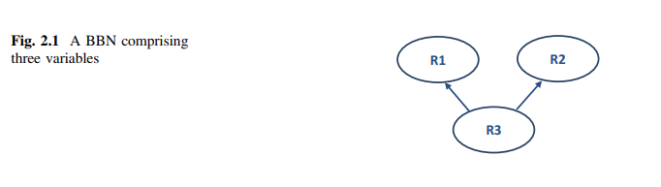
Chapter
01
Bayesian Belief Networks (BBNs)
integrating the cost and manageability of mitigation strategies within a theoretically grounded framework of Bayesian Belief Networks (BBNs) encompassing complex interactions between risks and strategies.
BBN is a directed acyclic graph comprising nodes representing uncertain variables and arcs indicating causal relationships between variables whereas the strength of dependency is represented by the conditional probability values.
www.midocean.ae

Slide 25
Chapter
01
BBN is a graphical framework for modelling uncertainty. BBNs have their background in statistics and artificial intelligence and were first introduced in the 1980s for dealing with uncertainty in knowledge-based systems .
. BBNs have been successfully used in addressing problems related to a number of diverse specialties including reliability modelling, medical diagnosis, geographical information systems, and aviation safety management among others.
www.midocean.ae

Slide 26
Chapter
01
A BBN consists of following elements:
• A set of variables (each having a finite set of mutually exclusive events).
and a set of directed edges between variables forming a directed acyclic graph; a directed graph is acyclic if there is no directed . the directed edges represent statistical relations if the BBN is constructed from the data whereas they represent causal relations if they have been gathered from experts’ opinion,
• A conditional probability table attached to each variable X with parents Y1; ...; Yn
www.midocean.ae

Slide 27
Chapter
01
Advantages of BBNs
BBNs present a useful technique for capturing interaction between risk events and performance measures .
Another advantage of using BBNs for modelling supply chain risks is their ability of back propagation that helps in determining the probability of an event that may not be observed directly.
BBNs also provide a clear graphical structure that most people find intuitive to understand. Besides, it becomes possible to conduct flexible inference based on partial observations, which allows for reasoning.
BBNs offer a unique feature of modelling risks combining both the statistical data and subjective judgment in case of non-availability of data
www.midocean.ae

Slide 28
Chapter
01
Another important feature of using BBNs is:
to conduct what-if scenarios .
There are certain problems associated with the use of BBNs:
along with the increase in number of nodes representing supply chain risks, a considerable amount of data is required in populating the network with (conditional) probability values; similarly, there are also computational challenges associated with the increase in number of nodes.
www.midocean.ae

Slide 29
Chapter
01
Our model is based on following assumptions:
1. Supply chain risks and corresponding sources are known and these can be modelled as a directed acyclic graph.
2. All random variables and risk mitigation strategies are represented by binary states.
3. Conditional probability values for the risks and associated losses can be elicited from stakeholders and the resulting network represents close approximation to the actual perceived risks and associated interdependency.
4. Cost and manageability associated with each potential risk mitigation strategy are known. 5. All stakeholders within the supply chain are willing to share information about key risks, loss values and effort involved in implementing potential strategies
www.midocean.ae

Slide 30
Chapter
01
Cost-Effectiveness Based Prioritization of Strategies
Problem Statement Given different options of implementing risk mitigation strategies within a probabilistic network of interconnected supply chain risks and strategies, how do we priorities these strategies keeping in view the cost, effectiveness and manageability of strategies?
we aim to priorities risk mitigation strategies yielding maximum weighted summation of normalized expected utility for loss and normalized utility for manageability weighted mitigation cost
www.midocean.ae

Slide 31
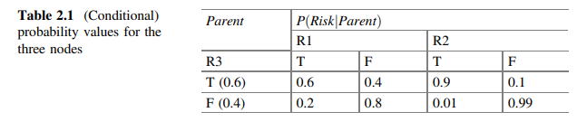
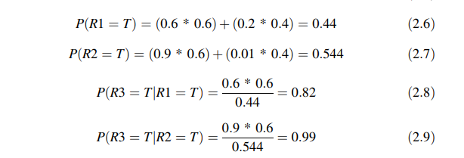
Chapter
Manageability and Cost-Effectiveness Based Prioritization of Strategies
01
www.midocean.ae

Slide 32
Chapter
01
Modelling Process Steps
The following steps must be followed in developing the proposed network of interacting supply chain risks and mitigation strategies:
1. Define the boundaries of the supply network and identify stakeholders.
2. Identify key risks and potential risk mitigation strategies on the basis of input received from each stakeholder through interviews and/or focus group sessions.
3. Refine the qualitative structure of the resulting network involving all stakeholders.
www.midocean.ae

Slide 33
Chapter
01
Modelling Process Steps
4.Determine (conditional) probability values, loss values resulting from risks and cost and manageability score associated with implementing each potential mitigation strategy and populate the BBN with all parameters.
5. Run the model for each combination of strategies and determine the expected utility (loss) value.
6. Analyze the results and priorities risk mitigation strategies on the basis of relative importance of normalized expected utility for loss and normalized utility for manageability weighted cost of strategies.
7. Validate the model output involving stakeholders.
www.midocean.ae

Slide 34
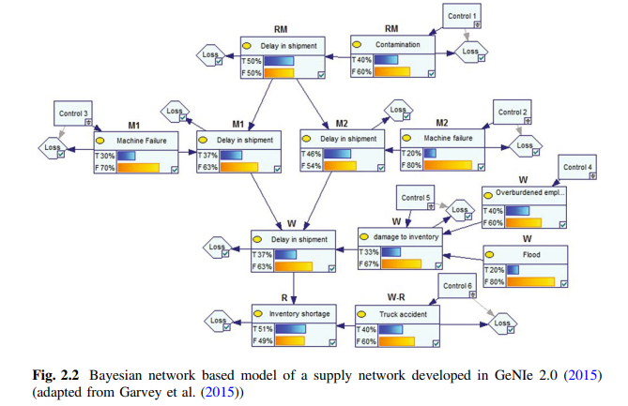
Chapter
a simple supply network
01
a simple supply network as shown in Fig. 2.2. comprises a raw material source (RM), two manufacturers (M1 and M2), a warehouse (W) and a retailer (R).
We also consider a transportation link between the warehouse and retailer (W-R). Risks are represented by nodes comprising bar charts whereas resulting losses and mitigation strategies are represented by diamond and rectangular shaped nodes, respectively. Though each domain of the supply network may comprise a number of risks and corresponding sources,
www.midocean.ae

Slide 35
Chapter
01
Each risk and mitigation strategy is represented by binary states of ‘True (T)’ or ‘False (F)’ and ‘Yes’ or ‘No’, respectively
www.midocean.ae

Slide 36
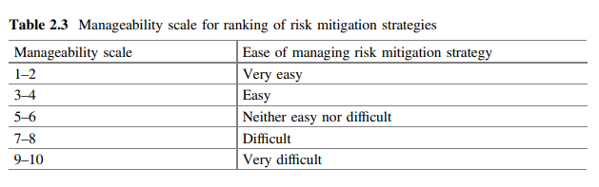
Chapter
01
www.midocean.ae

Slide 37
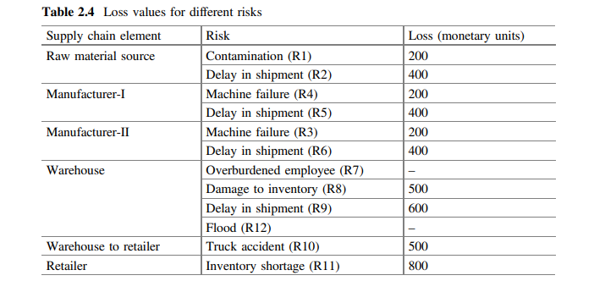
Chapter
01
www.midocean.ae

Slide 38
Chapter
01
Assumed loss values associated with the risks are shown in Table 2.4. The strength of interdependency between risks and the impact of strategies on related risks are represented by (conditional) probability values .As R1 does not have a parent node, its probability value is not contingent on any node. The italicized value represents the reduced probability of a risk after implementation of the related strategy. The conditional probability value of R2 (being True) is 0.8 given that its parent node ‘R1’ is in ‘True’ state. Implementation of each mitigation strategy is assumed to incur a cost of 100 units. The assumed manageability scores are shown in Table 2.6. All parameters specific to a real case study can be elicited from experts through interviews and focus group sessions
www.midocean.ae

Slide 39
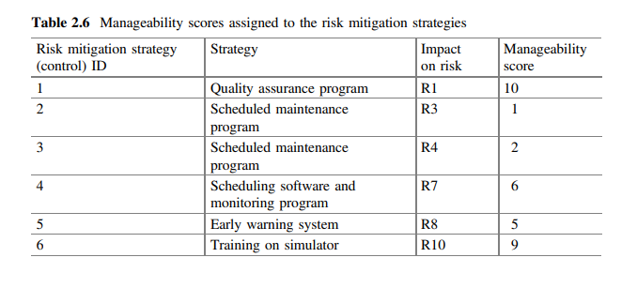
Chapter
01
www.midocean.ae

Slide 40

Chapter
01
Considering the cost-benefit analysis, strategies resulting in maximum improvement in the risk network expected loss (less mitigation cost) must be selected. Such strategies are represented by the peak points appearing in Fig. 2.4. It is interesting to note that there is only one cost-effective combination of 5 strategies, however, implementation of all 6 strategies does not result in achieving the net gain.
Moreover, the value of net improvement increases up to 2 strategies and declines beyond that point.
www.midocean.ae

Slide 41
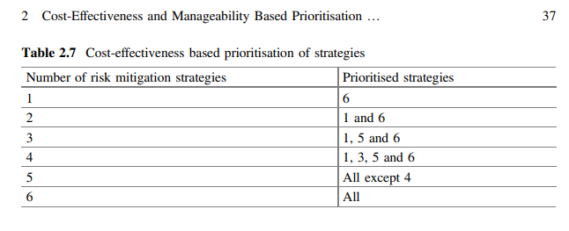
01
Chapter
Optimal strategies are shown in Table 2.7. Strategy 4 is not a feasible strategy except once all the potential strategies need to be implemented. This is mainly because of the fact that the strategy is linked to R7 with no loss value associated with the risk (Table 2.4). Furthermore, R7 does not appear to be a major source of disruption across the entire risk network and even if all 6 strategies are implemented (including Strategy 4), the risk network expected loss is not reduced substantially (Fig. 2.3). That is why, when all 6 strategies are selected, the total cost outweighs the associated benefits
www.midocean.ae

Slide 42
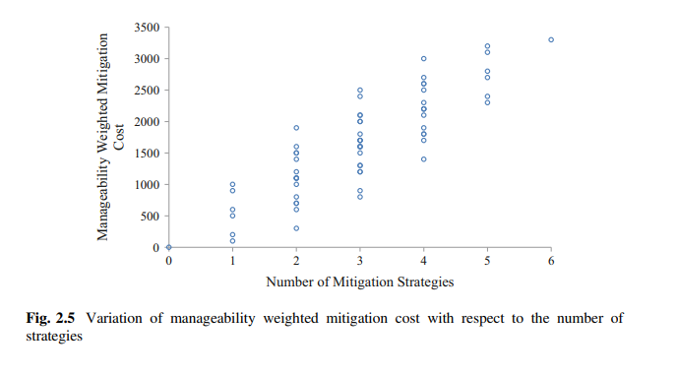
Chapter
01
We prioritized the strategies on the basis of associated manageability, cost and effectiveness. Values of manageability weighted cost corresponding to different combinations of strategies are depicted in Fig. 2.5. As each strategy was assumed to incur a cost of 100 units, the manageability weighted cost directly reflects the manageability score assigned to each strategy. The lowest points corresponding to the number of strategies are the optimal combinations keeping in view the factors of cost and manageability; however, these may not necessarily achieve the maximum improvement in the risk network expected loss
www.midocean.ae

Slide 43
Chapter
01
We evaluated the cost-effectiveness of strategies and prioritized these through the lens of risk network expected loss
.
As each strategy was assumed to incur 100 units of mitigation cost, the strategies represented by the lowest points corresponding to each number of strategies are also the cost-effective strategies
www.midocean.ae

Slide 44
Chapter
05
Reference
Supply Chain Risk Management Advanced Tools, Models, and Developments
By: Yacob Khojasteh
-ISBN 978-981-10-4106-8 (eBook)
Chapter 2
www.midocean.ae

Slide 45


Thank You

