Slide 1

Operations Research (OR)

Slide 2
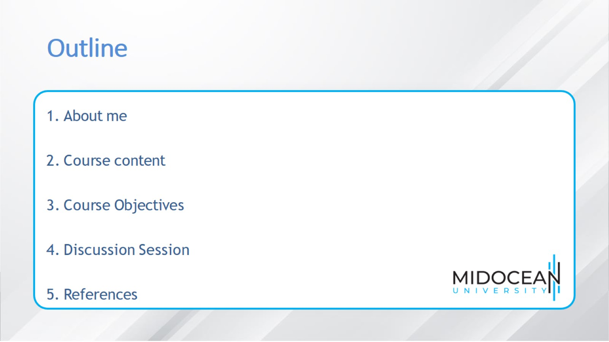
Outline

Slide 3
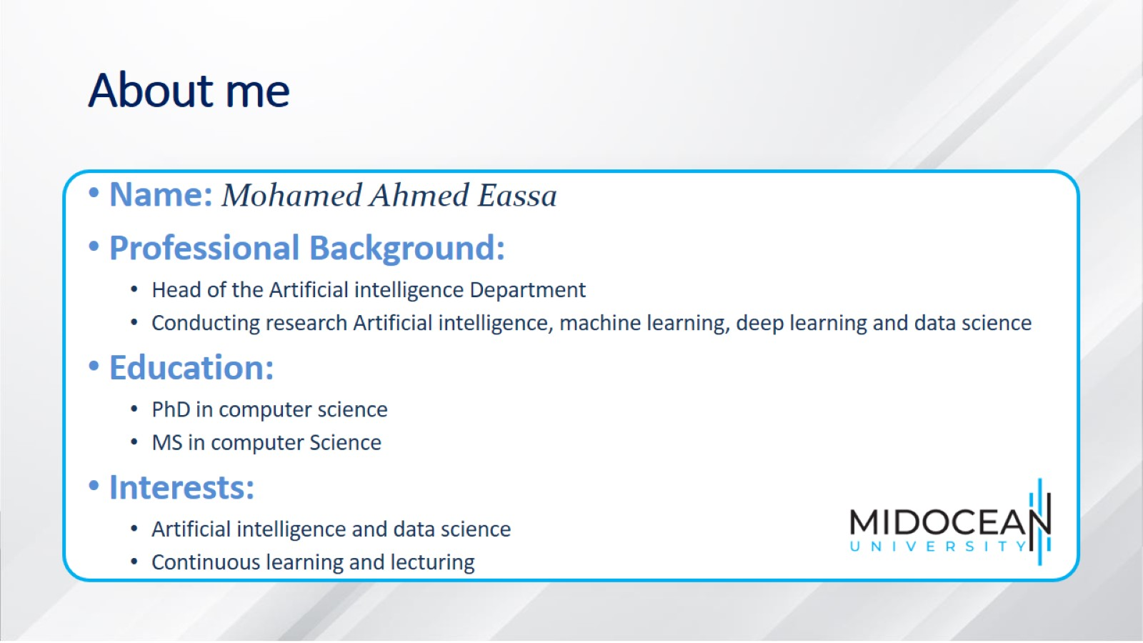
About me

Slide 4
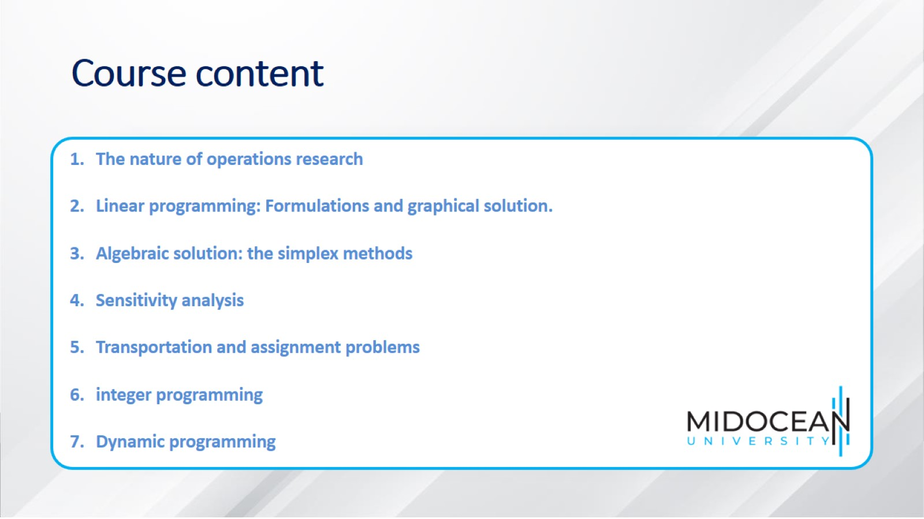
Course content

Slide 5
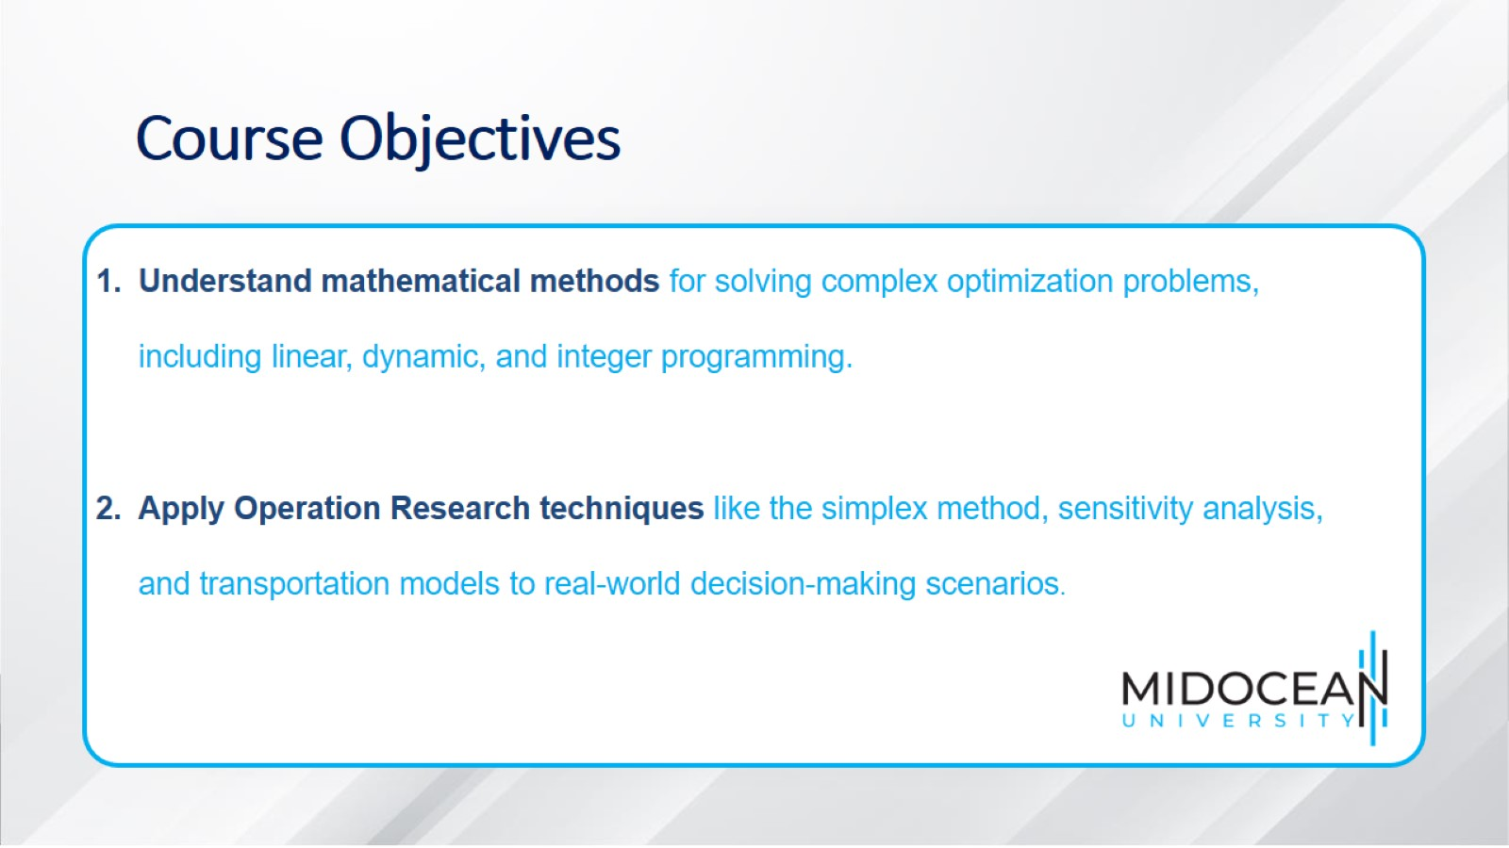
Course Objectives

Slide 6

Discussion Session Schedule

Slide 7
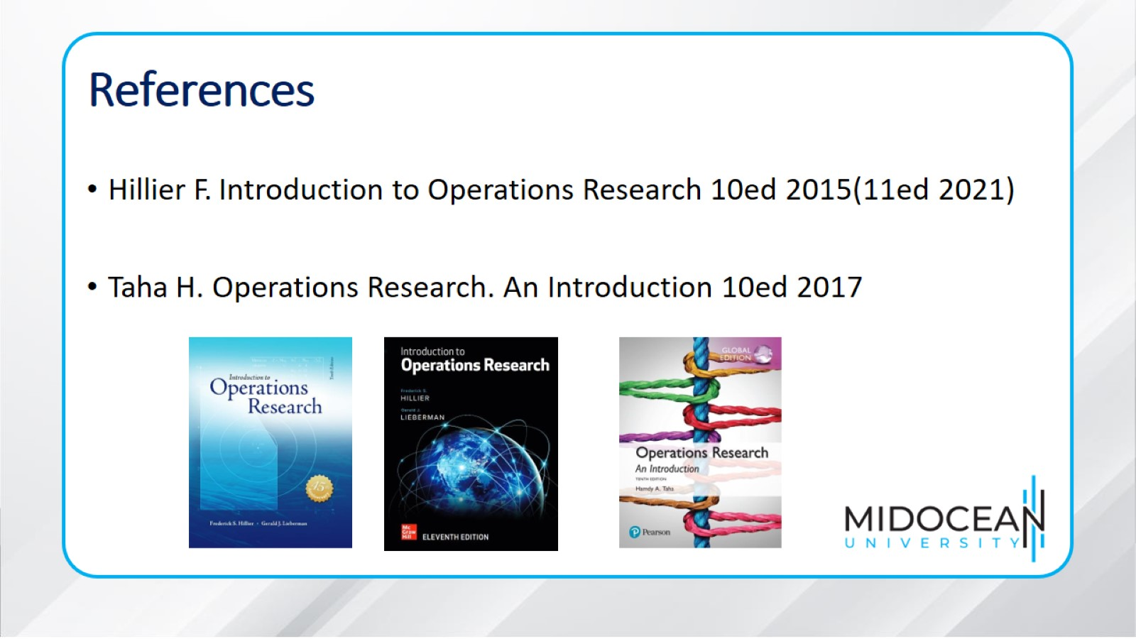
References

Slide 8

Thank You

