Slide 1



Overview of management
lecture-1
Principle of Management
MGM111
Dr. Magdy Alhaj

Slide 2

Learning Outcomes
• Explain the meaning of management
• Explain the Managers and their types
• Describe the essential skills for managers
Understand organization and its performance
Summarize the essential roles of managers

Slide 3
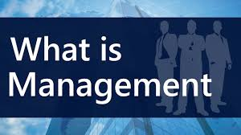

What is Management?
• Management is the process of working with people and resources to accomplish organizational goals.
• Management is the attainment of organizational goals in an effective and efficient manner through planning, organizing, leading and controlling organizational resources. (Daft,2012)
• Organizational resources include men(human beings), money, machines and materials.

Slide 4
What is Management? Cont…
• Management is the art of getting things done through other people.
Mary Parker Follet (1868-1933)
• Management is the art of getting things done through and with people in formally organized group. (Koontz)
• Management is the process of planning, organizing, commanding, coordinating and controlling. (Fayol,1930)
• Management is the process of planning, organizing, leading and controlling, the efforts of organization members and of using all other organizational resources to achieve organizational goals.

Slide 5


What is Management? Cont…
Management can be broadly defined as a process of planning, organizing, leading and controlling the limited resources efficiently and effectively to achieve predetermined goals and objectives in an ever changing business environment.
• The ultimate aim of management is to enhance the organizational productivity and performance.

Slide 6
Characteristics of Management
Management is a distinct process.
Management is an organized activity
Management aims at the accomplishment of predetermined objectives.
Management is both a science and an art.
Management is a group activity
Management principles are universal in nature
Management integrates human and other resources.

Slide 7

Why Study Management?
To maximize the utilization of scarce resources
To face the increasing competition for inputs and outputs
To enhance the quality of the products and services
To adopt/plan for the changes in the business environment
Helps people deal with their bosses and coworkers
Opens a path to a well-paying job and a satisfying career
Management offers challenging, exciting and creative opportunities for meaningful and fulfilling work.

Slide 8
What is an Organization?
• A group of people who work together in a structured way for a shared purpose (Cambridge Advanced Learners Dictionary)
• An organization is a two or more people who work together in a structured way to achieve a specific goal or set of goals. (Stoner and Freeman,2009)
• An organization is a deliberate arrangement of people to accomplish some specific purpose.
(Robbins and Coulter, 2007)

Slide 9
What is an Organization? Cont.
An Organization is – An arrangement of people and resources to accomplish some specific purpose
An organization can be any structured body such as department, business, company in private or public sector or nonprofit association.
Common Characteristics of Organizations
– Have a distinct purpose (goal)
– Composed of people
– Have a deliberate structure

Slide 10
What is an Organization?
organization
people
resource
Goals and objects

Slide 11
Organizational Performance
• A measure of how efficiently and effectively managers use available resources to satisfy customers and achieve organizational goals
Efficiency – A measure of how well or how productively resources are used to achieve a goal
Effectiveness – A measure of the appropriateness of the goals an organization is pursuing and the degree to which they are achieved

Slide 12
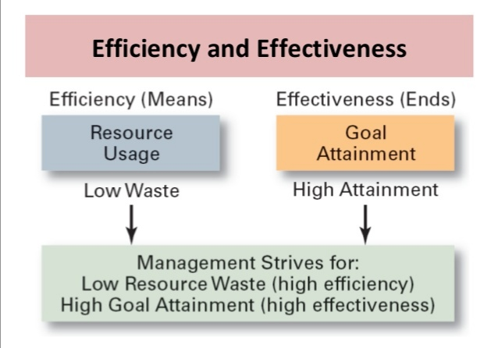

Slide 13

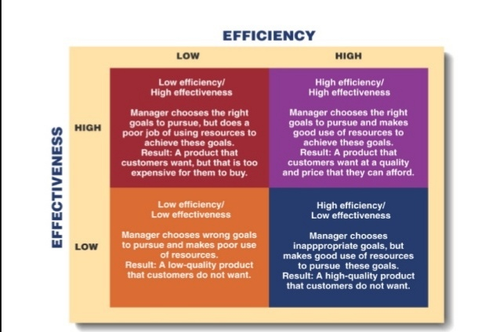

Slide 14
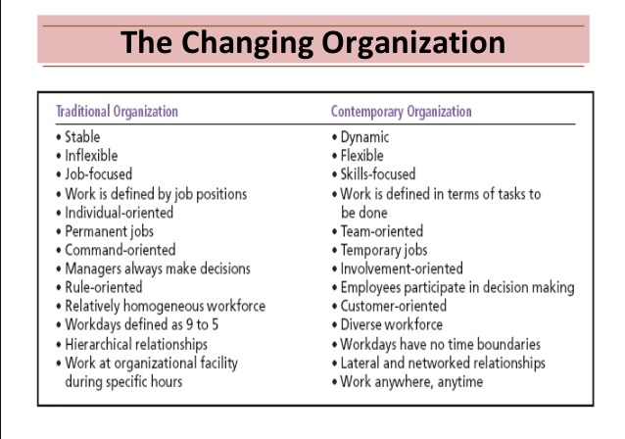

Slide 15
Manager/s
The people responsible for supervising the use of an organization’s resources to meet its goals.
(Stoner, Freeman and Gilbert, 2008)
Someone who coordinates and oversees the work of other people so that organizational goals can be accomplished.
(Robbins and Coulter, 2012)
Someone whose primary responsibility is to carry out the management process.
(Griffin,2012) 12/26/14 16Contemporary Management

Slide 16

Types of Managers
The Level of Authority (Levels of Managers)
First line managers
Middle managers
Top managers
Scope of the Activities
Functional managers
General managers
Responsibility of the Activities
Line managers
Staff managers

Slide 17
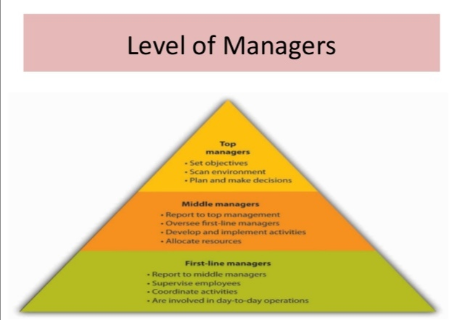

Slide 18
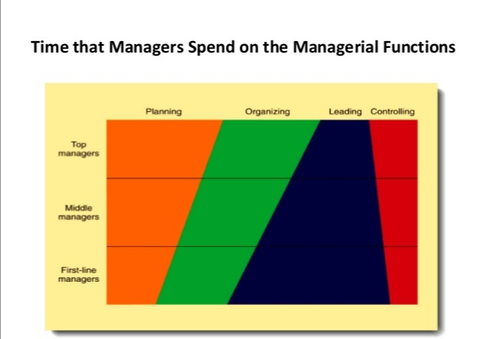

Slide 19
Manager’s Roles
1. Interpersonal role
2. Informational role
3. Decisional role

Slide 20
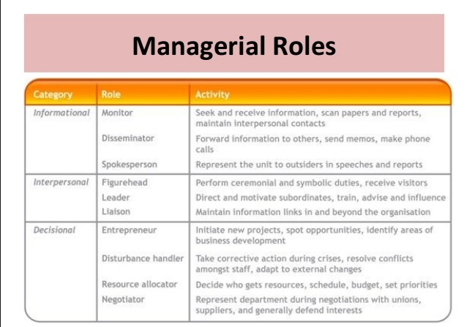

Slide 21
Interpersonal role
Roles that managers assume to provide direction and supervision to both employees and the organization as a whole
Figurehead—symbolizing the organization’s mission and what it is seeking to achieve.
Leader—training, counseling, and mentoring high employee performance.
Liaison—linking and coordinating the activities of people and groups both inside and outside the organization.

Slide 22
Informational role
Roles associated with the tasks needed to obtain and transmit information in the process of managing the organization.
Monitor—analyzing information from both the internal and external environment.
Disseminator—transmitting information to influence the attitudes and behavior of employees.
Spokesperson—using information to positively influence the way people in and out of the organization respond to it.

Slide 23
Decisional role
Roles associated with methods managers use in planning strategy and utilizing resources
Entrepreneur—deciding which new projects or programs to initiate and to invest resources in.
Disturbance handler—managing an unexpected event or crisis
Resource allocator—assigning resources between functions and divisions, setting the budgets of lower managers.
Negotiator—reaching agreements between other managers, unions, customers, or shareholders.

Slide 24
Managerial Skills
Technical skills
Human skills
Conceptual skills

Slide 25
Technical skills
Technical skills
A persons’ knowledge and ability to make effective use of any process or technique constitutes his technical skills.
Example: Engineer, Accountant, Data entry operator, Lawyer, Doctor etc.

Slide 26
Human skills
Human skills
• An individuals’ ability to cooperate with other members of the organization and work effectively in teams.
Example: Interpersonal relationships, solving people’s problem and acceptance of other employees.

Slide 27
Conceptual skills
Conceptual skills
“Ability of an individual to analyze complex situations and to rationally process and interpret available information”
Example: Idea generation and analytical process of information.

Slide 28
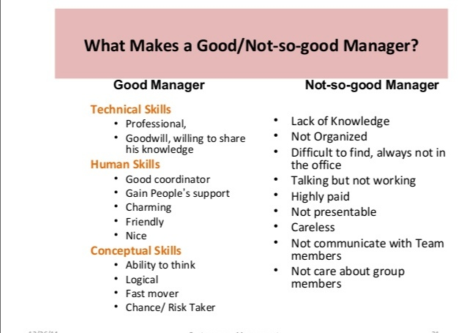

Slide 29
Mistakes Managers Make
Insensitive to others
Arrogant (over confidence)
Betrayal (disloyalty) of trust
Overly (excessively) ambitions
Specific performance problems with the business
Over managing: unable to delegate or build a team
Unable to staff effectively
Unable to think strategically
Unable to adapt to boss with different style
Over dependent on advocate or mentor

Slide 30
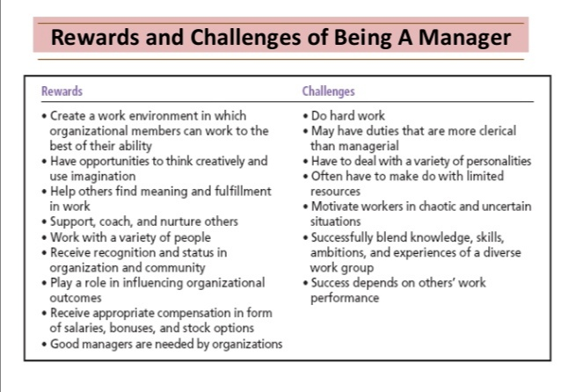

Slide 31
What make managers successful?
Reading and acquiring knowledge
Hard work
Ethical consciousness (awareness)
Smart work
Perseverance (firmness)
Out of box thinking
Collaborative relationship
Patience

Slide 32
How the Manager’s Job is Changing?
The increasing importance of Customers
– Customers: the reason that organizations exist
• Managing customer relationships is the responsibility of all managers and employees.
• Consistent high quality customer service is essential for survival.
Innovation
– Doing things differently, exploring new territory, and taking risks
• Managers should encourage employees to be aware of and act on opportunities for innovation.

Slide 33
TANKS

