Slide 1


Cybersecurity
Concepts
Prepared by Dr. Diaa Salama
FNT625
Classical Encryption Techniques
Lecture 5

Slide 2



Cybersecurity
Concepts
Lecture 5
FNT625
Classical Encryption Techniques
Prepared by
Dr. Diaa Salama
www.midocean.ae

Slide 3





Slide 4
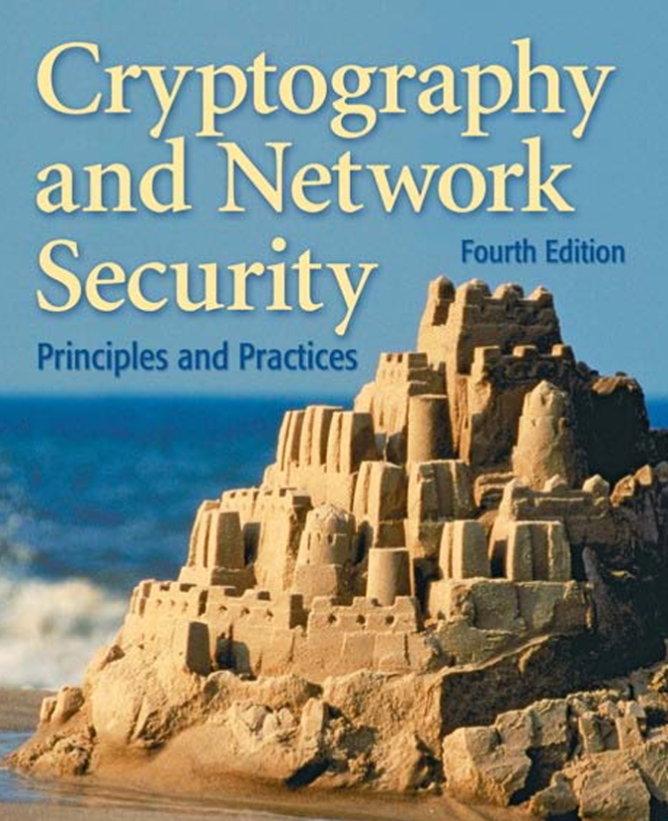
Book Title:
Cryptography and Network Security
Authors:
William Stallings
Publisher:
Pearson Education, Inc.
Edition:
Seven edition

Slide 5

Lecture
Lets Start the Fifth Lecture
05
Classical Encryption Techniques
www.midocean.ae

Slide 6
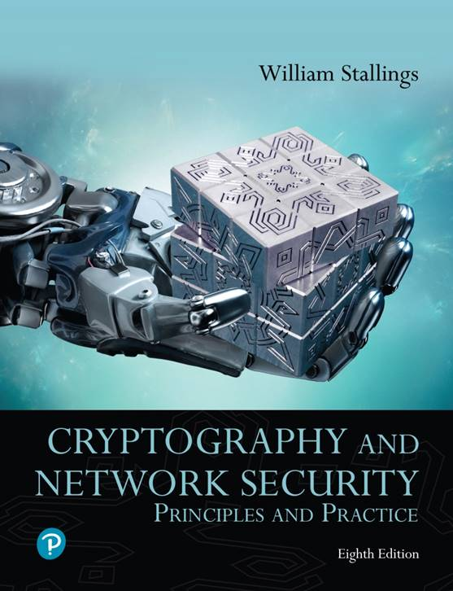
Cryptography and Network Security: Principles and Practice
Eighth Edition
Chapter 3
Classical Encryption Techniques
Notes:
Lecture slides prepared for “Cryptography and Network Security”, 8/e, by William Stallings, Chapter 3 – “Classical Encryption Techniques”.
Symmetric encryption, also referred to as conventional encryption or single-key
encryption, was the only type of encryption in use prior to the development of public-key
encryption in the 1970s. It remains by far the most widely used of the two types
of encryption. Part One examines a number of symmetric ciphers. In this chapter, we
begin with a look at a general model for the symmetric encryption process; this will
enable us to understand the context within which the algorithms are used. Next, we
examine a variety of algorithms in use before the computer era. Finally, we look briefly
at a different approach known as steganography. Chapters 4 and 6 introduce the two
most widely used symmetric cipher: DES and AES.

Slide 7





Symmetric Encryption
Substitution Techniques
Caesar Cipher
Monoalphabetic Cipher
Playfair Cipher
Hill Cipher
www.midocean.ae

Slide 8
Symmetric Encryption
Substitution Techniques
Caesar Cipher
Monoalphabetic Cipher
Playfair Cipher
Hill Cipher
www.midocean.ae

Slide 9

Pre-shared key
Symmetric Encryption
Key
Key
Encrypt
Decrypt
$1000
$!@#IQ
$1000
Best known as shared-secret key algorithms
The usual key length is 80 - 256 bits
A sender and receiver must share a secret key
Faster processing because they use simple mathematical operations.
❑ Examples include DES, 3DES, AES, IDEA, RC2/4/5/6, and Blowfish.
www.midocean.ae

Slide 10
Definitions (1 of 2)
Plaintext
  An original message
Ciphertext
  The coded message
Enciphering/encryption
  The process of converting from plaintext to ciphertext
Deciphering/decryption
  Restoring the plaintext from the ciphertext
www.midocean.ae
Notes:
Before beginning, we define some terms. An original message is known as the
plaintext, while the coded message is called the ciphertext. The process of converting
from plaintext to ciphertext is known as enciphering or encryption; restoring the
plaintext from the ciphertext is deciphering or decryption. The many schemes used
for encryption constitute the area of study known as cryptography Such a scheme
is known as a cryptographic system or a cipher. Techniques used for deciphering a
message without any knowledge of the enciphering details fall into the area of cryptanalysis.
Cryptanalysis is what the layperson calls “breaking the code.” The areas of
cryptography and cryptanalysis together are called cryptology.

Slide 11
Definitions (2 of 2)
Cryptography
  The area of study of the many schemes used for encryption
Cryptographic system/cipher
  A scheme
Cryptanalysis
  Techniques used for deciphering a message without any knowledge of the enciphering details
Cryptology
  The areas of cryptography and cryptanalysis
www.midocean.ae
Notes:
Before beginning, we define some terms. An original message is known as the
plaintext, while the coded message is called the ciphertext. The process of converting
from plaintext to ciphertext is known as enciphering or encryption; restoring the
plaintext from the ciphertext is deciphering or decryption. The many schemes used
for encryption constitute the area of study known as cryptography Such a scheme
is known as a cryptographic system or a cipher. Techniques used for deciphering a
message without any knowledge of the enciphering details fall into the area of cryptanalysis.
Cryptanalysis is what the layperson calls “breaking the code.” The areas of
cryptography and cryptanalysis together are called cryptology.

Slide 12
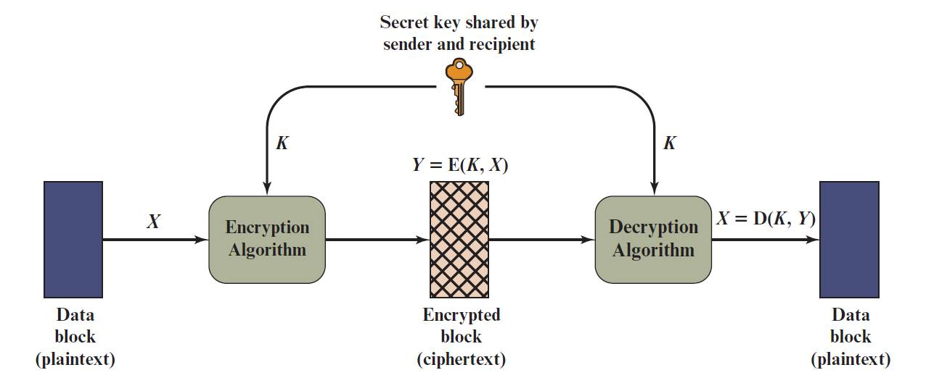
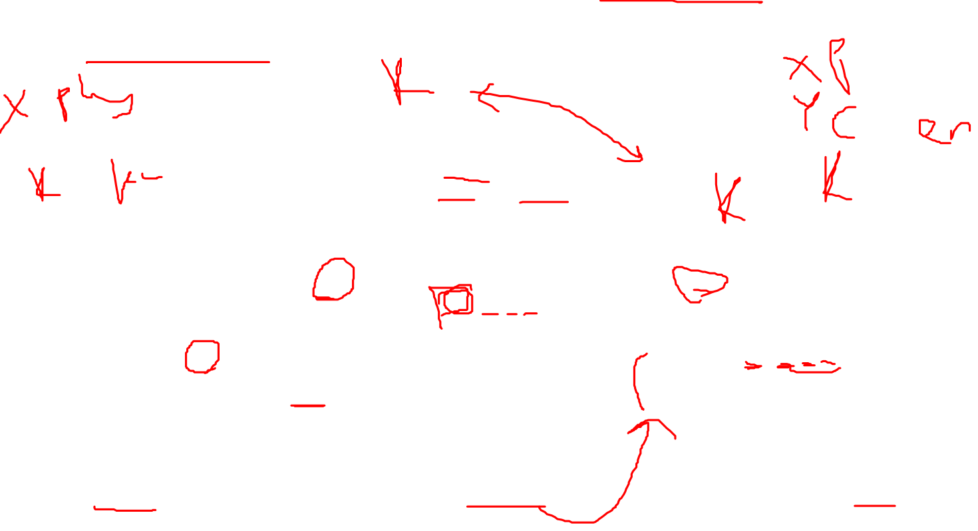
Figure 3.1 Simplified Model of Symmetric Encryption
www.midocean.ae
Notes:
A symmetric encryption scheme has five ingredients (Figure 3.1)
■ Plaintext: This is the original intelligible message or data that is fed into the
algorithm as input.
■ Encryption algorithm: The encryption algorithm performs various substitutions
and transformations on the plaintext.
■ Secret key: The secret key is also input to the encryption algorithm. The key is
a value independent of the plaintext and of the algorithm. The algorithm will
produce a different output depending on the specific key being used at the
time. The exact substitutions and transformations performed by the algorithm
depend on the key.
■ Ciphertext: This is the scrambled message produced as output. It depends on
the plaintext and the secret key. For a given message, two different keys will
produce two different ciphertexts. The ciphertext is an apparently random
stream of data and, as it stands, is unintelligible.
■ Decryption algorithm: This is essentially the encryption algorithm run in
reverse. It takes the ciphertext and the secret key and produces the original
plaintext.

Slide 13


Symmetric Cipher Model
There are two requirements for secure use of conventional encryption:
        A strong encryption algorithm
        Sender and receiver must have obtained copies of the secret key in a secure fashion and must keep the key secure
www.midocean.ae
Notes:
There are two requirements for secure use of conventional encryption:
1. We need a strong encryption algorithm. At a minimum, we would like the algorithm
to be such that an opponent who knows the algorithm and has access to
one or more ciphertexts would be unable to decipher the ciphertext or figure
out the key. This requirement is usually stated in a stronger form: The opponent
should be unable to decrypt ciphertext or discover the key even if he or
she is in possession of a number of ciphertexts together with the plaintext that
produced each ciphertext.
2. Sender and receiver must have obtained copies of the secret key in a secure
fashion and must keep the key secure. If someone can discover the key and
knows the algorithm, all communication using this key is readable.
We assume that it is impractical to decrypt a message on the basis of the
ciphertext plus knowledge of the encryption/decryption algorithm. In other words,
we do not need to keep the algorithm secret; we need to keep only the key secret.
This feature of symmetric encryption is what makes it feasible for widespread use.
The fact that the algorithm need not be kept secret means that manufacturers can
and have developed low-cost chip implementations of data encryption algorithms.
These chips are widely available and incorporated into a number of products. With
the use of symmetric encryption, the principal security problem is maintaining the
secrecy of the key.

Slide 14
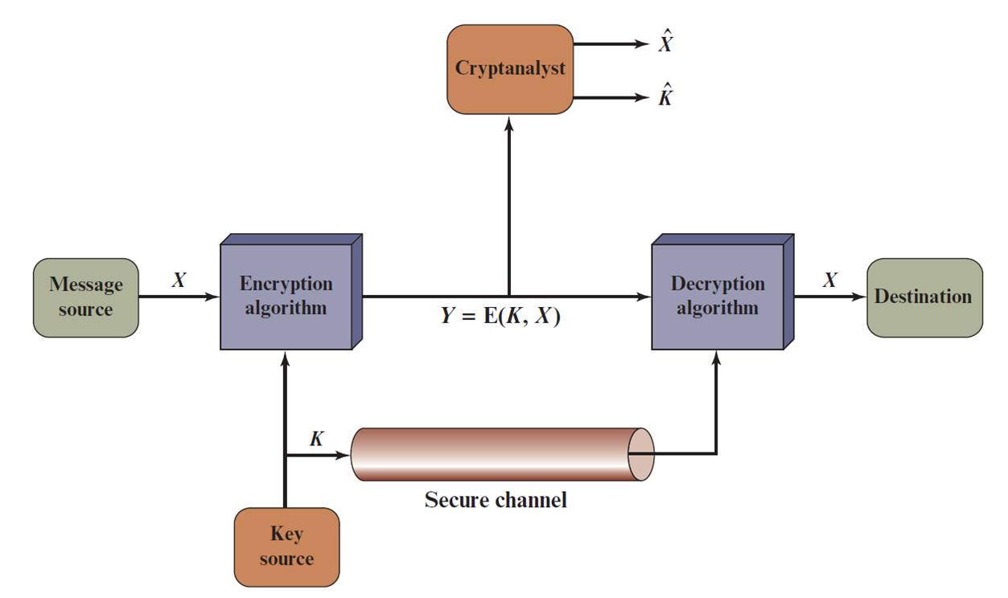
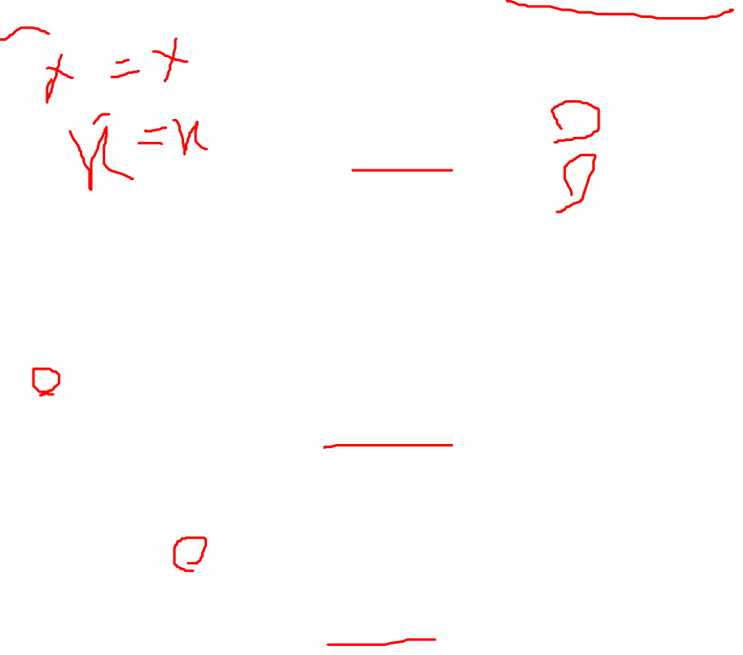
Figure 3.2 Model of Symmetric Cryptosystem
www.midocean.ae
Notes:
Let us take a closer look at the essential elements of a symmetric encryption scheme, using Figure 3.2.

Slide 15

Cryptographic Systems
Characterized along three independent dimensions:
The type of operations used for transforming plaintext to ciphertext
  Substitution
  Transposition
The number of keys used
  Symmetric, single-key, secret-key, conventional encryption
  Asymmetric, two-key, or public-key encryption
  The way in which the plaintext is processed
  Block cipher
  Stream cipher
www.midocean.ae
Notes:
Cryptographic systems are characterized along three independent dimensions:
1. The type of operations used for transforming plaintext to ciphertext. All
encryption algorithms are based on two general principles: substitution, in
which each element in the plaintext (bit, letter, group of bits or letters) is
mapped into another element, and transposition, in which elements in the
plaintext are rearranged. The fundamental requirement is that no information
be lost (i.e., that all operations are reversible). Most systems, referred to as
product systems , involve multiple stages of substitutions and transpositions.
2. The number of keys used. If both sender and receiver use the same key, the
system is referred to as symmetric, single-key, secret-key, or conventional
encryption. If the sender and receiver use different keys, the system is referred
to as asymmetric, two-key, or public-key encryption.
3. The way in which the plaintext is processed. A block cipher processes the
input one block of elements at a time, producing an output block for each
input block. A stream cipher processes the input elements continuously,
producing output one element at a time, as it goes along.

Slide 16
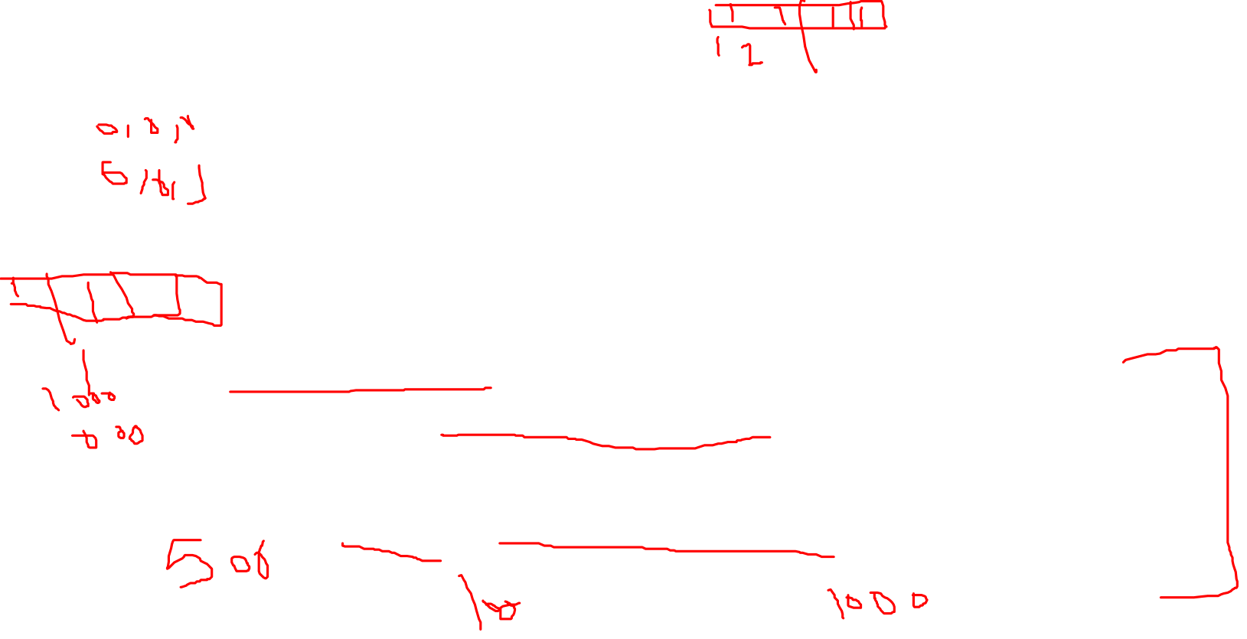
Cryptanalysis and Brute-Force Attack
Cryptanalysis
  Attack relies on the nature of the algorithm plus some knowledge of the general characteristics of the plaintext
  Attack exploits the characteristics of the algorithm to attempt to deduce a specific plaintext or to deduce the key being used
Brute-force attack
  Attacker tries every possible key on a piece of ciphertext until an intelligible translation into plaintext is obtained
  On average, half of all possible keys must be tried to achieve success
Notes:
Typically, the objective of attacking an encryption system is to recover the key in
use rather than simply to recover the plaintext of a single ciphertext. There are two
general approaches to attacking a conventional encryption scheme:
• Cryptanalysis: Cryptanalytic attacks rely on the nature of the algorithm plus
perhaps some knowledge of the general characteristics of the plaintext or
even some sample plaintext–ciphertext pairs. This type of attack exploits the
characteristics of the algorithm to attempt to deduce a specific plaintext or to
deduce the key being used.
• Brute-force attack: The attacker tries every possible key on a piece of ciphertext
until an intelligible translation into plaintext is obtained. On average, half
of all possible keys must be tried to achieve success.
If either type of attack succeeds in deducing the key, the effect is catastrophic:
All future and past messages encrypted with that key are compromised.

Slide 17
Brute-Force Attack
Involves trying every possible key until an intelligible translation of the ciphertext into plaintext is obtained
On average, half of all possible keys must be tried to achieve success
To supplement the brute-force approach, some degree of knowledge about the expected plaintext is needed, and some means of automatically distinguishing plaintext from garble is also needed
www.midocean.ae
Notes:
A brute-force attack involves trying every possible key until an intelligible
translation of the ciphertext into plaintext is obtained. On average, half of all possible
keys must be tried to achieve success. That is, if there are X different keys, on
average an attacker would discover the actual key after X/2 tries. It is important to
note that there is more to a brute-force attack than simply running through all possible
keys. Unless known plaintext is provided, the analyst must be able to recognize
plaintext as plaintext. If the message is just plain text in English, then the result pops
out easily, although the task of recognizing English would have to be automated. If
the text message has been compressed before encryption, then recognition is more
difficult. And if the message is some more general type of data, such as a numerical
file, and this has been compressed, the problem becomes even more difficult to
automate. Thus, to supplement the brute-force approach, some degree of knowledge
about the expected plaintext is needed, and some means of automatically
distinguishing plaintext from garble is also needed.

Slide 18
Table 3.1 Types of Attacks on Encrypted Messages
Type of Attack | Known to Cryptanalyst
Ciphertext Only | Encryption algorithm Ciphertext
Known Plaintext | Encryption algorithm Ciphertext One or more plaintext–ciphertext pairs formed with the secret key
Chosen Plaintext | Encryption algorithm Ciphertext Plaintext message chosen by cryptanalyst, together with its corresponding ciphertext generated with the secret key
Chosen Ciphertext | Encryption algorithm Ciphertext Ciphertext chosen by cryptanalyst, together with its corresponding decrypted plaintext generated with the secret key
Chosen Text | Encryption algorithm Ciphertext Plaintext message chosen by cryptanalyst, together with its corresponding ciphertext generated with the secret key Ciphertext chosen by cryptanalyst, together with its corresponding decrypted plaintext generated with the secret key
www.midocean.ae
Notes:
Table 3.1 summarizes the various types of cryptanalytic attacks based on the
amount of information known to the cryptanalyst. The most difficult problem is
presented when all that is available is the ciphertext only . In some cases, not even
the encryption algorithm is known, but in general, we can assume that the opponent
does know the algorithm used for encryption. One possible attack under these
circumstances is the brute-force approach of trying all possible keys. If the key space
is very large, this becomes impractical. Thus, the opponent must rely on an analysis
of the ciphertext itself, generally applying various statistical tests to it. To use this
approach, the opponent must have some general idea of the type of plaintext that
is concealed, such as English or French text, an EXE file, a Java source listing, an
accounting file, and so on.
The ciphertext-only attack is the easiest to defend against because the
opponent has the least amount of information to work with. In many cases, however,
the analyst has more information. The analyst may be able to capture one or more
plaintext messages as well as their encryptions. Or the analyst may know that certain
plaintext patterns will appear in a message. For example, a file that is encoded in the
Postscript format always begins with the same pattern, or there may be a standardized
header or banner to an electronic funds transfer message, and so on. All these are
examples of known plaintext . With this knowledge, the analyst may be able to deduce
the key on the basis of the way in which the known plaintext is transformed.
Closely related to the known-plaintext attack is what might be referred to as a
probable-word attack. If the opponent is working with the encryption of some general
prose message, he or she may have little knowledge of what is in the message.
However, if the opponent is after some very specific information, then parts of the
message may be known. For example, if an entire accounting file is being transmitted,
the opponent may know the placement of certain key words in the header of the
file. As another example, the source code for a program developed by Corporation
X might include a copyright statement in some standardized position.
If the analyst is able somehow to get the source system to insert into the system
a message chosen by the analyst, then a chosen-plaintext attack is possible. In general,
if the analyst is able to choose the messages to encrypt, the analyst may deliberately
pick patterns that can be expected to reveal the structure of the key.
Table 3.1 lists two other types of attack: chosen ciphertext and chosen text.
These are less commonly employed as cryptanalytic techniques but are nevertheless
possible avenues of attack.

Slide 19
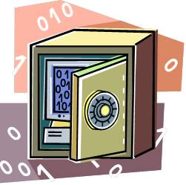
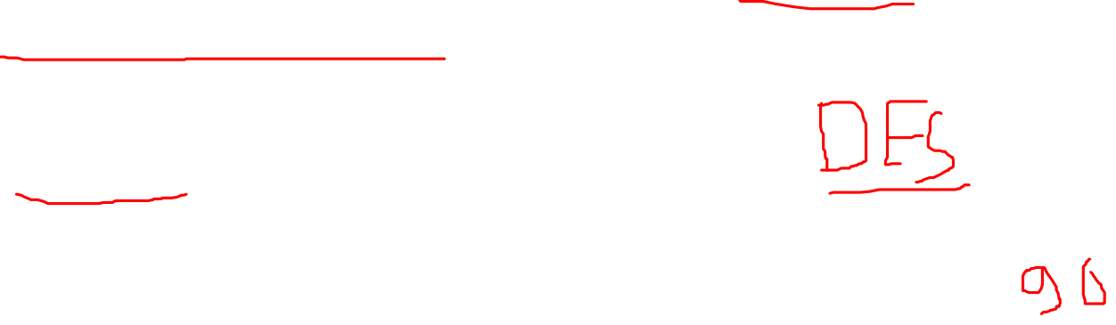
Encryption Scheme Security
Unconditionally secure
  No matter how much time an opponent has, it is impossible for him or her to decrypt the ciphertext simply because the required information is not there
Computationally secure
  The cost of breaking the cipher exceeds the value of the encrypted information
  The time required to break the cipher exceeds the useful lifetime of the information
www.midocean.ae
Notes:
Two more definitions are worthy of note. An encryption scheme is unconditionally
secure if the ciphertext generated by the scheme does not contain enough
information to determine uniquely the corresponding plaintext, no matter how
much ciphertext is available. That is, no matter how much time an opponent has, it
is impossible for him or her to decrypt the ciphertext simply because the required
information is not there. With the exception of a scheme known as the one-time pad
(described later in this chapter), there is no encryption algorithm that is unconditionally
secure. Therefore, all that the users of an encryption algorithm can strive
for is an algorithm that meets one or both of the following criteria:
• The cost of breaking the cipher exceeds the value of the encrypted information.
• The time required to break the cipher exceeds the useful lifetime of the
information.
An encryption scheme is said to be computationally secure if either of the
foregoing two criteria are met. Unfortunately, it is very difficult to estimate the
amount of effort required to cryptanalyze ciphertext successfully.
All forms of cryptanalysis for symmetric encryption schemes are designed
to exploit the fact that traces of structure or pattern in the plaintext may survive
encryption and be discernible in the ciphertext. This will become clear as we examine
various symmetric encryption schemes in this chapter. We will see in Part Three
that cryptanalysis for public-key schemes proceeds from a fundamentally different
premise, namely, that the mathematical properties of the pair of keys may make it
possible for one of the two keys to be deduced from the other.

Slide 20

Strong Encryption
The term strong encryption refers to encryption schemes that make it impractically difficult for unauthorized persons or systems to gain access to plaintext that has been encrypted
Properties that make an encryption algorithm strong are:
  Appropriate choice of cryptographic algorithm
  Use of sufficiently long key lengths
  Appropriate choice of protocols
  A well-engineered implementation
  Absence of deliberately introduced hidden flaws
www.midocean.ae
Notes:
For users, security managers, and organization executives, there is a requirement for strong encryption to protect data. The term strong encryption is an imprecise one, but in general terms, it refers to encryption schemes that make it impractically difficult for unauthorized persons or systems to gain access to plaintext that has been encrypted. [NAS18] lists the following properties that make an encryption algorithm strong: appropriate choice of cryptographic algorithm, use of sufficiently long key lengths, appropriate choice of protocols, a well-engineered implementation, and the absence of deliberately introduced hidden flaws. The first two factors relate to cryptanalysis, discussed in this section, and the third factor relates to the discussion in Part Six. The last two factors are beyond the scope of this book.

Slide 21
Symmetric Encryption
Substitution Techniques
Caesar Cipher
Monoalphabetic Cipher
Playfair Cipher
Hill Cipher
www.midocean.ae

Slide 22
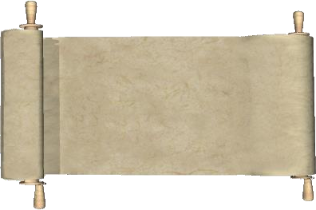
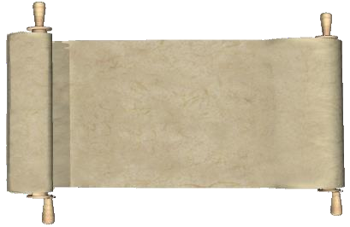
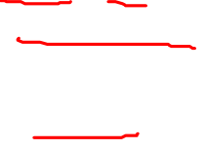
The clear text message would be encoded using a key of 3.
Substitution Techniques
1
FLANK EAST ATTACK AT DAWN
Clear text
Shift the top scroll over by three characters (key of 3), an A becomes D, B becomes E, and so on.
2
A B C D E F G H I J K L M N O P Q R S T U V W X Y Z
A B C D E F G H I J K L M N O P Q R S T U V W X Y Z A B C
3
The clear text message would be encrypted as follows using a key of 3.
IODQN HDVW DWWDFN DW GDZQ
Cipherered text
www.midocean.ae

Slide 23
Substitution Techniques
Caesar Cipher
Monoalphabetic Ciphers
Playfair Cipher
Hill Cipher
Polyalphabetic Ciphers
Vigenère Cipher
Autokey Cipher
Vernam Cipher
www.midocean.ae

Slide 24
Symmetric Encryption
Substitution Techniques
Caesar Cipher
Monoalphabetic Cipher
Playfair Cipher
Hill Cipher
www.midocean.ae

Slide 25
Caesar Cipher
Simplest and earliest known use of a substitution cipher
Used by Julius Caesar
Involves replacing each letter of the alphabet with the letter standing three places further down the alphabet
Alphabet is wrapped around so that the letter following Z is A
plain: meet me after the toga party
cipher: PHHW PH DIWHU WKH WRJD SDUWB
www.midocean.ae
Notes:
The earliest known, and the simplest, use of a substitution cipher was by Julius
Caesar. The Caesar cipher involves replacing each letter of the alphabet with the
letter standing three places further down the alphabet.

Slide 26
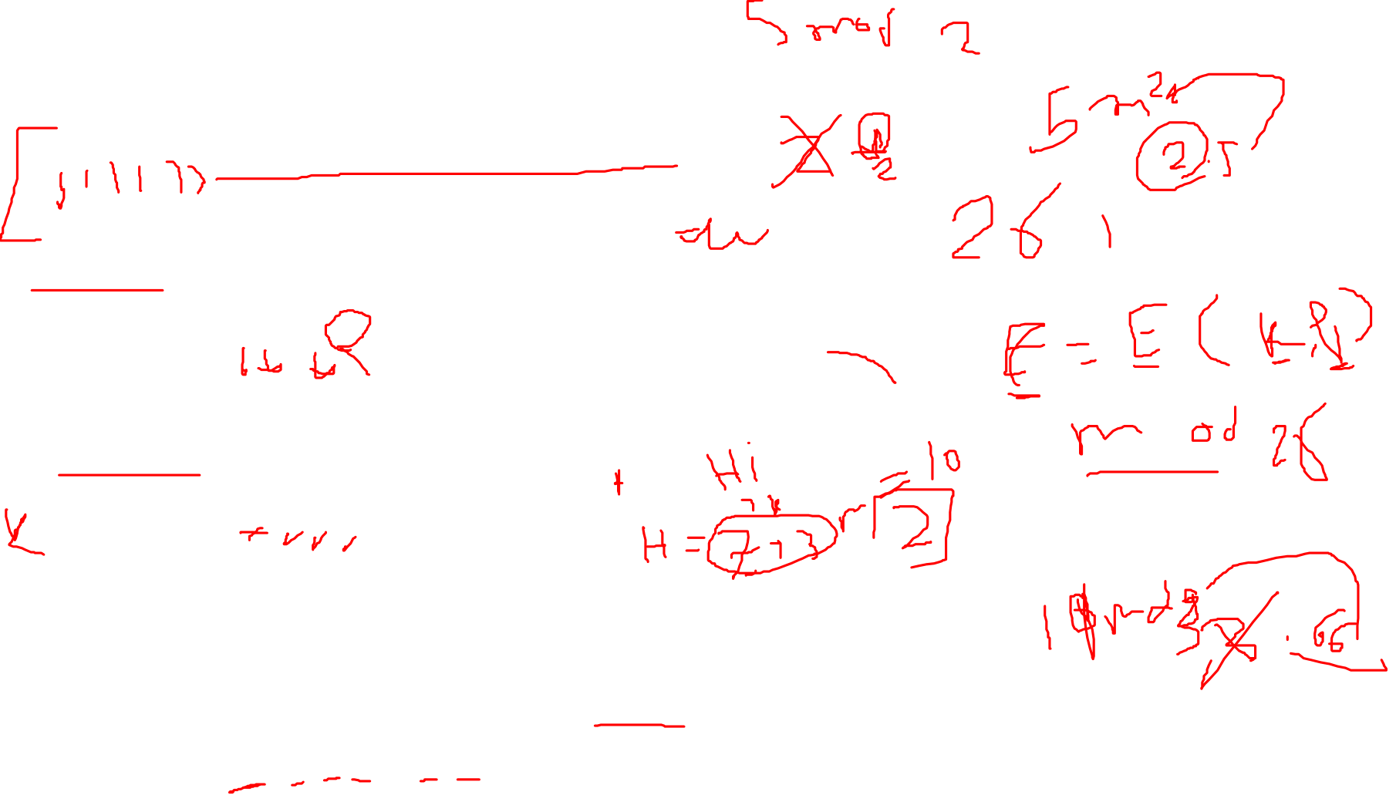
Caesar Cipher Algorithm
Can define transformation as:
a b c d e f g h i j k l m n o p q r s t u v w x y z
D E F G H I J K L M N O P Q R S T U V W X Y Z A B C
Mathematically give each letter a number
  a b c d e f g h i j k l m n o p q r s t u v w x y z
  0 1 2 3 4 5 6 7 8 9 10 11 12 13 14 15 16 17 18 19 20 21 22 23 24 25
Algorithm can be expressed as:
c = E(3, p) = (p + 3) mod (26)
A shift may be of any amount, so that the general Caesar algorithm is:
C = E(k , p ) = (p + k ) mod 26
Where k takes on a value in the range 1 to 25; the decryption algorithm is simply:
p = D(k , C ) = (C − k ) mod 26
www.midocean.ae
Notes:
Note that the alphabet is wrapped around, so that the letter following Z is A.
An algorithm can be expressed as follows. For each plaintext letter p , substitute
the ciphertext letter C

Slide 27
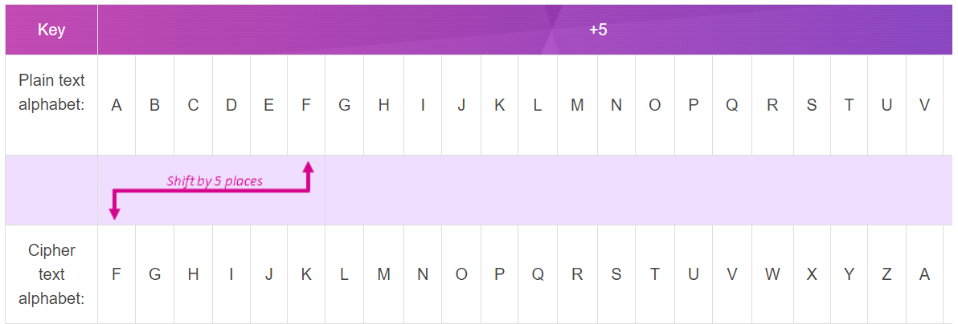

Caesar Cipher Algorithm
Can define transformation as:
a b c d e f g h i j k l m n o p q r s t u v w x y z
D E F G H I J K L M N O P Q R S T U V W X Y Z A B C
https://www.101computing.net/caesar-shift-substitution-cipher/
www.midocean.ae
Notes:
Note that the alphabet is wrapped around, so that the letter following Z is A.
An algorithm can be expressed as follows. For each plaintext letter p , substitute
the ciphertext letter C

Slide 28
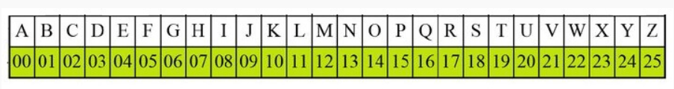
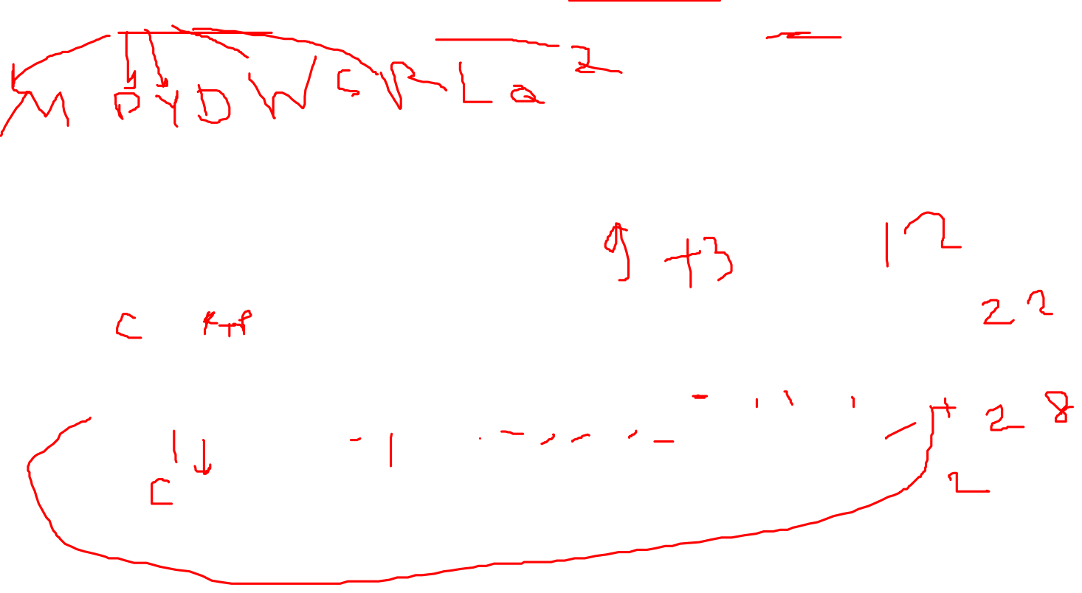
Caesar Cipher Algorithm
Example: 1 Use the Caesar cipher to encrypt and decrypt the message "JAVATPOINT," and the key (shift) value of this message is 3.
Encryption
We apply encryption formulas by character, based on alphabetical order.
The formula of encryption is:
En (x) = (x + n) mod 26
www.midocean.ae
Notes:
Note that the alphabet is wrapped around, so that the letter following Z is A.
An algorithm can be expressed as follows. For each plaintext letter p , substitute
the ciphertext letter C

Slide 29
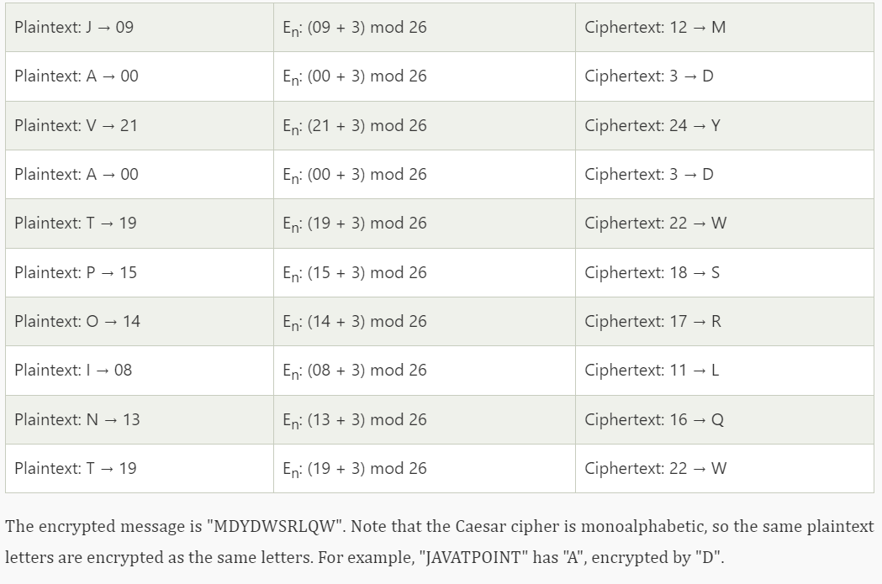

Caesar Cipher Algorithm
Solution :
www.midocean.ae
Notes:
Note that the alphabet is wrapped around, so that the letter following Z is A.
An algorithm can be expressed as follows. For each plaintext letter p , substitute
the ciphertext letter C

Slide 30
Caesar Cipher Algorithm
Solution :
www.midocean.ae
Notes:
Note that the alphabet is wrapped around, so that the letter following Z is A.
An algorithm can be expressed as follows. For each plaintext letter p , substitute
the ciphertext letter C

Slide 31
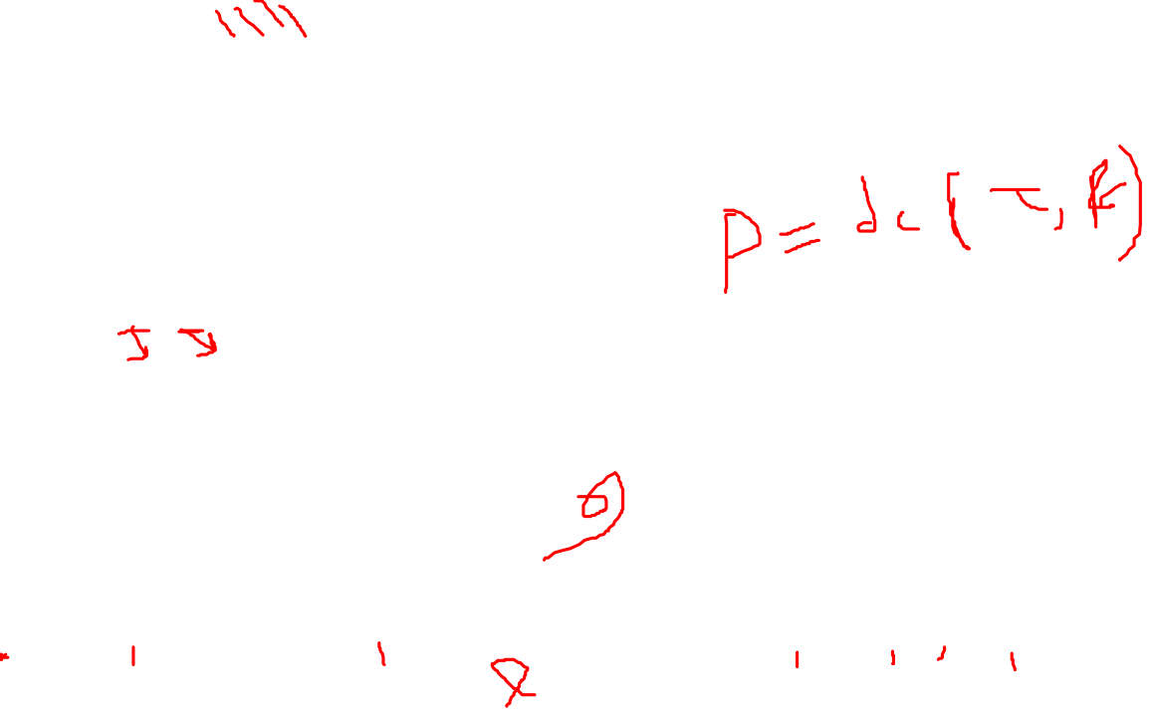
Caesar Cipher Algorithm
Decryption (MDYDWSRLQW)
We apply decryption formulas by character, based on alphabetical order.
The formula of decryption is:
Dn (x) = (xi - n) mod 26
If any case (Dn) value becomes negative (-ve), in this case, we will add 26 in the negative value.
www.midocean.ae
Notes:
Note that the alphabet is wrapped around, so that the letter following Z is A.
An algorithm can be expressed as follows. For each plaintext letter p , substitute
the ciphertext letter C

Slide 32
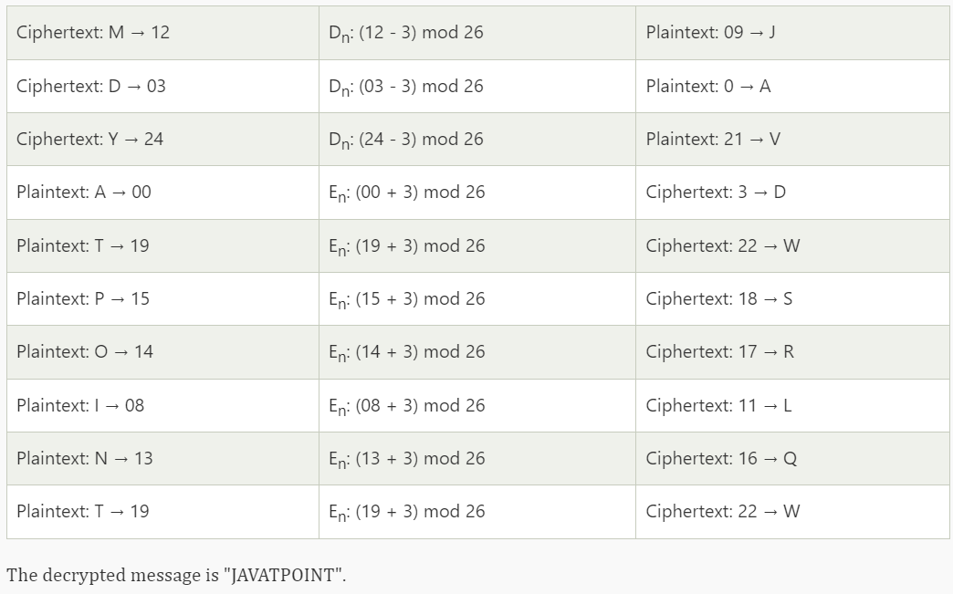
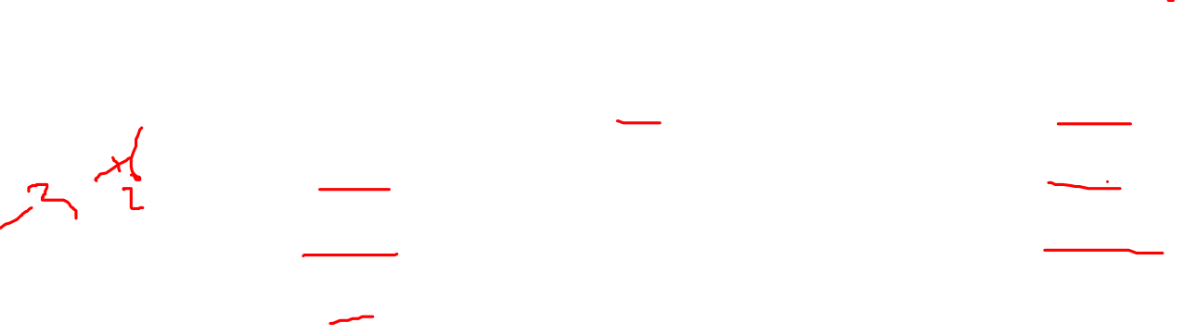
Caesar Cipher Algorithm
Solution : Decryption (MDYDWSRLQW)
www.midocean.ae
Notes:
Note that the alphabet is wrapped around, so that the letter following Z is A.
An algorithm can be expressed as follows. For each plaintext letter p , substitute
the ciphertext letter C

Slide 33

Caesar Cipher Algorithm
Example: 1 Plaintext: THE QUICK BROWN FOX JUMPS OVER THE LAZY DOG
Use the Caesar cipher to encrypt and decrypt the message "JAVATPOINT," and the key (shift) value of this message is 23.
Encryption
Ciphertext: QEB NRFZH YOLTK CLU GRJMP LSBO QEB IXWV ALD
https://www.101computing.net/caesar-cipher/
www.midocean.ae
Notes:
Note that the alphabet is wrapped around, so that the letter following Z is A.
An algorithm can be expressed as follows. For each plaintext letter p , substitute
the ciphertext letter C

Slide 34
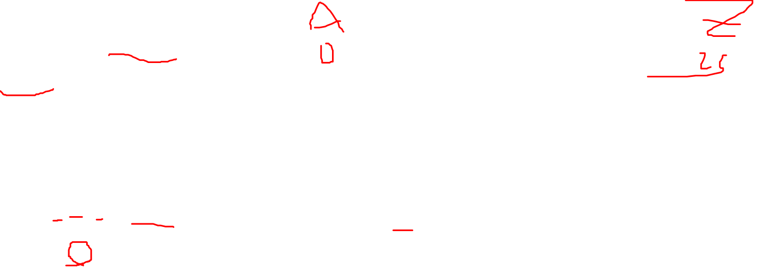
Lecture
Caesar Cipher Algorithm Example
05
PlainText = dcodex
K=3
P=d
2) P=3
3) C=P+K mod 26=3+3 mod 26=6 mod 26 =6
4) C=g
www.midocean.ae

Slide 35

Lecture
Caesar Cipher Algorithm Example
05
PlainText = dcodex
K=3
P=x 2) P=23
3) C=P+K mod 26=23+3 mod 26=26 mod 26= 0
4) C=a
www.midocean.ae

Slide 36
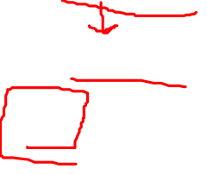
Lecture
Caesar Cipher Algorithm Example
05
P= dcodex
C= gfrgha
K=3
www.midocean.ae

Slide 37
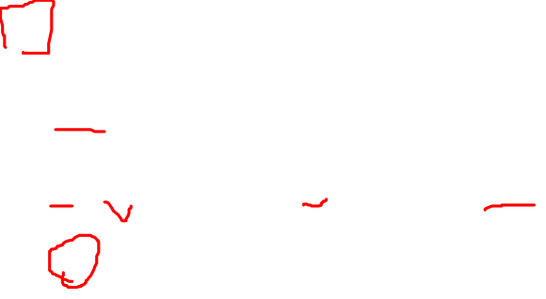
Lecture
Caesar Cipher Decryption Example
05
CipherText = gfrgha
K=3
C=g
2) C=6
3) P=C-K mod 26=6-3 mod 26=3
4) P=d
www.midocean.ae

Slide 38
Lecture
Caesar Cipher Decryption Example
05
CipherText = gfrgha
K=3
C=a
2) C=0
3) P=C-K mod 26=0-3 mod 26=-3 mod 26 =23
4) P=x
www.midocean.ae

Slide 39
Lecture
Brute-Force Cryptanalysis
05
Ensuring Three important characteristics of this problem enabled us to use a bruteforce cryptanalysis:
    The encryption and decryption algorithms are known.
    There are only 25 keys to try.
    The language of the plaintext is known and easily recognizable.
www.midocean.ae

Slide 40
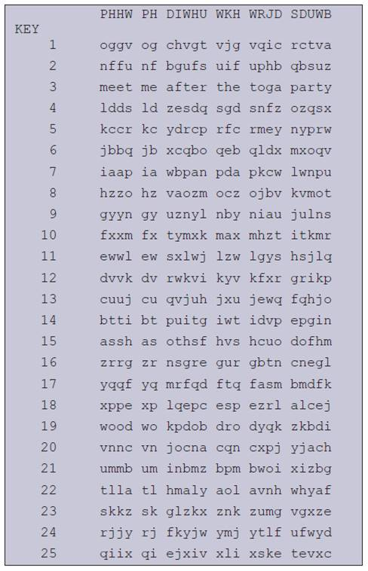

Figure 3.3 Brute-Force Cryptanalysis of Caesar Cipher
www.midocean.ae
Notes:
If it is known that a given ciphertext is a Caesar cipher, then a brute-force
cryptanalysis is easily performed: simply try all the 25 possible keys. Figure 3.3
shows the results of applying this strategy to the example ciphertext. In this case, the
plaintext leaps out as occupying the third line.
Three important characteristics of this problem enabled us to use a brute-force
cryptanalysis:
1. The encryption and decryption algorithms are known.
2. There are only 25 keys to try.
3. The language of the plaintext is known and easily recognizable.

Slide 41

How to implement Caesar Cipher technique on Arabic letters?
www.midocean.ae

Slide 42
Symmetric Encryption
Substitution Techniques
Caesar Cipher
Monoalphabetic Cipher
Playfair Cipher
Hill Cipher
www.midocean.ae

Slide 43
Lecture
monoalphabetic cipher
05
A monoalphabetic cipher uses fixed substitution over the entire message
Random Key
www.midocean.ae

Slide 44
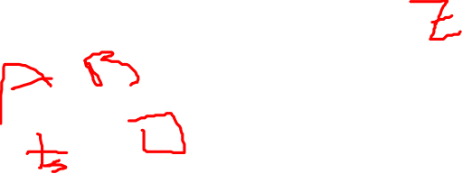
monoalphabetic cipher
Permutation
  Of a finite set of elements S is an ordered sequence of all the elements of S , with each element appearing exactly once
If the “cipher” line can be any permutation of the 26 alphabetic characters, then there are 26! or greater than 4 x 10²⁶ possible keys
  This is 10 orders of magnitude greater than the key space for DES
  Approach is referred to as a monoalphabetic substitution cipher because a single cipher alphabet is used per message
www.midocean.ae
Notes:
With only 25 possible keys, the Caesar cipher is far from secure. A dramatic increase
in the key space can be achieved by allowing an arbitrary substitution. Before proceeding,
we define the term permutation . A permutation of a finite set of elements S
is an ordered sequence of all the elements of S, with each element appearing exactly
once.
For example, if S = {a, b, c}, there are six permutations of S :
abc, acb, bac, bca, cab, cba
In general, there are n ! permutations of a set of n elements, because the first
element can be chosen in one of n ways, the second in n - 1 ways, the third in n - 2
ways, and so on.
If, instead, the “cipher” line can be any permutation of the 26 alphabetic characters,
then there are 26! or greater than 4 * 10²⁶ possible keys. This is 10 orders of magnitude
greater than the key space for DES and would seem to eliminate brute-force
techniques for cryptanalysis. Such an approach is referred to as a monoalphabetic
substitution cipher, because a single cipher alphabet (mapping from plain alphabet
to cipher alphabet) is used per message.

Slide 45
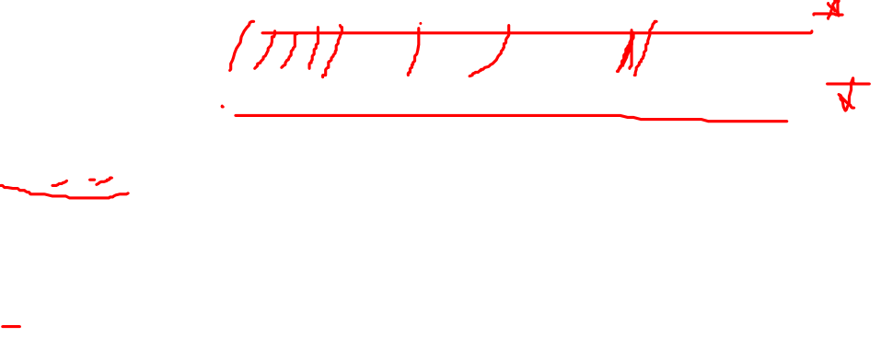
Lecture
monoalphabetic cipher
05
Example:
Plaintext alphabets: ABCDEFGHIJKLMNOPQRSTUVWXYZ
Ciphertext alphabet: ZEBRASCDFGHIJKLMNOPQTUVWXY
  P= ITEMS
Encoding
  C= FQAIP
Decoding
  P= ITEMS
www.midocean.ae

Slide 46
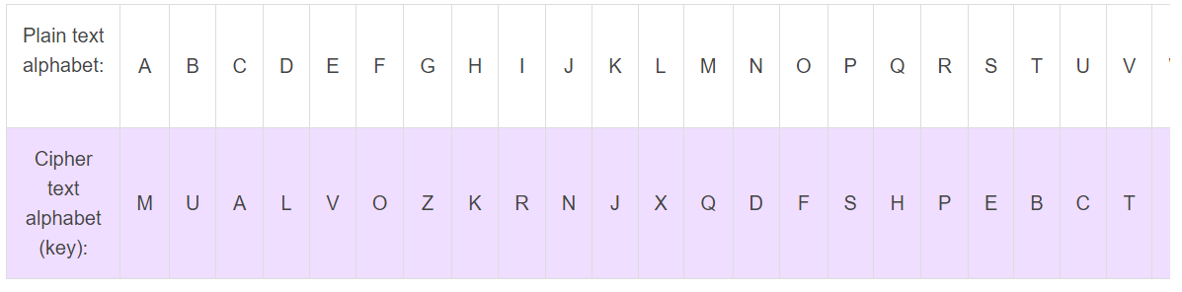
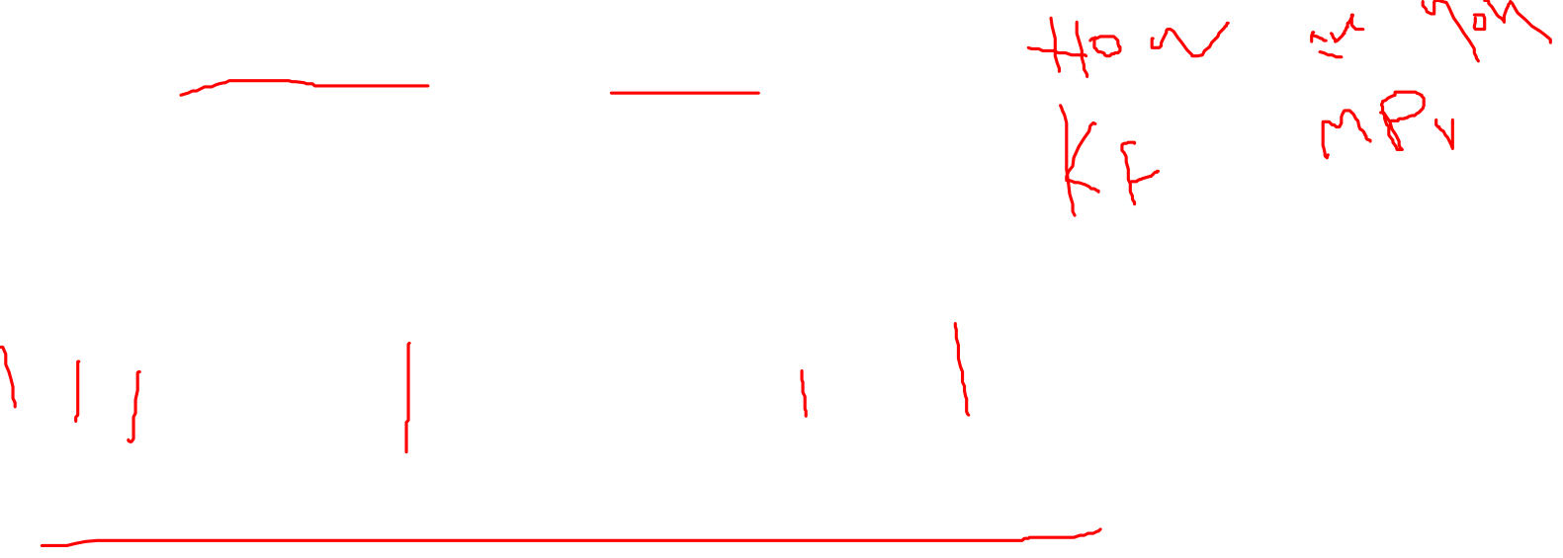
monoalphabetic cipher
A mono-alphabetic cipher (aka simple substitution cipher) is a substitution cipher where each letter of the plain text is replaced with another letter of the alphabet.
It uses a fixed key which consist of the 26 letters of a “shuffled alphabet”.
Plaintext : How Are you cipher text : ?????
https://www.101computing.net/mono-alphabetic-substitution-cipher/
www.midocean.ae
Notes:
With only 25 possible keys, the Caesar cipher is far from secure. A dramatic increase
in the key space can be achieved by allowing an arbitrary substitution. Before proceeding,
we define the term permutation . A permutation of a finite set of elements S
is an ordered sequence of all the elements of S, with each element appearing exactly
once.
For example, if S = {a, b, c}, there are six permutations of S :
abc, acb, bac, bca, cab, cba
In general, there are n ! permutations of a set of n elements, because the first
element can be chosen in one of n ways, the second in n - 1 ways, the third in n - 2
ways, and so on.
If, instead, the “cipher” line can be any permutation of the 26 alphabetic characters,
then there are 26! or greater than 4 * 10²⁶ possible keys. This is 10 orders of magnitude
greater than the key space for DES and would seem to eliminate brute-force
techniques for cryptanalysis. Such an approach is referred to as a monoalphabetic
substitution cipher, because a single cipher alphabet (mapping from plain alphabet
to cipher alphabet) is used per message.

Slide 47
monoalphabetic cipher
Example:
  Plaintext alphabets: ABCDEFGHIJKLMNOPQRSTUVWXYZ
  Ciphertext alphabet: ZEBRASCDFGHIJKLMNOPQTUVWXY
P= ITEMS
Encoding
C= FQAIP
Decoding
P= ITEMS
www.midocean.ae

Slide 48
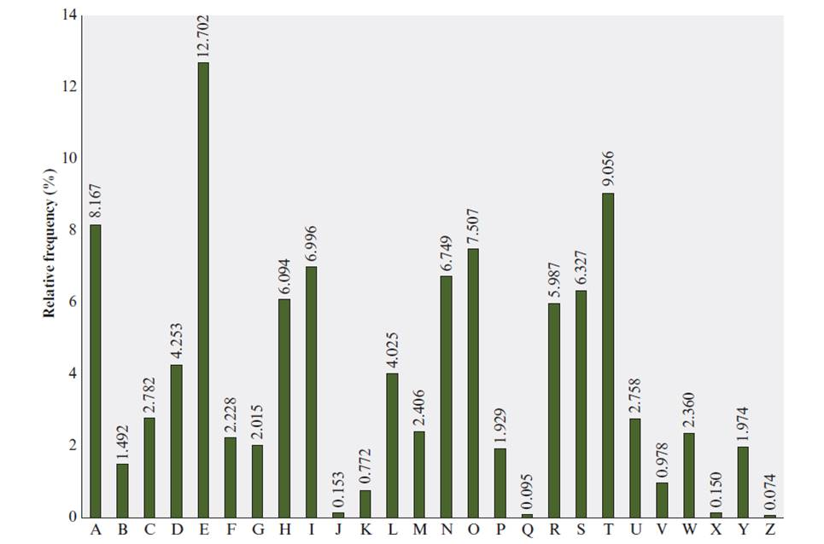

Figure 3.5 Relative Frequency of Letters in English Text
www.midocean.ae
Notes:
There is, however, another line of attack. If the cryptanalyst knows the nature
of the plaintext (e.g., noncompressed English text), then the analyst can exploit the
regularities of the language. To see how such a cryptanalysis might proceed, we give
a partial example here that is adapted from one in [SINK09]. The ciphertext to be
solved is
UZQSOVUOHXMOPVGPOZPEVSGZWSZOPFPESXUDBMETSXAIZ
VUEPHZHMDZSHZOWSFPAPPDTSVPQUZWYMXUZUHSX
EPYEPOPDZSZUFPOMBZWPFUPZHMDJUDTMOHMQ
As a first step, the relative frequency of the letters can be determined and
compared to a standard frequency distribution for English, such as is shown in
Figure 3.5 (based on [LEWA00]). If the message were long enough, this technique
alone might be sufficient, but because this is a relatively short message, we cannot
expect an exact match. In any case, the relative frequencies of the letters in the
ciphertext (in percentages) are as follows:
P 13.33 H 5.83 F 3.33 B 1.67 C 0.00
Z 11.67 D 5.00 W 3.33 G 1.67 K 0.00
S 8.33 E 5.00 Q 2.50 Y 1.67 L 0.00
U 8.33 V 4.17 T 2.50 I 0.83 N 0.00
O 7.50 X 4.17 A 1.67 J 0.83 R 0.00
M 6.67
Comparing this breakdown with Figure 3.5, it seems likely that cipher letters P
and Z are the equivalents of plain letters e and t, but it is not certain which is which.
The letters S, U, O, M, and H are all of relatively high frequency and probably correspond
to plain letters from the set {a, h, i, n, o, r, s}. The letters with the lowest
frequencies (namely, A, B, G, Y, I, J) are likely included in the set {b, j, k, q, v, x, z}.
There are a number of ways to proceed at this point. We could make some tentative
assignments and start to fill in the plaintext to see if it looks like a reasonable
“skeleton” of a message. A more systematic approach is to look for other regularities.
For example, certain words may be known to be in the text. Or we could look for
repeating sequences of cipher letters and try to deduce their plaintext equivalents.

Slide 49





monoalphabetic cipher
Easy to break because they reflect the frequency data of the original alphabet
Countermeasure is to provide multiple substitutes (homophones) for a single letter
Digram
  Two-letter combination
  Most common is th
Trigram
  Three-letter combination
  Most frequent is the
www.midocean.ae
Notes:
A powerful tool is to look at the frequency of two-letter combinations, known
as digrams . A table similar to Figure 3.5 could be drawn up showing the relative frequency
of digrams. The most common such digram is th. In our ciphertext, the most
common digram is ZW, which appears three times. So we make the correspondence
of Z with t and W with h. Then, by our earlier hypothesis, we can equate P with e.
Now notice that the sequence ZWP appears in the ciphertext, and we can translate
that sequence as “the.” This is the most frequent trigram (three-letter combination)
in English, which seems to indicate that we are on the right track.
Next, notice the sequence ZWSZ in the first line. We do not know that these
four letters form a complete word, but if they do, it is of the form th_t. If so, S
equates with a.
So far, then, we have
UZQSOVUOHXMOPVGPOZPEVSGZWSZOPFPESXUDBMETSXAIZ
t a e e te a that e e a a
VUEPHZHMDZSHZOWSFPAPPDTSVPQUZWYMXUZUHSX
e t ta t ha e ee a e th t a
EPYEPOPDZSZUFPOMBZWPFUPZHMDJUDTMOHMQ
e e e tat e the t
Only four letters have been identified, but already we have quite a bit of the
message. Continued analysis of frequencies plus trial and error should easily yield a
solution from this point. The complete plaintext, with spaces added between words,
follows:
it was disclosed yesterday that several informal but
direct contacts have been made with political
representatives of the Viet cong in Moscow
Monoalphabetic ciphers are easy to break because they reflect the frequency
data of the original alphabet. A countermeasure is to provide multiple substitutes,
known as homophones, for a single letter. For example, the letter e could be assigned
a number of different cipher symbols, such as 16, 74, 35, and 21, with each
homophone assigned to a letter in rotation or randomly. If the number of symbols
assigned to each letter is proportional to the relative frequency of that letter, then
single-letter frequency information is completely obliterated. The great mathematician
Carl Friedrich Gauss believed that he had devised an unbreakable cipher using
homophones. However, even with homophones, each element of plaintext affects
only one element of ciphertext, and multiple-letter patterns (e.g., digram frequencies)
still survive in the ciphertext, making cryptanalysis relatively straightforward.
Two principal methods are used in substitution ciphers to lessen the extent to
which the structure of the plaintext survives in the ciphertext: One approach is to
encrypt multiple letters of plaintext, and the other is to use multiple cipher alphabets.
We briefly examine each.

Slide 50
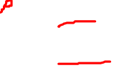
Example Cryptanalysis
Given ciphertext
uzqsovuohxmopvgpozpevsgzwszopfpesxudbmetsxaizvuephzhzshzowsfpappdtsvpquzwymxuzuhsxepyepopdzszufpombzwpfupzhmdjudtmohmq
Frequency Analysis
P 13.33 | H 5.83 | F 3.33 | B 1.67 | C 0.00
Z 11.67 | D 5.00 | W 3.33 | G 1.67 | K 0.00
S 8.33 | E 5.00 | Q 2.50 | Y 1.67 | L 0.00
U 8.33 | V 4.17 | T 2.50 | I 0.83 | N 0.00
O 7.50 | X 4.17 | A 1.67 | J 0.83 | R 0.00
M 6.67
www.midocean.ae

Slide 51
Example Cryptanalysis
Guess P & Z are E and T, respectively
utqsovuohxmoevgeoteevsgtwstoefeesxudbmetsxaitvueehthtshtowsfeaeedtsvequtwymxutuhsxeeyeeoedtstufeombtwefuethmdjudtmohmq
www.midocean.ae

Slide 52
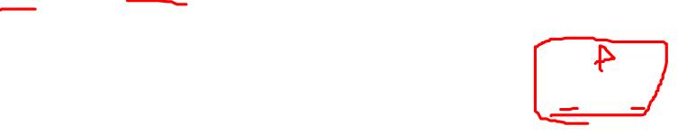
Example Cryptanalysis
Among digrams starting with Z, ZW has the highest occurrence (3 times)
Guess ZW is TH
Utqsovuohxmoevgeoteevsgthstoefeesxudbmetsxaitvueehthtshtowsfeaeedtsvequthymxutuhsxeeyeeoedtstufeombthefuethmdjudtmohmq
Hence ZWP is THE
www.midocean.ae

Slide 53

Example Cryptanalysis
Utqsovuohxmoevgeoteevsgthstoefeesxudbmetsxaitvueehthtshtowsfeaeedtsvequthymxutuhsxeeyeeoedtstufeombthefuethmdjudtmohmq
Guess S is A
Utqaovuohxmoevgeoteevagthatoefeeaxudbmetaxaitvueehthtahtowafeaeedtavequthymxutuhaxeeyeeoedtatufeombthefuethmdjudtmohmq
www.midocean.ae

Slide 54
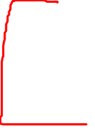
Example Cryptanalysis
U, V and M may correspond to O, I and N
Continuing with trial and error, we finally get the following plaintext
It was disclosed yesterday that several informal but direct contacts have been made with political representatives of the Viet Cong in Moscow
www.midocean.ae

Slide 55
Lecture
Task2
05
How to implement Monoalphabetic Cipher technique on Arabic letters?
www.midocean.ae

Slide 56



Thank You

