Slide 1

International Business Management
Prepared by Dr. Badur elgasim
Lecture 7
MGM 506
International Strategic Alliance

Slide 2

Learning Objectives
General Understanding of Strategic Alliance
Definition strategic alliance
motivations for strategic alliances
Challenging issues and risks of strategic alliance
International Strategic Alliance and Alliance Governance Mode Choice

Slide 3

Introduction
The unpredictable directionality of technological development and radically changing technology in the face of fourth industrial revolution has significantly changed the landscape of international business. It is more challenging for firms to do international business because of this uncertain environment. And it is not anymore guaranteed a business sustainability, because firms, regardless of their size, do not encompass the entire range of capability to cope with this continuously changing environment. Therefore, the need to ally with partners, even with international partners, has become more imperative

Slide 4
The number of electric vehicles on the road rocketed to 2 million in 2016 after being virtually non-existent just five years ago In 2014, Tesla Inc., an American electric vehicle (EV) manufacturer, has announced an alliance agreement with Panasonic to manufacture battery cells. The two companies are jointly investing in a new $5 billion battery production facility (i.e., Tesla Giga factory) where the companies intend to work together to integrate battery precursor material, cell, module, and battery pack production at a site near Reno, Nevada. Previously, Tesla buys battery cells from Panasonic in Japan which ships them to Tesla’s factory in California

Slide 5
Tesla faces at least two critical hurdles that make the business model of importing batteries from Japan and assembling them in the factory costly to maintain:
(1) mass production of electric vehicles and
(2) delivery of assembled vehicles to customers in a timely manner. But the Joint Venture agreement between Tesla and Panasonic allows Tesla to reduce manufacturing costs since Panasonic puts a huge amount of capital resource into the Giga factory for installation of its own production equipment and management of its own employees.

Slide 6

What is strategic alliance
A strategic alliance can be defined as “a relatively enduring inter-firm cooperative arrangement that utilizes resources and/or governance structures from autonomous organizations.” Strategic alliances include equity joint ventures (EJVs), licensing agreements, distribution and supply agreements, research and development (R&D) partnerships, co-production agreements, franchising, and technical exchanges. Its type may vary broadly depending upon
The degree of interorganizational dependence in terms of resource (e.g., financial, human capital, and intellectual properties such as technology, trademark, trade secret/formula, and know-how).
2. The complexity of alliance task coordination and inter-partner interaction.

Slide 7
Types of alliances
Technical Training:
It is a type of alliance in which a firm provides technical training service/program to a trainee firm in a short duration. And usually, the technology or training service provider is compensated with a lump-sum service fee. The technical training agreement is commonly used in high-tech industries (e.g., telecommunication and aircraft) where knowledge transferring and skills learning are involved in the manufacturing process and product.

Slide 8
Contract Manufacturing/Assembly Agreement:
It is associated with the outsourcing of manufacturing/assembly of products. A contract manufacturer with its own manufacturing capability designs and builds a product on behalf of customers. By outsourcing product manufacturing/assembly to contract manufacturers, customers can quickly achieve economies of scale (i.e., mass production) while reducing production costs and then better respond increased demands.

Slide 9
Patent Licensing:
Patent/technology licensing is widely used in high-tech industries such as biopharmaceuticals where a licensor grants a licensee the right to use and distribute (e.g., sell and sublicense) its technology as a patent. Not only does patent licensing allow the licensee to get access to unique technology, but it also helps reduce R&D investments.

Slide 10
Franchising:
Franchisors grant franchisees the right to use a package of business services including trademark/logo, trade secret, management (e.g., organizing, operating, and training), and merchandising. Usually, franchisees pay an initial franchise/signing fee as well as a royalty as a percentage of their revenues (e.g., gross sales) or profits. Given the financial benefits and relatively low financial risks, franchising allows a firm to expand its business quickly across geographically diverse markets.

Slide 11
Franchising is widely used in the food/drink and hospitality industry; a typical example of franchise includes McDonald’s, Dunkin donuts, and Hilton international. However, it is hard to distinguish whether a business chain is franchised, licensed, or company-owned because firms prefer to use a mixed alliance strategy in order to be able to better respond challenging global business environments. McDonald’s, for instance, opened 73 restaurants in Russia in 2016. Of those, 65 are company-owned (not franchised).

Slide 12
Know-How Licensing:
Know-how licensing is different from patent licensing in a way that know-how licensing is associated with “tacit” knowledge which is not simply codifiable, imitable, and teachable . Thus, the knowledge transfer process (in terms of teach ability and learning) becomes more difficult, protracted, or even uncertain as the tacitness of knowledge in licensing contract increases. To access deeply embedded or tacit knowledge in a partner firm

Slide 13
Management Service Agreement:
A management service contract is a long-term agreement of up to 10 years or even longer (unless terminated early), whereby a management service provider provides a partner a broad scope of business operating services including day-to-day management/operation (e.g., human resource management), fiscal/procurement (e.g., finance, accounting, and budget), marketing/sales, and business consulting service.

Slide 14
And since the service includes day-to-day management operation consulting services, the degree of inter-partner interaction and task coordination is relatively high.
An example of management service agreement can be found in the hospitality industry, where legal owners of the property and real estate enter into a contract with the hotel firm to run and operate the hotel on a day-to-day basis, usually under the latter’s internationally recognized name

Slide 15
Cooperative Agreement:
Cooperative agreement refers to non-equity-based contractual agreements (without the creation of a legal entity) between partners for joint activities such as coproduction and joint R&D (joint research and joint development). And the goal of the cooperative agreement is to share the cost and risk of production and R&D. For example, companies can reduce manufacturing costs through a co-production agreement, whereby each partner is responsible to produce a specific product (or part).

Slide 16
Equity Joint Venture:
As opposed to a contractual (non-equity-based) alliance, equity joint venture (EJV) refers to the creation of an independent legal entity by two (or more) partnering firms. Partners usually pool complementary resources to pursue common business goals and objectives of a venture. And due to its organizational embeddedness (i.e., hierarchical organizational structure), the partners can have the greatest degree of interaction.

Slide 17
What are the motivations for strategic alliances
There are various motivations for strategic alliance formation. Firms may form an alliance to:
• Reduce risk and cost of R&D.
• Achieve economies of scale.
• Get access to unique resources (e.g., technology).
• Overcome (international) investment barriers.
• Facilitate international expansion.
• Gain advantages of vertical quasi-integration

Slide 18
First, technological knowledge (or technology itself) is a basic resource of competitive advantage, particularly for firms in high-tech industries.
Second, firms can quickly achieve economies of scale through alliance collaboration.
Third, firms can overcome investment barriers through alliances. In international business, firms may face investment barriers such as excessive regulations on foreign direct investment and local bureaucratic practices

Slide 19
Fourth, foreign firms may facilitate international expansion by allying with a local partner, particularly when they are not familiar with local market environments (e.g., cultural, institutional, and economic environment).
An alliance with local partners allows foreign firms to gain local market legitimacy and reduce local market uncertainty

Slide 20
Finally, firms can gain advantages of vertical quasi-integration through alliances. The concept vertical quasi-integration refers to the vertical integration of value-creation activities without the rigidity of ownership (e.g., acquisition). For instance, firms in the pharmaceutical industry where R&D activity is vertically disintegrated (i.e., R, drug discovery, and D, clinical trials) oftentimes ally with biotech firms; pharmaceutical firms access complementary biotechnologies, while biotech firms lacking clinical practice (due to their tendency to focus on drug discovery) leverage the diverse R&D value-chain experience of pharmaceuticals

Slide 21
Succeeding in Strategic Alliances
Succeeding in Strategic Alliances Allying with partner firms is not a onetime irrevocable decision. But rather, it is a collaboration agreement that evolves over time depending upon its partner relationship, changing environments, and emergent contingencies. To be successful, it is important for firms to evolve their alliance strategy because of today’s challenging business environments (e.g., increased global competition, radically changing technology, and uncertain/unstable market environment).

Slide 22
Challenging issues and risks of strategic alliance
Strategic alliances, as long as multiple partners involved, are inherently challenging. Sometimes potential risks outweigh potential benefits. And this may possibly lead to discontinuation of alliance collaboration.
To be successful, at least two factors should be considered in any strategic alliance (see Fig. 7.2).
Challenging issues and risks of strategic alliances
2. Factors affecting the success of alliance (i.e., the area of intersection between two circles)

Slide 23
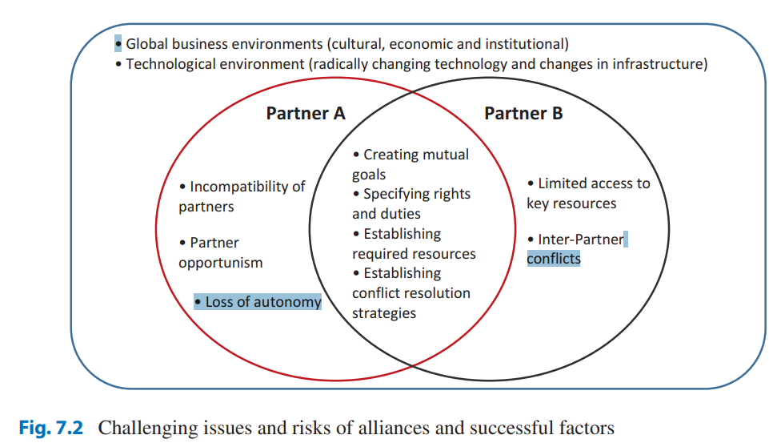

Slide 24
Challenging issues and risks of strategic alliance
Factors affecting the success of alliances
Incompatibility of Partners:
each alliance partner, as an independent organization, has its unique organizational culture, operating styles, and core competencies and thus pools special yet complementary resources into an alliance. For example, the joint venture agreement between Tesla Inc. and Panasonic can be vulnerable in the long run because of incompatibility of expectations for alliance; the goal of joint venture for Tesla is to leverage battery pack technology and manufacturing capability of Panasonic, whereas Panasonic would like to potentially increase battery cell production and its market share as demand for battery pack of EVs has increased.

Slide 25
Partner Opportunism
refers to “behaviors by a partner firm that is motivated to pursue its self-interest with deceit to achieve gains at the expense of the other alliance partners .” one of the goals of the alliance is probably to gain access to unique technology owned by an alliance partner
Loss of Autonomy :Alliance partners share resources, risks, costs, and profits (especially in the case of equity joint venture). And both partners are interdependent with each other especially for performing joint tasks

Slide 26
Limited Access to Key Resources: One of the challenging decisions that alliance partners sometimes have to make is whether to share their key resources (e.g., know-how, market knowledge, and core technology)
Inter-Partner Conflicts :arise anytime in alliance collaborations for various reasons. A misfit across organizational cultures, the purpose of alliance agreement (not always completely congruent), resources contributing to the alliance, and managerial practices (e.g., decision-making styles and organizational routines) is one of the significant reasons for inter-partner conflicts,

Slide 27
Factors Affecting the Success of Alliances
Creating mutual goals
Specifying rights and duties on the contract
Establishing required resources
Establishing conflict resolution strategies

Slide 28
International Strategic Alliance and Alliance Governance Mode Choice
the question is how alliance partners successfully collaborate when there is a significant difference between partners in terms of national-level environments?

Slide 29
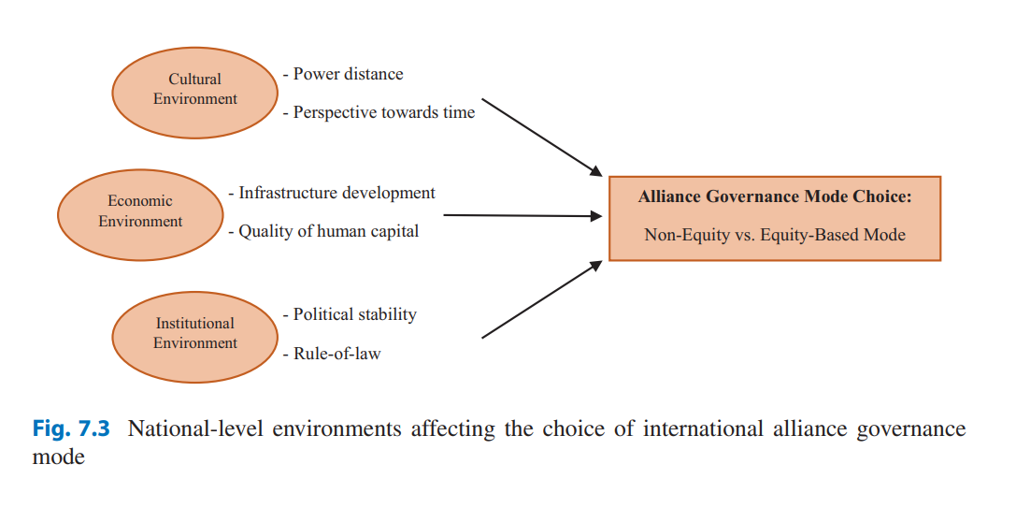

Slide 30
Cultural environment
Power distance :is referred to as the extent to which the members of a society expect power to be distributed equally in organizations and institutions. Firms from high-power-distance countries, accepting inequality and hierarchy of power in the organization, prefer to have greater control in interorganizational relationships and seek more organizationally integrated (or equity-based) modes such as EJVs. On the other hand, firms from low-power-distance countries are more open and willing to work as a group or a team for a certain project without formally integrating rules or hierarchies.

Slide 31
Perspective toward time (i.e., long-term vs. short-term orientation) is referred to as the degree to which individuals’ actions are driven by long-term/short-term goals and results and the need for long-term/immediate gratification. Firms from a long-term orientation culture, that focuses more on future interactions and rewards, perceive more clearly the shadow of the future, as opposed to those with a short-term-oriented organization which tends to be more opportunistic and less likely to build long-term interfirm trust in an alliance

Slide 32
Economic environment
Infrastructure development of a country as part of economic environments is important for alliance collaborations.
For instance, innovation infrastructure provides resources for innovation activity. And firms are more likely to collaborate internationally for their R&D in those nations with a developed innovation infrastructure

Slide 33
The quality of human resource
(i.e., availability of skilled and educated workers) plays a critical role in international collaborations. A greater difference in the quality of human capital between the countries of partnering firms increases partner uncertainty and reduces the likelihood of in-depth collaborations due to the gap in the capability of understanding complex projects (e.g., technology innovation) at hand

Slide 34
Institutional environment
Political stability
that contributes to a more predictable and stable policy helps sustain international alliance collaborations. For instance, Walmart decided to terminate the joint venture partnership with its Indian partner Bharti in 2013 due to the unpredictable/unstable FDI (foreign direct investment) regulations and enforcement that have made Walmart difficult to navigate regulations in India

Slide 35
Rule-of-law
refers to the extent to which agents have confidence in and abide by the rules of society and in particular the quality of contract enforcement, property rights, and the courts

Slide 36
Other contingency factors
Industrial knowledge intensity refers to the degree to which firms in an industry focus on technology innovation activities
Technology diversity refers to the dissimilarities between technological knowledge bases of the alliance partners. In general, there is a positive effect of the complementarities of the technological knowledge indicating that new products and new processes do not come from the combination of similar technologies but from the combination of different technologies

Slide 37
Managing Alliance Portfolios to Enhance Performance
Definition and Challenges of Alliance Portfolios
Strategic alliance portfolios can be defined as the sum of all types of strategic alliances that the focal firm is currently engaged in. Like literally, a firm can have as many strategic alliances as possible depending upon its number of business units and value-creation activities in which it involves for alliances

Slide 38
Here are some of the challenging tasks of alliance portfolio management
Portfolio Strategy: formulation of a portfolio strategy with implementation plans.
• Portfolio Coordination and Resource Allocation: To maximize its benefits, it is important to align multiple alliances for a primary joint goal.
• Portfolio Monitoring: This is to evaluate the contribution of the alliance portfolio to the focal firm’s success and to initiate control measures (e.g., reconfiguring the alliance portfolio) if there are performance deficits.

Slide 39
• Establishment of an Alliance Management System: This is to institutionalize alliance management capability by developing learning mechanisms (e.g., articulating learning experience and codifying alliance management knowledge) and by formalizing and standardizing alliance management processes and tools. In this way, alliance portfolio managing experiences can be collected, shared and diffused throughout the organization

Slide 40
Resources:
Kamal Fatehi & Jeongho Choi
International Business Management
Succeeding in a Culturally Diverse World, Second Edition
Chapter 5

