Slide 1

Digital
Consumer Behavior
Dr. Perihan Salah
MKT713
Master of Digital Marketing
Introduction

Slide 2
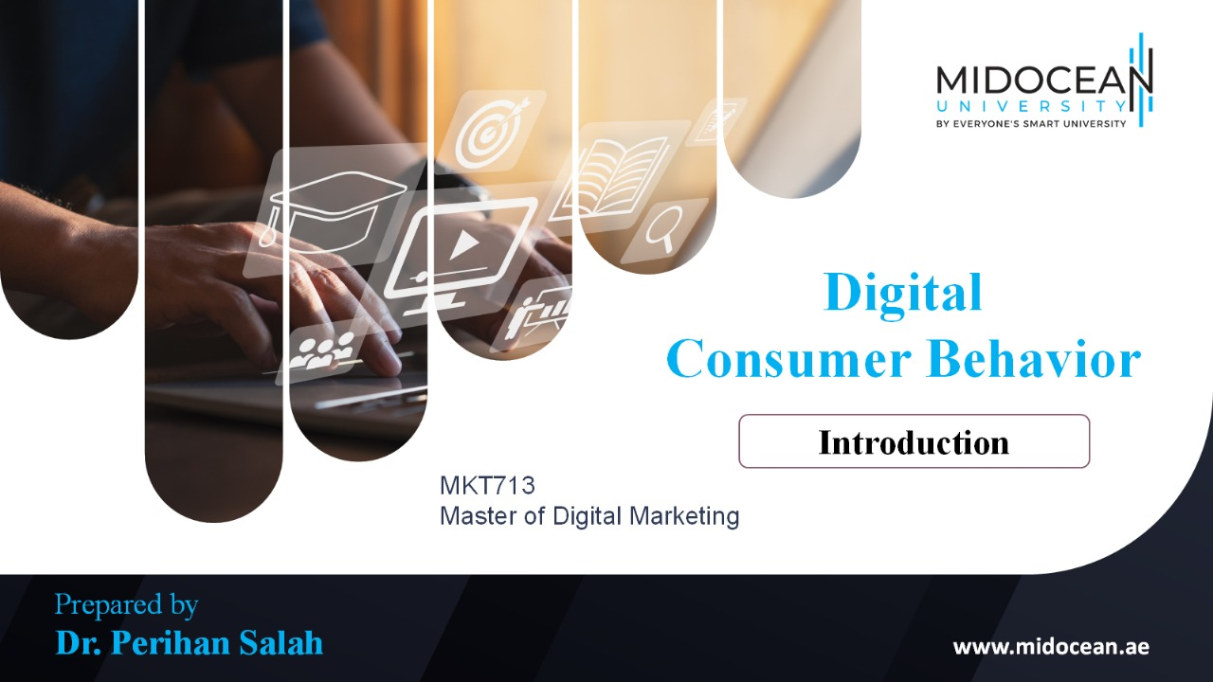

Slide 3
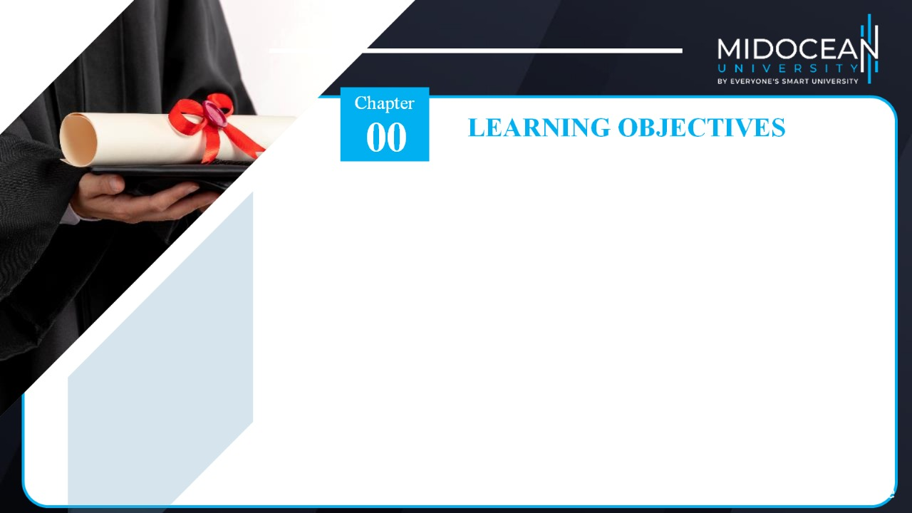
Module Outline
On successful completion of the program, graduate must be able to:
Explain and apply the key terms, definitions, and concepts used in the study of consumer behavior.
Demonstrate how as a marketer you can use your knowledge of consumer behavior concepts to develop better marketing programs and strategies to influence those behaviors.
Critically evaluate the effectiveness of various advertisement and promotions and their attempts to influence the behaviors of individuals.
Complete a project that demonstrates both your working knowledge and analytical skills in assessing the consumer decision-making process.
Analyze the trends in consumer behavior and apply them to the marketing of an actual product or service.

Slide 4


Topics
Introduction
00
1 Technology-Driven Consumer Behavior
2 Consumer Motivation
3 Consumer Personality
4 Consumer Perception
5 Consumer Learning
6 Consumer Attitude
7 Reference Groups & Word of mouth
8 The Family and It’s Social Standing
9 Culture’s Influence on Consumer Behavior

Slide 5
What is Marketing?
Marketing: the process by which companies create value for customers and build strong customer relationships in order to capture value back from customers
The Goal of Marketing: Is to attract new customers by promising superior value, and to keep current customers by delivering satisfaction.
Current Customers
Potential customers (customers of competitors or future customers)

Slide 6
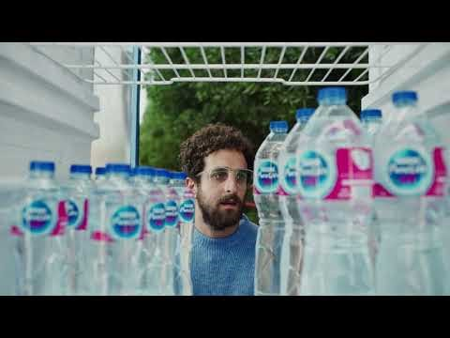

Slide 7
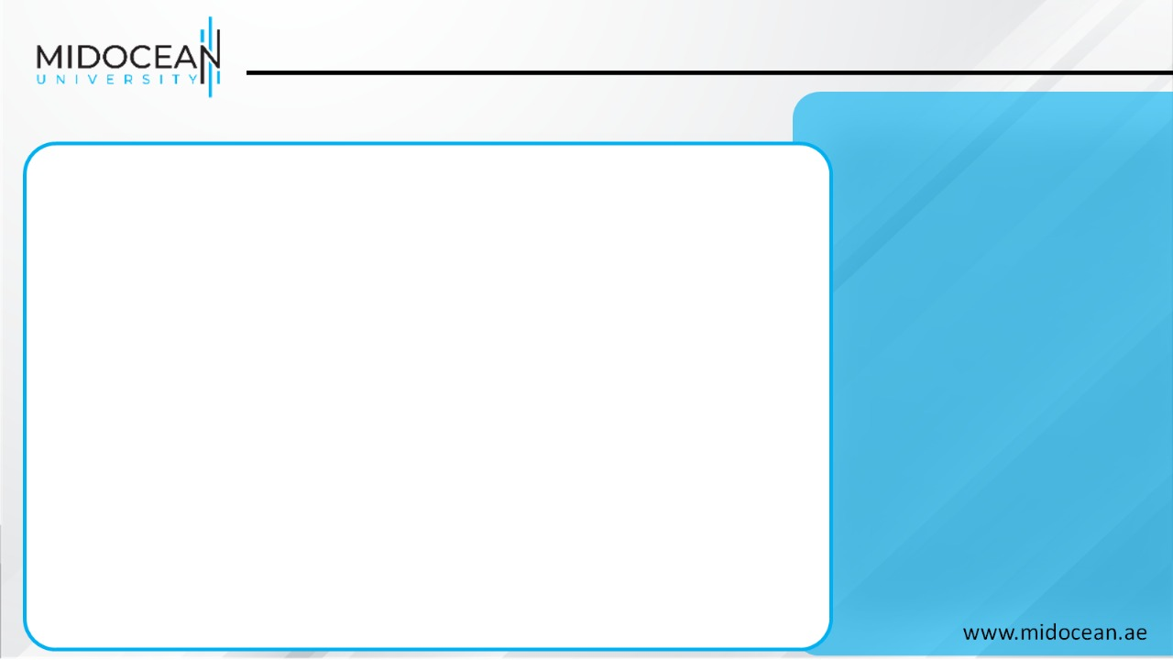
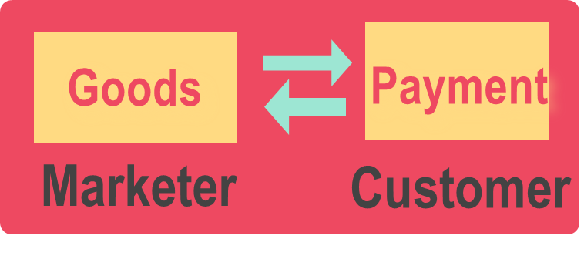

Marketing & Exchange
Exchange is the act of obtaining a desired object from someone by offering something in return.

Slide 8
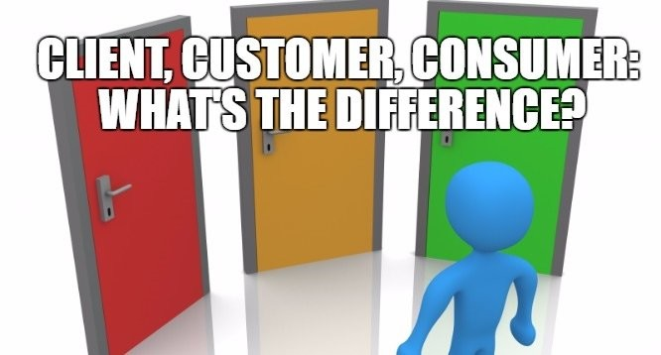
Consumer, Customer and Client
Consumer:
Someone who buys things for a non-commercial
purpose, either for themselves or for others.
Clients:
The word client refers to people who establish
long-term relationships with a service provider.
(Hospitals, transportation, banks, education,..etc)
Customer:
A customer is an individual, household or that
buys a product/brand. (is customed to buy
certain product/brand)

Slide 9
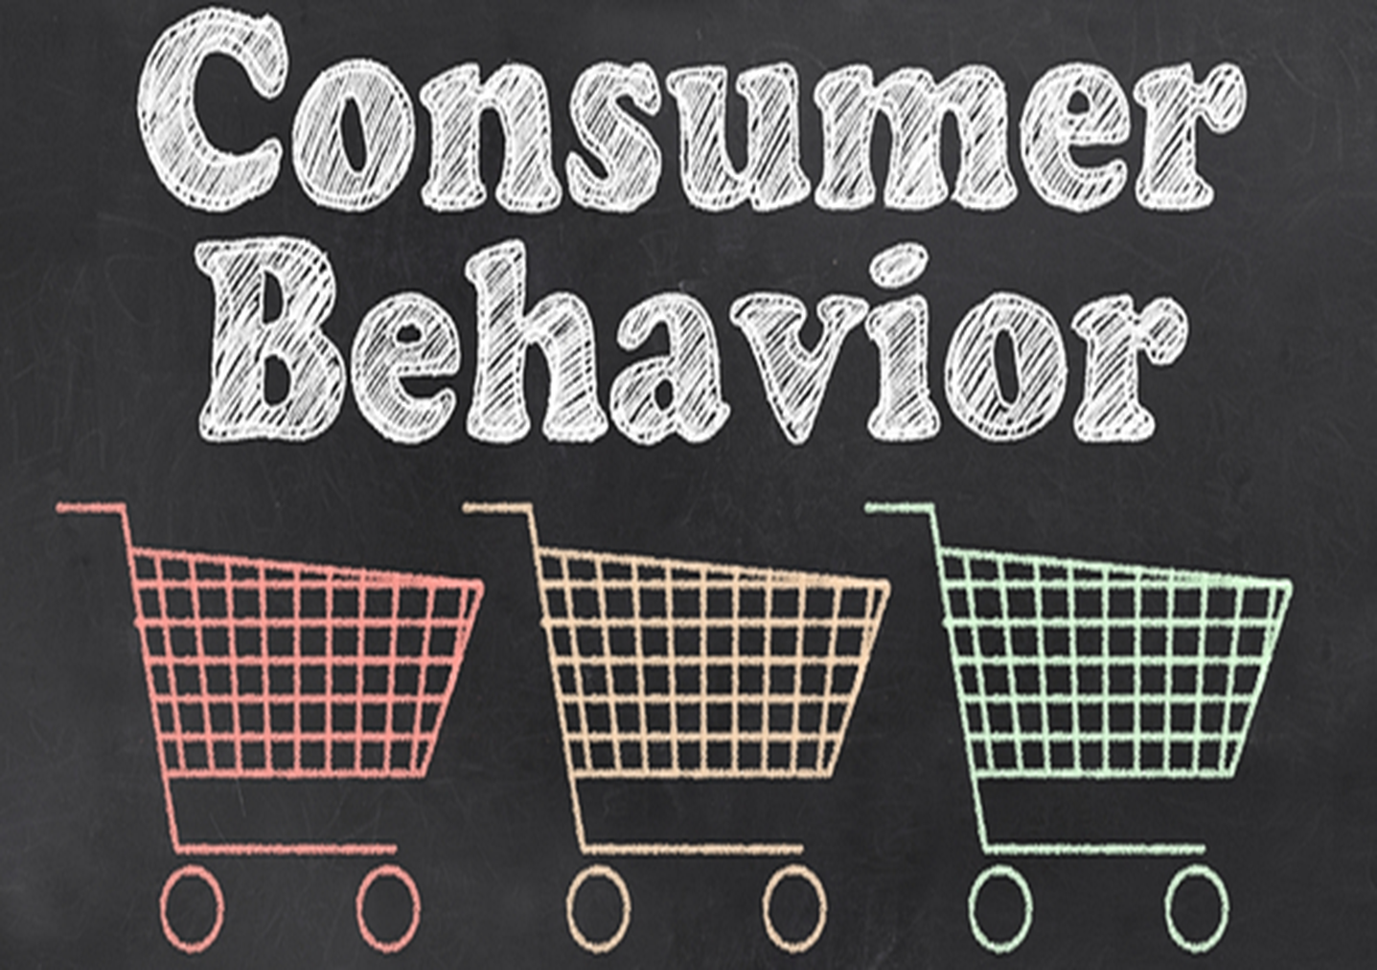
What is Consumer Behavior?

Slide 10
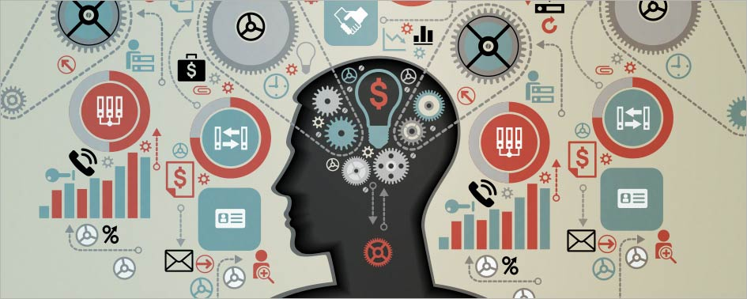
What is Consumer Behavior?
The buying behavior of final consumers, individuals and households who buy goods and services for personal consumption

Slide 11
What is Consumer Behavior?
The study of consumer behavior describes what products and brands consumers buy, why they buy them, when they buy them, where they buy them, how often they buy them, how often they use them, how they evaluate them after the purchase, and whether or not they buy them repeatedly.

Slide 12
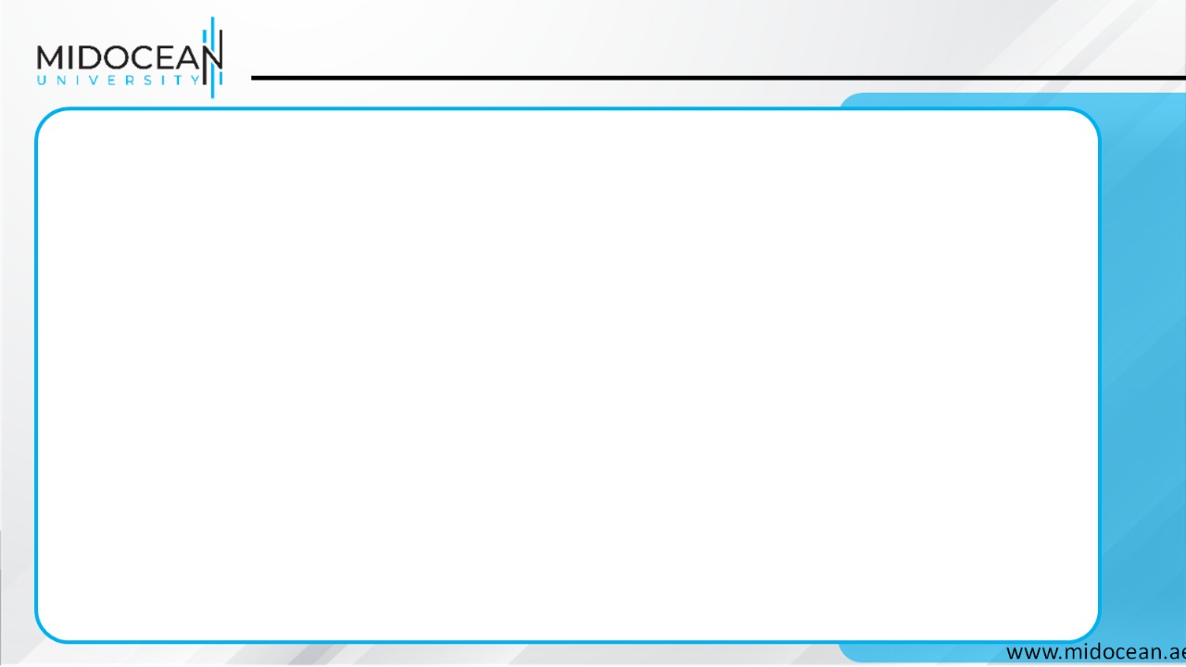
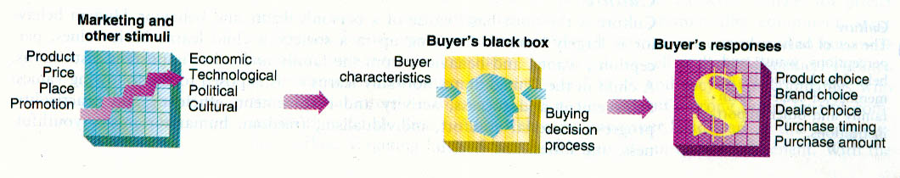
The stimulus response model of buyer behavior

Slide 13

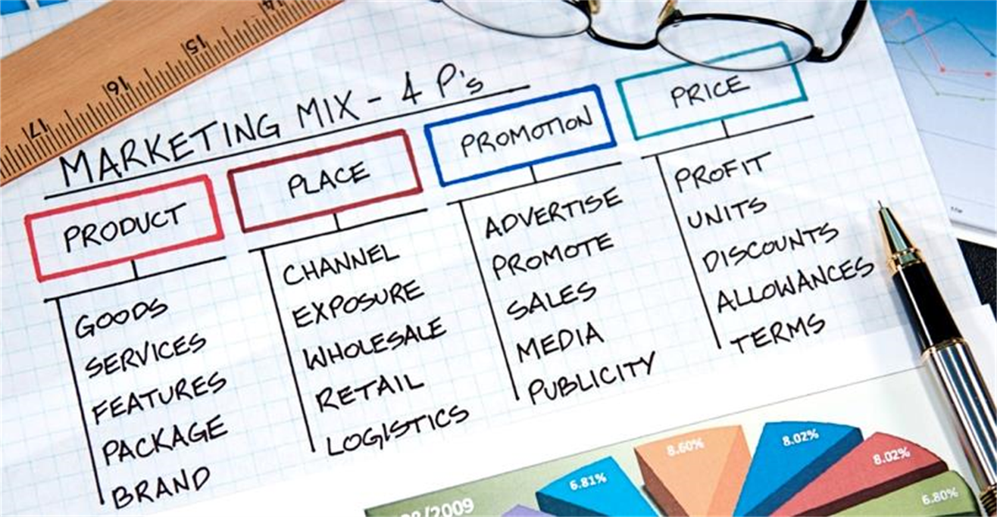
Marketing Concept Requirements
Consumer Research
Market Segmentation, Targeting and Positioning
The Marketing Mix (4 Ps)
- Product or service
  - Price
  - Place
  - Promotion

Slide 14
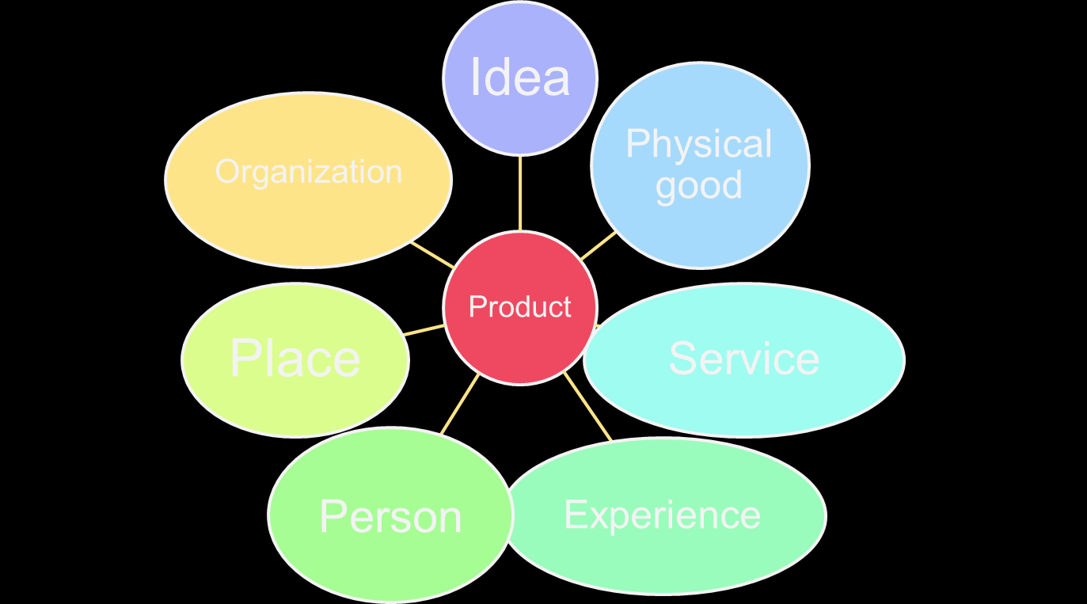
Forms of Product

Slide 15
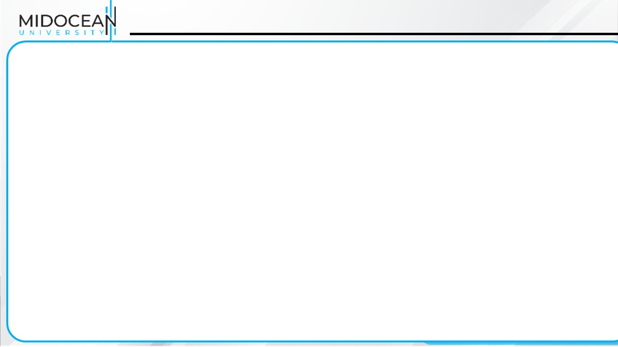
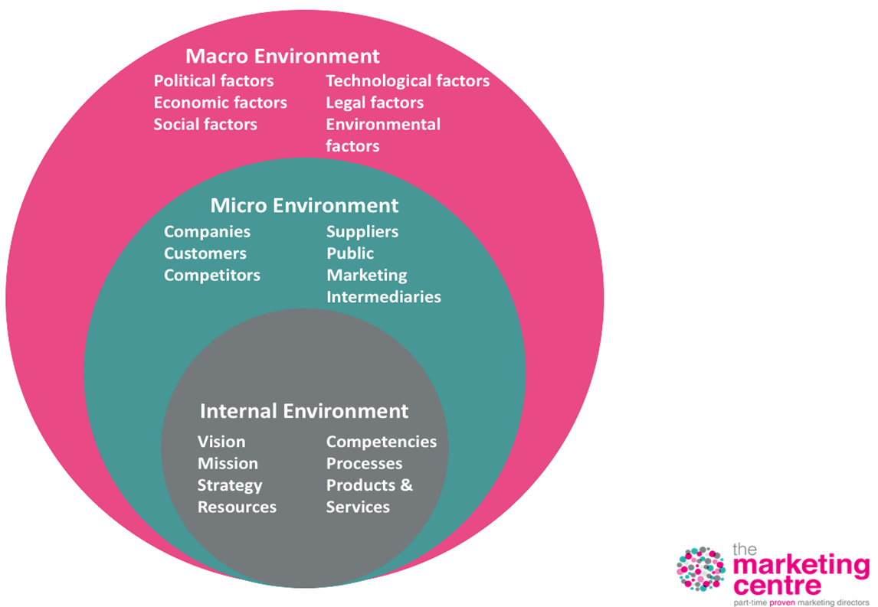
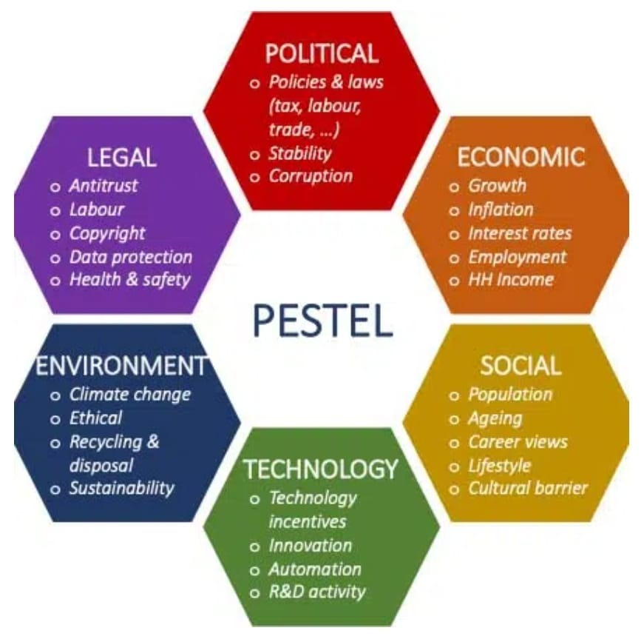
Marketing Environment

Slide 16
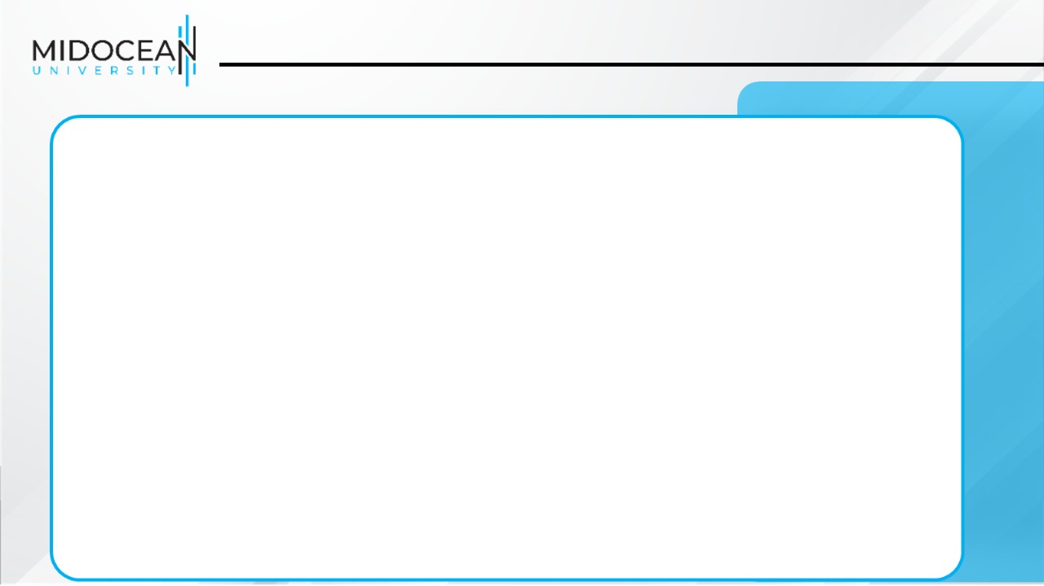
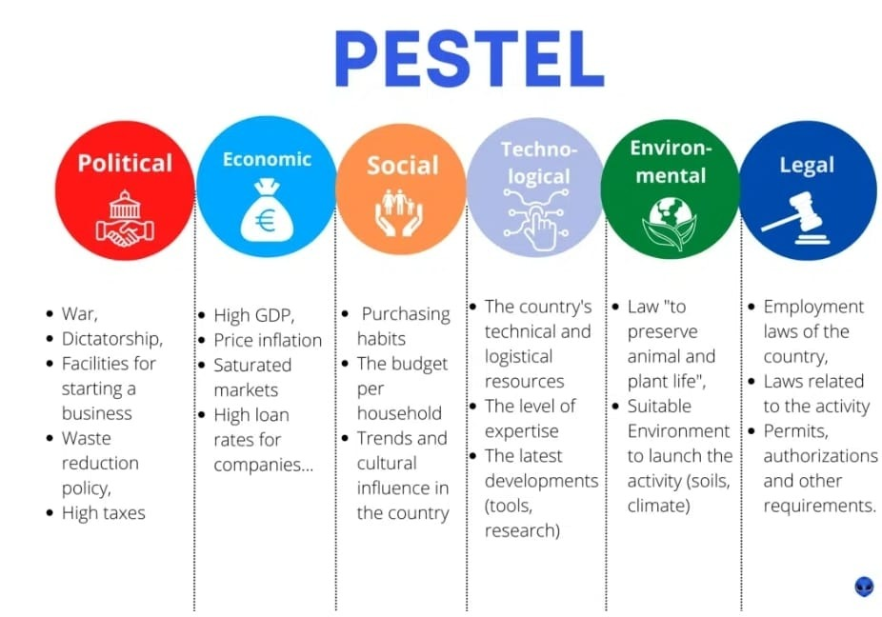
Marketing Environment

Slide 17
Socially Responsible Marketing/ Corporate Social Responsibility
Societal marketing concept requires marketers to fulfill the needs of the target audience in ways that improve, preserve, and enhance society’s well-being while meeting their business objectives.
Not all companies focus on society, but some companies believe socially responsible marketing is a part of organizational effectiveness.
Further, not-for-profit advocacy organizations are driven by a mission to encourage actions that are ethically and morally right.
CSR

Slide 18

Socially Responsible Marketing

Slide 19

To understand how the stimuli are changed into responses:
Buyer's characteristics influence how he/she perceives and reacts to the stimuli.
Buyer's decision process itself affects
the buyer's behavior.

Slide 20
Purchase Influences
Culture
Culture
Subculture
Social class
Social
Reference group
Family
Role & Status
Personal
Age ,life cycle
Occupation
Life style
Personality
Psychological
Attitude
Perception
Beliefs
Learning
motivation

Slide 21



Dr. Perihan Salah

