Slide 1

Interaction Design (DGM 729)
Prepared by
Dr. Mohamed Owies
Lecture_Intro
Interaction Design (DGM 719)

Slide 2
Course Description
Interaction Design

Slide 3
Intro lecture
Content
This Lecture will include the following points:
Course Description
Learning Outcomes
Topics
Recommended Reference
User Experience Team of One
What is a user experience team of one?
Introduction.

Slide 4
Intro lecture
Course Description
This course will explore the ideas, topics and themes that have shaped current digital design practice.
While practice-oriented or technical knowledge is a crucial element of digital design, developing an understanding of the underlying social, ethical and aesthetic issues challenging and motivating contemporary digital design culture is also essential.

Slide 5


Intro lecture
Course Description
The course will encourage you to be self-reflexive of the concepts, decisions and assumptions involved in your digital design practice or scholarly work.
Central design debates and topics will be explored, including:
Software/internet design history.
User interface design.
Collaborative or participatory design.
Considerations of intellectual property
Creative commons.

Slide 6

Intro lecture
Course Description
We will explore theories of digital media and how they relate to current research and debates about social media, virtual communities, mediated realities, and artificial intelligence. The course is an exploration of the ways in which various forms of new media shapes, guides, intersects, influences, and bounds today’s culture in a variety of contexts from organizations to social and political movements.

Slide 7

Intro lecture
Learning Outcomes
After completing this course, students should be able to:
Understanding and Exploring user experience (UX) and user interface (UI) design basics.
Understanding the definition and basic principles of UX Design
Describe the psychological influences behind human decisions and behaviors
Explain the different components of the User Experience.

Slide 8
Intro lecture
Learning Outcomes
After completing this course, students should be able to:
Learning the entirety of the life cycle of the design process
Design and conduct qualitative and quantitative user research studies to identify user needs
Adopting the basics of human-computer interaction and the psychology behind user decision-making.
Discovering the industry-standard tools and specific project deliverables in UI/UX.
Critically review the literature to identify knowledge gaps and write a concept note for proposed future research Content details

Slide 9

Intro lecture
Topics
The following is the main content of this course:
Chapter 1: UX 101
Chapter 2: Getting Started
Chapter 3: Building Support for Your Work
Chapter 4: Growing Yourself and Your Career
Chapter 5: Planning and Discovery Methods

Slide 10
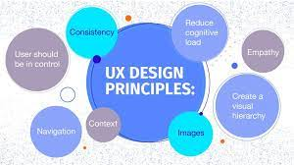
Intro lecture
Topics
The following is the main content of this course:
Chapter 6: Research Methods
Chapter 7: Design Methods
Chapter 8: Testing and Validation Methods
Chapter 9: Evangelism Methods
Chapter 10: What’s Next?

Slide 11

Intro lecture
Recommended Reference
The User Experience Team of One A Research and Design Survival Guide By Leah Buley.

Slide 12
Intro
lecture
User Experience Team of One
The user experience team of one ethos is equal parts philosophy and practice (see Figure 1). It focuses on having the right attitude, seeking out opportunities, being patient and inclusive, and doing the best work you can.
Between philosophy and practice, this book covers not just guiding principles, but also the nuts and bolts of how to successfully run a UX project as a team of one.

Slide 13
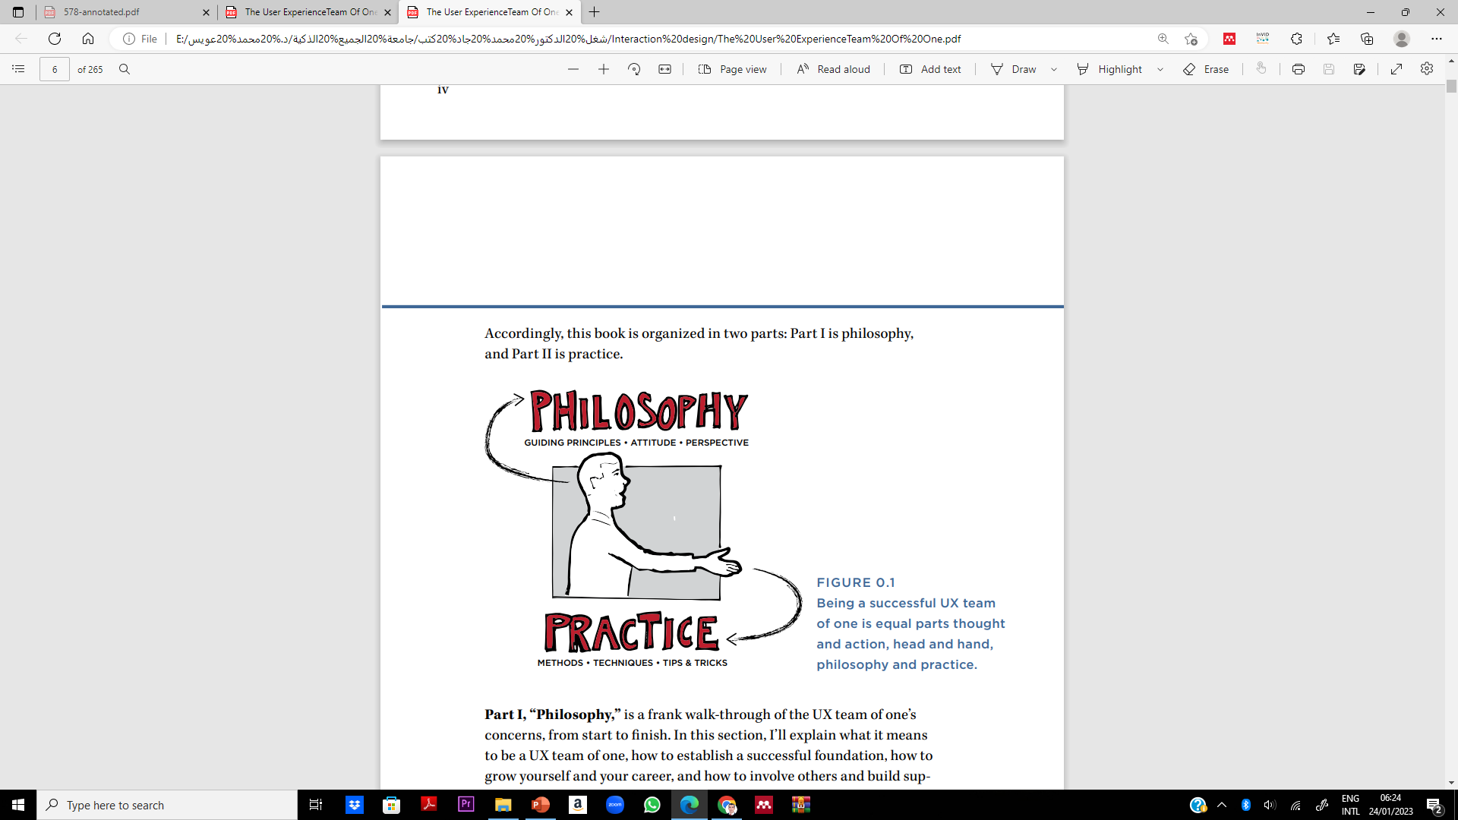
Intro
lecture
User Experience Team of One

Slide 14
Intro lecture
Philosophy
Part I, “Philosophy,” is a frank walk-through of the UX team of one’s concerns, from start to finish. In this section, I’ll explain what it means to be a UX team of one, how to establish a successful foundation, how to grow yourself and your career, and how to involve others and build support for UX along the way.
Chapter 1, “UX 101,” gives an overview of what UX is, how it came to be, and what it takes to be a UX practitioner.
Chapter 2, “Getting Started,” focuses on how to begin, including the fundamentals of user research and design for the new and aspiring UX team of one.

Slide 15
Intro lecture
Philosophy
Chapter 3, “Building Support for Your Work,” addresses some of the most challenging parts of life as a team of one: how to build support and do great work in spite of real-world organizational and interpersonal constraints.
Chapter 4, “Growing Yourself and Your Career,” is a blueprint for thriving and flourishing as you grow yourself and your career in user experience.

Slide 16
Intro lecture
Practice
In Part II, “Practice,” I’ll focus on the nuts and bolts of user experience work. This half of the book is intended to function as a ready reference, full of practical methods that have been selected and, in some cases, adapted to fit the realities of a UX team- of -one’s situation. What is this reality? Most importantly, teams of one must rely heavily on their non-UX colleagues to help them get work done.
That means there is a preference here for methods that can be done in a quick-and-dirty fashion, and an even greater bias toward methods that invite collaboration and cross-functional participation. In some cases, these methods may already be familiar to you, but the approach and tips are adapted for the work of a team of one

Slide 17
Intro lecture
Practice
Chapter 5, “Planning and Discovery Methods,” helps you set up a UX project for success. It includes planning and discovery of the team’s requirements and expectations. It also covers techniques for establishing a shared UX strategy with the team.
Chapter 6, “Research Methods,” is all about research. This includes research with users, the centerpiece of a UX practice, as well as research into competitors and best practices.
Chapter 7, “Design Methods,” covers methods and techniques for inclusive and participatory user experience design.

Slide 18
Intro lecture
Practice
Chapter 8, “Testing and Validation Methods,” provides methods for validating that your strategy, research, and design work has led you in the right direction.
Chapter 9, “Evangelism Methods,” brings our discussion of philosophy and practice full circle, and finishes up with approaches for building support and awareness of UX throughout your organization.
Chapter 10, “What’s Next,” closes with a personal challenge for you to think critically about where you’re taking your work in UX and how it aligns with the growth of the field overall.

Slide 19
Intro lecture
What is a user experience team of one?
A UX team of one is someone who works in a situation where they are the key person driving a user-centered design philosophy. Certainly, if you are the only person in your company practicing (or aspiring to practice) user-centered design, you are a user experience team of one.
However, even in organizations with multiple UX professionals, if you regularly work on a team where you are the only UX person, you are a UX team of one. Chapter 3 explains the kinds of challenges that UX teams of one commonly face, and explains what to do about them

Slide 20

Intro lecture
Introduction
in June 2011, this message appeared on the Interaction Designers Association (IXDA) discussion list:
I am at a point in my life where I know I want to do UX design after doing Web design for so long and then reading about usability testing, etc., 6 years ago. But my issue is I’m tired of working for orgs who say they care about their customer but don’t do testing to even know what their customers want from them… I’m kind of fed up with working for people who don’t get it.

Slide 21
Intro lecture
Introduction
It’s also an important avenue for doing good in the world. The UX team of one is as much a professional circumstance as a constructive philosophy. And here are its founding principles:
UX is a force for good. In an increasingly technological world, designing products with real people in mind helps us make sure that technology integrates in our lives in a human way. It’s a voice of reason, arguing that products and technology can support and even enrich our fundamental humanity.

Slide 22
Intro lecture
Introduction
The world needs more of it. As the boundaries continue to blur between the technological world and the analog world, everything that we buy, use, and do will need this user-centered perspective. Companies that never thought of themselves as being in the user experience business before will realize that they are now. We all are. This field can only grow.
Whatever your job title, whatever your career aspirations, you have it in your power to spark an awareness of the “user’s perspective” in the work that you do and with the people that you work with.

Slide 23

Intro lecture
Thank You

