Slide 1



Project Planning
Lecture 2
PMG202
Project Initiation
Prepared by
Lec. Dina ElWakkad

Slide 2


Learning Outcomes
At the end of this chapter, students should be able to:
Identify the activities required to initiate a project.
Write project objectives – SMART.
Discuss the purpose of the project.
Design a project proposal.
.

Slide 3

.

Slide 4
The project initiation stage
.

Slide 5
The project initiation stage
The project initiation stage is situated at the very start of the project management life cycle. This is the stage that precedes the actual start of the project.
.

Slide 6
The project initiation stage
The main goal of the initiation stage is to reduce the amount of uncertainty to an appropriate level to make a final decision whether to approve the project or not. We need to consider two types of risk:
Business Risk: Will the outcome of the project actually create the envisioned value?
Project Risk: Will the project deliver the promised outcome within budget and on time?
.

Slide 7
The project initiation stage
The project initiation stage consists of:
Analysis of the problem/opportunity under consideration
Stakeholder analysis
Development of a project proposal
Definition of the project rules
.

Slide 8
(1)
Analysis of the problem/opportunity
.

Slide 9
The project initiation stage
(1) Analysis of the problem/opportunity
The project initiation stage typically starts off with a first informal analysis of the problem/opportunity the project tries to tackle.
It is important to realize that the purpose of a project is to solve a problem or exploit an opportunity.
Therefore, it is important to define the problem/opportunity in a clear way.
One way to do this is by articulating the problem as the gap between the as-is state and the ideal state. This approach is also known as gap analysis.
.

Slide 10
The project initiation stage
(1) Analysis of the problem/opportunity
To identify and define requirements, the most important perspective is that of the customer.
.

Slide 11
The project initiation stage
(1) Analysis of the problem/opportunity
Therefore, it is important to:
  Understand who the customers are, what problems they face and any needs they have.
  Work to satisfy customers.
  Work to know the needs of customers.
.

Slide 12
The project initiation stage
(1) Analysis of the problem/opportunity
(1) Who are the end users of the project's products?
You need to assess your communication with the end users or their representative to make sure you understand their needs and interests to determine how they will use the results.
End users are the group of people who use the results of the project on a daily basis.
.

Slide 13
The project initiation stage
(1) Analysis of the problem/opportunity
(2) How do you satisfy the customer?
Try to realize that the customer's expectations are directly related to his satisfaction.
Unfortunately, there are degrees of satisfaction that are related to the extent to which the customer believes that you have understood his expectations, and most importantly, that you fulfill those expectations in the results you reach.
.

Slide 14
The project initiation stage
(1) Analysis of the problem/opportunity
(2) How do you satisfy the customer?
But if you are below the level of customer expectations (dissatisfaction of the customer), you will face a disgruntled and dissatisfied customer, and if you are also below the level of quality or expected performance standards, you will get a complaining customer, especially if:
  You did not receive the product on time according to the delivery schedule.
  Increased project cost
.

Slide 15
The project initiation stage
(1) Analysis of the problem/opportunity
(3) Do you know the customers’ needs?
Knowing the customers’ needs allows you to define the project to meet the customers’ expectations.
These are the customers’ demands that drive the planning process in the sense that this forms the solid foundation on which your project is based.
If you fail to give these demands and expectations the appropriate time and effort, this will affect the project's work continuously in all its stages.
.

Slide 16
(2)
Stakeholder Analysis
.

Slide 17
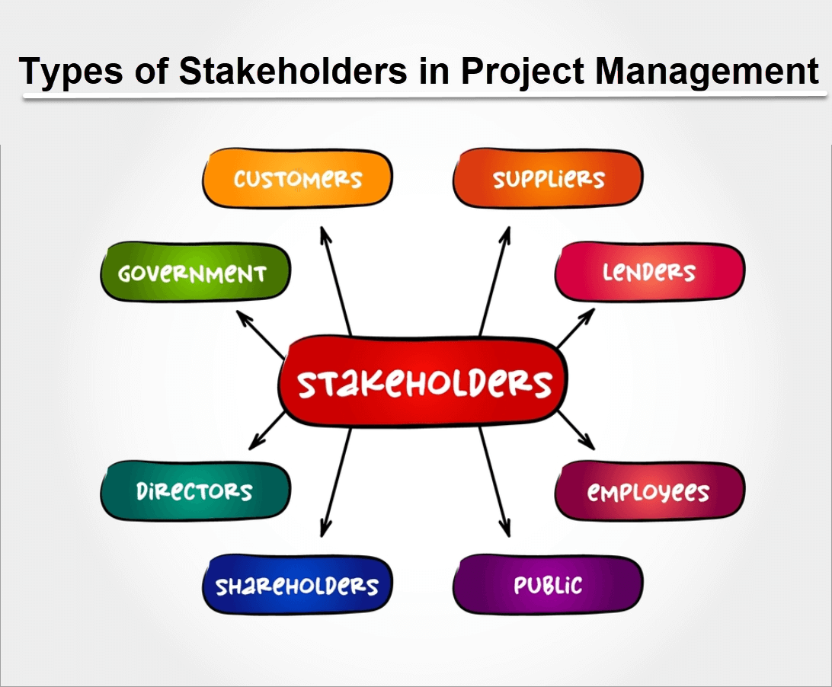
The project initiation stage
(2) Stakeholder Analysis
.

Slide 18
The project initiation stage
(2)Stakeholder Analysis
Typical roles of engaged stakeholders
The project manager
  Obviously, this is the person who has to manage the project and make sure the project delivers what is required on time and within budget.
  Identifying stakeholders should be one of the first tasks (typically done by the project manager) because all the important decisions during the definition and planning stage are made by these stakeholders.
.

Slide 19
The project initiation stage
(2)Stakeholder Analysis
Typical roles of engaged stakeholders
The project team
  These are the people who are actually going to do the work, and this should be considered in the broadest sense.
  People who contribute time, skills, and effort to the project..
.

Slide 20
The project initiation stage
(2)Stakeholder Analysis
Typical roles of engaged stakeholders
The customer
  The customer is the person who is typically paying for the project and therefore has final control over the requirements, budget, and time constraints
.

Slide 21
The project initiation stage
(2)Stakeholder Analysis
Involving stakeholders in the project initiation stage is very important but also relatively difficult.
It is very important as this is the stage where the goals and direction of the project are determined.
It is relatively difficult during this stage as the group of potential stakeholders is still very broad which makes it more complex to correctly analyze the problem and propose a solution.
.

Slide 22
The project initiation stage
(2)Stakeholder Analysis
Stakeholders can be involved in the following activities:
Establish agreements on the goals and constraints.
Construct strategies and schedules.
Approve the budget.
Ultimately judge the success of the project.
.

Slide 23
(3)
A project proposal
.

Slide 24
The project initiation stage
(3) A project proposal
A project proposal articulates the benefits of the project in contrast to the costs that need to be made.
.

Slide 25
The project initiation stage
(3) A project proposal
The proposal must convince the reader of the project’s value, which can be judged on the following 3 criteria:
Desirability: The outcome of the project is something the stakeholders want. (Customer perspective)
Viability: The lifetime cost of the project and its outcome are outweighed by the benefits. (Business perspective)
Feasibility: The proposed solution by the project is (technically) feasible to realize. (Technological perspective)
.

Slide 26
The project initiation stage
(3) A project proposal
Project Proposal Template
Project goal
Problem/Opportunity definition.
Proposed solution.
Cost-benefit analysis: It should focus on 4 elements:
  tangible benefits,
  intangible benefits,
  required resources (cost),
  financial return.
.

Slide 27
The project initiation stage
(3) A project proposal
Project Proposal Template
Business requirements: These are the requirements that must be fulfilled in order for the project to have a chance of being successful.
Scope: Describe the major accomplishments the project tries to realize.
Obstacles and Risks.
Schedule Overview.
.

Slide 28
(4)
Project Rules
.

Slide 29
The project initiation stage
(4) Project rules
Properly setting the project rules before the project starts is an important step to prevent difficult discussions during the project execution stage.
Clear project rules make sure all stakeholders agree up front on the goals of the project and expectations are properly managed.
Clear project rules make it explicit who, when, and how the scope of the project can (be) changed.
Clear project rules ensure that the project managers get the appropriate authority from management to properly manage the project
.

Slide 30
Summary
The project initiation stage
  Analysis of the problem/opportunity under consideration
  Stakeholder analysis
  Development of a project proposal
  Definition of the project rules
.

Slide 31

.

Slide 32
Questions
The initiation phase of the project is located at ------- The beginning of the project management life cycle The end of the project management life cycle Mid-life project management lifecycle It is not a phase of the project management life cycle
The initiation phase of the project consists of----- All answers are correct. Analyze the problem/opportunity. Development of a project proposal Definition of the project rules
.

Slide 33
Questions
Gap analysis is-------- The gap between the current state and the ideal state The gap between a recession and a boom The gap between profit and loss All answers are wrong
To define requirements, the most important perspective is----- Customer perspective Product perspective stakeholder perspective All answers are correct
.

Slide 34
Questions
The stakeholders are----- All answers are correct project manager project team customers
The person who has to manage the project and ensure that the project delivers what is needed on time and within budget is he/they---- project manager All answers are correct project team customers
.

Slide 35
Questions
The people who contribute time, skills, and effort to the project is/they---- project team customers All answers are correct project manager
The project proposal can be judged by--- All answers are correct desirability viability feasibility
.

Slide 36
Questions
The project proposal includes---- All answers are correct Project goal Define the problem/opportunity the scope
At problem analysis, we should--- All answers are correct. Understand who the customers are, what problems they face, and any needs they have. Work to satisfy customers. Work to know the needs of customers.
.

Slide 37
Questions
Cost benefit analysis focuses on--- All answers are correct Tangible benefits Intangible benefits financial return
Which of the following activities stakeholders engage in ---- All answers are correct. Establish agreements on the goals and constraints. Construct strategies and schedules. Approve the budget
.

Slide 38
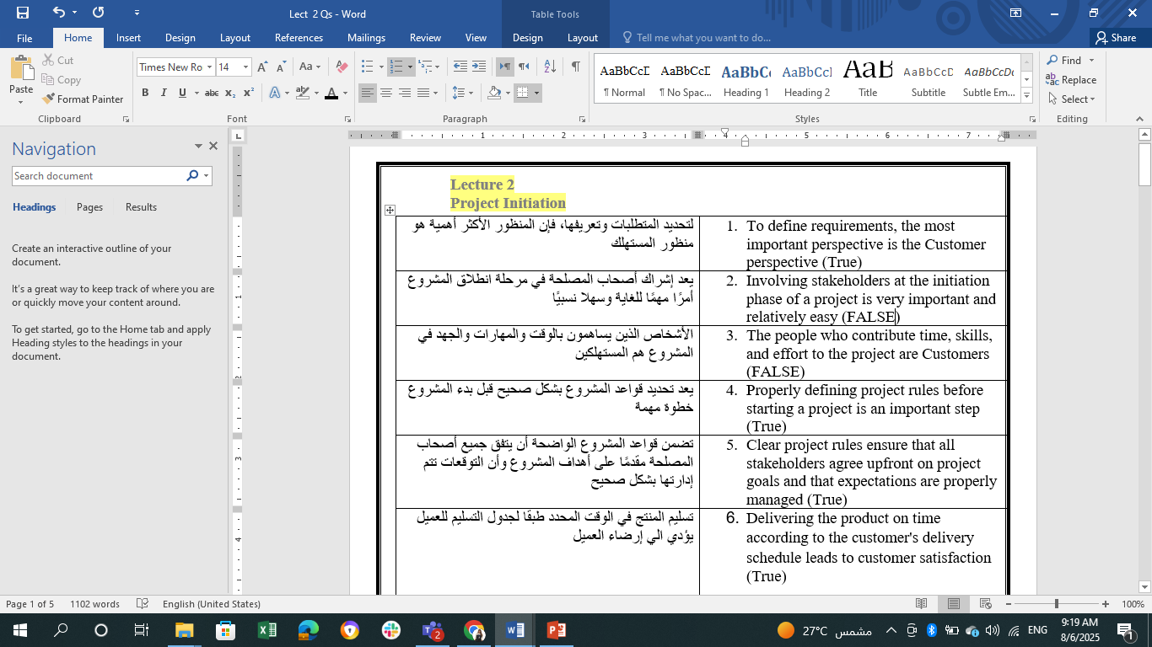
Questions
.

Slide 39
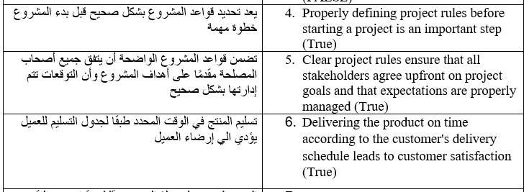
Questions
.

Slide 40
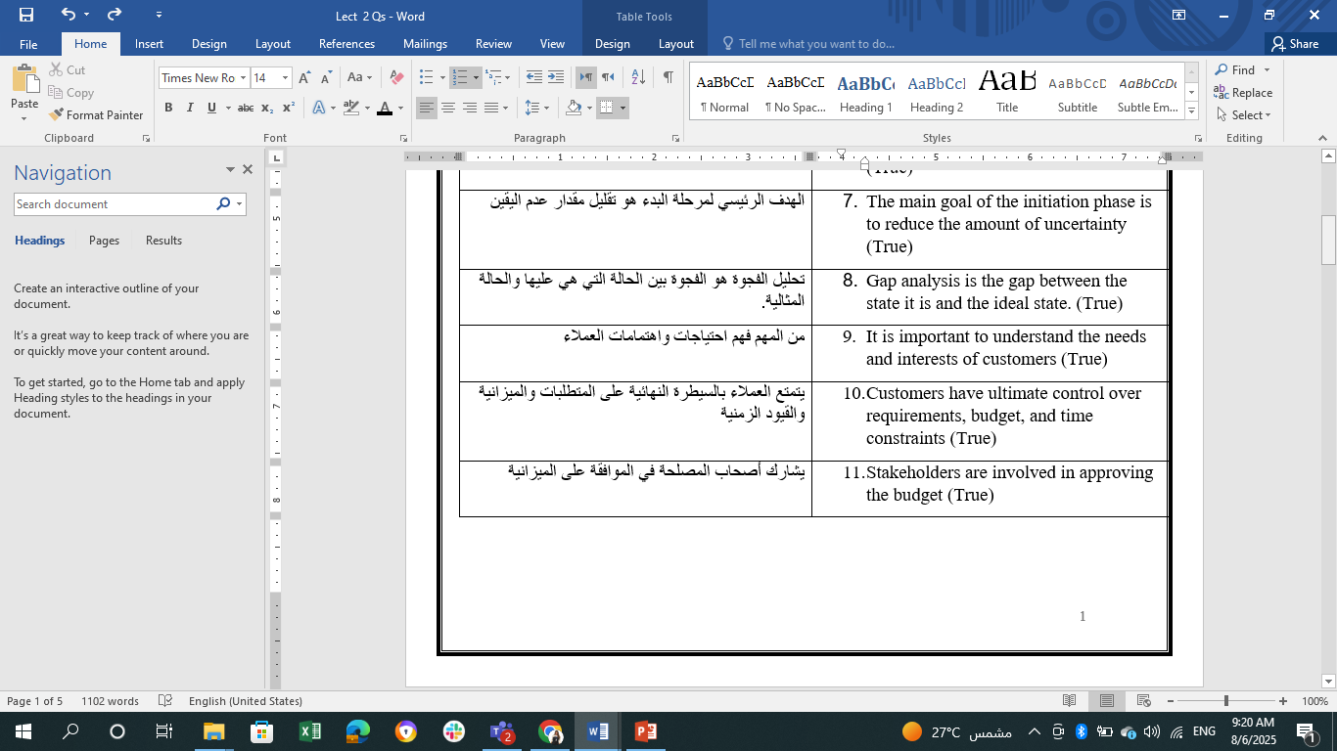
Questions
.

Slide 41
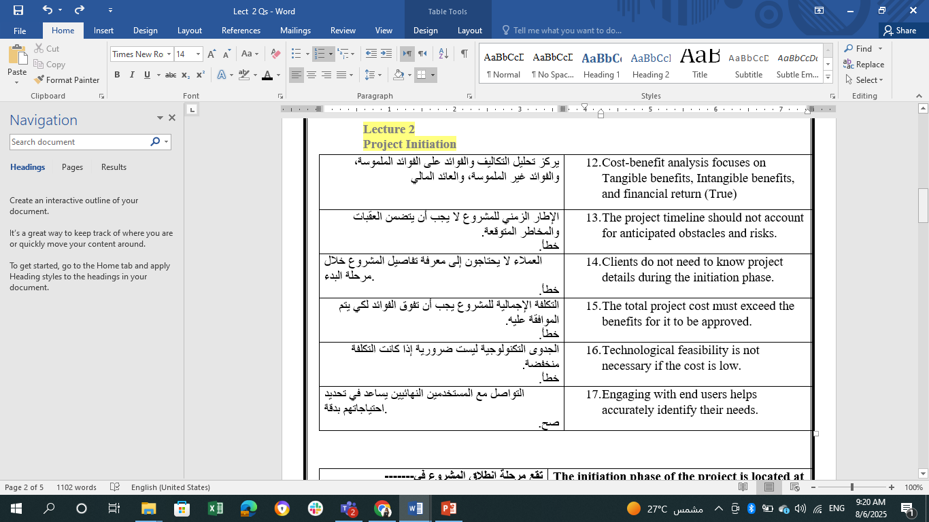
Questions
.

Slide 42
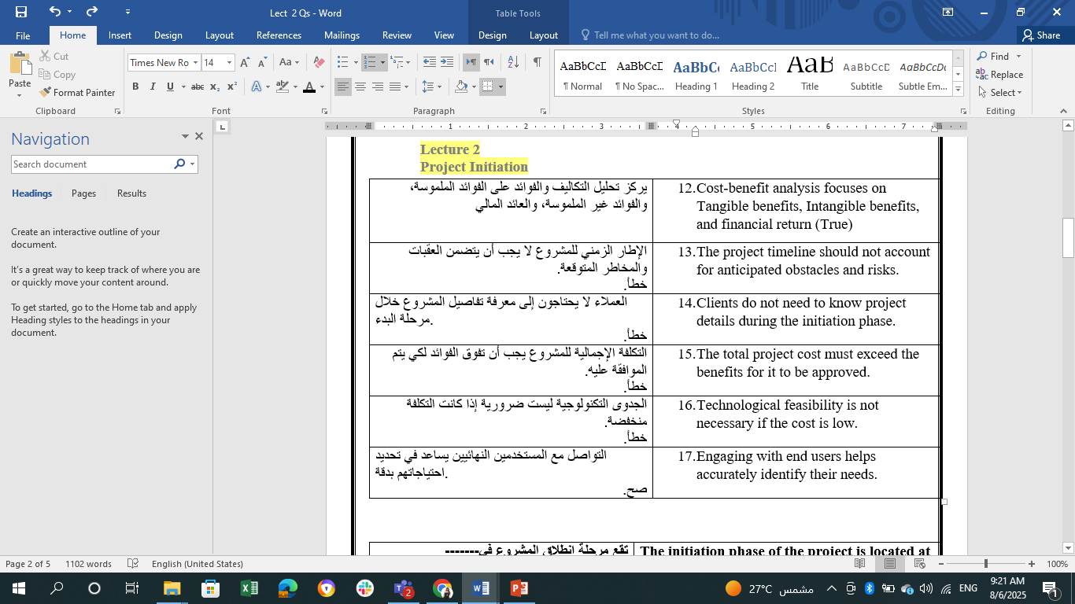
Questions
.

Slide 43


Thank You

