Slide 1


Introduction to
Finance
Prepared by
Dr. Mohamed Hussein
Assistant Professor of Accounting
MGM 237
Risk and Return
Lecture 7

Slide 2


Chapter
7
Risk and Return
Learning Outcomes
Students will be able to:
• Compute realized and expected returns.
• Measure risk using variance, standard deviation, and coefficient of variation (CV).
• Explain diversification, correlation, systematic risk, and beta.
• Use the Capital Asset Pricing Model (CAPM) to estimate the required return on equity.
01

Slide 3
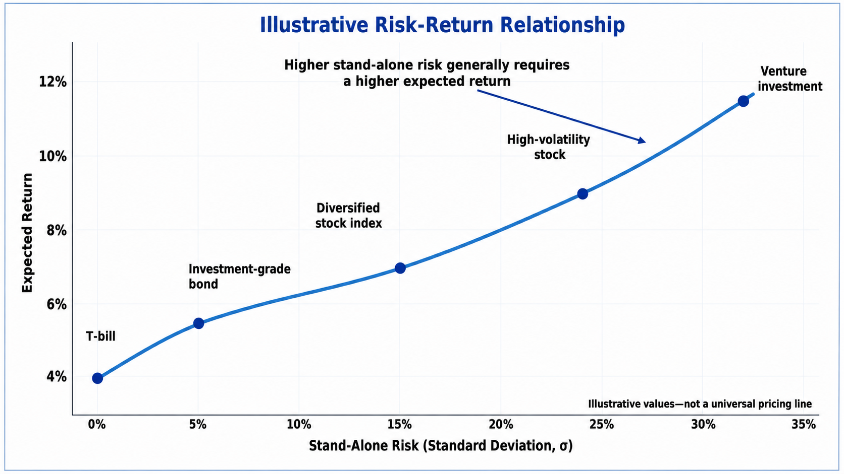
FOUNDATION
Why Risk and Return Are Central in Finance
Risk and return guide investment decisions and required returns.
01
Finance decisions always compare reward with uncertainty.
02
Investors require higher expected returns when they bear more risk.
03
Managers use risk and return to estimate required rates of return.
04
The same logic affects valuation, cost of capital, and capital budgeting.
Return
Expected reward
Risk
Uncertainty of reward
Decision
Accept only if reward justifies risk
Manager's Insight
A project or security is attractive only when expected return is sufficient for its risk.
Quick Example
A safe Treasury bill may offer 4%, while a risky stock may need 12% to attract investors.
Risk and Return
02

Slide 4
CONCEPT
Definition of Return
Risk and return guide investment decisions and required returns.
01
Return measures the gain or loss from an investment over a period.
Basic idea
Return = Total gain ÷ Beginning value
Total gain includes both price change and income.
02
It is usually expressed as a percentage of the amount invested.
03
Return includes price changes and any cash income received.
Interpretation
Identify the inputs, substitute carefully, and interpret the answer.
04
Return allows comparison across investments of different sizes.
Manager's Insight
Always convert gain into a percentage before comparing investments.
Quick Example
A $10 gain on a $100 investment is 10%; a $10 gain on a $1,000 investment is only 1%.
Risk and Return
03

Slide 5
FORMULA
Holding Period Return
Risk and return guide investment decisions and required returns.
01
Holding period return measures the total return earned while holding an asset.
Holding period return
HPR = (P1 − P0 + Income) / P0
Use decimal or percentage form consistently.
02
It combines income received and price appreciation or depreciation.
03
P0 is beginning price; P1 is ending price; Income is cash received.
Symbol
Meaning
The result can be positive or negative.
P0
Beginning price
04
P1
Ending price
Income
Dividend or interest received
Manager's Insight
Holding period return is the starting point for measuring investment performance.
Quick Example
Buy at $50, sell at $56, receive $2 dividend: HPR = (56 − 50 + 2) ÷ 50 = 16%.
Risk and Return
04

Slide 6
RETURN
Capital Gain Component
Risk and return guide investment decisions and required returns.
01
Capital gain is the change in market price over the holding period.
Capital gain return
Capital Gain Return = (P1 − P0) / P0
This isolates the price-change part of total return.
02
It is positive when the asset price increases.
03
It is negative when the asset price decreases.
Interpretation
Identify the inputs, substitute carefully, and interpret the answer.
04
It excludes dividends and interest income.
Manager's Insight
Separating capital gain from income helps explain where investment performance came from.
Quick Example
A stock rises from $40 to $46: capital gain return = 6 ÷ 40 = 15%.
Risk and Return
05

Slide 7
RETURN
Income Component
Risk and return guide investment decisions and required returns.
01
Income return comes from cash paid by the investment.
Income return
Income Return = Income / P0
Add this to capital gain return to get total HPR.
02
For bonds, income is usually coupon interest.
03
For stocks, income is usually dividends.
Interpretation
Identify the inputs, substitute carefully, and interpret the answer.
04
Income return is measured relative to beginning price.
Manager's Insight
Some investors prefer income-producing assets because cash income is visible and recurring.
Quick Example
A stock bought at $40 pays $2 dividend: income return = 2 ÷ 40 = 5%.
Risk and Return
06

Slide 8
RETURN
Realized Return
Risk and return guide investment decisions and required returns.
01
Realized return is the return that actually happened.
Probability distribution
02
It is calculated after the investment period is complete.
03
It can be compared with the expected return to evaluate accuracy.
50%
04
Realized returns are useful for historical performance analysis.
25%
25%
Before
Expected return
After
Realized return
Evaluate
Compare expectation with result
Recession
Normal
Boom
Manager's Insight
Managers and investors learn by comparing what was expected with what actually occurred.
Quick Example
If you expected 10% but earned 6%, the realized return was below expectation.
Risk and Return
07

Slide 9
CONCEPT
Probability Distribution of Returns
Risk and return guide investment decisions and required returns.
01
A probability distribution lists possible returns and their probabilities.
State
Probability
Return
02
The probabilities should add to 100%.
Recession
25%
−2%
03
It shows both expected reward and uncertainty.
Normal
50%
10%
04
A wider range of possible returns usually means more risk.
Boom
25%
18%
Manager's Insight
Do not look only at the most likely outcome; examine the full range of possible outcomes.
Quick Example
A project with returns from −20% to +35% is riskier than one ranging from 4% to 9%.
Risk and Return
08

Slide 10
RETURN
Expected Return
Risk and return guide investment decisions and required returns.
01
Expected return is the return investors anticipate before the outcome is known.
Expected return
E(r) = Σ [P(s) × r(s)]
Multiply each possible return by its probability, then add.
02
It is not guaranteed; it is a probability-weighted estimate.
03
It helps compare investments before making a decision.
Interpretation
Identify the inputs, substitute carefully, and interpret the answer.
04
Expected return is the “best estimate” of average future return.
Manager's Insight
Expected return is useful only when the assumptions about probabilities and outcomes are reasonable.
Quick Example
If good and bad outcomes are equally likely, expected return is their average.
Risk and Return
09

Slide 11
FORMULA
Weighted Average Expected Return
Risk and return guide investment decisions and required returns.
01
Expected return uses probability weights.
Weighted average
E(r) = P1r1 + P2r2 + ... + Pnrn
Each return is weighted by its probability.
02
Higher-probability outcomes have more influence on the final result.
03
Low-probability outcomes still matter, especially if they are extreme.
Interpretation
Identify the inputs, substitute carefully, and interpret the answer.
04
The formula works for securities, portfolios, and projects.
Manager's Insight
Expected return is not a simple average unless all probabilities are equal.
Quick Example
Returns: −2%, 10%, 18%; probabilities 25%, 50%, 25%. E(r)=9%.
Risk and Return
10

Slide 12
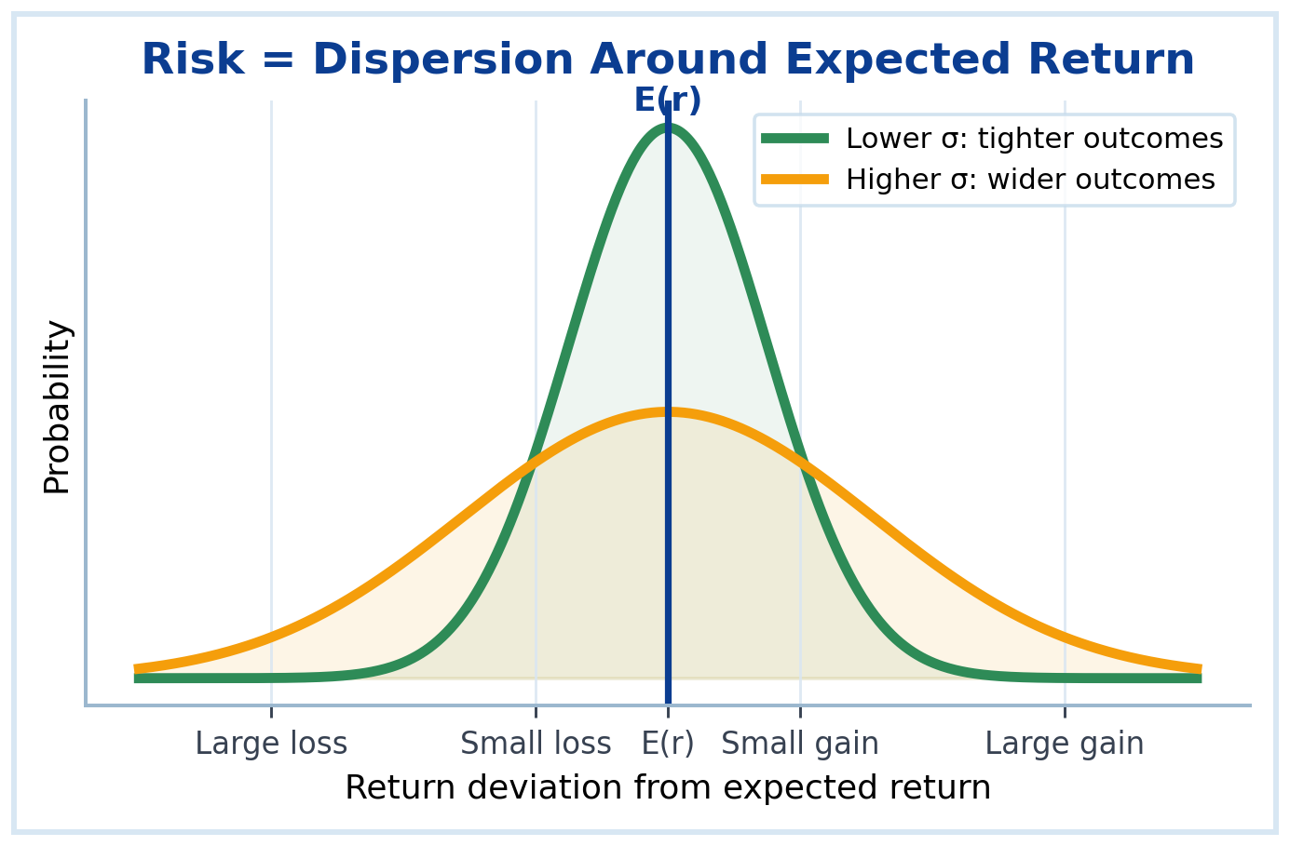
RISK
Risk Definition
Risk and return guide investment decisions and required returns.
01
Risk means uncertainty about actual future returns.
02
In finance, risk is often measured by variability around expected return.
03
A riskier asset has a wider range of possible outcomes.
04
Risk can create losses but also the possibility of higher gains.
Manager's Insight
Risk is not simply “bad”; it is uncertainty that must be priced and managed.
Quick Example
A guaranteed 5% return is less risky than a return that could be −10% or +25%.
Risk and Return
11

Slide 13
RISK
Stand-Alone Risk
Risk and return guide investment decisions and required returns.
01
Stand-alone risk is the risk of one asset considered by itself.
It ignores how the asset interacts with other investments.
Return
Possible outcome
Deviation
Return − Expected return
Squared
Penalizes large surprises
02
03
Variance and standard deviation are common stand-alone risk measures.
Stand-alone risk is useful but incomplete for diversified investors.
Risk logic
Variance → Standard deviation
Standard deviation converts risk back into percentage units.
04
Manager's Insight
A security that looks risky alone may reduce risk when added to a portfolio.
Quick Example
A stock with high volatility may still be useful if it moves differently from the rest of the portfolio.
Risk and Return
12

Slide 14
FORMULA
Variance
Risk and return guide investment decisions and required returns.
01
Variance measures how far possible returns are from expected return.
Variance
σ² = Σ P(s) × [r(s) − E(r)]²
Deviation = possible return minus expected return.
02
It squares deviations, so large surprises receive more weight.
03
For expected outcomes, multiply each squared deviation by probability.
Interpretation
Identify the inputs, substitute carefully, and interpret the answer.
04
Variance is useful, but its units are squared percentages.
Manager's Insight
Variance is the mathematical foundation for standard deviation.
Quick Example
If possible returns are far from E(r), variance becomes larger.
Risk and Return
13

Slide 15
FORMULA
Standard Deviation
Risk and return guide investment decisions and required returns.
01
Standard deviation is the square root of variance.
Standard deviation
σ = √Variance
Higher σ means higher stand-alone risk.
02
It measures risk in the same units as return: percentage points.
03
A larger standard deviation means returns are more spread out.
Interpretation
Identify the inputs, substitute carefully, and interpret the answer.
04
It is one of the most common risk measures in finance.
Manager's Insight
Standard deviation helps compare the uncertainty of different investments.
Quick Example
Investment A has σ = 5%; Investment B has σ = 18%. B has more variable returns.
Risk and Return
14

Slide 16
FORMULA
Coefficient of Variation
Risk and return guide investment decisions and required returns.
01
Coefficient of variation compares risk per unit of expected return.
Coefficient of variation
CV = σ / E(r)
Risk per unit of expected return.
02
It is useful when investments have different expected returns.
03
A lower CV means less risk for each unit of expected return.
Interpretation
Identify the inputs, substitute carefully, and interpret the answer.
04
It should not be used mechanically without judgment.
Manager's Insight
CV helps compare investments when one has both higher risk and higher expected return.
Quick Example
A: σ=6%, E(r)=12%, CV=0.50. B: σ=10%, E(r)=15%, CV=0.67. A has less risk per return.
Risk and Return
15

Slide 17
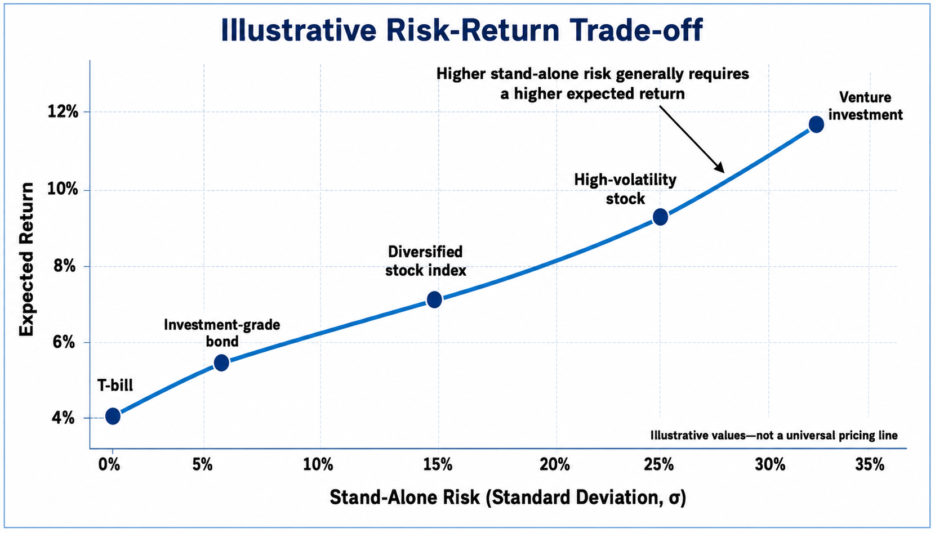
CONCEPT
Risk-Return Trade-off
Risk and return guide investment decisions and required returns.
01
Investors generally expect higher returns for accepting higher risk.
02
Low-risk assets usually offer lower expected returns.
03
High-risk assets must offer higher expected returns to attract capital.
04
The trade-off is central to valuation and investment decisions.
Manager's Insight
No investment should be judged by return alone; it must be judged against risk.
Quick Example
A 14% expected return may be unattractive if the risk is extremely high.
Risk and Return
16

Slide 18
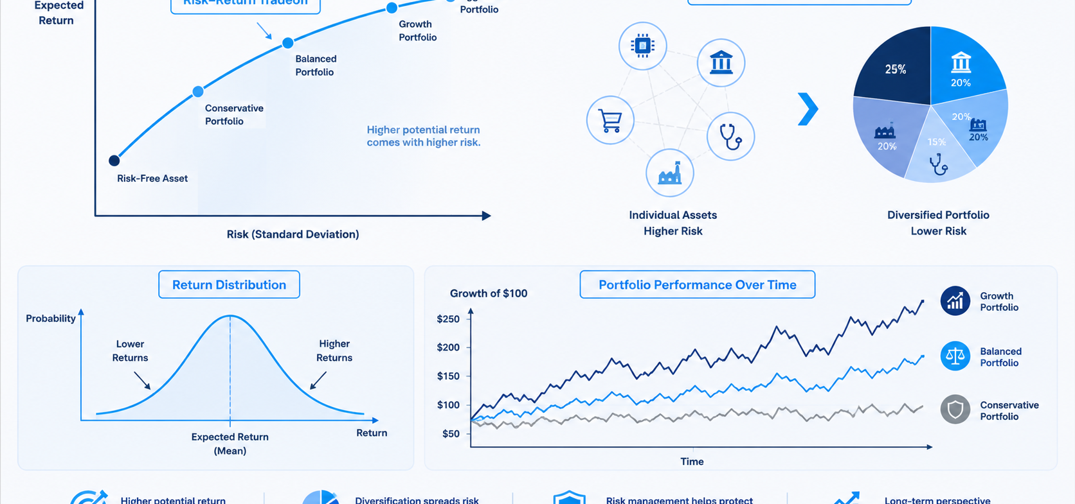
BEHAVIOR
Risk Aversion
Risk and return guide investment decisions and required returns.
01
Risk aversion means investors dislike risk when return is the same.
02
A risk-averse investor requires compensation for bearing additional risk.
03
Most finance models assume investors are risk averse.
04
Risk aversion explains why risk premiums exist.
Same return
Choose lower risk
More risk
Demand more return
Risk premium
Compensation for uncertainty
Manager's Insight
Risk aversion is why risky securities need higher expected returns than safe securities.
Quick Example
If two investments both expect 8%, most investors choose the less risky one.
Risk and Return
17

Slide 19
RETURN
Required Rate of Return
Risk and return guide investment decisions and required returns.
01
Required return is the minimum return investors demand.
Required return idea
Required Return = Risk-free return + Risk premium
The premium compensates investors for uncertainty.
02
It reflects time value of money and risk.
03
It is used as a discount rate in valuation.
Interpretation
Identify the inputs, substitute carefully, and interpret the answer.
04
Higher risk leads to a higher required return.
Manager's Insight
Required return connects this lecture directly to bond, stock, and firm valuation.
Quick Example
If risk-free return is 4% and risk premium is 6%, required return is 10%.
Risk and Return
18

Slide 20
HISTORY
Historical Returns Overview
Risk and return guide investment decisions and required returns.
01
Historical returns show how investments performed in the past.
02
Stocks historically have offered higher average returns than safer securities.
03
Higher historical return usually came with higher volatility.
04
Past performance informs judgment but does not guarantee the future.
Manager's Insight
Historical data helps students see the risk-return trade-off in real markets.
Quick Example
Common stocks may outperform bonds over long periods, but with larger short-term losses.
Risk and Return
19

Slide 21
RETURN
Risk-Free Return
Risk and return guide investment decisions and required returns.
01
The risk-free return is the return on an investment with no default risk and very low uncertainty over the chosen period.
Benchmark role
Risk-free return = Base return for valuation
Risk premiums are added to this base.
02
Treasury securities are commonly used as practical benchmarks.
03
It represents compensation for time value of money.
Interpretation
Identify the inputs, substitute carefully, and interpret the answer.
04
Risky assets should normally offer more than the risk-free return.
Manager's Insight
Risk-free return is the starting point for estimating required returns.
Quick Example
If Treasury bills yield 4%, a risky stock must offer more than 4% to be attractive.
Risk and Return
20

Slide 22
RETURN
Risk Premium
Risk and return guide investment decisions and required returns.
01
Risk premium is extra expected return above the risk-free rate.
Risk premium
Risk Premium = Expected Return − Risk-free Return
It measures the reward for bearing risk.
02
It compensates investors for uncertainty.
03
Riskier assets require larger risk premiums.
Interpretation
Identify the inputs, substitute carefully, and interpret the answer.
04
Risk premiums change with market conditions and investor confidence.
Manager's Insight
Risk premium is the price investors charge for accepting uncertainty.
Quick Example
Expected return = 11%, risk-free = 4%. Risk premium = 7%.
Risk and Return
21

Slide 23
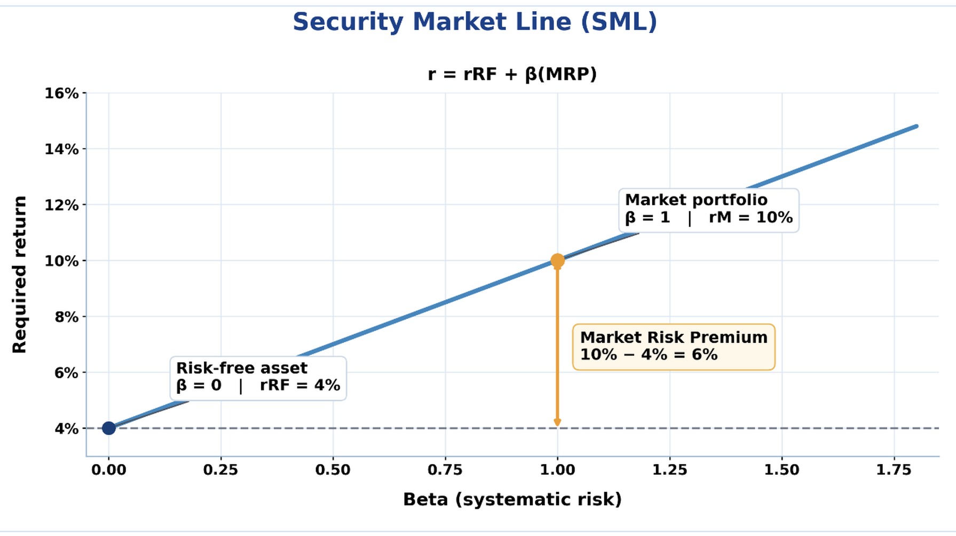
RETURN
Market Risk Premium
SML = Security Market Line; MRP = Market Risk Premium.
01
Market risk premium is the extra return investors expect from the market portfolio over the risk-free rate.
02
It is a key input in CAPM.
03
It reflects economy-wide risk that cannot be diversified away.
04
A higher market risk premium increases required return on equity.
Manager's Insight
CAPM scales the market risk premium by beta.
Quick Example
If expected market return is 10% and risk-free is 4%, MRP = 6%.
Risk and Return
22

Slide 24
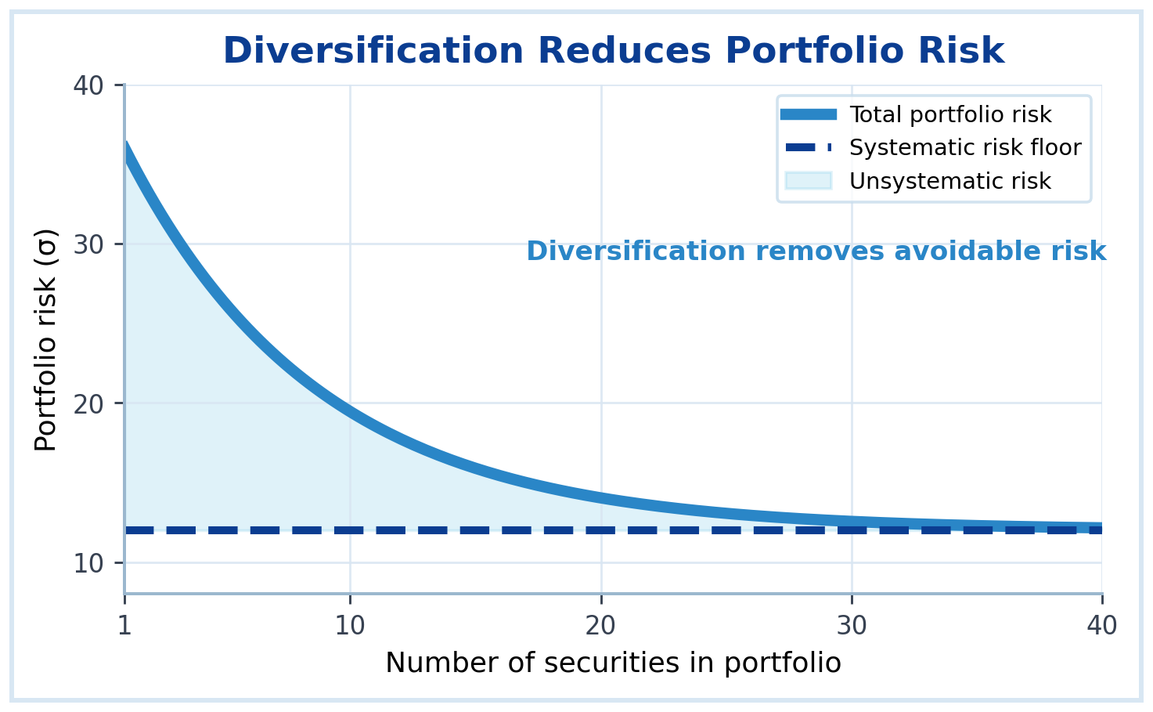
PORTFOLIO
Diversification Principle
Risk and return guide investment decisions and required returns.
01
Diversification means spreading funds across different assets.
02
It can reduce risk without necessarily reducing expected return.
03
The benefit is stronger when assets do not move together perfectly.
04
Diversification does not eliminate all risk.
Manager's Insight
Diversification is one of the most practical risk management tools in finance.
Quick Example
Owning stocks from different industries is less risky than owning one company only.
Risk and Return
23

Slide 25
PORTFOLIO
Portfolio Return
Risk and return guide investment decisions and required returns.
01
A portfolio is a collection of investments.
Portfolio expected return
E(rp) = Σ wi × E(ri)
wi = portfolio weight of asset i.
02
Portfolio expected return is a weighted average of asset expected returns.
03
Weights are based on the percentage of funds invested in each asset.
Interpretation
Identify the inputs, substitute carefully, and interpret the answer.
04
The weights should normally sum to 100%.
Manager's Insight
Portfolio return is easy to calculate; portfolio risk requires correlation.
Quick Example
60% in Asset A at 10% and 40% in Asset B at 5% gives E(rp)=8%.
Risk and Return
24

Slide 26
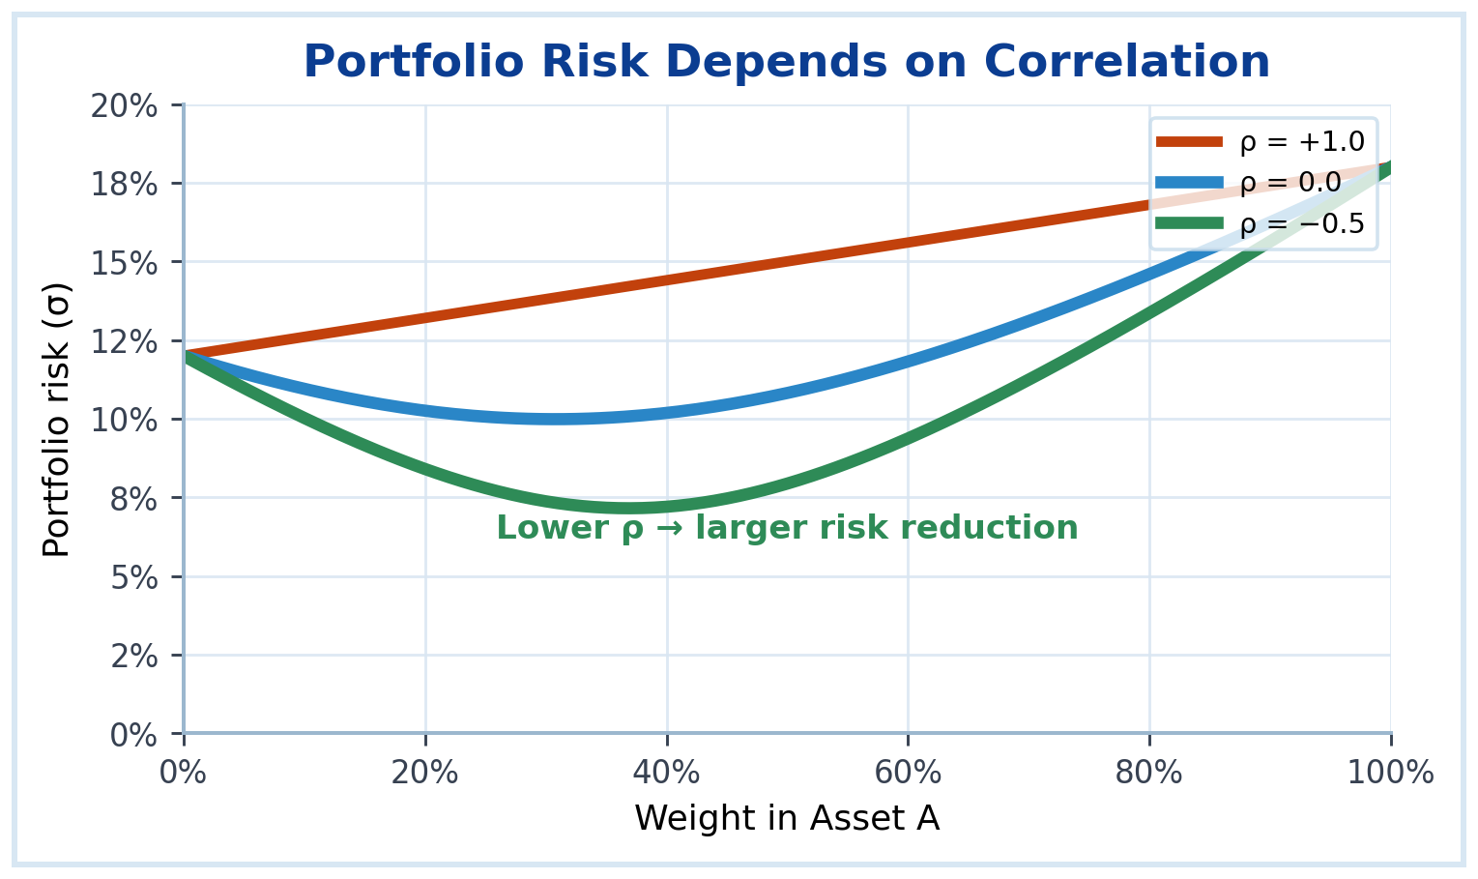
PORTFOLIO
Portfolio Risk
Risk and return guide investment decisions and required returns.
01
Portfolio risk is not simply the weighted average of individual risks.
02
It depends on how asset returns move together.
03
Correlation is the key driver of diversification benefit.
04
Lower correlation usually means lower portfolio risk.
Manager's Insight
Two risky assets can create a less risky portfolio if they offset each other.
Quick Example
If one asset performs well when another performs poorly, portfolio risk can fall.
Risk and Return
25

Slide 27
PORTFOLIO
Correlation Concept
Risk and return guide investment decisions and required returns.
01
Correlation measures how two returns move together.
Correlation
Meaning
Diversification benefit
02
It ranges from −1 to +1.
+1
Move together
Weakest
03
Positive correlation means returns tend to move in the same direction.
0
No clear pattern
Moderate
04
Negative correlation means returns tend to move in opposite directions.
−1
Move opposite
Strongest
Manager's Insight
Diversification works best when correlation is low or negative.
Quick Example
Airline stocks and fuel producers may react differently to oil price changes.
Risk and Return
26

Slide 28
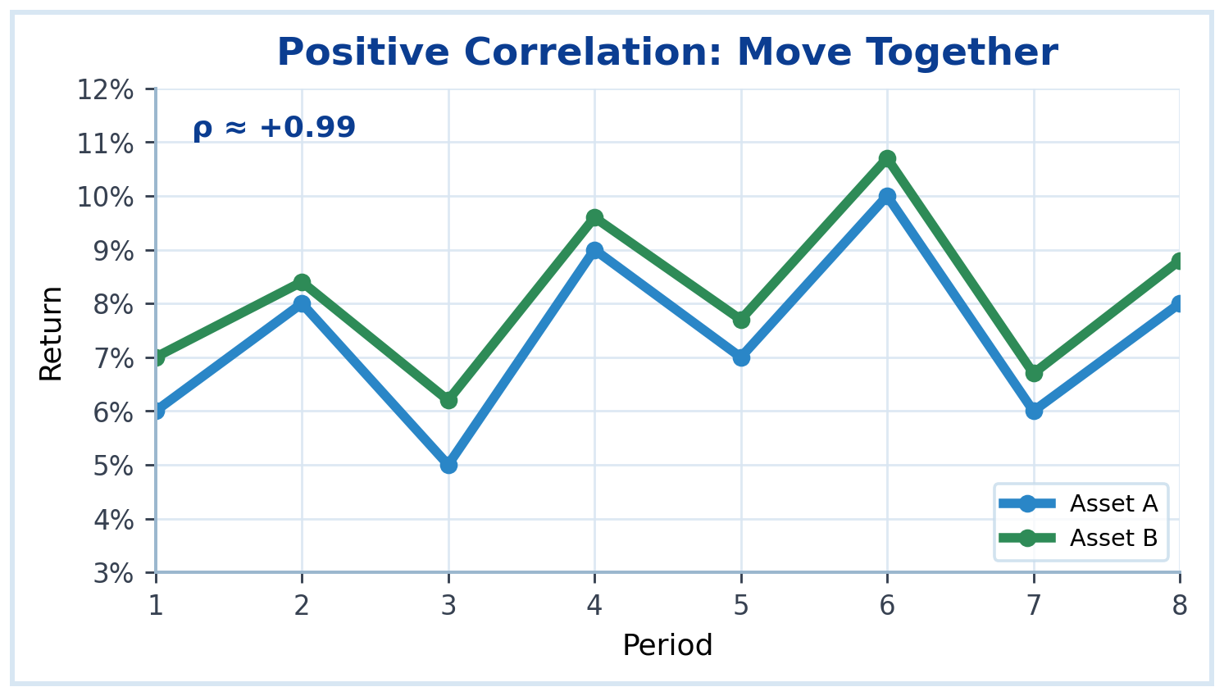
CORRELATION
Positive Correlation
Risk and return guide investment decisions and required returns.
01
Move in the same direction.
02
ρ close to +1 gives weak diversification.
03
Common within one industry or sector.
04
Similar movement, not identical returns.
Manager's Insight
A portfolio of very similar assets may not be as diversified as it appears.
Quick Example
Two bank stocks may both fall when interest rate uncertainty increases.
Risk and Return
27

Slide 29
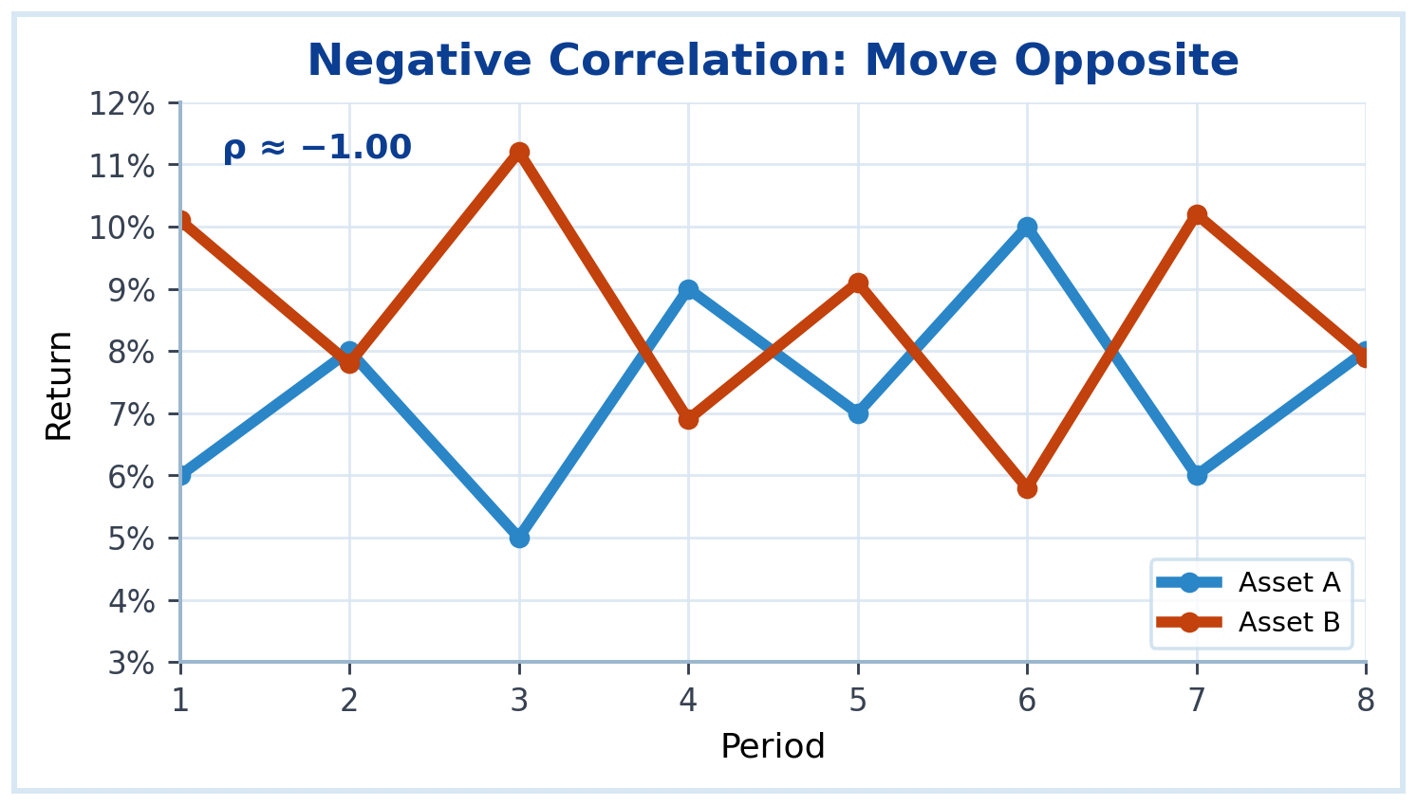
CORRELATION
Negative Correlation
Risk and return guide investment decisions and required returns.
01
Move in opposite directions.
02
Can strongly reduce portfolio risk.
03
Perfect ρ = −1 is rare in real markets.
04
Even imperfect negative ρ is valuable.
Manager's Insight
The goal is not to find only high-return assets, but assets that work well together.
Quick Example
When one investment loses 5% while another gains 4%, the portfolio loss is reduced.
Risk and Return
28

Slide 30
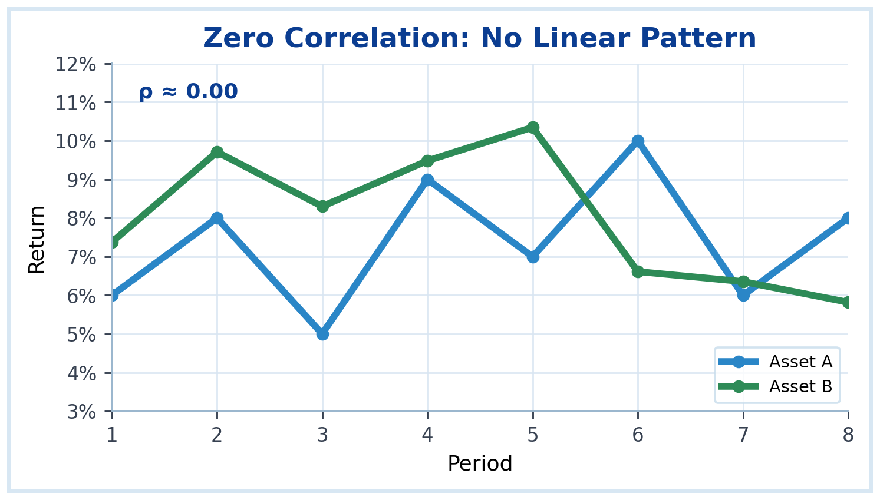
CORRELATION
Zero Correlation
Risk and return guide investment decisions and required returns.
01
No consistent linear relationship.
02
One asset does not predict the other.
03
Diversifies better than ρ = +1.
04
Common across unrelated assets.
Manager's Insight
Unrelated assets often improve diversification more than assets in the same business area.
Quick Example
A technology stock and a utility bond may have weak or near-zero correlation.
Risk and Return
29

Slide 31
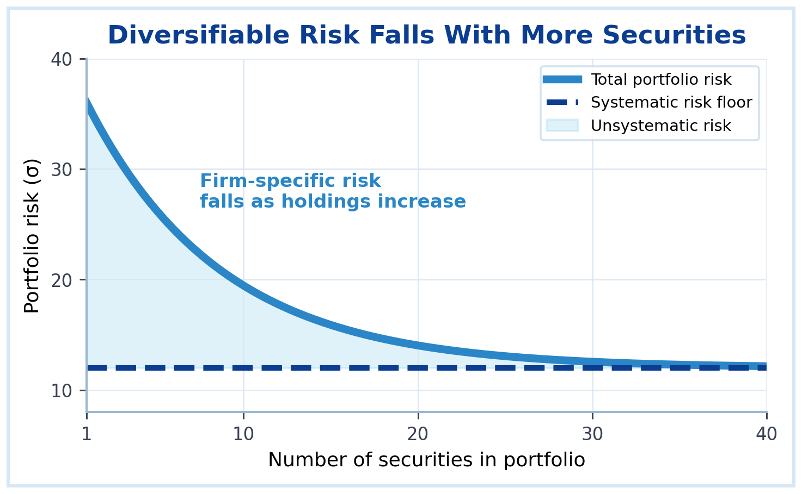
RISK
Diversifiable Risk
Risk and return guide investment decisions and required returns.
01
Diversifiable risk is risk specific to a company or industry.
02
It can be reduced by holding a diversified portfolio.
03
Examples include product failure, labor strike, or management problems.
04
It is also called unsystematic risk.
Manager's Insight
Investors are generally not rewarded for bearing risk that they could diversify away.
Quick Example
A factory fire affects one firm, not necessarily the entire market.
Risk and Return
30

Slide 32
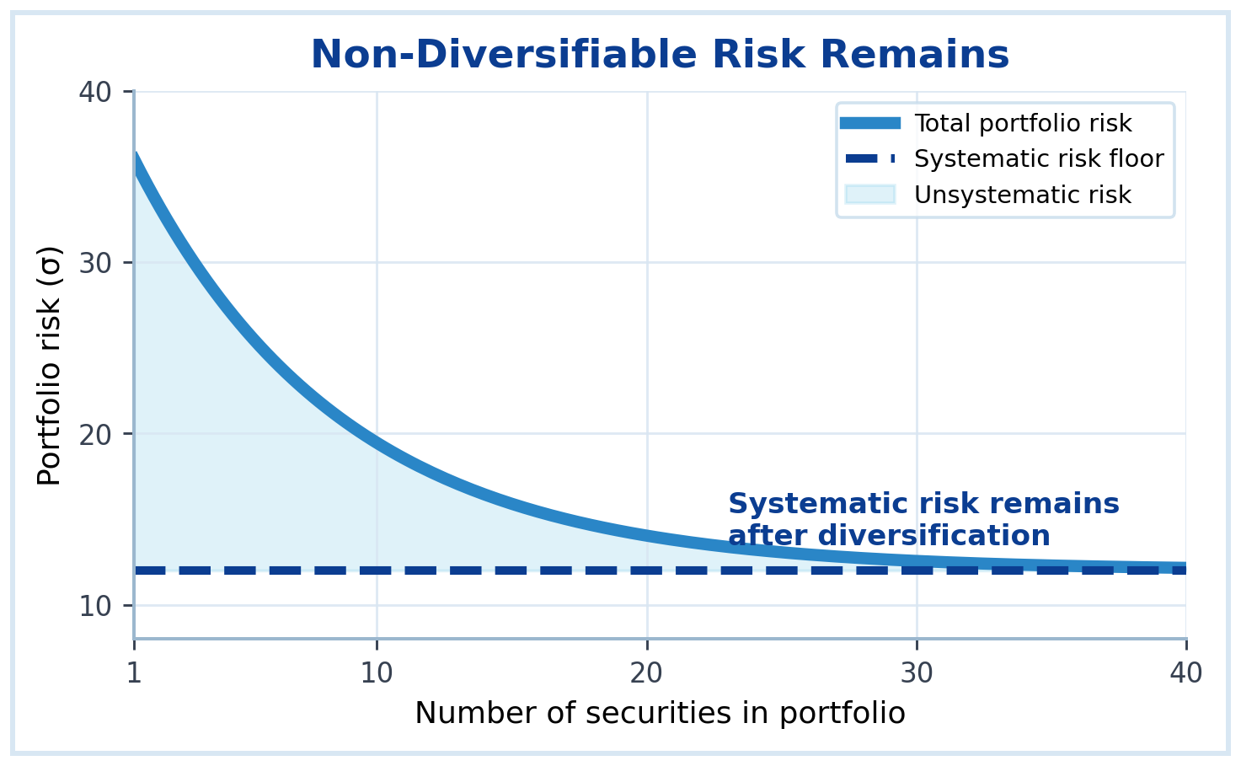
RISK
Non-Diversifiable Risk
Risk and return guide investment decisions and required returns.
01
Non-diversifiable risk affects the overall market or economy.
02
It cannot be eliminated by holding many securities.
03
Examples include recessions, inflation shocks, and major interest rate changes.
04
It is also called systematic or market risk.
Manager's Insight
Non-diversifiable risk is the risk that matters most for required return in CAPM.
Quick Example
A recession can reduce returns across many stocks at the same time.
Risk and Return
31

Slide 33
RISK
Systematic Risk
Risk and return guide investment decisions and required returns.
01
Systematic risk is economy-wide or market-wide risk.
Key idea
Systematic risk remains after diversification
This is the risk investors must be compensated for.
02
It affects many securities simultaneously.
03
It remains even in a well-diversified portfolio.
Interpretation
Identify the inputs, substitute carefully, and interpret the answer.
04
Beta measures systematic risk relative to the market.
Manager's Insight
Systematic risk drives the required return in the CAPM framework.
Quick Example
Interest rate increases can affect banks, manufacturers, and consumers at the same time.
Risk and Return
32

Slide 34

RISK
Unsystematic Risk
Risk and return guide investment decisions and required returns.
01
Unsystematic risk is firm-specific or industry-specific risk.
02
It can be reduced through diversification.
03
It includes events such as lawsuits, management errors, or supplier problems.
04
A diversified investor should not require a premium for avoidable unsystematic risk.
Manager's Insight
Good portfolio construction reduces exposure to avoidable company-specific shocks.
Quick Example
If one company loses a major customer, a diversified portfolio may absorb the impact.
Risk and Return
33

Slide 35
BETA
Beta Coefficient
Risk and return guide investment decisions and required returns.
01
Beta measures an asset’s systematic risk relative to the market.
Beta compared with market
02
The market portfolio has beta equal to 1.0.
β < 1
Lower market sensitivity
β = 1
Market-level sensitivity
β > 1
Higher market sensitivity
03
Beta focuses on market-related movement, not total stand-alone volatility.
04
Beta is a central input in CAPM.
Manager's Insight
Beta tells us how sensitive an investment is to broad market movements.
Quick Example
A beta of 1.5 indicates about 50% greater sensitivity to market movements than the market portfolio.
Risk and Return
34

Slide 36
BETA
Interpreting Beta
Risk and return guide investment decisions and required returns.
01
β = 1.0: the asset tends to move with the market.
Beta
Interpretation
Approx. movement if market +10%
02
β > 1.0: the asset is more sensitive than the market.
0.5
Lower market sensitivity
Approx. +5%
03
β < 1.0: the asset is less sensitive than the market.
1.0
Market-level sensitivity
Approx. +10%
04
A negative beta would move opposite the market, but is uncommon.
1.4
Higher market sensitivity
Approx. +14%
Manager's Insight
Beta is relative market risk, not a full measure of all possible risk.
Quick Example
A defensive utility stock may have beta below 1; a technology growth stock may have beta above 1.
Risk and Return
35

Slide 37
CAPM
Capital Asset Pricing Model Overview
Risk and return guide investment decisions and required returns.
01
CAPM links required return to systematic risk.
CAPM
r = rRF + β × (rM − rRF)
Required return equals risk-free return plus a beta-adjusted market risk premium.
02
It assumes diversified investors care mainly about market risk.
03
Beta measures the amount of systematic risk.
Risk-free
Time value
Beta
Systematic risk
Premium
Reward for market risk
04
Higher beta leads to higher required return.
Manager's Insight
CAPM provides a practical bridge between risk measurement and required return.
Quick Example
Managers use CAPM to estimate the cost of equity for valuation and capital budgeting.
Risk and Return
36

Slide 38
FORMULA
CAPM Formula
Risk and return guide investment decisions and required returns.
01
CAPM starts with the risk-free return.
CAPM
rj = rRF + βj × (rM − rRF)
Required return = risk-free rate + beta-adjusted market premium.
02
It adds a risk premium based on beta.
03
The market risk premium is the reward for market risk.
Symbol
Meaning
The formula estimates required return on equity.
rRF
Risk-free return
04
βj
Beta of asset j
rM − rRF
Market risk premium
Manager's Insight
CAPM says only systematic risk should increase required return for diversified investors.
Quick Example
If β = 1.2 and market premium = 6%, the risk premium is 7.2%.
Risk and Return
37

Slide 39
CAPM
Required Return on Equity Using CAPM
Risk and return guide investment decisions and required returns.
01
The required return on equity is the return shareholders demand.
Cost of equity by CAPM
rs = rRF + βs × Market Risk Premium
Use shareholder risk, not debt risk.
02
It becomes the cost of equity for the firm.
03
A higher beta means a higher cost of equity.
Interpretation
Identify the inputs, substitute carefully, and interpret the answer.
04
The cost of equity affects firm valuation and project decisions.
Manager's Insight
A firm with higher market risk must earn more to satisfy shareholders.
Quick Example
rRF=4%, β=1.3, market premium=6% → rs=4%+7.8%=11.8%.
Risk and Return
38

Slide 40
MANAGEMENT
Risk Management Implications
Risk and return guide investment decisions and required returns.
01
Risk measurement helps managers make better investment choices.
02
Diversification can reduce avoidable exposure.
03
Required returns must reflect risk.
04
Risk management protects value, but cannot remove all uncertainty.
Identify
Sources of risk
Measure
Return variability and beta
Manage
Diversify, hedge, or price risk
Manager's Insight
Managing risk does not mean avoiding all risk; it means accepting risks that are properly rewarded.
Quick Example
A firm may hedge exchange rate risk but still accept market demand risk if the expected return is high.
Risk and Return
39

Slide 41
APPLICATION
Risk and Capital Budgeting
Risk and return guide investment decisions and required returns.
01
Capital budgeting evaluates long-term investment projects.
Capital budgeting link
Higher project risk → Higher discount rate → Lower NPV
Risk changes the value of expected cash flows.
02
Risk affects the discount rate used in net present value (NPV) analysis.
03
Higher-risk projects require higher required returns.
Interpretation
Identify the inputs, substitute carefully, and interpret the answer.
04
Risk analysis helps avoid accepting projects that look profitable only under unrealistic assumptions.
Manager's Insight
NPV decisions are only reliable if the discount rate matches project risk.
Quick Example
A project in a volatile new market should use a higher required return than a stable replacement project.
Risk and Return
40

Slide 42
APPLICATION
Risk and Cost of Capital
Risk and return guide investment decisions and required returns.
01
Cost of capital is the required return demanded by capital providers.
Decision link
Risk ↑ → Required return ↑ → Cost of capital ↑
Higher required return makes financing and projects more expensive.
02
Debt holders and equity holders face different risks.
03
Higher business or financial risk can increase the cost of capital.
Interpretation
Identify the inputs, substitute carefully, and interpret the answer.
04
Cost of capital is used in valuation and project evaluation.
Manager's Insight
Reducing unnecessary risk can lower required return and support firm value.
Quick Example
A firm with stable cash flows may borrow at a lower cost than a firm with unpredictable cash flows.
Risk and Return
41

Slide 43
WORKED EXAMPLE
Worked Example: Expected Return
Risk and return guide investment decisions and required returns.
01
State probabilities and returns are given.
State
Probability
Return
Weighted return
Multiply each return by its probability.
Recession
25%
−2%
−0.50%
02
Normal
50%
10%
5.00%
03
Add the weighted returns.
Boom
25%
18%
4.50%
04
Interpret the result as the average expected return before uncertainty is resolved.
Expected return
9.00%
Manager's Insight
The expected return is a probability-weighted average, not the most likely return.
Quick Example
In this example, E(r) = −0.50% + 5.00% + 4.50% = 9.00%.
Risk and Return
42

Slide 44
WORKED EXAMPLE
Worked Example: Standard Deviation
Risk and return guide investment decisions and required returns.
01
Start from expected return: 9%.
State
Return
Deviation
Weighted squared deviation
Recession
−2%
−11%
30.25
02
Compute each deviation from 9%.
Normal
10%
1%
0.50
03
Square each deviation and multiply by probability.
Boom
18%
9%
20.25
Variance
51.00
04
Add the weighted squared deviations, then take the square root.
Standard deviation
7.14%
Manager's Insight
Standard deviation expresses risk in percentage points, making it easier to interpret.
Quick Example
A standard deviation of 7.14% means returns commonly vary around the 9% expected return.
Risk and Return
43

Slide 45
WORKED EXAMPLE
Worked Example: CAPM Required Return
Risk and return guide investment decisions and required returns.
01
Identify the risk-free rate, beta, and market risk premium.
Solved CAPM
r = 4% + 1.2 × 6% = 11.2%
Risk premium = 1.2 × 6% = 7.2%.
02
Multiply beta by the market risk premium.
03
Add the risk-free return.
Interpretation
The required return is 11.2% because the beta-adjusted premium is added to the risk-free return.
04
Interpret the answer as the return shareholders require.
Manager's Insight
CAPM converts systematic risk into a required return.
Quick Example
If a project has similar risk to this equity, 11.2% may be used as a benchmark discount rate.
Risk and Return
44

Slide 46
SUMMARY
Lecture Summary and Applied Practice
Risk and return guide investment decisions and required returns.
01
Return measures the reward from investing.
Practice item
Student task
Risk measures uncertainty around expected return.
Expected return
Calculate weighted average return.
02
Risk
Compute variance and standard deviation.
03
Diversification reduces unsystematic risk, but systematic risk remains.
Portfolio
Explain diversification using correlation.
04
Beta and CAPM connect systematic risk to required return.
CAPM
Estimate required return using beta.
Manager's Insight
Risk and return are not separate topics; they drive valuation, capital budgeting, and cost of capital.
Quick Example
Final practice: compute expected return, standard deviation, and CAPM return for one investment case.
Risk and Return
45

Slide 47
ASSESSMENT
Assessment Practice 1
Solved questions: concepts, calculations, and applications.
QUESTION 01/10
Which statement best describes the risk-return trade-off?
A Higher risk normally requires lower expected return
B Higher risk normally requires higher expected return
C Risk and return are unrelated
D Risk eliminates the need for return
ANSWER
B Higher risk normally requires higher expected return
EXPLANATION
Risk-averse investors demand compensation for bearing additional uncertainty.
EXAM TECHNIQUE: Compare expected reward with the uncertainty accepted.
Risk and Return
46
Notes:
Risk-averse investors demand compensation for bearing additional uncertainty.

Slide 48
ASSESSMENT
Assessment Practice 2
Solved questions: concepts, calculations, and applications.
QUESTION 02/10
A stock is bought for $40, sold for $46, and pays a $2 dividend. What is the holding period return?
A 10%
B 15%
C 20%
D 25%
ANSWER
C 20%
EXPLANATION
HPR = (46 − 40 + 2) / 40 = 8 / 40 = 20%.
EXAM TECHNIQUE: Add capital gain and income before dividing by beginning price.
Risk and Return
47
Notes:
HPR = (46 − 40 + 2) / 40 = 8 / 40 = 20%.

Slide 49
ASSESSMENT
Assessment Practice 3
Solved questions: concepts, calculations, and applications.
QUESTION 03/10
A project has returns of −2%, 10%, and 18% with probabilities 25%, 50%, and 25%. What is expected return?
A 6%
B 8%
C 9%
D 12%
ANSWER
C 9%
EXPLANATION
E(r)=0.25(−2%)+0.50(10%)+0.25(18%)=9%.
EXAM TECHNIQUE: Expected return is a probability-weighted average.
Risk and Return
48
Notes:
E(r)=0.25(−2%)+0.50(10%)+0.25(18%)=9%.

Slide 50
ASSESSMENT
Assessment Practice 4
Solved questions: concepts, calculations, and applications.
QUESTION 04/10
Which measure is the square root of variance?
A Beta
B Standard deviation
C Risk premium
D Correlation
ANSWER
B Standard deviation
EXPLANATION
Standard deviation converts variance back into percentage units of return.
EXAM TECHNIQUE: Variance first, then square root for standard deviation.
Risk and Return
49
Notes:
Standard deviation converts variance back into percentage units of return.

Slide 51
ASSESSMENT
Assessment Practice 5
Solved questions: concepts, calculations, and applications.
QUESTION 05/10
What does coefficient of variation measure?
A Total income received
B Risk per unit of expected return
C Market value per share
D Only systematic risk
ANSWER
B Risk per unit of expected return
EXPLANATION
CV = standard deviation divided by expected return.
EXAM TECHNIQUE: Use CV when comparing investments with different expected returns.
Risk and Return
50
Notes:
CV = standard deviation divided by expected return.

Slide 52
ASSESSMENT
Assessment Practice 6
Solved questions: concepts, calculations, and applications.
QUESTION 06/10
What type of risk can diversification reduce?
A Systematic risk
B Market risk
C Unsystematic risk
D Risk-free return
ANSWER
C Unsystematic risk
EXPLANATION
Firm-specific or industry-specific risk can be reduced by holding many different assets.
EXAM TECHNIQUE: Diversification reduces company-specific risk, not broad market risk.
Risk and Return
51
Notes:
Firm-specific or industry-specific risk can be reduced by holding many different assets.

Slide 53
ASSESSMENT
Assessment Practice 7
Solved questions: concepts, calculations, and applications.
QUESTION 07/10
A portfolio invests 60% in Asset A with expected return 10% and 40% in Asset B with expected return 5%. What is portfolio expected return?
A 6%
B 7%
C 8%
D 10%
ANSWER
C 8%
EXPLANATION
E(rp)=0.60(10%)+0.40(5%)=6%+2%=8%.
EXAM TECHNIQUE: Use portfolio weights as the multipliers.
Risk and Return
52
Notes:
E(rp)=0.60(10%)+0.40(5%)=6%+2%=8%.

Slide 54
ASSESSMENT
Assessment Practice 8
Solved questions: concepts, calculations, and applications.
QUESTION 08/10
Which correlation gives the strongest diversification benefit?
A +1.0
B +0.8
C 0.0
D −1.0
ANSWER
D −1.0
EXPLANATION
The lower the correlation, the greater the potential risk reduction; −1.0 is perfect opposite movement.
EXAM TECHNIQUE: Low or negative correlation is best for diversification.
Risk and Return
53
Notes:
The lower the correlation, the greater the potential risk reduction; −1.0 is perfect opposite movement.

Slide 55
ASSESSMENT
Assessment Practice 9
Solved questions: concepts, calculations, and applications.
QUESTION 09/10
A stock has a beta of 1.4. What does this indicate?
A Its market sensitivity is lower than the market's
B It has no systematic risk
C Its market sensitivity is about 40% higher than the market's
D It is risk-free
ANSWER
C Market sensitivity is about 40% higher than the market's
EXPLANATION
A beta of 1.4 indicates that, on average, the stock is about 40% more sensitive to market movements than the market portfolio.
EXAM TECHNIQUE: Beta measures systematic market sensitivity; market beta equals 1.0.
Risk and Return
54
Notes:
A beta of 1.4 indicates that, on average, the stock is about 40% more sensitive to market movements than the market portfolio.

Slide 56
ASSESSMENT
Assessment Practice 10
Solved questions: concepts, calculations, and applications.
QUESTION 10/10
Using the Capital Asset Pricing Model (CAPM), if the risk-free return (rRF) = 4%, beta = 1.2, and market risk premium = 6%, what is the required return?
A 7.2%
B 10.0%
C 11.2%
D 12.0%
ANSWER
C 11.2%
EXPLANATION
Required return = 4% + 1.2 × 6% = 4% + 7.2% = 11.2%.
EXAM TECHNIQUE: Multiply beta by the market risk premium, then add the risk-free rate.
Risk and Return
55
Notes:
Required return = 4% + 1.2 × 6% = 4% + 7.2% = 11.2%.

Slide 57
REFERENCE
Abbreviations and Short Labels
Use the full meaning first; then the shortened form becomes easier to remember.
01
HPR — Holding Period Return
Symbol / term
Meaning
CV — Coefficient of Variation
SML
Security Market Line
02
NPV
Net Present Value
03
CAPM — Capital Asset Pricing Model
T-bill
Treasury bill
04
MRP — Market Risk Premium
MGM 237
Course code
Manager’s Insight: Abbreviations shorten repeated terms; always connect each one to its full meaning.
Quick Example: CAPM means Capital Asset Pricing Model—not a separate return measure.
Risk and Return
56

Slide 58
REFERENCE
Return and Probability Symbols
Subscripts identify a time, state, asset, or portfolio in the formula.
01
P₀ — Price at the beginning
Symbol / term
Meaning
P₁ — Price at the end
r(s)
Return in state s
02
Σ
Sum of all outcomes
03
E(r) — Expected return
E(rₚ)
Expected portfolio return
04
P(s) — Probability of state s
wᵢ / E(rᵢ)
Asset weight / expected return
Manager’s Insight: Read the main letter first, then use the subscript to identify the time, state, or asset.
Quick Example: P₀ is the starting price, while P₁ is the ending price.
Risk and Return
57

Slide 59
REFERENCE
Risk and CAPM Symbols
Greek letters describe risk; r symbols describe required or expected returns.
01
σ — Standard deviation
Symbol / term
Meaning
σ² — Variance
rRF
Risk-free return
02
rM
Expected market return
03
ρ — Correlation coefficient
rj / rs
Required return for asset j / stock s
04
β — Beta: market sensitivity
rM − rRF
Market risk premium
Manager’s Insight: Higher beta means the asset is more sensitive to movements in the overall market.
Quick Example: β = 1.2 means the asset tends to move 20% more than the market.
Risk and Return
58

Slide 60




Thank You
Risk and Return

