Slide 1


Supply Chain Management
Prepared by Dr. Tarek Mohamed
MGM 660
Lecture 9

Slide 2


Sourcing decisions in a supply chain
Lecture 9
MGM 660
Prepared by
Dr. Tarek Mohamed

Slide 3

Course Agenda
Chapter
To discuss the Scope of Procurement.
Explain the role of sourcing in supply chain management.
Understand the strategic importance of sourcing decisions.
Differentiate between sourcing strategies.
Evaluate supplier selection criteria.
Compare outsourcing and insourcing.
Understand global sourcing challenges.
Analyze sourcing risks and mitigation strategies.
Apply sourcing concepts to real companies.

Slide 4
PROCUREMENT
Refers to the raw materials, component parts, and supplies bought from outside organizations to support a company’s operations
Procurement costs often range between 60%-80% of an organization’s revenues
Currently has a more strategic orientation in many organizations
Procurement manager may have responsibility for:
Reducing cycle times
Playing an integral role in product development
Generating additional revenues through collaboration with the marketing department

Slide 5
What is Procurement?
Procurement – The process of acquiring and evaluating goods and services beginning with determining needs through product utilization, conclusion of contracted service, or until the end of the useful life of a capital equipment item.
Purchasing – The process of “buying:” placing an order, receiving a product or service, and paying the supplier.

Slide 6
What is Procurement?
Procurement involves a more comprehensive scope of activities than does “purchasing”.
The term “purchasing” is most similar to the term buying.
Those with procurement responsibilities have two primary concerns: to identify and secure the products and services that will best allow the organization to meet the wants and needs of its customers, and to obtain them at a fair price.

Slide 7
Objectives of Effective Procurement
Obtain the right product or service at the right price from the right source in the right quantity at the right time.

Slide 8
What is Sourcing?
What is Sourcing?
Sourcing is the process of selecting suppliers and determining where and how
products, materials, and services will be obtained.
It answers questions such as:
Who should supply us?
Where should we buy from?
How many suppliers should we use?
Should we produce internally or outsource?
Should we source locally or globally?

Slide 9
Why is sourcing important?
Good sourcing decisions can
Reduce costs
Improve quality
Increase flexibility
Reduce risk
Improve innovation
Improve customer service

Slide 10
Why is sourcing important?
Example
Apple
Designs products internally
Sources processors from TSMC
Displays from Samsung and LG
Assembles products through Foxconn
Apple focuses on innovation while suppliers provide manufacturing expertise.

Slide 11
Objectives of Sourcing
Companies source to achieve:
Lower purchasing costs
Better quality
Reliable deliveries
Supplier innovation
Shorter lead times
Risk reduction
Sustainability
Competitive advantage

Slide 12
Types of Sourcing
A. Single Sourcing
Only one supplier.
Advantages
Strong relationship
Better quality
Lower coordination cost
Volume discounts
Disadvantages
High dependency
Supply disruption risk
Company Example
Toyota often uses long-term partnerships with strategic suppliers.

Slide 13
Types of Sourcing
B. Multiple Sourcing
Several suppliers provide the same item.
Advantages
Lower risk
Increased competition
Better availability
Disadvantages
Higher management effort
Less collaboration
Example
Hospitals purchasing medical gloves from several suppliers.

Slide 14
Types of Sourcing
C. Sole Sourcing
Only one supplier exists because of patents or technology.
Example
A patented pharmaceutical ingredient.
D. Dual Sourcing
Two suppliers provide the same product.
Benefits
Backup supplier
Risk reduction
Moderate competition

Slide 15
Insourcing vs Outsourcing
Insourcing
Company performs activities internally.
Advantages
Better control
Protects intellectual property
Better quality control
Disadvantages
Higher investment
Higher operating costs

Slide 16
Insourcing vs Outsourcing
Outsourcing
External suppliers perform activities.
Advantages
Lower costs
Access to expertise
Focus on core competencies
Disadvantages
Loss of control
Quality problems
Supplier dependence

Slide 17
Examples for Insourcing vs Outsourcing
Nike
Product design internally
Manufacturing outsourced
Apple
Product development internally
Assembly outsourced

Slide 18
In-House or Outsource
Increase supply chain surplus through
  Capacity aggregation
  Inventory aggregation
  Transportation aggregation by transportation intermediaries
  Transportation aggregation by storage intermediaries
  Warehousing aggregation
  Procurement aggregation
  Information aggregation
  Receivables aggregation
  Relationship aggregation
  Lower costs and higher quality

Slide 19
Make-or-Buy Decision
One of the most important sourcing decisions.
Should the company produce internally or purchase externally?
Factors
Cost
Quality
Capacity
Technology
Expertise
Strategic importance
Confidentiality
Risk
Example- Tesla
Makes batteries with partners while purchasing many electronic components from suppliers.

Slide 20
Make-or-Buy Decision
Local Sourcing
Buying from domestic suppliers.
Advantages
Short lead times
Easier communication
Lower transportation costs
Better responsiveness
Disadvantages
Higher prices
Limited supplier options

Slide 21
Make-or-Buy Decision
Global Sourcing
Buying internationally.
Advantages
Lower production costs
More supplier choices
Access to advanced technology
Disadvantages
Long lead times
Exchange-rate fluctuations
Political risks
Customs delays
Example
Starbucks sources coffee globally.

Slide 22
Make-or-Buy Decision
Nearshoring, Offshoring, and Onshoring
Offshoring
Moving production to distant countries.
Example
US company manufacturing in Vietnam.
Nearshoring
Moving production closer.
Example
US company manufacturing in Mexico.
Onshoring
Returning production to the home country.
Example
European companies moving production back from Asia.

Slide 23
Examples of Make-or-Buy Decision (Onshoring)
Example 1: General Motors (GM)
Industry: Automotive
GM has invested billions of dollars to
manufacture electric vehicles (EVs)
and batteries in the United States
instead of relying solely on overseas
production.
Reason
Reduce supply chain disruptions
Support domestic manufacturing
Meet government incentives
Improve responsiveness
Example 2: Intel
Industry: Semiconductor
Intel has expanded semiconductor manufacturing
in the United States by building new fabrication
plants.
Reason
Increase supply chain security
Reduce dependence on overseas chip manufacturers
Support national semiconductor production

Slide 24
Examples of Make-or-Buy Decision (Nearshoring)
Example 1: Tesla
Industry: Automotive
Tesla manufactures vehicles in
Mexico to serve the North American
market.
Benefits
Lower production costs
Close proximity to U.S. customers
Reduced transportation time
Faster delivery
Example 2: Whirlpool
Whirlpool operates manufacturing facilities in Mexico to supply the U.S. market.
Reason
Lower labor costs than the U.S.
Short shipping distance
Quick replenishment

Slide 25
Examples of Make-or-Buy Decision (Offshoring)
Example 1: Apple
Industry: Consumer Electronics
Apple designs products in the
United States but assembles many
products in China through
manufacturing partners such as
Foxconn and other suppliers.
Reason
Lower manufacturing costs
Highly skilled electronics manufacturing ecosystem
Large production capacity
Example 2: Nike
Industry: Sportswear
Nike outsources manufacturing to factories in countries such as Vietnam, Indonesia, and China.
Benefits
Lower production costs
Large manufacturing capacity
Flexibility during seasonal demand

Slide 26
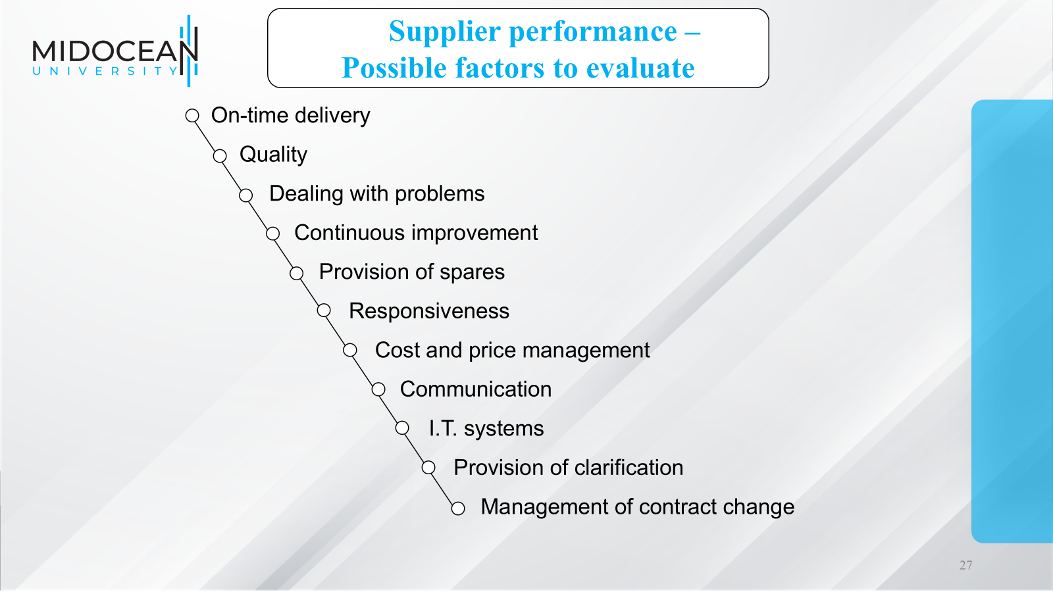

Slide 27
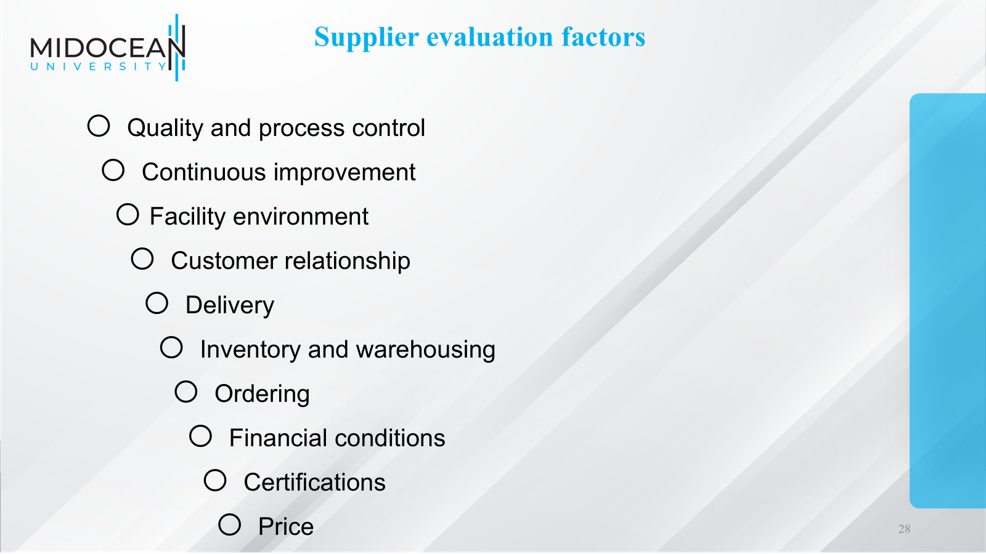

Slide 28
Supplier Evaluation Matrix
Criteria | Weight | Supplier A | Supplier B
Price | 20% | 8 | 9
Quality | 30% | 10 | 8
Delivery | 20% | 9 | 7
Technology | 15% | 8 | 10
Sustainability | 15% | 9 | 8

Slide 29
Supplier Relationship Management (SRM)
Not all suppliers should be managed the same way.
Supplier Relationship Management (SRM) aims to optimize the total value
created across the buyer–supplier relationship
Relationship types
Strategic partnership
Long-term contracts
Transactional purchasing
Collaborative sourcing
Example
Toyota develops suppliers through continuous improvement.

Slide 30
Examples of Supplier Relationship Management (SRM) in companies
Toyota – Long-Term Strategic Partnerships
Industry
Automotive
SRM Practice
Toyota builds long-term relationships with key suppliers instead of frequently changing
them. The company works closely with suppliers to improve quality, reduce costs, and eliminate
waste using Lean Manufacturing and the Toyota Production System (TPS).
Example
Engineers from Toyota regularly visit supplier facilities.
Toyota shares production schedules and demand forecasts.
Suppliers participate in continuous improvement (Kaizen) programs.
Benefits
High product quality
Reduced inventory
Reliable deliveries
Strong supplier loyalty

Slide 31
Examples of Supplier Relationship Management (SRM) in companies
Apple – Supplier Performance Management
Industry
Consumer Electronics
SRM Practice
Apple collaborates closely with strategic suppliers such as TSMC, Foxconn, Samsung, and LG.
Example
Conducts regular supplier audits.
Measures supplier performance on quality, delivery, sustainability, and labor practices.
Provides technical support for process improvements.
Shares future product forecasts with key suppliers.
Benefits
High product quality
Faster product launches
Reliable supply of advanced components
Better supplier innovation

Slide 32
Strategic Sourcing
Strategic Sourcing
Strategic sourcing is a long-term purchasing process focused on obtaining
maximum value.
Steps
Analyze spending
Understand demand
Analyze supply market
Select suppliers
Negotiate contracts
Monitor supplier performance
Continuous improvement

Slide 33
Risks in Sourcing
Risks in Sourcing
Major sourcing risks include
Supplier bankruptcy
Natural disasters
Political instability
Pandemics
Transportation disruption
Quality failures
Cybersecurity threats
Currency fluctuations
Example
COVID-19 disrupted global sourcing because factories closed and shipping was delayed.

Slide 34
Risk Mitigation Strategies
Companies reduce sourcing risk through
Multiple sourcing
Safety stock
Backup suppliers
Supplier audits
Long-term contracts
Digital supplier visibility
Geographic diversification
Nearshoring

Slide 35
Sustainable Sourcing
Modern sourcing also considers
Environmental protection
Ethical labor practices
Human rights
Carbon emissions
Supplier diversity
Circular economy
Example
Unilever requires suppliers to meet sustainability standards.

Slide 36
Digital Technologies in Sourcing
Technology is transforming sourcing through
Artificial Intelligence (AI)
Machine Learning
Blockchain
Big Data Analytics
IoT
Digital Procurement Platforms
e-Sourcing
e-Auctions
Supplier Portals
Robotic Process Automation (RPA)

Slide 37
Example of real-world companies
Apple
Strategic outsourcing
Global sourcing
Supplier diversification
Strong supplier monitoring
Toyota
Long-term supplier relationships
Lean sourcing
Supplier development
Just-in-Time purchasing
Zara
Nearshoring
Local sourcing for fashion responsiveness
Fast supplier collaboration
Amazon
Global supplier network
AI-driven sourcing
Supplier performance analytics

Slide 38
Design Collaboration
About 80% of the cost of a product is determined during design
Suppliers should be actively involved at this stage
50-70% of spending at a manufacturer comes from procurement
80% of the cost of a purchased part is fixed in the design phase
Design collaboration with suppliers can result in reduced cost, improved quality, and decreased time to market
Design for logistics, design for manufacturability
ESI has been defined as:
A practice that brings together one or more selected suppliers with a buyer’s product design team early in the product development process.
The objective is to utilise the supplier’s expertise and experience in developing a product specification that is designed for effective and efficient product roll-out.

Slide 39
Third- and Fourth-Party
Logistics Providers
Third-party logistics (3PL) providers performs one or more of the logistics activities relating to the flow of product, information, and funds that could be performed by the firm itself
A 4PL (fourth-party logistics) designs, builds and runs the entire supply chain process

Slide 40
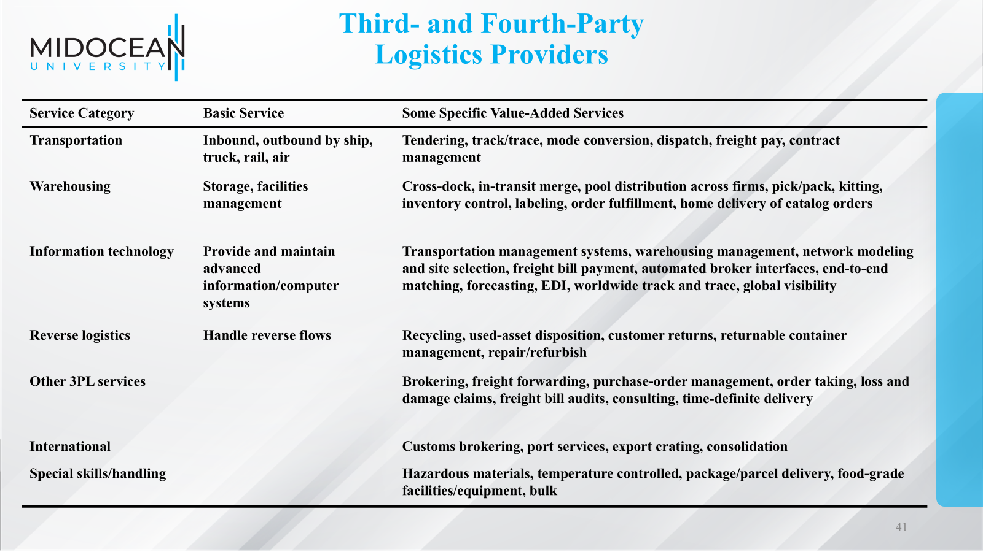

Slide 41
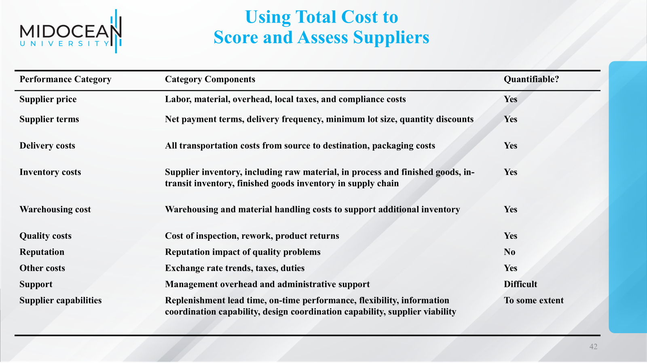

Slide 42
Designing a Sourcing Portfolio:
Tailored Sourcing
Options with regard to whom and where to source from
  Produce in-house or outsource to a third party
  Will the source be cost efficient or responsive
  Onshoring, near-shoring, and offshoring
Tailor supplier portfolio based on a variety of product and market characteristics

Slide 43
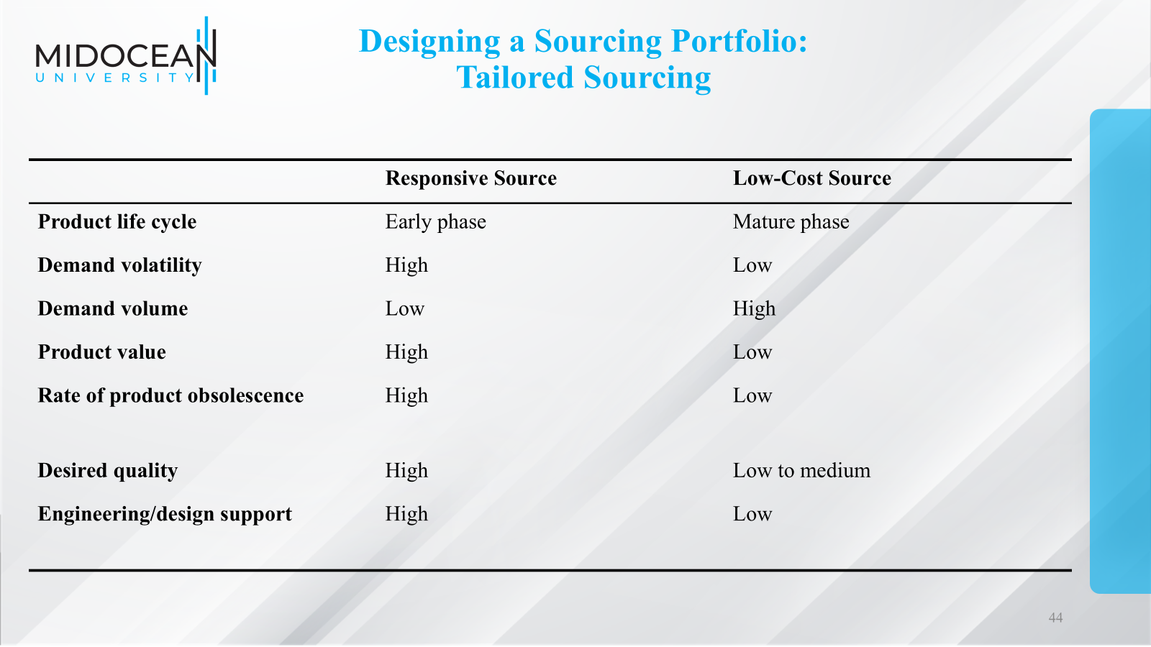

Slide 44
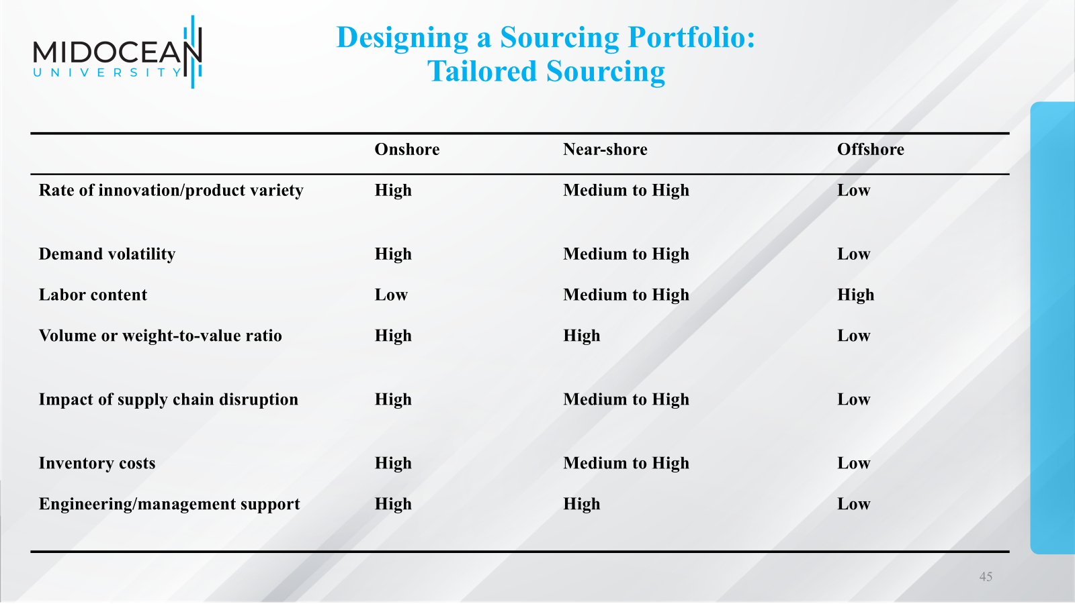

Slide 45
Making Sourcing Decisions in Practice
Sourcing is a strategic supply chain decision that influences cost, quality, flexibility, and competitiveness.
Companies must balance cost with quality, risk, innovation, and sustainability.
Common sourcing strategies include single, multiple, sole, and dual sourcing, as well as insourcing versus outsourcing.
Global sourcing offers cost advantages but introduces additional risks, while local and nearshore sourcing improve responsiveness.
Effective supplier selection uses multiple criteria rather than price alone.
Digital technologies such as AI, blockchain, and analytics are transforming sourcing decisions and supplier management.
Building strong supplier relationships and proactively managing sourcing risks are essential for long-term supply chain resilience.

Slide 46
Summary of Learning Objectives
Chapter
To discuss the Scope of Procurement.
Explain the role of sourcing in supply chain management.
Understand the strategic importance of sourcing decisions.
Differentiate between sourcing strategies.
Evaluate supplier selection criteria.
Compare outsourcing and insourcing.
Understand global sourcing challenges.
Analyze sourcing risks and mitigation strategies.
Apply sourcing concepts to real companies.

Slide 47
Essential Reference
Lysons, K., & Farrington, B. (2020). Procurement and supply chain management. Pearson UK.
Chopra, S., & Meindl, P. (2016). Global Edition. Pearson Education Limited. Chapter 15.
Morris, P. W., & Pinto, J. K. (Eds.). (2007). The Wiley guide to project technology, supply chain, and procurement management (Vol. 4). John Wiley & Sons.
Schwalbe, K. (2015). Information technology project management. Cengage Learning.
Supply Chain Council

Slide 48

Thank You

