Slide 1

Risk Management
Prepared by Dr. Dalia Hosni
Lecture 6
MGM 510
Risk Management

Slide 2

Negative Risk
Lecture 6
A dictionary definition of risk is “the possibility of loss or injury”
Negative risk involves understanding potential problems that might occur in the project and how they might impede project success
Negative risk management is like a form of insurance; it is an investment

Slide 3
Risk Can Be Positive
Lecture 6
Positive risks are risks that result in good things happening; sometimes called opportunities
A general definition of project risk is an uncertainty that can have a negative or positive effect on meeting project objectives
The goal of project risk management is to minimize potential negative risks while maximizing potential positive risks

Slide 4
Best Practice
Lecture 6
Some organizations make the mistake of only addressing tactical and negative risks when performing project risk management
David Hillson, (www.risk-doctor.com) suggests overcoming this problem by widening the scope of risk management to encompass both strategic risks and upside opportunities, which he refers to as integrated risk management
In a 2014 paper Hillson described the importance of good working relationships, especially between the project sponsor and project manager

Slide 5
Risk Utility
Lecture 6
Risk utility or risk tolerance is the amount of satisfaction or pleasure received from a potential payoff
  Utility rises at a decreasing rate for people who are risk-averse
  Those who are risk-seeking have a higher tolerance for risk and their satisfaction increases when more payoff is at stake
  The risk-neutral approach achieves a balance between risk and payoff

Slide 6
Project Risk Management Processes, Part 1
Lecture 6
Planning risk management : Deciding how to approach and plan the risk management activities for the project
Identifying risks: Determining which risks are likely to affect a project and documenting the characteristics of each
Performing qualitative risk analysis: Prioritizing risks based on their probability and impact of occurrence

Slide 7
Project Risk Management Processes, Part 2
Lecture 6
Performing quantitative risk analysis: Numerically estimating the effects of risks on project objectives
Planning risk responses: Taking steps to enhance opportunities and reduce threats to meeting project objectives
Controlling risk: Monitoring identified and residual risks, identifying new risks, carrying out risk response plans, and evaluating the effectiveness of risk strategies throughout the life of the project

Slide 8
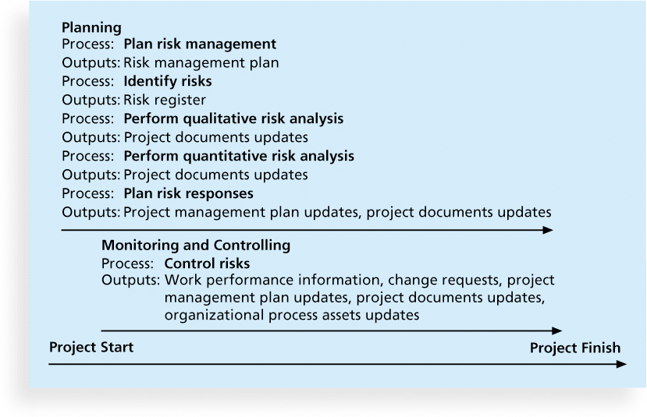
Project Risk Management Summary
Lecture 6
Planning
Process: Plan risk management
Outputs: Risk, management plan
Process: Identify risks
Outputs: Risk register
Process: Perform qualitative risk analysis
Outputs: Project documents updates
Process: Perform quantitative risk analysis
Outputs: Project documents updates
Process: Plan risk responses
Outputs: Project management plan updates, project documents updates
project documents updates
Monitoring and Controlling
Process: Control risks
Outputs: Work performance information, change requests, projects managements plan updates, project documents updates, organizational process assets updates.

Slide 9
Top Ten Risk Item Tracking
Lecture 6
Top Ten Risk Item Tracking is a qualitative risk analysis tool that helps to identify risks and maintain an awareness of risks throughout the life of a project
Establish a periodic review of the top ten project risk items
List the current ranking, previous ranking, number of times the risk appears on the list over a period of time, and a summary of progress made in resolving the risk item

Slide 10
Example of Top Ten Risk Item Tracking
Lecture 6
Risk Event | Rank this month | Rank last month | Number of months in top ten | Risk resolution progress
Inadequate planning | 1 | 2 | 4 | Working on revising the entire project management plan
Poor definition | 2 | 3 | 3 | Holding meetings with project customer and sponsor to clarify scope
Absence of leadership | 3 | 1 | 2 | After previous project manager quit, assigned a new one to lead the project
Poor cost estimates | 4 | 4 | 3 | Revising cost estimates
Poor time estimates | 5 | 5 | 3 | Revising schedule estimates
العمل على مراجعة خطة إدارة المشروع بالكامل
التخطيط غير كافي
عقد اجتماعات مع العميل والراعي للمشروع لتوضيح المجال
تعريف ضعيف
غياب القيادة
بعد استقالة مدير المشروع السابق ، قم بتعيين مدير جديد لقيادة المشروع
تقديرات تكلفة سيئة
مراجعة تقديرات التكلفة
تقديراتوقت ضعيفة
مراجعة تقديرات الجدول الزمني

Slide 11
Planning Risk Responses
Lecture 6
After identifying and quantifying risks, you must decide how to respond to them
Four main response strategies for negative risks:
  Risk avoidance
  Risk acceptance
  Risk transference
  Risk mitigation

Slide 12
General Risk Mitigation Strategies for Technical, Cost, and Schedule Risks
Lecture 6
Technical Risks | Cost Risks | Schedule Risks
Emphasize team support and avoid stand-alone project structure | Increase the frequency of project monitoring | Increase the frequency of project monitoring
Increase project manager authority | Use WBS and CPM | Use WBS and CPM
Improve problem handing and communication | Improve communication, project goals understanding, and team support | Select the most experienced project manager
Increase the frequency of project monitoring | Increase project manager authority | Empty cell
Use WBS and CPM | Empty cell | Empty cell

Slide 13
Response Strategies for Positive Risks
Lecture 6
Risk exploitation
Risk sharing
Risk enhancement
Risk acceptance

Slide 14
Residual and Secondary Risks
Lecture 6
It’s also important to identify residual and secondary risks
Residual risks are risks that remain after all of the response strategies have been implemented
Secondary risks are a direct result of implementing a risk response

Slide 15
Lecture 6
Plan Risk Responses
The risk register is designed to be written to a level of detail that corresponds with the priority ranking of the risk and its associated response. Frequently, the lower level, low priority risks are placed on a’ watch list' for periodic review and monitoring.

Slide 16
Lecture 6
Plan Risk Responses
Contingency Plans
Contingency plans are developed for a specific risk. Contingency plans are generally developed when you have accepted a risk and now have developed a plan 'B' or plan 'C' as a contingent response. These plans are executed only under predefined conditions, and when there is sufficient warning to implement the plan.
Fallback plans are implemented when a contingent response is not effective.

Slide 17
Lecture 6
Plan Risk Responses
Residual and Secondary Risks
Residual risks are identified as risks that remain after a risk response strategy was implemented. It is possible that residual risks can be identified in the risk planning process, in which case they are subject to contingency and fallback planning.

Slide 18
Lecture 6
Plan Risk Responses
if you know that certain key personnel on the project might leave before the project is over, your risk response strategy many include required cross-training of other lower level resources.
    There is a potential residual risk that even with cross-training, the lower level resources might not perform to the level expected. In this event, you may have identified a contingent or fallback plan to address the residual risk.

Slide 19

Lecture 6
Plan Risk Responses
A secondary risk is a risk that results from implementing a risk response strategy. Secondary risks can be identified in the planning process, or they might occur as a result of discovery.

Slide 20
Lecture 6
Plan Risk Responses
For example, you implemented a risk avoidance strategy by replacing an unreliable vendor with a highly dependable vendor on a project. However, unknown to you at the time, the dependable vendor was in negotiations to be bought out by a larger company. The secondary risk with the dependable vendor may include elements such as unexpected price changes, changes in resource availability, or a complete change in the business model.

Slide 21
Lecture 6
Potential risk areas

Slide 22
Results of Good Project Risk Management
Lecture 6
Unlike crisis management, good project risk management often goes unnoticed
Well-run projects appear to be almost effortless, but a lot of work goes into running a project well
Project managers should strive to make their jobs look easy to reflect the results of well-run projects

Slide 23
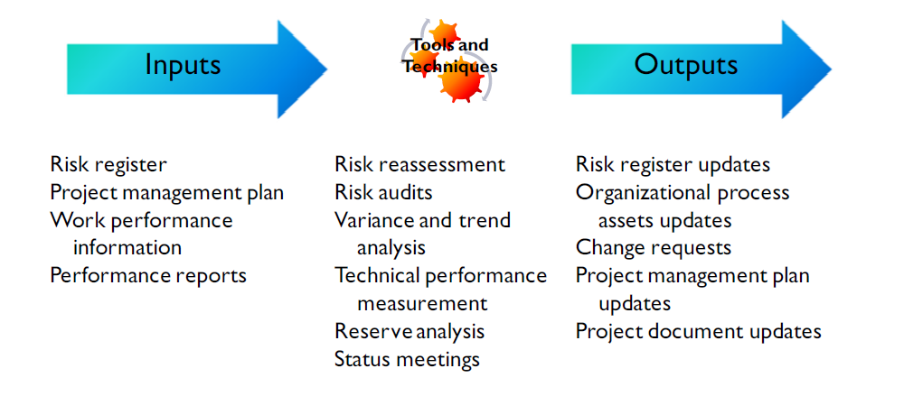
Lecture 6
Monitor and Control Risks
Goal: Change requests,
updates

Slide 24
Lecture 6
Monitor and Control Risks
As in other monitor and controlling activities, it is assumed you have performed all the necessary elements to identify and quantify project risk, and have a created the necessary strategies to respond to risk on the project.

Slide 25
Lecture 6
Monitor and Control Risks
Part of the process of monitoring and controlling risks is to perform risk reassessments of the project on a regular basis:
Have the risk elements changed?
Have lower level, low priority risks become high priority risks?
Have certain risks been addressed, and be considered closed on the risk log?
Do contingency or management reserves need to be adjusted?

Slide 26
Lecture 6
Risk Audits and Reviews
In most large organizations, there are individuals who specialize in risk auditing and conducting risk reviews.
You would do well to learn as much as you can from these individuals about project risk - it will help you do a better job of identifying risks and planning risk responses.
Usually, risk audits are periodically scheduled throughout the project.
They are typically conducted by people outside of your immediate organization.
Why do you think that is so?

Slide 27
Lecture 6
Risk Audits and Reviews
There are several reasons why auditors are not part of the project team:
Provides for an objective review of risks
Provides a fresh pair of eyes to review risk elements from a different perspective
Can help identify risks not considered by the team

Slide 28
Lecture 6
Risk reassessment or risk reviews
Periodic and scheduled
Should occur to determine if any risk priorities or ratings have Changed
Risk audits
Carried out throughout project life
Typically performed by experts outside project team

Slide 29
Lecture 6
Risk reassessment or risk reviews
Additional Risk Tools
Variance and Trend analysis compares planned results to the actual results. Variance tools such as earned value analysis can be used for monitoring overall project performance. As a result, potential forecasts of deviation at the project’s completion from cost and schedule targets are possible.
Technical Performance Measurement compares technical accomplishments during project execution to
the project management plan schedule of technical achievement. Quantifiable measurements are taken
and compared against actual results.
Reserve Analysis compares the amount of contingency reserves remaining to the amount of risk
remaining at any time in the project.

Slide 30
Lecture 6
Risk reassessment or risk reviews
Notes
reserve analysis and the funds set aside for contingencies apply only to the specific risks on the project for which they were set aside

Slide 31
Lecture 6
Risk reassessment or risk reviews
Workarounds
Workarounds are usually employed when no contingency plan exists, and are generally executed ‘on the-fly' to address some unplanned event.
The result of implementing a workaround can be the identification of an undiscovered risk for which the contingency and fallback planning can now be addressed.

Slide 32
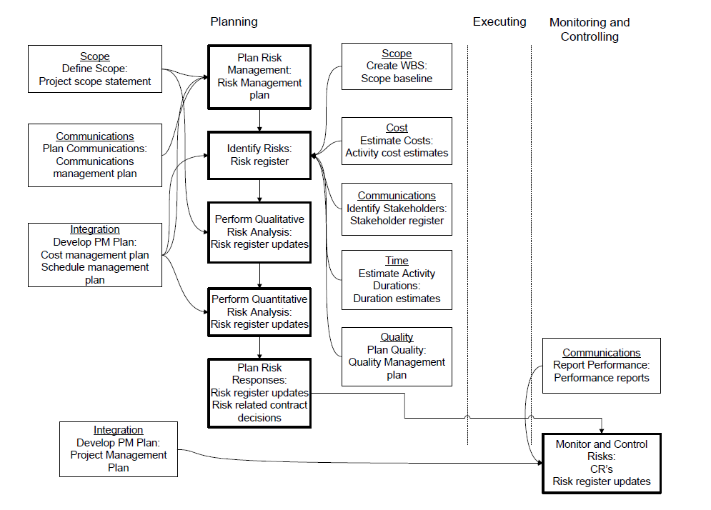
Lecture 6
Project Risk Management: Key Process Interactions

Slide 33
Lecture 6
In Summary
The benefit of using a risk breakdown structure
Information gathering techniques: brainstorming, Delphi technique, interviewing, root cause identification, and SWOT analysis
Importance and components of the risk register
Deciding on the best risk response strategy: avoid, transfer, mitigate, exploit, share, enhance, or accept risk events

