Slide 1


Attitudes and Job Satisfaction
Organizational Behavior
and Projects
Lecture 4
PMG421
Project Quality Assurance
Prepared by
Lec. Denna ibarheem
www.midocean.ae

Slide 2


Table of Contents
3- Developing Assurance Activities | 2- Principles of Quality Assurance | 1- Quality assurance (QA)
6- Benefits of Quality Assurance Plan | 5- The Quality Assurance Plan (QAP) and PDCA | 4- Quality Assurance Plan (QAP)
9- Types of quality metrics | 8- Why use quality metrics | 7- Metrics
12- Summary | 11- What is quality audit? | 10- Quality Audits
.
www.midocean.ae

Slide 3
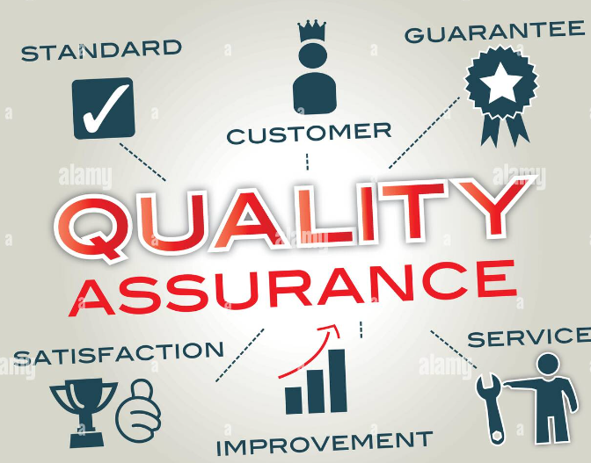
1- Quality assurance (QA) is a way of preventing mistakes and defects in manufactured products and avoiding problems when delivering products or services to customers; which ISO 9000 defines as "part of quality management focused on providing confidence that quality requirements will be fulfilled". This defect prevention in quality assurance differs subtly from defect detection and rejection in quality control and has been referred to as a shift left since it focuses on quality earlier in the process.
- Quality assurance = defect prevention. (Processes)
- Quality control = defect detection (outcomes)
www.midocean.ae

Slide 4
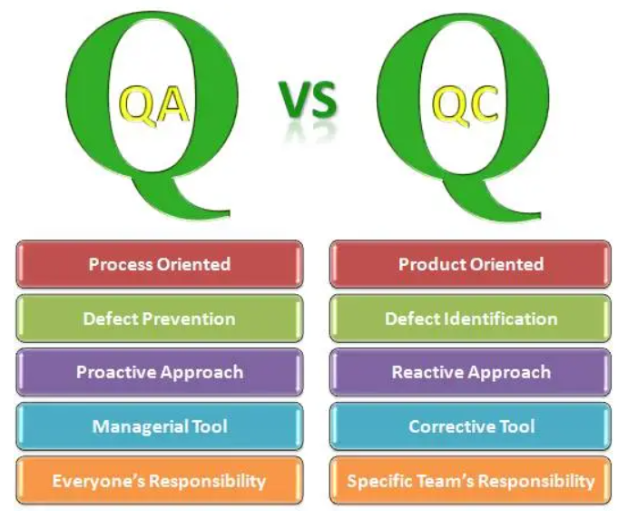
The terms "quality assurance" and "quality control" are often used interchangeably to refer to ways of ensuring the quality of a service or product. For instance, the term "assurance" is often used as follows: Implementation of inspection and structured testing as a measure of quality assurance . The term "control", however, is used to describe the fifth phase of the Define, Measure, Analyze, Improve, Control (DMAIC) model. DMAIC is a data-driven quality strategy used to improve processes.
www.midocean.ae

Slide 5
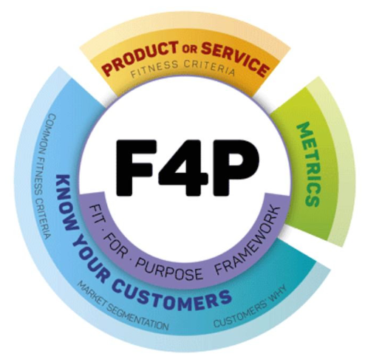

2- Principles of Quality Assurance,
Quality assurance includes two principles: "Fit for purpose" (the product should be suitable for the intended purpose); and "right first time" (mistakes should be eliminated). QA includes management of the quality of raw materials, assemblies, products and components, services related to production, and management, production and inspection processes.
www.midocean.ae

Slide 6
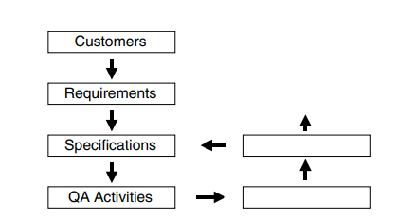
3- Developing Assurance Activities
Developing assurance activities involves more than delegation.
This process includes the following steps:
1. Select the relevant standard or specification.
2. Using operational definitions, define an activity that will collect data and compare results to the plan, Develop and apply metrics.
3. Define and provide resources.
4. Assign responsibility to a specific entity.
5. Assemble activities into a quality assurance plan.
www.midocean.ae

Slide 7
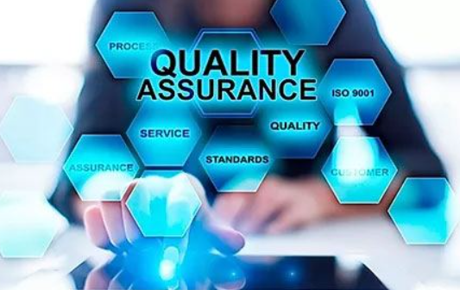
.
ELEMENTS OF A Quality Assurance,
Know the Underperforming Areas.
Keep Track of Processes and Progress.
Achieve Consistency and Accuracy in Output.
Dedicated Training of Employees.
Influence Organizational Culture.
Provide Invariable Customer Service.
Enhance Customer Loyalty.
www.midocean.ae

Slide 8

1. Know the Underperforming Areas
A QA system lets you regularly assess the roles of your employees based on the performance metrics that are needed to achieve the quality goals. Thus, you can easily identify where improvements are required and provide feedback or training to the concerned employees.
www.midocean.ae

Slide 9

2. Keep Track of Processes and Progress
A part of the QA system calls for continuous monitoring and assessment of your processes. You need to determine certain standard outcomes of every process meeting which are essential to assuring the quality of the end product.
Being able to quickly identify any process’s progress as well as gaps can help you act quickly to ensure consistency in your process.
www.midocean.ae

Slide 10
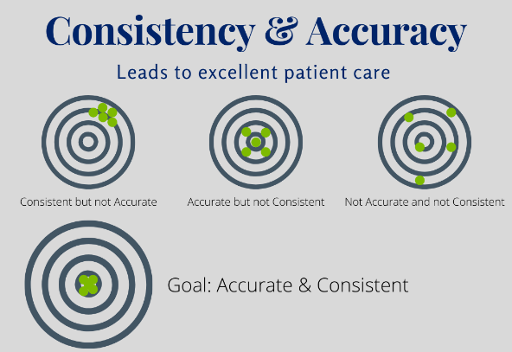
3. Achieve Consistency and Accuracy in Output,
Most customer surveys have shown that they rely on companies or brands that provide consistent products or services. A QA system helps you to deliver output guaranteeing accuracy and consistency in their purpose. One of the aspects of the QA system is to measure the customers’ satisfaction by recording their after-sales responses, feedback or complaints.
www.midocean.ae

Slide 11

4. Dedicated Training of Employees
To make your QA program, you need to impart training to your employees of every department of your business. Every new employee should also be trained during their initial weeks. All of them should be instructed and provided guidelines on how to achieve the defined quality goals of their business, prevent errors, or how to eliminate risks in their assigned processes.
www.midocean.ae

Slide 12

5. Influence Organizational Culture
A strong uniform culture across the organization is necessary for the establishment of a QA program. If commitment to deliver quality product/services to customers does not come from the top management, the employees are not going to realize their responsibilities and put efforts towards maintaining the quality.
It is hence crucial for your company to put forth a quality-oriented policy which employees are bound to accept, understand, and follow.
www.midocean.ae

Slide 13

6. Provide Invariable Customer Service
With a QA system established, you are more able to respond to your customers quickly and satisfactorily. Increased responsiveness to customers’ queries or grievances is another crucial objective of the system. You need to train your customer service team to reduce the waiting time for customers as much as possible and address their issues.
www.midocean.ae

Slide 14

7. Enhance Customer Loyalty
The delivery of better-quality products/services and faster customer services, both are contributing factors in developing customer loyalty for your business. You can experience a sharp increase in your customer retention rate following the implementation of a strong QA program. This is mainly because satisfied and contented customers are willing to come back again for their future needs.
www.midocean.ae

Slide 15
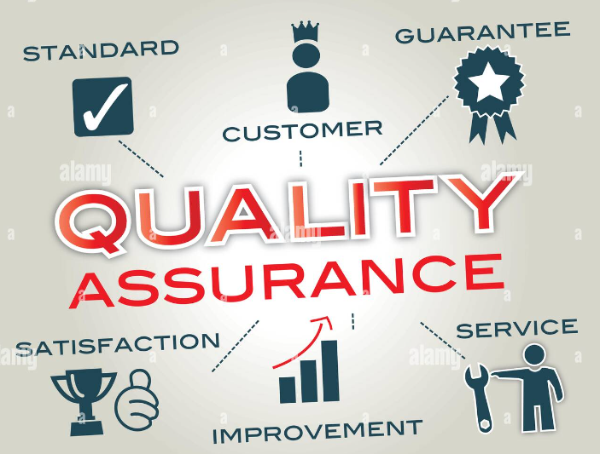
4- QUALITY ASSURANCE PLAN
A Quality Assurance Plan (QAP) is a document created by the project team, which if followed, will ensure the finished product meets all criteria making it the best possible quality product. The product should not only meet all customer requirements but also meet the business objectives and targets.
www.midocean.ae

Slide 16
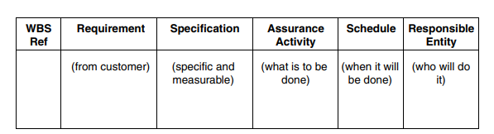
A quality assurance plan should include at least the following elements:
◆ The work breakdown structure reference number for the task concerned.
◆ A statement of the requirement (usually from the customer).
◆ A statement of the specification that is specific and measurable.
◆ A description of the assurance activity (what is to be done).
◆ Schedule information (when it is to be done).
◆ Designation of the responsible entity (who will do it).
www.midocean.ae

Slide 17
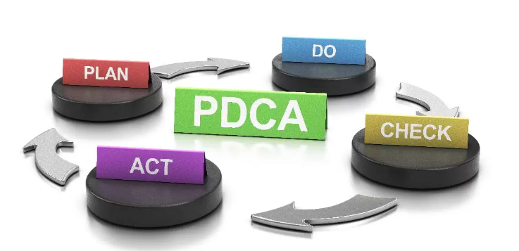
5- The Quality Assurance Plan (QAP) and PDCA
The Quality Assurance Plan (QAP), commonly using PDCA as its basis, provides the essential guidance, direction.
The purpose of QA within the context of a QAP is to provide executive and senior management with appropriate insight into the processes and products being used and developed.
www.midocean.ae

Slide 18
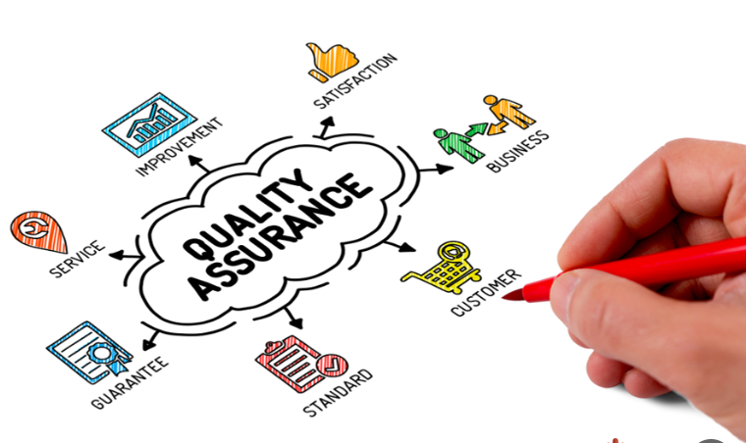
6- Benefits of Quality Assurance Plan:
Improve program delivery.
Improve client satisfaction.
Lower program costs.
Encourage communication.
Define the quality standard.
Impress funders.
www.midocean.ae

Slide 19
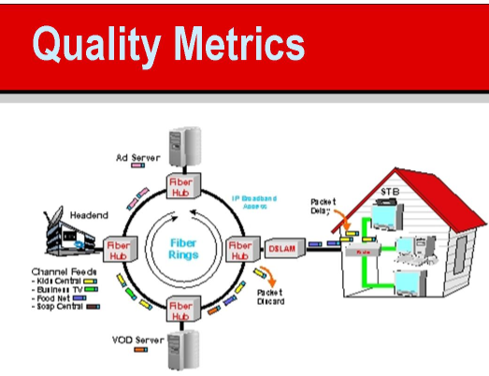
7- Metrics
What are quality metrics?
Quality metrics are measurements that companies can use to evaluate a product, service or processes value or performance. These can be numerical values often on a sliding scale that can help professionals determine if their products or processes are successful, what they can improve and how people respond and use tools or products.
www.midocean.ae

Slide 20

8- Why we use quality metrics?
There are several advantages for using quality metrics:
Determining process effectiveness: Quality metrics like tracking delivery times or task times can help identify if current processes work effectively.
Identifying improvements: Quality metrics can show where you can improve the quality and performance of products. If you have a high defect rate or low customer satisfaction rate, you can learn where you might improve.
www.midocean.ae

Slide 21
Adjusting strategy: In areas like manufacturing, measuring quality can help you adjust your strategy.
Reducing costs: . By measuring quality metrics, you can identify issues early to produce higher quality goods, services and processes which can reduce long-term costs.
www.midocean.ae

Slide 22

9- Types of quality metrics,
1. Customer satisfaction, Asking customers to rate their satisfaction can be a direct way to measure the quality of products and services for many companies.
2. Defect rate, Defect rate is the percentage of defects in proportion to the number of items produced or interactions.
3. Time between defects, This can help identify the frequency in which errors occur.
www.midocean.ae

Slide 23
4. Cost of quality.
5. Delivery time, Delivery time can include the length it takes to deliver service or products or the number of times you deliver something as scheduled
www.midocean.ae

Slide 24
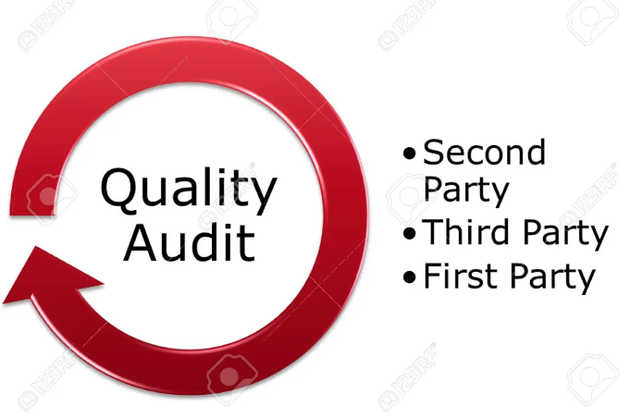
10- Quality Audits
www.midocean.ae

Slide 25
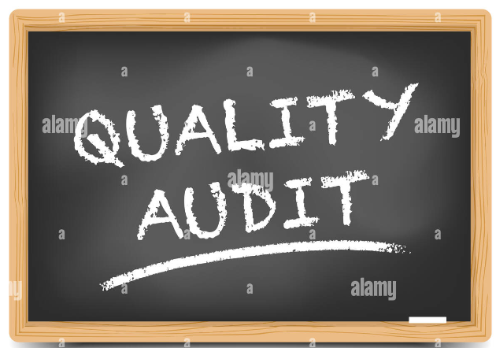
11- What is quality audit,
The primary mechanism for determining the effectiveness of quality assurance activities is the quality audit. The audit may use results obtained from quality control to determine if quality assurance activities are having the desired result.
www.midocean.ae

Slide 26
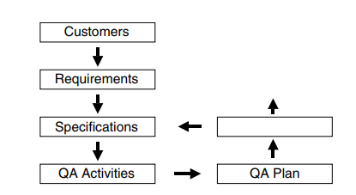
Quality assurance audits may be conducted by internal or external elements.
A dedicated, honest project team may have no difficulty conducting an internal audit, project team members may be just too close to things to get an accurate picture.
External audits often provide more objective results and are often more respected by third parties, such as higher level management.
This completes the fifth step in the quality journey.
www.midocean.ae

Slide 27
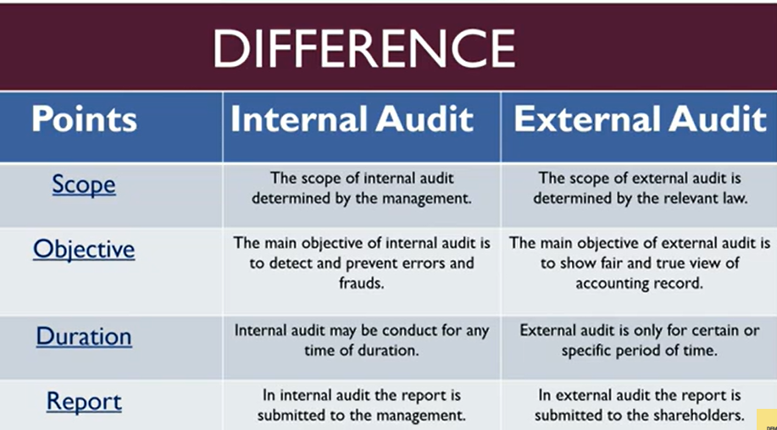
www.midocean.ae

Slide 28

www.midocean.ae

Slide 29

Summary,
◆ Quality assurance is the application of planned, systematic quality activities to ensure that the project will employ all processes needed to meet requirements identified during quality planning.
◆ Quality assurance addresses the program; it is the combined set of activities that the project team will perform to meet project objectives.
◆ Quality control addresses the outcomes; it is about monitoring performance and doing something about the results.
◆ Defining quality assurance activities is the fourth step in a seven-step quality journey that provides a general framework for quality management.
www.midocean.ae

Slide 30
◆ Quality assurance activities are based on specifications and operational definitions.
◆ Metrics are the means of measurement that link requirements, specifications, assurance activities, and the metrics themselves.
◆ The quality assurance plan lists all assurance activities in one place to assist in managing project quality.
◆ Preparing a quality assurance plan is the fifth step in the quality journey.
◆ Quality audits are structured reviews of the quality system. They may be scheduled or random and conducted by internal or external elements.
www.midocean.ae

Slide 31

www.midocean.ae

Slide 32



Thank You

