Slide 1

CYB 510 OPERATING SYSTEMS
Prepared by Prof. Dr. Lamiaa Fattouh
Lecture 5
CYB 510
Process Synchronization

Slide 2
Outline
Background
The Critical-Section Problem
Peterson’s Solution
Hardware Support for Synchronization
Mutex Locks
Semaphores

Slide 3
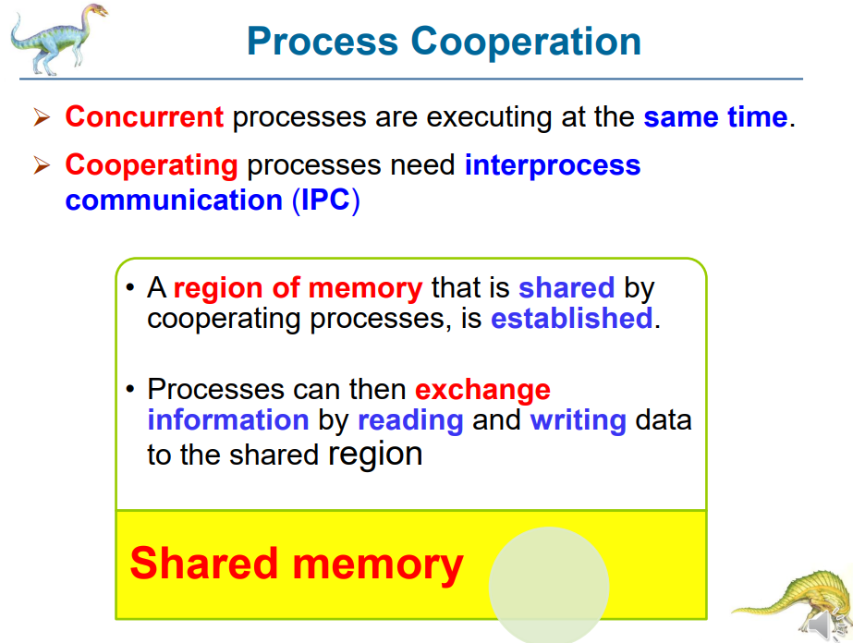

Slide 4
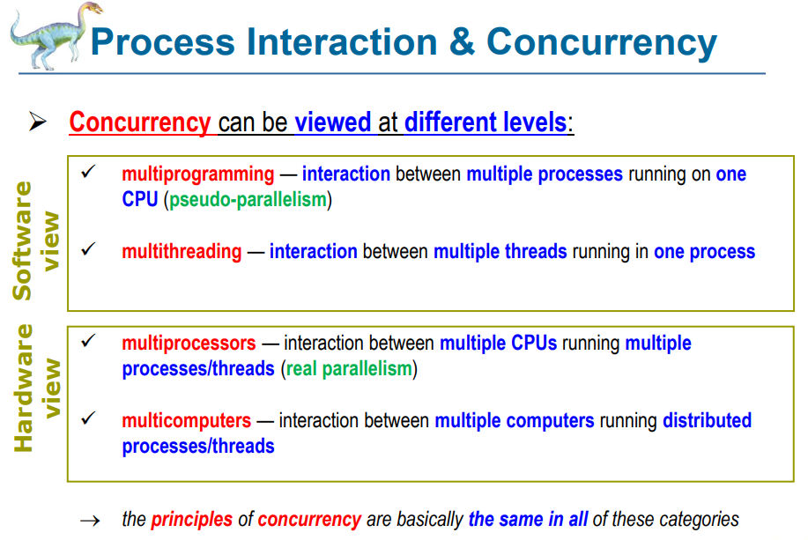

Slide 5
Remember : producer- consumer
Concurrent access to shared data may result in data inconsistency
Maintaining data consistency requires mechanisms to ensure the orderly execution of cooperating processes. Producer-Consumer is an example of cooperating processes where data consistency is an important issue:
  Compiler produces assembly code that is consumed by the assembler
  Web-server provides HTML files that is read by the internet browser

Slide 6
Remember : producer- consumer
Suppose that we wanted to provide a solution to the consumer-producer problem that fills all the buffers. We can do so by having an integer count that keeps track of the number of full buffers. Initially, count is set to 0. It is incremented by the producer after it produces a new buffer and is decremented by the consumer after it consumes a buffer.
Producer
Consumer
Buffer

Slide 7
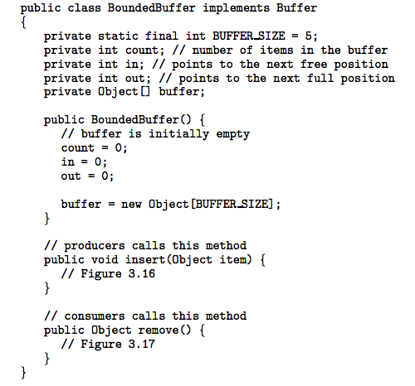
Remember : producer- consumer
Full
Count = size
R
A
Buffer
B
Producer
Consumer
w
Synchronization
Empty
Count = 0

Slide 8
Producer
while (true) {
/* produce an item and put in nextProduced */
while (count == BUFFER_SIZE)
; // do nothing
buffer [in] = nextProduced;
in = (in + 1) % BUFFER_SIZE;
count++;
}

Slide 9
Consumer
while (true) {
while (count == 0)
; // do nothing
nextConsumed = buffer[out];
out = (out + 1) % BUFFER_SIZE;
count--;
/* consume the item in nextConsumed
}

Slide 10
Bounded-Buffer – Producer
while (true) {
/* produce an item and put in nextProduced */
while (count == BUFFER_SIZE)
; // do nothing
buffer [in] = nextProduced;
in = (in + 1) % BUFFER_SIZE;
count++; //Do further
}
Shared
Bounded-Buffer – Consumer
while (true) {
while (count == 0)
; // do nothing
nextConsumed = buffer[out];
out = (out + 1) % BUFFER_SIZE;
count--;
/* Do further*/
}
Code correct? Yes but Only if no concurrency. What can happen
if P and C run concurrently or multiple P or C run concurrently?

Slide 11
Race Condition
count++ could be implemented as
register1 = count
register1 = register1 + 1
count = register1
count-- could be implemented as
register2 = count
register2 = register2 - 1
count = register2

Slide 12
Race Condition
Consider this execution interleaving with “count = 5” initially:
  S0: producer execute register1 = count {register1 = 5}
  S1: producer execute register1 = register1 + 1 {register1 = 6}
  S2: consumer execute register2 = count {register2 = 5}
  S3: consumer execute register2 = register2 - 1 {register2 = 4}
  S4: producer execute count = register1 {count = 6 }
  S5: consumer execute count = register2 {count = 4}

Slide 13
Race Condition
Race Condition is a situation that occurs when two or more concurrently processes are access (reading or writing) some shared data and the final results (outcome of the final result) depends on who runs precisely when (order of scheduling) . It leads to data inconsistency and should be avoided by guaranteeing that the communicating process are synchronized and coordinating in some way.

Slide 14
Critical Section
Let’s study the race condition situation more deeply to guard against it because Sharing for variable, files, … is needed everywhere.
Avoiding is possible if we guard the shared region (critical section (CS).
Each process has a segment of code, called a critical section, in which the process may be changing common variables, updating a table, writing a file, and so on.

Slide 15
Critical Section
CS similar problem: “Design a protocol for a shared room in an apartment where no more than one person can be inside the room at any time”? Shared room is the CS which needs permission to use it alone and when you finished just give others the chance to use it. Mutual exclusive Solution? You inside, others outside. Buy LOCK or Don’t Disturb sign and use the shared room without race condition.

Slide 16
Critical-Section Problem
The important feature of the system is that, when one process is executing in its critical section, no other process is to be allowed to execute in its critical section.
That is, no two processes are executing in their critical sections at the same time.

Slide 17
Critical-Section Problem
Critical section problem: is to design a protocol that the processes can use to cooperate. Each process must request permission to enter its critical section.
The section of code implementing this request is the entry section. The critical section may be followed by an exit section.
The remaining code is the remainder section.

Slide 18
Critical-Section Problem
do {
entry section
critical section
exit section
remainder section
}
while (TRUE);

Slide 19
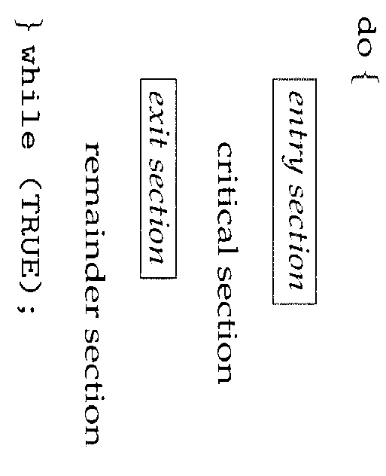
Critical Section
buf [in] = nextP;//produce item
in = (in + 1) % BUF_SIZE;
nextC = buf[out];//consume item
out = (out + 1) % BUF_SIZE
Count++
Count--
readLine()….
Println()….

Slide 20
Solution to Critical-Section Problem
A solution to the critical-section problem must satisfy the following three requirements:
1. Mutual Exclusion - If process P_{i} is executing in its critical section, then no other processes can be executing in their critical sections
2. Progress - If no process is executing in its critical section and there exist some processes that wish to enter their critical section, then the selection of the processes that will enter the critical section next cannot be postponed indefinitely
Bounded Waiting - A bound must exist on the number of times that other processes are allowed to enter their critical sections after a process has made a request to enter its critical section and before that request is granted
Assume that each process executes at a nonzero speed
No assumption concerning relative speed of the N processes

Slide 21
Test Solution to Critical-Section Problem
If one process is in critical section test the second process if the second process enter CS then Mutual Exclusion is not valid
If the two processes need to enter CS in the same time, if the two process
a) enter CS then Mutual Exclusion is not valid
b) Looping in the entry section ( progress is not valid)

Slide 22
Test Solution to Critical-Section Problem
If one process is in the remainder section and the second process need to enter its CS if it must wait for the first process the condition of progress is not valid
If the two process need to enter critical section if the first enter and leave the second must has the chance to enter the CS if not the bounded waiting is not valid

Slide 23
Initial Attempts to Solve Problem
Only 2 processes, P₀ and P₁
General structure of process P_{i} (other process P_{j})
do {
entry section
critical section
exit section
remainder section
} while (1);
Processes may share some common variables to synchronize their actions.

Slide 24
Algorithm 1
Process P_{J}
do {
while (turn != j) ;
critical section
turn = i;
remainder section
} while (1);
Shared variables:
  int turn;
  initially turn = 0
  turn = i ⇒ P_{i} can enter its critical section
  Process P_{i}
do {
while (turn != i) ;
critical section
turn = j;
remainder section
} while (1);
Satisfies mutual exclusion, but not progress

Slide 25
Test 1
Processor run one instruction from P1 and one instruction from P2. Initial turn = 1
1- P1→enter Critical section CS1
2- P2 →LOOP
3- P1 → exist CS1 and turn = 2
4- P2 can enter CS2
Mutual execution is valid
If P1 in remaining section and P2 finish CS2 and
set turn = 1
if P2 need to enter CS2 it can not enter
Therefore, Progress is not valid

Slide 26
Algorithm 2
Process Pj
do {
flag[j] := true;
while (flag[i]) ; critical section
flag [j] = false;
remainder section
} while (1);
Shared variables
  boolean flag[2];
  initially flag [0] = flag [1] = false.
  flag [i] = true ⇒ P_{i}
  ready to enter its critical section
Process P_{i}
do {
flag[i] := true;
while (flag[j]) ; critical section
flag [i] = false;
remainder section
} while (1);
Satisfies mutual exclusion, but not progress requirement.

Slide 27
Initial flag[1] = false and flag[2]=false
T1: flag[i] := true;
T2: flag[j] := true;
T3: while (flag[j]) ;
T4: while (flag[i]) ;
T5: P1 → LOOP
T6: P2 → LOOP
Progress is not valid

Slide 28
Peterson’s Solution
Two process solution
Assume that the LOAD and STORE instructions are atomic; that is, cannot be interrupted.
The two processes share two variables:
  int turn;
  Boolean flag[2]
The variable turn indicates whose turn it is to enter the critical section.
The flag array is used to indicate if a process is ready to enter the critical section. flag[i] = true implies that process P_{i} is ready!

Slide 29
Algorithm 3
Process i
do {
flag[i] = TRUE;
turn = j;
while ( flag[j] && turn == j);
CRITICAL SECTION
flag[i] = FALSE;
REMAINDER SECTION
} while (TRUE);
Process J
do {
flag[j] = TRUE;
turn = i;
while ( flag[i] && turn == i);
CRITICAL SECTION
flag[j] = FALSE;
REMAINDER SECTION
} while (TRUE);

Slide 30
Bakery Algorithm
Critical section for n processes
Before entering its critical section, process receives a number. Holder of the smallest number enters the critical section.
If processes P_{i} and P_{j} receive the same number, if i < j, then P_{i} is served first; else P_{j} is served first.
The numbering scheme always generates numbers in increasing order of enumeration; i.e., 1,2,3,3,3,3,4,5...

Slide 31
Bakery Algorithm
Notation <≡ lexicographical order (ticket #, process id #)
  (a,b) < (c,d) if a < c or if a = c and b < d
  max (a₀,…, a_{n-1}) is a number, k, such that k ≥ a_{i} for i = 0,
  …, n – 1
Shared data
boolean choosing[n];
int number[n];
Data structures are initialized to false and 0 respectively

Slide 32
Bakery Algorithm
do {
choosing[i] = true;
number[i] = max(number[0], number[1], …, number [n – 1])+1;
choosing[i] = false;
for (j = 0; j < n; j++) {
while (choosing[j]) ;
while ((number[j] != 0) && (number[j],j) < (number[i],i)) ;
}
critical section
number[i] = 0;
remainder section
} while (1);

Slide 33
Preemptive and Non-preemptive Kernel
OS itself consists of many modules (processes) that may run concurrently. What can happen to the shared data structures of the OS kernel? Say Process table, File table, memory allocation table.. etc?
There are 2 types of Kernel: preemptive and non-preemptive

Slide 34
Preemptive and Nonpreemptive Kernel
A non-preemptive kernel allows a process to run until it exits kernel mode, block, or voluntarily yields control of CPU.
  Because there is max one process in kernel mode, it is free from race conditions (situation to be controlled ) on kernel Data structure.
A preemptive kernel preempts a process while it is running in kernel mode
  Must be carefully designed to ensure that kernel shared data are free from race conditions especially on SMP architectures.
  More suitable for real time programming as it allows preemption
  May be more responsive (a process can’t run for long period)

Slide 35
Preemptive and Non-preemptive Kernel
Why, then, would anyone favor a preemptive kernel over a non-preemptive one?
A preemptive kernel is more suitable for real-time programming, as it will allow a real-time process to preempt a process currently running in the kernel.
Furthermore, a preemptive kernel may be more responsive, since there is less risk that a kernel-mode process will run for an arbitrarily long period before relinquishing the processor to waiting processes.

Slide 36
Synchronization Hardware
Many systems provide hardware support for critical section code
Uniprocessors – could disable interrupts
  Currently running code would execute without preemption
  Generally too inefficient on multiprocessor systems
    Operating systems using this not broadly scalable
Modern machines provide special atomic hardware instructions
    Atomic = non-interruptable
  Either test memory word and set value
  Or swap contents of two memory words

Slide 37
TestAndSet Instruction
Definition:
boolean TestAndSet (boolean *target)
{
boolean rv = *target;
*target = TRUE;
return rv:
}

Slide 38
Solution using TestAndSet
Shared boolean variable lock., initialized to false.
Solution:
do {
while ( TestAndSet (&lock ))
; /* do nothing
// critical section
lock = FALSE;
// remainder section
} while ( TRUE);

Slide 39
Swap Instruction
Definition:
void Swap (boolean *a, boolean *b)
{
boolean temp = *a;
*a = *b;
*b = temp:
}

Slide 40
Solution using Swap
Shared Boolean variable lock initialized to FALSE; Each process has a local Boolean variable key.
Solution:
do {
key = TRUE;
while ( key == TRUE)
Swap (&lock, &key );
// critical section
lock = FALSE;
// remainder section
} while ( TRUE);

Slide 41
Semaphore
Synchronization tool that does not require busy waiting
Semaphore S – integer variable
Two standard operations modify S: wait() and signal()
  Originally called P() and V()
Less complicated
Can only be accessed via two indivisible (atomic) operations
  wait (S) {
  while S <= 0
  ; // no-op
  S--;
  }
  signal (S) {
  S++;
  }

Slide 42
Semaphore as General Synchronization Tool
Counting semaphore – integer value can range over an unrestricted domain. Counting semaphores can be used to control access to a give resource consisting of a finite number of instances. The semaphore is initialized to the number of resources available. Each process that wishes to use a resource performs a wait() operation on the semaphore (thereby decrementing the count). When a process release a resource, it performs a signal() operation (incrementing the count). When the count for the semaphore goes to 0, all resources being used. After that, processes that wish to use a resource will block until the count becomes greater than 0.

Slide 43
Binary semaphore
Binary semaphore – integer value can range only between 0 and 1; can be simpler to implement
  Also known as mutex locks
Can implement a counting semaphore S as a binary semaphore
Provides mutual exclusion
  Semaphore S; // initialized to 1
  wait (S);
  Critical Section
  signal (S);

Slide 44
Deadlock and Starvation
Deadlock – two or more processes are waiting indefinitely for an event that can be caused by only one of the waiting processes
Let S and Q be two semaphores initialized to 1
P₀ P₁
wait (S); wait (Q);
wait (Q); wait (S);
. .
. .
. .
signal (S); signal (Q);
signal (Q); signal (S);
Another problem related to deadlocks is indefinite blocking, or starvation.
Starvation – indefinite blocking. A process may never be removed from the semaphore queue in which it is suspended. Indefinite blocking may occur if we add and remove processes from the list associated with a semaphore in LIFO (last-in, first-out) order.

Slide 45
Semaphore as a General Synchronization Tool
Execute B in P_{j} only after A executed in P_{i}
Use semaphore flag initialized to 0
Code:
P_{i} P_{j}
 
A wait(flag)
signal(flag) B

Slide 46
Classical Problems of Synchronization
Bounded-Buffer Problem
Readers and Writers Problem
Dining-Philosophers Problem

Slide 47
Bounded-Buffer Problem
N buffers, each can hold one item
Semaphore mutex provides mutual exclusion for accesses to the buffer pool and initialized to the value 1
Semaphore full initialized to the value 0
Semaphore empty initialized to the value N.
The empty and full semaphores count the number of empty and full buffers.

Slide 48
Bounded Buffer Problem (Cont.)
The structure of the producer process
do {
// produce an item
wait (empty);
wait (mutex);
// add the item to the buffer
signal (mutex);
signal (full);
} while (true);

Slide 49
Bounded Buffer Problem (Cont.)
The structure of the consumer process
do {
wait (full);
wait (mutex);
// remove an item from buffer
signal (mutex);
signal (empty);
// consume the removed item
} while (true);

Slide 50
Readers-Writers Problem
A data set is shared among a number of concurrent processes
  Readers – only read the data set; they do not perform any updates
  Writers – can both read and write.
Problem – allow multiple readers to read at the same time. Only one single writer can access the shared data at the same time.
No reader will be kept waiting unless a writer has already obtained permission to use the shared object. Writers may starve.
Shared Data
  Data set
  Semaphore wrt initialized to 1 and its functions as a mutual-exclusion semaphore for writers. it is also used by the first or last reader that enters or exists the critical section. It is not used by reader who enter or exit while other readers are in their critical sections.
  Integer readcount initialized to 0. Readcount keeps track of how many processes are currently reading the object.
  Semaphore mutex is used to ensure mutual exclusion when readcount is updated. Mutex is initialized to 1.

Slide 51
Readers-Writers Problem (Cont.)
The structure of a writer process
do {
wait (wrt) ;
// writing is performed
signal (wrt) ;
} while (true)

Slide 52
Readers-Writers Problem (Cont.)
The structure of a reader process
do {
wait (mutex) ;
readcount ++ ;
if (readercount == 1) wait (wrt) ;
signal (mutex)
// reading is performed
wait (mutex) ;
readcount - - ;
if readcount == 0) signal (wrt) ;
signal (mutex) ;
} while (true)
Note that,
if a writer is in the critical section and n readers are waiting, then one reader is queued on wrt, and n-1 readers are queued on mutex.
When a writer executes signal(wrt), we may resume the execution of either the waiting readers or a single waiting writer. The selection is made by the scheduler.

Slide 53
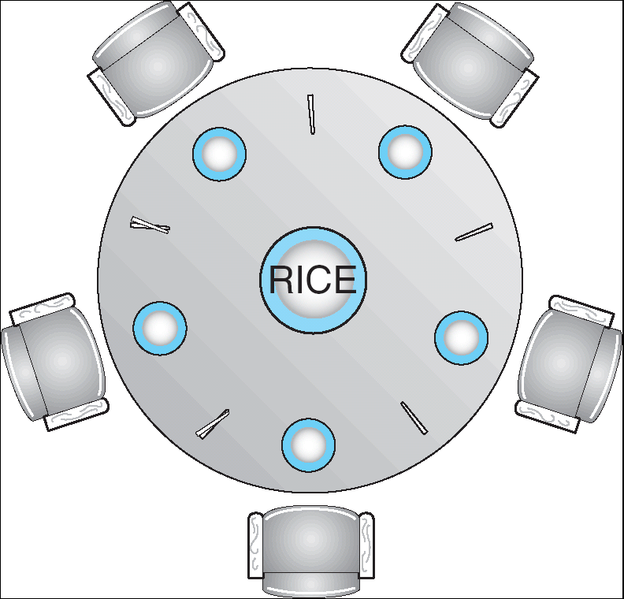
Dining-Philosophers Problem
Shared data
  Bowl of rice (data set)
  Semaphore chopstick [5] initialized to 1

Slide 54
Dining-Philosophers Problem (Cont.)
The structure of Philosopher i:
    Do {
    wait ( chopstick[i] );
    wait ( chopStick[ (i + 1) % 5] );
    // eat
    signal ( chopstick[i] );
    signal (chopstick[ (i + 1) % 5] );
    // think
    } while (true) ;

Slide 55
End of Chapter 6

