Slide 1





Global Project Management
Prepared by Dr. Mohamed Hamouda
Lecture 1

Slide 2
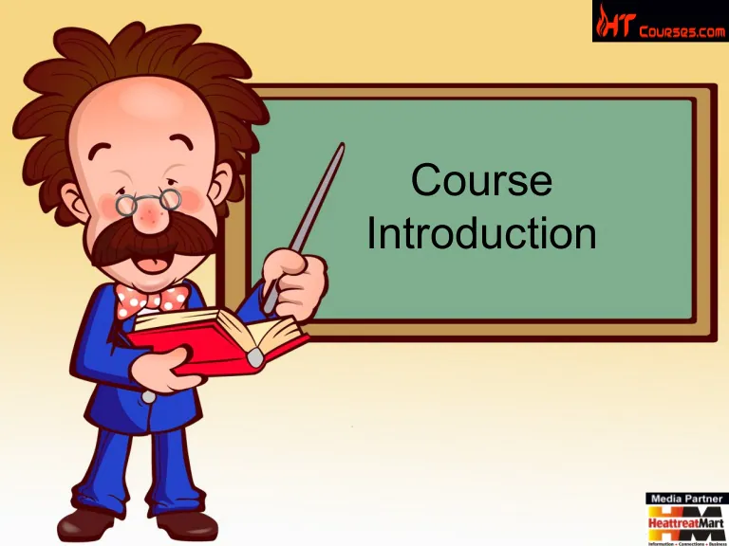
Introduction to the course

Slide 3
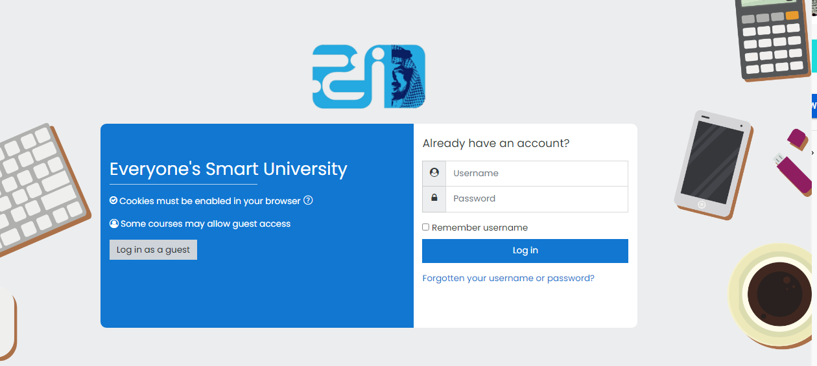
Learning Platform
https://moodle.esu.edu.sa/
IT MUST be checked frequently
Include All course material and information
  Lectures’ Videos and PDF/PPT files
  Course grades distribution
  Quizzes/Assignments/Exams Dates
  Regulations for accepted excuses
  Zoom weekly meeting link (same link is used for all meetings)

Slide 4

References
Resources:
Global Project Management
Communication, Collaboration and Management Across Borders
© Jean Binder 2007

Slide 5


Slide 6
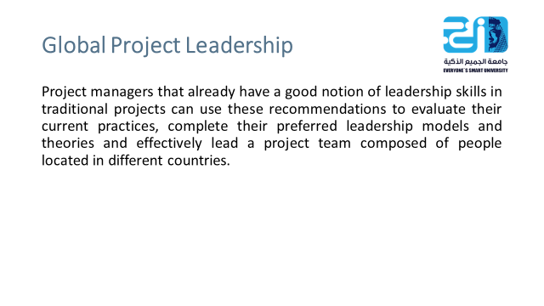

Slide 7
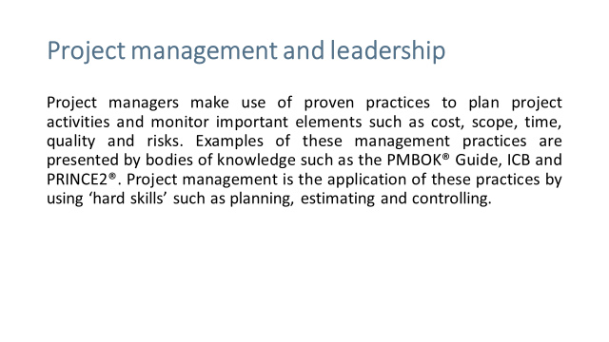

Slide 8
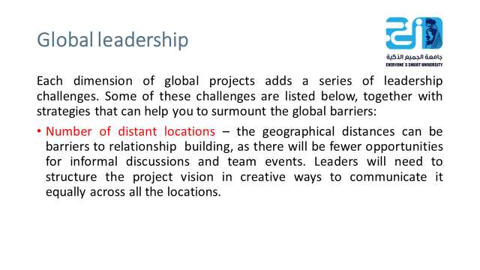

Slide 9
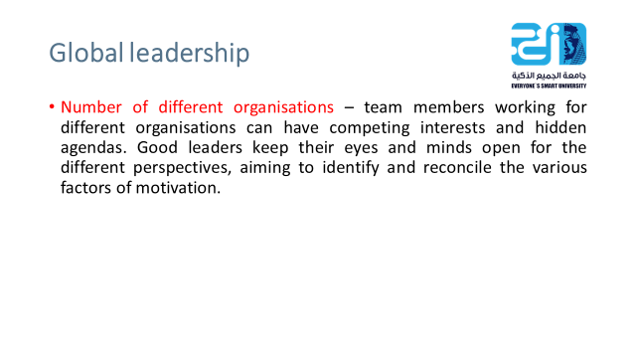

Slide 10


Slide 11
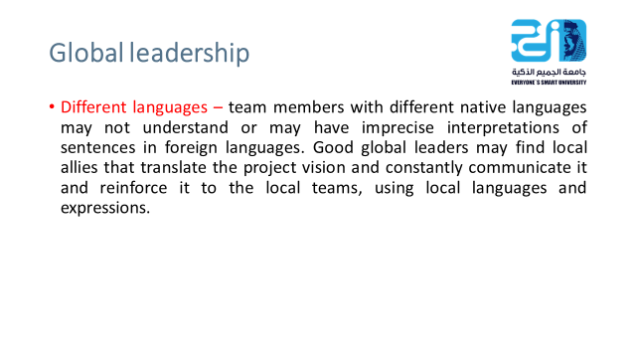

Slide 12
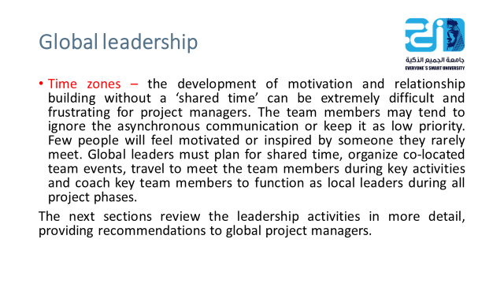

Slide 13
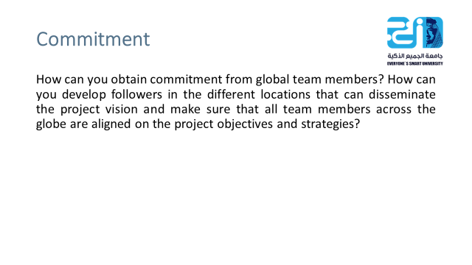

Slide 14
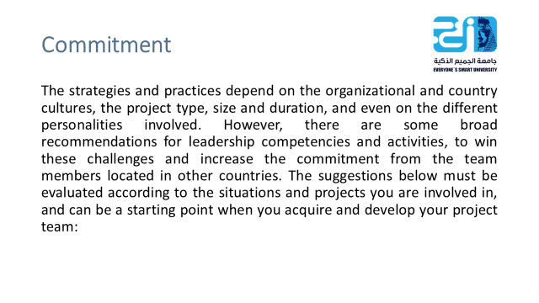

Slide 15
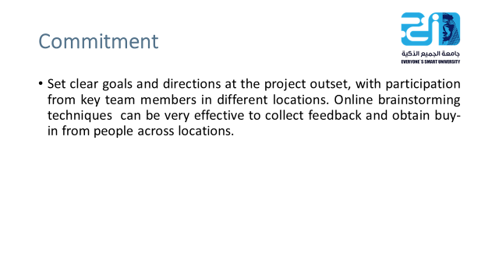

Slide 16
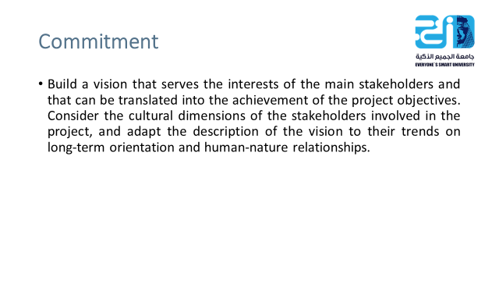

Slide 17
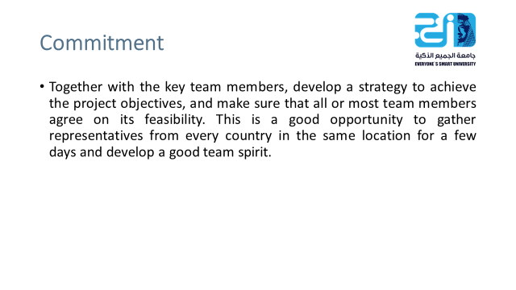

Slide 18
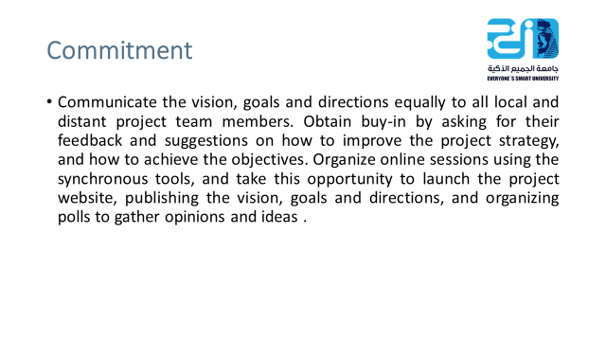

Slide 19
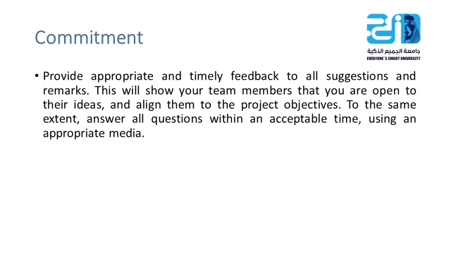

Slide 20
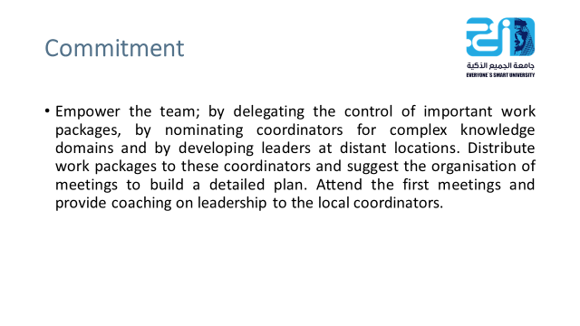

Slide 21
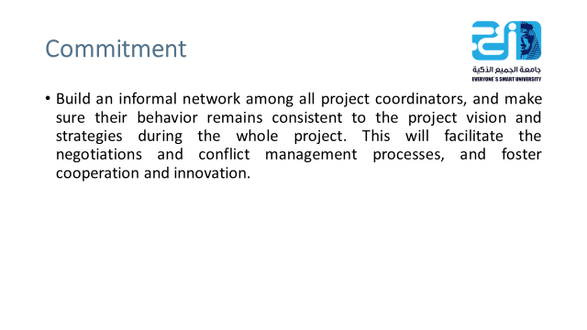

Slide 22
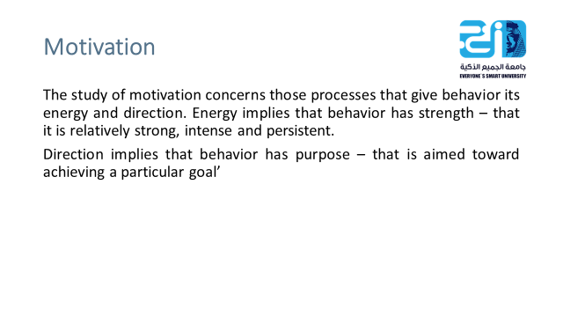

Slide 23
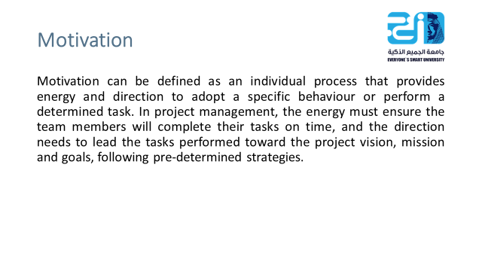

Slide 24
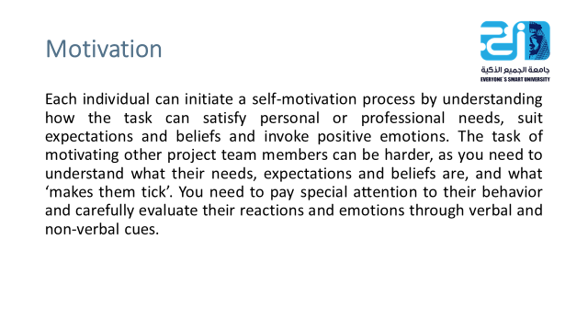

Slide 25
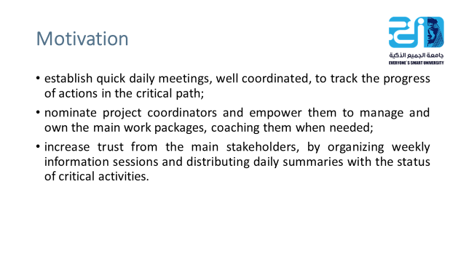

Slide 26
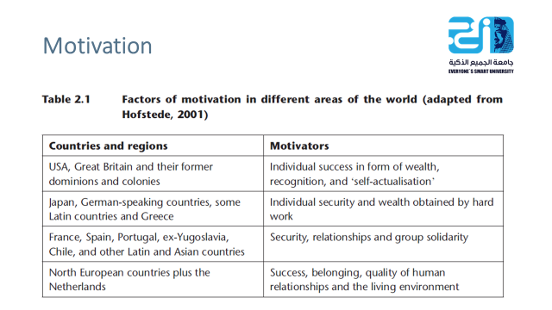

Slide 27
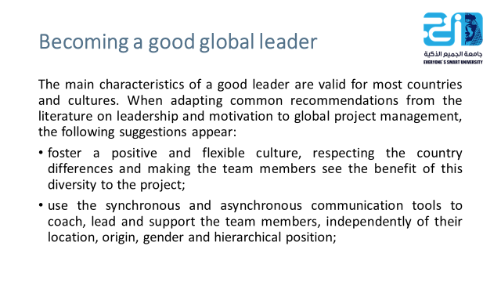

Slide 28
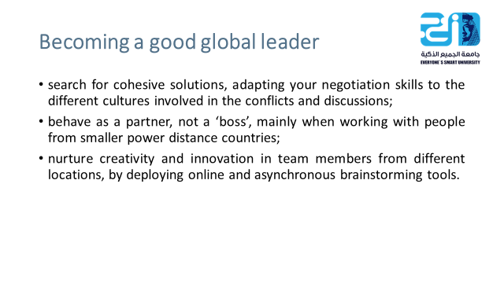

Slide 29


Slide 30


