Slide 1




AWS Cloud Security Foundations– AWS-CSF
Dr. Ibrahim Gomaa
Lecture 1 – Cloud Concepts and Pricing

Slide 2



Lecture
Cloud Concepts and pricing
1
Topics
Introduction to cloud computing
Advantages of cloud computing
Introduction to Amazon Web Services (AWS)
Fundamentals of pricing
Total Cost of Ownership
AWS Organizations
AWS Billing and Cost Management
Technical Support
Activities
AWS Pricing Calculator
Demo
Overview of the Billing Dashboard
Knowledge check
AWS Cloud Security Foundations– AWS-CSF
Lecture 1 – Cloud Concepts and Pricing
Dr. Ibrahim Gomaa

Slide 3
Lecture
Cloud Concepts and pricing
1
Introduction to Cloud Computing
AWS Cloud Security Foundations– AWS-CSF
Lecture 1 – Cloud Concepts and Pricing
Dr. Ibrahim Gomaa

Slide 4
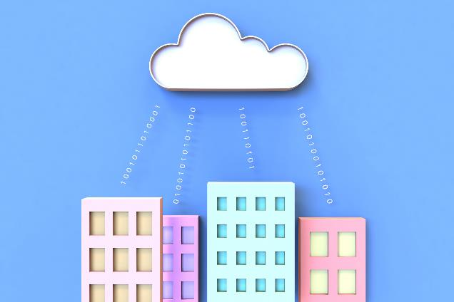
Lecture
Introduction to Cloud Computing
1
What is cloud computing?
Cloud computing is the on-demand delivery of compute power, database, storage, applications, and other IT resources via the internet with pay-as-you-go pricing.
AWS Cloud Security Foundations– AWS-CSF
Lecture 1 – Cloud Concepts and Pricing
Dr. Ibrahim Gomaa

Slide 5
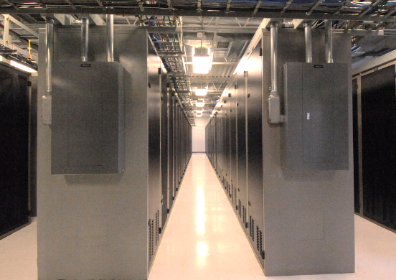

Lecture
Introduction to Cloud Computing
1
Infrastructure as software
Cloud computing enables you to stop thinking of your infrastructure as hardware, and instead think of (and use) it as software.
AWS Cloud Security Foundations– AWS-CSF
Lecture 1 – Cloud Concepts and Pricing
Dr. Ibrahim Gomaa

Slide 6
Lecture
Introduction to Cloud Computing
1
Traditional computing model
Infrastructure as hardware
Hardware solutions:
  Require space, staff, physical security, planning, capital expenditure
  Have a long hardware procurement cycle
  Require you to provision capacity by guessing theoretical maximum peaks
AWS Cloud Security Foundations– AWS-CSF
Lecture 1 – Cloud Concepts and Pricing
Dr. Ibrahim Gomaa

Slide 7

Lecture
Introduction to Cloud Computing
1
Cloud computing model
Infrastructure as software
Software solutions:
  Are flexible
  Can change more quickly, easily, and cost-effectively than hardware solutions
  Eliminate the undifferentiated heavy-lifting tasks
AWS Cloud Security Foundations– AWS-CSF
Lecture 1 – Cloud Concepts and Pricing
Dr. Ibrahim Gomaa

Slide 8

Lecture
Introduction to Cloud Computing
1
Cloud service models
IaaS
(infrastructure as a service)
PaaS
(platform as a service)
SaaS
(software as a service)
More control
over IT resources
Less control
over IT resources
AWS Cloud Security Foundations– AWS-CSF
Lecture 1 – Cloud Concepts and Pricing
Dr. Ibrahim Gomaa

Slide 9
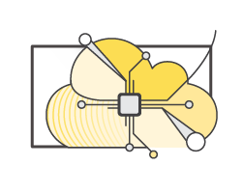
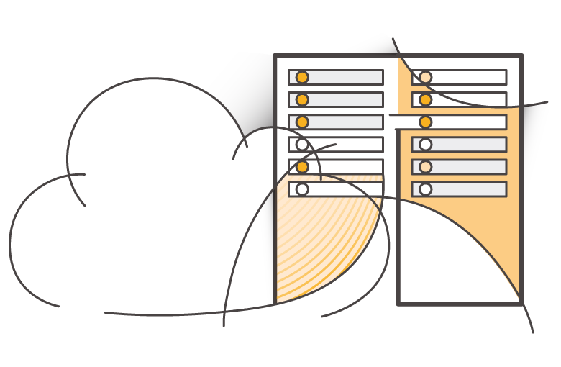
Lecture
Introduction to Cloud Computing
1
Cloud computing deployment models
On-premises
(private cloud)
Cloud
Hybrid
A cloud-based application is fully deployed in the cloud, and all parts of the application run in the cloud
A hybrid deployment is a way to connect infrastructure and applications between cloud-based resources and existing resources that are not located in the cloud
Deploying resources on-premises, using virtualization and resource management tools, is sometimes called private cloud
AWS Cloud Security Foundations– AWS-CSF
Lecture 1 – Cloud Concepts and Pricing
Dr. Ibrahim Gomaa

Slide 10

















Lecture
Introduction to Cloud Computing
1
Similarities between AWS and traditional IT
Traditional, on-premises IT space
AWS
Security
Security
groups
Firewalls
ACLs
Administrators
Network ACLs
IAM
Networking
Router
Network pipeline
Switch
Elastic Load Balancing
Amazon VPC
On-premises
servers
Compute
AMI
Amazon EC2 instances
Storage and
database
DAS
SAN
NAS
RDBMS
Amazon EBS
Amazon
EFS
Amazon
S3
Amazon RDS
AWS Cloud Security Foundations– AWS-CSF
Lecture 1 – Cloud Concepts and Pricing
Dr. Ibrahim Gomaa

Slide 11
Lecture
Cloud Concepts and pricing
1
Advantages of Cloud Computing
AWS Cloud Security Foundations– AWS-CSF
Lecture 1 – Cloud Concepts and Pricing
Dr. Ibrahim Gomaa

Slide 12


Lecture
Advantages of Cloud Computing
1
Trade capital expense for variable expense
Capital
Data center investment
based on forecast
Pay only for the amount
you consume
AWS Cloud Security Foundations– AWS-CSF
Lecture 1 – Cloud Concepts and Pricing
Dr. Ibrahim Gomaa

Slide 13

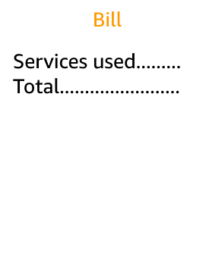


Lecture
Advantages of Cloud Computing
1
Massive economies of scale
AWS Cloud
Savings
Economies of scale
AWS Cloud Security Foundations– AWS-CSF
Lecture 1 – Cloud Concepts and Pricing
Dr. Ibrahim Gomaa

Slide 14
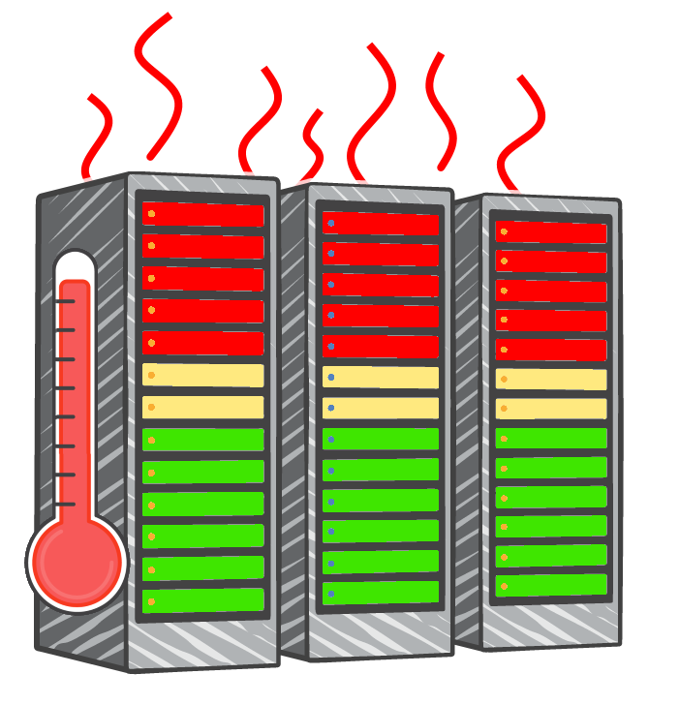
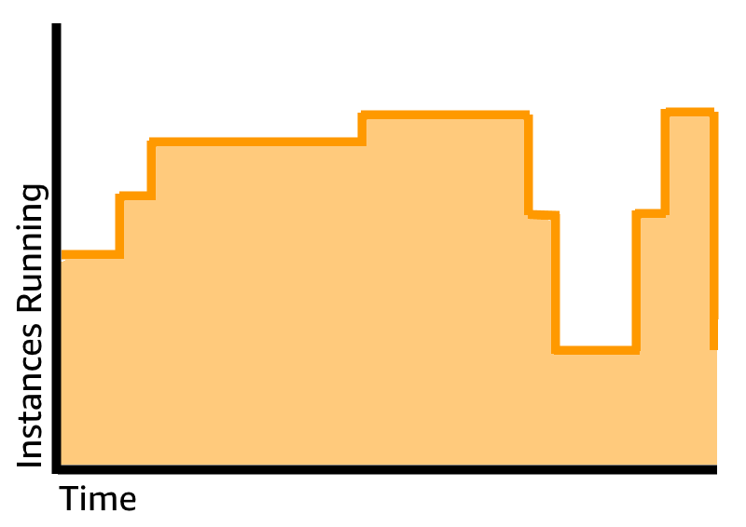
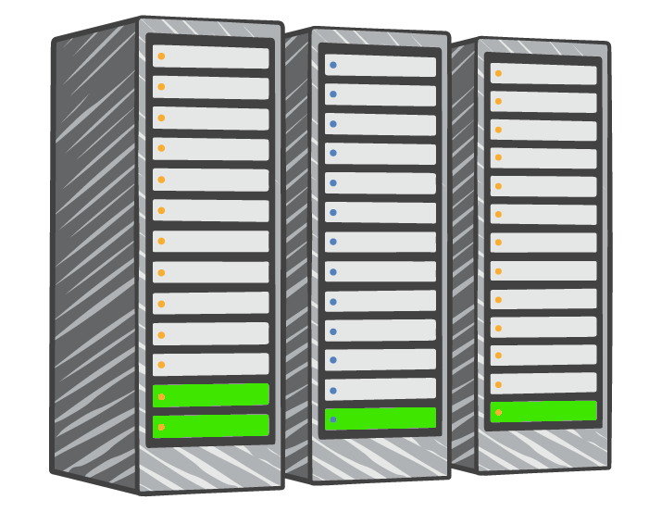
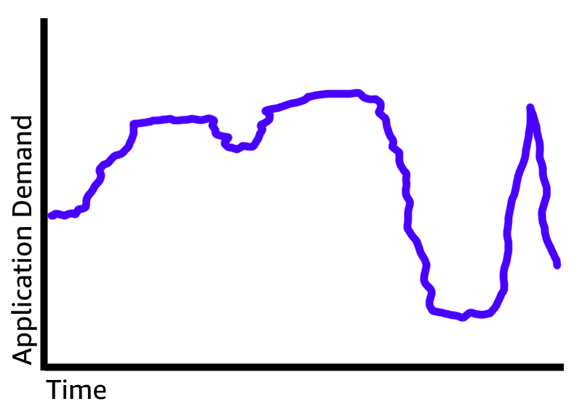

Lecture
Advantages of Cloud Computing
1
Stop guessing capacity
Overestimated
server capacity
Underestimated
server capacity
Scaling on demand
AWS Cloud Security Foundations– AWS-CSF
Lecture 1 – Cloud Concepts and Pricing
Dr. Ibrahim Gomaa

Slide 15
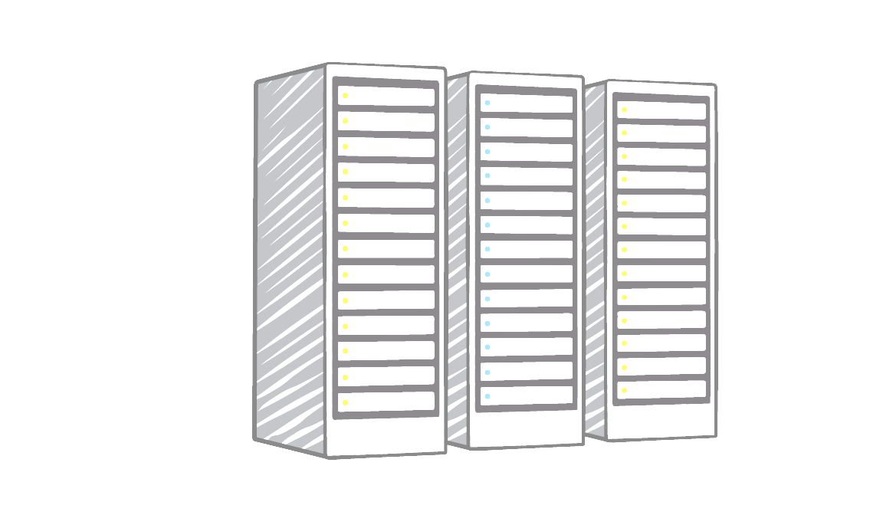



Lecture
Advantages of Cloud Computing
1
Stop spending money on
running and maintaining data centers
Payroll
…. … .. …
…. … .. …
…. … .. …
…. … .. …
…. … .. …
…. … .. …
Utilities
…. … .. …
…. … .. …
…. … .. …
…. … .. …
…. … .. …
…. … .. …
Maintenance
…. … .. …
…. … .. …
…. … .. …
…. … .. …
…. … .. …
…. … .. …
Landscaping
…. … .. …
…. … .. …
…. … .. …
…. … .. …
…. … .. …
…. … .. …
Hardware
…. … .. …
…. … .. …
…. … .. …
…. … .. …
…. … .. …
…. … .. …
Investment
Running data centers
Business and customers
AWS Cloud Security Foundations– AWS-CSF
Lecture 1 – Cloud Concepts and Pricing
Dr. Ibrahim Gomaa

Slide 16
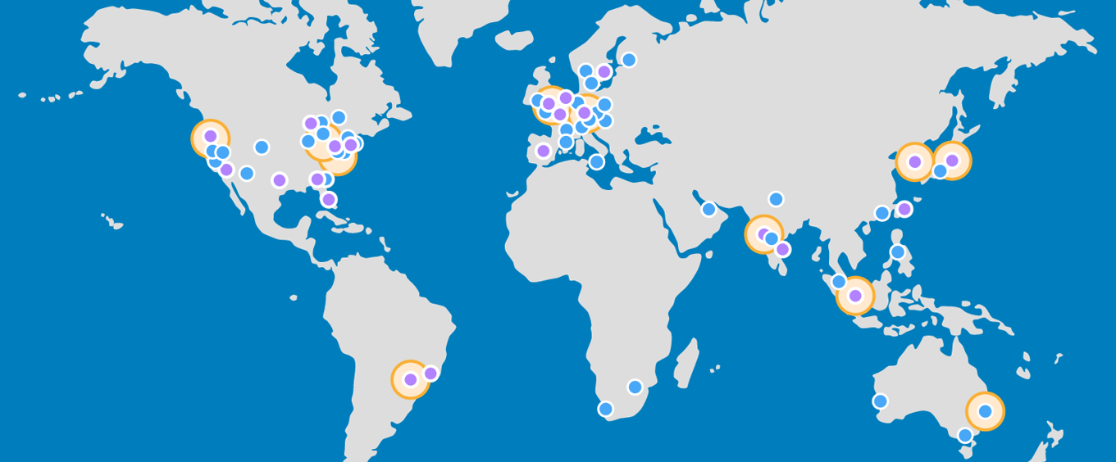

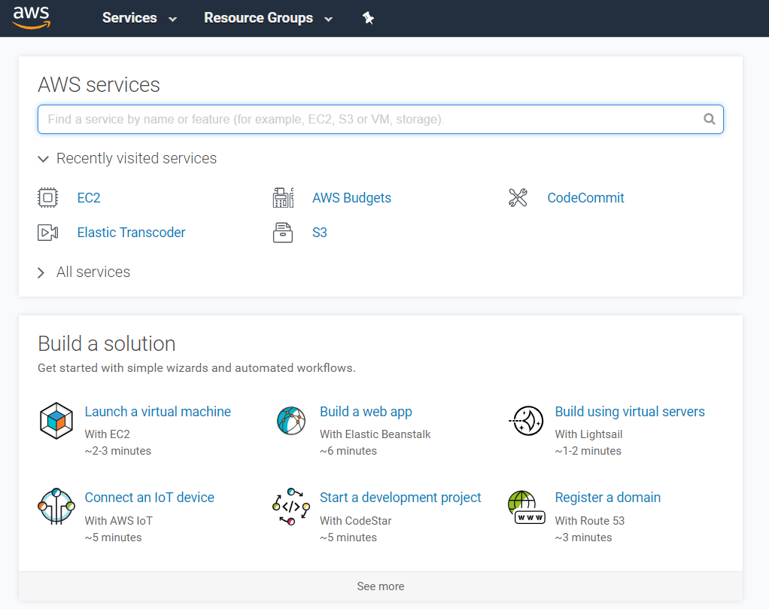
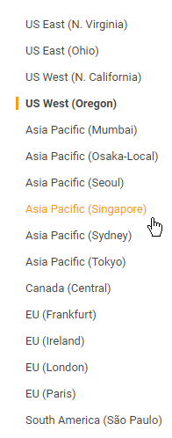
Lecture
Advantages of Cloud Computing
1
Go global in minutes
AWS Cloud Security Foundations– AWS-CSF
Lecture 1 – Cloud Concepts and Pricing
Dr. Ibrahim Gomaa

Slide 17
Lecture
Cloud Concepts and pricing
1
Introduction to
Amazon Web Services (AWS)
AWS Cloud Security Foundations– AWS-CSF
Lecture 1 – Cloud Concepts and Pricing
Dr. Ibrahim Gomaa

Slide 18



Lecture
Introduction to
Amazon Web Services (AWS)
1
What are web services?
A web service is any piece of software that makes itself available over the internet and uses a standardized format—such as Extensible Markup Language (XML) or JavaScript Object Notation (JSON)—for the request and the response of an application programming interface (API) interaction.
Request message
Internet
Response message
Client
Web service
AWS Cloud Security Foundations– AWS-CSF
Lecture 1 – Cloud Concepts and Pricing
Dr. Ibrahim Gomaa

Slide 19
Lecture
Introduction to
Amazon Web Services (AWS)
1
What is AWS?
AWS is a secure cloud platform that offers a broad set of global cloud-based products.
AWS provides you with on-demand access to compute, storage, network, database, and other IT resources and management tools.
AWS offers flexibility.
You pay only for the individual services you need, for as long as you use them.
AWS services work together like building blocks.
AWS Cloud Security Foundations– AWS-CSF
Lecture 1 – Cloud Concepts and Pricing
Dr. Ibrahim Gomaa

Slide 20










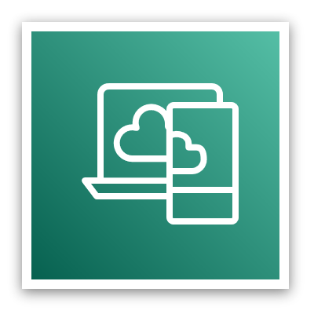






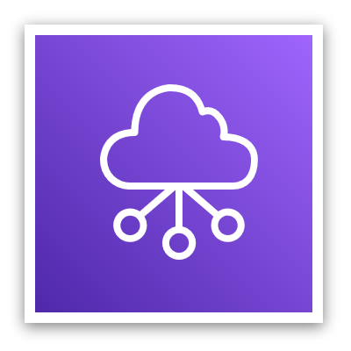





Lecture
Introduction to
Amazon Web Services (AWS)
1
Categories of AWS services
Analytics
Application
Integration
AR and VR
Blockchain
Business
Applications
Compute
Cost
Management
Customer
Engagement
Database
Developer Tools
End User
Computing
Security, Identity, and
Compliance
Internet
of Things
Machine Learning
Management and
Governance
Media Services
Migration and
Transfer
Networking and
Content Delivery
Mobile
Robotics
Game Tech
Satellite
Storage
AWS Cloud Security Foundations– AWS-CSF
Lecture 1 – Cloud Concepts and Pricing
Dr. Ibrahim Gomaa

Slide 21





Lecture
Introduction to
Amazon Web Services (AWS)
1
Simple solution example
Networking
Compute
Database
Storage
AWS Cloud
Virtual Private Cloud (VPC)
Amazon
DynamoDB
Users
Amazon S3
Amazon EC2
AWS Cloud Security Foundations– AWS-CSF
Lecture 1 – Cloud Concepts and Pricing
Dr. Ibrahim Gomaa

Slide 22

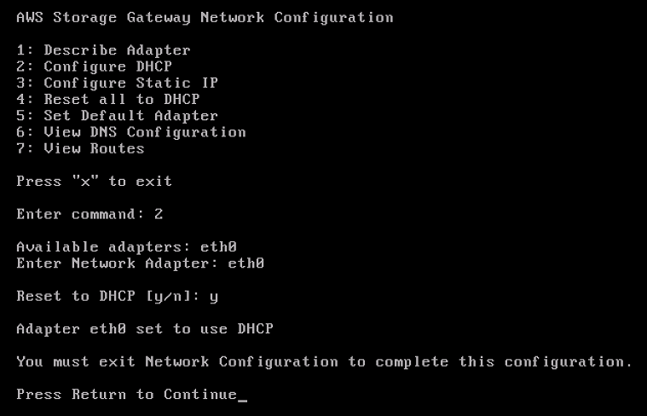
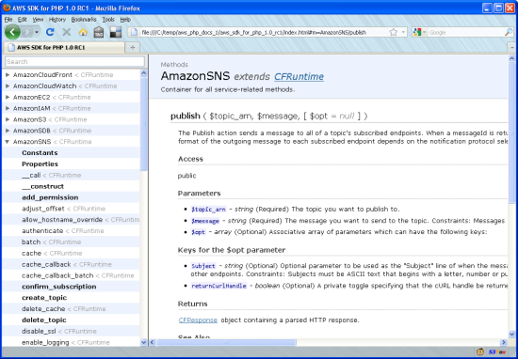
Lecture
Introduction to
Amazon Web Services (AWS)
1
Three ways to interact with AWS
AWS Management Console
Easy-to-use graphical interface
Command Line Interface (AWS CLI)
Access to services by discrete commands or scripts
Software Development Kits (SDKs)
Access services directly from your code (such as Java, Python, and others)
AWS Cloud Security Foundations– AWS-CSF
Lecture 1 – Cloud Concepts and Pricing
Dr. Ibrahim Gomaa

Slide 23
Lecture
Cloud Concepts and pricing
1
Fundamentals of pricing
AWS Cloud Security Foundations– AWS-CSF
Lecture 1 – Cloud Concepts and Pricing
Dr. Ibrahim Gomaa

Slide 24
Lecture
1
Fundamentals of pricing
AWS pricing model
Three fundamental drivers of cost with AWS
Compute
Storage
Data transfer
Charged per hour/second
Varies by instance type
Charged typically per GB
Outbound is aggregated and charged
Inbound has no charge (with some exceptions)
Charged typically per GB
AWS Cloud Security Foundations– AWS-CSF
Lecture 1 – Cloud Concepts and Pricing
Dr. Ibrahim Gomaa

Slide 25


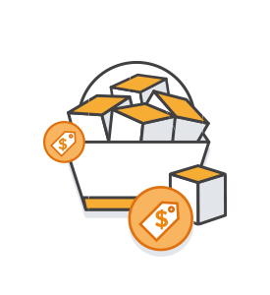
Lecture
1
Fundamentals of pricing
How do you pay for AWS?
Pay for what you use
Pay less when you reserve
Pay less when you use more and as AWS grows
AWS Cloud Security Foundations– AWS-CSF
Lecture 1 – Cloud Concepts and Pricing
Dr. Ibrahim Gomaa

Slide 26
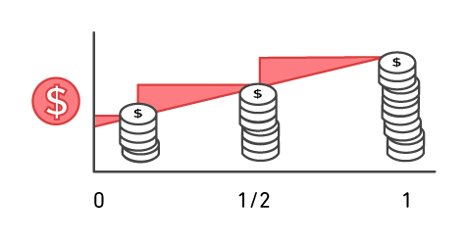
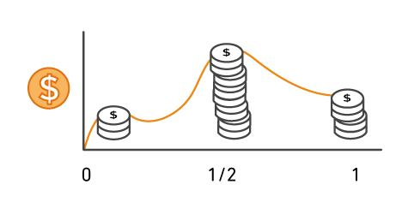
Lecture
1
Fundamentals of pricing
Pay for what you use
Pay only for the services that you consume, with no large upfront expenses.
On premises
AWS
AWS Cloud Security Foundations– AWS-CSF
Lecture 1 – Cloud Concepts and Pricing
Dr. Ibrahim Gomaa

Slide 27





Lecture
1
Fundamentals of pricing
Pay less when you reserve
Invest in Reserved Instances (RIs):
Save up to 75 percent over equivalent on-demand capacity
RIs Options:
    All Upfront Reserved Instance
    (AURI) → largest discount
    Partial Upfront Reserved Instance (PURI) → lower discounts
    No Upfront Reserved Instance
    (NURI) → smaller discount
EC2
instance
On
Demand
NURI
PURI
AURI
AWS Cloud Security Foundations– AWS-CSF
Lecture 1 – Cloud Concepts and Pricing
Dr. Ibrahim Gomaa

Slide 28
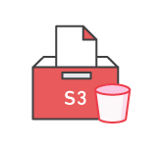
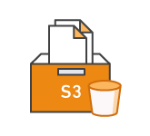
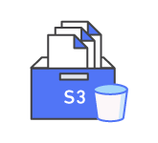


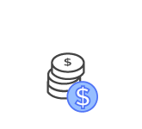
Lecture
1
Fundamentals of pricing
Pay less by using more
Realize volume-based discounts:
Savings as usage increases.
Tiered pricing for services like Amazon Simple Storage Service (Amazon S3), Amazon Elastic Block Store (Amazon EBS), or Amazon Elastic File System (Amazon EFS) → the more you use, the less you pay per GB.
Multiple storage services deliver lower storage costs based on needs.
the AWS storage services portfolio offers options to help you lower pricing based on
how frequently you access data and the performance that you need to retrieve it
AWS Cloud Security Foundations– AWS-CSF
Lecture 1 – Cloud Concepts and Pricing
Dr. Ibrahim Gomaa

Slide 29


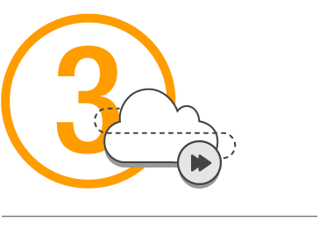
Lecture
1
Fundamentals of pricing
AWS Free Tier
Enables you to gain free hands-on experience with the AWS platform, products, and services. Free for 1 year for new customers.
Sign up for an
AWS account
Learn with 10-
minute tutorials
Start building
with AWS
AWS Cloud Security Foundations– AWS-CSF
Lecture 1 – Cloud Concepts and Pricing
Dr. Ibrahim Gomaa

Slide 30



Lecture
1
Fundamentals of pricing
Services with no charge
Amazon VPC
Elastic Beanstalk**
Auto Scaling**
AWS CloudFormation**
AWS Identity and Access Management (IAM)
**Note: There might be charges associated with other AWS services that are used with these services.
AWS Cloud Security Foundations– AWS-CSF
Lecture 1 – Cloud Concepts and Pricing
Dr. Ibrahim Gomaa

Slide 31
Lecture
Cloud Concepts and pricing
1
Total Cost of Ownership
AWS Cloud Security Foundations– AWS-CSF
Lecture 1 – Cloud Concepts and Pricing
Dr. Ibrahim Gomaa

Slide 32
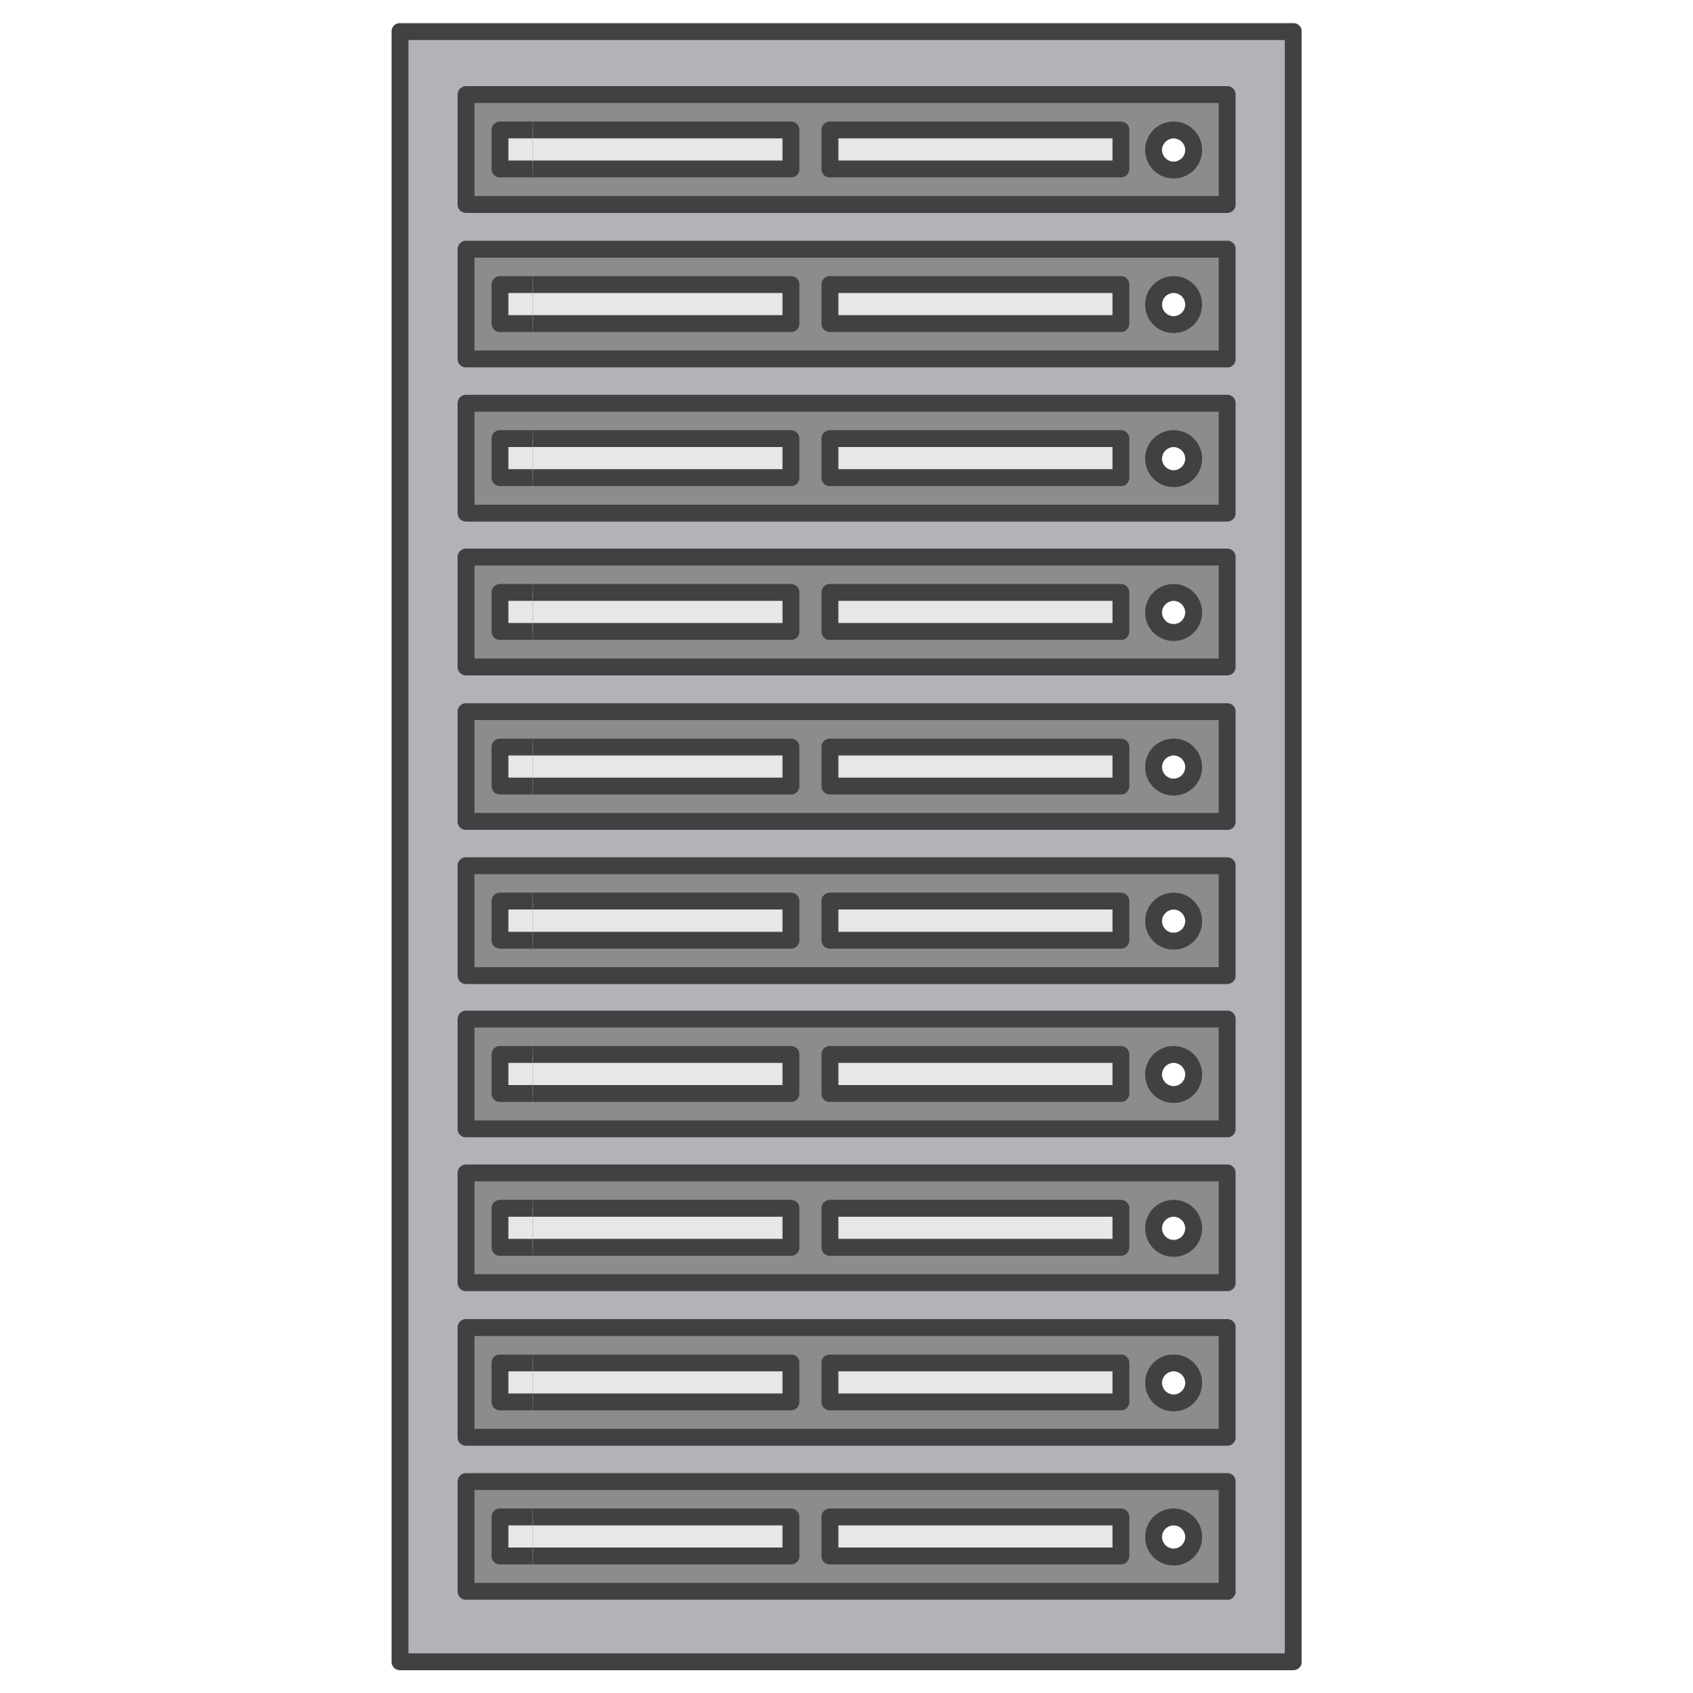







Lecture
1
Total Cost of Ownership
On-premises versus cloud
Traditional Infrastructure
AWS Cloud
≠
Equipment
Resources and administration
No upfront expense—pay for what you use
Improve time to market and agility
Contracts
Cost
Scale up and down
Self-service infrastructure
AWS Cloud Security Foundations– AWS-CSF
Lecture 1 – Cloud Concepts and Pricing
Dr. Ibrahim Gomaa

Slide 33


Lecture
1
Total Cost of Ownership
What is Total Cost of Ownership (TCO)?
Total Cost of Ownership (TCO) is the financial estimate to help identify direct and indirect costs of a system.
Why use TCO?
To compare the costs of running an entire infrastructure environment or specific workload on-premises versus on AWS
To budget and build the business case for moving to the cloud
AWS Cloud Security Foundations– AWS-CSF
Lecture 1 – Cloud Concepts and Pricing
Dr. Ibrahim Gomaa

Slide 34
Lecture
1
Total Cost of Ownership
TCO Considerations
Hardware: Server, rack chassis power distribution units (PDUs), top-of-rack (TOR) switches (and maintenance)
Software: Operating system (OS), virtualization licenses
(and maintenance)
Facilities cost
1
Server Costs
Space
Power
Cooling
Hardware: Storage disks, storage area network (SAN) or Fibre Channel (FC) switches
Storage administration costs
Facilities cost
2
Storage Costs
Space
Power
Cooling
Network hardware: Local area network (LAN) switches, load balancer bandwidth costs
Network administration costs
Facilities cost
3
Network Costs
Space
Power
Cooling
Server administration costs
4
IT Labor Costs
AWS Cloud Security Foundations– AWS-CSF
Lecture 1 – Cloud Concepts and Pricing
Dr. Ibrahim Gomaa

Slide 35
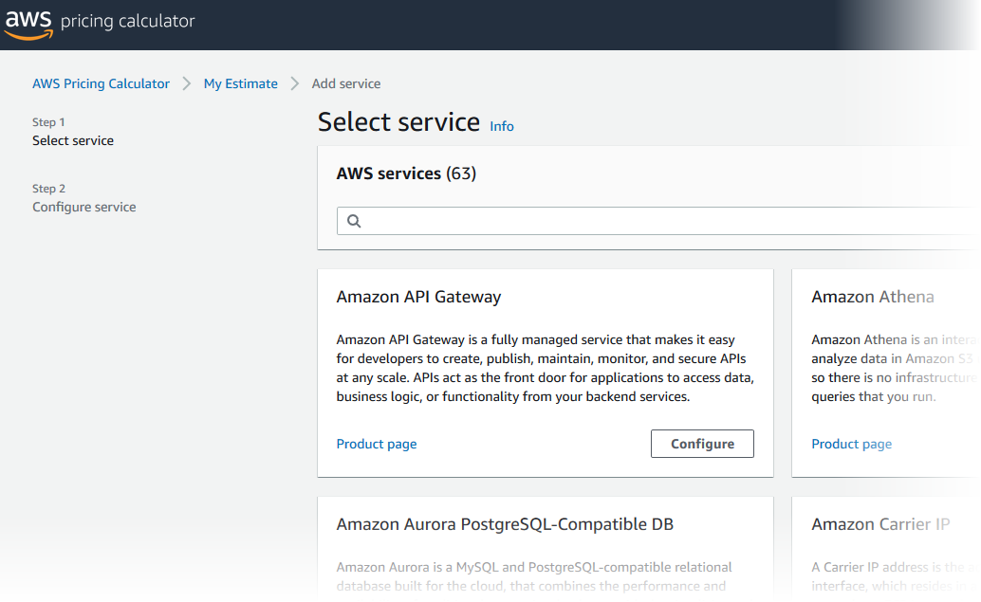
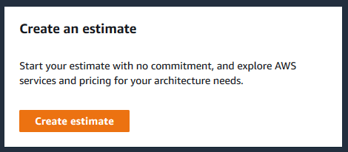
Lecture
1
Total Cost of Ownership
Activity: AWS Pricing Calculator activity
  Break up into groups of four or five and use the AWS Pricing Calculator and specifications provided to develop a cost estimate.
  Be prepared to report your findings back to the class.
AWS Pricing calculator website
AWS Cloud Security Foundations– AWS-CSF
Lecture 1 – Cloud Concepts and Pricing
Dr. Ibrahim Gomaa

Slide 36
Lecture
Cloud Concepts and pricing
1
AWS Organizations
AWS Cloud Security Foundations– AWS-CSF
Lecture 1 – Cloud Concepts and Pricing
Dr. Ibrahim Gomaa

Slide 37

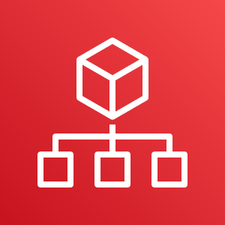
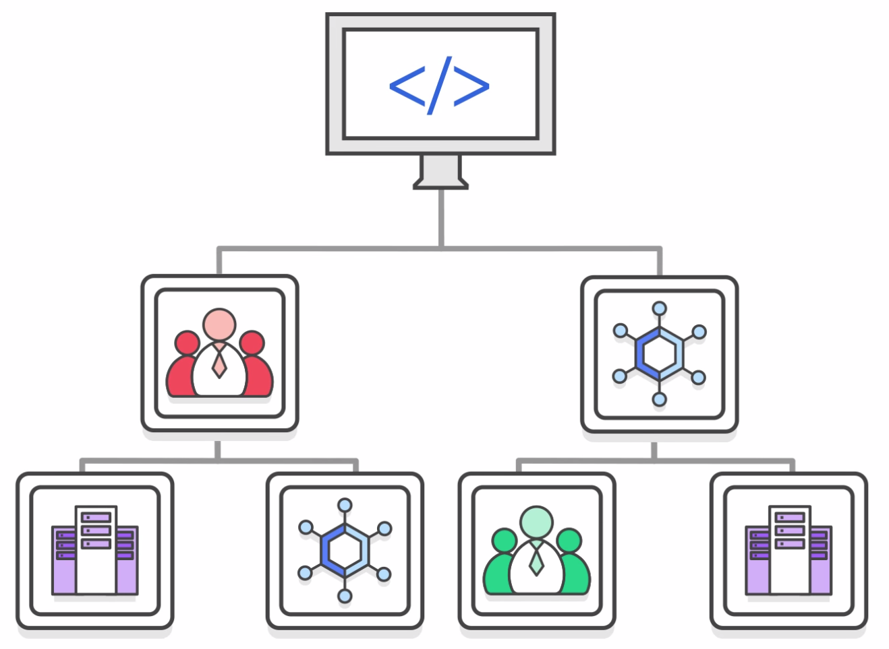
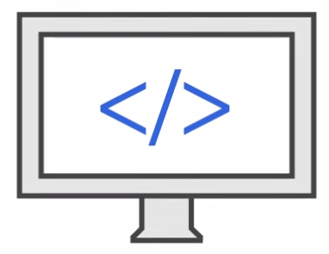

Lecture
1
AWS Organizations
Key features and benefits
  Policy-based account management
  Group based account management
  Application programming interfaces (APIs) that automate account management
AWS
Organizations
  Consolidated billing
AWS Cloud Security Foundations– AWS-CSF
Lecture 1 – Cloud Concepts and Pricing
Dr. Ibrahim Gomaa

Slide 38
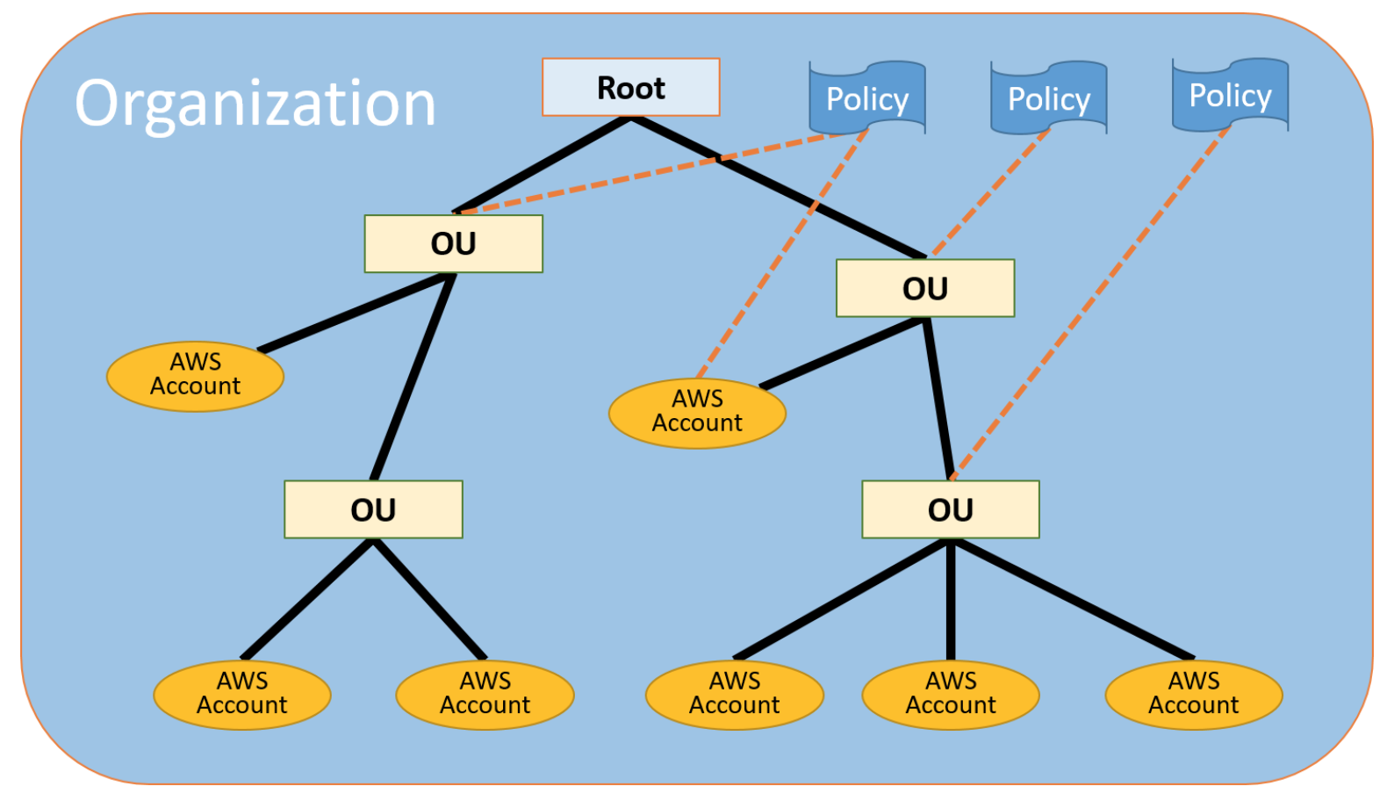
Lecture
1
AWS Organizations
AWS Organizations terminology
AWS Cloud Security Foundations– AWS-CSF
Lecture 1 – Cloud Concepts and Pricing
Dr. Ibrahim Gomaa

Slide 39


Lecture
1
AWS Organizations
Security with AWS Organizations
  Control access with
  AWS Identity and
  Access Management
  (IAM).
  IAM policies enable you to allow or deny access to AWS services for users, groups, and roles.
  Service control policies (SCPs) enable you to allow or deny access to AWS services for individuals or group accounts in an organizational unit (OU).
AWS Cloud Security Foundations– AWS-CSF
Lecture 1 – Cloud Concepts and Pricing
Dr. Ibrahim Gomaa

Slide 40
Lecture
Cloud Concepts and pricing
1
AWS Billing and Cost Management
AWS Cloud Security Foundations– AWS-CSF
Lecture 1 – Cloud Concepts and Pricing
Dr. Ibrahim Gomaa

Slide 41
Lecture
AWS Billing and Cost Management
1
Introducing AWS Billing and Cost Management
AWS Billing and Cost Management is the service that you use to pay your AWS bill, monitor your usage, and budget your costs.
Billing and Cost Management enables you to forecast and obtain a better idea of what your costs and usage might be in the future so that you can plan ahead.
AWS Cost and Usage Report Tool enables you to identify opportunities for optimization by understanding your cost and usage data trends and how you are using your AWS implementation.
AWS Cloud Security Foundations– AWS-CSF
Lecture 1 – Cloud Concepts and Pricing
Dr. Ibrahim Gomaa

Slide 42
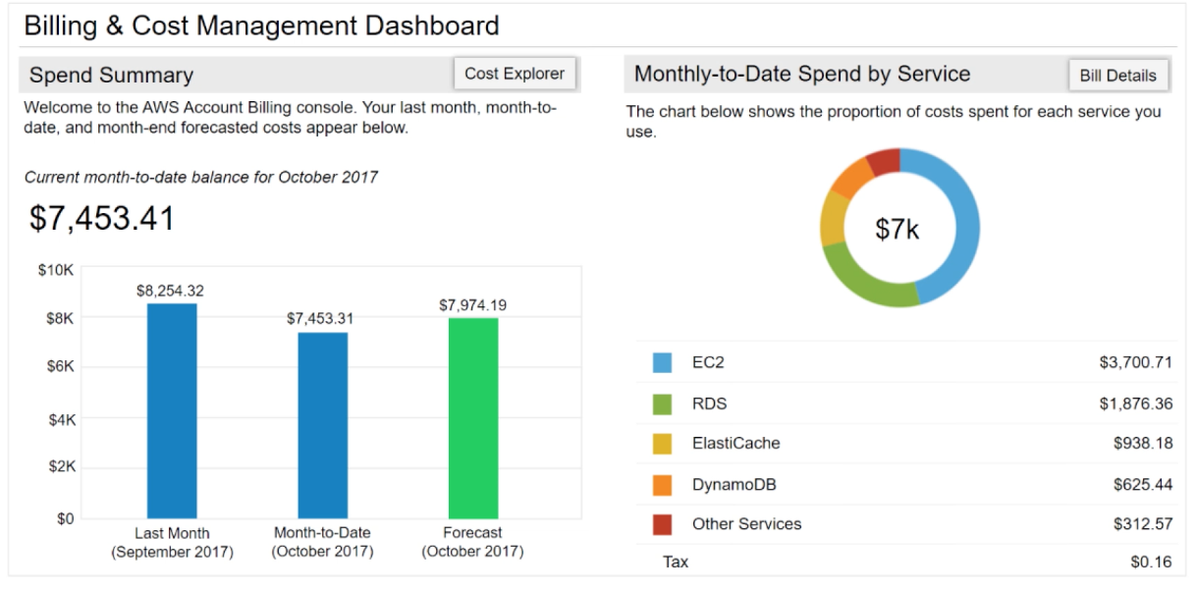
Lecture
AWS Billing and Cost Management
1
AWS Billing Dashboard
The AWS Billing Dashboard lets you view the status of your month-to-date AWS expenditure, identify the services that account for the majority of your overall expenditure, and understand at a high level how costs are trending.
AWS Cloud Security Foundations– AWS-CSF
Lecture 1 – Cloud Concepts and Pricing
Dr. Ibrahim Gomaa

Slide 43



Lecture
AWS Billing and Cost Management
1
Tools
AWS Budgets
AWS Cost and Usage Report
AWS Cost Explorer
uses the cost visualization that is provided by Cost Explorer to show you the status of your budgets and to provide forecasts of your estimated costs
enables you to identify opportunities for optimization by understanding your cost and usage data trends and how you are using your AWS implementation.
includes a default report that visualizes your costs and usage for your top cost-incurring AWS services. The monthly running costs report gives you an overview of all your costs for the past 3 months.
AWS Cloud Security Foundations– AWS-CSF
Lecture 1 – Cloud Concepts and Pricing
Dr. Ibrahim Gomaa

Slide 44
Lecture
Cloud Concepts and pricing
1
Technical Support
AWS Cloud Security Foundations– AWS-CSF
Lecture 1 – Cloud Concepts and Pricing
Dr. Ibrahim Gomaa

Slide 45

Lecture
Technical Support
1
AWS support
Provide unique combination of tools and expertise:
  AWS Support
  AWS Support Plans
Support is provided for:
  Experimenting with AWS
  Production use of AWS
  Business-critical use of AWS
AWS Cloud Security Foundations– AWS-CSF
Lecture 1 – Cloud Concepts and Pricing
Dr. Ibrahim Gomaa

Slide 46

Lecture
Technical Support
1
AWS support
Proactive guidance :
  Technical Account Manager (TAM)
  provide guidance, architectural review, and continuous ongoing communication to keep you informed and prepared as you plan, deploy, and optimize your solutions.
Best practices :
  AWS Trusted Advisor
  ensure that you follow best practices to increase performance and fault tolerance in the AWS environment (customized cloud expert)
Account assistance :
  AWS Support Concierge
  a billing and account expert who will provide quick and efficient analysis on billing and account issues
AWS Cloud Security Foundations– AWS-CSF
Lecture 1 – Cloud Concepts and Pricing
Dr. Ibrahim Gomaa

Slide 47

Lecture
Technical Support
1
Support plans
AWS Support offers four support plans:
Basic Support – Resource Center access, Service Health Dashboard, product FAQs, discussion forums, and support for health checks
Developer Support: Support for early development on AWS
Business Support: Customers that run production workloads
Enterprise Support: Customers that run business and mission-critical workloads
AWS Cloud Security Foundations– AWS-CSF
Lecture 1 – Cloud Concepts and Pricing
Dr. Ibrahim Gomaa

Slide 48
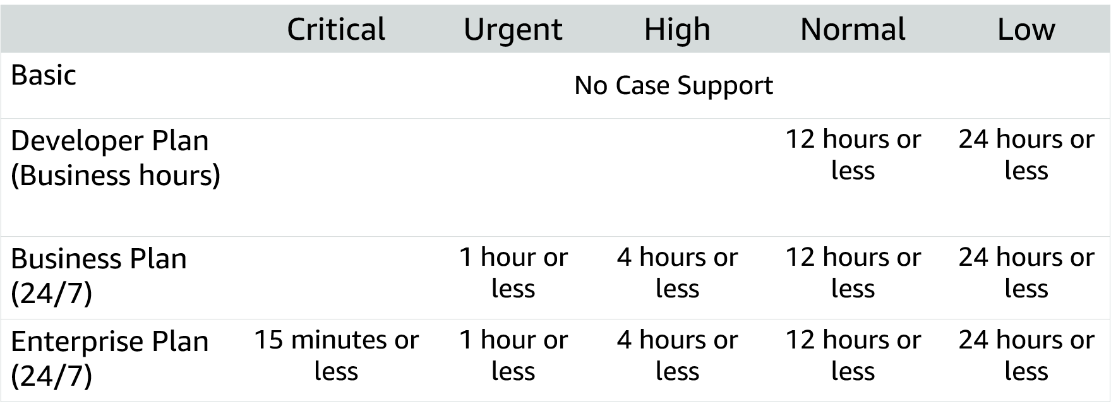
Lecture
Technical Support
1
Case severity and response times
AWS Cloud Security Foundations– AWS-CSF
Lecture 1 – Cloud Concepts and Pricing
Dr. Ibrahim Gomaa

Slide 49
Lecture
Cloud Concepts and pricing
1
Thanks
AWS Cloud Security Foundations– AWS-CSF
Lecture 1 – Cloud Concepts and Pricing
Dr. Ibrahim Gomaa

