Slide 1




flow Chart part2
IT111 - Introduction to Information Technology
Bachelor of Science in Information Technology
Eng. Eman Hamdy
Eng: Eman Hamdy
Flow Chart- Part2

Slide 2
Flow Chart part2
start
Draw flowchart to calculate factorial of 4.
4! ->1*2*3*4
Set i=1 , fact=1
No
yes
Print fact
i<=4
fact=fact*i
end
i=i+1

Slide 3
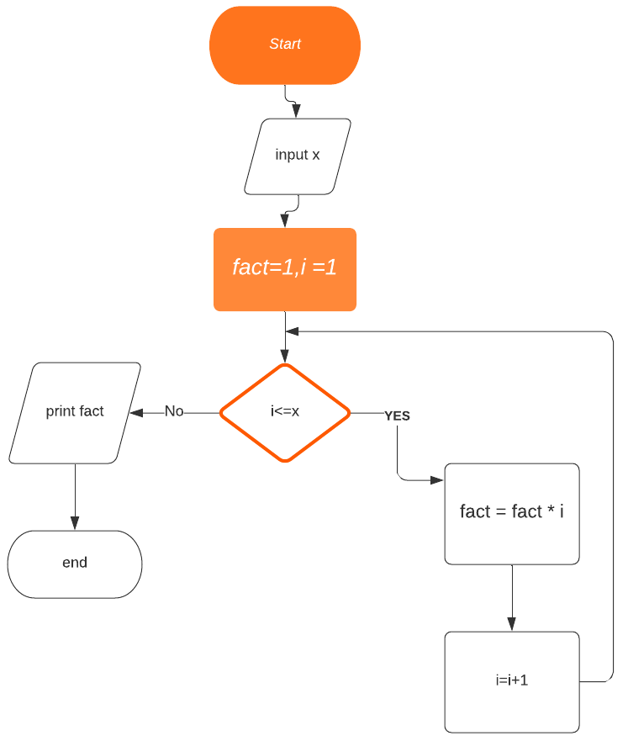
flow Chart part2
Draw flowchart to calculate factorial of number,

Slide 4
Flow Chart part2
start
input n
Draw flow chart to display the divisor of number
Divisor of 8 are 1, 2, 4, 8
6-> 1,2,3,6
8-> 1,2,4,8
mod (%)
مينفعش ابدء من صفر
لان مينفعش اقسم على صفر
Set i=1
No
yes
N must be >i
i<=n
yes
end
No
n % i =0
Print i
i=i+1

Slide 5
flow Chart part2
start
Input x
Draw flowchart to determine a number is prime or not.
1,3,5,7,..
5 -> prime (1,5)
6-> not prime
count=2
No
yes
Print prime
Count< x
1
2
3
4
5
6
yes
no
X%count
=0
Count=count +1
6
Print not prime
end

Slide 6
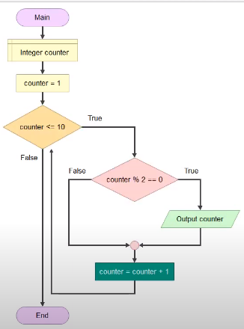
flow Chart part2
Draw flowchart that display all numbers divisible by 2 in the rang 1 to 10

Slide 7

Flow Chart

Slide 8
Flow Chart
start
Input hours
input skills
hourPrice
== -> علشان بسئل سوال فى شرط بسئل بيساوا بعض ولالا؟
= -> assign
No
skills==”
unskilled”
yes
hourPrice= 8.15
No
skills==”semi skilled”
yes
hourPrice=12.55
No
yes
Print “wrong input”
skills==” skilled”
hourPrice=18.6
hourPrice=0
total=hourPrice*hours
End

