Slide 1



Data Preprocessing
Prepared by Dr. Amjad Qtaish
DS601
Data Mining
Lecture 02

Slide 2




Lecture: #02
Data Preprocessing
Dr. Amjad Qtaish
Faculty of Informatics
Midocean University
Data Mining (DS601)

Slide 3
Chapter
Outline
02
    Data Preprocessing
Data Preprocessing: An Overview
  Data Quality
  Major Tasks in Data Preprocessing
Data Cleaning
Data Integration
Data Reduction
Data Transformation and Data Discretization
Summary
Data Mining, Dr. Amjad Qtaish
3

Slide 4
Chapter
Data Quality: Why Preprocess the Data?
02
Measures for data quality: A multidimensional view
  Accuracy: correct or wrong, accurate or not
  Completeness: not recorded, unavailable, …
  Consistency: some modified but some not, dangling, …
  Timeliness: timely update?
  Believability: how trustable the data are correct?
  Interpretability: how easily the data can be understood?
Data Mining, Dr. Amjad Qtaish
4

Slide 5
Chapter
Major Tasks in Data Preprocessing
02
Data cleaning
Data integration
  Integration of multiple databases, data cubes, or files
  Fill in missing values, smooth noisy data, identify or remove outliers, and resolve inconsistencies
Data reduction
  Dimensionality reduction
  Numerosity reduction
  Data compression
Data transformation and data discretization
  Normalization
  Concept hierarchy generation
Data Mining, Dr. Amjad Qtaish
5

Slide 6
Chapter
Outline
02
    Data Preprocessing
Data Preprocessing: An Overview
  Data Quality
  Major Tasks in Data Preprocessing
Data Cleaning
Data Integration
Data Reduction
Data Transformation and Data Discretization
Summary
Data Mining, Dr. Amjad Qtaish
6

Slide 7
Chapter
Data Cleaning
02
Data in the Real World Is Dirty: Lots of potentially incorrect data, e.g., instrument faulty, human or computer error, transmission error
  incomplete: lacking attribute values, lacking certain attributes of interest, or containing only aggregate data
    e.g., Occupation=“ ” (missing data)
  noisy: containing noise, errors, or outliers
    e.g., Salary=“−10” (an error)
  inconsistent: containing discrepancies in codes or names, e.g.,
    Age=“42”, Birthday=“03/07/2010”
    Was rating “1, 2, 3”, now rating “A, B, C”
    discrepancy between duplicate records
  Intentional (e.g., disguised missing data)
    Jan. 1 as everyone’s birthday?
Data Mining, Dr. Amjad Qtaish
7

Slide 8
Chapter
Incomplete (Missing) Data
02
Data is not always available
  E.g., many tuples have no recorded value for several attributes, such as customer income in sales data
Missing data may be due to
  equipment malfunction
  inconsistent with other recorded data and thus deleted
  data not entered due to misunderstanding
  certain data may not be considered important at the time of entry
  not register history or changes of the data
Missing data may need to be inferred
Data Mining, Dr. Amjad Qtaish
8

Slide 9
Chapter
How to Handle Missing Data?
02
Ignore the tuple: usually done when class label is missing (when doing classification)—not effective when the % of missing values per attribute varies considerably
Fill in the missing value manually: tedious + infeasible?
Fill in it automatically with
  a global constant : e.g., “unknown”, a new class?!
  the attribute mean
  the attribute mean for all samples belonging to the same class: smarter
  the most probable value: inference-based such as Bayesian formula or decision tree
Data Mining, Dr. Amjad Qtaish
9

Slide 10
Chapter
Noisy Data
02
Noise: random error or variance in a measured variable
Incorrect attribute values may be due to
  faulty data collection instruments
  data entry problems
  data transmission problems
  technology limitation
  inconsistency in naming convention
Other data problems which require data cleaning
  duplicate records
  incomplete data
  inconsistent data
Data Mining, Dr. Amjad Qtaish
10

Slide 11
Chapter
How to Handle Noisy Data?
02
Binning
  first sort data and partition into (equal-frequency) bins
  then one can smooth by bin means, smooth by bin median, smooth by bin boundaries, etc.
Regression
  smooth by fitting the data into regression functions
Clustering
  detect and remove outliers
Combined computer and human inspection
  detect suspicious values and check by human (e.g., deal with possible outliers)
Data Mining, Dr. Amjad Qtaish
11

Slide 12
Chapter
Outline
02
    Data Preprocessing
Data Preprocessing: An Overview
  Data Quality
  Major Tasks in Data Preprocessing
Data Cleaning
Data Integration
Data Reduction
Data Transformation and Data Discretization
Summary
Data Mining, Dr. Amjad Qtaish
12

Slide 13
Chapter
Data Integration
02
Data integration:
  Combines data from multiple sources into a coherent store
Schema integration: e.g., A.cust-id ≡ B.cust-#
  Integrate metadata from different sources
Entity identification problem:
  Identify real world entities from multiple data sources, e.g., Bill Clinton = William Clinton
Detecting and resolving data value conflicts
  For the same real world entity, attribute values from different sources are different
  Possible reasons: different representations, different scales, e.g., metric vs. British units
Data Mining, Dr. Amjad Qtaish
13

Slide 14
Chapter
Handling Redundancy in Data Integration
02
Redundant data occur often when integration of multiple databases
  Object identification: The same attribute or object may have different names in different databases
  Derivable data: One attribute may be a “derived” attribute in another table, e.g., annual revenue
Redundant attributes may be able to be detected by correlation analysis and covariance analysis
Careful integration of the data from multiple sources may help reduce/avoid redundancies and inconsistencies and improve mining speed and quality
Data Mining, Dr. Amjad Qtaish
14

Slide 15
Chapter
Correlation Analysis (Nominal Data)
02
Χ² (chi-square) test
The larger the Χ² value, the more likely the variables are related
The cells that contribute the most to the Χ² value are those whose actual count is very different from the expected count
Correlation does not imply causality
  # of hospitals and # of car-theft in a city are correlated
  Both are causally linked to the third variable: population
Data Mining, Dr. Amjad Qtaish
15

Slide 16
Chapter
Chi-Square Calculation: An Example
02
Χ² (chi-square) calculation (numbers in parenthesis are expected counts calculated based on the data distribution in the two categories)
It shows that like_science_fiction and play_chess are correlated in the group
 | Play chess | Not play chess | Sum (row)
Like science fiction | 250(90) | 200(360) | 450
Not like science fiction | 50(210) | 1000(840) | 1050
Sum(col.) | 300 | 1200 | 1500
Data Mining, Dr. Amjad Qtaish
16

Slide 17
Chapter
Correlation Analysis (Numeric Data)
02
Correlation coefficient (also called Pearson’s product moment coefficient)
  where n is the number of tuples, and are the respective means of A and B, σ_{A} and σ_{B} are the respective standard deviation of A and B, and Σ(a_{i}b_{i}) is the sum of the AB cross-product.
If r_{A,B} > 0, A and B are positively correlated (A’s values increase as B’s). The higher, the stronger correlation.
r_{A,B} = 0: independent; r_{AB} < 0: negatively correlated
Data Mining, Dr. Amjad Qtaish
17

Slide 18
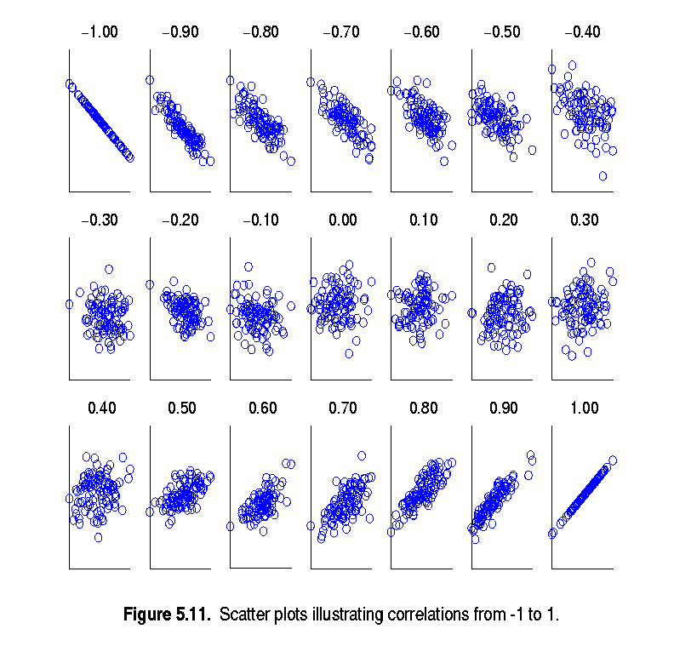
Chapter
Visually Evaluating Correlation
02
Scatter plots showing the similarity from –1 to 1.
Data Mining, Dr. Amjad Qtaish
18

Slide 19
Chapter
Correlation (viewed as linear relationship)
02
Correlation measures the linear relationship between objects
To compute correlation, we standardize data objects, A and B, and then take their dot product
Data Mining, Dr. Amjad Qtaish
19

Slide 20
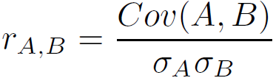
Chapter
Co-variance (Numeric Data)
02
Covariance is similar to correlation
  where n is the number of tuples, and are the respective mean or expected values of A and B, σ_{A} and σ_{B} are the respective standard deviation of A and B.
Positive covariance: If Cov_{A,B} > 0, then A and B both tend to be larger than their expected values.
Negative covariance: If Cov_{A,B} < 0 then if A is larger than its expected value, B is likely to be smaller than its expected value.
Independence: Cov_{A,B} = 0 but the converse is not true:
  Some pairs of random variables may have a covariance of 0 but are not independent. Only under some additional assumptions (e.g., the data follow multivariate normal distributions) does a covariance of 0 imply independence
Correlation coefficient:
Data Mining, Dr. Amjad Qtaish
20

Slide 21

Chapter
Co-Variance: An Example
02
It can be simplified in computation as
Suppose two stocks A and B have the following values in one week: (2, 5), (3, 8), (5, 10), (4, 11), (6, 14).
Question: If the stocks are affected by the same industry trends, will their prices rise or fall together?
  E(A) = (2 + 3 + 5 + 4 + 6)/ 5 = 20/5 = 4
  E(B) = (5 + 8 + 10 + 11 + 14) /5 = 48/5 = 9.6
  Cov(A,B) = (2×5+3×8+5×10+4×11+6×14)/5 − 4 × 9.6 = 4
Thus, A and B rise together since Cov(A, B) > 0.
Data Mining, Dr. Amjad Qtaish
21

Slide 22
Chapter
Outline
02
    Data Preprocessing
Data Preprocessing: An Overview
  Data Quality
  Major Tasks in Data Preprocessing
Data Cleaning
Data Integration
Data Reduction
Data Transformation and Data Discretization
Summary
Data Mining, Dr. Amjad Qtaish
22

Slide 23
Chapter
Data Reduction Strategies
02
Data reduction: Obtain a reduced representation of the data set that is much smaller in volume but yet produces the same (or almost the same) analytical results
Why data reduction? — A database/data warehouse may store terabytes of data. Complex data analysis may take a very long time to run on the complete data set.
Data reduction strategies
  Dimensionality reduction, e.g., remove unimportant attributes
    Wavelet transforms
    Principal Components Analysis (PCA)
    Feature subset selection, feature creation
  Numerosity reduction (some simply call it: Data Reduction)
    Regression and Log-Linear Models
    Histograms, clustering, sampling
    Data cube aggregation
  Data compression
Data Mining, Dr. Amjad Qtaish
23

Slide 24
Chapter
Data Reduction 1: Dimensionality Reduction
02
Curse of dimensionality
  When dimensionality increases, data becomes increasingly sparse
  Density and distance between points, which is critical to clustering, outlier analysis, becomes less meaningful
  The possible combinations of subspaces will grow exponentially
Dimensionality reduction
  Avoid the curse of dimensionality
  Help eliminate irrelevant features and reduce noise
  Reduce time and space required in data mining
  Allow easier visualization
Dimensionality reduction techniques
  Wavelet transforms
  Principal Component Analysis
  Supervised and nonlinear techniques (e.g., feature selection)
Data Mining, Dr. Amjad Qtaish
24

Slide 25
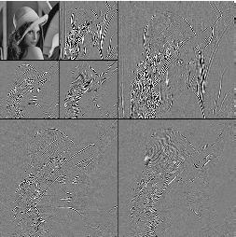
Chapter
What Is Wavelet Transform?
02
Decomposes a signal into different frequency subbands
  Applicable to n-dimensional signals
Data are transformed to preserve relative distance between objects at different levels of resolution
Allow natural clusters to become more distinguishable
Used for image compression
Data Mining, Dr. Amjad Qtaish
25

Slide 26
Chapter
Wavelet Transformation
02
Discrete wavelet transform (DWT) for linear signal processing, multi-resolution analysis
Compressed approximation: store only a small fraction of the strongest of the wavelet coefficients
Similar to discrete Fourier transform (DFT), but better lossy compression, localized in space
Method:
  Length, L, must be an integer power of 2 (padding with 0’s, when necessary)
  Each transform has 2 functions: smoothing, difference
  Applies to pairs of data, resulting in two set of data of length L/2
  Applies two functions recursively, until reaches the desired length
Haar2
Daubechie4
Data Mining, Dr. Amjad Qtaish
26

Slide 27
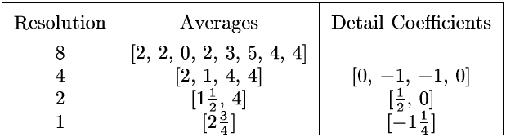
Chapter
Wavelet Decomposition
02
Wavelets: A math tool for space-efficient hierarchical decomposition of functions
S = [2, 2, 0, 2, 3, 5, 4, 4] can be transformed to S^ = [2³/₄, -1¹/₄, ¹/₂, 0, 0, -1, -1, 0]
Compression: many small detail coefficients can be replaced by 0’s, and only the significant coefficients are retained
Data Mining, Dr. Amjad Qtaish
27

Slide 28
Chapter
Principal Component Analysis (PCA)
02
Find a projection that captures the largest amount of variation in data
The original data are projected onto a much smaller space, resulting in dimensionality reduction. We find the eigenvectors of the covariance matrix, and these eigenvectors define the new space
x₂
e
x₁
Data Mining, Dr. Amjad Qtaish
28

Slide 29
Chapter
Principal Component Analysis (Steps)
02
Given N data vectors from n-dimensions, find k ≤ n orthogonal vectors (principal components) that can be best used to represent data
  Normalize input data: Each attribute falls within the same range
  Compute k orthonormal (unit) vectors, i.e., principal components
  Each input data (vector) is a linear combination of the k principal component vectors
  The principal components are sorted in order of decreasing “significance” or strength
  Since the components are sorted, the size of the data can be reduced by eliminating the weak components, i.e., those with low variance (i.e., using the strongest principal components, it is possible to reconstruct a good approximation of the original data)
Works for numeric data only
Data Mining, Dr. Amjad Qtaish
29

Slide 30
Chapter
Data Reduction 2: Numerosity Reduction
02
Reduce data volume by choosing alternative, smaller forms of data representation
Parametric methods (e.g., regression)
  Assume the data fits some model, estimate model parameters, store only the parameters, and discard the data (except possible outliers)
  Ex.: Log-linear models—obtain value at a point in m-D space as the product on appropriate marginal subspaces
Non-parametric methods
  Do not assume models
  Major families: histograms, clustering, sampling, …
Data Mining, Dr. Amjad Qtaish
30

Slide 31
Chapter
Parametric Data Reduction: Regression and Log-Linear Models
02
Linear regression
  Data modeled to fit a straight line
  Often uses the least-square method to fit the line
Multiple regression
  Allows a response variable Y to be modeled as a linear function of multidimensional feature vector
Log-linear model
  Approximates discrete multidimensional probability distributions
Data Mining, Dr. Amjad Qtaish
31

Slide 32
Chapter
Regression Analysis
02
Regression analysis: A collective name for techniques for the modeling and analysis of numerical data consisting of values of a dependent variable (also called response variable or measurement) and of one or more independent variables (aka. explanatory variables or predictors)
The parameters are estimated so as to give a "best fit" of the data
Most commonly the best fit is evaluated by using the least squares method, but other criteria have also been used
Y1
Y1’
y = x + 1
X1
x
Data Mining, Dr. Amjad Qtaish
32

Slide 33
Chapter
Regress Analysis and Log-Linear Models
02
Linear regression: Y = w X + b
  Two regression coefficients, w and b, specify the line and are to be estimated by using the data at hand
  Using the least squares criterion to the known values of Y₁, Y₂, …, X₁, X₂, ….
Multiple regression: Y = b₀ + b₁ X₁ + b₂ X₂
  Many nonlinear functions can be transformed into the above
Log-linear models:
  Approximate discrete multidimensional probability distributions
  Estimate the probability of each point (tuple) in a multi-dimensional space for a set of discretized attributes, based on a smaller subset of dimensional combinations
  Useful for dimensionality reduction and data smoothing
Data Mining, Dr. Amjad Qtaish
33

Slide 34
Chapter
Histogram Analysis
02
Divide data into buckets and store average (sum) for each bucket
Partitioning rules:
  Equal-width: equal bucket range
  Equal-frequency (or equal-depth)
Data Mining, Dr. Amjad Qtaish
34

Slide 35
Chapter
Clustering
02
Partition data set into clusters based on similarity, and store cluster representation (e.g., centroid and diameter) only
Can be very effective if data is clustered but not if data is “smeared”
Can have hierarchical clustering and be stored in multi-dimensional index tree structures
There are many choices of clustering definitions and clustering algorithms
Data Mining, Dr. Amjad Qtaish
35

Slide 36
Chapter
Sampling
02
Sampling: obtaining a small sample s to represent the whole data set N
Allow a mining algorithm to run in complexity that is potentially sub-linear to the size of the data
Key principle: Choose a representative subset of the data
  Simple random sampling may have very poor performance in the presence of skew
  Develop adaptive sampling methods, e.g., stratified sampling:
Note: Sampling may not reduce database I/Os (page at a time)
Data Mining, Dr. Amjad Qtaish
36

Slide 37
Chapter
Types of Sampling
02
Simple random sampling
  There is an equal probability of selecting any particular item
Sampling without replacement
  Once an object is selected, it is removed from the population
Sampling with replacement
  A selected object is not removed from the population
Stratified sampling:
  Partition the data set, and draw samples from each partition (proportionally, i.e., approximately the same percentage of the data)
  Used in conjunction with skewed data
Data Mining, Dr. Amjad Qtaish
37

Slide 38
Chapter
Sampling: With or without Replacement
02
SRSWOR
(simple random
sample without
replacement)
SRSWR
Raw Data
Data Mining, Dr. Amjad Qtaish
38

Slide 39
Chapter
Sampling: Cluster or Stratified Sampling
02
Raw Data
Cluster/Stratified Sample
Data Mining, Dr. Amjad Qtaish
39

Slide 40
Chapter
Data Cube Aggregation
02
The lowest level of a data cube (base cuboid)
  The aggregated data for an individual entity of interest
  E.g., a customer in a phone calling data warehouse
Multiple levels of aggregation in data cubes
  Further reduce the size of data to deal with
Reference appropriate levels
  Use the smallest representation which is enough to solve the task
Queries regarding aggregated information should be answered using data cube, when possible
Data Mining, Dr. Amjad Qtaish
40

Slide 41
Chapter
Data Reduction 3: Data Compression
02
String compression
  There are extensive theories and well-tuned algorithms
  Typically lossless, but only limited manipulation is possible without expansion
Audio/video compression
  Typically lossy compression, with progressive refinement
  Sometimes small fragments of signal can be reconstructed without reconstructing the whole
Time sequence is not audio
  Typically short and vary slowly with time
Dimensionality and numerosity reduction may also be considered as forms of data compression
Data Mining, Dr. Amjad Qtaish
41

Slide 42
Chapter
Data Compression
02
Original Data
Compressed
Data
lossless
Original Data
Approximated
lossy
Data Mining, Dr. Amjad Qtaish
42

Slide 43
Chapter
Outline
02
    Data Preprocessing
Data Preprocessing: An Overview
  Data Quality
  Major Tasks in Data Preprocessing
Data Cleaning
Data Integration
Data Reduction
Data Transformation and Data Discretization
Summary
Data Mining, Dr. Amjad Qtaish
43

Slide 44
Chapter
Data Transformation
02
A function that maps the entire set of values of a given attribute to a new set of replacement values s.t. each old value can be identified with one of the new values
Methods
  Smoothing: Remove noise from data
  Attribute/feature construction
    New attributes constructed from the given ones
  Aggregation: Summarization, data cube construction
  Normalization: Scaled to fall within a smaller, specified range
    min-max normalization
    z-score normalization
    normalization by decimal scaling
  Discretization: Concept hierarchy climbing
Data Mining, Dr. Amjad Qtaish
44

Slide 45
Chapter
Normalization
02
Min-max normalization: to [new_min_{A}, new_max_{A}]
  Ex. Let income range $12,000 to $98,000 normalized to [0.0, 1.0]. Then $73,600 is mapped to
Z-score normalization (μ: mean, σ: standard deviation):
  Ex. Let μ = 54,000, σ = 16,000. Then
Normalization by decimal scaling
Where j is the smallest integer such that Max(|ν’|) < 1
Data Mining, Dr. Amjad Qtaish
45

Slide 46
Chapter
Discretization
02
Three types of attributes
  Nominal—values from an unordered set, e.g., color, profession
  Ordinal—values from an ordered set, e.g., military or academic rank
  Numeric—real numbers, e.g., integer or real numbers
Discretization: Divide the range of a continuous attribute into intervals
  Interval labels can then be used to replace actual data values
  Reduce data size by discretization
  Supervised vs. unsupervised
  Split (top-down) vs. merge (bottom-up)
  Discretization can be performed recursively on an attribute
  Prepare for further analysis, e.g., classification
Data Mining, Dr. Amjad Qtaish
46

Slide 47
Chapter
Data Discretization Methods
02
Typical methods: All the methods can be applied recursively
  Binning
    Top-down split, unsupervised
  Histogram analysis
    Top-down split, unsupervised
  Clustering analysis (unsupervised, top-down split or bottom-up merge)
  Decision-tree analysis (supervised, top-down split)
  Correlation (e.g., χ²) analysis (unsupervised, bottom-up merge)
Data Mining, Dr. Amjad Qtaish
47

Slide 48
Chapter
Simple Discretization: Binning
02
Equal-width (distance) partitioning
  Divides the range into N intervals of equal size: uniform grid
  if A and B are the lowest and highest values of the attribute, the width of intervals will be: W = (B –A)/N.
  The most straightforward, but outliers may dominate presentation
  Skewed data is not handled well
Equal-depth (frequency) partitioning
  Divides the range into N intervals, each containing approximately same number of samples
  Good data scaling
  Managing categorical attributes can be tricky
Data Mining, Dr. Amjad Qtaish
48

Slide 49
Binning Methods for Data Smoothing
Chapter
02
Sorted data for price (in dollars): 4, 8, 9, 15, 21, 21, 24, 25, 26, 28, 29, 34
* Partition into equal-frequency (equi-depth) bins:
- Bin 1: 4, 8, 9, 15
- Bin 2: 21, 21, 24, 25
- Bin 3: 26, 28, 29, 34
* Smoothing by bin means:
- Bin 1: 9, 9, 9, 9
- Bin 2: 23, 23, 23, 23
- Bin 3: 29, 29, 29, 29
* Smoothing by bin boundaries:
- Bin 1: 4, 4, 4, 15
- Bin 2: 21, 21, 25, 25
- Bin 3: 26, 26, 26, 34
Data Mining, Dr. Amjad Qtaish
49

Slide 50
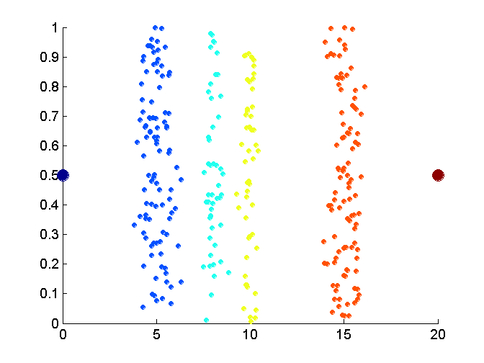
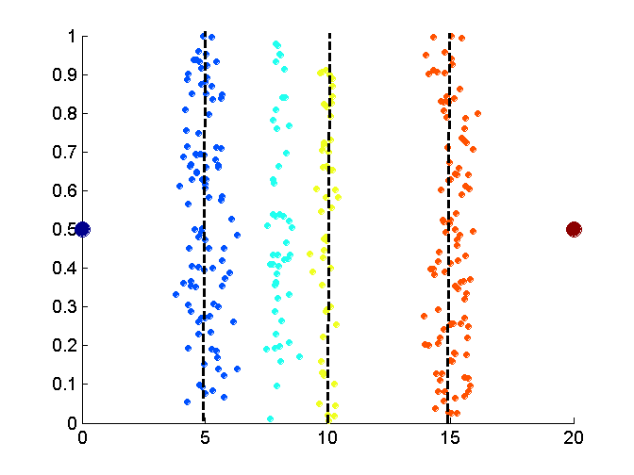
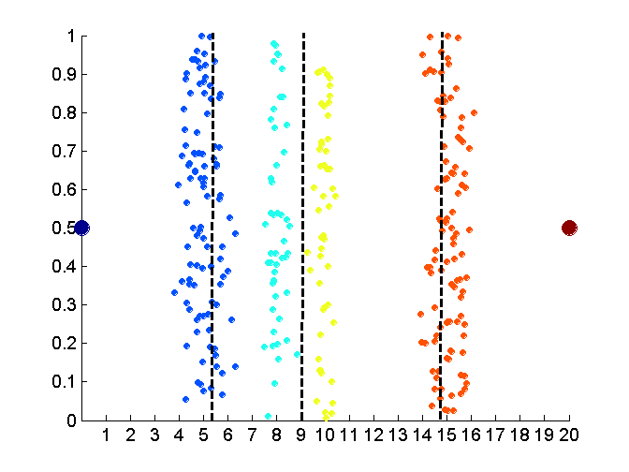
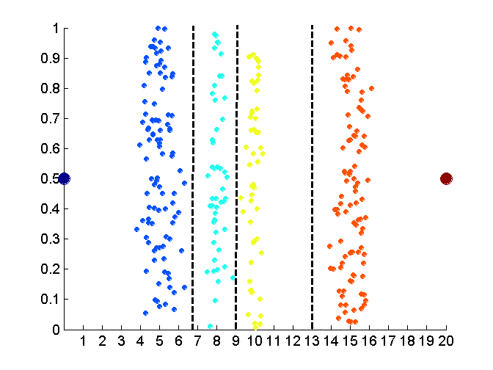
Discretization Without Using Class Labels
(Binning vs. Clustering)
Chapter
02
Data
Equal interval width (binning)
Equal frequency (binning)
K-means clustering leads to better results
Data Mining, Dr. Amjad Qtaish
50

Slide 51
Discretization by Classification & Correlation Analysis
Chapter
02
Classification (e.g., decision tree analysis)
  Supervised: Given class labels, e.g., cancerous vs. benign
  Using entropy to determine split point (discretization point)
  Top-down, recursive split
  Details to be covered in Chapter 7
Correlation analysis (e.g., Chi-merge: χ²-based discretization)
  Supervised: use class information
  Bottom-up merge: find the best neighboring intervals (those having similar distributions of classes, i.e., low χ² values) to merge
  Merge performed recursively, until a predefined stopping condition
Data Mining, Dr. Amjad Qtaish
51

Slide 52
Chapter
Concept Hierarchy Generation
02
Concept hierarchy organizes concepts (i.e., attribute values) hierarchically and is usually associated with each dimension in a data warehouse
Concept hierarchies facilitate drilling and rolling in data warehouses to view data in multiple granularity
Concept hierarchy formation: Recursively reduce the data by collecting and replacing low level concepts (such as numeric values for age) by higher level concepts (such as youth, adult, or senior)
Concept hierarchies can be explicitly specified by domain experts and/or data warehouse designers
Concept hierarchy can be automatically formed for both numeric and nominal data. For numeric data, use discretization methods shown.
Data Mining, Dr. Amjad Qtaish
52

Slide 53
Concept Hierarchy Generation
for Nominal Data
Chapter
02
Specification of a partial/total ordering of attributes explicitly at the schema level by users or experts
  street < city < state < country
Specification of a hierarchy for a set of values by explicit data grouping
  {Urbana, Champaign, Chicago} < Illinois
Specification of only a partial set of attributes
  E.g., only street < city, not others
Automatic generation of hierarchies (or attribute levels) by the analysis of the number of distinct values
  E.g., for a set of attributes: {street, city, state, country}
Data Mining, Dr. Amjad Qtaish
53

Slide 54
Chapter
Automatic Concept Hierarchy Generation
02
Some hierarchies can be automatically generated based on the analysis of the number of distinct values per attribute in the data set
  The attribute with the most distinct values is placed at the lowest level of the hierarchy
  Exceptions, e.g., weekday, month, quarter, year
country
15 distinct values
province_or_ state
365 distinct values
city
3567 distinct values
street
674,339 distinct values
Data Mining, Dr. Amjad Qtaish
54

Slide 55
Chapter
Outline
02
    Data Preprocessing
Data Preprocessing: An Overview
  Data Quality
  Major Tasks in Data Preprocessing
Data Cleaning
Data Integration
Data Reduction
Data Transformation and Data Discretization
Summary
Data Mining, Dr. Amjad Qtaish
55

Slide 56
Chapter
Summary
02
Data quality: accuracy, completeness, consistency, timeliness, believability, interpretability
Data cleaning: e.g. missing/noisy values, outliers
Data integration from multiple sources:
  Entity identification problem
  Remove redundancies
  Detect inconsistencies
Data reduction
  Dimensionality reduction
  Numerosity reduction
  Data compression
Data transformation and data discretization
  Normalization
  Concept hierarchy generation
Data Mining, Dr. Amjad Qtaish
56

Slide 57



Thank You

Slide 58

Data Preprocessing - Practice
Dr. Amjad Qtaish

Slide 59
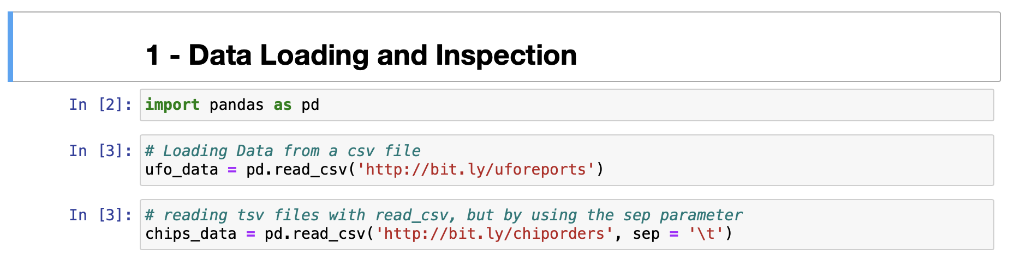
Data Preprocessing - Practice
Dr. Amjad Qtaish

Slide 60
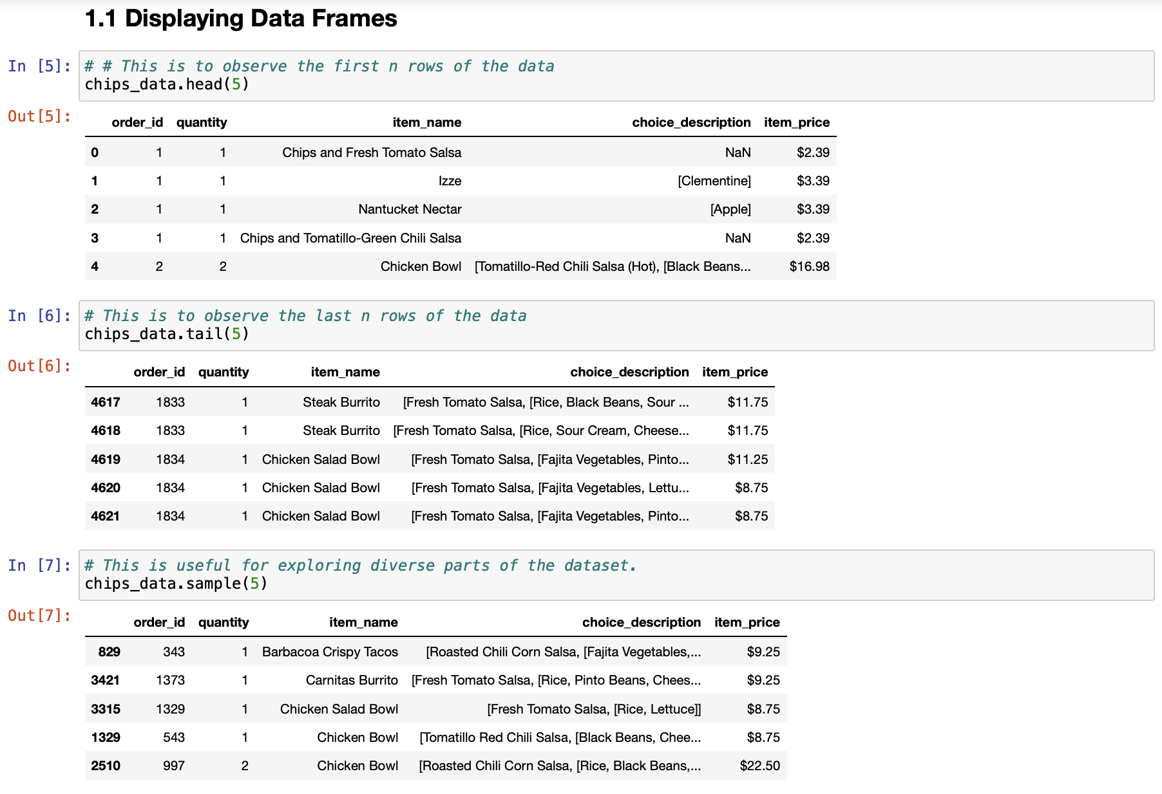
Data Preprocessing - Practice
Dr. Amjad Qtaish

Slide 61
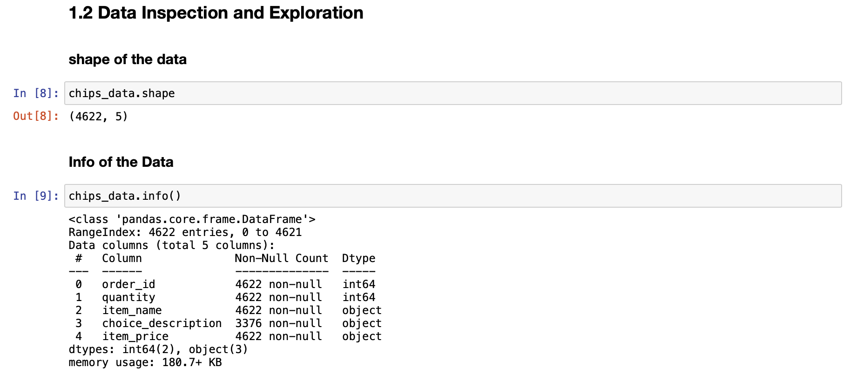
Data Preprocessing - Practice
Dr. Amjad Qtaish

Slide 62
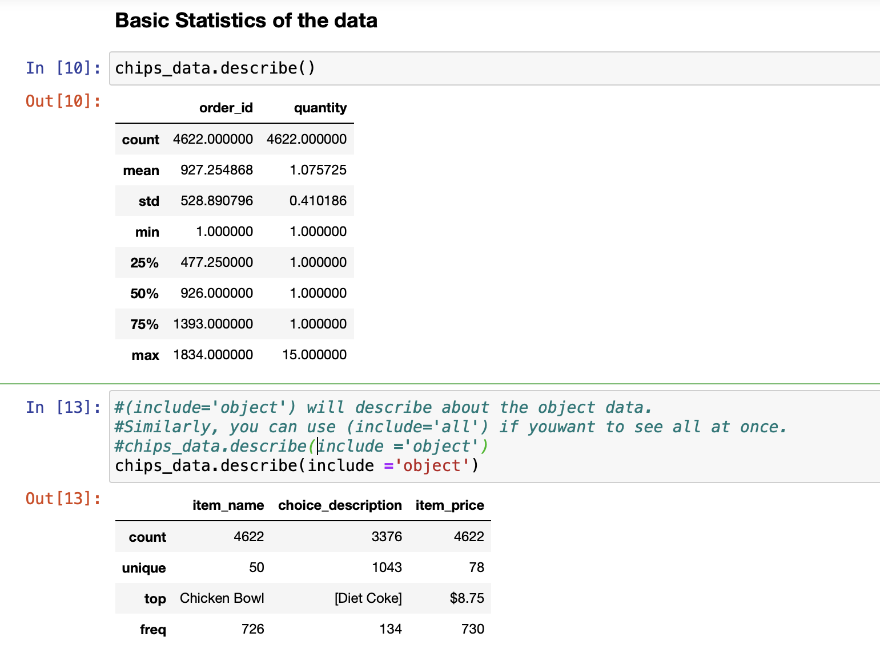
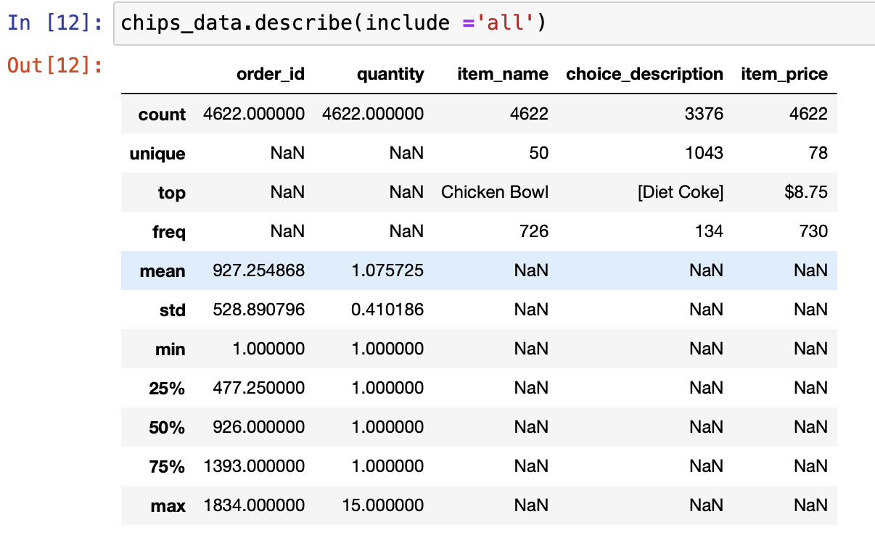
Data Preprocessing - Practice
Dr. Amjad Qtaish

Slide 63
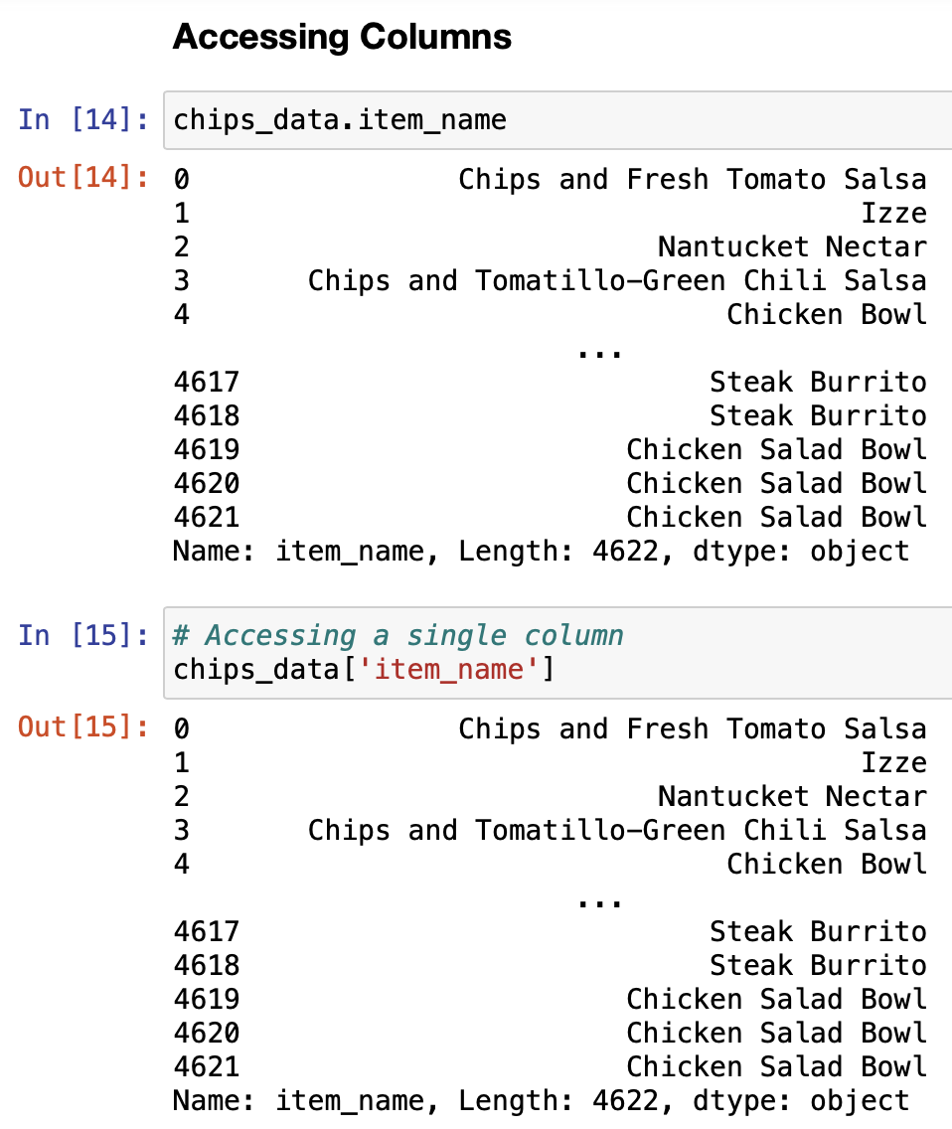
Data Preprocessing - Practice
Dr. Amjad Qtaish

Slide 64
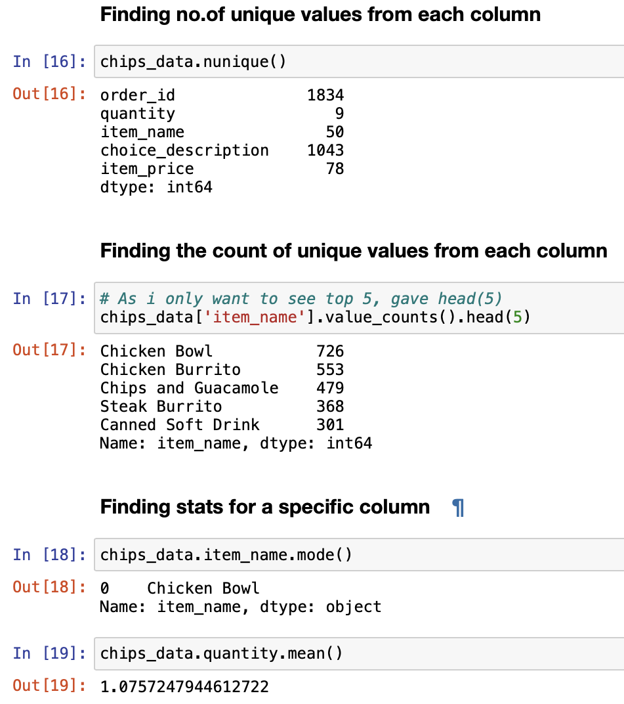
Data Preprocessing - Practice
Dr. Amjad Qtaish

Slide 65
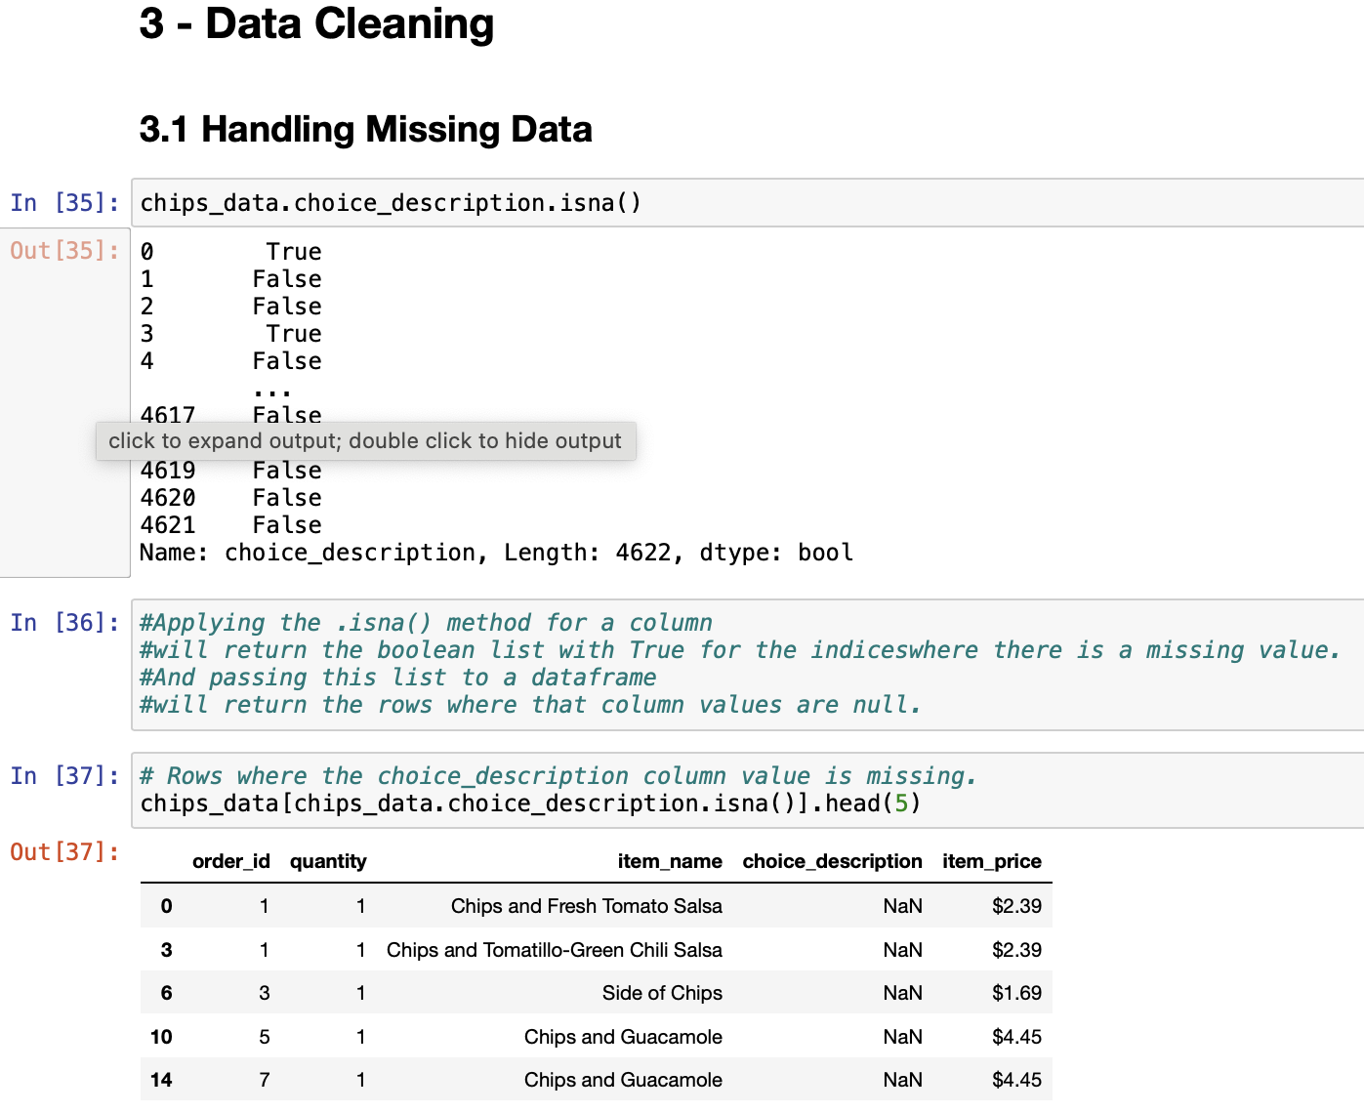
Data Preprocessing - Practice
Dr. Amjad Qtaish

Slide 66
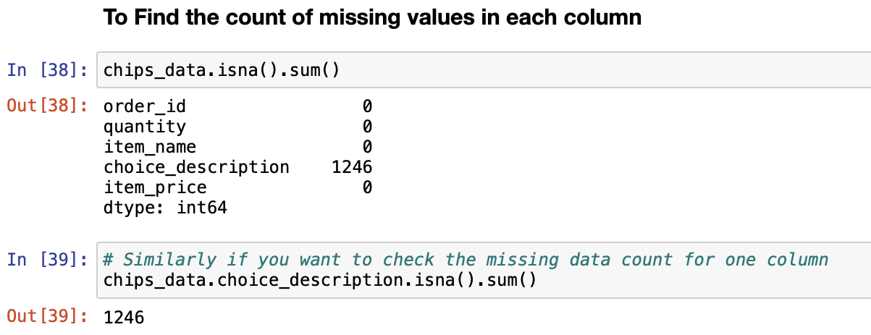
Data Preprocessing - Practice
Dr. Amjad Qtaish

Slide 67
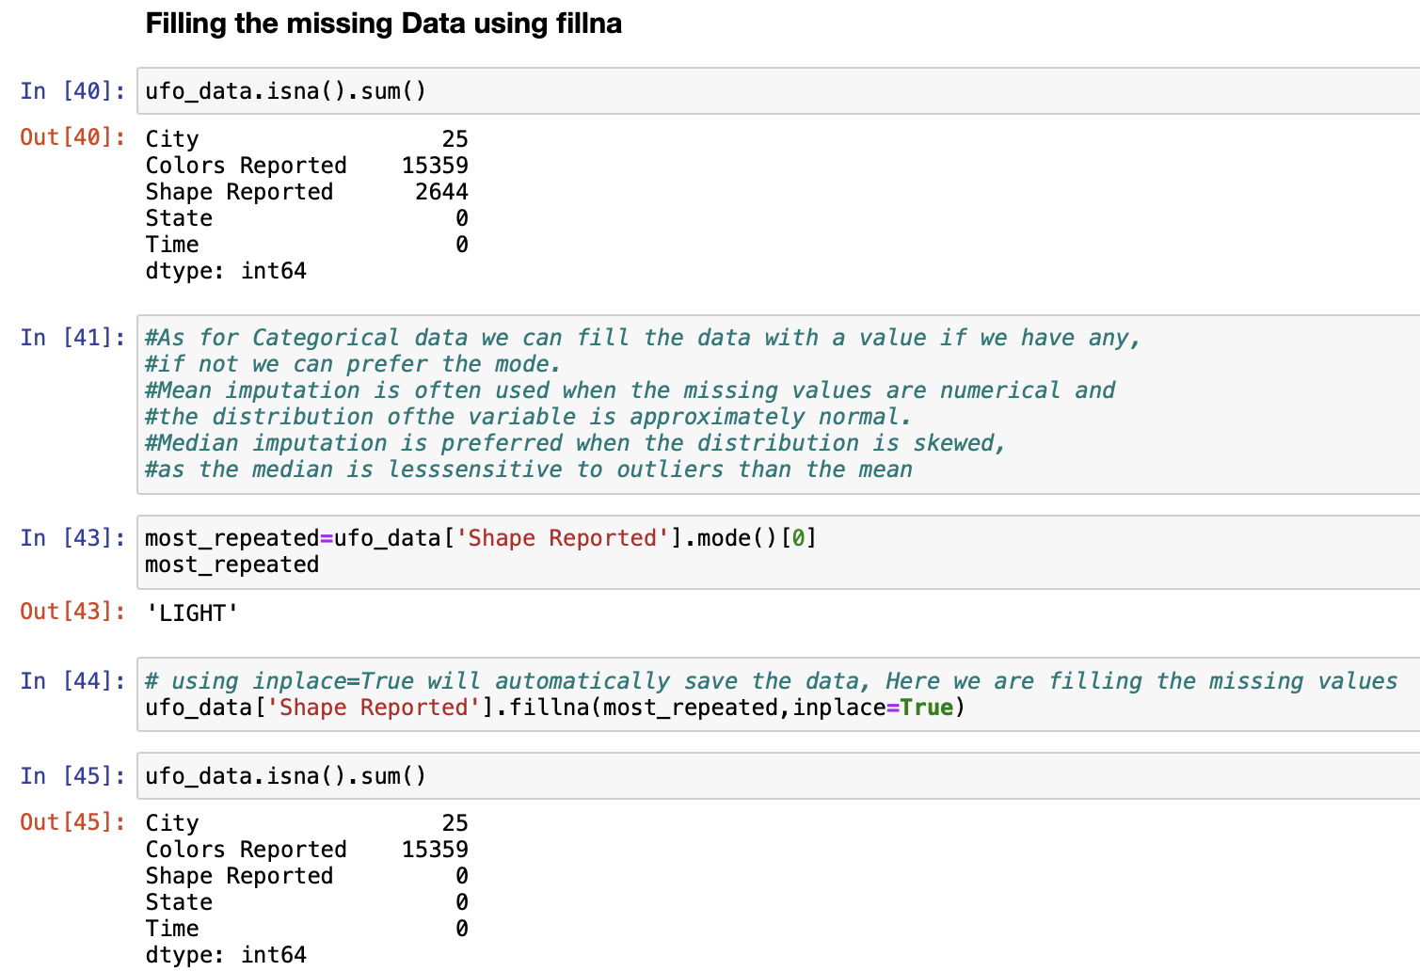
Data Preprocessing - Practice
Dr. Amjad Qtaish

Slide 68
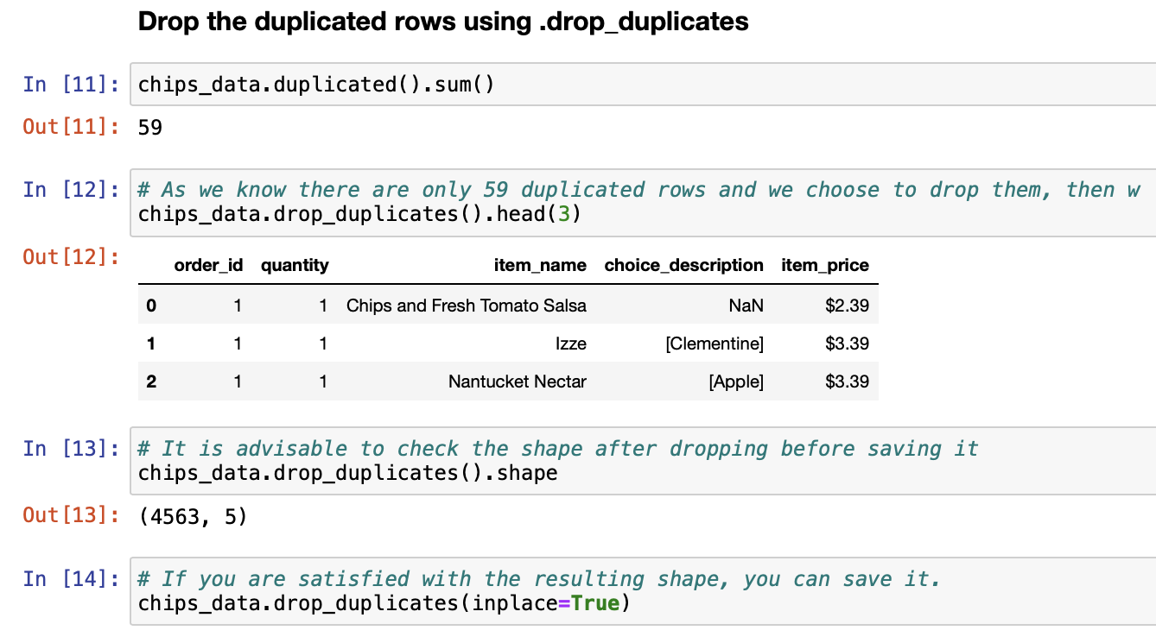
Data Preprocessing - Practice
Dr. Amjad Qtaish

