Slide 1




Social Media and Crises
Lecture 10
DGM 730
Crisis Communication and Management
Prepared by
Dr. Doaa Rady

Slide 2

Lecture
10
Exam
Final Exam DGM730
الاثنين 23 ديسمبر 2024
الساعة 7:30 ل 8:30 م

Slide 3
Lecture
10
Lecture outline
Crisis Communication and Management
Internal Communication
Influencer Communication
Media Communication
Communicating on Social Channels
Crisis Scenario Planning
Ten rules for crisis management

Slide 4
Lecture
10
Introduction
The use of social media has increased in the world of communication, with Twitter and Facebook as the most used platforms, and organizations have gained mileage by using it to communicate in a much more effective and fast way with their customers about their businesses as well as responding to queries and questions.
However, in as much as the emergence of social media has brought in the advantage of fast, effective communication, it has also given room for the fast spread of negative. An organization depends on its reputation, it is a pertinent aspect that directly translates to its financial achievement, and with the emergence of social media, crisis might arise and spread faster than it can ever do on any other traditional forms of communication.

Slide 5
Lecture
10
Introduction
Therefore, the success of any organization is highly dependent on what it says or the effort it makes after a crisis strike.
For this reason, crisis management helps the companies in being able to address issues that threaten its reputation.
It has been suggested that it is paramount for organizations to understand fully how to manage different kinds of crisis via social media.
Wang (2015) observes that social media has been utilized for public relations since its advent in 2004, and this has had an influence on both individuals and the society.

Slide 6

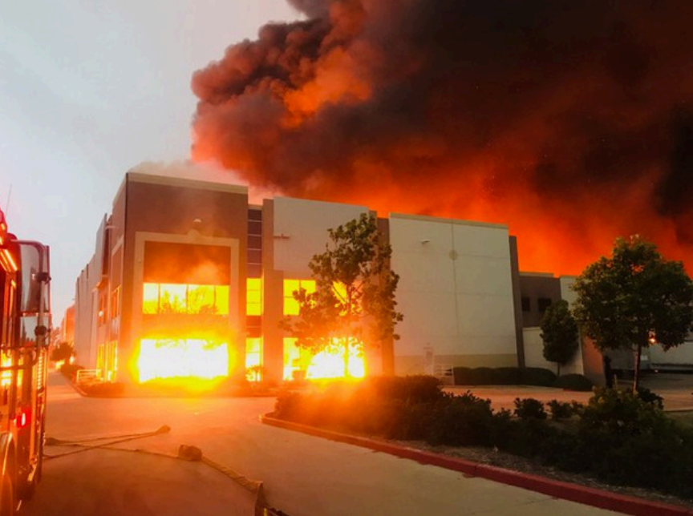
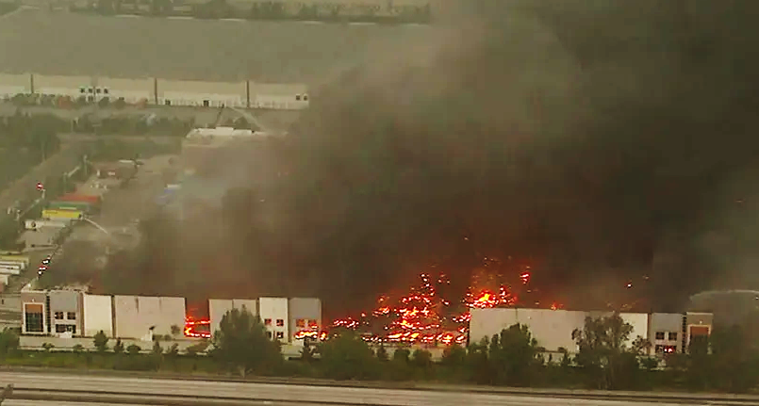
Live
Amazon Crisis
A fire early Friday destroyed a Southern California distribution facility that was used to ship items to Amazon customers.
Authorities said employees got out and there were no reports of injuries.

Slide 7
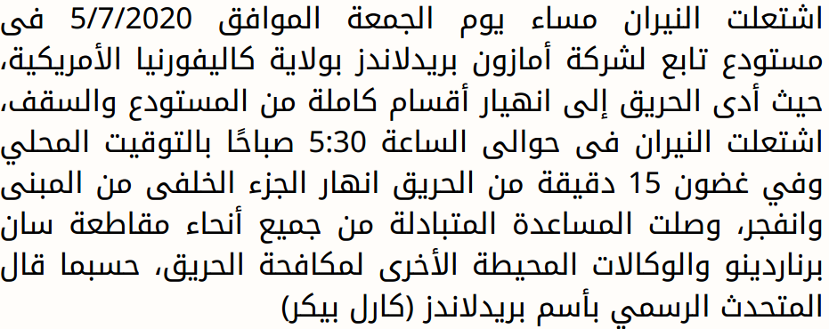
Lecture
10
Case Study
Live

Slide 8
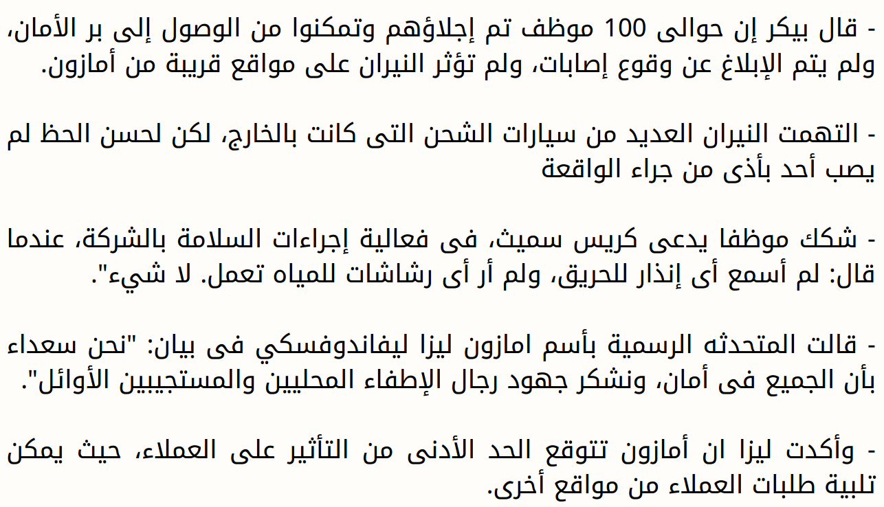
Lecture
10
Case Study
Live

Slide 9
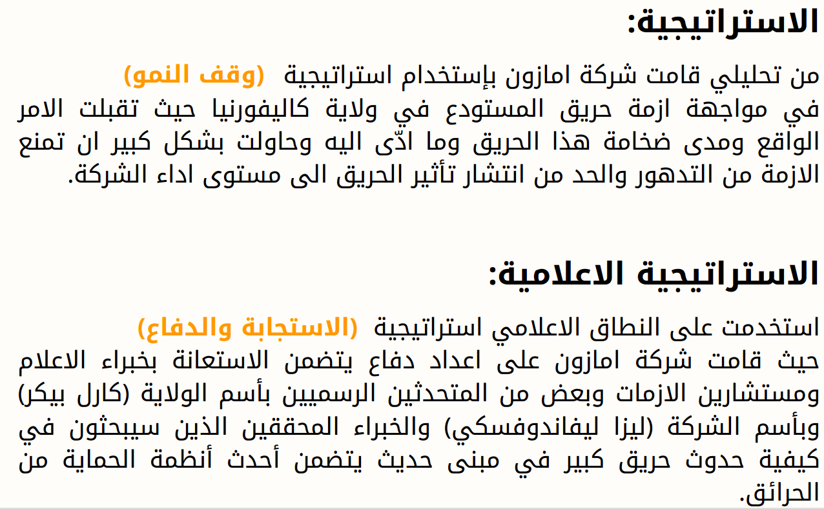
Lecture
10
Case Study
Live

Slide 10
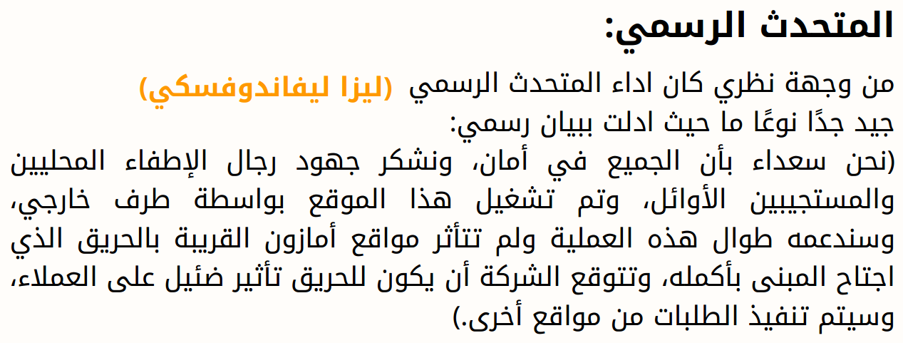
Lecture
10
Case Study
Live

Slide 11
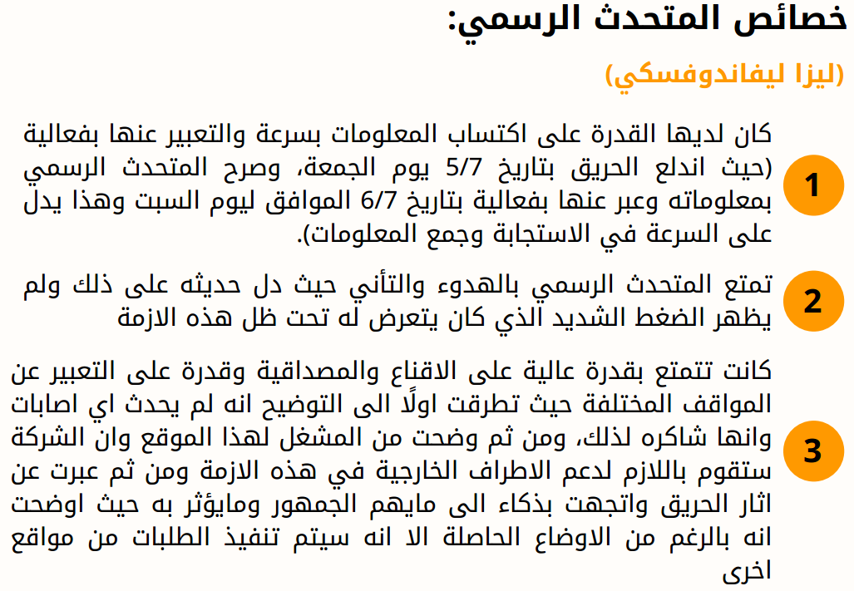
Lecture
10
Case Study
Live

Slide 12
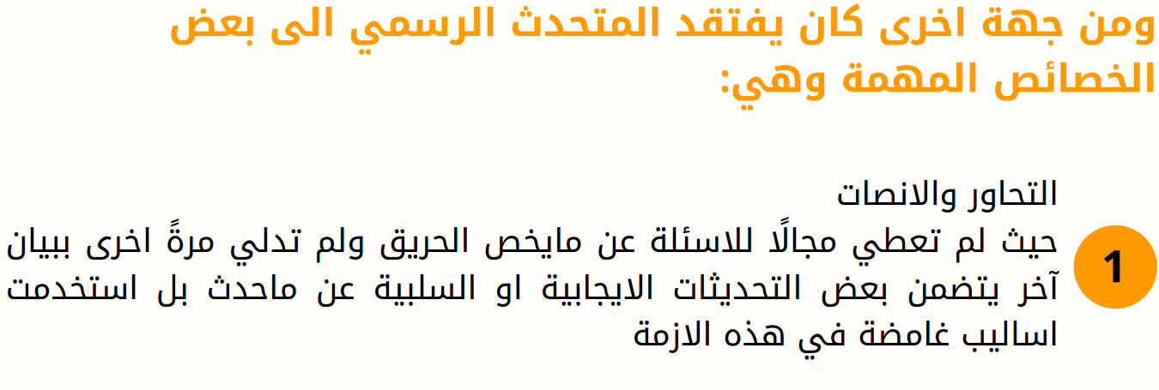
Lecture
10
Case Study
Live

Slide 13
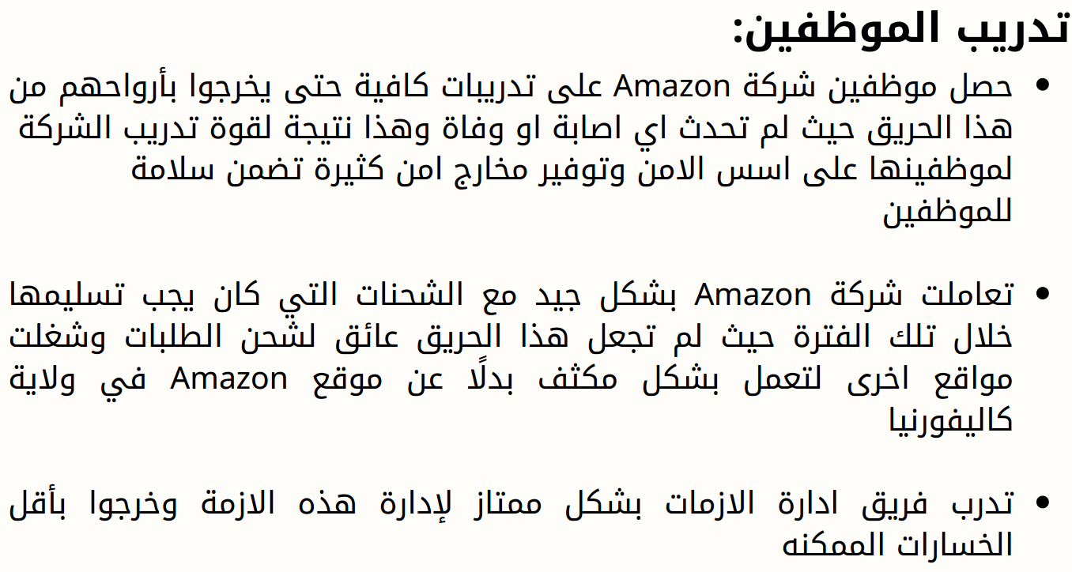
Lecture
10
Case Study
Live

Slide 14
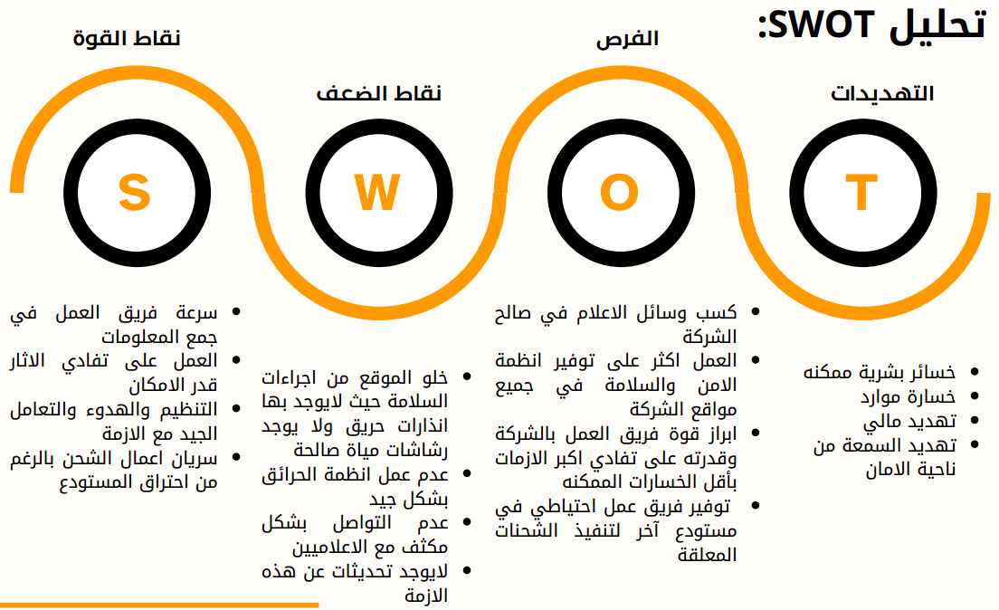
Lecture
10
Case Study
Live

Slide 15
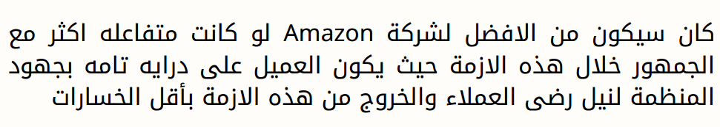
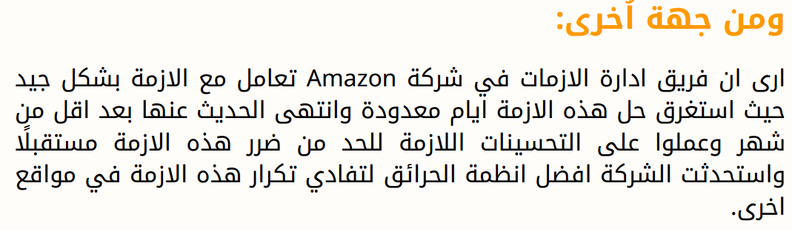

Lecture
10
Case Study
Live
تحليل الأزمة
استراتيجية الإماتة

Slide 16

Internal Communication

Slide 17
Lecture
10
Internal Communication
Organizations communicate in two directions: internally to staff and externally to clients, customers, shareholders, stakeholders, the media.
Faulty internal communications can lead to mistakes, discouraged and unhappy staff, employees leaving the company.
Poor external communications can damage image and sales. It really is that simple. Any overall management strategy needs a communications plan or the whole operation might fail.
A communications auditمراجعة / تدقيق / فحص analyzes an organization’s practices to reveal how effective they are—throughout a whole company or in specified parts of the organization. It can pinpoint problem areas such as frequent misunderstandings سوء الفهم, information blocks حجب المعلومات, information lacks ، نقص المعلومات, information duplication ازدواجية المعلومات, misrepresentation التحريف. An audit could be part of a periodic health check, but it is especially helpful at a time of change: a merger or acquisition, launch of a new product or service, entry into new markets, for example.

Slide 18
Lecture
10
Internal Communication
Communication is a complex process with potential pitfalls الصعوبات at each stage. Is the message clear? Is the medium for transmitting it appropriate? Has the recipient actually received it? If so, has it been understood? Has it had the desired effect? Does the recipient have a channel for feedback? Can the recipient understand how to provide the feedback? You thought you said one thing but when you check you find that a totally different message was actually received.
The evaluation report will consider attitudes towards the communications (do people look forward to meetings or consider them a waste of time?); it will look at the needs of different groups (the most appropriate way to deliver training, for example) and it will provide evidence of any problems that need to be addressed.

Slide 19
Lecture
10
Internal Communication
When a crisis occurs, it is essential to:
• Demonstrate your willingness to cooperate with officials, key audiences and industry support;
• Provide timely, accurate, and credible information regarding the situation;
• Communicate accurately and effectively to all target audiences;
• Are prepared to verify the training provided to workers;
• Act quickly and appropriately in response to the media;
• Protect the name and reputation of your company; and
• Maintain employee, producer, customer and industry confidence.

Slide 20

Influencer Communication

Slide 21
Lecture
10
Influencer Communication
What is Influencer Communication?
Influencer Communications اتصالات المؤثرينis a messaging-based approach to marketing communications that ensures consistency in how brands are perceived in different mediums, such as news coverage, social media, speaking engagements, investor presentations, analyst reports, and content marketing.
The relevance of social media influencers for organizations has grown rapidly during the last years. Strategic communication الاتصال الاستراتيجي faces the challenge to find new ways how to manage their influencer activities because established communication management concepts cannot simply be applied to influencers.
التسويق المؤثر أو التسويق عبر المؤثرين

Slide 22
Lecture
10
Influencer Communication
This is due to at least two characteristics of influencer communication:
First, many influencers strive to monetize their status as micro-celebrities المشاهير الصغار.
Second, influencers combine functions that different actors have fulfilled previously, e.g. creative agencies, advertising media, journalistic media, testimonial givers, and opinion leaders. This intermingling متداخل of functions in just one actor implies that routine procedures that are tailored to mono-functional actors may fall short.
For example, organizations have to approach travel influencers differently than travel journalists.
Due to these two characteristics, organizations’ communication departments and their agencies are confronted with the task of adapting their routines to influencer communication or even developing new routines.
يسعى العديد من المؤثرين لتحقيق الدخل من وضعهم كمشاهير صغار
وهذا الاختلاط بين الوظائف في جهة فاعلة واحدة فقط يعني أن الإجراءات الروتينية المصممة خصيصًا للجهات الفاعلة ذات الوظيفة الواحدة قد تكون قاصرة.
وبسبب هاتين الخاصيتين، تواجه أقسام الاتصال في المنظمات ووكالاتها مهمة تكييف إجراءاتها الروتينية وفقًا للتواصل مع المؤثرين أو حتى تطوير إجراءات جديدة.

Slide 23
Lecture
10
Influencer Communication
Yet despite the growing importance of influencer communication, little is known about how organizations and agencies manage their influencer activities.
Influencers as a new voice in strategic communication
Early research on social media influencers has defined this stakeholder group as “third party endorser الطرف الثالث المؤيدwho shape audience attitudes through blogs, tweets, and the use of other social media”
The Role of Internal Influencers in Communications Strategy
Many companies have long relied on external influencers, such as industry experts, analysts, and thought leaders, to communicate their message. But the rise of employee advocacy has given way to a new breed of influencers—internal influencers. These key people, located within the heart of your business, can be crucial in shaping your organization’s employee communications strategy.

Slide 24
Lecture
10
Influencer Communication
Internal influencers are employees who can shape their colleagues’ opinions, beliefs, and behaviors. Sometimes referred to as employee influencers, these individuals are highly respected and trusted by their colleagues. By leveraging their power, internal influencers can significantly impact your company’s culture and communications. ثقافة واتصالات الشركة
According to a study, 70% of employees are likelier to trust information about their company that they receive from their colleagues than from the company’s official channels. When you think about it, this makes a ton of sense. Who better to understand the decisions made by the leadership team than those directly affected by them? Who better to disseminate a new policy or initiative than someone “on the inside”?

Slide 25

Media Communication

Slide 26
Lecture
10
Media Communication
Relationships & Preparation
Good media relations begin
long before you are contacted.
Draft and implement a media policy.
Educate employees on the policy.
Identify and train a lead spokesperson.
Establish relationships with reporters.
Know your Target Audiences.
Develop and know your Key and Secondary Messages.
Anticipate and prepare for questions.
Answer questions with your messages.
No comment is usually no good.
If you hide from the media, most people
will suspect that you have something to hide.

Slide 27
Lecture
10
Media Communication
What to Do When a Reporter Calls :
Immediately
WHO is calling?
Get a name, title, media outlet, deadline.
Try to get a “time out”
Decide who will speak to the reporter
Decide your key messages
Think of likely questions…write them down
Rehearse, at least mentally

Slide 28
Lecture
10
Media Communication
Your Target Audiences/Publics:
If you say something publicly
Who
will hear it and
How
will it affect them?
The general public (current, past and future clients)
Regulators and legislatorsالمنظمين والمشرعين
Employees
The media

Slide 29
Lecture
10
Media Communication
Develop Your Messages :
What you say will have an effect on each target audience.
So, what do you say?
  Key Messages
  The Key Message is applicable to any audience.
  The Key Message should register an immediate impression.
  Secondary Messages
  Secondary Messages are customized for specific audiences.
  Develop your messages before you talk with a reporter.
  Rehearse and repeat them during the interview, no matter the question.

Slide 30
Lecture
10
Media Communication
Develop Your Messages :
Appearance is critical ?
  Studies show upwards of 75 percent of information comes from the eyes – much less from the ears
  Need to look the role تحتاج إلى إلقاء نظرة على الدور
  Professional
  Execution
  Be brief.
  Get your key messages across early and frequently.
  Know when to stop talking.
  Do not speculate المضاربة .
  Avoid sarcasm سخرية.

Slide 31
Lecture
10
Media Communication
Develop Your Messages :
  Execution
  Always tell the truth. NEVER lie to a reporter!
  Keep your cool.
  Be positive, not negative.
  Avoid slang language.
  Build bridges from loaded questions to informative answers.
  Repeat your key messages before you conclude.

Slide 32
Lecture
10
Media Communication
  Evaluation
  1. Read your clips; watch newscasts نشرات الأخبار.
  2. Be critical of your performance.
  3. Check your quotes — accurate or inaccurate?
  4 Make corrections, if necessary.
  5. Commend accuracy أثني على الدقة.
  6. Follow up in writing.
  7. All correspondence on an issue must be consistent.
  8. Send copies of the stories that support your messages to your key audiences.
يجب أن تكون جميع المراسلات المتعلقة بمسألة ما متسقة
أرسل نسخًا من القصص التي تدعم رسائلك إلى جماهيرك الرئيسية.

Slide 33

Communicating on Social Channels

Slide 34
Lecture
10
Communicating on Social Channels
Social media are internet-based technologies that allow collaboration and information sharing. Importantly, social media enables the two-way flow of information where the public can contribute to content development and sharing. Social media technologies are often referred to as web 2.0 technologies as they move from a one-way dissemination model of information sharing to an interactive environment where communication and conversations flow in multiple directions.
The relationship between social media and crisis communications is an interesting and somehow controversial topic. While it is undeniable that social media platforms represent useful low-cost tools, their use during a crisis carries a number of risks that we must consider carefully. Nowadays, organizations cannot avoid having a social media footprint and, whether they like it or not, building a strong social media presence can make a difference during a crisis.

Slide 35
Lecture
10
Communicating on Social Channels
Social Media in Crisis Communications Report 2020

Slide 36
Lecture
10
Communicating on Social Channels
The majority (72%) of organizations rely on social media to communicate or gather information during a disruptive event. Most respondents revealed during a series of in-depth interviews that they monitor a wealth of threats, including reputation damage. While most of them perform this function internally, two stated that their organizations employ a third party to take care of social media monitoring. Out of the interviewees who analyze social media, nearly two-thirds use specific software to do so, while the remaining third adopt manual monitoring.
The report highlights the attractiveness of social media for crisis communications, due to low costs and staff familiarity with them, among others. Further, professionals think that social media has a responsibility in guaranteeing a reliable service during an incident. Nearly half of the sample rely on social media to the extent which, in case these were unavailable, their crisis communications capabilities would be seriously limited.
ويسلط التقرير الضوء على جاذبية وسائل التواصل الاجتماعي للاتصالات في الأزمات، بسبب انخفاض تكاليفها وإلمام الموظفين بها، من بين أمور أخرى. علاوة على ذلك، يعتقد المحترفون أن وسائل التواصل الاجتماعي تتحمل مسؤولية ضمان خدمة موثوقة أثناء وقوع الحادث. ويعتمد ما يقرب من نصف العينة على وسائل التواصل الاجتماعي لدرجة أنه في حالة عدم توفرها، ستكون قدراتهم على الاتصال بالأزمات محدودة للغاية.

Slide 37

Crisis Scenario Planning

Slide 38
Lecture
10
Crisis Scenario Planning
A crisis is the ultimate unplanned activity and the ultimate test for managers. In a time of crisis, conventional management practices are inadequate and ways of responding usually insufficient. A communications practitioner with global experience, details a well-managed crisis response that will leave stakeholders with a favorable impression and renewed confidence in the affected company.
1. Crisis prevention: The case for issues management
The first task is to identify crisis risks or to recognize a crisis when it breaks out. From a communications standpoint, a crisis is a business or organizational problem that is exposed to public attention, and that threatens a company’s reputation and its ability to conduct business.
Although some risks are beyond a company’s control, others can be foreseen.

Slide 39
Lecture
10
Crisis Scenario Planning
Research shows that the vast majority of crises arise when companies fail to identify a potentially contentious issue at an earlier, more benign stage مرحلة حميدة, and to develop a plan of action to manage the issue before the issue manages them.
Creating a crisis communications plan
The issues audit becomes the front end of a company’s crisis communications plan, and arguably, the most important document in the plan. As a complement to a company’s emergency procedures, the crisis plan should contain detailed communications response procedures in the event that any of the potential crises identified in the communications audit, or unforeseen external events, come to pass.
Testing the plan
In order to ensure that the messages contained in the crisis plan are delivered effectively and with credibility, and that the plan can be carried out, it needs to be tested. This is where crisis training and simulations come in, as well as media training.

Slide 40
Lecture
10
Crisis Scenario Planning
2. Crisis Management: “Plan for the worst; hope for the best”
Despite the best planning and foresight, organizations inevitably لا محالة find themselves in a crisis from time to time.
Research has discovered common internal reactions when the issue first breaks.
Before the company knows about the incident, cameras are on the scene. In the absence of real information, an organization cannot respond meaningfully. However, that doesn’t stop media from reporting on it live, minute by minute.
As events escalate, management senses a loss of control over the issue.
خطط للأسوأ؛ نأمل للأفضل
قبل أن تعرف الشركة بالحادث، تكون الكاميرات في مكان الحادث. وفي غياب المعلومات الحقيقية، لا تستطيع المنظمة الاستجابة بشكل هادف. ومع ذلك، فإن هذا لا يمنع وسائل الإعلام من الإبلاغ عنها مباشرة، دقيقة بدقيقة. ومع تصاعد الأحداث، تشعر الإدارة بفقدان السيطرة على المشكلة.

Slide 41
Lecture
10
Crisis Scenario Planning
Assessing a crisis
One of the most vital skills a company can possess is the ability to determine if, when and at what level of importance a crisis has struck:
Is this a crisis, or is it simply a continuing business problem coming to the surface?
Is it confined to a local area, or does it have the potential to become a situation of national or international importance?
Has someone verified the incident or crisis?
What are the legal implications?
What level of resources will be required to manage it?
هل هذه أزمة أم أنها مجرد مشكلة تجارية مستمرة تظهر على السطح؟
هل هي محصورة في منطقة محلية أم أنها لديها القدرة على التحول إلى موقف له أهمية وطنية أو دولية؟
هل قام أحد بالتحقق من الحادث أو الأزمة؟
ما هي الآثار القانونية؟
ما هو مستوى الموارد المطلوبة لإدارتها؟

Slide 42
Lecture
10
Crisis Scenario Planning
3. Crisis recovery: Regaining trust
A company should examine the impact the incident has had on its brand(s) and reputation. If the brand has taken a hit, a company may need to give consumers a reason to trust them again.
Companies should consider a broad range of potential communication initiatives to restore trust and loyalty.
Public opinion surveys can track changes in attitudes towards a company in the weeks and months after reputation-focused programs are launched.

Slide 43

Ten rules for crisis management

Slide 44
Lecture
10
Ten rules for crisis management
1. Respect the role of the media.
The media are not the enemy; they have direct access to the audiences you need to reach. Rather than avoiding media, use them as a channel to communicate key messages. Prepare a statement that includes the confirmed facts; communicate what the company is doing and provide background information.

Slide 45
Lecture
10
Ten rules for crisis management
2. Communicate, communicate, communicate.
The first rule of crisis management is to communicate. Early hours are critical and they set the tone for the duration of the crisis. The media’s first questions are likely to be simple and predictable:
              What happened? What are you doing about it?
              Why happened? Were there warning signs?
              Where?
              When did you know of the problem?
              Who’s to blame?
              How will life or property be protected or compensated?
5 Ws & H?

Slide 46
Lecture
10
Ten rules for crisis management
3.Take responsibility. One of the more controversial tenets of crisis management is that someone involved in a crisis must be prepared to empathize, even publicly apologize, for the events that have transpired. This is different from accepting blame. Taking responsibility means communicating what an organization is doing to remedy a situation علاج الوضع that the media and the public have determined involve that organization in some way.
4.Centralize information. A company needs to move quickly to gain control over information and the resolution of the crisis. Ensure that appropriate levels of management are updated with information from a wide variety of sources (media coverage, analyst comments, competitive intelligence, managers’ first-hand reports, etc.).

Slide 47
Lecture
10
Ten rules for crisis management
5.Establish a crisis team. Create and train the crisis team before a crisis strikes, and establish a situation room. During a crisis, when everyone goes into action, be sure the team has access to the highest levels of management.
6.“Plan for the worst; hope for the best.” Assume the worst-case scenario. Develop contingencies for the hours and days ahead, forecast possible consequences and determine plans of action.
7.Communicate with employees. Remember that employees are your front-line “ambassadors” in a crisis. Be sure they are aware of what the company is doing to deal with the situation.

Slide 48
Lecture
10
Ten rules for crisis management
8.Third parties. Use third parties to speak on your behalf. Third parties act as character witnesses and often carry more credibility than the organization at the center of a crisis. (INFLUENCERS)
9.Use research to determine responses. Polling, market research and focus groups provide essential insight into the magnitude of a crisis and public attitudes about where hidden issues may lie. Monitor the Internet, chat rooms and blogs.
10.Create a website – If circumstances warrant, create a website to give quick, up-to-the-minute information and get the company’s story out.

Slide 49
Lecture
10
Conclusion
Crisis Communication and Management
Internal Communication
Influencer Communication
Media Communication
Communicating on Social Channels
Crisis Scenario Planning
Ten rules for crisis management

Slide 50
Lecture
10
Recommended Reference
Borchers, N. S., & Enke, N. (2021). Managing strategic influencer communication: A systematic overview on emerging planning, organization, and controlling routines. Public Relations Review, 47(3), 102041. https://doi.org/10.1016/j.pubrev.2021.102041
Riglietti, G., Eyerman, J., Aguada, L., & Muhammad, K. (2023, July 9). Social Media in Crisis Communications Report 2020. RTI. https://www.rti.org/publication/social-media-crisis-communications-report-2020
Kim, Y. (2015). Toward an Ethical Model of Effective Crisis Communication. Business &
Society Review (00453609), 120(1), 57-81.
Britton, G. (2023, March 23). The role of internal influencers in communications strategy. Poppulo. https://www.poppulo.com/blog/the-role-of-internal-influencers-in-communications-strategy
Destiny , O., & Asude, E. (2018, December). Social Media and Crisis Management: A review and analysis of existing ... LAÜ Sosyal Bilimler Dergisi. http://euljss.eul.edu.tr/article-6.pdf
Influencer Communications. public relations. Shaping Infleunce. JMRConnect. (2023, August 1). https://jmrconnect.net/influencer-communications-services-2/
Morris, A. (n.d.). Media Relations . Power of Ten Leadership Academy. Retrieved July 1, 2023, from https://dokumen.tips.
Zink, J. (n.d.). Chapter 11: Assessing Organizational Communication Quality. Organizational Communication. https://pressbooks.pub/jgzink/chapter/chapter-11-assessing-organizational-communication-quality/

Slide 51


Thank You

