Slide 1


Computer Organization and Architecture
Prepared by Dr. Eng. Gamal Selim
Lecture 09

Slide 2
Revision

Slide 3
Digital Circuits Cont.
Multiplexer
Demultiplexer

Slide 4
Multiplexer / Demultiplexer
The basic function of the Multiplexer (MUX).
The typical application of a MUX.
A 4-to-1 MUX designed with Small Scale Integration (SSI).
A 4-to-1, 8-to-1, & 16-to-1 Medium Scale Integration (MSI) MUX.
The basic function of the Demultiplexer (DEMUX).
The typical application of a DEMUX.
A 1-to-4 DEMUX design with Small Scale Integration (SSI).

Slide 5
Multiplexer (MUX)

Slide 6
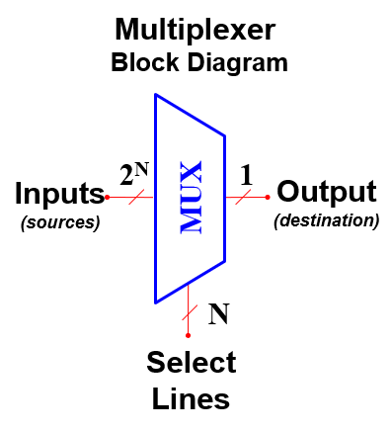
What is a Multiplexer (MUX)?
A MUX is a digital switch that has multiple inputs (sources) and a single output (destination).
The select lines determine which input
is connected to the output.
MUX Types
  → 2-to-1 (1 select line)
  → 4-to-1 (2 select lines)
  → 8-to-1 (3 select lines)
  → 16-to-1 (4 select lines)

Slide 7
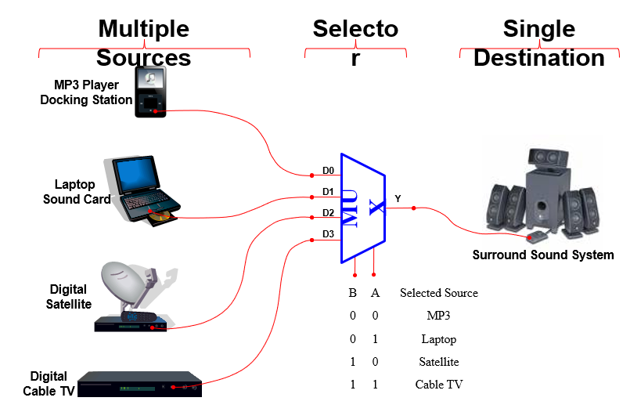
Typical Application of a MUX

Slide 8
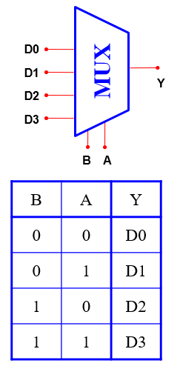
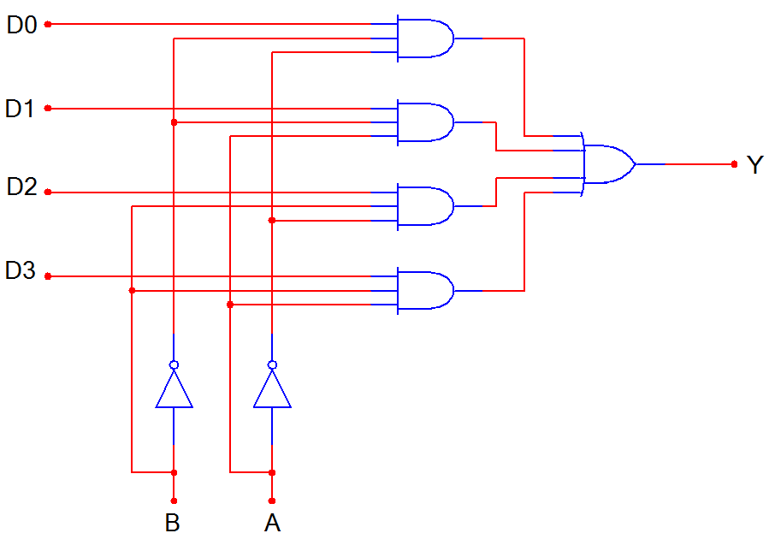
4-to-1 Multiplexer (MUX)

Slide 9
DeMultiplexer (DEMUX)

Slide 10
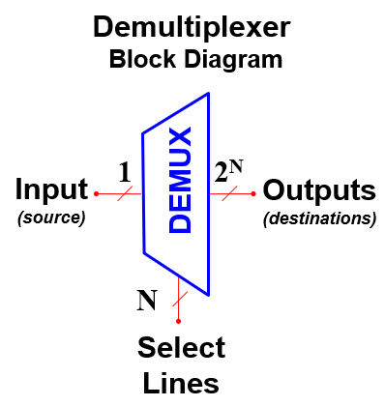
What is a Demultiplexer (DEMUX)?
A DEMUX is a digital switch with a single input (source) and a multiple outputs (destinations).
The select lines determine which output
the input is connected to.
DEMUX Types
  → 1-to-2 (1 select line)
  → 1-to-4 (2 select lines)
  → 1-to-8 (3 select lines)
  → 1-to-16 (4 select lines)

Slide 11
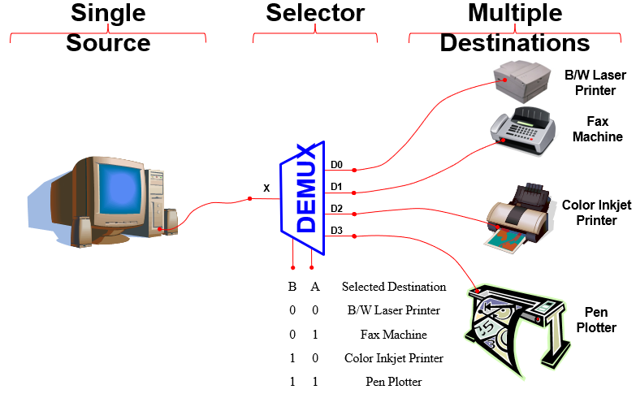
Typical Application of a DEMUX

Slide 12
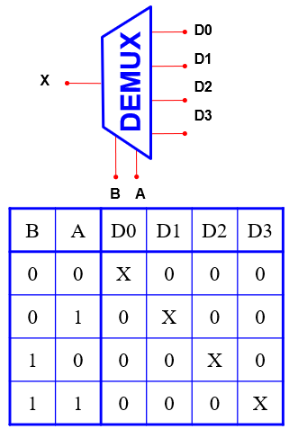
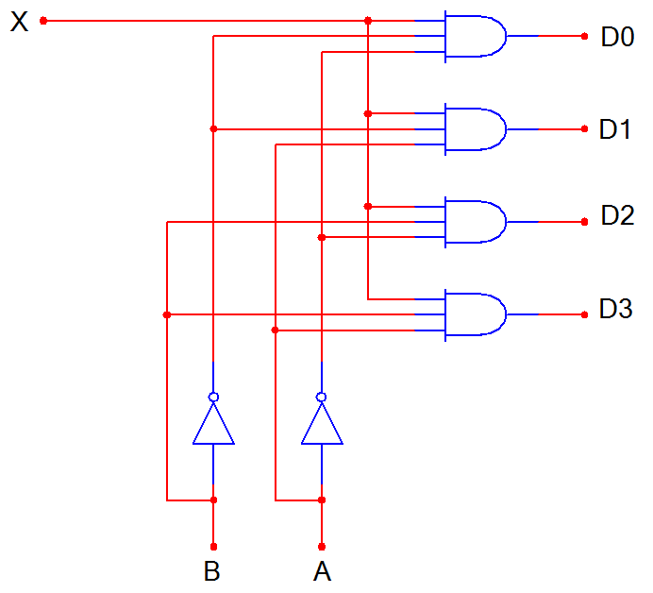
1-to-4 De-Multiplexer (DEMUX)

Slide 13
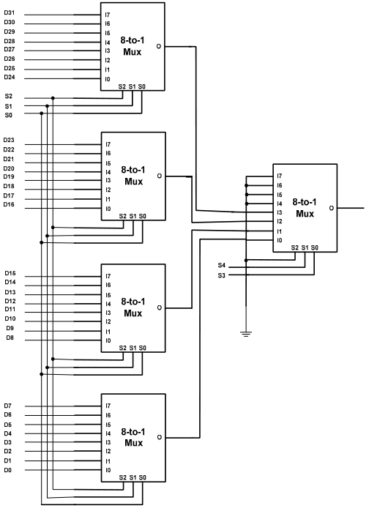
Example of expansion Multiplexer
  Design a 32-to-1 multiplexer using only 8-to-1 multiplexer
We use four 8-to-1 in the first stage and another
one to select between the output of the others:

Slide 14
MUX vs DeMUX

Slide 15
Difference between Multiplexer and Demultiplexer
  Both multiplexer and demultiplexer are types of combinational digital circuit that are used in several large-scale digital systems. However, there are many differences between a multiplexer and a demultiplexer, which are highlighted in the following table

Slide 16
Difference between Multiplexer and Demultiplexer
Basis of Difference | Multiplexer | Demultiplexer
Definition | A multiplexer is a combinational digital circuit that takes multiple data inputs and provides only single output. | A demultiplexer is a combinational digital circuit that takes single input and provides multiple outputs.
Abbreviated name | The abbreviation used to represent the multiplexer is MUX. | The abbreviation used to represent the demultiplexer is DEMUX.
Input and output lines | Multiplexer has 2^{n} input lines and 1 output line. Where, n is the number of select lines. | Demultiplexer has 1 input line and 2^{n} output lines. Where, n is the number of select lines.
Also known as | Multiplexer is also known as a "data selector". | Demultiplexer is also known as "data distributor".

Slide 17
Difference between Multiplexer and Demultiplexer
Basis of Difference | Multiplexer | Demultiplexer
Operating principle | The operating principle of the multiplexer is "many to one". | The operating principle of a demultiplexer is “one to many".
Acts as | Multiplexer acts as a digital multi-position switch. | Demultiplexer acts as a digital circuit.
Conversion technique | A multiplexer performs parallel to serial conversion. | A demultiplexer performs serial to parallel conversion.
Function of control signal | In case of multiplexer, the function of control signal is to select a specific input that has to be transmitted at the output. | In demultiplexer, the function of control signal is to deliver the single input signal over the multiple output lines.

Slide 18
Difference between Multiplexer and Demultiplexer
Basis of Difference | Multiplexer | Demultiplexer
Examples | Examples of some common multiplexers are − 8:1 Multiplexer 16:1 Multiplexer 32:1 Multiplexer | Some common demultiplexers are − 1:2 Demultiplexer 1:4 Demultiplexer 1:8 Demultiplexer 1:16 Demultiplexer
Practical importance | In practice, the multiplexer increases the efficiency of the communication system by enabling the data transmission using a single line. | In practice, the demultiplexer takes the output of a multiplexer and convert in its original form at the receiver end.

Slide 19
Difference between Multiplexer and Demultiplexer
Basis of Difference | Multiplexer | Demultiplexer
Usage in time-division multiplexing | A multiplexer is used at the transmitter end in the time-division multiplexing (TDM). | The demultiplexer is used at the receiver end in the time-division multiplexing.
Applications | The multiplexers are commonly used in communication systems, telephone networks, computer memories, etc. | The demultiplexers are used in communication systems, reconstruction of parallel data, ALU, etc.

Slide 20
Internal Memory

Slide 21
Computer memories
Computer memories are categorized into:
  Internal memories
  External Memories
Internal memories: directly attached to main board and directly accessible by the processor.
  Main memories (RAM and ROM)
  Cache Memory
  Registers
External memories: secondary storage devices that are accessible by the processor via an I/O module.
  Disks (Hard Disk or Floppy Disk or optical Disks)
  Tape

Slide 22
Characteristics of memory systems
The most important characteristics of computer memories are:
Location
Capacity
Unit of transfer
Access method
Performance
Physical type
Physical characteristics
Organization

Slide 23
Location
The term location refers to whether the memory is internal or external to the computer.
  CPU (registers)
  Internal (main memory and caches)
  External (secondary storages)

Slide 24
Capacity
Capacity is the size of memory.
For internal memory, capacity is expressed in terms of bytes or words with:
  Word size: Common word lengths are 8, 16, and 32 bits
  Number of words
For external memory, capacity is expressed in terms of bytes.

Slide 25
Unit of Transfer
For internal memory, unit of data transfer is the number of bits read out of or written into memory at a time.
  The unit of transfer need not equal a word or an addressable unit. It is Usually governed by data bus width.
For External memory, unit of data transfer is the blocks.
  a block is Usually much larger than a word.
Addressable unit:
  Smallest location which can be uniquely addressed
    Word level or byte level in internal memory
    Cluster on M$ disks

Slide 26
Access Methods (1)
Access Method is the way the processor can write or retrieve data to or from a memory.
Sequential Access: Access is made in a linear sequence.
  Start at the beginning and read through locations in order
  Access time depends on the location of data and previous location
  e.g. tape
Direct Access:
  Individual blocks have unique address based on its location
  Access is done by jumping (direct access) to a general part, then additional sequential search in this part to reach the final location.
  Access time depends on location and previous location
  e.g. disk

Slide 27
Access Methods (2)
Random Access:
  Each location in memory has individual/unique address.
  Access time is independent on the location or the previous access and is then constant
  e.g. RAM
Associative Access:
  Data is located by a comparison with contents of a portion of the store
  Access time is independent of location or previous access
  e.g. cache

Slide 28
Performance
Three performance parameters are used:
Access time (Latency)
  the time required to perform a read or write operation, that is, the time between presenting the address and getting the valid data.
Memory Cycle time
  Cycle time is the access time + recovery time
  The recovery time is the additional time required before a next access can commence. (required time for transients of signals on system bus)
Transfer Rate
  Rate at which data can be moved or transferred into or out of memory unit.

Slide 29
Physical Types
The most common physical types are:
Semiconductor memory
  RAM
  ROM
Magnetic surface memory
  used for Disks & Tape
Optical
  used for CD & DVD
magneto-optical

Slide 30
Physical Characteristics
The physical characteristics of data storage are: volatile and nonvolatile memory .
volatile memory: information decays naturally or is lost when electrical power is switched off.
nonvolatile memory: information once recorded remains without change until deliberately changed.
Examples:
    Magnetic-surface memories are nonvolatile.
    Semiconductor memory may he either volatile or nonvolatile.
    Nonerasable memory cannot be altered, except by destroying the storage unit, hence, a nonerasable memory must also be nonvolatile. Semiconductor memory of this type is known as read­-only memory (ROM).

Slide 31
Organization
The organization is meant the following:
The Physical arrangement of bits to form words. The obvious arrangement is not always used, as will be explained presently.
The Physical arrangement of words to form a memory device.

Slide 32
Memory Hierarchy
- Computer memory is organized into a hierarchy:
Registers
  In CPU
Cache memory
  May include one or more levels of cache
Main memory
  “RAM” and ROM
External memory
  secondary storage

Slide 33
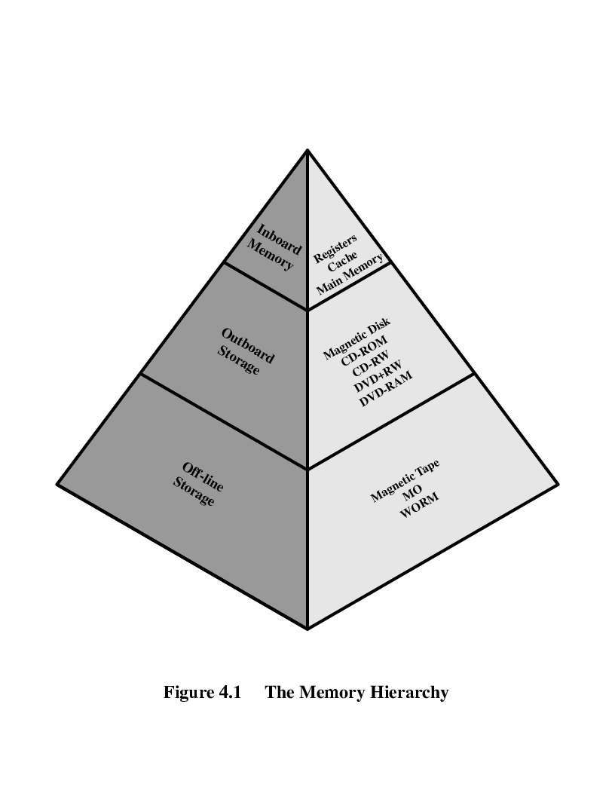
Memory Hierarchy Diagram and List
Registers
L1 Cache
L2 Cache
Main memory
Disk cache
Disk
Optical
Tape

Slide 34
Three key Questions
How much?
  Capacity
How fast?
  Access Time
How expensive?
  Cost or money
There is a trade-off among the three key characteristics of memory: cost, capacity, and access time:
  Faster access time, greater cost per bit
  Greater capacity, smaller cost per bit
  Greater capacity, slower access time

Slide 35
So you want fast?
It is possible to build a computer which uses only static RAM (see later)
This would be very fast
This would need no cache
  How can you cache cache?
This would cost a very large amount

Slide 36
The Bottom Line
As one goes down the hierarchy, the following occur:
  Decreasing cost per bit
  Increasing capacity
  Increasing access time
  Decreasing frequency of access of the memory by the processor

Slide 37
Semiconductor Memory
Today, the main memories chips are constructed from semiconductor.
Types of semiconductor memories:
  RAM
    SRAM
    DRAM
  ROM
    Mask ROM,
    PROM,
    EPROM,
    EEPROM,
    flash Memory
The main difference between a RAM and a ROM is that a RAM is written under normal operation, while a ROM is programmed outside the computer and is only normally read.

Slide 38
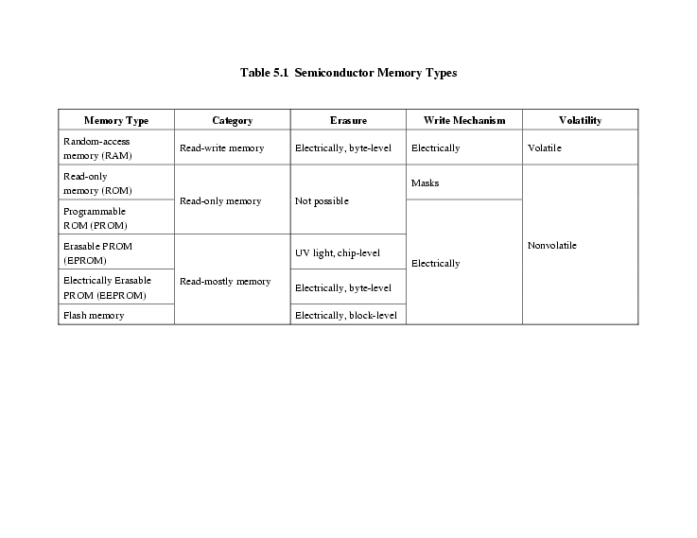
Semiconductor Memory Types
Types of semiconductor memories and properties:

Slide 39
Semiconductor Memory cell
The basic element of a semiconductor memory is the memory cell.
All semiconductor memory cells share certain properties:
  They exhibit two stable states, which can be used to represent binary 1 and 0.
  They are capable of being written into (at least once), to set the state.
  They are capable of being read to sense the state.

Slide 40
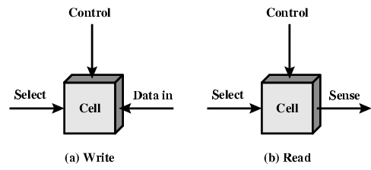
Memory Cell Operation
The memory cell has three terminals capable of carrying an electrical signal.
  Select terminal, selects a memory cell for a read or write operation (through address Bus).
  Control terminal indicates read or write (control Bus).
  Data in, for writing, provides an electrical signal that sets the state of the cell to 1 or 0 (Data Bus).
  Sense, for reading, that terminal is used for output of the cell’s state (Data Bus).

Slide 41
Random Access Memory (RAM)
Characteristics of RAM:
  Random Access: individual words of memory are directly accessed through wired-in addressing logic.
  Read/Write data from/to memory.
  Volatile: data are lost when the power turned OFF
  RAM is used only as Temporary data storage
  Access time is constant for any location.
Types of RAM:
  SRAM (Static RAM)
  DRAM (Dynamic RAM)

Slide 42
Static RAM
A static RAM (SRAM) is a digital device, using the same logic elements used in the processor.
Binary values are stored using traditional flip-flop logic-gate configurations.
Reading or Writing binary bits are based on two on/off switches.
A static RAM will hold its data as long as the power is supplied to it.
Because no special action (except power) is required to retain stored data, these devices are called static memory. In other words, a binary bit is temporary stored as a result of the operation of two inverters connected back to back.

Slide 43
Dynamic RAM
A dynamic RAM (DRAM) is an analog device that made with cells store data as charge on capacitors.
The presence or absence of charge on a capacitor is interpreted as a binary 1 or 0.
Because capacitors have a natural tendency to discharge, a DRAM requires periodic charge refreshing to maintain data storage, even when powered.
Because refresh circuit is required to retain stored data, these devices are called dynamic memory.

Slide 44
SRAM versus DRAM
Both SRAM and DRAM are Volatile
  Power is needed to preserve data
DRAM
Essentially analogue
  Level of charge determines the binary value
DRAM more dense
Less expensive
Dynamic cell
  Simpler to build
  smaller per bit
  Bits are stored as charge
  Need refresh circuit
Less expensive
Slower
Used in Main memory
SRAM
Essentially Digital
  the bin values are stored as a static volt level high or low.
SRAM less dense
More expensive
SRAM Cell
  More complex construction
  Larger per bit
  Bits are stored in flip-flop.
  No refreshing needed when powered
more expensive
Faster
Used in Cache

Slide 45




  Thank You

