Slide 1


Foundations of
Individual Behaviour
Personality and Values
Prepared by Dr. Mumen Thabet
Lecture 8

Slide 2
Ability
Ability is an individual’s capacity to perform the various tasks in a job. It is made up of two sets of factors:
Intellectual Abilities
  The abilities needed to perform mental activities like thinking and reasoning.
  No correlation between intelligence and job satisfaction.
Physical Abilities
  The capacity to do tasks demanding stamina, dexterity, strength, and similar characteristics.

Slide 3
Dimensions of Intellectual Ability
Intellectual Ability
Number Aptitude
Verbal Comprehension
Perceptual Speed
Inductive Reasoning
Deductive Reasoning
Spatial Visualization
Memory

Slide 4
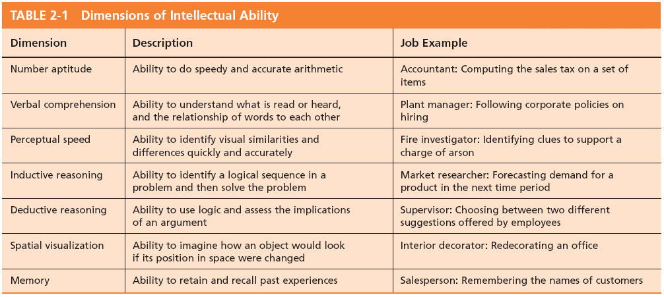
Dimensions of Intellectual Ability
© Pearson Education 2012

Slide 5
Biographical Characteristics
Objective and easily obtained personal characteristics:
Age
  Older workers bring experience, judgment, a strong work ethic, and commitment to quality.
Gender
  Very few differences exist between men and women that affect job performance.
Race
  The biological heritage used to identify oneself.
  Contentious issue: differences exist but could be more culture-based than race-based.

Slide 6
Learning
Learning is any relatively permanent change in behavior that occurs because of experience
Learning components:
Involves Change
Is Relatively Permanent
Is Acquired Through Experience

Slide 7
Theories of Learning
Classical Conditioning
  A type of conditioning in which an individual responds to some stimulus that would not ordinarily produce such a response.
Operant Conditioning
  A type of conditioning in which desired voluntary behavior leads to a reward or prevents a punishment.
Social-Learning Theory
  People can learn through observation and direct experience.

Slide 8
Classical Conditioning
Pavlov’s Dog Drool
Key Concepts:
  Unconditioned stimulus
    A naturally occurring phenomenon.
  Unconditioned response
    The naturally occurring response to a natural stimulus.
  Conditioned stimulus
    An artificial stimulus introduced into the situation.
  Conditioned response
    The response to the artificial stimulus.
This is a passive form of learning. It is reflexive and not voluntary—not the best theory for OB learning.

Slide 9
Operant Conditioning
Skinner’s Behaviorism
B. F. Skinner’s concept of Behaviorism: behavior follows stimuli in a relatively unthinking manner.
Key Concepts:
  Conditioned behavior: voluntary behavior that is learned, not reflexive.
  Reinforcement: the consequences of behavior which can increase or decrease the likelihood of behavior repetition.
  Pleasing consequences increase likelihood of repetition.
  Rewards are most effective immediately after performance.
  Unrewarded/punished behavior is unlikely to be repeated.

Slide 10
Social-Learning Theory
Based on the idea that people can also learn indirectly: by observation, reading, or just hearing about someone else’s—a model’s—experiences.
Key Concepts:
  Attentional processes
    Must recognize and pay attention to critical features to learn.
  Retention processes
    Model’s actions must be remembered to be learned.
  Motor reproduction processes
    Watching the model’s behavior must be converted to doing.
  Reinforcement processes
    Positive incentives motivate learners.

Slide 11
Shaping: A Managerial Tool
Systematically reinforcing each successive step that moves an individual closer to the desired response.
Four Methods of Shaping Behavior:
  Positive reinforcement
    Providing a reward for a desired behavior (learning).
  Negative reinforcement
    Removing an unpleasant consequence when the desired behavior occurs (learning).

Slide 12
Shaping: A Managerial Tool (cont’d)
  Punishment
    Applying an undesirable condition to eliminate an undesirable behavior (“unlearning”).
  Extinction
    Withholding reinforcement of a behavior to cause its cessation (“unlearning”).

Slide 13
Schedules of Reinforcement: A Critical Issue
There are two major types:
Continuous Reinforcement
  A desired behavior is reinforced each time it is demonstrated.
Intermittent Reinforcement
  A desired behavior is reinforced often enough to make the behavior worth repeating but not every time it is demonstrated.
  Multiple frequencies.

Slide 14
Types of Intermittent Reinforcement
Ratio
  Depends on the number of responses made.
Interval
  Depends on the time between reinforcements.
Fixed
  Rewards are spaced at uniform time intervals or after a set number of responses.
Variable
  Rewards that are unpredictable or that vary relative to the behavior.

Slide 15
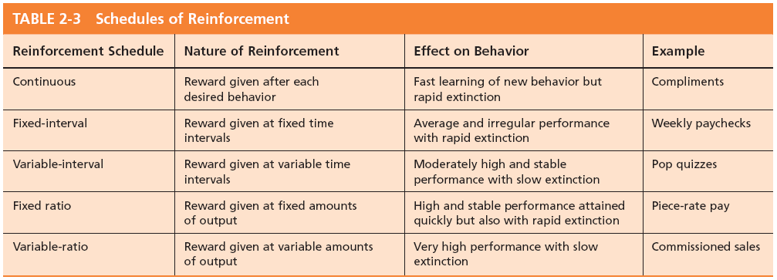
Schedules of Reinforcement

Slide 16
Behavior Modification (OB Mod)
The application of reinforcement concepts to individuals in the work setting
Follows the Five-Step Problem-Solving Model
1
Identify critical behaviors
2
Develop baseline data
3
Identify behavioral consequences
4
Develop and apply intervention
Evaluate performance improvement
5

Slide 17
What is Personality?
The dynamic organization within the individual of those psychophysical systems that determine his unique adjustments to his environment.
Gordon Allport.
Personality is the total of ways in which an individual reacts and interacts with others, the measurable traits a person exhibits.

Slide 18
What is Personality?
Measuring Personality
  Helpful in hiring decisions.
  Most common method: self-reporting surveys.
  Observer-ratings surveys provide an independent assessment of personality—often better predictors.

Slide 19
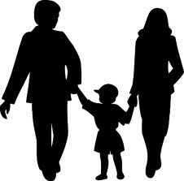
Personality Determinants
Heredity
  Factors determined at conception: physical stature, facial attractiveness, gender, temperament, muscle composition and reflexes, energy level, and bio-rhythms.
  This ‘Heredity Approach’ argues that genes are the source of personality.
  Twin studies: raised apart but very similar personalities.
  Parents don’t add much to personality development.
  There is some personality change over long
  time periods.

Slide 20
Personality Traits
Traits are enduring characteristics that describe an individual’s behavior.
  The more consistent the characteristic and the more frequently it happens in diverse situations, the more important the trait.
Two dominant frameworks are used to describe personality:
  Myers-Briggs Type Indicator (MBTI)
  Big Five Model

Slide 21
Myers-Briggs Types and Their Uses
Each of the sixteen possible combinations has a name, for instance:
  Visionaries (INTJ) – original, stubborn, and driven.
  Organizers (ESTJ) – realistic, logical, analytical, and business-like.
  Conceptualizer (ENTP) – entrepreneurial, innovative, individualistic, and resourceful.
Research results on the validity of MBTI are mixed.
  MBTI is a good tool for self-awareness and counseling.
  Should not be used as a selection test for job candidates.

Slide 22
The Myers-Briggs Type Indicator
Most widely used instrument in the world.
Participants are classified on four axes to determine one of 16 possible personality types, such as ENTJ.
Extroverted (E)
Introverted (I)
Quiet and
Shy
Sociable and Assertive
Sensing (S)
Intuitive (N)
Unconscious
Processes
Practical and
Orderly
Thinking (T)
Feeling (F)
Uses Values & Emotions
Use Reason
and Logic
Judging (J)
Perceiving (P)
Flexible and Spontaneous
Want Order
& Structure

Slide 23
The Big Five Model of Personality Dimensions
Extroversion
Sociable, gregarious, and assertive
Agreeableness
Good-natured, cooperative, and trusting
Conscientiousness
Emotional Stability
Openness to Experience
Responsible, dependable, persistent, and organized
Calm, self-confident, secure under stress (positive), versus nervous, depressed, and insecure under stress (negative)
Curious, imaginative, artistic, and sensitive

Slide 24
How Do the Big Five Traits Predict Behavior?
Research has shown this to be a better framework.
Certain traits have been shown to strongly relate to higher job performance:
  Highly conscientious people develop more job knowledge, exert greater effort, and have better performance.
  Other Big Five Traits also have implications for work.
    Emotional stability is related to job satisfaction.
    Extroverts tend to be happier in their jobs and have good social skills.
    Open people are more creative and can be good leaders.
    Agreeable people are good in social settings.

Slide 25

The Big Five Traits

Slide 26
Other Personality Traits Relevant to OB
Core Self-Evaluation
  The degree to which people like or dislike themselves.
  Positive self-evaluation leads to higher job performance.
Machiavellianism ( Manipulation)
  A pragmatic, emotionally distant power-player who believes that ends justify the means.
  High Mach's are manipulative, win more often, and persuade more than they are persuaded. Flourish when:
    they have direct interaction;
    they work with minimal rules and regulations;
    their emotions distract others.

Slide 27
Other Personality Traits Relevant to OB (Cont’d)
Narcissism
  A narcissist is an arrogant, entitled, self-important person who needs excessive admiration.
  Less effective in their jobs.
Self-Monitoring
  The ability to adjust behavior to meet external, situational factors.
  High self-monitors conform more and are more likely to become leaders.

Slide 28
Other Personality Traits Relevant to OB (Cont’d)
Risk Taking
  The willingness to take chances.
  May be best to align propensities with job requirements.
  Risk takers make faster decisions with less information.
  Creates positive change in the environment.

Slide 29
Other Personality Traits Relevant to OB (Cont’d)
Type A and B Personalities
  Aggressively involved in a chronic, incessant struggle to achieve more in less time.
    Impatient: always moving, walking, and eating rapidly.
    Strive to think or do two or more things at once.
    Cannot cope with leisure time.
    Obsessed with achievement numbers.
  Quality of the work can be low.
  Type B people are the complete opposite.
Proactive Personality
  Identifies opportunities, shows initiative, acts, and perseveres to completion.

Slide 30
Values
Values are basic convictions on how to conduct yourself or how to live your life that are personally or socially preferable— “How To” live life properly.
Attributes of Values:
Content Attribute—that the mode of conduct or end-state is important.
  Intensity Attribute—just how important that content is.
Value System:
  A person’s values rank-ordered by intensity.
  Tends to be relatively constant and consistent.

Slide 31
Classifying Values – Rokeach Value Survey
Terminal Values
  Desirable end-states of existence; the goals that a person would like to achieve during his or her lifetime.
Instrumental Values
  Preferable modes of behavior or means of achieving one’s terminal values.
People in same occupations or categories tend to hold similar values, but:
  values vary between groups
  value differences make it difficult for groups to negotiate and may create conflict.

Slide 32

Value Differences Between Groups

Slide 33
Linking Personality and Values to the Workplace
Person–Job Fit
Managers are less interested in someone’s ability to do a specific job than in that person’s flexibility.
John Holland’s Personality-Job Fit Theory
  Six personality types.
  Vocational Preference Inventory (VPI).
Key Points of the Model:
  There appear to be intrinsic differences in personality between people.
  There are different types of jobs.
  People in jobs congruent with their personality should be more satisfied and therefore turnover should reduce.

Slide 34

Holland’s Personality Typology & Occupations

Slide 35
Still Linking Personality to the Workplace
Person–Organizational Fit
In addition to matching the individual’s personality to the job, managers are also concerned with Person-Organization Fit.
  The employee’s personality must fit with the organizational culture.
  People are attracted to organizations that match their values.
  Those who match are most likely to be selected.
  Mismatches will result in turnover.
  Can use the Big Five personality types to match to the organizational culture.

Slide 36
Linking Cultures and Behaviors
Hofstede’s Framework: Power Distance
Power Distance is the extent to which a society accepts that power in institutions and organizations is distributed unequally.
  Low distance
    Relatively equal power between those with status/wealth and those without status/wealth
  High distance
    Extremely unequal power distribution between those with status/wealth and those without status/wealth

Slide 37
Linking Cultures and Behaviors
Hofstede’s Framework: Individualism
Individualism
  The degree to which people prefer to act as individuals rather than a member of groups.
Collectivism
  A tight social framework in which people expect others in groups of which they are a part to look after them and protect them.

Slide 38
Linking Cultures and Behaviors
Hofstede’s Framework: Masculinity
Masculinity
  The extent to which society values the work roles of achievement, power, and control, and where assertiveness and materialism are also valued.
Femininity
  The extent to which there is little differentiation between roles for men and women.

Slide 39
Linking Cultures and Behaviors
Hofstede’s Framework: Uncertainty Avoidance
Uncertainty avoidance is the extent to which a society feels threatened by uncertain and ambiguous situations and tries to avoid them.
High Uncertainty Avoidance:
Society does not like ambiguous situations and tries to avoid them.
Low Uncertainty Avoidance:
Society does not mind ambiguous situations and embraces them.

Slide 40
Linking Cultures and Behaviors
Hofstede’s Framework: Time Orientation
Long-term Orientation
  A national culture attribute that emphasizes the future, thrift, and persistence.
Short-term Orientation
  A national culture attribute that emphasizes the present and the here and now.

Slide 41



Thank You

