Slide 1
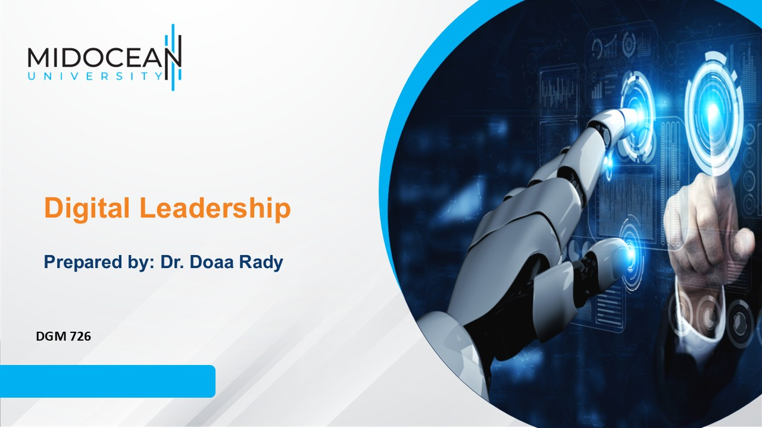
Final Revision

Slide 2

Final
Exam
About Exam Design
  20 Questions
  60 mins
  Each question 3 mins
Exam date:
Final Exam DGM726
يوم الخميس الموافق 01 /01 /2026
من 09:00 إلى 10:00 مساءً، بتوقيت مكة المكرمة

Slide 3
W2 – Lecture 1

Slide 4
Lec. 1
What is Management?
Management is a process which exists to get results by making the best use of the human, financial & material resources available.
The planning, organizing, leading, and controlling of human and other resources to achieve organizational goals effectively and efficiently.

Slide 5
Lec. 1
What is Management?
Resources include people, skills, know-how and experience, machinery, raw materials, computers and IT, patents, financial capital, and loyal customers and employees.
“It is the art of getting things done through others.”
(Mary Parker Follet)

Slide 6
Lec. 1
Why management is important?
1. The more efficient and effective use of resources that organizations make of those resources, the greater the relative well-being and prosperity of people in that society
2. Helps people deal with their bosses and coworkers
3. Opens a path to a well-paying job and a satisfying career

Slide 7
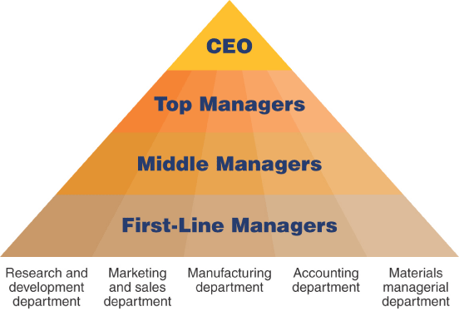
Levels of Management
Lec. 1
Areas of Managers
Department
  A group of managers and employees who work together and possess similar skills or use the same knowledge, tools, or techniques

Slide 8
Levels of Management
Lec. 1
First line managers - Responsible for daily supervision of the non-managerial employees who perform many of the specific activities necessary to produce goods and services
Middle managers - Supervise first-line managers. Responsible for finding the best way to organize human and other resources to achieve organizational goals

Slide 9
Levels of Management
Lec. 1
Top managers – Responsible for the performance of all departments and have cross-departmental responsibility.
  Establish organizational goals and monitor middle managers
  Decide how different departments should interact
  Ultimately responsible for the success or failure of an organization
Chief executive officer (CEO) is company’s most senior and important manager

Slide 10
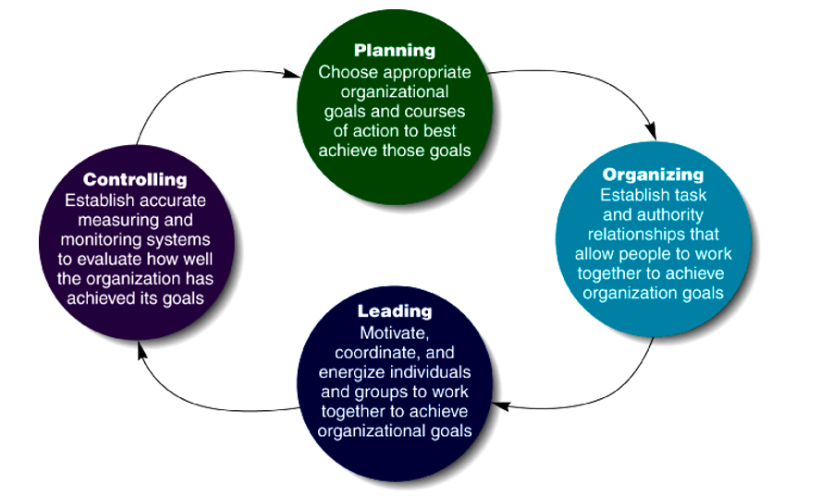
Management Functions
Lec. 1
Remember Mind Map

Slide 11
Lec. 1
Management Functions
Organizing is a task that managers perform to create a structure of working relationships that allow organizational members to interact and cooperate to achieve organizational goals
  Involves grouping people into departments according to the kinds of job-specific tasks they perform
  Managers lay out lines of authority and responsibility
  Decide how to coordinate organizational resources
  Organizational Structure
  A formal system of task and reporting relationships that coordinates and motivates members so that they work together to achieve organizational goals.

Slide 12
Lec. 1
Organizational Performance
Organizational Performance
Is a measure of how efficiently and effectively managers use available resources to satisfy customers and achieve organizational goals.
Efficiency كفاءة
  is a measure of how well or how productively resources are used to achieve a goal
Effectiveness فعالية
  is a measure of the appropriateness of the goals an organization is pursuing and the degree to which they are achieved.

Slide 13
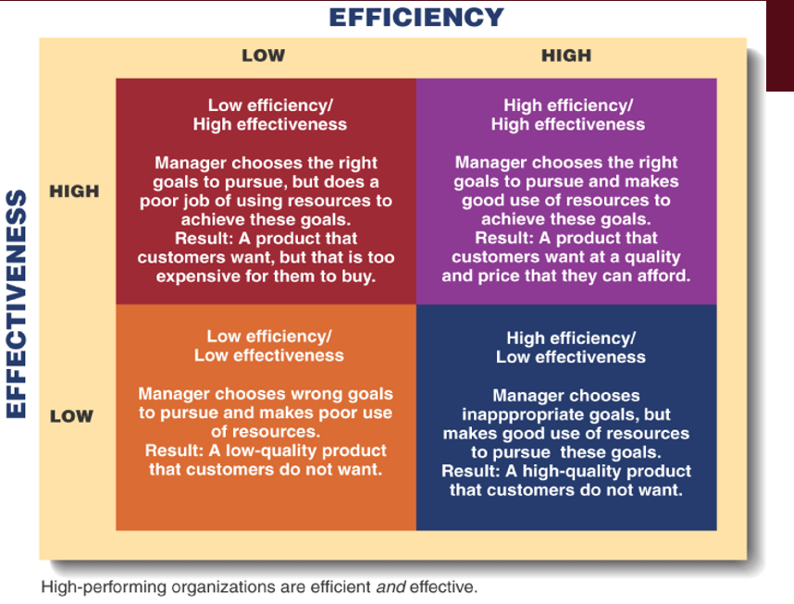
Lec. 1
Organizational Performance

Slide 14
Lec. 1
What is Leadership?
Digital leadership is currently considered a necessity in improving organizational performance by creating competitive advantage in the era of the industrial revolution 4.0.
Digital leadership: practice-oriented research has linked digitization and leadership.
Digital leadership refers to the leadership abilities to manage the staff’s online activities (e.g., posting product descriptions & handling customer queries), leading marketing activities, problem-solving, and decision-making concerning online activities of the business.

Slide 15
Lec. 1
What is Leadership?
Leading people
Influencing people
Commanding people
Guiding people
Leadership in Times of Change
Good leaders are sensitive to the impact of change & uncertainty
“Effective change leadership is the key to shifting people’s perceptions from seeing change as a threat to seeing it as an exciting challenge”
Hooper & Potter

Slide 16
W3 – Lecture 2

Slide 17
Lec. 2
How do people learn how to lead?
Even the people who seem to do it naturally had to learn the skills of leadership. They might have learned by watching their parents, teachers,…... They might have been given a lot of responsibility when they were young and might have been expected to take charge.
You can become a leader by:
    Jumping in and practicing
    Observing others lead
    Finding a mentor
    Taking a class or workshop
    Reading books about leaders and leadership
    Remembering that people who are now successful leaders, once weren't leaders at all

Slide 18
Lec. 2
Qualities of successful leaders
Integrity: To trust you, people have to know that you say what you believe and act accordingly. If people trust you, they may follow you to the ends of the earth.
Courage: Leadership means that you show others the way through the dark, scary, forest. Go ahead and speak the truth--even when it's not popular.
Commitment: You have to stick with a task through the good times and the bad. Your commitment will serve as a model.
Ability to care about others: People will follow you if they know you care about them and about others. The greater your ability to care about all types of people, the more confidence they will have in you.
Creativity and flexibility: Every situation will call for a different response. Be ready to change and come up with new solutions.

Slide 19
Lec. 2
Developing a Vision
What is a vision?
  It is a statement that communicates how you would like things to be.
  A vision is your big picture of the way things ought to be. It is your billboard image of what you are working towards.
What is the vision process?
  Developing your vision.
  Communicating your vision to others.
  Developing the group's vision.

Slide 20
Lec. 2
Developing a Vision
Why do you need to communicate a vision to others?
  People have to know what direction you’re going in before they will follow you.
When do you need to communicate your vision?
  All the time.

Slide 21
Lec. 2
Understanding people's needs
Why should the leader try to understand people's needs?
  To keep the group moving forward towards shared and desired goals.
  To strengthen connections with the group and increase the likelihood of success .
  To keep morale high.
  To reinforce members' belief in the leader.

Slide 22
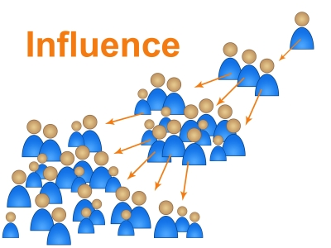
Lec. 2
Influencing People
Influence:
    Is the ability to persuade someone to act or think in the way you want.
  Elements of influence
    Communicator
    Message
    Audience

Slide 23
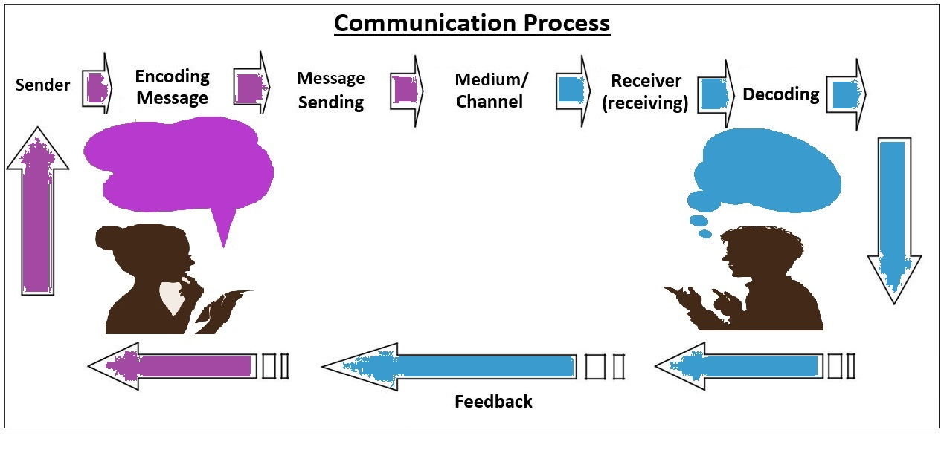

W3 Lecture
Elements of Communication
a) Sender
b) Message
c) Channel
d) Receiver
e) Noise
f) Feedback
g) Context
h) Effect

Slide 24
Lec. 2
Elements of Communication
B) Message:
The message is any verbal or non-verbal method that produces meaning in the mind of the receiver. Simply, it is the meaning transferred from sender’s mind to receiver’s mind. This happens mainly in two ways: verbal and non-verbal methods.
Verbal message means written or oral messages. They are composed of words. Example: A newspaper report or a lecture by a teacher.
Non-verbal messages are those communicated through our behavior, movements, actions, clothes, style of conversation, pitch of the sound etc.

Slide 25
Lec. 2
Elements of Communication
E) Context:
Communication takes place in a context. At times it is noticeable and at other times not.
In other words, time, place, culture, physical and social condition and psychology of the participants are important in determining communication effect. If we try to interpret a message out of its context, we may get an entirely different meaning which may result in communication error.
Rules and roles are two important factors related to communication context.

Slide 26
Elements of Communication
Lec. 2
G) Effect: Communication effects are of three types
Cognitive effects تأثيرات إدراكية | Affective effects تأثيرات عاطفية | Behavioral effects تأثيرات سلوكية
The consequences take place in the receiver’s intelligence due to communication. | The consequences occurred in the emotions of the person/s due to communication. | The change in the receiver’s behavior or actions due to communication.
Example : Knowledge acquisition | Eg. Compassion تعاطف , love etc. | Eg. Political campaign and change in people’s voting behavior or purchasing new products inspired by the advertisements.

Slide 27
W4 – Lecture 3

Slide 28
2. Trait Theories of Leadership
نظرية السمات
Lec. 3
Theories that sought personality, social, physical or intellectual traits and differentiated leaders from non-leaders.
Leaders tend to be described as: confident, iron-willed, determined & decisive (Margaret Thatcher, Mandella, Sadat). Whom else??
Other terms used include: Charismatic, Enthusiastic & Courageous
Research failed to show consistent attributes that differentiated LEADERS from NON LEADERS
However, research was successful in identifying traits that were CONSISTENTLY ASSOCIATED WITH LEADERS.

Slide 29
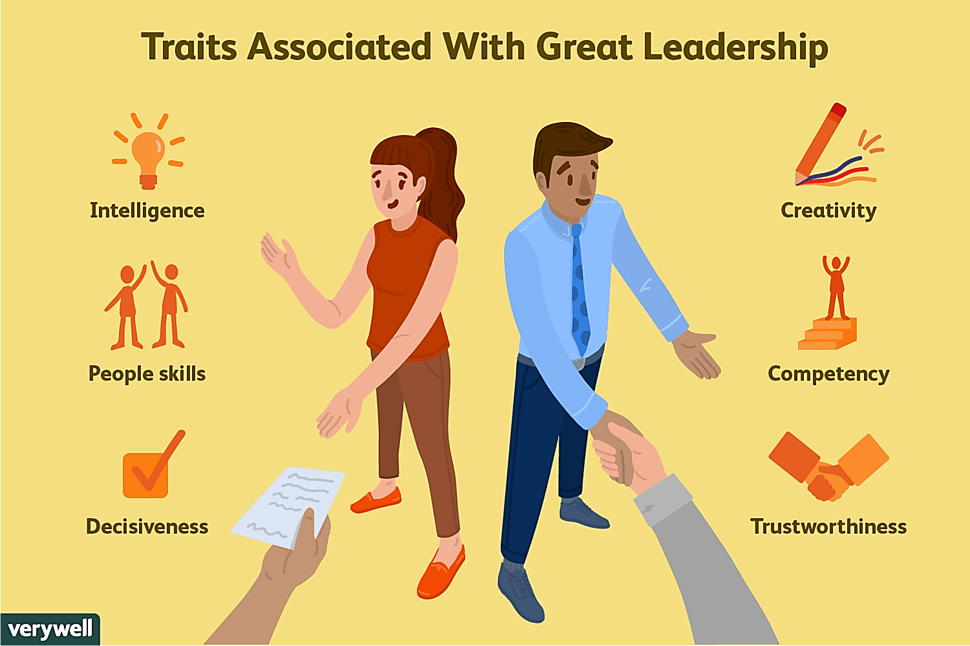
2. Trait Theories of Leadership
Lec. 3
6 Traits in which LEADERS Differ from Non-Leaders:
  Ambition & Energy
  The Desire to Lead
  Honesty & Integrity
  Self-Confidence
  Intelligence
  Job-Relevant Knowledge and more recently,
  High self-monitors (high flexibility in adjusting their behavior in different situations)

Slide 30
النظرية السلوكية
3. Behavioral Theories of Leadership
Lec. 3
This type of leadership theory focuses on a leader’s actions and behavior, with very little emphasis on their qualities and traits.
According to behavioral leadership theory, an effective leader has many acquired skills. In addition to it, the theory also considers that an individual can learn skills to become a good leader.
So, theories proposing that specific behaviors differentiate leaders from non-leaders.
If so, we could train non-leaders to become leaders.
These theories had some success in identifying consistent relationships between Leadership & Group Performance.

Slide 31
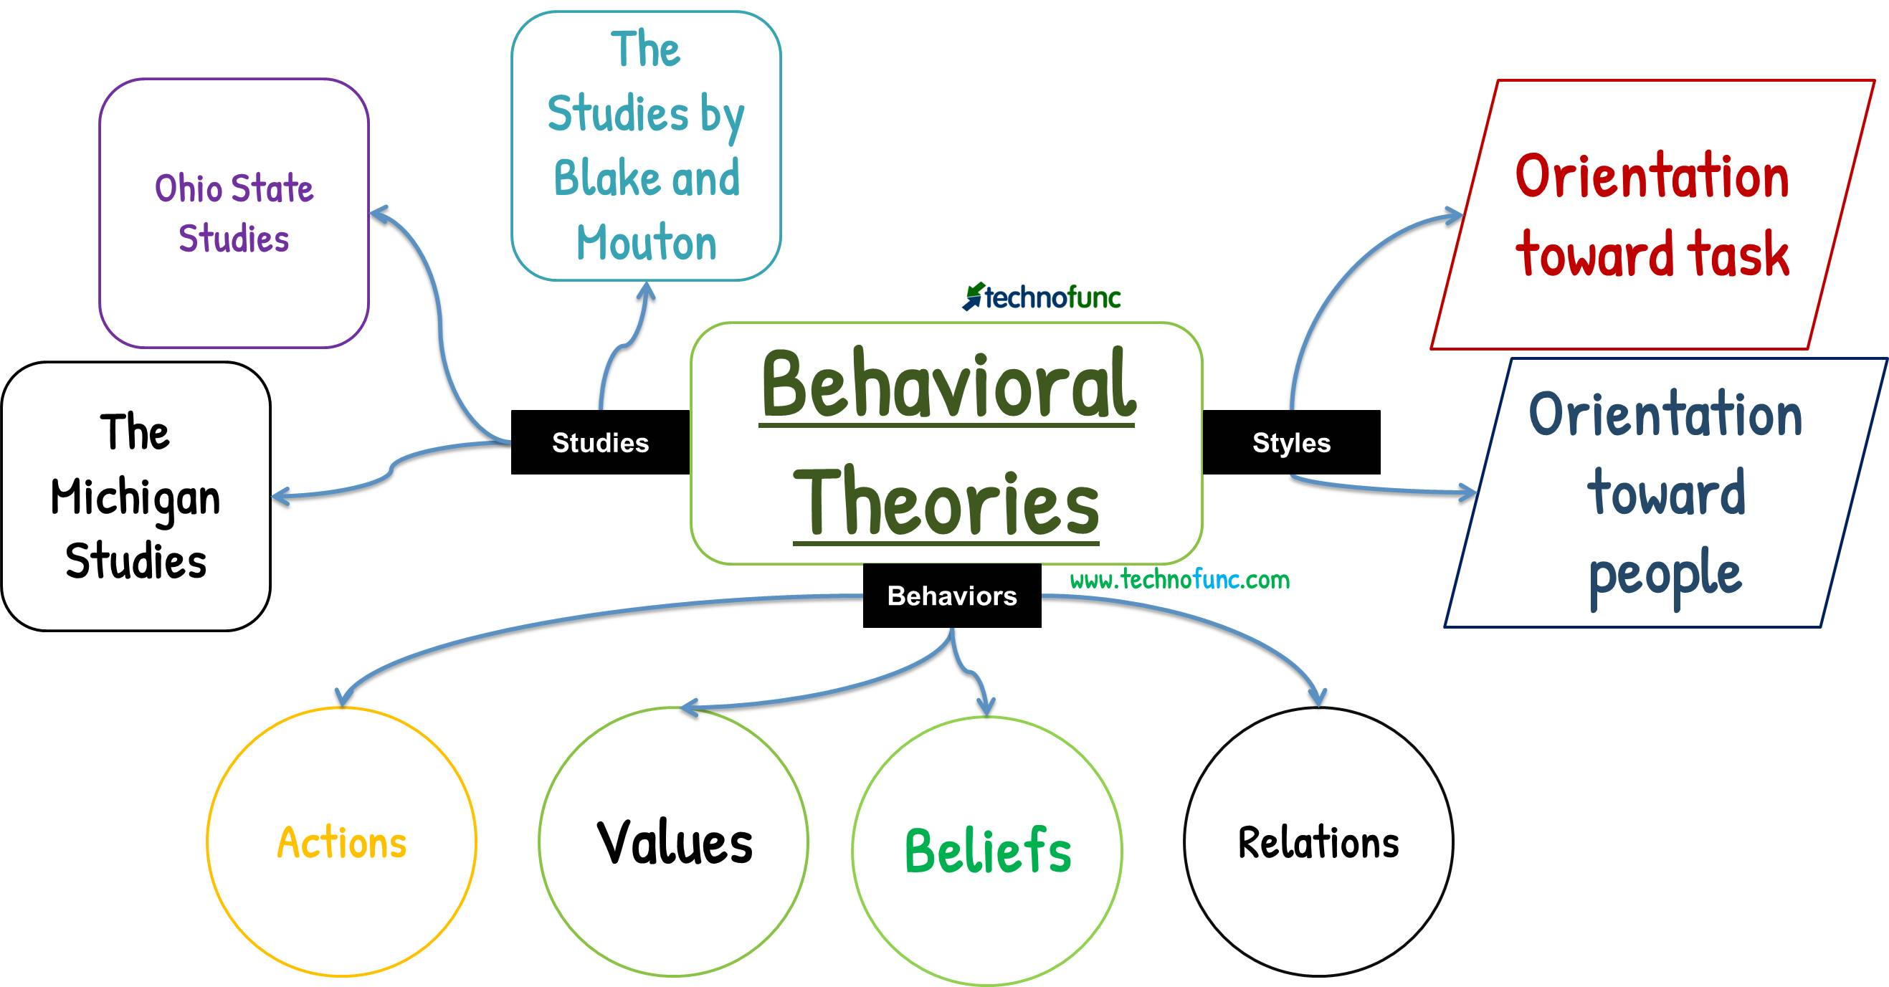
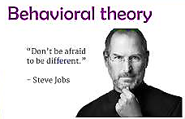

النظرية السلوكية
3. Behavioral Theories of Leadership
Lec. 3

Slide 32
نظرية المعاملات/ التبادلية والتحولية
4.Transactional & Transformational Theories
Lec. 3
A different view, popularized by James MacGregor Burns, contrasts two styles of leadership: transactional and transformational.
Transactional Leader: One who guides or motivates their followers in the direction of established goals by clarifying role and task requirements.
  Transactional leadership views leadership as based on transactions between leader and followers. Thus rewards, punishments, exchanges (economic, emotional, physical) and other such "transactions" are the basis of leadership.
    An organization leads by paying you and telling you what you need to do; you respond by doing what you need to do efficiently and well, and the organization will prosper.

Slide 33
4.Transactional & Transformational Theories
Lec. 3
Transformational Leader: One who inspires followers to transcend (go beyond) their own self-interests for the good of the organization, provide personal consideration and intellectual stimulation, and who possess charisma (heroic or extraordinary leadership abilities observed by the followers).
  Transformational leadership sees a true leader as one who can distill the values and hopes and needs of followers into a vision, and then encourage and empower followers to pursue that vision.
  A transactional leader thinks of improvement or development as doing the same thing better: an organization that reaches more people, a company that makes more money.
  A transformational leader thinks about changing the world, even if only on a small scale.

Slide 34
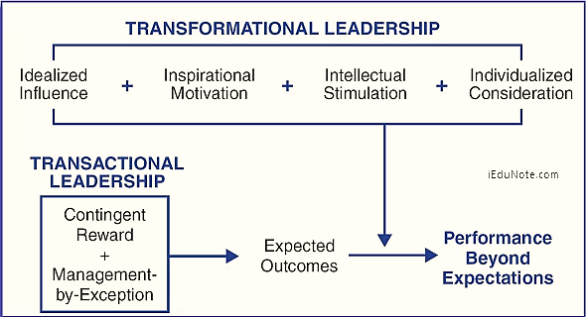
4.Transactional & Transformational Theories
Lec. 3

Slide 35

6. Neo-Charismatic Theories
Lec. 3
Leadership theories that stress symbolism, emotional appeal and extraordinary follower commitment
They include:
    Charismatic Leadership
    Transformational & Transactional
    Visionary Leadership
Key Characteristics of Charismatic Leaders
Vision & Articulation الرؤية والتعبير (expressed as an idealized goal that proposes a better future than status quo الوضع الراهن & in understandable terms to others)
Personal Risk
Environmental Sensitivity (realistic assessment of environmental constraints قيود & resources to bring about change)
Sensitivity to Follower Needs & Feelings
Unconventional Behavior السلوك غير التقليدي (novel & counter to norms)

Slide 36
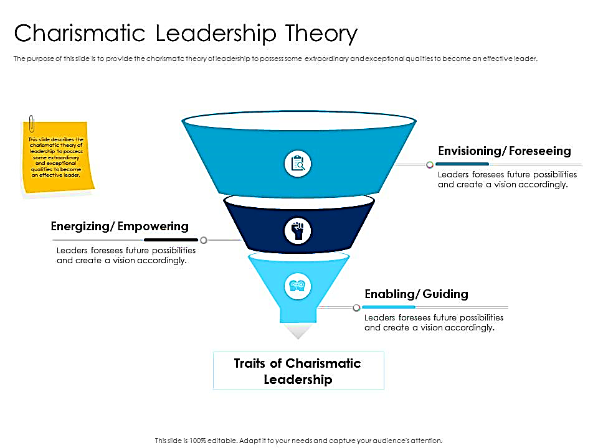
النظرية الكاريزمية
Lec. 3
6. Neo-Charismatic Theories
The Charismatic Leader
Charismatic leaders may affect an organization and the individuals they lead in a strong, positive way.
However, this leadership style can also lead to dangerous situations if used in the wrong manner.
Charismatic leadership is defined by three behavioral dimensions: envisioning (communication about vision), energizing (communication about passion), and enabling (communication about care and support).
3Es: Envisioning, Energizing, Enabling
“Vision, Passion, and Care”
1
2
3

Slide 37
Lec. 3
6. Neo-Charismatic Theories
Visionary Leadership
Visionary Leaders Have 3 Common Qualities:
  Ability to explain vision
  Express vision thru من خلال his/her behavior
  Extend vision to different leadership contexts so as to be applied in different situations, e.g. in various departments of marketing, sales, accounting, HR, and in all geographic locations of the company

Slide 38
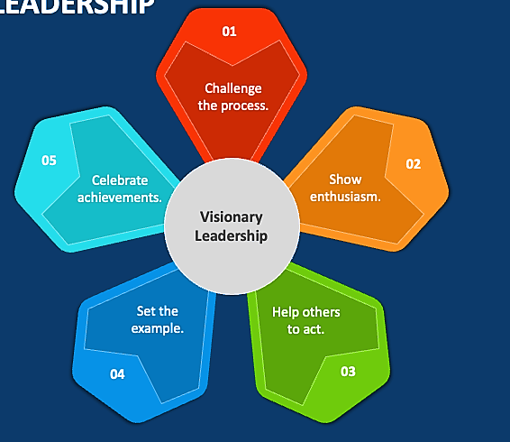
6. Neo-Charismatic Theories
Lec. 3
القيادة المتبصرة / الرؤيوية
Five Principles Of Visionary Leadership
Challenge the Process - Be a pioneer - encourage innovation and support people with ideas.
Be Enthusiastic - Inspire others through personal enthusiasm to share in a common vision.
Help Others to Act - Be a team player and support the efforts and talents of others.
Set the Example - Provide a consistent role model of how others can and should act.
Celebrate Achievements - Bring emotion into the workplace and rally "hearts" as well as "minds."

Slide 39
Methods of leadership
Lec. 3
Charisma. Some leaders are charismatic enough to simply pull others along by the power of their personalities alone. They may, in fact, advocate and accomplish wonderful things, but they do it through people's loyalty to and awe of them.
Involving followers in the goal. The leader gets others to buy into the vision for the organization, and to make it their own. The leader may accomplish this through charisma, through the force of the belief in power and rightness of the vision, or through the nature of the vision itself.

Slide 40
Leading Effectively
The 70-20-10 Rule for Leadership Development
Lec. 3
The 70-20-10 rule emerged from over 30 years of Lessons of Experience research
According to the 70-20-10 rule, leaders learn and grow from 3 types of experience, following a ratio of:
    70% challenging experiences and assignments
    20% developmental relationships
    10% coursework and training
The underlying assumption of the 70-20-10 rule is that leadership can be learned that leaders are made, not born.
A leader’s ability and willingness to learn from experience
is the foundation for leading with impact.

Slide 41
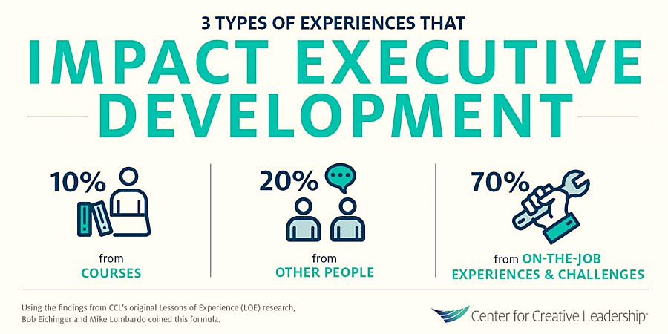
Leading Effectively
The 70-20-10 Rule for Leadership Development
Lec. 3
The 70-20-10 rule reveals that individuals tend to learn 70% of their knowledge from challenging experiences and assignments, 20% from developmental relationships, and 10% from coursework and training.
Skilled training specialists can help an organization establish a shared knowledge base and align its members with respect to a common leadership vision and the 70-20-10 rule.

Slide 42
New Leader Traps
Lec. 3
Not learning quickly
Isolation
Know-it-all
Keeping existing team
Ignoring Potential Problems
Taking the Easy Path
Ignoring Feedback, You Don't Like

Slide 43
W5 – Lecture 4

Slide 44
Leadership styles
Lec. 4
Leaders' styles encompass how they relate to others within and outside the organization, how they view themselves and their position, and - to a very large extent - whether or not they are successful as leaders.
If a task needs to be accomplished, how does a particular leader set out to get it done? If an emergency arises, how does a leader handle it? If the organization needs the support of the community, how does a leader go about mobilizing it? All of these depend on leadership style.

Slide 45
Lec. 4
Leadership styles
We will focus on individual leaders, but leadership can be invested in a team, or in several teams, or in different people at different times.
Many - perhaps most - organizations have several levels of leadership, and thus many leaders.
The style of an organization's leadership is reflected in both the nature of that organization and its relationships with the community.
If a leader is suspicious and jealous of power, others in the organization are likely to behave similarly, in dealing with both colleagues and the community.
If a leader is collaborative and open, this behavior is likely to encourage the same attitudes among staff members, and to work collaboratively with other organizations.

Slide 46
Leadership styles
Lec. 4
Autocratic leadership allows quick decision-making, and eliminates arguments over how and why things get done. At the same time, however, it may reduce the likelihood of getting a range of different ideas from different people, and can treat people badly, or as if they don't matter. If, as is often true, the leader is concerned with his own power and status, he'll be looking over his shoulder, and moving to squelch any opposition to him or his ideas and decisions. Innovation or the use of others' ideas is only permissible if it's part of the leader's plan.

Slide 47
Leadership styles
Lec. 4
2. Managerial. The leader who sees him/herself as a manager is concerned primarily with the running of the organization. Where it's going is not at issue, as long as it gets there in good shape. The leader may pay attention to relationships with and among staff members, but only in the service of keeping things running smoothly. Depending upon the nature and stability of the organization, the main focus may be on funding, on strengthening the organization's systems and infrastructure (policies, positions, equipment, etc.), or on making sure day-to-day operations go well (including making sure that everyone is doing what he's supposed to).

Slide 48
Leadership styles
Lec. 4
4. Collaborative. A collaborative leader tries to involve everyone in the organization in leadership. The leader is truly first among equals, in that he/she may initiate discussion, pinpoint problems or issues that need to be addressed, and keep track of the organization as a whole, rather than of one particular job. But decisions are made through a collaborative process of discussion, and some form of either majority or consensus agreement. Toward that end, a collaborative leader tries to foster trust and teamwork among the staff as a whole.

Slide 49
Leadership styles
Lec. 4
David Chrislip and Carl E. Larson identify four characteristics of the collaborative leader:
  Inspiring commitment and action. The collaborative leader helps people develop the vision and passion to start and maintain the work.
  Leading as a peer problem solver. The collaborative leader facilitates problem solving by modeling and teaching a process, and by helping others bring their experience and ideas to bear.
  Building broad-based involvement. The collaborative leader invites everyone concerned into an inclusive process.

Slide 50
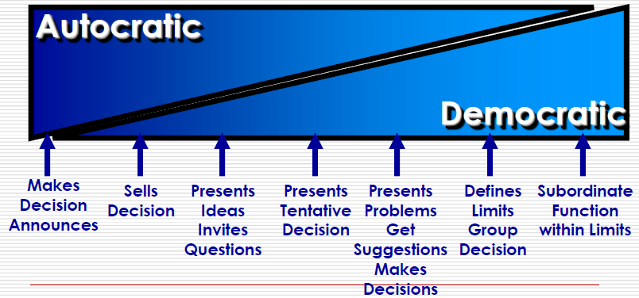
Leadership styles
Lec. 4
Notes:
Makes decision annonces

Slide 51
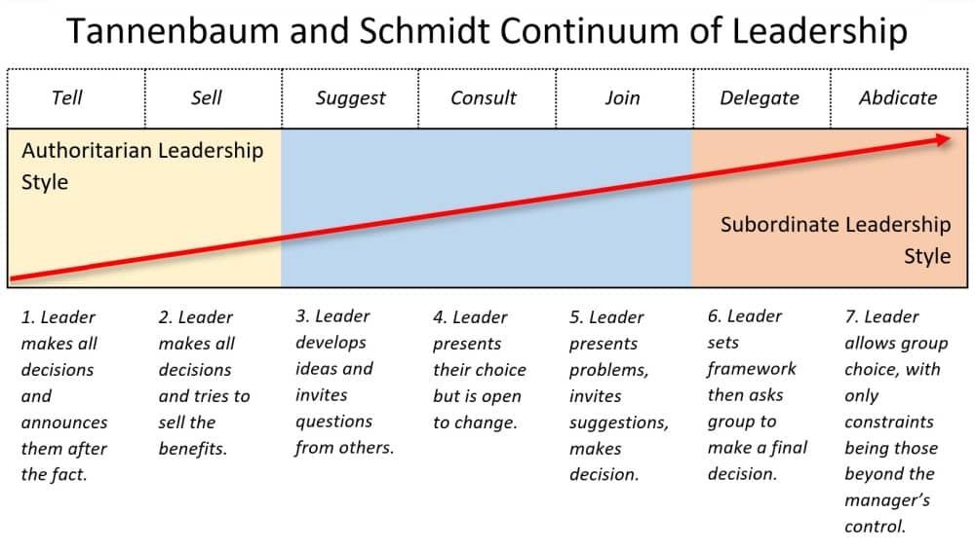
Leadership styles
Lec. 4
Autocratic

Slide 52
Lec. 4
What is an appropriate style?
There are at least two other factors that have to be considered when choosing a leadership style.
Leadership style must be consistent with what people in the organization expect. You can try to change their expectations and perceptions of how an organization should be run - that's part of leadership - but you have to start by meeting them at least halfway, or you'll never get close enough to talk about it.

Slide 53
Lec. 4
What is an appropriate style?
Finally, your style needs to be consistent with the goals, mission, and philosophy of your organization. An organization cannot remain faithful to its mission if its internal structure is at odds with its guiding principles. An organization dedicated to empowerment of the target population, for instance, must empower its staff as well. For most grass roots and community-based organizations, this consistency would mean using some variation of a democratic or collaborative style.

Slide 54
Lec. 4
What is an appropriate style?
It is probably true that any leader uses a range of different styles at different times.
It is important to realize that different styles may be appropriate at different times, and for different purposes.
In an emergency, no one would suggest sitting down and making a group decision about what to do. There has to be decisive action, and one person has to take it as soon as possible.
Good leaders usually have a style that they consciously use most of the time, but they're not rigid. They change as necessary to deal with whatever comes up.

Slide 55
Lec. 4
Develop a leadership style
Start with yourself.
Think about the needs of the organization or initiative.
Observe and learn from other leaders.
Use the research on leadership.
Believe in what you're doing.
Be prepared to change.

Slide 56
Develop a leadership style
Lec. 4
What kind of leader do you want to be? Perhaps even more important, how would you be most effective as a leader? What kind of leadership style would be of the most benefit to your organization, and would allow you to be the best leader you could be?
Most real leaders use a combination of styles.

Slide 57
W6 – Lecture 5

Slide 58
Digitalization & Digitization
Lec. 5
Digitization
  The Digitization refers to creating a digital representation of physical objects or attributes. For instance, we scan a paper document and save it as a digital document (e.g., PDF). In other words, digitization is about converting something non-digital into a digital representation or artifact. Computerized systems can then use it for various use cases.
  Digitization is foundational. This is the connection between the physical world and software. This is what we been doing since the 1960s. It is an enabler for all the processes that provide business value because of the need for consumable data.

Slide 59
Digitalization & Digitization
Lec. 5
Digitalization
  Digitalization refers to enabling or improving processes by leveraging digital technologies and digitized data. Therefore, digitalization presumes digitization. Digitalization improves an existing business process or processes but doesn’t change or transform them.
  Digitalization is the use of digital technologies to change a business model and provide new revenue and value-producing opportunities; it is the process of moving to a digital business.
  Digitalization affects many aspects of organizations, including information technology, strategy and business models, products and services, internal and external processes, organization, and company culture.

Slide 60
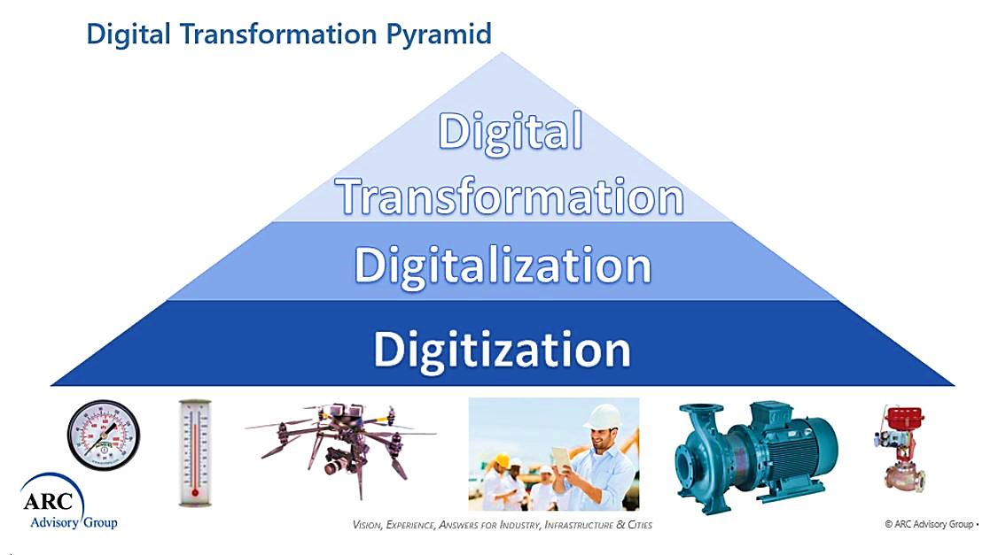
Digitalization & Digitization
Lec. 5

Slide 61
Lec. 5
Digital Transformation
Digital Transformation is really business transformation enabled by digitalization. The “digital” moniker is a little bit of a misnomer because the essence of digital transformation is the changing of business processes enabled or forced by digitalization technologies.
Industry 4.0 is revolutionizing the way companies manufacture, improve and distribute their products. It focuses on the combination of Digital Transformation and Digitalization.

Slide 62
Lec. 5
Digital Transformation
The ability to redesign businesses digitally is largely driven by a clear digital strategy that is supported by executives that promote an adaptable and innovative culture.
It encompassed the incorporation of new digital technologies such as social media, artificial intelligence, and big data into business processes, as well as the subsequent development of new business models

Slide 63
Lec. 5
Digital Transformation
What is digital transformation in media?
  Personalized content
    By using data about their readers, media companies can deliver tailored content that is more likely to engage and retain readers. This approach has already yielded success for some publishers, and it is expected to become even more widespread in the years to come.
    In conclusion, there are many benefits of embracing digital transformation in media, such as increased audience engagement, new revenue opportunities, and cost savings.

Slide 64

Digital leadership & Digital Transformation
Lec. 5
Digital disruption refers to a change in expectations and behaviors caused by, or expressed through, digital capabilities, channels, or assets, that radically alters the culture, market, industry, or process.
Innovation management is a combination of the management of innovation processes, and change management. It includes a set of tools that allow managers plus workers or users to cooperate with a common understanding of processes and goals.
The leader will increasingly act as an online influencer and integrator of virtual identities that are aligned around their own ideals and objectives. Digital leadership has been demonstrated to have a bigger impact on digital disruption than innovation management.
The sustainable competitive advantage afforded by technology and digitalization enables businesses to create a digitalization objective and guides organizations in determining how to accomplish this goal.

Slide 65
W7 – Lecture 6

Slide 66
Digital Leaders
Lec. 6
Digital leaders act on three levels:
  they encourage members of the organization to consolidate knowledge gained through their individual activities,
  they consolidate and share knowledge within the team or group to foster deeper understanding,
  they mediate knowledge between members of the organization or groups, and they bring outside knowledge into the organization .

Slide 67
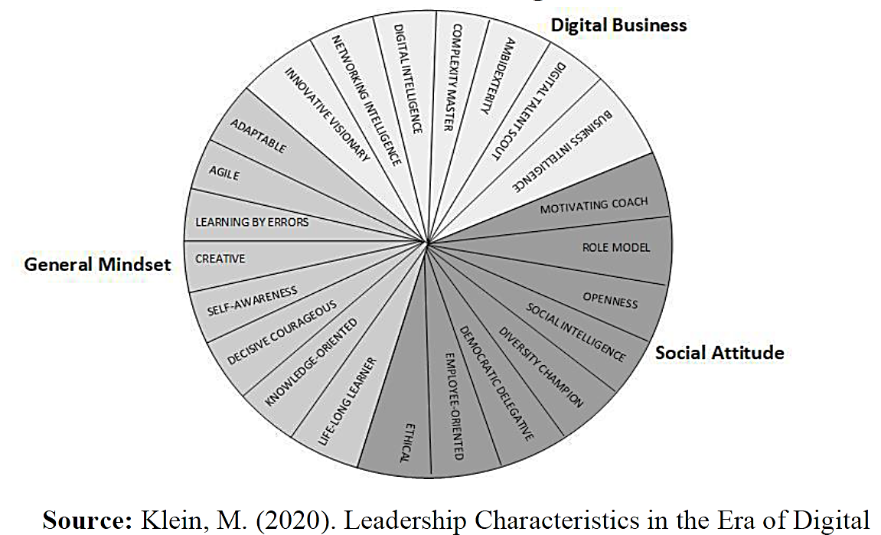
Characteristics of
digital leaders
Lec. 5

Slide 68
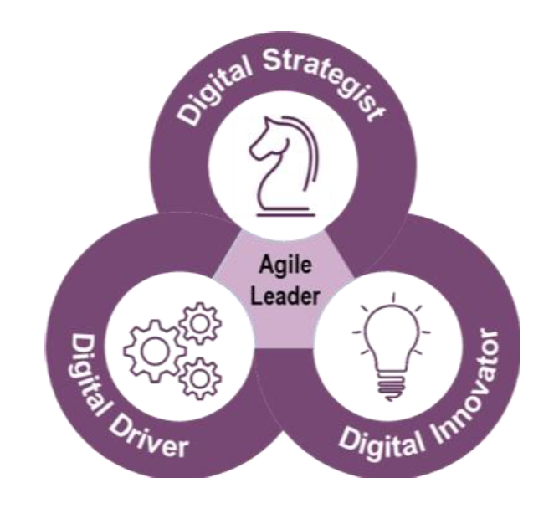
Digital Leaders
Lec. 5
An Agile leader is a combination of Digital Strategist, Digital Innovator, and Digital Driver.
A digital strategist stays ahead of emerging trends and technologies, experiments with them personally where possible, and finds ways to apply them to drive transformative change for customers and/or business operations.
A digital innovator disrupts the status quo and keeps moving the organization toward the vision for winning in the future.
Lastly, a digital driver builds trust and collaborates across the organization with diverse stakeholders to enable rapid action.
Critical Skills of Digital Leaders

Slide 69
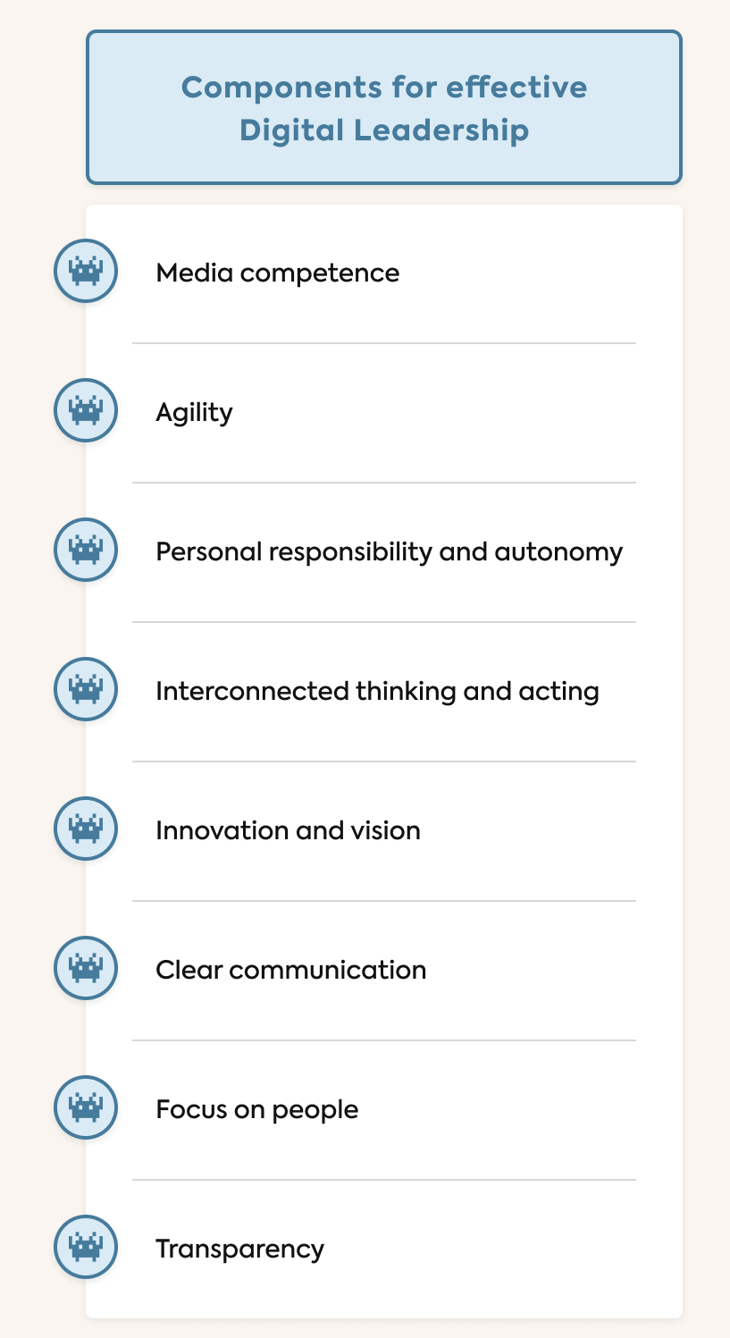
8 components of digital leadership
Lec. 5
1. Media competence: An effective digital leader is technically savvy and knows digital programs and media so well they can use them optimally to achieve business goals.
2. Agility: Nowadays, the demands placed on companies change frequently and at high speed. Being able to react flexibly to these changes is essential to remain competitive. Complex tasks can no longer be planned in detail over the long term, especially when it comes to digital and IT-related projects.

Slide 70
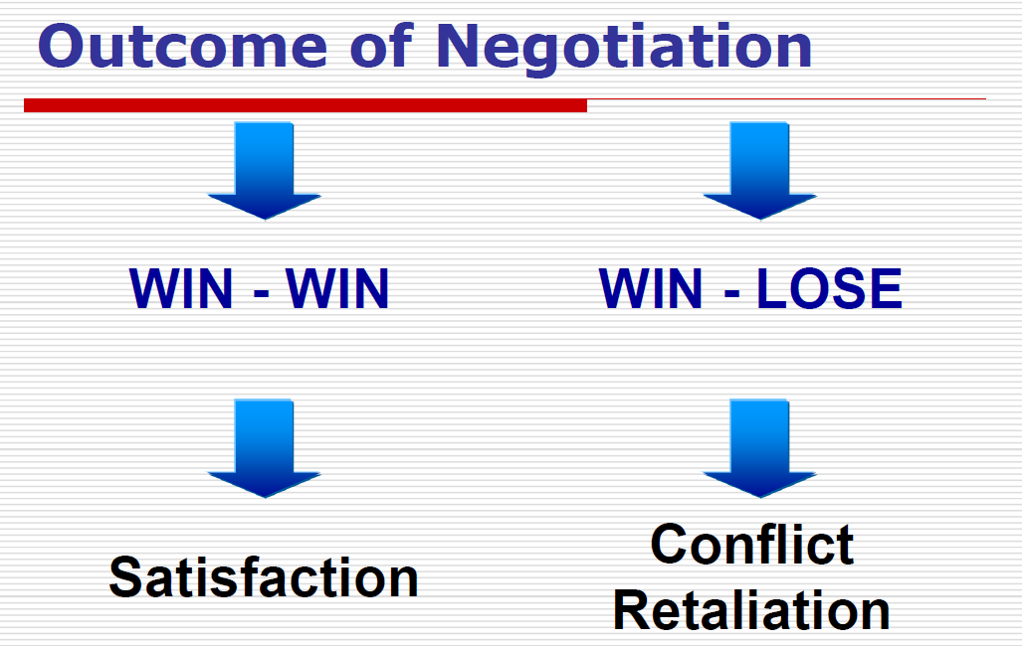
8 key leadership strengths
4. Negotiation
Lec. 5
Elements of Negotiation
Two or more parties
Involved for desired outcome
Different interests and objectives
Some possibility to modify position
Hope of desirable acceptable outcome
Degree of POWER over other
Verbal Interaction between people
Negotiation is a means to resolve differences

Slide 71
8 key leadership strengths
6. Conflict resolution skills
Lec. 5
  Understand an argument‘s structure (including issues, rationale, and conclusions).
  Know that language and persuasion have a powerful impact on the portrayal and Conflict occurs when two or more people’s interests are not in alignment with each other. It can also occur due to an individual’s biases, cultural beliefs, social status, and other factors determining which values they prioritize above the ones others might not.
  Conflict is an inevitable part of any organization, whether it is between co-workers, managers and employees, or different departments within the company. While conflict can sometimes be beneficial, allowing for creativity and different perspectives to be brought to the table, it can also quickly escalate and become detrimental to the business.
  Generally, conflict should not be considered good or bad, rather it may be viewed as a necessity to facilitate meaningful relationships between people and groups.

Slide 72
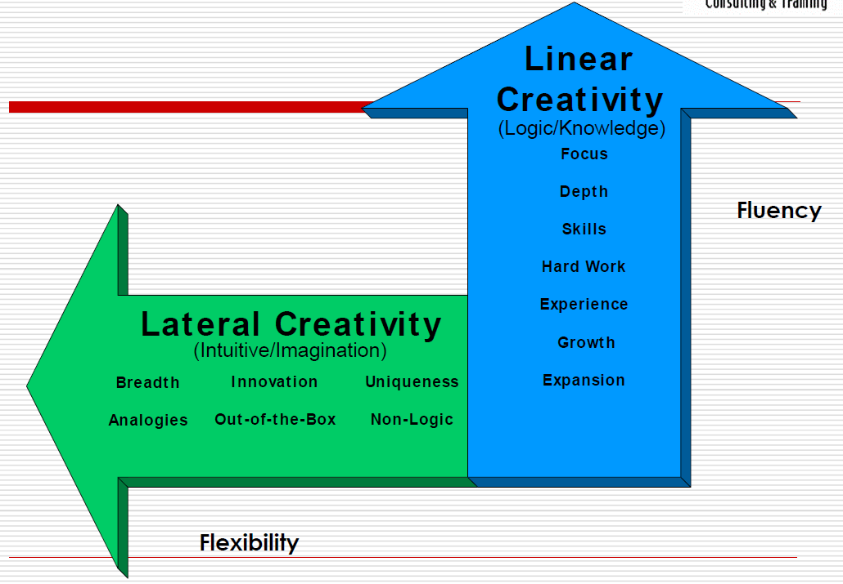
8 key leadership strengths
7. Creative Problem Solving
Lec. 5
What is Creativity?
A way of thinking and doing that brings unexpected and original ideas to fruition; to produce novel and useful ideas.
“The best way to have a good idea is to have lots of them”
Linus Pauling (2-time Nobel prize winner)
Types of Creativity

Slide 73
8 key leadership strengths
8. Decision Making
Lec. 5
Decisions are choices made from among options recognized by the decision maker. The decision-making process involves alternative development and analysis followed by the selection of an option.
There are various types of decisions, including:
  Programmed decisions (standard or regular responses to routine or uncomplicated problems allowing for pre-programmed solutions).
  Programmed decisions involve familiar and straightforward solutions. They are the most common type of decision faced by individuals in the office, and they are often handled by the use of the use of a routine approach.

Slide 74
8 key leadership strengths
8. Decision Making
Lec. 5
  Non-programmed decisions (responses to unique and unstructured problems and situations requiring special or custom-made solutions).
  Non-programmed decisions are made in situations where standard procedures, policies, and rules cannot be applied to attain an adequate solution. They include situations such as crisis, in which case judgment, creativity, and intuition must be used. Principles and basic problem-solving processes are also utilized in the marketing of non-programmed decisions.

Slide 75
W8 – Lecture 7

Slide 76
Lec. 7
Action-Centered Leadership
Task Needs
Team Maintenance Needs
Individual Needs
Action Centered Leadership is also a simple leadership and management model, which makes it easy to remember, apply and adapt to your own situation.
John Adair's Action-Centered Leadership model is commonly represented by three overlapping circles, that explain how to be able to use each of the elements according to the situation.

Slide 77
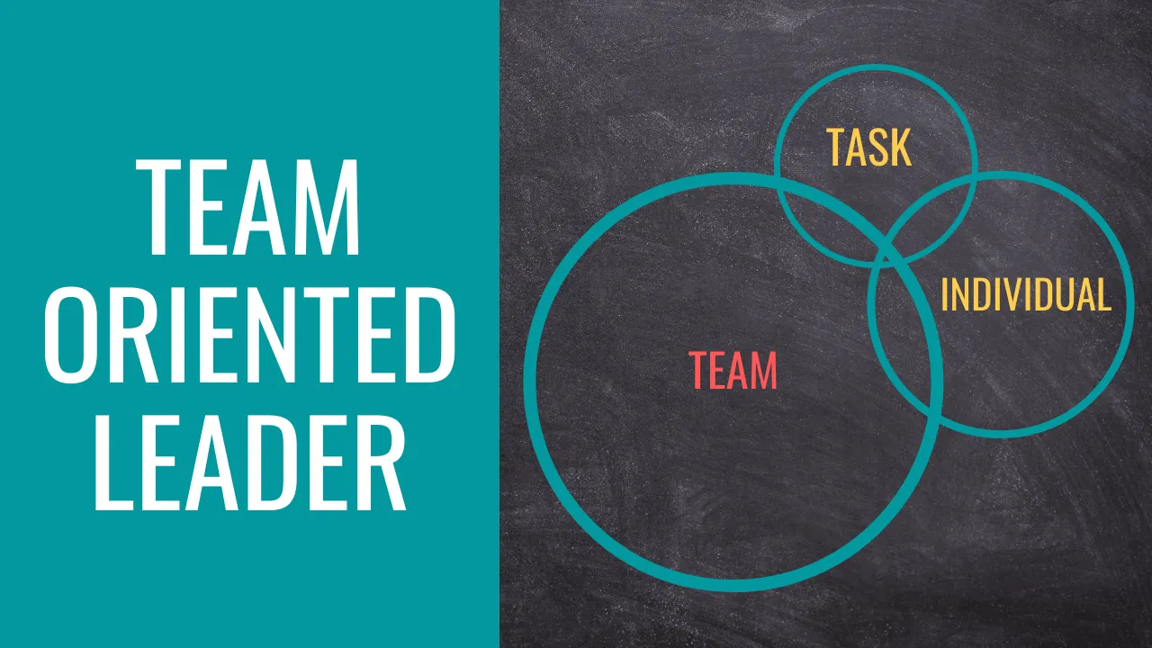
Action-Centered Leadership:
The Team Oriented Profile
Lec. 7
If your diagram presents a large circle for the team element, then you are more oriented towards a team-focused leadership style.
This means that you tend to focus more on team cohesion and less on task completion and the individuals within the team.

Slide 78
Team Building
Lec. 7
What is a team?
A team is a group of people with a commitment to one another, to the team, to a high level of achievement, to a common goal, and to a common vision.
The advantages of teams:
  A team broadens what individuals can do.
  Several heads mean a wider range of ideas.
  Teams have a great array of talents and skills.
  Team members learn new skills from their colleagues.
  Teamwork is more efficient than a number of individuals working singly.
  Teamwork provides relief when someone's having a problem.
  Team workers are more effective.
  A team member has more ownership of what he/she's doing.
  Good teams can build leaders.
  A shared vision keeps everyone moving forward.

Slide 79
Team Building
Lec. 7
The disadvantages of teams:
  Team decision-making takes longer.
  Team effort can be wasted effort.
  The team's success may hang on the work of the least effective team member.
  A team might gain momentum in the wrong direction.
  The work of team can bog down in interpersonal issues, resentments, and blame.
  Team members may be reluctant to tell other about their unsatisfactory work.
  Lost motivation for lack of individual recognition.

Slide 80
Virtual Teams
Lec. 7
Adaptability of virtual teams
Development and change are continuous in the current era of the knowledge culture. Successful changes in organizations and teams, require adaptability.
Adaptability can be described as a capacity to understand and comprehend changes and as a willingness to being flexible and open-minded.
The importance of adaptability of team members in virtual teams, states that adaptive team members form an adaptive virtual time, which in turn contributes to the organization’s goals and outcomes.

Slide 81
Lec. 7
Virtual Teams
Adaptability of virtual teams
Team members, who show flexibility, calmness and an interest in learning are contributing to an adaptive team performance.
This shows that individual actions affect team outcomes, and vice versa. Technological, work, and social adaptation are considered as key factors for virtual teams.
Technological adaptation consists of different technological tools, that organizations provide and must be flexible and used for problem solving, because technological tools are meant to reduce technological limitations and increase effortless communication.
The behavior emerged from work adaptation is then furthermore implemented in social adaptation, by creating patterns of interaction.

Slide 82
Lec. 7
Virtual Teams
Trust in virtual teams
Trust is seen as a statement of confidence and mirrors as a cooperative behavior. Trust is an action where people are in good faith to each other and where honesty replaces the act of taking advantage of others. Trust in virtual teams, must be examined separately from trust in face-to-face interactions, due to lack of in-person interaction.
The lack of face-to-face interaction in virtual teams, interferes with building trust in other team members.

Slide 83
Virtual Teams
Lec. 7
Trust in virtual teams
Studies showed that trust is highly associated with leadership, which makes leadership in virtual teams a higher factor for successful outcomes. The study showed that a strong connection between leadership skills and trust. The study examined how lack of in-person interactions affect trust in teams. Results showed that in order for a virtual team to be efficient and effective, lack of in-person interaction must be replaced by a leader’s effectiveness and proper use of correct communication tools and techniques.

Slide 84
W9 – Lecture 8

Slide 85
Lec. 8
VUCA
There have been many changes in Information and Communication Technology, and one thing that can be noticed was it is very agile and dynamic. The U.S. military coined the acronym VUCA (volatility, uncertainty, complexity, and ambiguity) in the late 1990s, and it has become general shorthand for conditions leaders may encounter especially in digital transformation context and leaders need to be prepared for many types of turbulence or upheaval.

Slide 86
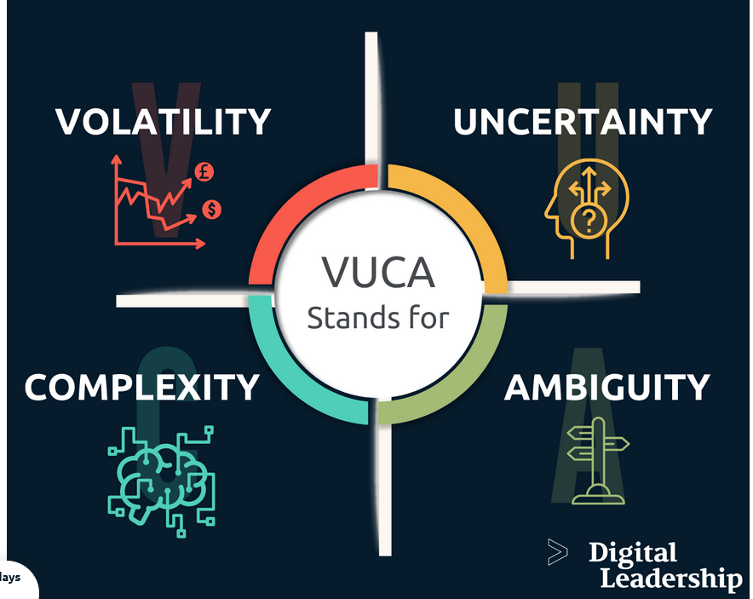
VUCA
Lec. 8
Volatility in VUCA stands for the fact that we live in a world that is constantly changing, becoming more unstable, more unpredictable and more rapid. Volatility refers to frequent and strong changes in the market environment.
Uncertainty in VUCA stands for the rapidly decreasing predictability of events, forecasts, and experiences from the past as a basis for shaping the future losing their validity and relevance.

Slide 87
Lec. 8
VUCA
Complexity in VUCA stands for the fact that our world is more complex than ever. What is the cause? What is the effect? – Problems and their effects are becoming more complex and harder to understand. Decisions become an uncontrollable web of reaction and counter-reaction.
Ambiguity refers to the ambiguity of the information situation. Information that can be interpreted in different ways carries a high risk and often leads to wrong decisions.

Slide 88
Effective Communication
in virtual organizations
Lec. 8
Virtual teams communicate via ICT (e.g., email, web conferencing, instant messaging and telephone)
Communication in virtual teams separate from communication in traditional teams, as a result of lack of in-person interaction.
Poor communication quality is the main problem in virtual teams and that most effort was put in improving communication.
A study showed that communication quality – in means of poor communication quality - is a primary reason for failure in virtual teams. All in all, the study showed that communication is the primary factor affecting team effectiveness.

Slide 89
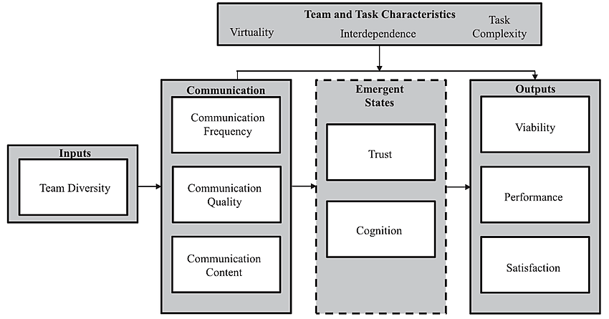
Effective Communication
in virtual organizations
Lec. 8
The process of communication in virtual teams include various factors, however, communication is highlighted as the leading aspect, as shown in the figure.

Slide 90
Digital Skills for Improving
Organizational Performance
Lec. 8
Digital skills include all technology-related skills ranging from basic skills or literacy, general skills for all workers, and specific skills for information technology professionals.
There are 4 dimensions in measuring digital skills including digital technical skills, digital communication, digital analysis, and digital thinking.

Slide 91
Lec. 8
Digital Literacy Skills
Digital literacy is the knowledge of, and the ability to use digital technologies to locate information; evaluate information; synthesize, create, and communicate information; and understand the human and technological complexities of a digital media landscape.
Being digitally literate means having the skills to be an informed consumer, critical thinker, and creator in the digital world, and requires an ability to continuously learn and grow alongside technological developments.

Slide 92
Digital Literacy Skills
Lec. 8

Slide 93
Digital Literacy Skills
Lec. 8

Slide 94
W10 – Lecture 9

Slide 95
Digital Media and Social Media
Lec. 9
Combined with the Internet and personal computing, digital media has caused disruption in publishing, journalism, entertainment, education, commerce and politics.
Digital media has also posed new challenges to copyright and intellectual property laws, fostering an open content movement in which content creators voluntarily give up some or all of their legal rights to their work.
The ubiquity of digital media and its effects on society suggest that we are at the start of a new era in industrial history, called the Information Age, perhaps leading to a paperless society in which all media are produced and consumed on computers.

Slide 96
Lec. 9
Digital Media and Social Media
Privacy is one of the main concerns that has emerged with these new changes, as many aspects of our lives leak into cyberspace. New tools such as cell phones and digital cameras can invade one’s privacy, unbeknownst to the victim.
Although some people choose to share images with others online, it has also become apparent that others can capture images without consent, and share them online without the knowledge of the victim, risking their reputation, credibility, and relationships.
The issue of privacy also interacts with cultural differences. Some cultures have different standards and expectations of communicative practices and privacy than others.

Slide 97
Lec. 9
Digital Media and Social Media
The cultural imperialism الإمبريالية الثقافية is a common problem that has emerged, especially on the Internet, as many people often choose to impose their own practices and expectations on those who do not share a similar standard.
At the same time, skilled users of new technologies tend to be of a younger generation who see the use of such technology as second nature, while older generations have much different experiences.
Thus, the expectations of older generations about new digital media greatly differ from younger generations.

Slide 98

Digital Media and Social Media
Lec. 9
The boomerang effect
الأثر المرتد/ الارتداد "العكسي"
is a situation where people tend to pick the opposite of what something or someone is saying or doing because of how it is presented to them.
The leaders blog is less visible. The possible explanation is that the companies have managers and leadership and are not concerned with the transmission of the vision and mission of the organization they lead.
The image transmitted through social media organization should be related to existing organizational culture type. A negative image transmitted from the organization can harm fragile company.
This may however have a boomerang effect on employees: if their organization is in decline, their own situation may be endangered, employees are the ones who bear direct consequences.

Slide 99
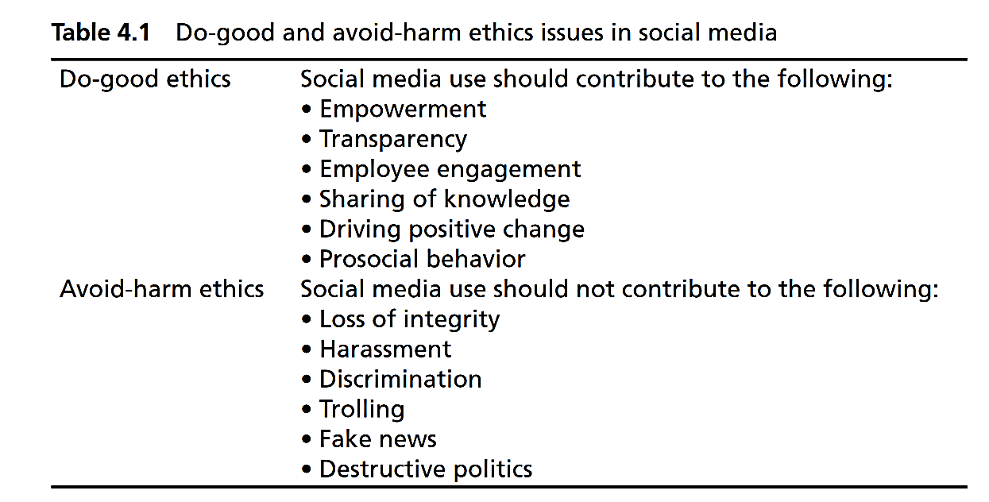
Leaders and Social Media
Lec. 9
مضايقة
تمييز
التصيد
السياسة المدمرة

Slide 100
Ethical Leadership
Lec. 9
Why practice ethical leadership?
Ethical leadership models ethical behavior to the organization and the community.
Ethical leadership builds trust.
Ethical leadership brings credibility and respect, both for you and for the organization.
Ethical leadership can lead to collaboration.
Ethical leadership creates a good climate within the organization.
If you have opposition, or are strongly supporting a position, ethical leadership allows you to occupy the moral high ground.
Ethical leadership is simply the right way to go.
Ethical leadership affords self-respect.

Slide 101
Ethical Leadership
Lec. 9
Specific components of ethical leadership:
Put the good of the organization and the general good before your own interests and ego.
Encourage the discussion of ethics in general and of the ethical choices involved in specific situations and decisions as an ongoing feature of the organizational culture.
Institutionalize ways for people to question your authority.
Don’t take yourself too seriously.
Consider the consequences to others of your decisions, and look for ways to minimize harm.
Treat everyone with fairness, honesty, and respect all the time.
Treat other organizations in the same way you treat other people – with fairness, honesty, and respect.

Slide 102
W11 – Lecture 10

Slide 103
Lec. 10
Leaders’ Core Tasks
Create Momentumالدافعية للتقدم
Master technologies of learning, visioning, and coalition buildingإتقان تقنيات التعلم والرؤية وبناء التحالفات
Manage oneselfإدارة النفس / الذات

Slide 104
Developing a Plan for
Building Leadership
Lec. 10
Why do you need a plan for
building leadership?
A plan will get you where you want to go.
A simple leadership plan is just a list of leadership development goals, with a timeline and some actions for accomplishing the goals.
When do you develop a plan?
At the very beginning.
If you haven't done it already, do it now.
Every person needs to continue learning and growing in order to meet the challenges around them.

Slide 105
Developing a Plan for
Building Leadership
Lec. 10
How do you develop a plan?
Envision your leadership team. تصور فريق القيادة الخاص بك
Set leadership development goals for your group or organization.
Pick your methods:
  Teaching as you lead
  Mentoringالتوجيه والارشاد
  Exchange programsبرامج التبادل
  Orientations التوجيه عن المؤسسة والفريق لتسهيل الاندماج
  Workshops & training sessions
  Retreats الخلوات لمراجعة الذات – راحة للمناقشة خارج مكان العمل
  Leadership groupsالتعاون بين المجموعات

Slide 106
Developing a Plan for
Building Leadership
Lec. 10
How do you develop a plan?
Set individual leadership development goals
  Expect people to act like leaders.
  Consider what individual skills you need in your group.
  Invest in each person.
  Write individual leadership plans.
Recruit new people to lead.
Develop yourself as a leader.

Slide 107
Building Leadership: 11 Steps
Lec. 10
11. Indicate how you will build a great group with strong leadership. Communicate how you will:
    Find and attract talented people.
    Create a situation in which people can apply their talents.
    Get great projects in which people can work together.
    Assure that the right people are in the right jobs.
    Protect members from distractions and demands of the broader environment.
    Build bridges to those people and resources that can help.
    Prompt reflection on the meaning of the work.
    Maintain a climate of optimism in the group.

Slide 108
How to Develop a Personal
Leadership Philosophy?
Lec. 10
The four key components of your personal leadership philosophy are defined as follows:
Theory: This refers to how you define leadership.
Attitude: This refers to your feelings about approaching leadership.
Guiding principles: Your guiding principles refer to your personal beliefs and values you consider when leading others.
Behavior: Your behavior refers to the way you conduct yourself to ultimately reach a favorable outcome.

Slide 109
How to Develop a Personal
Leadership Philosophy?
Lec. 10
Why is a personal leadership philosophy important?
A personal leadership philosophy is important for several reasons, regardless of your company size. Here are the three benefits of having a personal leadership philosophy:
Defines your character: Having a personal leadership philosophy will help you understand your character. This is important because your character affects how you interact with others and in various situations.
Provides consistency: When you have a personal leadership philosophy, you're more apt to be consistent with your actions and behaviors.
Fosters collaboration: This type of philosophy also helps foster meaningful collaboration. Once your employees understand why you act the way you do, they'll be more apt to collaborate with you because they're aware and comfortable with your leadership style.

Slide 110
How to Develop a Personal
Leadership Philosophy?
Lec. 10
3. Start writing your personal leadership philosophy
Next, begin writing your personal leadership philosophy. If you write your philosophy, it will help you gather your thoughts and ensure you state all you want to. Doing so will also keep you accountable.
Use the four components of a personal leadership philosophy mentioned previously as you write. This includes theory, attitude, principles and behavior.

Slide 111
How to Develop a Personal
Leadership Philosophy?
Lec. 10
Here are some examples of a personal leadership philosophy:
Example 1
Leadership is about inspiring and encouraging others every step of the way. It's about building a positive environment where employees can thrive and use the skills to the best of their ability. My support for others will foster healthy communications and innovative ideas. Leadership is about motivating others and providing them with the confidence they need to see their full potential.
As a leader, it's important to be considerate of others' feelings and use everyone's passion for good. I value the opinion of others, respect their beliefs and listen to their concerns with an open mind. I care about leading with heart and using my leadership platform to cultivate a positive place for growth. Ultimately, leadership is about being a strong leader that others can depend on.

Slide 112



Thank You

