Slide 1




Deep Generative Models (AI314)
Master of Science in AI
Dr. Nibras Abdullah
Assistant professor
Faculty of Informatics
Midocean University
Orientation show عرض توجيهي
www.midocean.ae

Slide 2

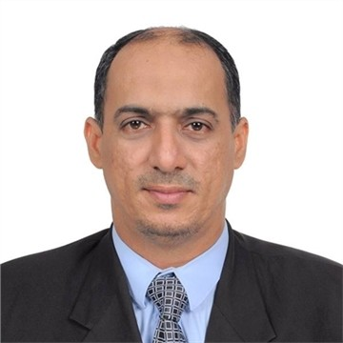
Who am I?
      Senior Lecturer (Assistant Professor)
      School of Computer Sciences, UNIVERSITI SAINS MALAYSIA,11800 USM, MALAYSIA.
      Faculty member at Hodeidah University, Yemen.
  Worked as a teaching fellow for two years at the National Advanced IPv6 Center,
  University Sains Malaysia, Malaysia.
  2017- PhD in Computer Science (Multimedia Network Protocols), Universiti Sains Malaysia
  Thesis title: Genetic-Based Routing Algorithm with Priority Constraints (GRAPC)
  2010- Master in (Computer Science/ Information and Knowledge Engineering), USM
  Dissertation Title: Handwritten Arabic Digits Recognition using Cascading Neural Network Ensembles
  2003- Bachelor in Computer Science from College of Engineering and Petroleum,
  Hadhramout University of science and technology, Hadhramout,Yemen.
www.midocean.ae

Slide 3
The course that will be taught
Deep Generative Models
www.midocean.ae

Slide 4
Primary Goal of This Course
The Deep Generative Models course is designed to provide students with
a comprehensive understanding of generative models and their applications in various domains..
www.midocean.ae

Slide 5
What This Course is About
  Introduction to Generative Models
  Basics of Deep Learning
  Variational Autoencoders (VAEs)
  Generative Adversarial Networks (GANs)
  Advanced Generative Models
  Evaluation of Generative Models
  Real-world Applications
  Recent Developments and Future Directions
www.midocean.ae

Slide 6
Units of Course Contents
Module | Course Unit | No.of. Weeks | Contact Hours
1 | Lecture 1: Introduction to Generative Models | 1st | 3
2 | Lecture 2: Basics of Deep Learning | 2nd | 3
3 | Lecture 3: Variational Autoencoders (VAEs) | 3rd | 3
4 | Lecture 4: Generative Adversarial Networks (GANs) | 4th | 3
5 | Lecture 5: Autoregressive Models | 5th | 3
6 | Lecture 6: Advanced Generative Models | 6th | 3
7 | Lecture 7: Evaluation of Generative Models | 7th | 3
8 | Lecture 8: Real-wortd Applications Part1 | 8th | 3
9 | Lecture 9: Real-wortd Applications Part2 | 9th | 3
10 | Lecture 10: Recent Devel opments and Future Directions | 10th | 3
www.midocean.ae

Slide 7

Teaching Methodology
منهجية التدريس
Recorded Lectures
المحاضرات المسجلة
Live Sessions
جلسات وحلقات النقاش
References
المراجع المعتمدة للمقرر الدراسي
Virtual Labs
المعامل الأفتراضية
www.midocean.ae

Slide 8

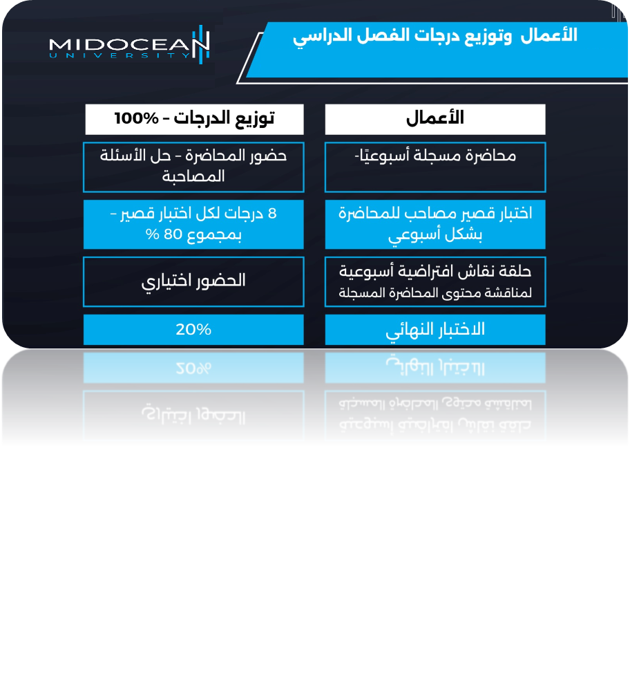
Study System
www.midocean.ae

Slide 9

Course Information - Evaluation
  Assessment Method:
Short Exam
  80% marks
    Count of short Exam 10 (Weekly)
    8 Marks for each of short Exam.
  20% marks
  Final Examination
www.midocean.ae

Slide 10
Learning Outcomes
Upon successful completion of this course, students should be a ble to:
Understanding of Generative Models
Knowledge of Deep Learning Fundamentals
Familiarity with Variational Autoencoders (VAEs)
Understanding of Generative Adversarial Networks (GANS)
Knowledge of Advanced Generative Models
Evaluation of Generative Models
Application of Deep Generative Model
www.midocean.ae

Slide 11
Learning Resources:
Credit Hours:
3 credit hours.
  Essential References:
  Generative Deep Learning By David Foster.2022
  Foster, David. Generative deep learning. " O'Reilly Media, Inc.", 2022.
  2. Deep Generative Modeling By Jakub M. Tomczak · 2022
  Tomczak, J. M. (2022). Deep Generative Modeling. Switzerland: Springer International Publishing.
www.midocean.ae

Slide 12
Thank You

