Slide 1


Prepared by Dr. Rana Maya
REA617
Real Estate & Urban Economics
Lecture 3

Slide 2



Housing Market Economics and Affordability
Lecture 3
REA617
Real Estate & Urban Economics
Prepared by
Dr. Rana Maya

Slide 3

lecture
Abstract
03
This lecture introduces the fundamental economic principles that govern housing markets and explains how these principles determine housing affordability.

Slide 4

lecture
03
Contents
Introduction
2. Basic Economic Concepts for Housing Markets
3. Determinants of Housing Prices
4. Housing Market Dynamics
5. Measuring Affordability
6. Policy Tools to Improve Affordability
7.Case Studies
8.Market and demand tools to decide about new real estate investment?

Slide 5
lecture
03
  Learning outcomes
By the end of the lecture, you will be able to:
1.Explain the fundamental concepts of housing market economics, including supply, demand, price-to-income ratios, and rent burden.
2.Analyze the key determinants that influence housing affordability, such as income levels, housing prices, interest rates, and government policies.
3.Differentiate between various housing affordability indicators (e.g., PIR, rent-to-income ratio, housing cost burden) and their applications in assessing housing markets.
4.Evaluate the role of market dynamics, urbanization, and demographic shifts in shaping housing affordability challenges.
5.Examine international case studies to compare housing affordability trends across different regions and cities.
6.Discuss policy tools and interventions (e.g., subsidies, rent controls, affordable housing programs) aimed at improving housing affordability.

Slide 6
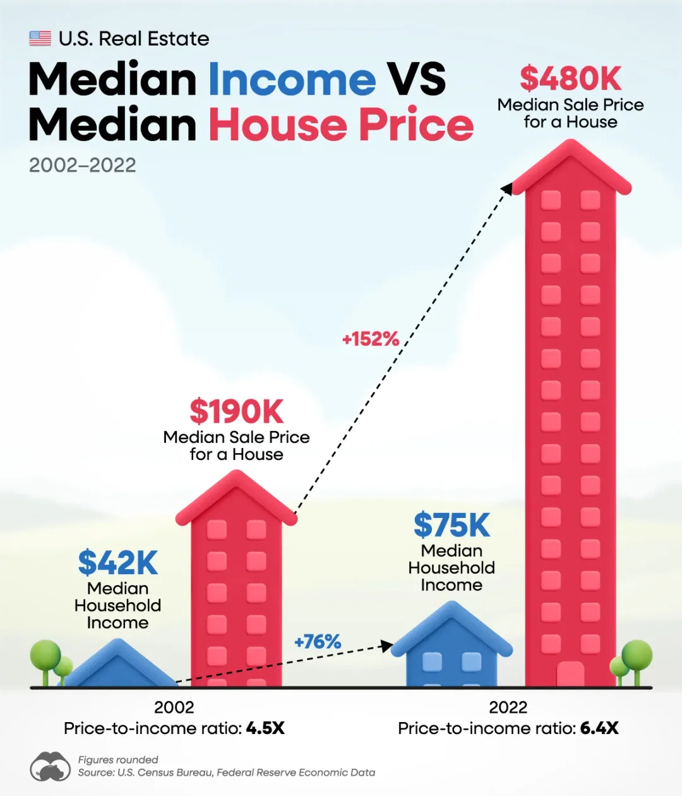
1. Introduction
Housing markets are central to household welfare, urban form, macroeconomic stability, and public policy.
Housing is simultaneously a consumption good (place to live), an investment (store of wealth), and a component of urban infrastructure. Because of this multi-role nature and the high share of household budgets devoted to housing, affordability problems quickly become political and social priorities.
Why?
This lecture aims to provide the reader with intuitive economic frameworks and applied tools to analyze housing markets and evaluate affordability policies.

Slide 7

2. Basic Economic Concepts for Housing Markets
2.1 Opportunity Cost
Behavioral economists claim that we are “creatures of habit” with a tendency to engage in a status quo mindset such that stick to decision rules without really exploring our alternatives.

Slide 8
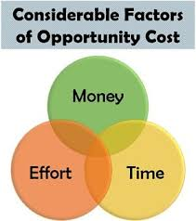
2. Basic Economic Concepts for Housing Markets
2.1Opportunity Cost
Every time we choose to take an action; we have an alternative. You could be doing something else with the time that it will take you to read this lecture.
How much do you value this next alternative?
By being aware of the “opportunity cost” concept, this helps us to make better decisions that we are less likely to regret because we recognize that we are making a choice and we do have alternatives.

Slide 9
2. Basic Economic Concepts for Housing Markets
2.1Opportunity Cost
For many urban decisions, the opportunity cost reasoning comes into play.
You can take a bus or a private vehicle from your starting point to any location within a city.
The private car is quicker and saves you time, even though the bus fare is less expensive than owning a car.
Which one is Depending on how much you value the time you spend commuting, it may be less expensive.
Give more examples about opportunity costs?

Slide 10

2. Basic Economic Concepts for Housing Markets
2.1Opportunity Cost
A city has a limited amount of land.
How much land should be left aside for wetlands to prevent flooding versus how much should be used for housing?
How much should be set aside as public parks or used for key infrastructure such as roads, water treatment plants and public schools?

Slide 11
2. Basic Economic Concepts for Housing Markets
2.1 Opportunity Cost
Example: Developer Building Apartments
A property developer is considering adding one more apartment unit to a new housing project.
Marginal Benefit (MB):
The extra apartment can be sold for $250,000.
Marginal Cost (MC):
The cost of building that additional unit (materials, labor, permits, etc.) is $220,000.
Marginal Analysis
MB = $250,000
MC = $220,000
Since MB > MC, the developer should build the extra apartment.
Now imagine costs rise because of land scarcity and labor shortages:
New MC = $260,000
MB ($250,000) < MC ($260,000) → the developer should not build the extra unit.

Slide 12

2. Basic Economic Concepts for Housing Markets
2.2 The logic of revealed preference.
Estimating each person’s bounds on their willingness to pay for a service can be informative for a government that is considering bearing a cost to improve a local public good such as environmental protection.
If 1000 people will be affected by the improvement in the local public good (such as cleaning up the local lake) and if a lower bound on each person’s willingness to pay for a cleaner lake is $200 per year, per person then a lower bound on the aggregate willingness to pay to enhance this local public good is 1000*$200 or $200,000.

Slide 13
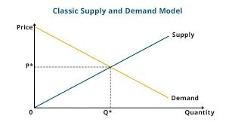
2. Basic Economic Concepts for Housing Markets
2.3 Supply and Demand in Housing
1. Axes
Vertical axis (Price): Shows the price level of the good or service.
Horizontal axis (Quantity): Shows the quantity of the good bought and sold in the market.
2. Curves
Demand Curve (downward sloping):
As price decreases, consumers demand more (law of demand).
Supply Curve (upward sloping):
As price increases, producers are willing to supply more (law of supply).
At prices below P*: Demand exceeds supply → leads to shortage. Prices tend to rise.
The market naturally moves toward (P*, Q*), the balance point.

Slide 14
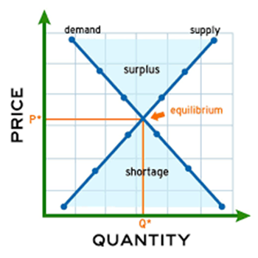
2. Basic Economic Concepts for Housing Markets
2.3 Supply and Demand in Housing
3. Market Equilibrium
The intersection point of supply and demand is the equilibrium.
  P* = Equilibrium Price (the price where buyers and sellers agree).
  Q* = Equilibrium Quantity (the number of units exchanged at that price).
4. Meaning
At prices above P*: Supply exceeds demand → leads to surplus. Prices tend to fall.
At prices below P*: Demand exceeds supply → leads to shortage. Prices tend to rise.
The market naturally moves toward (P*, Q*), the balance point.

Slide 15
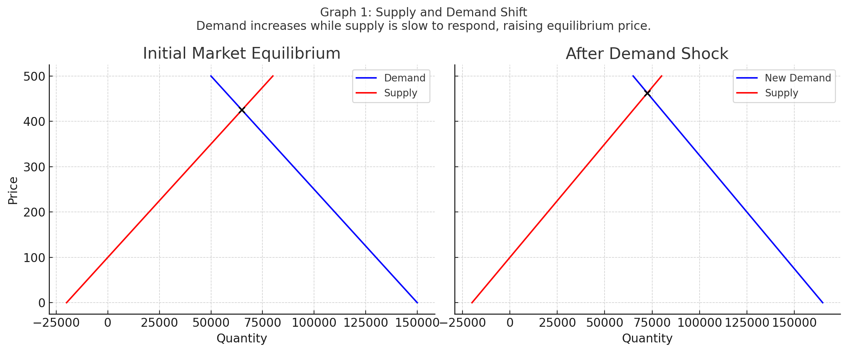
2. Basic Economic Concepts for Housing Markets
Graph 1: Supply and Demand Shift — showing the initial market equilibrium and the new higher equilibrium price after a demand increase while supply stays constant

Slide 16
2. Basic Economic Concepts for Housing Markets
2.3 Supply and Demand in Housing
The supply and demand model helps an economist to explain why prices and quantities vary across time and space.
For example, consider the San Francisco housing market. Suppose that local officials decide to stop issuing permits for new housing in the area in attempt to control local growth.
-How will this policy shock affect the demand for local housing and the supply of local housing?
-What will be the change in the city’s price and quantity of local real estate?
By using the supply and demand model, the economist can make informed predictions, and this helps us to anticipate who will be the winners and losers from the policy shift.

Slide 17
2. Basic Economic Concepts for Housing Markets
📌 Example: Housing Market in a Growing City
Situation:
A large tech company opens a new headquarters in a mid-sized city. Thousands of new employees move in, increasing housing demand.
1. Before the shock
The city’s housing market is at equilibrium:
  Equilibrium Price (P*) = $250,000 (average home price).
  Equilibrium Quantity (Q*) = 50,000 housing units available.
2. Demand Shock (New Company Employees)
As new workers arrive, demand for housing increases.
Demand curve shifts rightward.
3. Result in the Market
New Equilibrium Price rises to $320,000 (houses become more expensive).
New Equilibrium Quantity rises to 55,000 homes (more houses are built or sold).

Slide 18
2. Basic Economic Concepts for Housing Markets
4. Interpretation
Short-term: Prices increase faster than supply because building houses takes time → affordability crisis for locals.
Long-term: Developers respond to higher prices by building more housing units → supply catches up, stabilizing prices.
✅ Practical Application
Urban planners use this model to forecast housing shortages.
Governments may intervene with subsidies, zoning changes, or affordable housing programs to reduce shortages.
Investors & developers use demand-supply analysis to decide when and where to build new housing.

Slide 19
2. Basic Economic Concepts for Housing Markets
Exercise— Simple Supply-Demand Shift
Problem: City A has 100,000 housing units and 95,000 households. Annual population growth raises households by 10,000 in one year. Short-run new construction adds 2,000 units.
Assume demand increase shifts demand curve right by 10% and supply increases by 2%. What is the qualitative effect on prices?
Solution: Demand rises faster than supply (10% vs 2%) so equilibrium price will increase. Because housing supply is inelastic short-run, price increases are likely substantial.

Slide 20
2. Basic Economic Concepts for Housing Markets
Exercise — Supply Elasticity Impact
Question: Two cities, X and Y, experience the same 10% demand shock. City X supply elasticity is 0.1 (inelastic), City Y supply elasticity is 0.8 (elastic). Which city sees a larger price increase? Explain.
Solution: City X sees larger price increases because inelastic supply means less new construction responds to rising prices; City Y can expand supply more and therefore dampen price increases.

Slide 21

2. Basic Economic Concepts for Housing Markets
2.4 Housing as a Durable Asset and a Consumption Good
Housing provides flow services (shelter, location, amenities) while its durable nature means past investment decisions affect current supply.
Investors may hold housing for rental income or capital appreciation, which links housing markets to broader financial markets.

Slide 22

2. Basic Economic Concepts for Housing Markets
2.5 Market Equilibrium and Price Formation
Equilibrium in housing markets occurs where the quantity of housing demanded equals the quantity supplied—but because housing is heterogeneous (size, quality, location), equilibrium is a distribution across units rather than a single point.

Slide 23
2. Basic Economic Concepts for Housing Markets
2.6 Present Discounted Value -
Is the current worth of a future stream of cash flows or payments, calculated by "discounting" those future amounts back to the present using a specific discount rate.
This process accounts for the "time value of money“
The idea that a dollar today is worth more than a dollar in the future because it can be invested and earn interest.

Slide 24

2. Basic Economic Concepts for Housing Markets
2.6 Present Discounted Value
An analogous concept arises when comparing flows of money over time. Is $200 today more money than $300 dollars next year?
If the market rate of interest is 0% then $300 next year is more money.
If the market rate of interest is greater than 50% then $200 today is more money than $300 next year?
Why? Think of the opportunity cost.

Slide 25

2. Basic Economic Concepts for Housing Markets
2.6 Present Discounted Value
In an economy where the interest rate is 100%, you can deposit $200 in the bank this year and have $400 next year.
In an economy where the market rate of interest is r%, the present discounted value of $100 next year measured in today’s dollars is 100/(1+r). Why?

Slide 26

2. Basic Economic Concepts for Housing Markets
2.6 Present Discounted Value - Exercise
A real estate developer must decide whether to invest $100 today for a project that will pay out $0 for each of the next five years starting next year if the economy is in recession. The project will payout $300 each year for each of the next five years if the economy is booming.
The probability of the boom is 50%.
Assume the interest rate is 0% in this economy. From the perspective of today when evaluating this 6 year project, does this project offer a positive expected value?
Calculate the expected value.

Slide 27
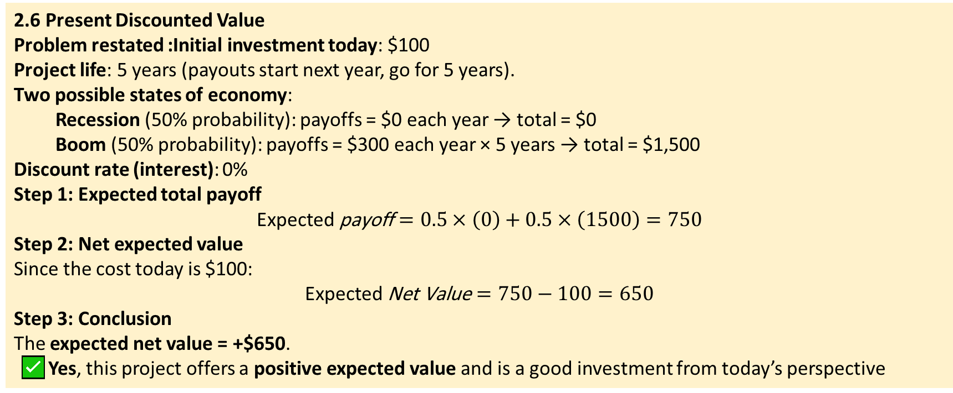
2. Basic Economic Concepts for Housing Markets
2.6 Present Discounted Value
Problem restated :Initial investment today: $100
Project life: 5 years (payouts start next year, go for 5 years).
Two possible states of economy:
  Recession (50% probability): payoffs = $0 each year → total = $0
  Boom (50% probability): payoffs = $300 each year × 5 years → total = $1,500
Discount rate (interest): 0%
Step 1: Expected total payoff
$$\text{Expected} \text{payoff}=0.5×\left(0\right)+0.5×\left(1500\right)=750$$
Step 2: Net expected value
Since the cost today is $100:
$$\text{Expected} \text{Net} \text{Value}=750−100=650$$
Step 3: Conclusion
The expected net value = +$650.
✅ Yes, this project offers a positive expected value and is a good investment from today’s perspective

Slide 28

3. Determinants of Housing Prices
3.1 Location and Accessibility
Location is the most important determinant. Proximity to job centers, transit, schools, and amenities raises willingness to pay.
Classic urban models (e.g., Alonso-Muth-Mills) describe how bid-rent declines with distance from a central business district.
Example: A commuter’s willingness to pay more for location closer to transit reduces commuting time and cost.

Slide 29
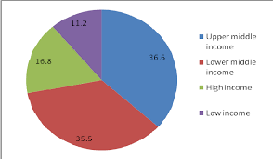
3. Determinants of Housing Prices
3.2 Income and Demographics
Rising incomes increase housing demand—especially for higher-quality homes—while household formation rates (young adults moving out, migration) affect the number of households and thus demand for housing units.

Slide 30

3. Determinants of Housing Prices
3.3 Construction Costs, Land Supply, and Regulation
Construction costs (labor, materials), availability of flat developable land, and regulatory constraints (e.g., zoning, height limits) shape supply.
Stringent zoning that restricts density increases prices by limiting the number of units that can be built.

Slide 31

3. Determinants of Housing Prices
3.4 Financial Factors: Interest Rates and Mortgage Markets
Lower mortgage interest rates reduce monthly payments for the same loan size and typically increase demand and prices. Mortgage availability and lending standards also influence who can buy.

Slide 32
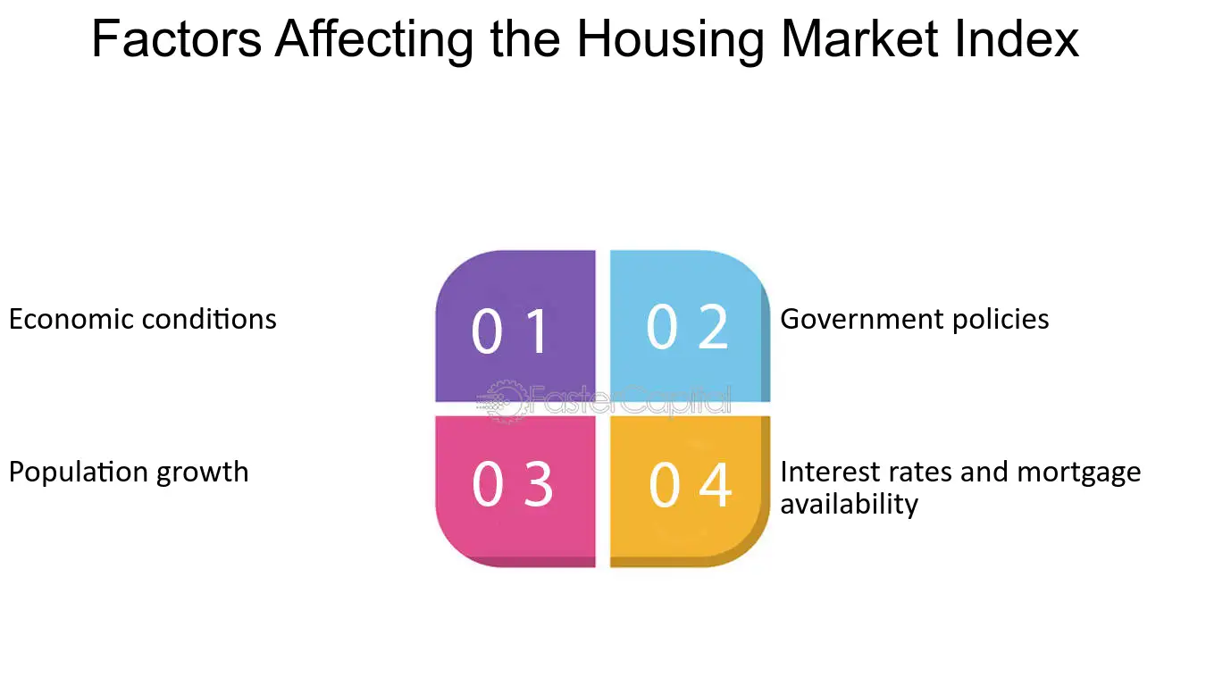
3. Determinants of Housing Prices

Slide 33
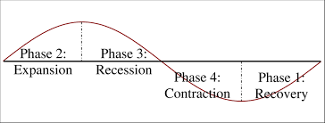
4. Housing Market Dynamics
4.1 Housing Cycles and Bubbles
Housing markets are cyclical: expansions when demand outpaces supply and contractions when supply catches up or credit tightens.
Speculative bubbles occur when expectations of future price increases feed demand, sometimes driving prices away from fundamentals.
Historical note: Many countries experienced housing booms in the 2000s followed by a crash in 2007–2009. Lessons include the dangers of loose credit and inadequate regulatory oversight.

Slide 34
4. Housing Market Dynamics
4.2 Spatial Patterns and Urban Structure
Cities can be monocentric or polycentric. The spatial distribution of jobs, amenities, and transport infrastructure determines housing price gradients and localized affordability pressures.
4.3 Supply Elasticity and Its Importance
Elasticity of housing supply measures how responsive new construction is to price changes. High elasticity (e.g., in cities with abundant land and permissive planning) helps stabilize prices; low elasticity (dense, regulated cities) leads to more volatile and higher prices.

Slide 35
5. Measuring Affordability
5.1 Common Affordability Metrics
1.Price-to-Income Ratio (PIR): Median house price divided by median household income. A commonly cited benchmark is that a ratio above 4–5 indicates affordability problems.
2.Rent-to-Income Ratio: Share of household income spent on rent. Internationally 30% is a common affordability threshold; households paying more are considered cost-burdened.
3.Residual Income Approach: After necessary non-housing expenditures, the remaining income should cover housing costs.
4.Housing Cost Overburden Rate: Percentage of households spending more than a given share (usually 40%) of disposable income on housing.

Slide 36

5. Measuring Affordability
5.2 Strengths and Limits of Different Measures
•PIR is simple but ignores mortgage terms, interest rates, and household heterogeneity.
•Rent-to-income is useful for renters but misses owner costs (mortgage, taxes, maintenance).
•Residual income is more comprehensive but needs good data on non-housing necessities.

Slide 37
5. Measuring Affordability
Exercise 1 — Price-to-Income Ratio Calculation
Problem: Median house price in City B is $350,000 and median household income is $60,000. Compute PIR.
Solution: PIR = 350,000 / 60,000 = 5.83 (a high ratio indicating poor affordability).

Slide 38
5. Measuring Affordability
Exercise 2 — Price-to-Income and Affordability
Question: City C has median house price $420,000 and median household income $70,000.
Compute PIR.
b) If a policymaker wants PIR below 5, by what percent must median price fall (holding income constant)?
Solution:
a) PIR = 420,000 / 70,000 = 6.0.
b) Desired price = 5 * 70,000 = 350,000.
Required reduction = (420,000 − 350,000)/420,000 = 70,000/420,000 = 0.1667 → 16.67% price reduction.

Slide 39
5. Measuring Affordability
Exercise 3 — Rent Burden Calculation
Question: A household pays $1,200 rent and has monthly net income $4,000.
Are they rent-burdened using the 30% rule?
What about using a 40% severe burden threshold?
Solution:
- Rent/income = 1,200 / 4,000 = 0.30 → exactly 30%, so they are at the threshold (not over-burdened but vulnerable).
- Using 40% threshold: 0.30 < 0.40 → not severely burdened.

Slide 40
5. Measuring Affordability
Table A1: Example city indicators (sample values)
Construction Coverage, April 2025 Construction CoverageNumbeo Property Prices Index, Mid-Year 2025 NumbeoUBS Global Real Estate Bubble Index, September 2025 UBSInvestropa, September 2025 InvestropaEconomic Times, June 2025
City | PIR (Median Multiple) | Affordability Status
Los Angeles, USA | 12.2 | Severely Unaffordable
San Francisco, USA | 10 | Severely Unaffordable
New York, USA | 15.43 | Severely Unaffordable
Miami, USA | 7.7 | Severely Unaffordable
London, UK | 20.6 | Severely Unaffordable
Paris, France | 16.8 | Severely Unaffordable
Dubai, UAE | 8.5 | Unaffordable
Berlin, Germany | 10.7 | Unaffordable
Mumbai, India | 7.0 | Unaffordable
Kuala Lumpur, Malaysia | 5.5 | Moderately Affordable
Construction Coverage, April 2025
Numbeo Property Prices Index, Mid-Year 2025
Global Real Estate Bubble Index, September 2025
Investropa, September 2025
Economic Times, June 2025

Slide 41
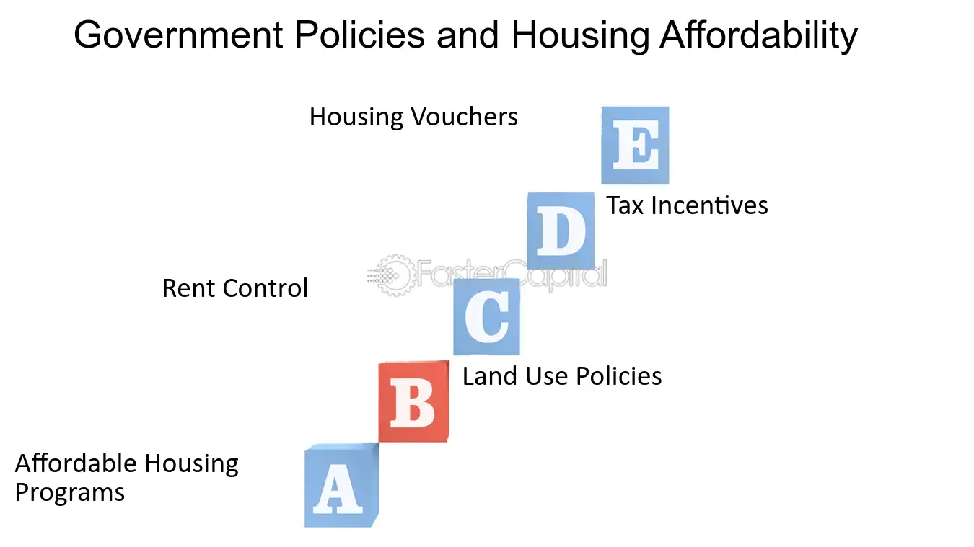
6. Policy Tools to Improve Affordability
6.1 Supply-side Policies
Increase land and housing supply through zoning reform, upzoning near transit, and reducing permitting delays.
Public land development and incentives for affordable housing in private developments (inclusionary zoning).
6.2 Demand-side Policies
Housing vouchers and rental assistance for low-income households.
Mortgage support (e.g., down-payment assistance) to help first-time buyers

Slide 42

6. Policy Tools to Improve Affordability
6.3 Land-use Reforms and Zoning
Reforming restrictive zoning (allowing duplexes, triplexes, and accessory dwelling units) can increase supply and improve affordability.
6.4 Social Housing and Targeted Subsidies
Public or non-profit social housing provides stable, long-term affordable units. Targeted subsidies help the most vulnerable households but require funding and administrative capacity.

Slide 43

7. Case Studies (Detailed)
https://dubailand.gov.ae/en/about-dubai-land-department/rules-regulations/#/
7.1 Vienna: Social Housing and Long-term Affordability
Overview: Vienna’s long tradition of municipally-led social housing provides a large stock of high-quality, rent-regulated apartments. This has helped maintain affordability and social mix.
Key lessons: Sustained public investment in housing, mixed-income developments, and strong tenant protections can produce stable affordability without sacrificing urban quality.

Slide 44

7. Case Studies (Detailed)
Law No. (26) of 2007
Regulating the Relationship between Landlords and Tenants
in the Emirate of Dubai1tween Landlords and Tenants
in the Emirate of Dubai1
7.2 London: Market Pressures and Policy Responses
Overview: London faces strong demand from domestic and international buyers, limited central land supply, and complex planning rules. High prices pushed many households to peripheries and stimulated contentious policy debates on densification and social housing provision.
Key lessons: Liberalizing supply near transit and strengthening targeted social housing can be complementary but politically difficult.

Slide 45

7. Case Studies (Detailed)
Law No. (26) of 2007
Regulating the Relationship between Landlords and Tenants
in the Emirate of Dubai1tween Landlords and Tenants
in the Emirate of Dubai1
7.3 Portland (USA): Growth Management, NIMBYism, and Affordability
Overview: Portland’s urban growth boundary slowed suburban sprawl but constrained land supply, contributing to price increases. Local opposition to densification (NIMBYism) complicates efforts to add housing.
Key lessons: Growth management without flexible urban infill strategies can unintentionally harm affordability.

Slide 46

7. Case Studies (Detailed)
Law No. (26) of 2007
Regulating the Relationship between Landlords and Tenants
in the Emirate of Dubai1tween Landlords and Tenants
in the Emirate of Dubai1
7.4 Dubai: Rapid Supply, Price Volatility
Overview: Cities with rapid, supply-driven growth like Dubai experience boom-bust cycles and high volatility in prices and rents.
Key lessons: Rapid construction without matching long-term demand forecasting can lead to oversupply and price collapses.

Slide 47
8. Market and demand tools to decide about new real estate investment?
Law No. (26) of 2007
Regulating the Relationship between Landlords and Tenants
in the Emirate of Dubai1tween Landlords and Tenants
in the Emirate of Dubai1
Market & Demand Tools
Comparative Market Analysis (CMA) → Evaluates prices and rents of similar properties.
Supply & Demand Studies → Measures pipeline projects vs. housing demand.
Real Estate Market Reports → Provide forecasts and trends.
Demographic Analysis → Population growth, income levels, urbanization trends.
Location Analysis → Accessibility, infrastructure, schools, hospitals, transport links.

Slide 48

Conclusion
Housing affordability results from interactions between supply constraints, strong demand (local and global), financial conditions, and policy choices. Combining supply-side reforms, targeted subsidies, and careful planning can improve outcomes while balancing social objectives and market efficiency
lecture
03
EXERSICE
Using supply demand in housing and equilibrium price ,predicate about the prices trend at your country/city?

Slide 49



Thank You

