Slide 1


Project Governance
Prepared by Dr. Fayez Jrad
PMG 424
Lecture 02

Slide 2



Project Governance
Lecture 02
PMG 424
Governance Structures and Management Scope
Prepared by
Dr. Fayez Jrad

Slide 3
Chapter
Learning Outcomes
02
Discuss the governance scope.
Explore the different orientations of organizations regarding governance.
Explain the differences between the various paradigms of governance.
Understand how governance relates to different management approaches.

Slide 4
Governance Scope
Governance, and its different structures, is not confined to the board level of the organization.
Many of the major project failures were caused by lack of appropriate governance at the level of individual projects and their management.

Slide 5
Governance Scope
Organizations with a large percentage of their business done through projects are especially dependent on good project results.
In these organizations, the impact of project results on corporate results demands rigid governance structures for projects.

Slide 6
Governance Scope
Project management methodologies, such as PRINCE2, suggest that governance of projects and project management originates at the top of the organization and trickles down to the lower levels

Slide 7
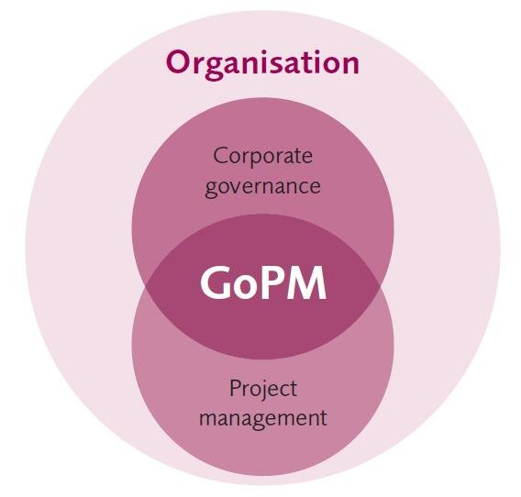
Governance and Project Management

Slide 8
Governance and Project Management
At the corporate level, governance of projects and project management is a responsibility of the board of directors, including:
  Definition and goal setting for the projects, programs and portfolios in order to achieve its strategic objectives.
  - Defining the model by which they will be governed.

Slide 9
Governance and Project Management
- Developing enterprise project management capabilities to ensure their successful implementation.
Controlling progress in the implementation of these actions and taking corrective actions in case of plan deviation.

Slide 10
Governance and Portfolios
The project management governance structure includes a governance entity at the level of projects, programs and portfolios.
At the portfolio level, it is the board of directors which defines portfolio goals as a subset of:
The organization’s strategic goals.
The criteria for prioritization and measurement of progress and the means to monitor progress.

Slide 11
Governance and Projects
At the level of individual projects and programs, it is the responsibility of the sponsor or project/program steering group to:
Set the business objective and agrees the program/project deliverables.
Provide the means (resources, facilities, processes, project manager and so on) to achieve objectives.
Define the means to control progress (for example, at milestones and stage gate reviews).

Slide 12
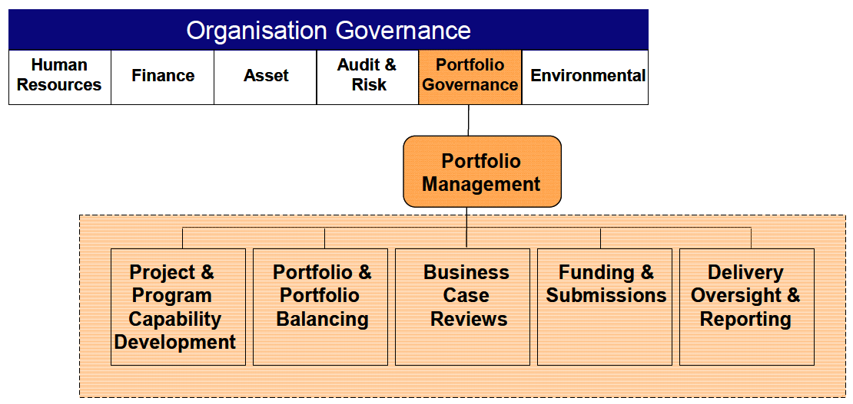
Example of a Portfolio Governance Model
مراجعة

Slide 13
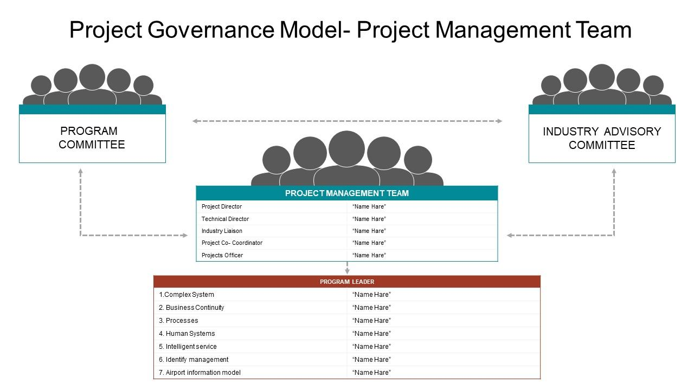
Example of a Portfolio Governance Model
www.midocean.ae

Slide 15
Decisions and methods related to how projects, programs, and portfolios are managed within an organization must be clear with regards to the unit or people (board of directors, project management offices, sponsor steering committees) responsible for them, the way they will be practiced and the accountability model on each of them

Slide 16
Paradigms for Project Management Governance
Organizations differ in the priorities they assign to the project processes or the project outcomes.
According to the paradigm followed to manage projects, two types of organizations can be identified:
Behavioral-oriented organizations.
Outcome-oriented organizations.

Slide 17
Behavioral-oriented Organizations
Organizations emphasizing the importance of following a strict project management processes to accomplish project outcomes.
These organizations perceive project management as being inherent in the process of delivering the project outcome, often in form of a technology development methodology or a corporate project management methodology.
These organizations are ambivalent as to whether project management is done by individuals internal or external to their organization, as long as the process conforms to given standards or policies.

Slide 18
Outcome-oriented Organizations
Organizations emphasizing the fit of project deliverables to existing expectations.
These organizations give more autonomy to their projects and project managers than behaviour-oriented organizations.
Typically, they do perceive project management as a corporate core competency and a major differentiator for competing in the marketplace.
In these organizations, projects are typically managed by dedicated project managers, who possess a wider spectrum of project management related skills and are directly employed by the organization.

Slide 19
Other Governance Paradigms
The combination of the previous two approaches with an underlying corporate shareholder or stakeholder philosophy provides four different governance paradigms:
The Conformist Paradigm.
The Flexible Economist Paradigm.
The Versatile Artist Paradigm.
The Agile Pragmatist Paradigm.

Slide 20
The Conformist Paradigm
This paradigm utilizes strict compliance with existing processes, rules and policies to attempt to ensure lowest project costs in environments with a relatively homogeneous set of projects.
A typical example is quality improvement projects using Six Sigma techniques.
Due to their repetitive nature, strict process orientation and relatively low level of innovation, these projects are often led by technical experts or specialists in each field.

Slide 21
The Flexible Economist Paradigm
This paradigm aims for low project costs through a well-informed selection of project management methodologies which ensure less costly economic delivery.
This paradigm assumes that well experienced project managers can identify the process that deliver the most economic result and save costs through professional management.
Skilled, educated, flexible and experienced project managers are needed to economize on the methods used in environments with a relatively heterogeneous set of projects.
Examples include customer specific software application development projects in fixed price contracts.

Slide 22
The Versatile Artist Paradigm
This paradigm aims at maximizing benefits through balancing the diverse set of requirements arising from several different stakeholders and their needs and desires.
Balance is achieved either by tailoring existing project management methodologies or by developing new ones to balance these diverse requirements.
This paradigm assumes that versatile and experienced project managers can balance diverse conflicting requirements.
Examples of organizations using this governance paradigm include project management consulting companies working with very heterogeneous sets of projects.

Slide 23
The Agile Pragmatist Paradigm
This paradigm aims for maximization of technical usability, often through a time-phased approach to the development and product release of functionality over a period of time.
This paradigm assumes that a limited but key functionality (especially in software development) allows for a limited but early use of the new product.

Slide 24
The Agile Pragmatist Paradigm
Examples include projects for IT software development, where a few key functions allow a limited productive use of the product.
These projects often use Agile methods, such as Scrum, to identify project scope to be achieved using the customer’s prioritization of functions over a given timeframe.

Slide 25
The Choice of Governance Paradigm
Large and complex enterprises apply different governance paradigms in their different organizational parts, often reflecting:
  The strategic goals of the organization.
  The preferences of the leaders.
  The demands of the market.
  The level of project management maturity.
The choice of governance paradigm impacts both the breadth and depth with which governance of projects and project management is implemented in an organization.

Slide 26
The Choice of Governance Paradigm
When deciding on their most suitable governance paradigm, organizations prioritize between realizing holistic benefits for all stakeholders or making the highest return on investment for shareholders.
Organizations also have to decide whether better results or more compliance to ethics and adopted processes is their key motivator.
Having these two aspects answered allows organizations more awareness about their effective governance strategy and paradigm.

Slide 27
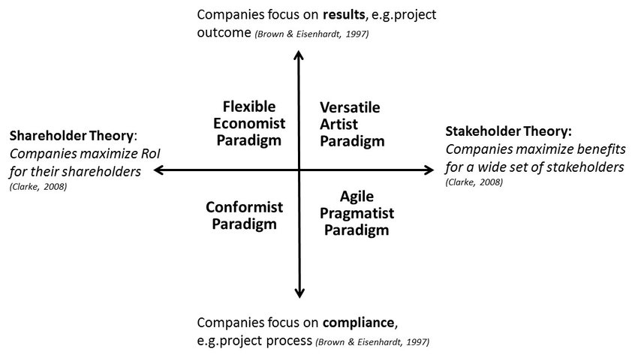
The Choice of Governance Paradigm

Slide 28
Combination 1
Outcome Control Focus With Shareholder Orientation
Outcome Control Focus | Shareholder Orientation
Outcome control focus | Flexible Economist Paradigm Achieving highest possible Return on Investment (ROI) for the organizations’ shareholders through optimization of the management of projects. Done by establishing project management as core competence (for example, through training, certification and related career ladders) executed by professional project managers who are employees of the organization. They are guided by tactical Project Management Offices (PMO), which support and control the application of accepted project management methods and tools

Slide 29
Combination 2
Outcome Control Focus With Stakeholder Orientation
Outcome Control Focus | Stakeholder Orientation
Outcome control focus | Versatile Artist Paradigm Consists of balancing the qualitative and quantitative requirements of a wide range of stakeholders (both often differ by project). Achieved through selection or tailoring of project management methods for the different projects. Project management is understood to be a core competence of the organization and a profession of the individual. Both aspects are guided by a strategic PMO which defines the organization’s business results to be achieved through project management

Slide 30
Combination 3
Behavior Control Focus With Shareholder Orientation
Behaviour Control Focus | Shareholder Orientation
Outcome control focus | Conformist Paradigm Maximizing shareholder return by strictly applying existing development methodologies. Project management is often a subset (possibly invisible) in the specific development processes for technical products or services. Project management is understood as an on-the-side task for leading technical experts

Slide 31
Combination 4
Behavior Control Focus With Stakeholder Orientation
Behaviour Control Focus | Stakeholder Orientation
Outcome control focus | Agile Pragmatist Paradigm Balances the diverse requirements of a variety of stakeholders by maximizing their collective benefits through the timely development of functionality or value. Project management methods maximize value of a series of project outcomes over time, based on the strict prioritization of user needs

Slide 32
There is no universal project governance paradigm that all organizations must adopt, it always depends on the context or sector of the organization and on the model of project management that is appropriate to that context or sector (waterfall, agile, hybrid)

Slide 33
Task 1
For further understanding of project, program, and portfolio governance, try to identify a successful project-based company and explain how governance affected their efficient project outcomes.

Slide 34
Task 2
Select a local, regional, or global company that you are impressed of how smoothly it performs its projects, programs, and portfolios and explore which governance paradigm it adopts; then, discuss its organizational orientation and focus.

Slide 35
Task 3
Search for the largest companies in the world and compare between their commercial and financial performance and their governance approaches and strategies; is their any relationship between both? If your answer is yes, kindly elaborate on this relationship.

Slide 36
Conclusion
Governance structures are not confined to the board level of the organization.
Project may failure because of lack of appropriate governance at the level of individual projects and their management.
Some project management methodologies, such as PRINCE2, suggest that governance of projects is a top-to-bottom organizational approach.
Corporate governance of projects, programs, and portfolios include defining their goals and controlling their implementation to achieve these goals.

Slide 37
Conclusion
Behavior-oriented organizations emphasize the importance of following a strict project management process to accomplish project outcomes.
These organizations are ambivalent as to whether project management is done by individuals internal or external to their organization, as long as the process conforms to given standards or policies.
Organizations emphasizing the fit of the project’s deliverables to existing expectations.
Typically, they do perceive project management as a corporate core competency and a major differentiator for competing in the marketplace.

Slide 38
Conclusion
There are four main governance paradigms decided based on the underlying corporate shareholder or stakeholder philosophy.
The four governance paradigms are The Conformist Paradigm, The Flexible Economist Paradigm, The Versatile Artist Paradigm, and The Agile Pragmatist Paradigm.
Choosing the suitable governance paradigm impacts both the breadth and depth with which governance of projects and project management is implemented in an organization.

Slide 39

Reference

Slide 40



Thank You

