Slide 1

Organization Structure
Organization is a social entity that has a collective goal and is linked to an external environment.
The purpose of an organization to coordinate the efforts of many to accomplish goals.
An organizational structure defines how activities such as tasks allocation, coordination, and supervision are directed toward the achievement of organizational aims. Organizational structure affects organizational action and provides the foundation on which standard operating procedures and routines rest.

Slide 2

Organization Structure
3. Design of systems for
  effective communication
  coordination
  integration across departments
Basic forms of organization structures are:
  1- Functional organization
  2- Pure Project organization (Projectized)
  3- Matrix organization

Slide 3
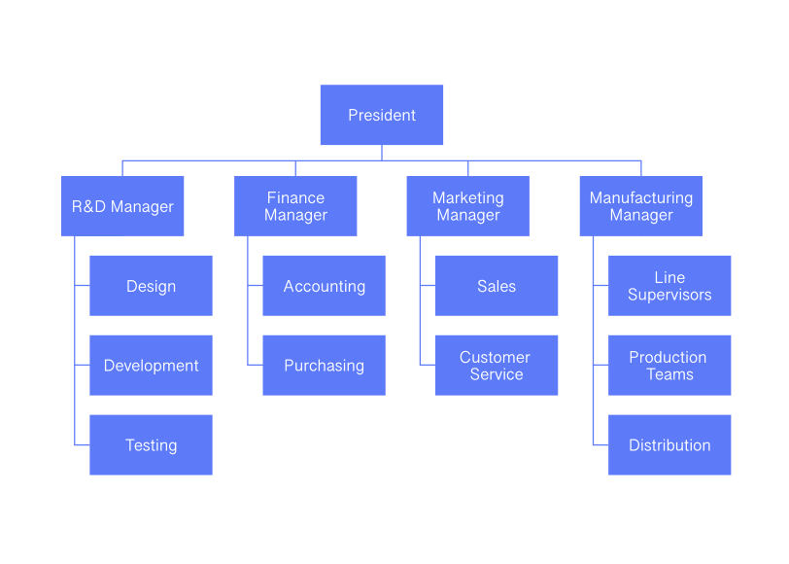
1. Functional organization structure

Slide 4
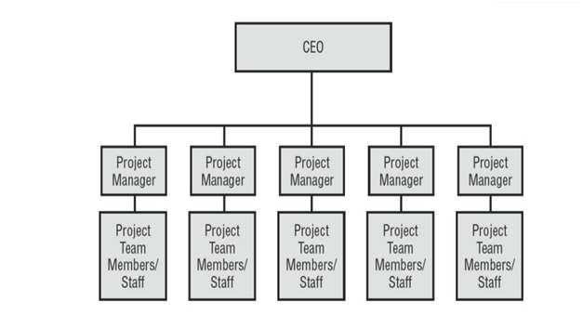
2. Projectized organizational structure

Slide 5

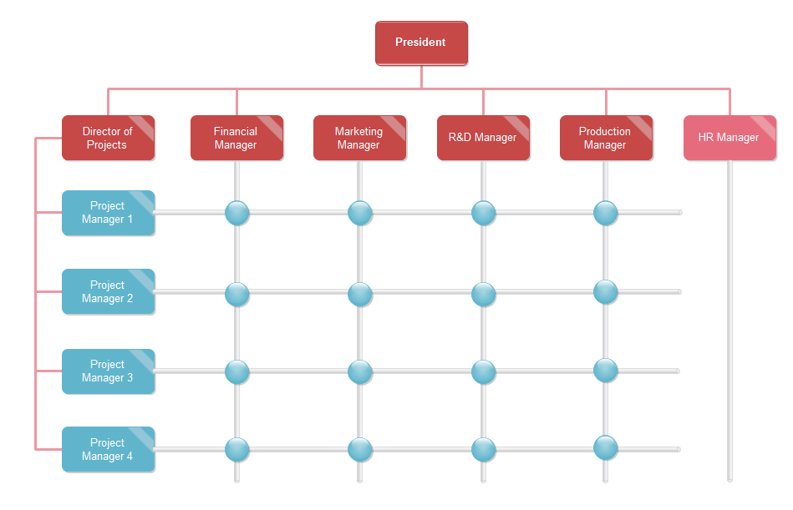
  3. Matrix organizational structure (Hybrid)

Slide 6
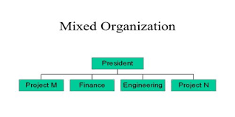

Slide 7

Choosing the Appropriate Project Management Structure
Depending on the autonomy the project needs to complete successfully, the project considerations include the following:
1. Size of the project
2. Strategic importance
3. Novelty and need for innovation.
4. Need for integration (number of departments involved)
5. Environmental complexity.

Slide 8

Choosing the Appropriate Project Management Structure
6. Budget and time constraints.
7. Stability of resource requirements.
Higher the levels of these seven factors, the more autonomy and authority the project manager and project team need to be successful. This would lead to using of either projectized structure or a matrix structure.

