Slide 1



Introduction to Economics
Lecture 4
MGM112
Market Equilibrium
Prepared by
Lec. Dina ElWakkad
www.midocean.ae

Slide 2

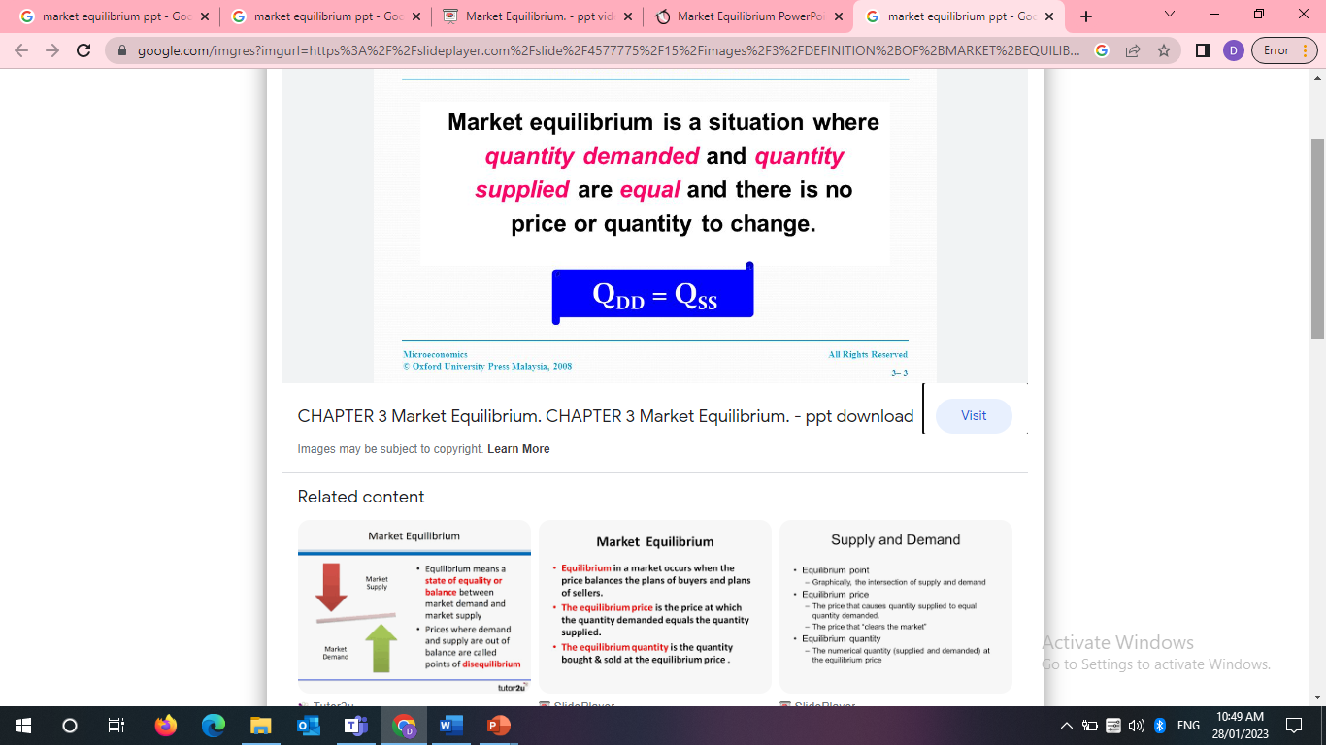
Chapter
Market Equilibrium
04
www.midocean.ae

Slide 3
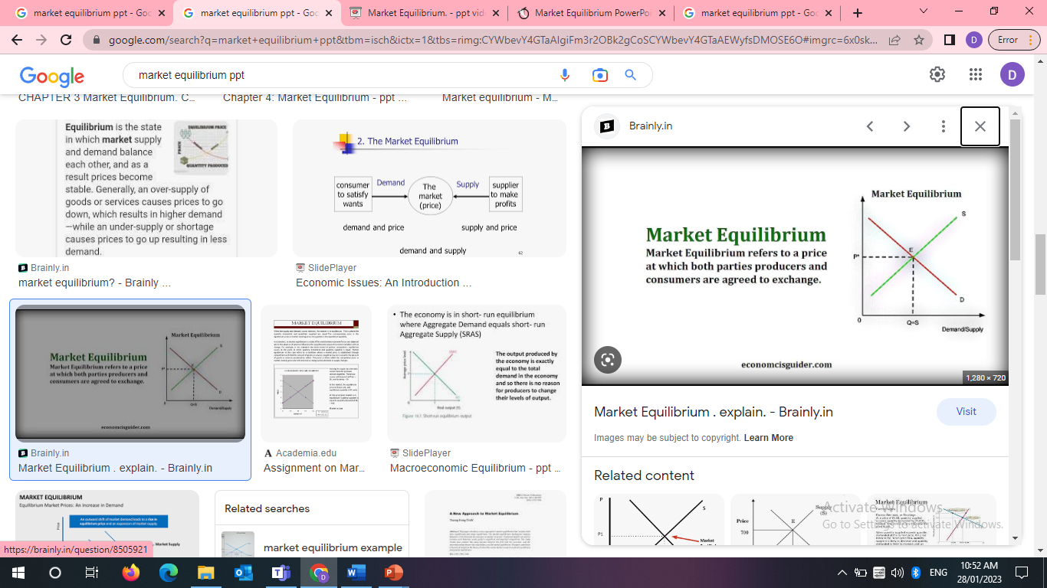
Chapter
Market Equilibrium
04
www.midocean.ae

Slide 4
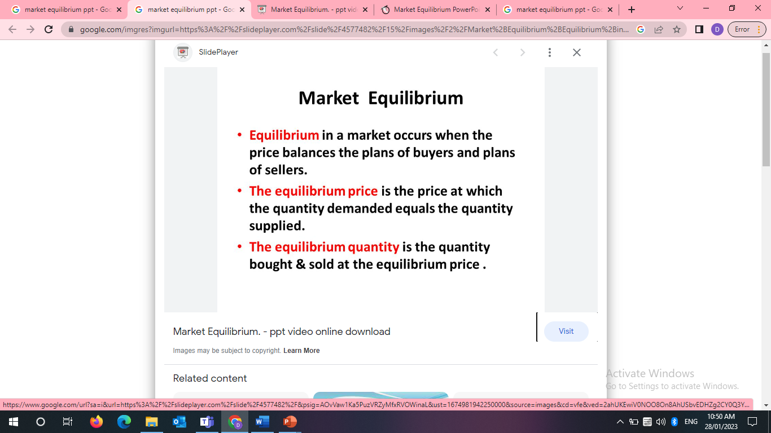
Chapter
Market Equilibrium
04
www.midocean.ae

Slide 5
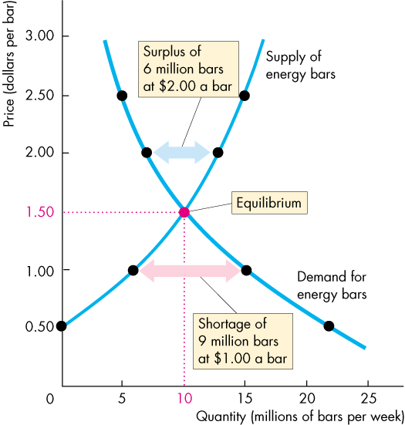
Chapter
Market Equilibrium
04
  If the price is $1.50 a bar,
  the quantity demanded equals the quantity supplied. Qs=Qd
  There is neither a shortage nor a surplus of energy bars.
  At the equilibrium price, buyers’ plans and sellers’ plans agree and the price doesn’t change until some event changes either demand or supply.
www.midocean.ae

Slide 6
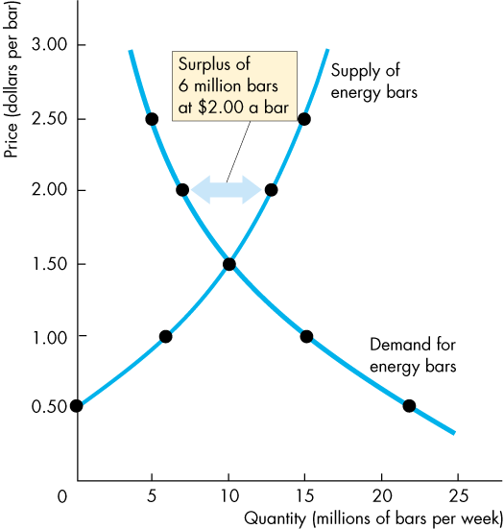
Chapter
Price as a Regulator
04
  If the price is $2.00 (Above equilibrium price) a bar,
  the quantity supplied exceeds the quantity demanded. Qs>Qd
  There is a surplus of
  6 million energy bars.
www.midocean.ae

Slide 7
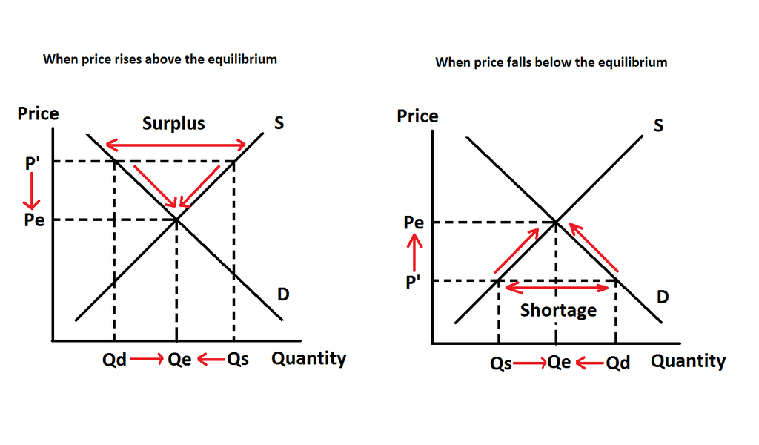
Chapter
Price Adjustments
04
A surplus cause:
  the price to fall,
  decreasing quantity supplied
  increasing quantity demanded
  Until the equilibrium price is attained
www.midocean.ae

Slide 8
Chapter
Price as a Regulator
04
  If the price is $1.00 (below equilibrium price) a bar,
  the quantity demanded exceeds the quantity supplied. Qs<Qd
  There is a shortage of
  9 million energy bars.
www.midocean.ae

Slide 9
Chapter
Price Adjustments
04
A shortage cause:
  the price to rise,
  decreasing quantity demanded
  increasing quantity supplied
Until the equilibrium price is attained
www.midocean.ae

Slide 10
Chapter
Price adjustment / Price as a regulator
04
Over what range of prices does a surplus arise? What happens to the price when there is a surplus (price adjustment / Price as a regulator)? | Over what range of prices does a shortage arise? What happens to the price when there is a shortage (price adjustment/ Price as a regulator)?
A surplus arises at market prices above the equilibrium price. A surplus cause: the price to fall, decreasing quantity supplied increasing quantity demanded Until the equilibrium price is attained | A shortage arises at market prices below the equilibrium price. A shortage cause: the price to rise, decreasing quantity demanded increasing quantity supplied Until the equilibrium price is attained.
www.midocean.ae

Slide 11
Chapter
Change in Market Equilibrium
04
When does the equilibrium price and equilibrium quantity change?
www.midocean.ae

Slide 12
Chapter
Change in Market Equilibrium
04
When does the equilibrium price and equilibrium quantity change?
∆D only
∆S only
∆D &∆S
www.midocean.ae

Slide 13
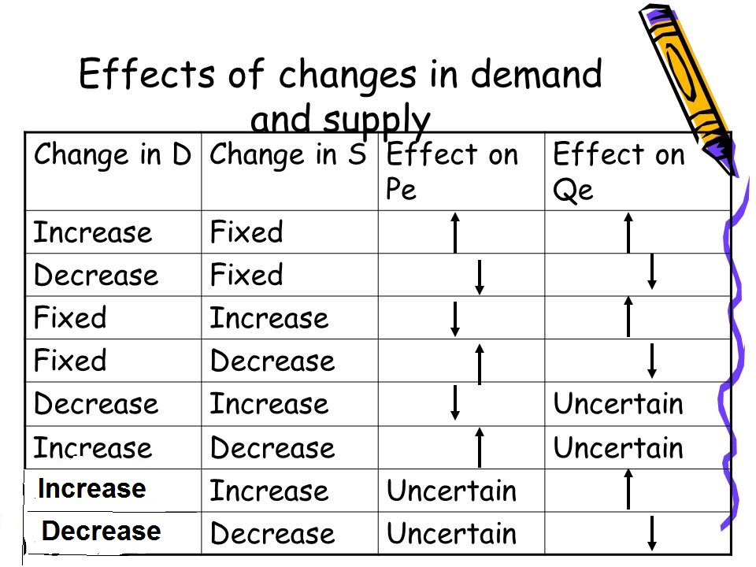
Chapter
Change in Market Equilibrium
04
Effects of change of the demand or supply
www.midocean.ae

Slide 14
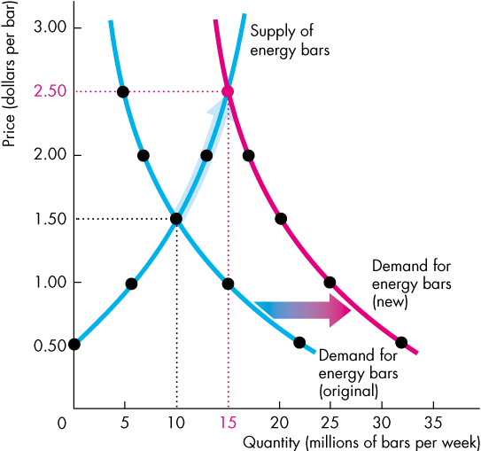
Chapter
Change in Market Equilibrium
04
Effects of change of the demand or supply
An Increase in Demand
  when demand increases the demand curve shifts rightward.
  Supply remains unchanged; there is a movement up along the supply curve.
    The equilibrium price of increases
    The equilibrium quantity increases.
www.midocean.ae

Slide 15
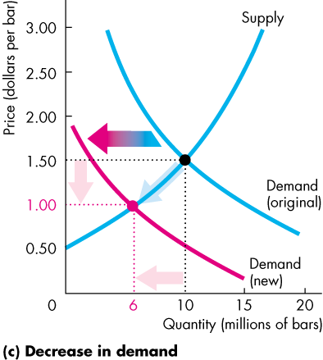
Chapter
Change in Market Equilibrium
04
Effects of change of the demand or supply
A decrease in Demand
  when demand increases the demand curve shifts leftward.
  Supply remains unchanged; there is a movement down along the supply curve.
    The equilibrium price of decreases
    The equilibrium quantity decreases.
www.midocean.ae

Slide 16
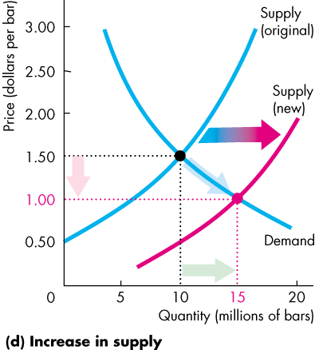
Chapter
Change in Market Equilibrium
04
Effects of change of the demand or supply
An Increase in Supply
  When supply increases the supply curve shifts rightward.
  Demand remains unchanged; there is a movement down along the demand curve.
    The equilibrium price of falls
    The equilibrium quantity increases.
www.midocean.ae

Slide 17
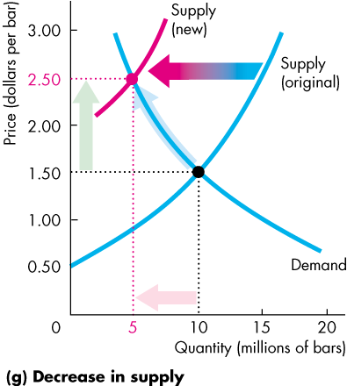
Chapter
Change in Market Equilibrium
04
Effects of change of the demand or supply
A decrease in Supply
  When supply decreases the supply curve shifts leftward.
  Demand remains unchanged; there is a movement up along the demand curve.
    The equilibrium price of increases
    The equilibrium quantity decreases.
www.midocean.ae

Slide 18
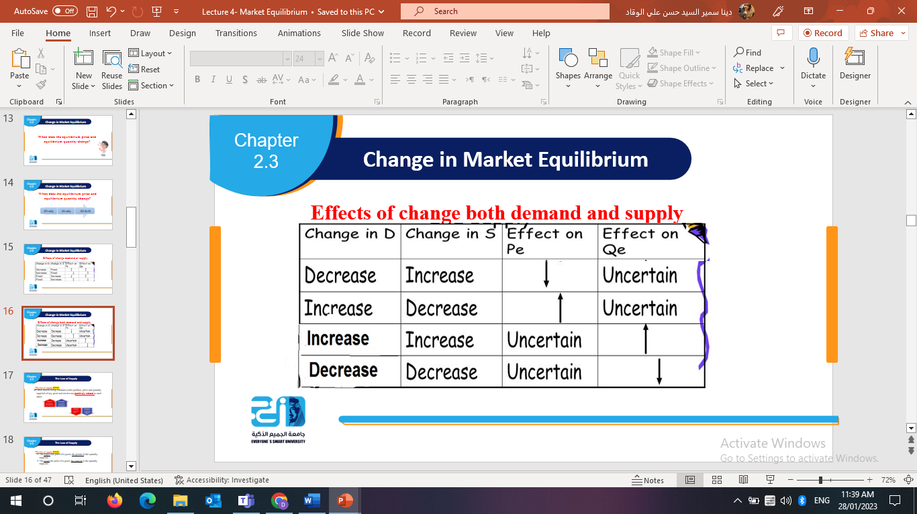
Chapter
Change in Market Equilibrium
04
Effects of change both demand and supply at the same direction
As D & S curves change at same directions → the equilibrium price is uncertain
www.midocean.ae

Slide 19
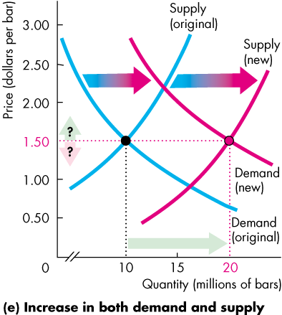
Chapter
Change in Market Equilibrium
04
Effects of change both demand and supply at the same direction
Increase in Both Demand and Supply
  An increase in demand and an increase in supply increase the equilibrium quantity.
  The change in equilibrium price is uncertain because the increase in demand raises the equilibrium price and the increase in supply lowers it.
www.midocean.ae

Slide 20
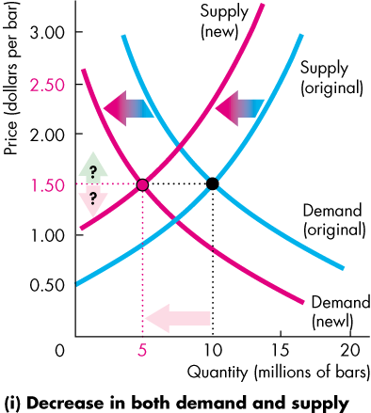
Chapter
Change in Market Equilibrium
04
Effects of change both demand and supply at the same direction
Decrease in Both Demand and Supply
  A decrease in both demand and supply decreases the equilibrium quantity.
  The change in equilibrium price is uncertain because the decrease in demand lowers the equilibrium price and the decrease in supply raises it.
www.midocean.ae

Slide 21
Chapter
Change in Market Equilibrium
04
Effects of change both demand and supply at opposite direction
As D & S curves change at opposite directions → the equilibrium quantity is uncertain
www.midocean.ae

Slide 22
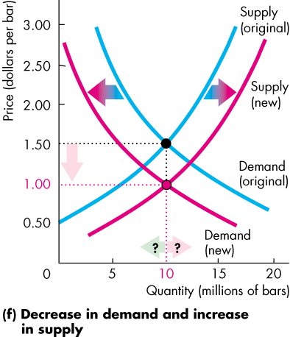
Chapter
Change in Market Equilibrium
04
Effects of change both demand and supply at opposite direction
Decrease in Demand and Increase in Supply
  A decrease in demand and an increase in supply lowers the equilibrium price.
  The change in equilibrium quantity is uncertain because the decrease in demand decreases the equilibrium quantity and the increase in supply increases it.
www.midocean.ae

Slide 23
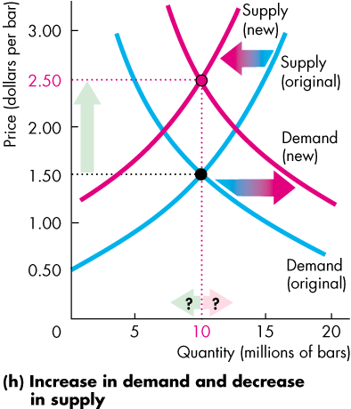
Chapter
Change in Market Equilibrium
04
Effects of change both demand and supply at opposite direction
Increase in Demand and Decrease in Supply
  An increase in demand and a decrease in supply raises the equilibrium price.
  The change in equilibrium quantity is uncertain because the increase in demand increases the equilibrium quantity and the decrease in supply decreases it.
www.midocean.ae

Slide 24
Chapter
Change in Market Equilibrium
04
www.midocean.ae

Slide 25

Chapter
04
Problem Questions
www.midocean.ae

Slide 26
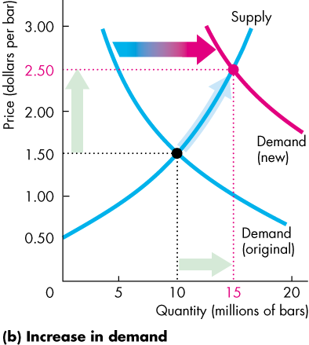
Chapter
Think
04
What is the effect on the Eq.price and Eq.quantity of Coffee if The price of a Tea rises? (Draw the diagrams!)
As tea is a substitute for a coffee:
  A rise in the price of a tea increases the demand for coffee
  The demand curve for coffee shifts rightward,
  Supply remains unchanged; there is a movement up along the supply curve.
  The equilibrium price of a coffee rises
  The equilibrium quantity of coffee increases.
www.midocean.ae

Slide 27
Chapter
Think
04
What is the effect on the Eq.price and Eq.quantity of Coffee if the price of a Sugar falls? (Draw the diagrams!)
A sugar is a complement of a coffee
  A fall in the price of sugar increases the demand for coffee
  The demand curve for coffee shifts rightward.
  Supply remains unchanged; there is a movement up along the supply curve.
  The equilibrium price of a coffee rises
  The equilibrium quantity of coffee increases.
www.midocean.ae

Slide 28
Chapter
Think
04
What is the effect on the Eq.price and Eq.quantity more firms produce coffee? (Draw the diagrams!)
Increase the supply of coffee
The supply curve of coffee increases and shifts rightward.
Demand remains unchanged; there is a movement down along the demand curve.
  The equilibrium price of a coffee falls
  The equilibrium quantity of coffee increases.
www.midocean.ae

Slide 29
Chapter
Think
04
What is the effect on the Eq.price and Eq.quantity workers’ wages rise? (Draw the diagrams!)
An increase in the wages of workers leads to:
Increase the cost of producing coffee.
The supply curve of coffee decreases and shifts leftward.
Demand remains unchanged; there is a movement up along the demand curve.
  The equilibrium price of a coffee rises
  The equilibrium quantity of coffee decreases
www.midocean.ae

Slide 30
Chapter
Think
04
What is the effect on the Eq.price and Eq.quantity if the price of a tea falls and more firms produce coffee? (Draw the diagrams!)
When the price of a tea falls → this affects demand curve, demand decreases and shift leftward
When more firms produce coffee → this affects supply curve, supply increases and shift rightward
  The equilibrium price of a coffee falls
  The equilibrium quantity of coffee is uncertain because
    The decrease in demand → decreases the equilibrium quantity
    The increase in supply → increases the equilibrium quantity
    So, the equilibrium quantity might increase, decrease, or not change
www.midocean.ae

Slide 31
Think
The equilibrium quantity will decrease, and the price might rise, fall, or stay the same when the
A) demand and the supply of a good both increases.
B) demand for a good increase and the supply of it decreases.
C) demand for a good decrease and the supply of it increases.
D) demand and the supply of a good both decreases.
www.midocean.ae

Slide 32
Think
When supply and demand both increases, the
A) quantity definitely decreases.
B) quantity definitely increases.
C) price definitely increases.
D) price definitely decreases
www.midocean.ae

Slide 33
Think
When a market is in equilibrium,
A) everyone has all they want of the commodity in question.
B) there is no shortage and no surplus at the equilibrium price.
C) the number of buyers is exactly equal to the number of sellers.
D) the supply curve has the same slope as the demand curve.
www.midocean.ae

Slide 34
Think
If the price of a video download is below its equilibrium price, the quantity supplied is ________ than the quantity demanded. If the price of a video download is above its equilibrium price, the quantity supplied is ________ than the quantity demanded.
A) less; greater
B) greater; less
C) less; less
D) greater; greater
www.midocean.ae

Slide 35
Think
If the price of a CD is equal to the equilibrium price, there will be ________ of CDs and the price will ________.
A) surplus; rise
B) surplus; fall
C) shortage; fall
D) neither a shortage nor surplus; not change
If the quantity demanded exceeds the quantity supplied, then there is
A) a shortage and the price is below the equilibrium price.
B) a shortage and the price is above the equilibrium price.
C) a surplus and the price is below the equilibrium price.
D) a surplus and the price is above the equilibrium price.
www.midocean.ae

Slide 36
Think
If the quantity supplied exceeds the quantity demanded, then there is
A) a shortage and the price is below the equilibrium price.
B) a shortage and the price is above the equilibrium price.
C) a surplus and the price is below the equilibrium price.
D) a surplus and the price is above the equilibrium price.
www.midocean.ae

Slide 37
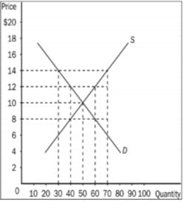
Think
In this market, Equilibrium price and Equilibrium quantity would be
14$, 70
12$, 40
10$, 50
8$, 50
If Price in this market is currently 14$, there would be
Shortage of 20 units and price would tend to rise
Surplus of 20 units and price would tend to fall
Shortage of 40 units and price would tend to rise
Surplus of 40 units and price would tend to fall (70-30)
www.midocean.ae

Slide 38
Think
If Price in this market is currently 8 $, the quantity supplies would be
40 and quantity demanded would be 60
60 and quantity demanded would be 40
50 and quantity demanded would be 50
70 and quantity demanded would be 30
www.midocean.ae

Slide 39
Summary outlines
Market Equilibrium
Price as a Regulator
Price Adjustments
Change in Market Equilibrium
www.midocean.ae

Slide 40


Thank You

