Slide 1

Digital Consumer Behavior
Prepared by Dr. Noha El Aswad
Lecture 2
MKT713_
Master of Digital Marketing

Slide 2
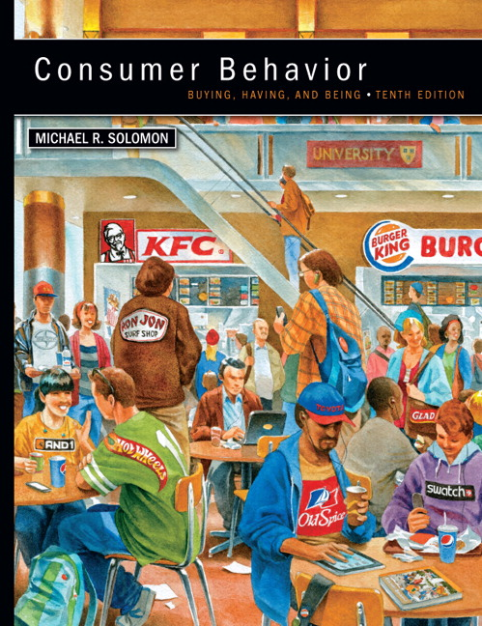

Chapter
01
Buying, Having, Being
CONSUMER BEHAVIOR, 10e
Michael R. Solomon

Slide 3
Chapter
01
Chapter Objectives
When you finish this chapter, you should understand why:
Consumers use products to help them define their identities in different settings.
Consumer behavior is a process.
Marketers need to understand the wants and needs of different consumer segments.

Slide 4
Chapter
01
Chapter Objectives (continued)
The Web is changing consumer behavior.
Consumer behavior relates to other issues in our lives.
Many different types of specialists study consumer behavior.
There are two major perspectives that seek to understand and study consumer behavior.

Slide 5

Chapter
01
Learning Objective 2
Consumer behavior is a process.

Slide 6
Chapter
01
Consumer behavior is an ongoing process
Most marketers now recognize that consumer behavior is in fact an ongoing process, not merely what happens at the moment a consumer hands over money or a credit card and in turn receives some good or service.

Slide 7
Chapter
01
The exchange
Is a transaction in which two or more organizations or people give and receive something of value, is an integral part of marketing.

Slide 8
Chapter
01
Expanded view
Although exchange theory remains an important part of consumer behavior, the expanded view emphasizes the entire consumption process, which includes the issues that influence the consumer before, during, and after a purchase.

Slide 9
Chapter
01
A consumer
is a person who identifies a need or desire, makes a purchase, and then disposes of the product during the three stages of the consumption process. In many cases, however, different people play a role in this sequence of events.

Slide 10
Chapter
01
The purchaser and the user of a product
Might not be the same person, as when a parent picks out clothes for a teenager. In other cases, another person may act as an influencer when he or she recommends certain products without actually buying or using them.

Slide 11
Chapter
01
Organizations or groups 1/2.
Finally, consumers may take the form of organizations or groups. One or several persons may select products that many will use, as when a purchasing agent orders a company’s office supplies.

Slide 12
Chapter
01
Organizations or groups 2/2.
In other organizational situations, a large group of people may make purchase decisions: for example, company accountants, designers, engineers, sales personnel, and others—all of whom will have a say in the various stages of the consumption process.

Slide 13
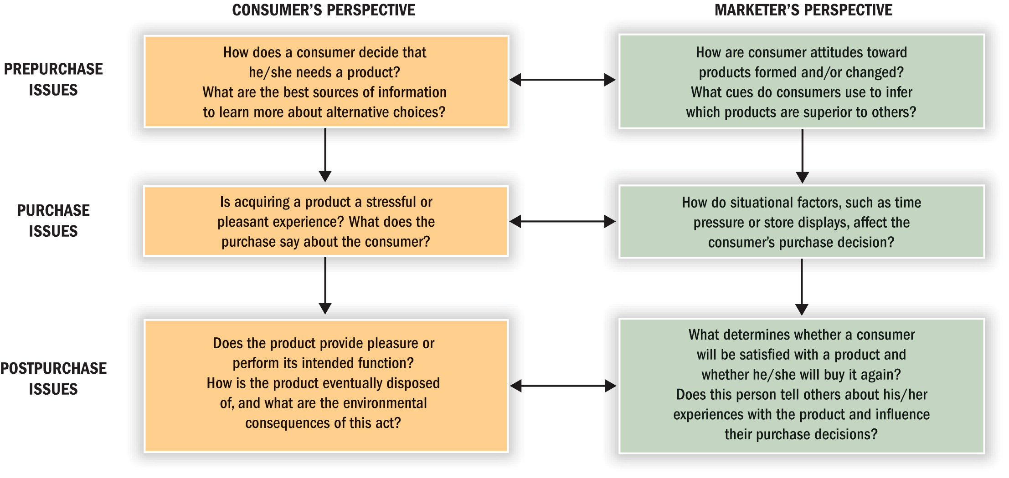
Chapter
01
Stages in the Consumption Process

Slide 14
Chapter
01
PRE-PURCHASE ISSUES1/2
CONSUMER’S PERSPECTIVE
How does a consumer decide that he/she needs a product? What are the best sources of information to learn more about alternative choices?.

Slide 15
Chapter
01
PRE-PURCHASE ISSUES 2/2
MARKETER’S PERSPECTIVE
How are consumer attitudes toward products formed and/or changed? What cues do consumers use to infer which products are superior to others?

Slide 16
Chapter
01
PURCHASE ISSUES 1/2
CONSUMER’S PERSPECTIVE
Is acquiring a product a stressful or pleasant experience? What does the purchase say about the consumer?

Slide 17
Chapter
01
PURCHASE ISSUES 2/2
MARKETER’S PERSPECTIVE
How do situational factors, such as time pressure or store displays, affect the consumer’s purchase decision?

Slide 18
Chapter
01
POST-PURCHASE ISSUES 1/2
CONSUMER’S PERSPECTIVE
Does the product provide pleasure or perform its intended function? How is the product eventually disposed of, and what are the environmental consequences of this act?

Slide 19
Chapter
01
POST-PURCHASE ISSUES 2/2
MARKETER’S PERSPECTIVE
What determines whether a consumer will be satisfied with a product and whether he/she will buy it again? Does this person tell others about his/her experiences with the product and influence their purchase decisions?

Slide 20
Chapter
01
Consumers’ Impact on Marketing Strategy 1/3
Why should managers, advertisers, and other marketing professionals bother to learn about consumer behavior? Simply, it’s good business.

Slide 21
Chapter
01
Consumers’ Impact on Marketing Strategy 2/3
The basic marketing concept that you (hopefully) remember from your basic Marketing class states that organizations exist to satisfy needs.

Slide 22
Chapter
01
Consumers’ Impact on Marketing Strategy 3/3
Marketers can satisfy these needs only to the extent that they understand the people or organizations that will use the products and services they sell. Voila! That’s why we study consumer behavior.

Slide 23
Chapter
01
Consumers Are Different! How We Divide them Up.1/2
Our Society is evolving from a mass culture in which many consumers share the same preferences to a diverse one in which we each have almost an infinite number of choices—just think about how many shades of lipstick or necktie patterns compete for your attention.

Slide 24
Chapter
01
Consumers Are Different! How We Divide them Up.2/2
This change makes it more important than ever to identify distinct market segments and to develop specialized messages and products for those groups.

Slide 25
Chapter
01
Loyalty
As we’ll see later, building loyalty to a brand is a smart marketing strategy, so sometimes companies define market segments when they identify their most faithful customers or heavy users.

Slide 26
Chapter
01
80/20 Rule
As a rule of thumb, marketers use the 80/20 rule: 20 percent of users account for 80 percent of sales. This guideline often holds up well, and in some cases even this lopsided split isn’t big enough: A study of 54 million shoppers reported that only 2.5 percent of consumers account for 80 percent of sales for the average packaged-goods brand.

Slide 27
Chapter
01
Divide up the market = Segmentation
Aside from heavy usage of a product, we use many other dimensions to divide up a larger market. As we’ve already seen, demographics are statistics that measure observable aspects of a population, such as birth rate, age distribution, and income.

Slide 28
Chapter
01
Demographics segmentation 1/4
Age
Consumers of different age groups obviously have different needs and wants. Although people who belong to the same age group differ in many other ways, they do tend to share a set of values and common cultural experiences that they carry throughout life.

Slide 29
Chapter
01
Demographics segmentation 2/4
Gender
We start to make gender distinctions at an early age—even diapers come in pink versions for girls and blue for boys. Many products, from fragrances to footwear, target either men or women.

Slide 30
Chapter
01
Demographics segmentation 3/4
Family Structure
A person’s family and marital status is yet another important demographic variable because this has a huge effect on consumers’ spending priorities.

Slide 31
Chapter
01
Demographics segmentation 4/4
Income
People who belong to the same social class are approximately equal in terms of income and social standing in the community. They work in roughly similar occupations, and they tend to have similar tastes in music, clothing, leisure activities, and art. They also share many ideas and values regarding the way they should live.

Slide 32
Chapter
01
Psychographic segmentation
Lifestyles
Consumers also have different lifestyles, even if they share other demographic characteristics such as gender or age. The way we feel about ourselves, the things we value, the things we like to do in our spare time—all of these factors help to determine which products will push our buttons or even those that make us feel better.

Slide 33
Chapter
01
Segmenting by Behavior: relationships and “Big Data”1/2
Marketers now realize that a key to success is building relationships between brands and customers that will last a lifetime. Marketers who subscribe to this philosophy of relationship marketing interact with customers on a regular basis and give them solid reasons to maintain a bond with the company over time.

Slide 34
Chapter
01
Segmenting by Behavior: relationships and “Big Data” 2/2
Database marketing tracks specific consumers’ buying habits closely and crafts products and messages tailored precisely to people’s wants and needs based on this information. Walmart stores massive amounts of information on the 100 million people who visit its stores each week, and the company uses these data to fine-tune its offerings.

Slide 35
Chapter
01
For Reflection
Thinking about the three stages in the consumption process, what issues do you consider in each stage when you are making important decisions?

Slide 36
Chapter
01
Chapter Objectives
We have been learning:-
Consumer behavior is a process.
Stages in the Consumption Process
Consumers’ Impact on Marketing Strategy
Consumers Are Different! How We Divide the
Divide up the market = Segmentation

Slide 37


